Slide 1
Accreditation Learning Community
August 22, 2018
1:00-2:00pm
Dial-In Number: 1 877 916 8051
Access Code: 539-9866

Slide 2
Aligning SHIP with local CHIPs
State Health Improvement Plan | Bridgeport | Norwalk | Hartford | Naugatuck Valley | Central CT | Wallingford | Greater Danbury | Greater New Haven | East Shore District | Manchester | Chesprocott | Ledge Light Health District
Maternal, Infant, and Child Health |  |  | X |  |  | X |  |  | X | X
Environmental Risk Factors and Health |  |  |  |  |  | X
Chronic Disease Prevention and Control | X | X | X | X | X | X | X | X | X | X | X | X
Infectious Disease Prevention and Control |  |  | X |  |  | X
Injury and Violence Prevention |  |  |  |  | X | X | X
Mental Health, Alcohol, and Substance Abuse | X | X |  | X | X | X | X | X | X | X | X | X
Health Systems | X | X | X | X | X | X | X | X | X | X |  | X

Slide 3
Implementing a Strategic Plan (Measure 5.3.3)

Slide 4
Recap from July’s ALC
Form a Strategic Planning Committee that consists of a diverse group of internal staff and external stakeholders/members of the LHD’s governing entity
Strategic plans are living documents that are used, reviewed and revised
Perfect plans can be the enemy of the good – plan it and act on it. It will be good enough!
The agency strategic plan is for all staff!
Vision - Articulates the future view of the organization and for the community. Should be explicit, straightforward, and concise. What do we want to achieve? What will success look like?
Mission - Clearly describes an agency’s purpose: why it exists, what it does, and whom it serves
Value Statements - Are guiding principles that provide a framework for how things are done in the organization

Slide 5
Alignment of PHAB Prerequisites
Community Health Assessment (CHA)
Community Health Improvement Plan (CHIP)
Partners
Public Health Department
Strategic Plan
QI Plan
Implementation
Plans
Other Plans (i.e. WDP)

Slide 6
National Standards for the Strategic Plan Process
Measure 5.3.3A – Implemented department strategic plan
The health department must provide reports developed since the plan’s adoption showing that it has reviewed the strategic plan and has monitored and assessed progress towards reaching the goals and objectives.
The reports must include how the targets were monitored and must be completed no less frequently than annually.
One example must be dated within 14 months; second example may be older, but within 5 years

Slide 7
Strategy Phase – Priorities (or Goals)
Strategic plans are strategic – consider 3-4 priorities
Two tests of a strategic priority:
Is the priority necessary to achieve the vision?
Are the strategic priorities together sufficient to achieve the vision?
Each Strategic Priority will have specific objectives identified that will address that priority
For LHDs that have prepared a CHA or CHIP, agency strategic priorities should align with the broader priorities identified through those processes
For LHDs working on their CHA or CHIP, agency strategic priorities can still align with these processes, especially in getting systems in place

Slide 8
Strategy Phase - Objectives
Objectives are a higher level of specificity in defining what is meant by the strategic priority or goal
Objectives are still the “what” level of strategy, not the “how” level of implementation
To get organized for implementation, prioritize objectives to focus on in Year 1
1. From our list of objectives, what needs to be done first?
2. Are there any easy wins we can accomplish to create momentum?

Slide 9
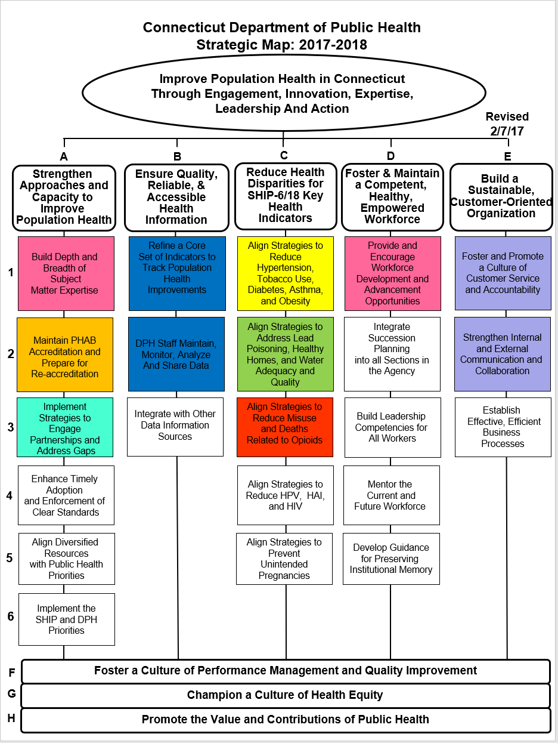
Strategic Map
DPH went with the Strategic Map as way to display the agency’s strategic goals and objectives (updated annually)
It is a one-page visual shorthand of the strategic plan
Colored boxes are strategic objectives that have been prioritized by staff on the Public Health Strategic Team (which means they get extra attention and focus, and are tracked through implementation worksheets)
DPH had 14 prioritized objectives in 2017-2018 (WAY TOO MANY)

Slide 10
Workplan Phase
This phase involves developing a detailed workplan to implement priorities
Workplans should:
Include an appropriate level of detail – which programs or activities are going to be implemented for the upcoming year, by whom, by when
Use a format that allows for periodic reports on progress toward specific goals/objectives – performance or process measures should track progress of objectives/activities
Use a structure that lets the reader easily see how activities are linked to strategic plan objectives

Slide 11
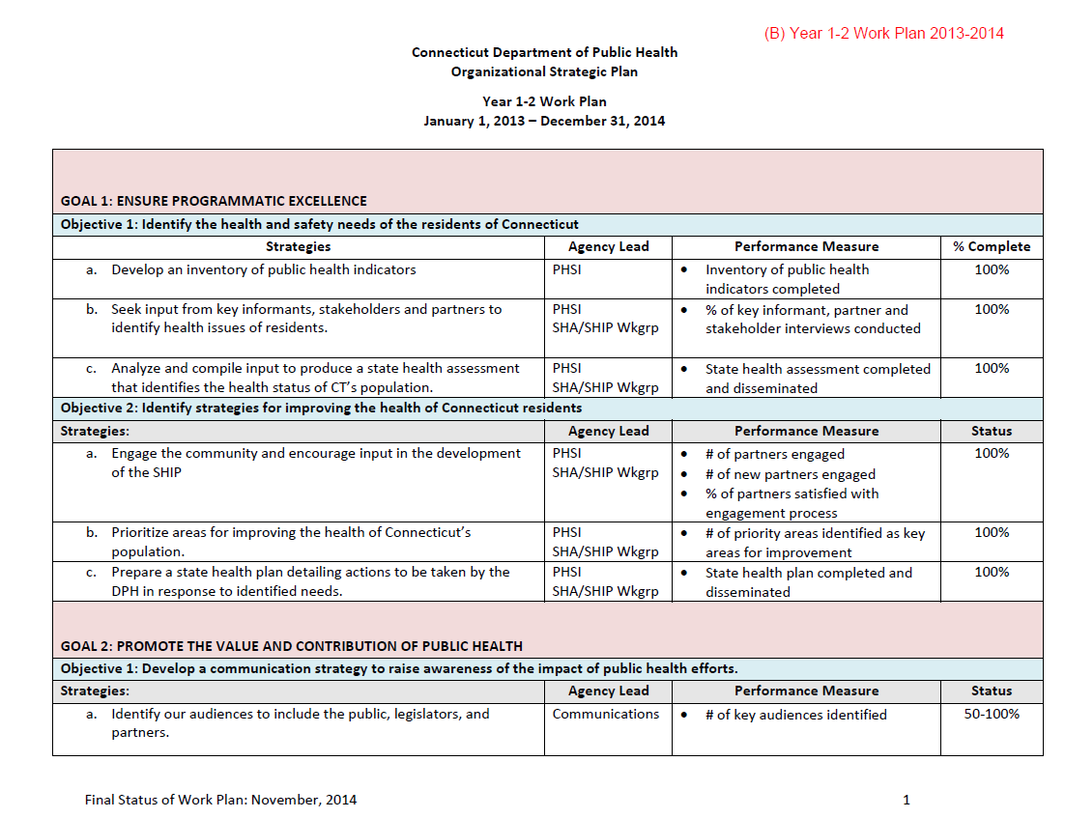
DPH Documentation/Process for 5.3.3A

Slide 12
DPH Documentation/Process for 5.3.3A

Slide 13
DPH Documentation/Process for 5.3.3A

Slide 14
Norwalk Health Department Nationally accredited since 2014

Slide 15
Norwalk Health Department
5.3.3 A v1.0 – Annual reports of progress towards goals and objectives contained in the plan, including monitoring and conclusions on progress toward meeting targets
5.3.3 A v1.5 – Progress towards achievement of the goals and objectives contained in the plan
Notes:
Always review guidance:
In guidance v 1.5- Reports must be completed no less frequently than annually.

Slide 16
Required Documentation Examples
Notes:
Implementation Progress
Targets are monitored by the supervisors weekly.
The Senior Management Team reviews and reports out on progress of the strategic plan weekly during meetings with the Director of Health.
The Director of Health utilizes a Gantt chart to monitor the timeframes.

Slide 17
Strategic Plan progress Update

Slide 18
NHD 2017-2018 Strategic Plan
Notes:
Goal 1: Continue to be Leaders in Public Health Practice
Goal 2: Maximize Capacity of Staff and Volunteers
Goal 3: Strengthen Public Awareness of Health Department Programs and Services and Effectively Communicate their Value
Example:
1.2 Maintain Core Functions
1.2.1 Meet state and local mandates
Director of Environmental Services reports on # of inspections
Notes
Our supervisors meet weekly and report on their divisions.
We have a sign in sheet for each meeting.
Supervisors also complete monthly management reports.
Annual review to the BOH
Update plan every few years. The plan is only for a 2 year timeframe.
Reaccreditation
Reaccreditation: 5.3. Requirements Narrative Description of the current process
Describe the department’s process used to continually track the implementation of the strategic plan and revise it, as needed.

Slide 19
Megan DiMeglio Project Coordinator Mdimeglio@norwalkct.org 203-854-7984

Slide 20
Discussion Questions
How is your department linking accreditation to its strategic plan?
How about the CHA/CHIP?
What challenges has your agency experienced in developing or implementation your strategic plan?
Any successes?

Slide 21
Tips for Strategic Planning and Implementation
Remember that strategic plans should be living documents that are applied, tested, and revised when appropriate.
To monitor implementation, you may choose to assign one individual as the “prime mover” for each overall strategy in the strategic plan.
Conduct an annual strategy update to:
1. Review progress on implementation.
2. Set implementation priorities for the next 12 months.
3. Align human and financial resources with the updated map and implementation priorities.

Slide 22
Up Next…
Next Meeting:
September 27| 1-2pm
Topic: Domain 12 – Engaging the Governing Entity

