Slide 1
Caring for Patients in Isolation
A Temporary nurse aide Guide
Notes:
Welcome to “Caring for Patients in Isolation: A PCT Guide”.
In this training you will learn how to work with COVID-19 patients or other patients that are in isolation.
Instructions for navigating the WBT go here.

Slide 2
Temporary Nurse Aide Primary Duties
Help patients with basic living activities
Listen to health concerns of patients
Measure vital signs
Housekeeping
Tending to patient issues and problems
Notes:
A Patient Care Technician is a healthcare professional who assists patients with various healthcare needs, under the direct supervision of a registered nurse or a licensed practical nurse. As a Patient Care Technician you have five primary duties and responsibilities. They are:
Help Patients With Their Basic Living Activities. The most critical care that CNAs provide is to help patients with basic living activities that they cannot currently do for themselves without assistance. Some of the things that you will help with include cleaning and bathing your patients. Many patients have a great deal of difficulty keeping themselves clean when they are in the hospital or nursing home. It is of great importance for you to help to keep them as clean as possible, and you will spend much of your time doing this.
Take care of combing hair, shaving caring for nails and brushing teeth.
Help your patient use the toilet and to get dressed.
Turn, transfer and reposition your patients between the wheelchair and bed.
Help to take patients to eat and to participate in various activities.
Serve the patients meals and in some cases, to help them eat if they cannot do it for themselves.
Listen to the Health Concerns Of Patients. One of your key roles is to assist your RN supervisor in doing his or her job. One of the ways that you do this is to talk to the patient while you are doing your work. You will need to listen to their health concerns and record them in notes, either on paper or in an electronic system. After that, you will need to report this new health information to nurses in an accurate fashion.
Measure Vital Signs. When you are going about your tasks of feeding your patients, bathing them and helping with their activities of daily living, you will also need to take vital signs every day. These include: temperature, blood pressure, pulse, weight and pain levels..
Housekeeping. The person that you are caring for does not have the ability to take care of him or herself, so they will not be able to take care of their immediate environment either. You will need to clean the room in which the person is staying every few days. Also, you will need to move the patient out of the bed every few days to change the linens.
Tending to Patient Issues and Problems. You will be dealing with a person with a number of health problems, which will vary depending upon the patient. You are going to need to spend much of your time as a Personal Care Technician working to manage those problems. For example, you will in some cases need to tend to patient wounds. You will need to clean them, dress them, and ensure that they are healing properly. Also, you will need to work to prevent bed sores in your patients. You will need to reposition your patient often and turn them regularly.

Slide 3
What a Temporary Nurse Aide Can Do
A Temporary Nurse Aide can work under the supervision of a registered or enrolled nurse to help provide basic nursing care such as showering, hair, skin and mouth care. They can assist with activities essential for daily living including helping people with dressing and feeding.
They may also perform simple wound dressings, transport stable patients or residents between beds or wards, and undertake nursing observations such as pulse, temperature and respiratory rates.
Notes:
A Patient Care Technician can work under the supervision of a registered or enrolled nurse to help provide basic nursing care such as showering, hair, skin and mouth care. They can assist with activities essential for daily living including helping people with dressing and feeding.
They may also perform simple wound dressings, transport stable patients or residents between beds or wards, and undertake nursing observations such as pulse, temperature and respiratory rates.

Slide 4
Caring for Patients in Isolation
Monitor symptoms
Prevent the spread of the virus
Treat symptoms
Decide when to end isolation
Notes:
As a Patient Care Technician, your role may involve caring for patients in isolation, either due to a positive diagnosis for COVID-19 or because they are suspected of having the virus.
The Centers for Disease Control and Prevention recommends four steps for caring for a person with COVID-19: monitor the person for worsening symptoms, prevent the spread of germs, treat their symptoms and, finally, decide when to end isolation.
Monitor symptoms. If the person’s symptoms worsen, contact your nurse and or physician. Signs that someone may require immediate medical attention include pain or pressure in the chest, shortness of breath, confusion or turning blue.
Prevent the spread of the virus. The most important thing to do to prevent the spread of the virus is to isolate the patient. Try to limit the patient’s movements. Use fresh towels, bedding and dishes with infected patients. And use personal protective equipment (PPE) when entering the patient’s room.
Treat the symptoms. Patients should drink lots of fluids to stay hydrated. They need rest. Over-the-counter medications such as Tylenol can help with fever., but only if ordered by your nurse or physician.
Decide when to end isolation. The CDC recommends waiting until the person’s fever has subsided for 72 hours (three full days of no fever without the use of fever-reducing medication), other symptoms such as shortness of breath have improved, and at least seven days have passed since their symptoms first appeared. However, your nurse and/or physician will make that decision.

Slide 5
Visits for COVID-19 Positive Patients
In the U.S., federal government guidelines recommend halting all visits except during end-of-life and other extraordinary situations, when visitors should be equipped with personal protective gear.
The federal agency that regulates nursing homes urges them to designate separate facilities to keep COVID-19 residents away from those who have tested negative.
Notes:
In the U.S., federal government guidelines recommend halting all visits except during end-of-life and other extraordinary situations, when visitors should be equipped with personal protective gear. The federal agency that regulates nursing homes urges them to designate separate facilities to keep COVID-19 residents away from those who have tested negative.

Slide 6
Environmental Cleaning and Disinfection
Routine cleaning and disinfection procedures are appropriate for SARS-CoV-2 in healthcare settings, including those patient-care areas in which aerosol-generating procedures are performed.
Products with EPA-approved emerging viral pathogens claims are recommended for use against SARS-CoV-2.
Management of laundry, food service utensils, and medical waste should also be performed in accordance with routine procedures.
Notes:
Routine cleaning and disinfection procedures are appropriate for SARS-CoV-2 in healthcare settings, including those patient-care areas in which aerosol-generating procedures are performed. Products with EPA-approved emerging viral pathogens claims are recommended for use against SARS-CoV-2. Management of laundry, food service utensils, and medical waste should also be performed in accordance with routine procedures.

Slide 7
In-Home Care
In-home care patients should be screened for fever, shortness of breath and cough.
Your day should start and end with self-monitoring.
If symptoms are presenting, but there's been no known exposure to COVID-19, wear goggles, gloves and a surgical mask.
Notes:
In-home care patients should be screened for fever, shortness of breath and cough.
Your day should start and end with self-monitoring.
If symptoms are presenting, but there's been no known exposure to COVID-19, wear goggles, gloves and a surgical mask.

Slide 8
How You Can Protect Yourself
Healthcare personnel caring for patients with confirmed or possible COVID-19 should adhere to CDC recommendations for infection prevention and control.
Assess and triage those patients with acute respiratory symp­toms and risk factors for COVID-19 to minimize chances of exposure, including placing a facemask on the patient and placing them in an examination room with the door closed in an Airborne Infection Isolation Room (AIIR), if available.
Use standard precautions, contact precautions, and airborne precautions and eye protection when caring for patients with confirmed or possible COVID-19.
Perform hand hygiene with alcohol-based hand rub before and after all patient contact, contact with potentially infectious material, and before putting on and upon removal of PPE, including gloves. Use soap and water if hands are visibly soiled.
Notes:
Healthcare personnel caring for patients with confirmed or possible COVID-19 should adhere to CDC recommendations for infection prevention and control.
Assess and triage those patients with acute respiratory symp­toms and risk factors for COVID-19 to minimize chances of exposure, including placing a facemask on the patient and placing them in an examination room with the door closed in an Airborne Infection Isolation Room (AIIR), if available.
Use standard precautions, contact precautions, and airborne precautions and eye protection when caring for patients with confirmed or possible COVID-19.
Perform hand hygiene with alcohol-based hand rub before and after all patient contact, contact with potentially infectious material, and before putting on and upon removal of PPE, including gloves. Use soap and water if hands are visibly soiled.

Slide 9
Personal Protective Equipment (PPE)
The type of PPE used will vary based on the level of precautions required, such as standard and contact, droplet or airborne infection isolation precautions.
The procedure for putting on and removing PPE should be tailored to the specific type of PPE.
Notes:
The type of PPE used will vary based on the level of precautions required, such as standard and contact, droplet or airborne infection isolation precautions. The procedure for putting on and removing PPE should be tailored to the specific type of PPE.
In the next few slides, you will learn appropriate use of PPE.

Slide 10
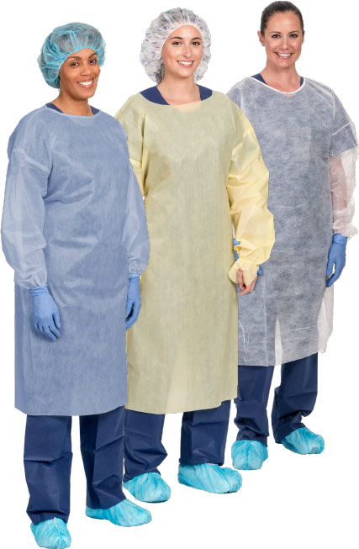
Gown
Fully cover torso from neck to knees, arms to end of wrists, and wrap around the back.
Fasten in back of neck and waist.
To remove the gown, first release the tie, then grasp the gown at the hip area, and pull the gown down and away from the sides of your body.
Once the gown is off your shoulders, pull one arm at a time from the sleeves of the gown so that the gown arms are bunched at your wrists. Then, roll the exposed side of the gown inward until it’s a tight ball. Dispose of it.
Notes:
Fully cover torso from neck to knees, arms to end of wrists, and wrap around the back.
Fasten in back of neck and waist.
To remove the gown, first release the tie, then grasp the gown at the hip area, and pull the gown down and away from the sides of your body.
Once the gown is off your shoulders, pull one arm at a time from the sleeves of the gown so that the gown arms are bunched at your wrists. Then, roll the exposed side of the gown inward until it’s a tight ball. Dispose of it.

Slide 11
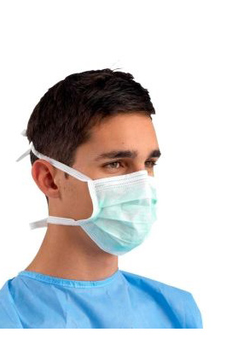
Mask
Secure the ties or elastic bands at the middle of the head and neck.
Fit the flexible band to the bridge of the nose.
Fit snug to the face and below the chin.
To remove the mask first, tilt your head forward. Then, use two hands to grab the bottom strap, pull to the sides, then over your head. Next, use both hands to grab the upper strap, pull to the sides, then over your head. Keep tension on the upper strap as you remove it, which will let the mask fall forward. Dispose of the mask.
Notes:
Secure the ties or elastic bands at the middle of the head and neck.
Fit the flexible band to the bridge of the nose.
Fit snug to the face and below the chin.
To remove the mask first, tilt your head forward. Then, use two hands to grab the bottom strap, pull to the sides, then over your head. Next, use both hands to grab the upper strap, pull to the sides, then over your head. Keep tension on the upper strap as you remove it, which will let the mask fall forward. Dispose of the mask.

Slide 12
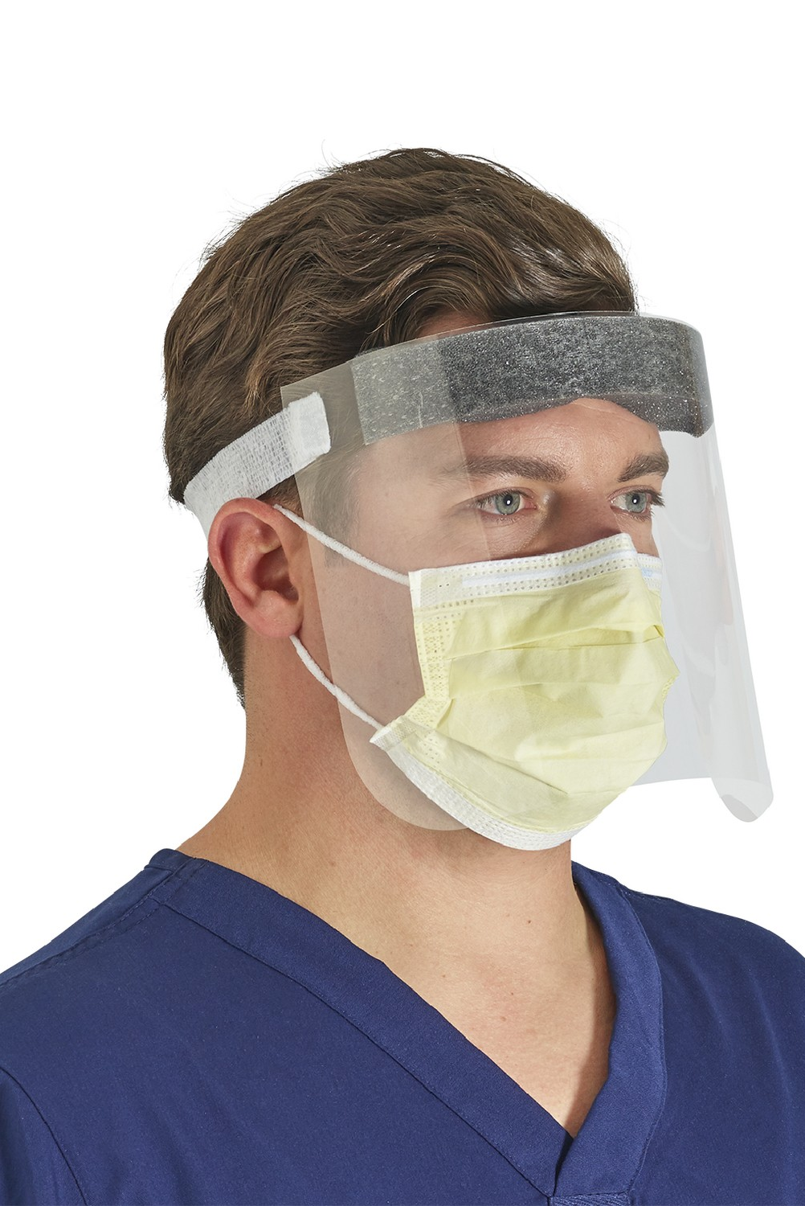
Goggles or Face Shield
Place over the face and eyes and adjust to fit.
To remove the face shield, tilt your head forward slightly, grab the strap at the temples and pull it forward and over your head, which will let the face shield fall from your face. Dispose of the face shield.
Notes:
Place over the face and eyes and adjust to fit.
To remove the face shield, tilt your head forward slightly, grab the strap at the temples and pull it forward and over your head, which will let the face shield fall from your face. Dispose of the face shield.

Slide 13
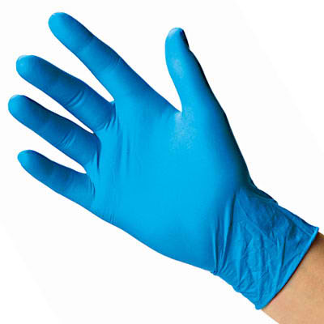
Gloves
Extend to cover the wrist of the isolation gown.
To remove the gloves, grasp the outside of one glove at the wrist.
Do not touch your bare skin.
Peel the glove away from your body, pulling it inside out. Hold the glove you just removed in your gloved hand.
Clean your hands immediately after removing gloves.
Peel off the second glove by putting your fingers inside the glove at the top of your wrist.
urn the second glove inside out while pulling it away from your body, leaving the first glove inside the second.
Dispose of the gloves safely.
Do not reuse the gloves.
Notes:
Extend the gloves to cover the wrist of the isolation gown.
To remove the gloves, grasp the outside of one glove at the wrist. Do not touch your bare skin. Peel the glove away from your body, pulling it inside out. Hold the glove you just removed in your gloved hand. Peel off the second glove by putting your fingers inside the glove at the top of your wrist. Turn the second glove inside out while pulling it away from your body, leaving the first glove inside the second. Dispose of the gloves safely. Do not reuse the gloves. Clean your hands immediately after removing gloves.

Slide 14
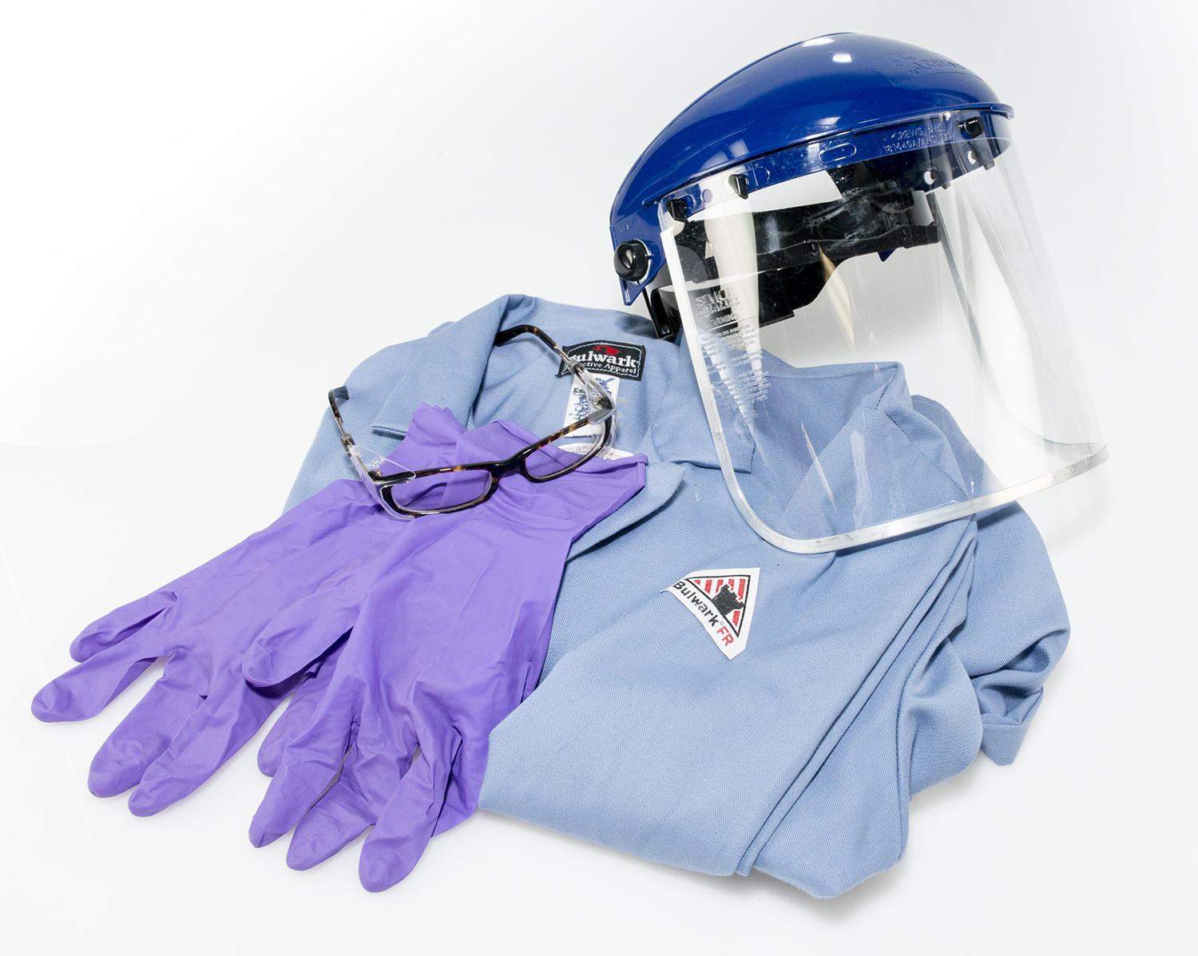
Use Safe Work Practices
Keep hands away from face.
Limit surfaces touched.
Change gloves after each patient interaction.
Perform hand hygiene.
Notes:
Use safe work practices to protect yourself and limit the spread of contamination.
Keep your hands away from your face at all times.
Limit the surfaces touched. It’s important to remember this to prevent cross-contamination.
Change gloves after each patient interaction. Perform hand hygiene. Wash your hands with soap and water after every patient interaction.

Slide 15
Resources
https://www.cdc.gov/coronavirus/2019-ncov/hcp/caring-for-patients-H.pdf
https://www.voanews.com/covid-19-pandemic/nations-seek-ease-nursing-home-loneliness-yet-keep-safe
https://theconversation.com/using-nursing-assistants-to-fill-coronavirus-gaps-brings-risks-if-theyre-not-up-to-the-job-134242
http://www.tribtown.com/2020/04/14/health_department_shares_info_on_how_to_care_for_virus_patients/
https://nursejournal.org/certified-nursing-assistant/certified-nursing-assistant-responsibilities/
https://www.latimes.com/california/story/2020-03-25/how-to-care-for-someone-with-covid-19

