Slide 1
Nursing Home Financial Advisory Committee Money Follows the Person Program Update 4/12/23
Lauren Carabetta, Program Manager
Money Follows the Person Program
Department of Social Services (DSS) Community Options Unit- Strategy Group

Slide 2
Money Follows the Person Overview
The Money Follows the Person Rebalancing Demonstration was created by Section 6071 of the Deficit Reduction Act of 2005
Supports states’ efforts to “rebalance” their long-term support systems, so that individuals can choose where to live and receive services
UConn Health, Center on Aging, Operating Agency: CT Department of Social Services Funder: Centers for Medicare and Medicaid Services
CT Money Follows the Person Report Quarter 4: October 1-December 31, 2022 (Based on latest data available at the end of the quarter)

Slide 3
Benchmark 1
Transition 5200 people from qualified institutions to the community
Benchmark 1: Total Transitions = 7,571
Demonstration = 7,102
Non-demonstration = 469
UConn Health, Center on Aging, Transition Data as of 3/31/23

Slide 4
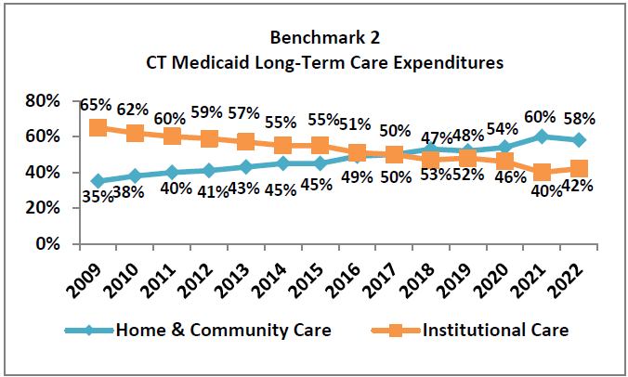
Benchmark 2
Increase dollars to home and community-based services
UConn Health, Center on Aging, Operating Agency: CT Department of Social Services Funder: Centers for Medicare and Medicaid Services
CT Money Follows the Person Report Quarter 4: October 1-December 31, 2022 (Based on latest data available at the end of the quarter)

Slide 5
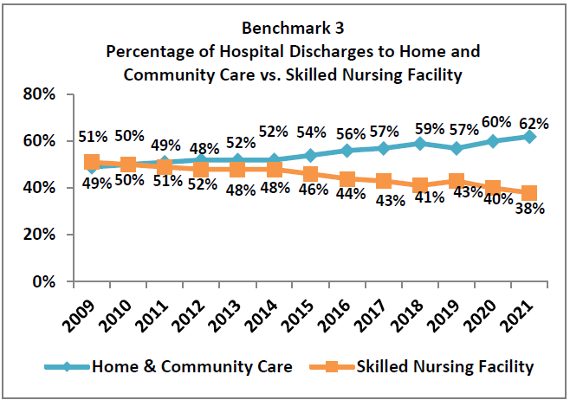
Benchmark 3
Increase hospital discharges to the community rather than to institutions
UConn Health, Center on Aging, Operating Agency: CT Department of Social Services Funder: Centers for Medicare and Medicaid Services
CT Money Follows the Person Report Quarter 4: October 1-December 31, 2022 (Based on latest data available at the end of the quarter)

Slide 6
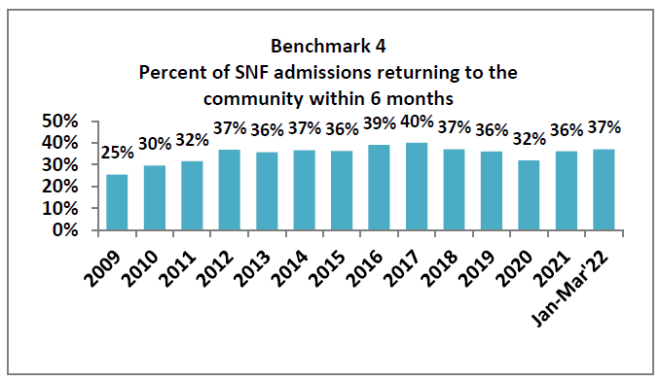
Benchmark 4
Increase probability of returning to the community during the six months following nursing home admission
UConn Health, Center on Aging, Operating Agency: CT Department of Social Services Funder: Centers for Medicare and Medicaid Services
CT Money Follows the Person Report Quarter 4: October 1-December 31, 2022 (Based on latest data available at the end of the quarter)

Slide 7
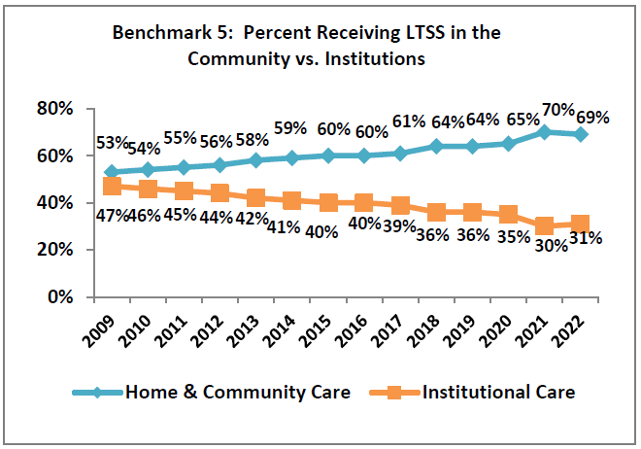
Benchmark 5
Increase the percentage of long-term care participants living in the community compared to an institution
UConn Health, Center on Aging, Operating Agency: CT Department of Social Services Funder: Centers for Medicare and Medicaid Services
CT Money Follows the Person Report Quarter 4: October 1-December 31, 2022 (Based on latest data available at the end of the quarter)

Slide 8
Helpful Links
Reports: Research Reports | UConn Center on Aging
Application: Apply CT MFP – Home
Information: Money Follows the Person (MFP) | MyPlaceCT

