Slide 1
Department of Children & Families (DCF) Department of Developmental Services (DDS) Department of Public Health (DPH)
Uniform Interagency Medication Administration Training Program
Go Live: April 2022

Slide 2
Special Act 17-21
OPM convened a workgroup to conduct a review of the certification and licensure processes of certain nonprofit community providers, and study potential efficiencies.
Membership consisted of six representatives of non-profit community providers and two representatives from DCF, DDS, DMHAS and DPH.
A progress report and final report was submitted to the legislature.
SCOPE
Steps in preparing, scheduling, executing and reporting of site visits for initial licensing applications and renewals.
WHAT HAPPENED NEXT……..

Slide 3
Special Act 17-21
Special Act 17-21 directed a Lean process to streamline and standardize the process by which certain types of facilities are licensed by state agencies,.
A subcommittee which includes private service providers was convened post SA 17-21 work to review and revise the currently existing processes by which DCF, DDS and DPH train and certify unlicensed personnel who assist with medication administration in the aforementioned facilities.
Currently, individuals in licensed residential and/or other state funded community programs supported by Agencies may receive medications by unlicensed personnel who have been trained and certified in medication administration by and through the state agency that is their employer.
Each Agency has its own unique individualized training and certification program and does not allow reciprocity across the state agencies even though base competencies are identical. This workgroup has developed and agreed on content for, a uniform training program that would become the statewide standard for web based training. All certificates would be honored with reciprocity between partner agencies.

Slide 4
What Have We Done
2018
Lean
2019
Active Prep
2020-2021
Work Continued Despite COVID

Slide 5
The Work Continued
February 2022
Pilot
March 2022
Debrief
April 2022
GO LIVE

Slide 6
Two Phases
The process has been divided into two phases:
Phase 1 is the uniform interagency medication administration training online curriculum and exam (with a classroom option)
Phase 2 consists of agency-specific certification and the onsite practicum.

Slide 7
Training Program
Each hiring authority may have specific pre-requisites and those must be satisfied prior to Learners launching the course. Once pre-requisites are satisfied, e.g. criminal background check, the learner will receive a code from their employer to launch the course.
The learner registers through CT Train. Demographic information is collected as required by CT Train.

Slide 8
Training Program
Once the learner initiates the course, it is anticipated that the course will be completed in 15 hours of on-line time and should not exceed 3 weeks, to complete the course. CT Train has functionality to track the hours the leaner has taken to compete the course.
Should there be technical issues, the sponsor state agency should be notified. The learner may pause, stop and resume, using the same sign in and code that was issued from the employer.

Slide 9
Training Program
It is expected that the learner will be completing the course independently and will not have support from others to complete the course. During the course the learner will attest to such.
Once the course is successfully completed, a certificate of completion will be issued from CT Train.
At the completion of the on-line course, a course evaluation is required of each learner. Your feedback is very important as we move forward. We expect there will be modifications based on your feedback.

Slide 10
Points to Remember
The Learner is responsible for contacting the sponsor agency (Residential Care Home, Person in Charge) of their successful completion of the on-line training.
The sponsor agency arranges for the proctored final exam.
100 Question exam that will be ready for on line soon.
85% passing grade
Exam is proctored

Slide 11
Points to Remember
Upon successful completion of the final exam, the learner moves on to Phase 2.
If the learner fails the exam they must contact the sponsor agency for next steps. Retaking the exam and/or the course is an option.
Phase 2: Each sponsor agency has developed individual policies that direct Phase 2 activities.

Slide 12
Phase One
The learner registers through CT Train.Demographic information is collected as required by CT Train.https://ct.train.org/connecticut
Learner will need to Create an Account to gain access to the course
Course Title: State of Connecticut Medication Administration Training -Phase 1
Course ID#: 1101521
Pass Code for Registration: DDSDCFDPH

Slide 13
Step-by-Step on How to Launch the Online CT Train Course

Slide 14
CT Train

Slide 15
Step-by-Step on How to Launch the Online CT Train Course

Slide 16
Step-by-Step on How to Launch the Online CT Train Course

Slide 17
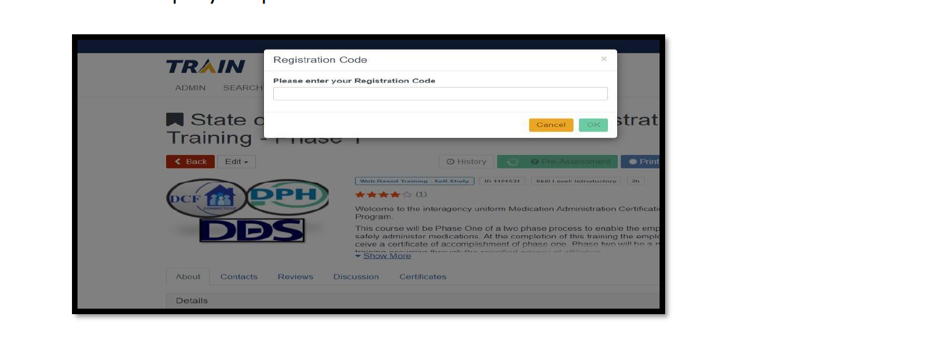
Step-by-Step on How to Launch the Online CT Train Course
Step 5: CT Train will then prompt you to enter a “Registration Code”.

Slide 18
Step-by-Step on How to Launch the Online CT Train Course

Slide 19
Step-by-Step on How to Launch the Online CT Train Course
Step 6b, Confirm the statement

Slide 20
Step-by-Step on How to Launch the Online CT Train Course

Slide 21
Step-by-Step on How to Launch the Online CT Train Course

Slide 22
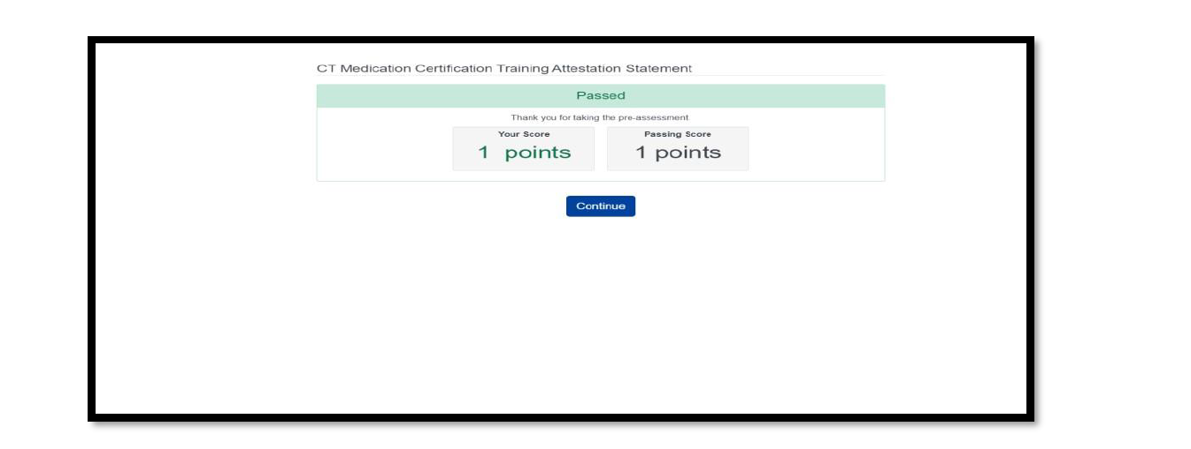
Step-by-Step on How to Launch the Online CT Train Course
Step 9: Click “Continue” Button

Slide 23
Step-by-Step on How to Launch the Online CT Train Course

Slide 24
Step-by-Step on How to Launch the Online CT Train Course
Step 11: you are ready to start the course

Slide 25
Step-by-Step on How to Launch the Online CT Train Course

Slide 26
Website: https://portal.ct.gov/DPH/Facility-Licensing--Investigations/Facility-Licensing--Investigations-Section-FLIS/Medication-Administration

Slide 27
Student Manual is found on the website

Slide 28
Future State
The work is ongoing with actual and potential future enhancements:
Short Term Goal: The group is currently developing renewal requirements, which include content length for training and exams.
Development of a central registry that could be accessed by all affected agencies which will track certification status (suspension due to medication errors) of individual’s certified to participate in medication administration.
Shared policy and procedures to mitigate redundancy and confusion.
Development of a steering committee/advisory board that will monitor and direct future enhancements.

Slide 29
Questions

