Slide 1
WIC Contract & Specialized Formulas & Medical Food Key Nutrition Policies, References, and Revisions
Connecticut WIC Program
Local WIC Staff Orientation
May 2021
Notes:
I will be covering
WIC Contract & Specialized Formulas & Medical Foods. Any one of these could take at least an hour in themselves, so there is no way we will be able to cover everything.
Rather, this will be an overview of key things with some additional resources provided as well for future references
The formula presentation will focus on the contract formula policy, when medical documentation is required to issue a food package with formulas.

Slide 2
Objectives
New WIC staff will be able to:
Review Regulatory Agencies & Formula Protection
Review Formula Related CT-WIC Policies
Mention types of Infant Formula, Specialized Formulas, and Medical Food
Discuss WIC Contract formulas
Discuss Medical Documentation

Slide 3
Regulatory Agencies and Formula Protection
USDA-FDA
CFSAN
ONLDS
FFDCA
OFAS
Notes:
In order for an infant formula to be legally marketed and distributed in the United States, it has to have met all applicable USDA-FDA laws and regulations.
CFSA –Center for Food Safety and Applied Nutrition – is responsible for regulation of infant formula.
Subdivisions:
ONLDS – The Office of Nutrition Labeling and Dietary Supplements – has program responsibility for infant formula.
Evaluates whether the infant formula manufacturer has met the requirement under section 412 of Federal Food, Drug, and Cosmetic Act (FFDCA).
OFAS – The Office of Food Additive Safety has program responsibility for food ingredients and packaging.
Under the section 201 (s) of the Federal Food, Drug, and Cosmetic Act (FFDCA) OFAS evaluates the safety of substances intended for use in or in contact with infant formula.
ONLDS consults with OFAS regarding the safety of ingredients in infant formula and of packaging materials for infant formula.

Slide 4
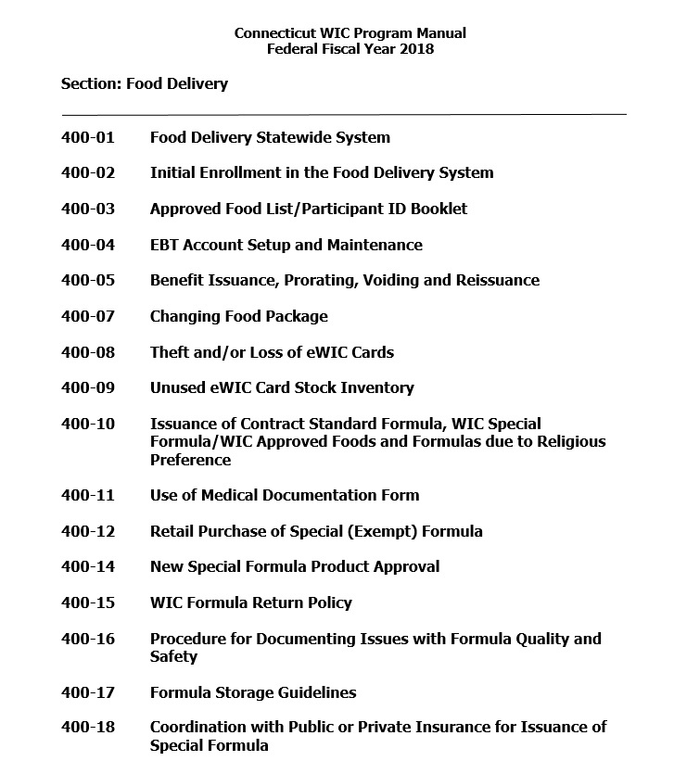
Notes:
https://portal.ct.gov/DPH/WIC/Resources-for-Local-Agency-Staff

Slide 5
Infant Formulas & WIC-eligible nutritionals
Infant formulas are nutritionally complete, not requiring the addition of any ingredients other than water before being served in a liquid state. They are intended for enteral digestion and it can be used as an oral and/or tube feeding.
WIC-medical food/nutritionals serve the purpose of a food, meal, and provides a source of calories and one or more nutrients (may be nutritionally complete or incomplete). They are intended for inborn errors of metabolism, malabsorption syndromes, severe food allergies, etc.

Slide 6
Two Regulatory Categories of Infant Formula
Non-Exempt: formulas for term infant with generally good health status (e-WIC category 21)
Exempt: formula products for infants use for prematurity, inborn errors of metabolism, low birth weight, malabsorption problems, or who otherwise have an unusual medical or dietary problem (e-WIC category 31)
Notes:
Exempt: These formulas must be used under the direction of a physician since feeding requirements (amount, scheduling, special preparations) may be quite different from regular formulas.

Slide 7
Types of Infant Formulas
Milk-based – Carbohydrate source is lactose and contain cow’s milk protein (for healthy term infants)
Soy-based – Contain soy protein and does not contain lactose. Carbohydrate source is sucrose and/or corn syrup solids and corn maltodextrins (for healthy term infants)
Hydrolyzed formulas- often called “predigested” contains smaller protein molecules that can be digested easier.
Partially Hydrolyzed – for mild tolerance symptoms, for easy digestion. Contraindicated in the management of infants with documented cow’s milk protein allergy.
Notes:
Partially hydrolyzed – Similac Total Comfort

Slide 8
Types of Infant Formulas
Extensively Hydrolyzed- Hypoallergenic formulas are marketed for infants with allergies or intolerances to milk or soy-based infant formulas or those with a family history of allergies.
Amino Acid-Based- formulas are indicated for extreme protein hypersensitivity, when symptoms persist even when extensively hydrolyzed protein formulas are used.
Notes:
Extensively hydrolyzed (peptide based) – Nutramigen, RTF, Nutramigen with Enflora LGG, Pregestimil
Aminoacid- based – EleCare, Neocate Infant with DHA/ARA/ Puramino; , Similac Alimentum;

Slide 9
WIC is a supplemental program
Food packages I, II, III
(I) Fully Formula Fed, Partially Breastfeeding for 0-3 months, 4-5 months
(II) Fully Formula Fed, Partially Breastfeeding for 6-11 months,
(III) -Infant Formulas, Exempt Infant Formulas 0 to 11 months
-WIC-Eligible Nutritionals for children 1 through 4 years
- and for Women pregnant and partially breastfeeding up to
1year post partum, Post partum up to 6 months
postpartum, Fully breastfeeding up to 1 year
postpartum.
Notes:
Food package III – Any Participant’s category that health condition require infant formula (nonexempt, exempt, or metabolic formula, medical food) and that correspond with nutrition assessment and with ICD 10 code in medical documentation.

Slide 10
Determining food package issuance
Who is a Competent Professional Authority (CPA) on the local agency?
Nutritionist
A CPA is staff who is authorized to determine nutritional risks and prescribe supplemental foods for WIC participants.

Slide 11
Determining food package issuance
It is the intent of the WIC Program that all breastfeeding women be supported to exclusively breastfeed their infant and to choose the fully breastfeeding food package without infant formula.
Inquire with the target to discover the reason the mother believes the baby needs infant formula and ensure she receives support and referrals as appropriate to continue to breastfeed.
In CT some agencies have peer breastfeeding support and a great number of nutritionist have become Certified Lactation Counselors (CLC).
Notes:
The food packages for partially (mostly) breastfed mothers and infants are designed to provide for the supplemental nutrition needs of the mother and infant, provide minimal formula supplementation to help mothers maintain milk production, and provide incentives for continued breastfeeding by way of a larger variety and quantity of food than the full formula/postpartum packages.
FNS emphasizes that the benefits of the partially breastfed food packages are lost if the breastfeeding mother-infant is issued the full formula/postpartum packages. Appropriate support and counseling should be provided to mothers to minimize the number of breastfeeding infants receiving the full formula packages.

Slide 12
Determining food package issuance
The CPA performs an assessment of breastfeeding status and risk.
Food packages are tailored based on nutritional needs and preferences.
Determine appropriate nutrition breastfeeding education.
Make referrals to health and social services for follow up as necessary and appropriate.
Notes:
CPA – Competent Professional Authority
CT State Plan WIC 100 – Administration WIC 100=01 Local WIC Agency Staffing
CPA will provide support for breastfeeding by assessing the infant’s hydration (wet & soiled diapers), nutritional status (anthropometrics trend) and growth. If abnormal findings, the CPA will set a nutrition plan in base of breastfeeding frequency, needs to increase feedings.
WIC staff are expected to individually tailor the amounts of infant formula based on the assessed needs of the breastfeeding infant and provide the minimal amount of formula that meets but does not exceed the infant’s nutritional needs (this amount will be less than the Full Nutrition Benefit.

Slide 13
Nutrition Tailoring
A process of modifying food packages by the CPA to better meet the supplemental nutrition needs of individual participants.
It is based on assessment of the participant’s nutritional risk condition, breastfeeding assessment, dietary needs, and personal preferences.
Minimize formula return to the local agency. Help to establish breastmilk supply.
Decrease non-redemption rate.
Notes:
CPA – Competent Professional Authority. With Nutrition Tailoring less likely that formula is returned back to the WIC office. Prevent temptation to be used in fraudulent practices (selling it in internet)
AAP (American Academy of Pediatrics) recommends exclusive breastfeeding for the first 6 months of life, followed by continued breastfeeding as complementary foods are introduced, with continuation of breastfeeding for 1 year or longer as mutually desired by the mother and child. While the fat content of human milk increases with breastfeeding duration, human milk should not be discontinued for concerns about being overweight.

Slide 14
Policy WIC 400-15 WIC Formula Return
Reissuance of formula returned by participants is not permitted.
All returned formula must be discarded in such a way to prevent human consumption:
Open returned container and discard contents fully, followed by the canister
Concentrate and RTU can be poured down the drain
Powder can be discarded in any trash receptacle

Slide 15
Policy WiC 400-15 WIC Formula Return
Tips for reducing formula returns and /or formula sales:
Educate participants on how to redeem their formula benefits
Tailor WIC Formulas when indicated
Review the Participants Right and Responsibilities
Notes:
When tolerance of formula has not been well established, the authorized person should be instructed to redeem the formula cautiously. Instruct the participant to buy formula in small increments until tolerance is well established.
Infant formula for partially breastfeeding infants should be tailored after a careful assessment of nutritional needs by CPA.
Any WIC formula in Food Package III for infants, children and women should be tailored based on the assessed needs, and not exceed the
nutritional needs of the participant. (Refer to WIC 300-02 Food Package Prescription/Food Package Tailoring Guidelines)
Local Agency staff should carefully explain that attempting to sell, trade or donate WIC food benefits (including formula) constitutes a participant violation, and that any unused formula must be returned to the WIC Program.

Slide 16
Practice tailoring Formula (Mostly Breastfeeding)
When discussing amount of formula a partially (mostly)breastfeeding infant 3 months old is fed, the authorized person provides the following information:
Breast milk at 6:00 AM, 8:00AM, 10:00 AM, 12PM, 5PM, 8PM, 10PM
Similac Advance feeds 3 ounces at 2 PM, 12AM, 3AM
How much formula in cans will need for one month?

Slide 17
Practice tailoring Formula (Mostly Breastfeeding)
Similac Advance Powder 1 can = 90 reconstituted fluid ounces
Infant drinks 9 ounces daily or 270 ounces per month.
Will need 3 cans of formula.
(At 3 months old the maximum WIC provides for mostly breastfeeding is 4 cans)

Slide 18
Practice Tailoring Formula (Limited Breastfeeding)
When discussing amount of formula a partially (limited) breastfeeding infant 5 months old is fed, the authorized person provides the following information:
Breast milk at 7 AM, 5 PM, 10 PM (Bedtime)
Formula Similac Advance 9 AM, 12 PM, 3 PM, 7 PM –
5 ounces each feeding
How much formula in cans will need for one month?

Slide 19
Practice Tailoring Formula (Limited Breastfeeding)
Similac Advance Powder 1 can = 90 reconstituted fluid ounces
Infant drinks ounces daily or 600 ounces per month.
Will need 6.6 (7) cans of formula.
(At 5 months old the maximum WIC provides for limited breastfeeding is 10 cans).

Slide 20
When more than regulatory maximum of formula is needed.
Make referrals to other social services programs
To learn more about other nutrition assistance programs go to http://www.benefits.gov/
Notes:
WIC formula issuance is based on prescribed food packages according to the category and nutritional needs of the participant in quantities that do not exceed the regulatory maximum. If more formula is needed is important to perform referrals to social services programs.

Slide 21
WIC Rebate Contract Formula
Require by law to competitively bid infant formula rebate contracts with infant formula manufacturers
“A contract is awarded by the State agency as a result of that bid”
The state agency must use the primary contract infant formula as the first choice of issuance
Contract brand infant formula
Notes:
States agencies are required by law to competitively bid infant formula rebate contracts with infant formula manufacturers. This means WIC agencies agree to provide the winning bidder’s brand of infant formula to infants and in return the manufacturer gives the WIC agency a rebate for each can of infant formula purchased by WIC participants (Abbott is 100% of rebate for each can). The rebate dollars help WIC serve more participants. In fiscal year 2013, rebates supported about 23 percent of all WIC participants. In addition to the primary contract infant formula, the manufacturers must pay a rebate on any infant formula in its products line that the state agency chooses to authorize (except exempt infant formula). All are referred to as contract brand infant formula

Slide 22
CT Approved Product Listing (APL)
Infant formula rebate contract
Nutritional integrity and provision of maximum allowance of supplemental food
Special medical/nutritional needs of participants
Input form stakeholders (participants, health care providers, staff, vendors, and food manufacturers)
Religious consideration such as provision of Kosher/Halal foods
Availability, packaging, cost, product distribution within the State, participant acceptance, and administrative feasibility
Tools available: NUPC , eWIC Infant Formula Calculator
Notes:
When determining which infant formulas to authorize on CT approved product listing (APL), in addition to the terms of the formula rebate contract, CT-WIC also must consider product availability, product container size, as well as participant acceptance. Also CT-WIC verify that products meet minimum Federal requirements when formulating and updating APL . NUPC – WIC National UPC database – is intended to serve as a centralized repository of information about food products that have been determined to meet the minimum WIC federal requirements. The database identifies food categories, subcategories, brand, package size, UPC and other relevant information necessary for a State agency to evaluate food products for inclusion on CT APL.

Slide 23
How Special Formulas Get CT-WIC Approved
Request from manufacturers or from a local agency
Discussion of the exclusiveness of the formula, ingredients
Comparison with the current formulary with similar products description and indication for use
Be in the market for at least one year, demonstrate safety, benefit of formula by submitting research papers.
Notes:
Connecticut State WIC Office get a request from manufacturers or from a local agency.
Nutrition Services Unit Team meet to discuss the exclusiveness of the formula, and ingredients.
Make a comparison with the current formulary with similar product description and indication for use.
Prior to approval, the formula needs to be in the market for at least one year, demonstrate safety and benefit
of formula by submitting research papers.

Slide 24
CT APL in the WEB Page

Slide 25
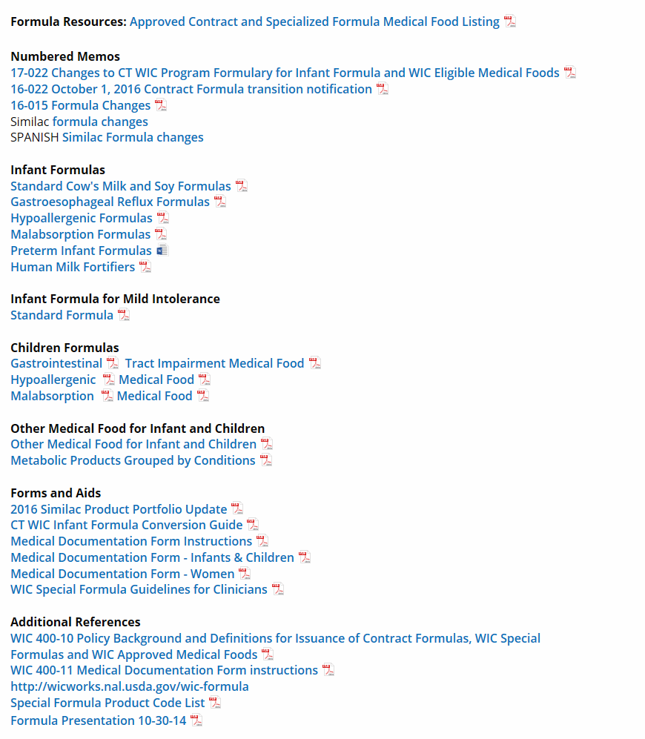

Slide 26
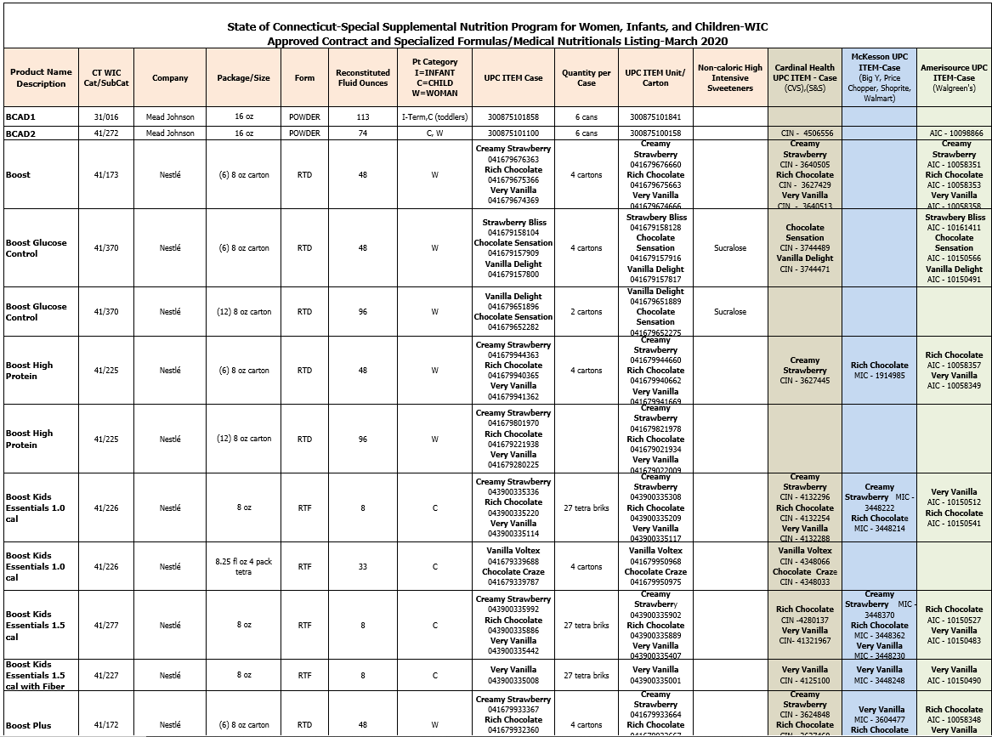

Slide 27
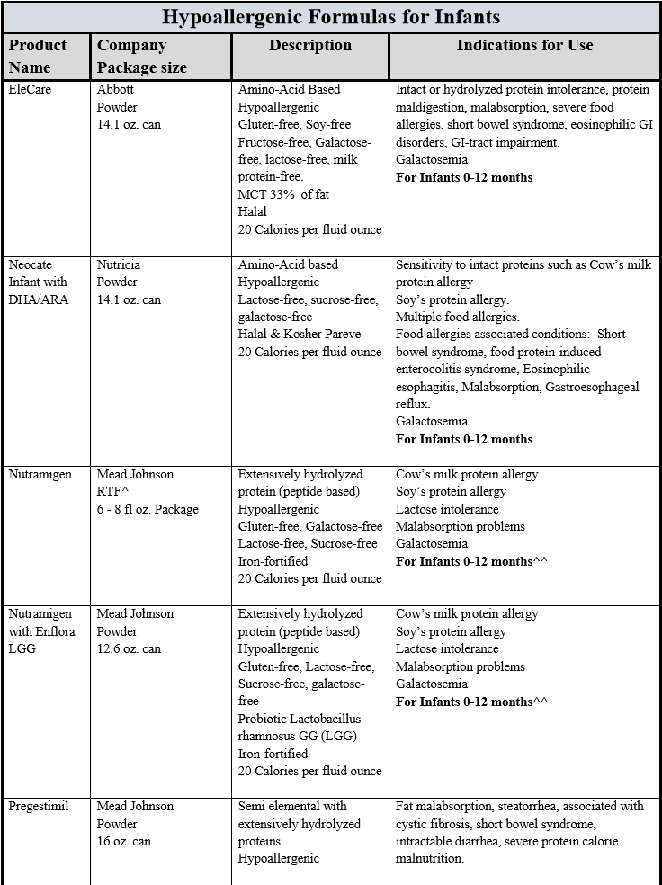

Slide 28
WIC Contract Formula
Similac Advance, Similac Soy Isomil, are Abbott Company standard contract infant formulas
*Current policy: only standard contract formula are allowed. All other formulas will need medical documentation and/or a qualifying medical condition documented by a healthcare provider.
ALSO, other contract formulas for mild intolerance include:
Similac Sensitive
Similac Total Comfort
Similac for Spit up for GER,
*These 3 formulas has been reformulated from 19 Calories per ounce to 20 Calories per ounce formula. The new reformulation started to appear on shelves on October 2020 and December 2020. It is required to receive medical documentation from a healthcare provider in order to issue these formulas until supplies has been depleted on shelves of old reformulation.

Slide 29
Non-contract Infant Formulas or Medical Food
Non-contract standard formulas are not allowed. These include cow, soy, and cow’s milk based lactose-free/low-lactose standard formulas.
For example, Enfamil Infant, Enfamil Prosobee or Enfamil Gentlease ARE NOT allowed formula products through the Connecticut WIC Program.
*Other formulas (exempt, metabolic, hypoallergenic, premature, etc.) continue to be allowed with medical documentation based on ICD-10 medical codes

Slide 30
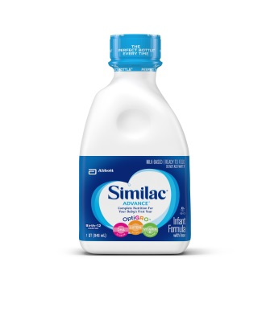
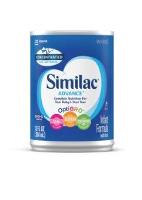
Specifications of Standard Infant Formula and Indications for Use
Infant formula with iron
Similac Advance
Powder 12.4 oz.. can Yields 90 fl oz..
Concentrate Liquid can 13 fl oz..
Yields 26 fl oz..
Ready to Feed 32 fl oz.. plastic bottle
20 kcal/fl oz..
Milk based
DHA for brain and eye development
Lutein to support eye health
Vitamin E and Carotenoids (found in breastmilk)
Prebiotics
Clinically proven tolerance in newborns
Gluten free
Kosher, Halal
Notes:
This product does not require a prescription.

Slide 31
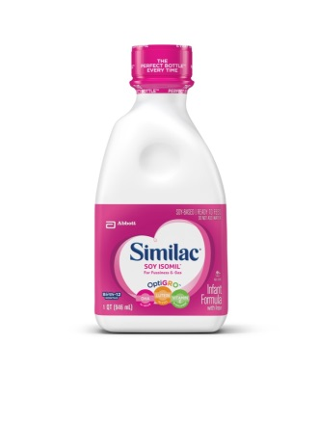
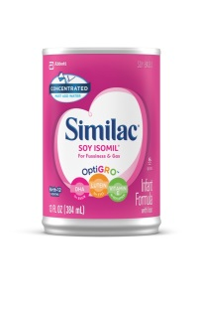
Specifications of Standard Infant Formula and Indications for Use
Infant Formula with iron
Similac Soy Isomil
Powder 12.4 oz.. Yields 90 fl oz..
Concentrate Liquid 13 oz.. can
Yields 26 oz..
Ready to Feed 32 oz.. plastic bottle
20 Cal/fl oz.
Soy based
Fussiness and gas, parent choice, vegetarian families
Lactose free
DHA, Lutein, Vitamin E, and carotenoids
Prebiotics
Gluten-free
Kosher, Halal
Notes:
This product also does not require a prescription.

Slide 32
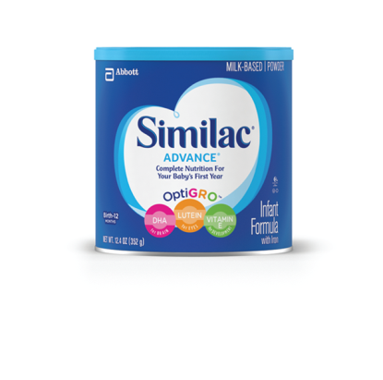
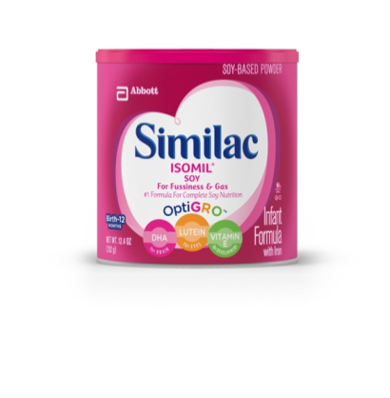
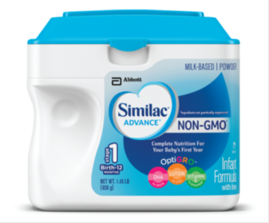
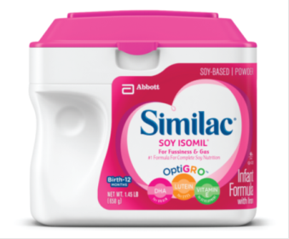
Similac Advance & Similac Soy Isomil Standard Formula WIC Approved vs. Not Approved
WIC Approved
Powder in cans
20 calories per ounce
NOT Approved
Powder in tubs
19 calories per ounce

Slide 33
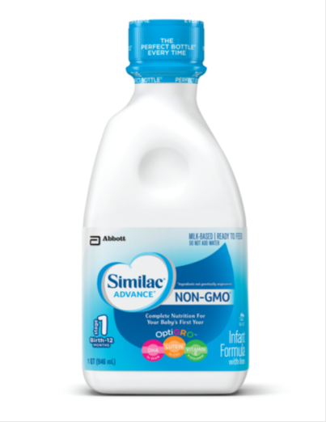
Similac Standard Formula Products – WIC Approved vs. Not Approved
NOT Approved
Similac Advance RTF
19 calories per ounce
Stage 1
Light blue label
WIC Approved
Similac Advance RTF
20 calories per ounce
Dark blue label

Slide 34
Federal Regulation 246.10 (e) (1) (iv)
Local agencies must issue all WIC formulas (WIC formulas mean all infant formula, exempt infant formula and WIC-eligible nutritionals) :
Concentrated Liquid
Powder

Slide 35
Policy CT-WIC 400-10 Federal Regulation 246.10 (e) (1) (iv)
Ready-to-feed WIC formulas may be authorized when the CPA determines that:
The participant’s household has an unsanitary or restricted water supply or poor refrigeration
The person caring for the participant may have difficulty in correctly diluting concentrated or powder forms
The WIC infant formula is only available in ready-to-feed”
Notes:
CPA – Competent Professional authority

Slide 36
Policy CT-WIC 400-10 Federal Regulation 246.10 (e) (3) (iii)
RTF in Food Package III
Better accommodates the participant’s condition
It improves the participant’s compliance in consuming the prescribed WIC formula
Notes:
In addition to those requirements, there are two additional conditions which may be used to issue RTF in Food Package III:
If a RTF form better accommodates the participant’s condition; or If it improves the participant’s compliance in consuming the prescribed WIC formula.

Slide 37
Policy CT-WIC 400-10: Revised to Provide Direction on the Health Risks in Food Package III to Issue RTF formula
Risk 362- Developmental, sensory or motor delays interfering with the ability to eat (Autism with eating disturbances sensory-taste)
Risk 353- Food allergies (hypersensitivity to powdered formula)
Risk 352a 352b- Nutrition related infectious diseases, Acute and Chronic that require specialized formula in ready to feed form
Risk 358- Eating disorders that involve food aversion to the extent of putting at risk intake of essential nutrients
Notes:
The WIC Nutritionist should engage in communication with the Health Care Provider to determine the best form of formula that meets the needs of the participant. In specific cases, with appropriate documentation, RTF may be medically appropriate. These include:

Slide 38
Similac Alimentum RTF | Similac Alimentum Powder
Water (87%) Casein Hydrolysate (2%) Sugar (4%) Modified Tapioca Starch (2%) Safflower Oil (1%) MCT (1%) Soy Oil (1%) Less than 0.5% of: C. Cohnii Oil (Source of DHA) M. Alpina Oil (Source of ARA) Calcium Citrate Calcium Hydroxide Calcium Phosphate Calcium Pantothenate Carrageenan (emulsifier) Potassium Citrate Potassium Chloride Potassium Hydroxide Potassium Phosphate Potassium Iodine Magnessium Chloride Ascorbic Acid Salt L-Carnitine L-Cystine Dihydrochloride L-Tyrosine L-Tryptophan Choline Chloride Ferrous Sulfate Taurine M-Inositol dl-alpha-Tocopheryl Acetate Zinc Sulfate Niacinamide Vitamin A Palmitate Copper Sulfate Thiamine Hydrochloride Riboflavin Pyridoxine Hydrochloride Folic Acid Phylloquinone (Vitamin K) Biotin Sodium Selenate Vitamin D3 Vitamin B12 | Corn Maltodextrin (35%) Casein Hydrolysate (18%) Sugar (15%) High Oleic Safflower Oil (10%) MCT (10%) Soy Oil (8%) Less than 2% of: C. Cohnii Oil (Source of DHA) M. Alpina Oil (Source of ARA) Calcium Carbonate Calcium Phosphate Calcium Pantothenate DATEM (Diacetyl Tartaric Acid Esters of Monoglycerides) (emulsifier) Potassium Citrate Potassium Chloride Potassium Hydroxide Potassium Iodine Xanthan Gum (thickening agent) Magnessium Chloride Monoglycerides Ascorbic Acid Salt L-Carnitine L-Cystine Dihydrochloride L-Tyrosine L-Tryptophan Choline Chloride Ferrous Sulfate Taurine M-Inositol dl-alpha-Tocopheryl Acetate Ascorbyl Palmitate (fat-soluble form of vitamin C) Zinc Sulfate Niacinamide Mixed Tocopherols Cupric Sulfate Vitamin A Palmitate Thiamine Chloride Hydrochloride Riboflavin Pyridoxine Hydrochloride Folic Acid Phylloquinone (Vitamin K) Biotin Sodium Selenate Vitamin D3 Vitamin B12 (Cyanocobalamin)
Notes:
What ingredient is not tolerated by the infant in the powder form? Refer to the arrows above

Slide 39
Policy CT-WIC 400-10 Federal Regulation 246.10 (e) (3) (iii)
When issuing Ready-to-Feed (RTF) formula:
The participant’s condition should be re-assessed in a period not to exceed 3 months
And as the medical condition improves, transition back to a non-RTF formula.

Slide 40
Other Standard Similac Products Included in Rebate Contract
Similac Total Comfort
Similac Sensitive
Similac for Spit Up
All are 19 Cal/oz which require Medical Documentation!
Notes:
If a parent chooses to switch to Similac Advance, medical documentation will not be required.

Slide 41
Federal Regulation 246.10 (d) (1) (vi)
“Medical Documentation. Supplemental foods requiring medical documentation.”
“Any contract brand infant formula that does not meet the requirements in Table 4 of paragraph (e)(12) of this section.”
“Provide at least 67 kilocalories per 100 milliliter (approximately 20 Kilocalories per fluid ounce) at standard dilution.”

Slide 42
Specifications of Other Standard Infant Formula and Indications for Use
Similac Total Comfort
*ONLY Powder 12 oz.. can Yields 90 fl oz..
Partially Hydrolyzed- Protein Infant formula w/ Iron
Recently changed to 20 Calories per fl oz.
For fussiness and gas due to lactose sensitivity.
DHA, Lutein, and Vitamin E found in breast milk
Prebiotics
Gluten Free
Kosher, Halal
Notes:
This product only is available in powder form.
Since this formula contains partially hydrolyzed proteins, this may be similar to Gentlease and may be better tolerated by some infants.
This formula requires medical documentation.

Slide 43
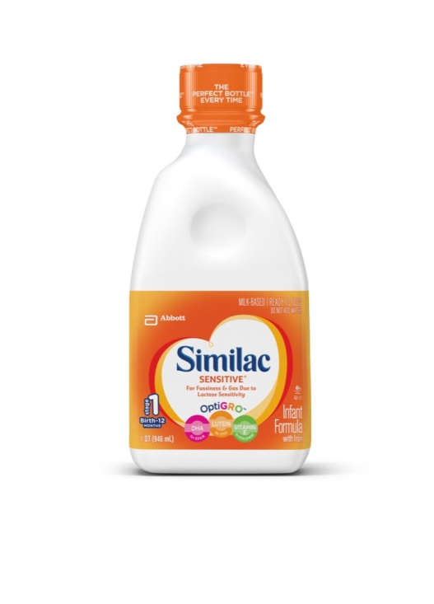
Specifications of Other Standard Infant Formula and Indications for Use
Infant Formula w/ Iron
Similac Sensitive
Powder 12 oz.. can Yields 90 fl oz..
Ready to feed 32 fl oz.. bottle
Recently change to 20 Cal/fl oz.
For fussiness and gas due to lactose sensitivity
DHA, Lutein, and Vitamin E found in breastmilk
Prebiotics
Low Osmolality (200mOsm/kg water)
Gluten Free
Kosher, Halal
Notes:
Similac Sensitive is available in Powder and Ready to Feed forms. Please continue to only provide RTF products based on the individual need such as poor water supply, prematurity or low cognitive levels.
This formula may be suitable for infants who are on Gentlease due to lactose sensitivity.
Medical documentation is also required for this formula.

Slide 44
Specifications of Other Standard Infant Formula and Indications for Use
Similac for Spit-Up
Powder 12 oz. Yields 90 fl oz.
Infant Formula w/ Iron
Will change to 20 Cal/fl oz by 12/20
Reduce frequency of spit-up
Suitable for lactose sensitivity
DHA, Lutein, Vitamin E, Carotenoids found in breast milk
Added rice starch
Prebiotics
Gluten Free
Kosher, Halal
Continue to Require Medical Documentation and ICD 10 code such as GER.
Notes:
This formula is offered in powder and RTF forms.
Similac for Spit-Up is a good replacement for infants who are issued Enfamil AR.
This product requires medical documentation and ICD 10 code such as GI reflux.
For 2020 – These formulas will be reformulated to provide 20 Cal/Oz. Therefore Medical Documentation will no longer be required for Similac Sensitive and Similac Total Comfort.

Slide 45
Notes:
Last year, Similac for Spit UP RTF was discontinued by the manufacturer/company.

Slide 46
Special Formulas: CT-WIC Definition
Any formula other than Similac Advance, Similac Soy Isomil, Similac Total Comfort, Similac Sensitive, Similac for Spit UP
Must be approved by USDA and CT WIC (Special Formula Approval List)
Requires medical documentation with medical rationale (ICD-10 code)
Includes formulas for women, infants and children.

Slide 47
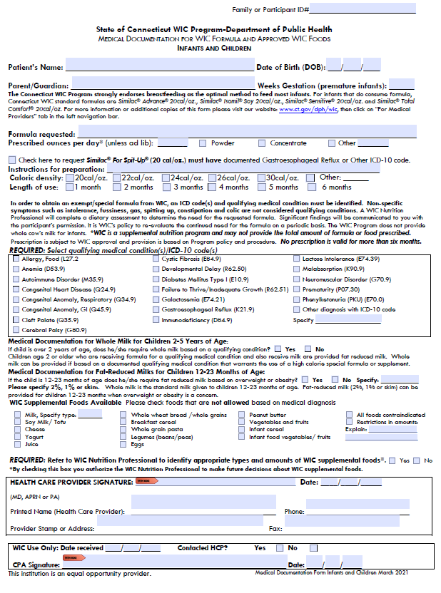
Medical Documentation Form
Notes:
CT-WIC Policy 400- 11 - WIC Medical Documentation must comply with WIC regulations. Medical documentation verifies that the WIC participant has a medical condition that requires the use of formula and that the participant has medical supervision for the dietary management of their medical condition. Medical documentation is required for issuance of infant formula, exempt infant formula, and WIC-eligible nutritionals in Food Package III.

Slide 48
Medical Documentation Approved HCP Signatures
CT Medical Documentation can be signed only by:
Medical Doctor (M.D.) (D.O.)
Advanced Practice Registered Nurse (APRN)
Physician’s Assistant (PA)
Notes:
Essentially someone who is authorized by CT Law to sign the medical documentation form. Therefore, this does NOT include RD’s.
Note: While an RD can sign a certification form, cannot sign WIC prescription form.
Medical documentation means a determination by a licensed health care professional authorized to write medical prescriptions under State law.
D.O. doctor is an osteopathic physician who practices medicine whose medical school training included a focus on the muscular and skeletal system to treat problems throughout the body. It regard the body as an integral whole, rather than treating for specific symptoms only.
DOs are licensed in all 50 States to practice medicine and surgery and to prescribe medications.
MD is a medical doctor, an allopathic physician that treat disease symptoms.
The education for both degrees is similar and both required to complete accredited medical residencies.
D.O. requires additional classes between 300 and 500 hours on the skeletal system and interactions of the body with diseases.

Slide 49
Formula Requested Section
Ounces/day, instructions for preparation
Disclaimer re: amount of formula is supplemental, coordinate with Medicaid/insurance company if formula needed is more than MMA WIC can provide
Notes:
Sometimes the HCP wants a caloric density different than the standard dilution – for which needs to write the Instruction for preparation. MMA (Maximum Monthly Allowance)

Slide 50
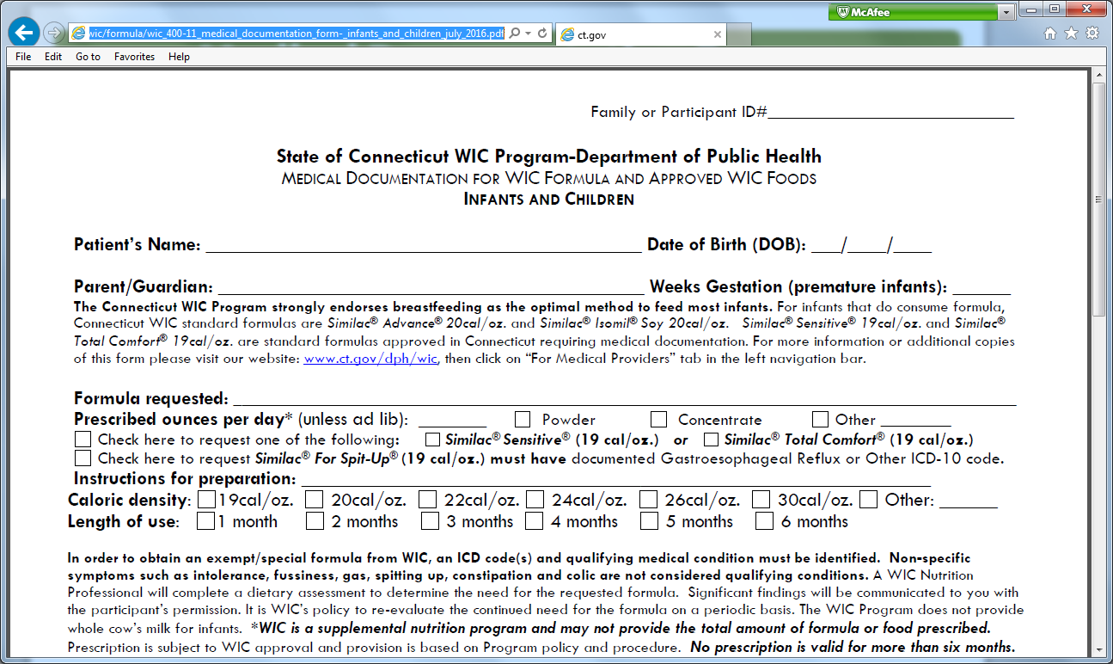
Medical Documentation: Local WIC Nutritionist Role
Refer to the various formula references in the State Plan, local agency formula files and State memos/emails
Contacts State WIC Office for technical assistance if needed

Slide 51
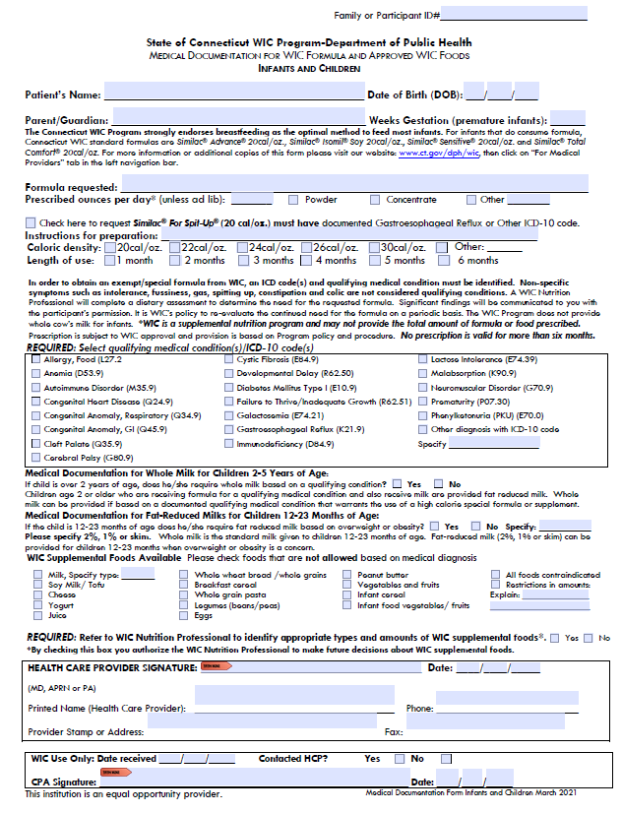
Medical Documentation: Local WIC Nutritionist Role
Screens WIC medical documentation form
Contacts Health Care Provider for clarification
Ensure the product is WIC approved
Check for age appropriateness, medical rationale

Slide 52
Medical Documentation Screening: Length of Use (LOU)
Issuance must not exceed expiration date
New order immediately invalidates previous order
Need new form with recertification
Maximum LOI is 6 months
Notes:
The ‘length of use’ start to count the date the Health Care Provided signed the form, and not the date in which the local agency received the medical documentation form.

Slide 53
Medical Conditions –ICD-10 Codes
Most common nutrition-related diagnoses are listed.
Has “Other diagnosis with ICD-10 code” option to be considered on a case-by-case basis
*CAUTION: Symptoms are disallowed.
For example, formula intolerance is not an acceptable medical condition/ICD-10 code.
Notes:
Rationale for formula should be based on indications for usage a related ICD-9 code (not enough to have just a code-the whole picture needs to make sense)
Disallows – exclude, disqualifies, omits, disregards, leave out : fussiness, flatulence, etc.
Important to remember-not all ICD10-codes are medical dx’s
Not all medical dx’s have ICD-10 codes

Slide 54
What do you do if the ICD-10 Code or Medical Diagnosis is missing on the form?
If only diagnosis provided: Refer to list (or website) for code. In some cases, diagnosis alone may be sufficient.
If only code provided: Need to contact HCP
If both code and diagnosis are provided, but don’t match up ICD-10 code reference list, follow-up with HCP
If both code and diagnosis provided and match, but the rationale is in question: Contact HCP
Notes:
Website address: http://icd9cm.chrisendres.com/
Bottom line use a common sense approach, contact HCP for clarifications, contact State WIC office if needed
i. e. PediaSure – Failure to Thrive – But BMI %tile is above 95%tile.

Slide 55
Supplemental Foods
In addition to exempt infant formula (child or adult), WIC can provide supplemental foods for participants such as formula, food and/or whole/2%/1%/skim milk.
WIC Supplemental Foods NOT to be given to a participant based on a medical diagnosis which contraindicates a food to be present in a participant’s diet.

Slide 56
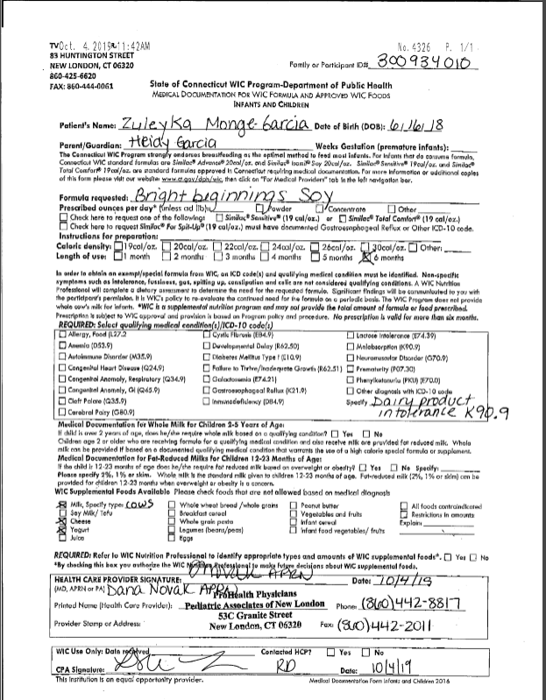
Ask yourself…
Would you approve this?
What would you question?
How would you go about addressing this?

Slide 57
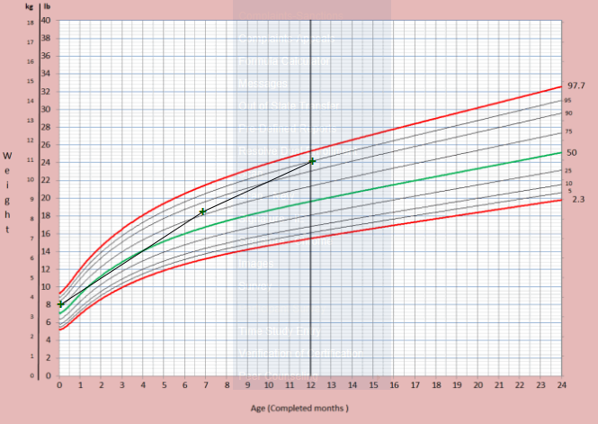

Slide 58
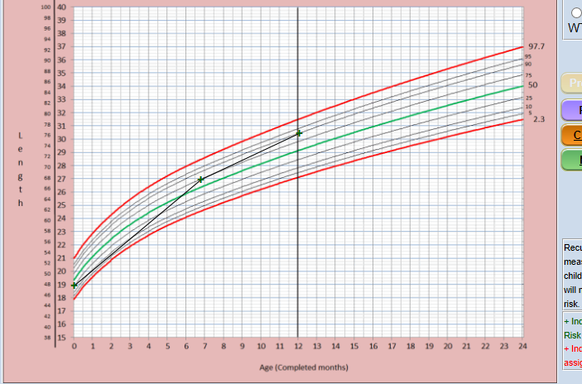

Slide 59
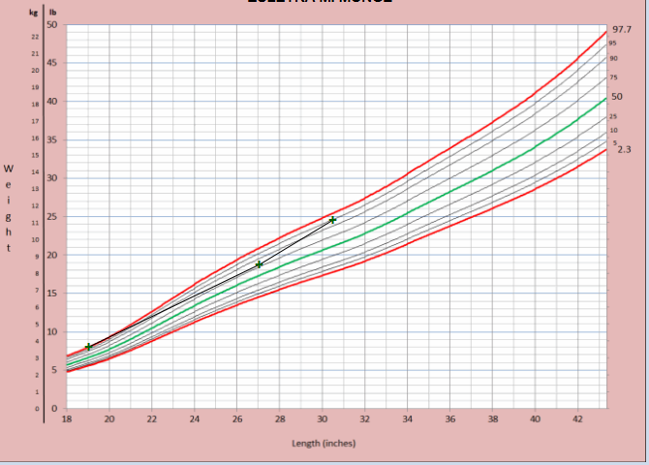

Slide 61
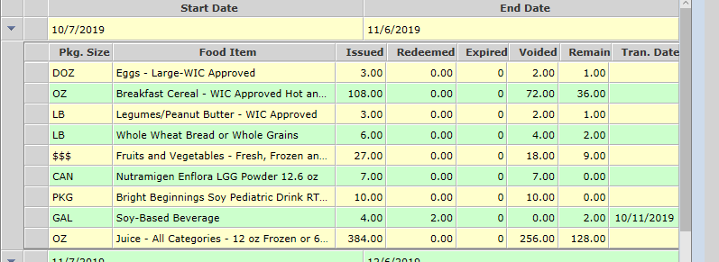

Slide 62
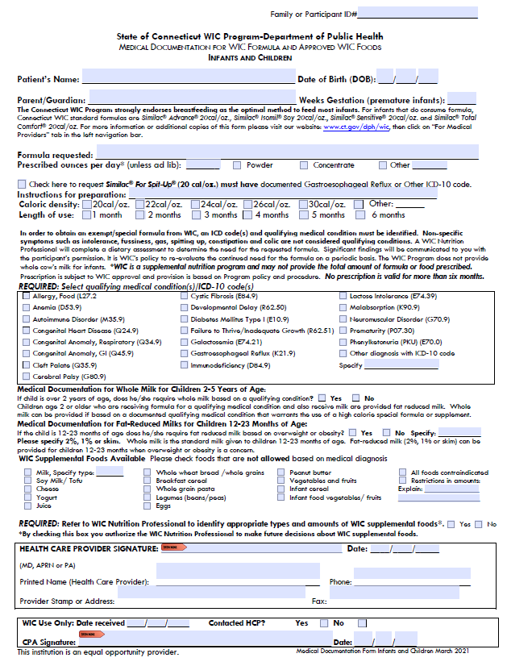
Participant ID#
Parent/Guardian name
Weeks Gestation (prematurity)
Caloric Density/ Instructions for Preparation
Length of Use
ICD-10 Code
HCP: Signature, Date, Printed Name, Address/Stamp, Phone/Fax
Food NOT Allowed
CPA Signature
Notes:
The date the HCP signed the form is important, because that is the date in which the Length of Use start counting.

Slide 63
HCP Medical Documentation: Verbal Orders
Verbal orders (VO) are ok in emergency
Document orders received and by whom
VO must be followed by written documentation within 24 business hours
( 1 business day)
*Refer to WIC Policy 400-11 Use of Medical Documentation Form

Slide 64
HCP Medical Documentation: Verbal Orders
Similac Alimentum, Powder V.O. Dave Smith, MD received by Jane Doe, WIC Nutritionist 5/4/2018.
Notes:
Document on the Medical Documentation form that the order is a verbal order (V.O.), date it, and sign your name. Also specify the name/credentials of the Health Care Provider who gave the verbal order.
Once all necessary information is obtained, a local agency CPA must sign and date the form, and scan into CT-WIC.

Slide 65
Food Package III
SOAP Progress Note needs to be completed!

Slide 66
Connecticut WIC Purchasing: Special Formula Purchases
All formula products - Standard or Specialized - and Medical Foods
Could be already available in stores
Or can be arranged to be available
Notes:
Coordinate with vendor unit if availability issues

Slide 67
Numbered Memorandum 16-005
The WIC Nutritionist or other CPA is expected to assist the Authorized Person in identifying and contacting at least one WIC authorized retail and/or grocery store pharmacy.
The nutritionist or other CPA will inquire if the prescribed WIC Special formula is in stock.
If it is not, assist the participant in placing the first-time order.
Notes:
‘This process’ – refer to the e CT-WIC.

Slide 68
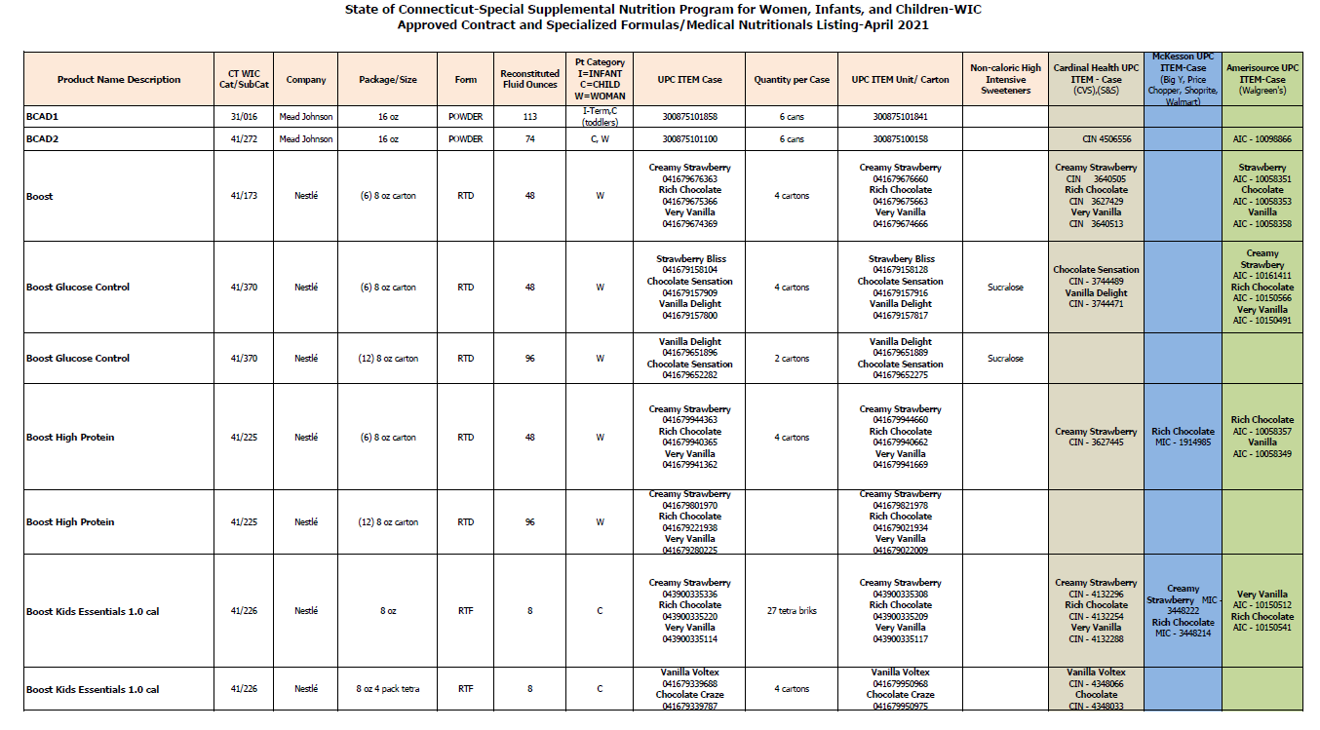

Slide 69
Handouts on formula preparation
Powder form
Concentrated and Ready to feed form
English and Spanish
Sent via e-mail to local agencies

Slide 70
Formula Usage Report
Notes:
Local agencies should use the Formula Usage Report in CT-WIC to track, monitor and review the issuance of any formula.

Slide 71
Formula Usage Report

Slide 72
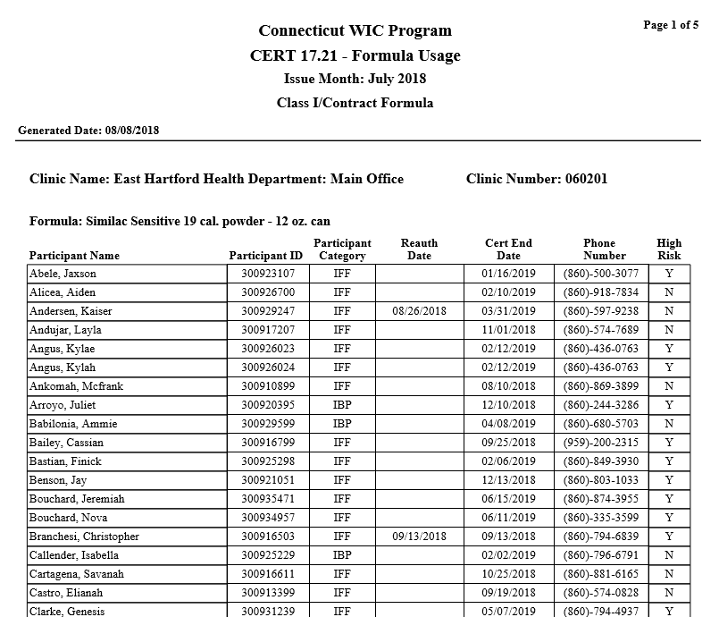
Notes:
The Program Nutritionist can look ID of participants and monitor that the specialized formula has a Medical Documentation scanned into the file, that the Medical Documentation is correctly completed by the HCP; duration in comparison with issuance; if the ICD 10 code matches the formula; etc.

Slide 73
State WIC Office: Who To Call For What
Luz Hago or other Nutrition staff - Nutrition/Clinical Issues
Rafael Lima / Barbara Quiros or other Food Delivery (FD) unit staff -Local store availability
For CT-WIC Food Package assignments issues contact Pam Beaulieu, Nutrition Consultant State of CT
Notes:
There is a form for this (not formula reconciliation form) but Carol will accept e-mails on this.

Slide 74
Questions?

Slide 75
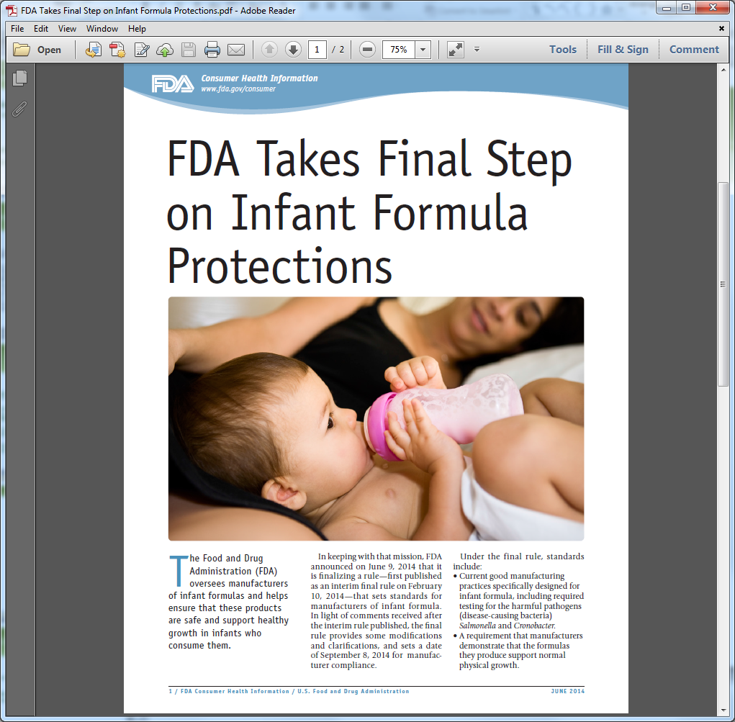

Slide 76
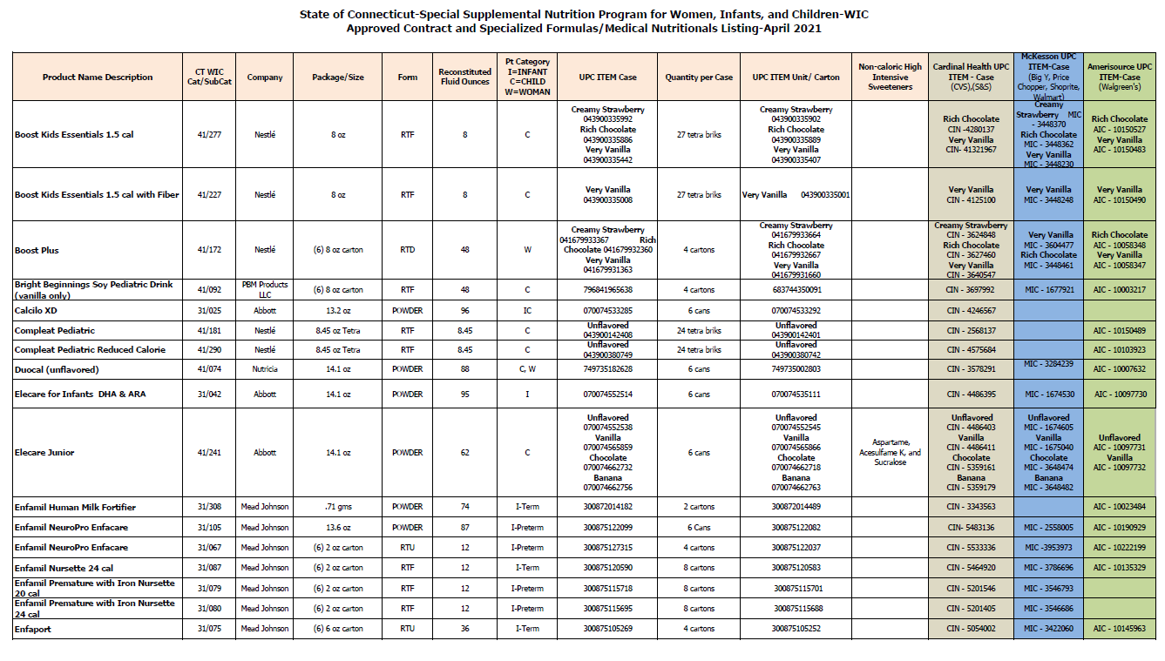

Slide 77
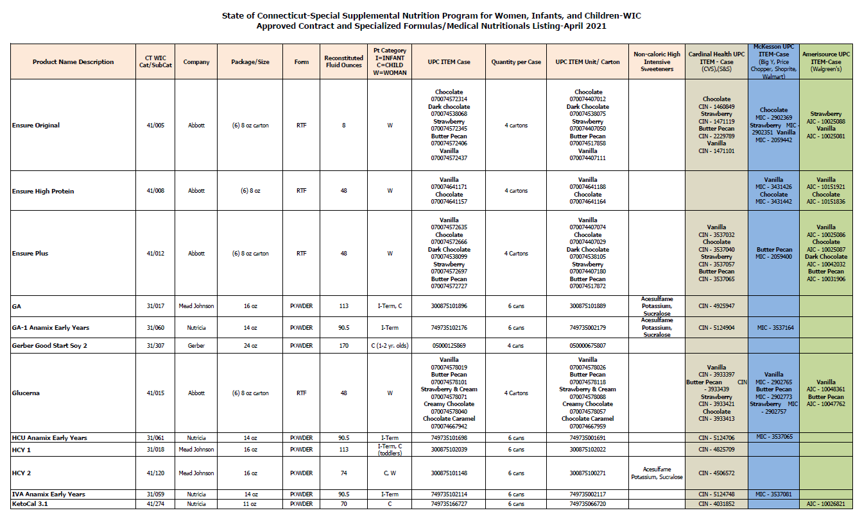

Slide 78
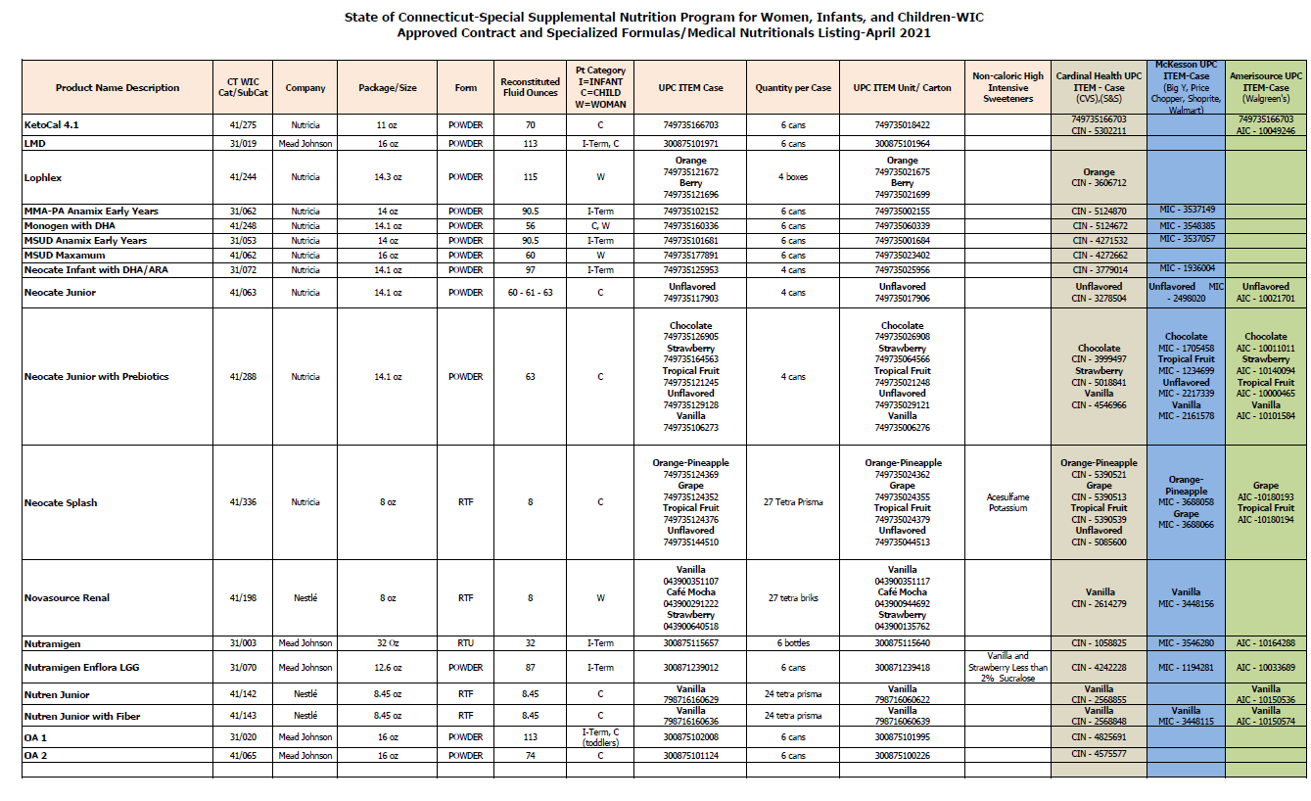

Slide 79
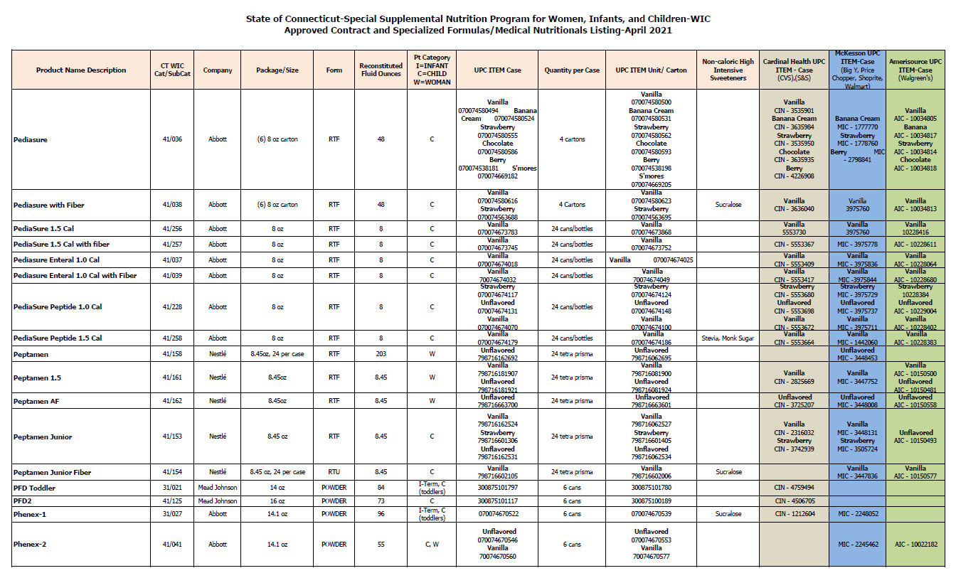

Slide 80
