Slide 1
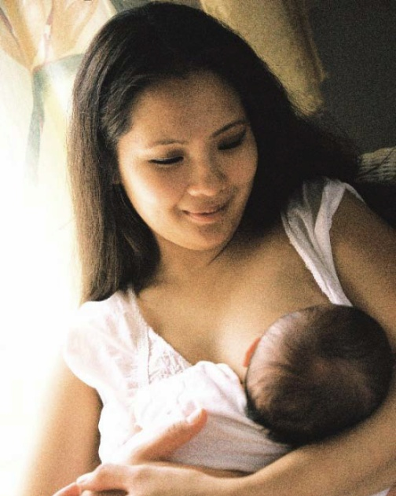

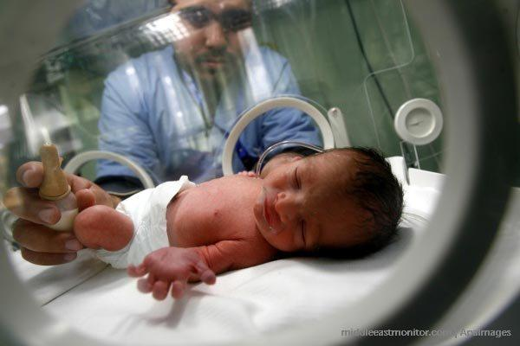

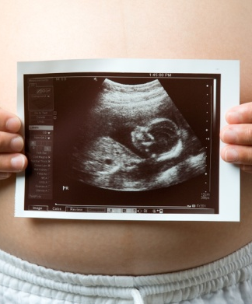

The Power of Positive Health Outcomes
Overview of CT WIC Outcome Objectives
Notes:
The following set of slides takes you through the CT WIC Program Outcome objectives. At the end of the slide deck, there are discussion questions that we will review during our live session the afternoon of Nov 19th so please make sure you come prepare to share your thoughts.

Slide 2

Overview of Objectives
Must be measurable
Based on data
Evaluation. Did we accomplish what we wanted to?
Let us know that our hard work is paying off!
Notes:
Many programs and businesses have objectives. Objectives can be short and/or long term.
Objectives help you to:
Plan to determine where you want to be
Decide what you want to happen
Objectives must be measurable

Slide 3

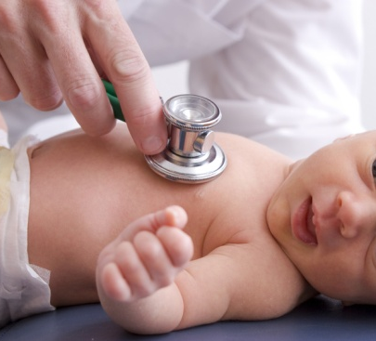

Core Objectives
Increase 1st trimester entry into WIC
Pregnant women gain appropriate weight
Decrease low birth weight (LBW)
Notes:
The next few slides are reviews the WIC Outcome objectives that we have established as a state.
Objectives are a part of both our State agency plan as well as your Local agency plan or (LAP).
We submit our State agency plan to USDA annually on August 15th.
We require local agencies to submit their LAP to us on September 30th each year. Each local program is required to address these 6 outcome objectives in the LAP.
The 3 objectives on this slide are focused on our prenatal participants. They are: increasing 1st trimester enrollment, improving prenatal weight gain (in the appropriate range based on pre-pregnancy weight); and reduce incidence of low birth weight infants.
Of these 3 objectives, which do you think is the most important and why? Write it down so we can talk about in November.

Slide 4

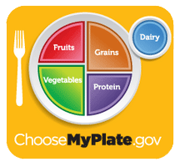
Core Objectives
Increase breastfeeding
Decrease anemia (low iron)
Reduce risk of childhood overweight and obesity
Notes:
This slide covers the 3 objectives for breastfeeding women and child participants.
We have goals to increase breastfeeding initiation AND duration. More detail about breastfeeding was covered in the breastfeeding presentation.
When WIC was implemented in 1973, anemia, or low iron was a major issue for children in the US. Over the past 40+ years, WIC has helped reduce the prevalence of anemia nationally, however safeguarding against anemia remains as part of our program’s goals, so we do not regress. Like the notorious RBG said in her dissent of the SCOTUS decision to gut the voting rights act, “You don’t throw out your umbrella in the middle of a rainstorm because you aren’t getting wet.” IN CT we still have pockets of high anemia rates, so we need to continue to monitor and connect participants to quality health care when needed.
Reduction of childhood overweight and obesity is a more recent objective, and it is one that we need to be sensitive about and responsive to participant feelings on this topic. We all know that excess weight can be a risk factor for chronic health diseases such as diabetes, heart disease and/or hypertension. Maintaining a healthy weight in childhood can help reduce the risk of these conditions.
Nutrition staff receive training on how to discuss weight with families and how to build up confidence and health behaviors and make sure that participants can incorporate healthy habits at any size or age

Slide 5
Why is this important to the State?
Report to funders
Monitor trends
Target resources
Plan for future, quality improvements
Notes:
Why are Objectives important to the State agency? Well, we have several reasons that are listed on the slide.
First and foremost, because WIC is a federal nutrition program, we at the State agency need to ensure we are spending taxpayer funds appropriately. We use data on our core nutrition objectives to monitor trends and ensure we are targeting our limited resources effectively. The data that we get from CT-WIC (data that you and your Nutrition staff colleagues enter in CT-WIC, allow us to generate reports and determine how to effectively assess our interventions and allows us to plan for the future as well as improve our service delivery.

Slide 6
Why is this important to your agency?
Report to funders ☺ State agency
Foundation of local agency plan
Target resources
Monitor progress and readjust strategies as needed
Notes:
Objective data are important to your local agency because your management needs to report progress annually to us, at the State. The data is the foundation of your LAP, Management staff can use progress and results from your annual strategies and activities to then target your local level resources as well as making any adjustments as needed if the original plans aren’t producing results.

Slide 7

Outreach Process Objective
To increase to 40% the rate of first trimester enrollment of pregnant women.
Measure includes breastfeeding and postpartum women who were on WIC for at least 6 months during pregnancy.
Notes:
There is one objective that is defined as a process objective related to 1st trimester enrollment. As we talked about previously, this is the KEY objective that allows the other prenatal based objectives to become their most effective. Research and data show that women that participate in WIC for 6 months or more, during pregnancy, have better pregnancy outcomes. We are always striving to get moms on the program as early as possible in order to maximize this effect.

Slide 8
Why is this important to you?
___________________________________________
___________________________________________
___________________________________________
___________________________________________
___________________________________________
Notes:
Now, let’s talk a bit about why working for WIC is important to you? Take a few moments and write down a few reasons that you can share during our discussion in November.

Slide 9
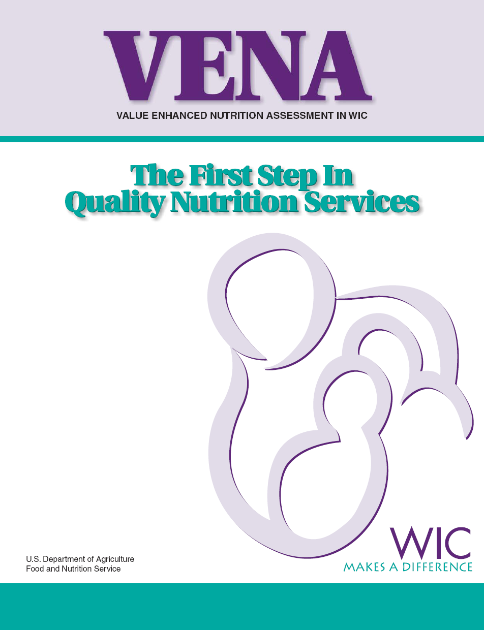
I’ll give you one reason…..
WIC isn’t just a JOB.
  We have a role in helping participants achieve Positive Health Outcomes
  Based on national health policy HP2010 & now HP2020, HP2030.
  Considers “health determinants” i.e. behaviors, health history, family and social environment
Notes:
Whatever your reason(s) is/are for your working at WIC. Mellessa and I would like to give you ONE amazing reason why working for WIC is important to us. (and we hope you).
You see WIC isn’t just a JOB, you are part of a national health promotion program that has improved families nutrition and overall health for over 40 years.
The image on the right, is of the VENA Guidance. Released in 2006, the Value Enhanced Nutrition Assessment in WIC guidance was developed to ensure that WIC nutrition assessment is more consistent across all states. Much of the VENA guidance, was based on the Healthy People (HP2010) goals and objectives. Since that time, we have moved to HP2020 and now HP2030 with many of the same national health goals for maternal and child health.
While HealthyPeople.gov outlines goals and objectives for certain populations of people, the VENA guidance outlines for each participant category, desired health outcomes, Health Determinants, and Health Status (which is the data and labs we collect).
The next few slides will show an example of what we mean my this. While you review the slides, think about how you in your role may impact routine processes. Think about how you interact with nutrition staff to make a participant’s WIC visit, efficient and effective.

Slide 10
Desired health outcome:
Pregnant woman
Delivers a healthy, full-term infant while maintaining optimal health status
Receives ongoing health care
Achieves recommended maternal weight
Remains free from nutrition or food-related illness
Avoid alcohol, tobacco and illicit drugs
Chooses a varied diet to meet needs
Makes an informed decision to breastfeed her infant
Notes:
This is the desired health outcome for a pregnant woman:
We strive to have all pregnant participants to deliver a health, full-term infant while maintaining optimal health status.
The way in which we assess if the desired health outcome is realized, is by reviewing the health determinants outlines on the slide above.
For a quick example, we assess if a participant receives ongoing health care by 1.) asking her about her health care provider, and 2.) checking in to see if she is keeping her scheduled appointments.
If she doesn’t have a provider, we refer her to one.

Slide 11
Your Questions?
Notes:
While your position may not have a direct impact on the nutrition status of participants ALL WIC staff impact positive health outcomes by working as a team.
We have enclosed a handout that talks about how you can incorporate VENA skills into your role at WIC. Please review and then come prepare to discuss when we meet in November.
Make sure you write any questions that you may have about these topics so we can address when we talk!

Slide 12
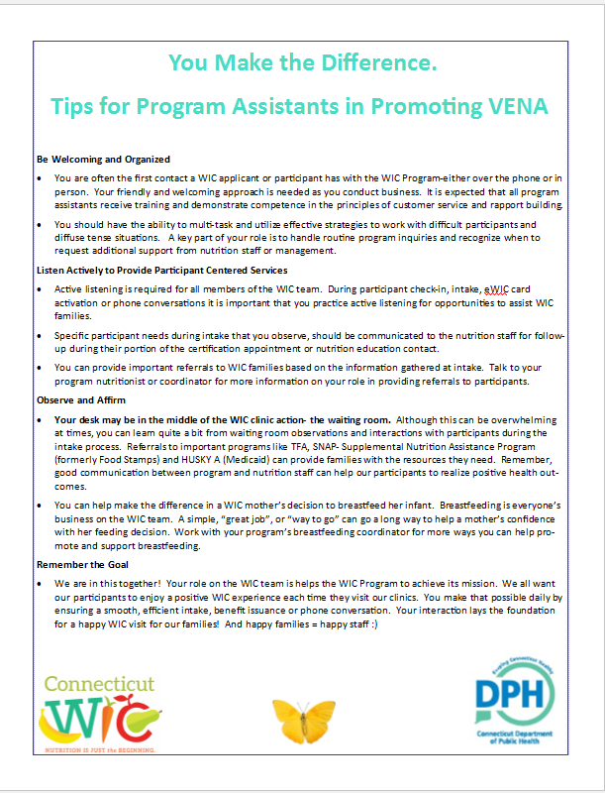
Your Role in VENA
Be Welcoming & Organized
Listen Actively
Observe & Affirm
Remember the Goal
Notes:
This handout we will review about how you can incorporate VENA skills into your role at WIC. Please review and then come prepare to discuss when we meet in November.

Slide 13
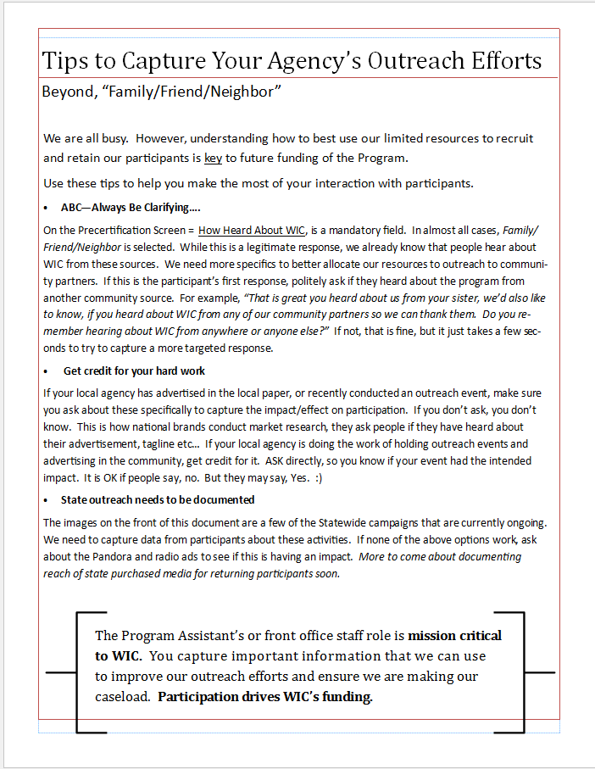

Help us Learn about Outreach Efforts!
Notes:
Here is an overview of our current outreach efforts. We have ways to document these efforts at subsequent certifications so we can track to see what outreach activities are effective.

Slide 14

Your thoughts?
Let’s discuss your role in WIC’s positive health outcomes.
Notes:
When we come together in November, we can talk more about how you see your role in achieving WIC’s positive health outcomes.

Slide 15
A dad who very recently lost his wife and now must care for their 23mo old and 11mo old children, shows up 40 minutes late for his 2x recert appointments. He is very upset because he’s late, the 2yr old just spilled chocolate milk all over himself in the car and he does not have proof of income nor the WIC forms he was told to bring.
How can you help this family?
Scenario #1
Notes:
The next few slides are a series of scenarios that we will review in November as well. Please come prepared to talk about your responses to these situations.

Slide 16
Scenario #2
Dad shared with you that both children were seen by the doctor the previous week and she told him that the 2y/o needs extra iron/multivitamins.
Is there a Statewide objective that can be impacted here? Which one?
What is your role once you became aware of this information?

Slide 17
Scenario #3
An elementary school friend of yours shares with you that she’s expecting her 1st child and she is very anxious.
What advice would you give to her?

Slide 18
You have supported your friend through out the pregnancy. You have made suggestions that have worked for her and now she has a healthy, happy 1month old baby. She’s exclusively breastfeeding comfortably.
How do you feel about the role you have played?
Was that the desired health outcome?
Scenario #4

Slide 19

Welcome to WIC…
“You play an important role in the lives of the families you serve! Thank you. Let your empathy, welcoming attitude and willingness to help shine through. Thank you!”
Notes:
We are overjoyed that you have decided to work for Connecticut WIC. The sentiment on this slide is on behalf of all State agency staff.
Welcome.

