Slide 1
Connecting the Dots: The Local Agency Plan (LAP)
New Staff WIC Orientation: Thursday, November 19, 2020
Notes:
Welcome to the final presentation for the New Staff WIC Orientation, Connecting the Dots: The Local Agency Plan or commonly referred to as the LAP. This presentation focuses on not only creating a workable document for local agency staff but use of the LAP by all local agency staff encompasses all the content that was provided to you during this orientation, whether it was in the form of a self-guided presentation or a live webinar.

Slide 2
Objectives
Identify 1 Outcome Objective and 2 Nutrition Objectives
Develop 1 SMART Strategy
Identify 1 role a Nutritionist plays in achieving an Objective
Identify where the ReNEW developed Lesson Plans and other Guidance Documents can be found
Notes:
The objectives listed on this slide are only a sample of what you will learn about during this presentation. You will be able to: Identify 1 Outcome Objective and 2 Nutrition Objectives, Develop 1 SMART Strategy, Identify 1 role a Nutritionist plays in achieving an Objective, and Identify where the ReNEW developed Lesson Plans and other Guidance Documents can be found.

Slide 3
What is the LAP?
Who writes the LAP?
What is put in the LAP?
How often is it written or updated?
What do you do with it once it’s written?
Who looks at the LAP?
Does the State agency have a plan too?
Notes:
The USDA states that “The WIC Program aims to safeguard the health of low-income women, infants, and children up to age 5 who are at nutrition risk by providing nutritious foods to supplement diets, information on healthy eating, and referrals to health care”.
The LAP is a combined effort among all local agency WIC staff to carry out these program goals and objectives.
The LAP is a required document that must be submitted to the State WIC agency annually no later than the last day of the fiscal year – September 30.
Once the LAP is submitted to the State WIC agency, the State Nutrition Unit reviews each plan and the State agency liaison consolidates recommendations, suggestions and comments for the local agency. Some the feedback requires immediate attention with a re-submission while other feedback is taken into consideration when working on the LAP for the following year. While the Program Coordinator and Program Nutritionists are the typical writers of the LAP, all staff have a hand in carrying out certain strategies to achieve a target goal. The next slide will discuss what the Nutritionists’ role is in the LAP. The LAP is a working document. This means that even though the submission date is by September 30, local agency staff continue to document progress or modifications to strategies that were set in place. Ongoing documentation in the LAP holds local WIC agency staff accountable in following through with set strategies and making sure target dates are kept. The State WIC agency also completes a plan, called the State Plan, and it is submitted to the FNS USDA Northeast Regional Office (NERO) in Boston annually in August. The State Plan can be located on the State of Connecticut Department of Public Health WIC webpage.

Slide 4
What Role does a Nutritionist Have?
Counseling
Conduct nutrition assessment
Assist the participant in setting a goal
Provide food benefits
Make relevant referrals
LAP
May conduct special chart audits/observations to evaluate effectiveness of strategies
Work with local agency management in achieving goals in the LAP
Notes:
A Nutritionist is one role within the WIC Program. However, a Nutritionist can be tasked with more than simply counseling a participant. The LAP is a document that can help local agency staff meet specific goals and strategies that are driven by data. This data can come in the form of monthly and quarterly reports prepared by the State WIC epidemiologist or it can come from data gathered by local agency staff. Data gathered at the local agency level consists of the following: chart audit and observation findings, participant and staff survey results, community data, etc… In most local agencies, the Program Coordinator and Program Nutritionist are charged with updating, evaluating and creating the contents of the LAP. In order to have an effective LAP that is for the benefit of the participants, the Nutritionist must work with local agency management staff in achieving the goals of the LAP. For example, to decrease anemia rates among 2-5 year old children enrolled in WIC, a strategy is to retrain all nutrition staff in anemia prevention and trained in a new office process in obtaining hemoglobin/hematocrit levels from the targeted population. Another way a nutritionist can be involved in the LAP is to conduct chart audits and/or observations specific to a set strategy. Another example related to anemia prevention could be that a Nutritionist will conduct 5 chart audits in each quarter for the 2nd, 3rd and 4th quarters of the fiscal year. The Nutritionist will target charts of 2-5-year old's who are anemic and look for documentation that the new office process in obtaining bloodwork is being followed. Not all local agencies have Nutrition staff conducting specific chart audits/observations for the LAP. When all staff are involved in the process, success may be more likely.

Slide 5
LAP Breakdown
Overview
Evaluation of Prior Year’s Objectives: State and Local
Needs Assessment
Program Participant
Resource Allocation (Upcoming Year’s Objectives): State and Local
Emergency Preparedness and Response Planning
Staff Community
Notes:
The Local Agency Plan has the following main parts: Overview, Evaluation of Prior Year’s Objectives: State and Local, Needs Assessment, Resource Allocation: State and Local and Emergency Preparedness and Response Planning.
Section I, the Overview provides a detailed description of the host agency and local agency. This includes organizational charts for both entities, specific initiatives/community partnerships/cooperative agreements which benefit WIC participants, a description of permanent/sub-contracted/satellite locations including service hours, and staff and participant details.
The Evaluation section is split into Sections II (Evaluation of the Prior Year’s Workplan) and III (Local Agency Objectives – Prior Year). This section evaluates the effectiveness of the strategies set in the previous year’s Resource Allocation. A Progress area is written for both of these sections to determine if the targets, strategies and goals were met. It is in this area where it will be determined if further action is needed in these areas for the upcoming fiscal year. A description of relevant Outreach activities and a Staff Training Log/Summary is in this section as well.
Section IV is the Needs Assessment. This section provides data on the following needs: Program, Staff, Participant and Community. Data is gathered from all these areas to help local agency staff identify specific goals and objectives to work on for the upcoming fiscal year.
Section V is Resource Allocation and Section VI is Local Agency Developed Objectives. These sections are dedicated to describing how the local agency will use its funds to improve state outcomes and local agency identified outcomes. This also includes an Outreach Activities and Staff Training plan.
Section VII is a Wrap-up Statement and Section VIII is the Emergency Preparedness and Response Planning area. A specific template for Emergency Preparedness and Response Planning is provided by the State agency and the local agency is responsible for completing these plans. These plans will include plans for when a WIC office is displaced and securing an alternate location for WIC services to be offered to participants during the emergency.

Slide 6
Outcome & Nutrition Objectives
First Trimester Enrollment - Increase to 40% the rate of first trimester enrollment of pregnant women.
Maternal Weight Gain - At least 35% of pregnant women participating in the WIC Program for a minimum of 6 months gain appropriate weight.
Low Birth Weight - The incidence of low birth weight (LBW) among infants whose mothers were on the WIC Program for at least six months during pregnancy does not exceed 6%.
Anemia - The prevalence of anemia among children enrolled in the WIC Program for at least one year does not exceed 7.5%.
BF Initiation - At least 70% of infants enrolled in the WIC Program initiate breastfeeding.
BF Duration - At least 50% of infants enrolled in the WIC Program are breastfed for 6 months or more.
Overweight - The prevalence of BMI > 85th percentile to < 95th percentile for children 2-5 years does not exceed 15%.
Obesity - The prevalence rate of BMI > 95th percentile for children 2-5 years of age does not exceed 10%.
Notes:
On the previous slide, we discussed the Evaluation of Prior Year’s Objectives: State and Resource Allocation (Upcoming Year’s Objectives). This slide provides a list of the State Outcome and Nutrition Objectives. The Targets (or Goals) are set by the State WIC agency based on data reports developed by the State WIC Epidemiologist. The State agency and the local agencies use these objectives to gauge the effectiveness of the WIC program from providing nutrition education counseling to issuing WIC food benefits to providing relevant referrals.
First Trimester Enrollment is an outcome objective focusing on increasing the rate of first trimester enrollment of pregnant women. First trimester enrollment in the WIC program can improve birth outcomes such as improved maternal weight gain during pregnancy, decreasing premature delivery and low birth weight rates. Targeted outreach to providers serving prenatal women is a common strategy for this objective.
The next 7 objectives are all Nutrition specific objectives. The Maternal Weight Gain objective tracks the percentage of pregnant women who gain appropriate weight. Data provided by the State agency contains all pre-pregnancy weight classifications so that local agencies can determine which group(s) has more needs and where strategies can be focused.
The Low Birth Weight and Anemia objectives target infants and children in reducing and/or eliminating those risks.
The Breastfeeding Initiation and Duration objectives targets infants enrolled in the WIC Program. Typically, the local agency Breastfeeding Coordinators have a hand in developing the strategies for these objectives.
The Overweight and Obesity objectives provide the rates of children 2-5 years of age who are on. In many local agencies, nutrition staff are also involved in creating strategies to help decrease these rates.

Slide 7
Childhood Obesity Rates by Permanent Site
The prevalence rate of BMI ≥ 95th percentile for children 2-5 years of age does not exceed 10%.
*Among children who have been on WIC for at least 1 year.
Notes:
Now, let’s look at an objective, Childhood Obesity. The State’s target is: The prevalence rate of BMI ≥ 95th percentile for children 2-5 years of age does not exceed 10%. This applies to children who have been on WIC for at least 1 year. Why 1 year on WIC? When a child is on WIC for 1 year, this allows for the data to reflect on any positive or negative changes to a child’s BMI since they have been receiving WIC services. Over time, we can analyze trends from this data and come up with strategies to improve rates.

Slide 8
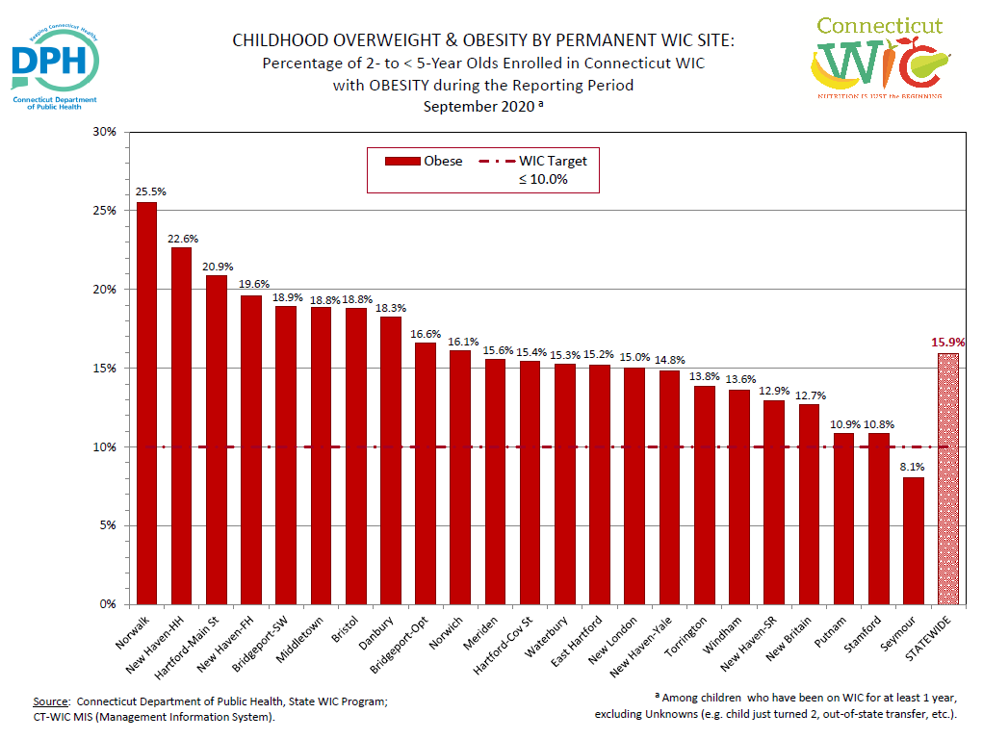
Notes:
Here is an example of a data report provided by the WIC Epidemiologist on Childhood Overweight and Obesity. This specific chart displays obesity among all the permanent WIC sites in Connecticut for the Reporting Period of September 2020. At the far right of the bar graph, there is a white spotted red bar with a value of 15.9%. This represents the Statewide average for Obesity among all of the permanent locations. Look on this chart to see if you can find the obesity rate for your local agency permanent site. Rates range from the lowest at 8.1% to the highest at 25.5%.

Slide 9
SMART Goal Setting
Relevant to the goals and objective
Use action verbs
Available resources
What to do
Baseline measurement
Can be counted
Specific
Measurable
Attainable
Achievable
Realistic
Time Based
Specific time
Reasonable time
Notes:
Now that we have taken a look at a specific objective – Obesity rates – and the current rates, let’s look at creating strategies to improve rates. Specifically, SMART Goal Setting. There are 5 points to a SMART goal: Specific, Measurable, Achievable, Realistic and Time Based. When all of these are put in place, you are more likely to follow through with strategies and achieve your goal. It is also easier to evaluate your accomplishments.
SPECIFIC - What are you going to be doing and for whom? Is it clear or is the goal too broad? It’s important to use action verbs such as train, increase, decrease, build, etc… Avoid verbs that are hard to evaluate such as encourage, support, coordinate, etc…
MEASURABLE - This means that a goal or strategy can be counted or quantified. Do you want to know if a rate increases or decreases? If this is a first-time goal, a baseline measurement will be the first step. Ex. “Baseline to be determined by conducting 10 chart audits in each quarter for Q1 and Q2.” It is good to identify the tool that is being used.
ACHIEVABLE – Can you achieve this goal with the resources you currently have? If limited resources are available, will the effort needed be enough to attain the goal?
REALISTIC – Will this objective have an effect on the goals of the program?
TIME BASED – When will this goal be achieved?

Slide 10
Example: Goal NOT Met
Obesity Objective: Results
State Target | Local Agency Result: FY 2019 | Local Agency Target: FY 2020 | Local Agency Results: FY 2020
Obesity: BMI ≥95% for children 2-5 years of age does not exceed 10% | 14% | 12.5% | 15%
Notes:
For some of your objectives, you will meet your target as well as the State targets. But, for other objectives, you will need to set goals and strategies to improve rates.
In this example, we are looking at an objective that did not meet the target rate - the Obesity target and the results for FY 2020. In order to set a target for FY 2020, you must look at previous year’s results. In FY 2019, the actual Local Agency result was a 14% Obesity rate. The local agency decided to set an ambitious target at 12.5% for FY 2020. However, the actual results for FY 2020 ended up being 15%. What happened? It could be that the target was set much lower than it should have been and was unrealistic for staff to achieve at that time. Another reason could be that the strategy that was developed was not SMART. In the next few slides, we will look at examples of a SMART and NOT SMART strategy.

Slide 11
Setting Your Target for FY 2021
Obesity – 14%
How is the local agency planning to reach this target?
Set objectives and strategies that are SMART.
Think about resources – Professional Staff, Paraprofessional staff
What tools are already available?
What tools have been created by ReNEW 2.0 education subcommittee?
What evaluation activities will be implemented to measure accomplishments and outcomes?
Notes:
The last slide showed an FY 2020 rate for Obesity at 15%. What target should be set? Is the local agency in a place where they can be aggressive or non-aggressive with this goal? Let’s assume they are in-between and set the target at 14% for FY 2021. Ask yourself the questions on these slides.

Slide 12
Strategy: Nutrition Objective on Childhood Obesity SMART or NOT SMART?
Objective: Decrease obesity in children enrolled in the WIC Program from 15% to 14% by September 2021. Strategy: Encourage mom to provide more nutritious snacks with fruits, vegetables and nuts
Specific | Measurable | Achievable | Realistic/ Relevant | Time based
No | No | Not determined at this point | Not determined at this point | Needs work
Notes:
The Objective reads: Decrease obesity in children enrolled in the WIC Program from 15% to 14% by September 2021.
The Strategy reads: Encourage mom to provide more nutritious snacks with fruits, vegetables and nuts.
This strategy is not specific – it’s too broad. It is not measurable. How will the local agency evaluate the effectiveness of this strategy? There are no evaluation tools indicated that will be used. It is unclear if it is achievable or realistic. And lastly, even though the Objective states the obesity rates will decrease to 14% by September 2021, there is no mid-way check-in to evaluate progress. A mid-way check-in can be an important step because minor changes to the strategy may be needed in order to achieve success. It is good to identify a timeframe for when the strategy should be evaluated and completed.

Slide 13
Strategy: Nutrition Objective on Childhood Obesity SMART or NOT SMART?
Objective: Decrease obesity in children enrolled in the WIC Program from 15% to 14% by September 2021. Strategy #1: The tool “Tell me more about your child” will be implemented for children 2-5 years of age at follow-up appointments in Quarter 1. The Program Nutritionist will conduct 3 observations for each nutritionist and nutrition aide each in Quarters 2 and 3. Strategy #2: Investigate the percentage of nutritionists documenting individualized goals and action plans for children with obesity problems. The Program Nutritionist will conduct 10 chart audits each in Quarters 2 and 3 specifically targeting children assigned the obesity risk factor.
Specific | Measurable | Achievable | Realistic/ Relevant | Time based
Yes | Yes | Yes | Yes | Yes
Notes:
This objective has been improved by adding 2 SMART strategies. Both strategies are specific in that they are actionable and achievable. They are measurable because actual evaluation tools will be used to determine effectiveness. It is realistic in that the staff can incorporate the strategies easily and the evaluations could be a simple addition to the Program Nutritionists quarterly observations and chart audits. Also, this type of evaluation could easily be assigned to a nutritionist who is interested in assisting with this objective. And finally, it is time based due to the addition of adding the evaluation methods in Quarters 2 and 3.

Slide 14
Updated Workplan for Obesity
Nutrition Outcome Objective: The prevalence rate of BMI > 95th percentile for children 2-5 years of age does not exceed 10%.
Local Agency Target: 14%
Problem, Issue, Need(Optional) | SMART Strategies (Includes audience, staff involved and target date) | Evaluation Sources (e.g. chart audit, observations, peer review, surveys, and pre/posttests)
Decrease obesity in children enrolled in the WIC Program from 15% to 14% by September 2021. | #1: The tool “Tell me more about your child” will be implemented for children 2-5 years of age at follow-up appointments. | The Program Nutritionist will conduct 40 chart audits total in Quarters 1 and 2 of FY 2020 by March 2020.
 | #2: Investigate the percentage of nutritionists documenting individualized goals and action plans for children with obesity problems. | The Program Nutritionist will conduct 20 chart audits by May 31, 2020.
Notes:
This is an example of the updated workplan that can be found in the LAP.

Slide 15
Evaluation Tools
Chart Audits
Observations
Local Agency Self-Evaluation
Participant Satisfaction Survey
Suggestion Box
Audit Findings:
State agency
Local agency
CT-WIC Reports:
Predefined (Misc. dropdown)
Clinic & Admin module
Data Reports (provided by State agency):
Annual
Quarterly
Monthly
Notes:
Evaluation tools are not just observations and chart audits. They can be participant survey results, audit findings, CT-WIC reports and data reports provided by the State agency.

Slide 16
Participant Satisfaction Survey Results – What Information Will You Get From It?
How the program is perceived by the participants
The barriers participants are facing
Ex. Late arrival to appointments
What needs to be prioritized when setting measurable goals?
Ex. 96% of participants have trouble with parking at your local agency and many arrive late to their appointments
What nutrition topics are of interest to mothers
Ex. 77% of moms want more education on finding reputable nutrition information on the internet
Ex. 99% of moms want more healthy recipes provided to them
Notes:
The Participant Satisfaction Survey, offered through Survey Monkey, is now created by the State WIC agency and distributed via One Call Now text messages directly to participants. The survey is intended to determine the following information from WIC participants:
How is the program perceived by participants?
What barriers do participants face? Do they have transportation issues? Are more late hours needed do to their work schedule?
How do you know what to prioritize when setting targets and creating goals/strategies?
What nutrition topics are of interest to mothers?
How has their shopping experience been using the eWIC card?

Slide 17
Guidance Documents Available – for Staff
iPAUSE
Consistent Education Messages: Childhood Overweight and Obesity Guide for BMI Assessment and Effective Communication with Families – includes “Tell Me More About Your Child”, a guide to start a conversation with families
Motivational Interviewing (MI) Guidance
Adequate Weight Gain During Pregnancy, Guidelines for Consistent Messaging – includes a survey: “Tell me more about you…”
Breastfeeding Content Sheets – topics range from “Building and Maintaining a Milk Supply” to “Secrets of Baby Behavior”
Notes:
Over the years, the State WIC agency has worked with local agency WIC staff on creating guidance documents to assist nutrition staff in meeting the needs of the participant during nutrition assessments and counseling sessions. These guidance documents have been used in local agency strategies in previous years, especially when there is a need for it. For example, your local agency may wish to improve the Maternal Weight Gain rates by re-training or training all nutrition staff on the “Adequate Weight Gain During Pregnancy, Guidelines for Consistent Messaging” guidance document and how to use the Tell Me More About You survey for participants.
The State WIC agency is working on getting these documents uploaded to the State WIC webpage. In the meantime, your Program Nutritionist should have electronic copies of some, if not all these documents. Please have your Program Nutritionist reach out to your State agency liaison if your local agency does not have an electronic copy.

Slide 18
Lesson Plans
Anemia Prevention and Iron Rich Food Sources
Fruit and Vegetables for Children
Introduction to Food
Physical Activity (Playing)
Notes:
The State WIC agency in partnership with select local agency staff, has developed specific lesson plans for local agency nutritionists and nutrition aides. The intent of the lesson plans is to use them in a facilitated group discussion setting. However, they can be used one on one with participants. The topics of these lesson plans coincide directly with the State Objectives and can be used as a strategy to improve objective rates.

Slide 19
Outline of Lesson Plans
The Lesson Plan provides the following answers/guidance for a chosen subject:
Why is this important?
Learning Objectives
Key Educational Messages
Resources Brochures
Ideas for Group Activities
Equipment/Materials needed during the session
References
Notes:
Lessons Plans are broken out in these sections in order to provide direction and organization when facilitating group discussions.

Slide 20
Project ReNEW Nutrition Education Pamphlets
Designed to be one source low-literacy reference for parents/caregivers on key nutrition issues for each of the WIC participant categories
8 pamphlets
Healthy Eating During Your Pregnancy
Feeding Your Baby 0-4 months, 4-8 months and 8-12 months
Feeding Your Baby Birth to 1 Year (includes more pictures, larger font size & bold-faced headings)
Feeding Your Toddler
Breastfeeding Brochure
Healthy Eating After You Deliver
Nutrition Education pamphlets guidelines for use
Notes:
The Project ReNEW Nutrition Education Pamphlets are intended to be discussed and provided to WIC participants as appropriate. They are meant to offer anticipatory guidance to participants for where they are at the moment. These documents must not simply be given to participants without a discussion on what the content is. These can be really good tools to use in helping a participant set a goal. Local agencies are able to order a supply of these handouts through the State agency. If you have not seen these before, ask your Program Nutritionist where you can find them.

Slide 21
Pamela Beaulieu
Pamela.Beaulieu@ct.gov

