Slide 1
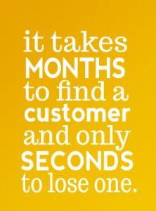
Customer Service
Providing Quality Services to all WIC Customers
Notes:
The manner in which customer service is provided impacts how effective WIC staff can assist participants in achieving lifelong health and nutrition goals. When WIC staff provide good customer service, participants are more likely to continue to participate and will get the most from the benefits WIC has to offer including nutrition education, referrals and access to healthy food. Today we are going to talk about customer service and how in Connecticut we can provide the best customer service to both our WIC families and co-workers.
In order to provide excellent customer service we must first understand our participants and their values, experiences and current situation.

Slide 2

Notes:
Watch Empathy: The Human Connection to Patient Care video. https://www.youtube.com/watch?v=cDDWvj_q-o8

Slide 3
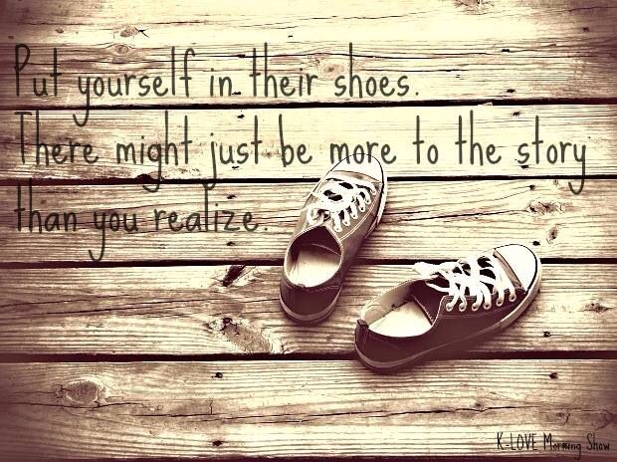
Empathy
Notes:
What is your reaction to this video?
We don’t always know where people are coming from or what they are experiencing in their lives. Ask questions and be genuine. The more you understand their story or current situation the more comfortable they will feel and are more likely to open up.
Empathy the ability to understand and share the feelings of another.
If you could stand in someone else's shoes . . . hear what they hear. See what they see. Feel what they feel. Would you treat them differently?

Slide 4
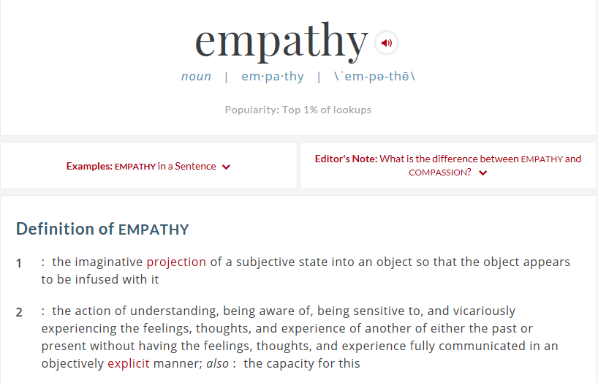
Notes:
For your reference, the definition of empathy.

Slide 5
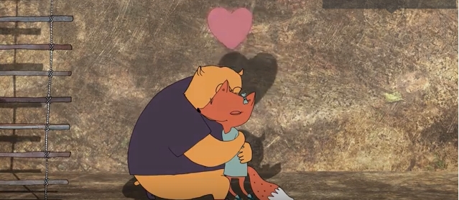
Empathy & Sympathy
Brené Brown
Notes:
Watch Brené Brown on Empathy https://www.youtube.com/watch?v=1Evwgu369Jw
Tell me about how you think her message fits into the WIC Program and the concept of Value Enhanced Nutrition Assessment? Or keep in mind this message as you learn more about VENA.

Slide 6
Here are a few ways to improve your ability to empathize:
CHALLENGE your own assumptions.
DO NOT JUDGE the choices of others based on your personal upbringing/life experiences.
LISTEN to others’ stories.
TRY to put yourself in someone else’s shoes.
Notes:
Join us in practicing improving your ability to empathize which these four ideas.

Slide 7
What are the messages we are trying to convey?
WIC Cares
WIC is here to help
You are important to us
We want to serve you
We know you care about your family
You have choices
Let’s work together
We believe in you
Notes:
The manner in which we provide customer service should convey these messages to our participants.
If you are not conveying these messages, we encourage you to take a step back and ask yourself why?
Determine how to get back on track so that the type of service you provide follows these basic concepts.
WIC is a rewarding place to work. It can also be difficult. Direct customer service is the central part of your job and must be done with a smile from the time you open to the time you close. It can be tiring. But it is worth it.
Our participants and coworkers are worth it. If you find a coworker not conveying these messages be a role model, they too will find their way back.

Slide 8

Our personal experience with customer service can help remind us about the way customer service should and should not be provided.
Notes:
Next let’s talk about some of our personal experiences with positive and negative customer service experiences.
Think about one situation when you were provided poor customer service.
What could have been done differently to turn it from a negative experience to a positive one?
What is one take away from this experience?
Think about a time you received excellent customer service.
Why was it so good?
What is one take away from this experience?
Meeting customer expectations results in customer satisfaction. How do we know what our customers expect? There are common expectations all customers have about the way they should be treated and the actions they expect staff to take to assist them. WIC participants are no different than any other type of customer.

Slide 9
How to Handle Negative Situations
Avoid negative responses
  Begin with a positive response
  Communicate your willingness to help
  Let the participant know what you can do to help
For example: A participant calls and asks if she can come in for her benefits. It is 4:55pm and your office closes at 5:00pm.
Notes:
What do you think about the 2 responses:
1. No we are about to close for the day. It’s too late.
2. I can see you first thing in the morning, but unfortunately the office is closing in 5 minutes and doesn’t allow either of us enough time for you to receive your benefits. Can I schedule an appointment for you tomorrow?

Slide 10
Defusing Difficult Situations
Tips for working with people during difficult situations
Point of view
Show you care
Don’t take it personally
Remember, let the person know first what you can do. Then offer solutions, if necessary.
Example: A participant arrives 15 minutes late for her appointment. She assumes you will not see her because she is late. When you greet her, she uses a raised voice and begins explaining why she was late.
Notes:
Point of View: Take time to try to understand the participants point of view. State that you want to help and ask how you can be of assistance. Ask questions to gather more information.
Show you Care: Gather facts. Demonstrate your willingness to help. Be honest. Offer solutions
Don’t take it personally: know that even when you’ve done your best, the person may want help from another staff member or manager.
Example: How will you handle this situation? What words can you use? How will you treat her? How can you put her at ease?

Slide 11


Cultural Diversity or Multiculturalism?
Diversity = Cultural identities should not be discarded or ignored, but celebrated & valued
Multiculturalism = Every culture & race has made a substantial contribution to this country
Notes:
The next series of slide briefly reviews some concepts related to “cultural competence”.
Historically, the WIC Program has worked to provide its staff with education to ensure all participants feel welcomed. The Program also strives to cultivate a diverse workforce reflective of its participants.
There are several ways to look at how we view culture. Take a moment to read about the terms on the screen.
It may seem that these are conflicting definitions- cultural diversity and multiculturalism, but both views together can be part of a comprehensive approach to how we work in WIC not only with our participants but also our co-workers.
For example, cultural diversity is based on the idea that cultural identities should not be discarded or ignored, but rather maintained and valued.
The foundation of multiculturalism is that every culture and race has made a substantial contribution to American History.
So for the next few slides, we will explore how culture impacts WIC Nutrition Services.

Slide 12

What does this have to do with WIC Nutrition Services?
Once someone understands their own cultural foods are not widely accepted by other cultures, it’s easier to view other cultural food choices with less hesitance.
Notes:
Since we serve a variety of people in the WIC program, it is key to understand your own knowledge, feelings and beliefs about culture and its impact on food and health prior to providing information or counseling to our participants.
As this illustration suggests, we need an open mind to meet our participants where they are at, on many levels, not just diet habits, but in order to begin to understand how our perceptions of “others” can impact our counseling.
Let’s use this example.
It is common knowledge that most people tend to regard their own diet as sensible and the diets of other cultures as bizarre or strange.
Is this statement true for you? How much of an adventurous eater are you? Are you hesitant to try foods or dishes from cultures that are different from yours?
In this basic example, we use food, but this same way of thinking can be said for other topics such as health beliefs, holiday traditions or parenting styles.
Once someone understands their own cultural foods are not widely accepted by other cultures, it’s easier to view other cultural food choices with less hesitance. The same can be said for other practices that impact health outcomes.
https://portal.ct.gov/DPH/Workforce--Professional-Development/Office-of-Health-Equity/Office-of-Health-Equity

Slide 13
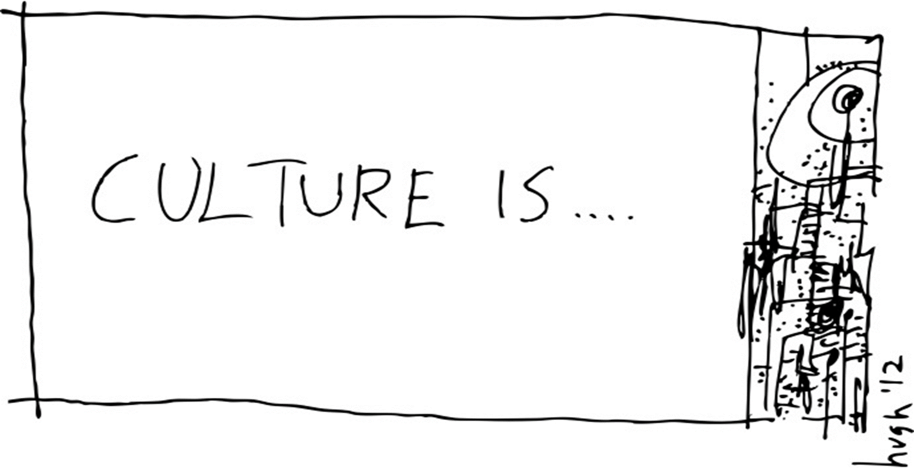
What is culture? What are values?
Notes:
Next let’s define culture and values.
Culture is a set of learned customs, beliefs, values, ways of communication, actions, and institutions shared by a racial, ethnic, religious, or social groups that shape their manner of living.
A value is a widely held belief about what is important in a culture.
Culture is learned.
Culture is all the things that give an individual identity.

Slide 14

Remember: Culture is dynamic & changes over time. AVOID cultural stereotyping!
Notes:
With those definitions in mind, we need to also allow that even though culture is learned, it is not static, it is dynamic and adapts to both internal and external factors.
This slide shows what we tend to do when we think of members of a particular culture, i.e. ethnic or religious groups, race or gender- we generalize or could stereotype because it is faster…
As WIC staff we must resist stereotyping because it doesn’t serve us well in our daily work.
Above all, WIC participants are individuals and although they exist in various cultural backgrounds, ethnic or religious groups, may be of different race or genders- these characteristics do not need to be solely defining about a participant, but can provide us with some information we need to put in context for our role in WIC.

Slide 15

A word about dominant culture and cultural sensitivity.
Cultural sensitivity implies that both groups understand and respect each other’s characteristics.
You are aware that people are not all the same and that you recognize that your culture is no better than any other culture.
Photo Credit: letsbuildnebraska.blogspot.com
Notes:
This definition of dominant culture was found on the red shoe movement blog (The red shoe movement is a company dedicated to women’s career and leadership development.)
Dominant culture is described in the United States as the European American, whereas Hispanic, African American and Chinese cultures are all secondary.
Cultural sensitivity implies that both groups understand and respect each other’s characteristics. And also means that you are aware that people are not all the same and that you recognize that your culture is no better than any other culture.
Of course, achieving this level of culture sensitivity can be a challenge for members of dominant the culture.
https://www.idrinstitute.org/resources/basic-concepts-intercultural-communication/

Slide 16
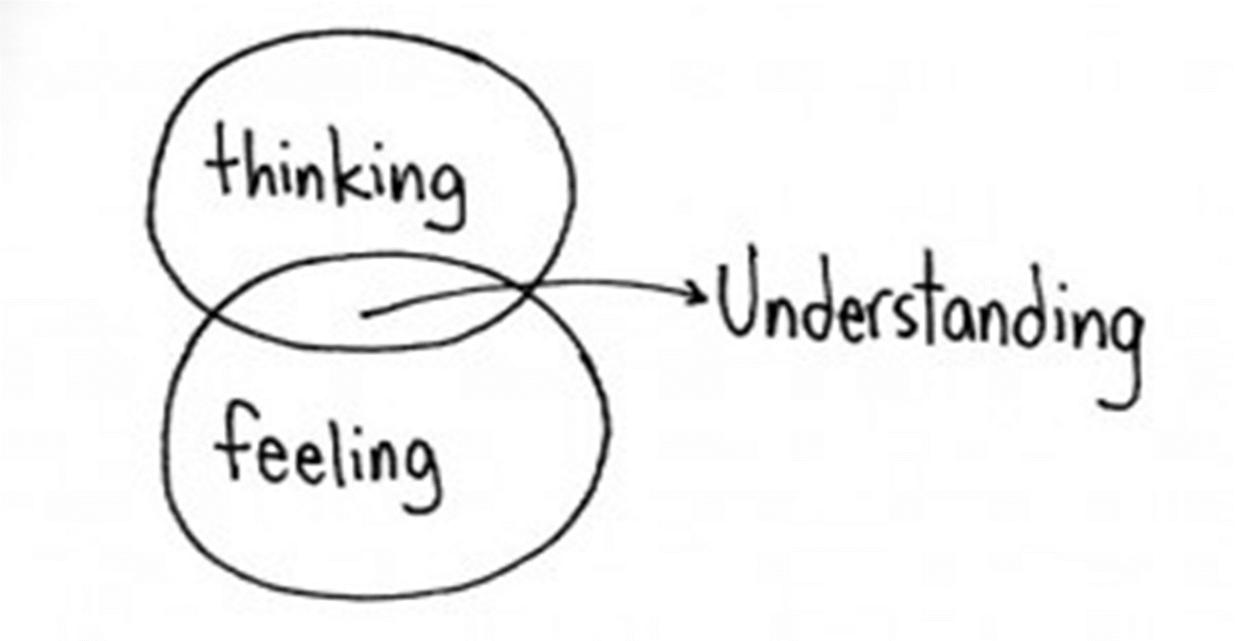
Notes:
So, how can we gain understanding of other cultures?
The first step is to gain knowledge to balance your existing beliefs and feelings.
It is okay when you are new to WIC to not have information about all the diverse populations that you serve in your local agency.
However, over time, you should be working to gain understanding of the varied populations you serve in order to be able to provide excellent customer service and provide relevant nutrition information.
The next few slides will provide you with various academic resources if you wish to explore these topics more deeply.
Before we move on, a quick reminder that the information gained from your research on culture, race and ethnicities, needs to be balanced by understanding that participants come with individual experiences as well, to avoid cultural stereotyping.
For example, I (Marilyn Lonczak) have polish ancestry, but it do not like all polish foods nor do I subscribe to all polish cultural traditions. I wouldn’t want WIC staff to make assumptions about my food preferences based on my heritage.
The best way to bridge this gap is to ask clarifying questions and avoid making assumptions.

Slide 17
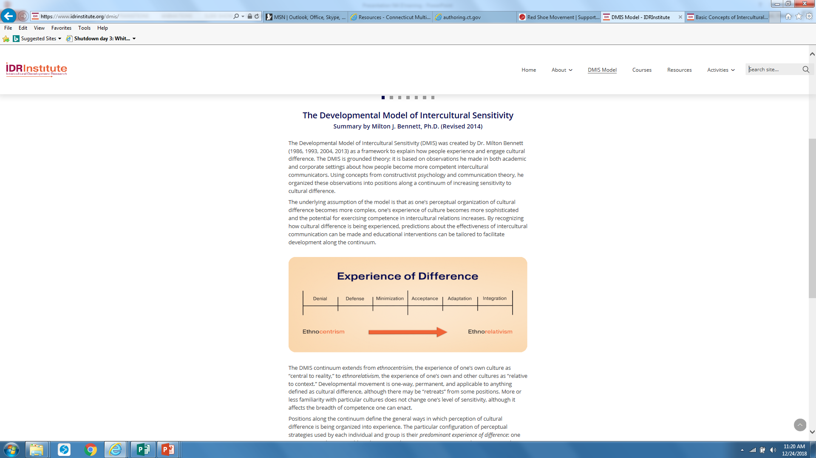
Resources for deeper learning
The Developmental Model of Intercultural Sensitivity (DMIS)
Underlying assumption is that as one’s understanding of cultural difference becomes more complex, one’s experience of culture is more sophisticated and there is potential to increase competence in intercultural interactions.
https://www.idrinstitute.org/resources/basic-concepts-intercultural-communication/
Video link: https://www.bing.com/videos/search?q=Milton+Bennett%2c+Developmental+Model+of+Cultural+you+tube&view=detail&mid=981AD892D47489C70549981AD892D47489C70549&FORM=VIRE
Notes:
For those of you that would like to gain a deeper understanding of a leading theory behind intercultural sensitivity, there are resources on this slide.
https://www.idrinstitute.org/resources/basic-concepts-intercultural-communication/
https://www.bing.com/videos/search?q=Milton+Bennett%2c+Developmental+Model+of+Cultural+you+tube&view=detail&mid=981AD892D47489C70549981AD892D47489C70549&FORM=VIRE
The key premise of this developmental model of intercultural sensitivity or D-M-I-S is that as one’s understanding of cultural differences become more complex, one’s experience of culture is more sophisticated and there is potential to increase competence in intercultural interactions.
The continuum on the right shows the various “stages” moving from “ethnocentrism” which is
Believing that your own race, culture, nation, and way of living is better than all others
Using the standards of your own culture to judge another culture
Making false assumptions about others' ways based on our own limited experience
…to ethnorelativism which is
Accepting that the ways of other groups are equal to our own in value
Realizing that we act from our own values and asking ourselves if we have the right to decide what is right for others
This can be hard as it brings up a lot of ethical questions in health care. So ethics teams are involved in those hard decisions at times.

Slide 18
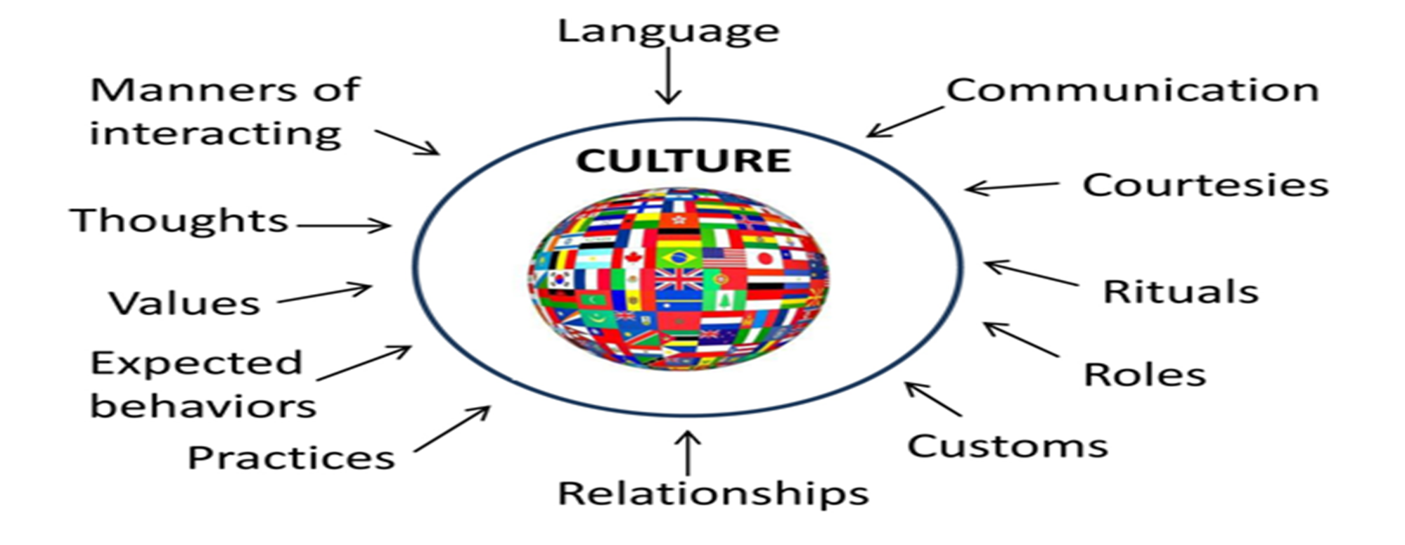
Cultural Sensitive or Culturally Appropriate?
Notes:
What are some ways that we can become more culturally sensitive or appropriate?
First, understand that we are all ethnocentric. We judge and misunderstand others based on our own limited life experience.
Become aware of your own beliefs. Be mindful that ethnocentrism may be exploited to foster conflict and promote the power of a particular group.
To move along the continuum
Observe the reactions of ourselves and others, look for both similarities and differences. Be open to learn from others who are different from you.
When working with participants.
Appreciate their life experience, contemplate, what are their feelings and thoughts about their health care situation?
How does this belief help them to adapt to life? This helps you gain insight into their culture
Remember participants are the experts in what is important in their lives.
Seek out opportunities to be involved in inter-ethnic opportunities to learn more about other people. Your work with diverse patients can help you learn new ways of seeing and experiencing life
https://quizlet.com/206325892/ethnocentric-to-ethnorelative-flash-cards/

Slide 19
A culturally appropriate person is someone who demonstrates both sensitivity to cultural differences and similarities, and effectiveness in using cultural symbols to communicate a message.
Notes:
A culturally appropriate person is someone who demonstrates both sensitivity to cultural differences and similarities, and effectiveness in using cultural symbols to communicate a message. Keep in mind there is a learning curve and continual process.

Slide 20
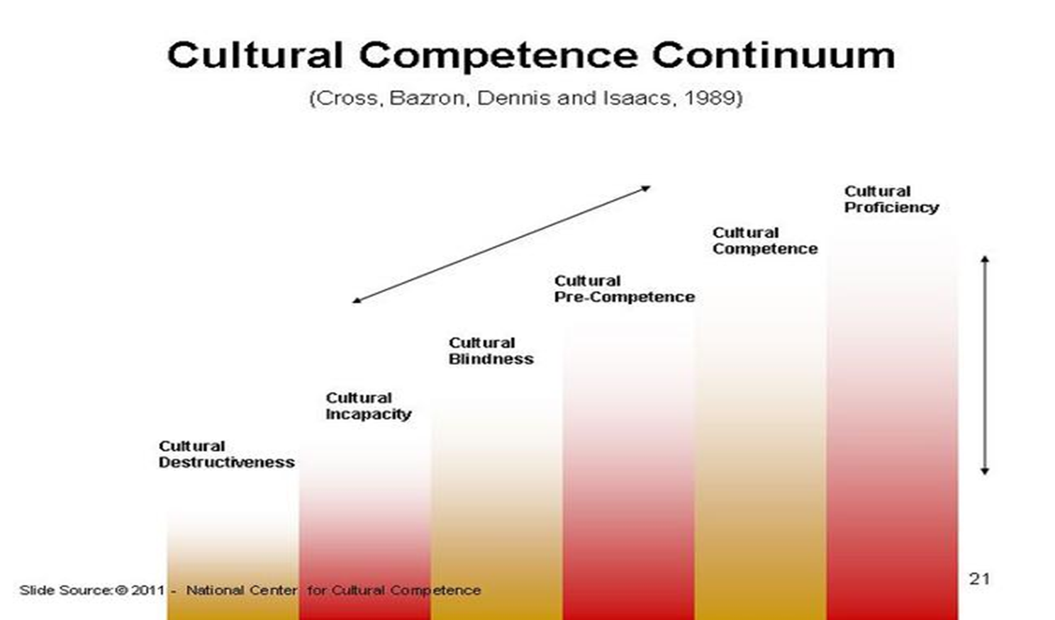
Another framework for understanding cultural competence
When systems, agencies, and practitioners that have the capacity, skills, and knowledge to respond to the unique needs of populations whose cultures are different to that which might be called dominant or mainstream America.
Notes:
Here is another framework for understanding people’s movement towards cultural competence.
When systems, agencies, and practitioners that have the capacity, skills, and knowledge to respond to the unique needs of populations whose cultures are different that that which might be called dominant or mainstream America we are moving toward a more inclusive society.
It is also valuable to remember that you do not have to agree with all behaviors or practices of different cultures, but you should make an effort to learn about and understand to build rapport and make connections.

Slide 21
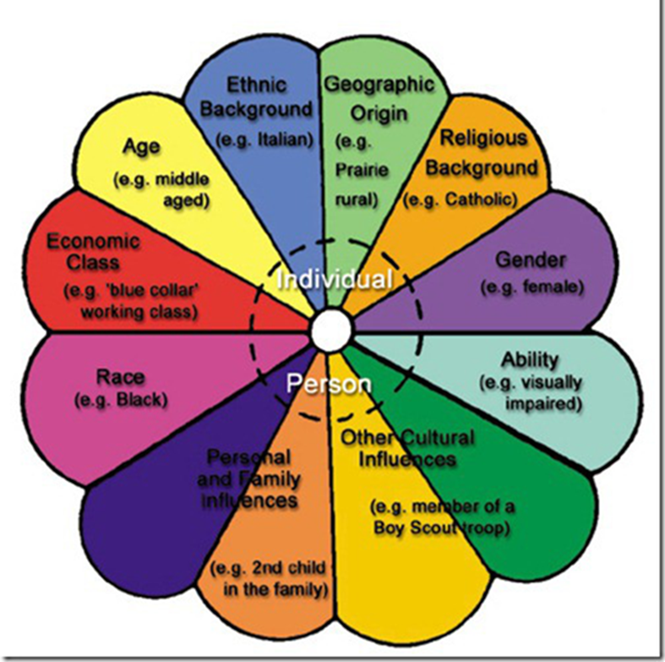
How can cultural beliefs about health impact WIC Nutrition Services?
Definition of Good Health
Causes/Prevention of Illness
Patterns of Seeking Health Care
Notes:
Now that we have explored some basics and theory regarding cultural interactions, let’s briefly talk about how cultural beliefs can impact WIC Nutrition Services.
Take a few moments to write down your views on the following-
What defines “good health”?
How does your culture think about how illnesses are caused and/or prevented.
What are your beliefs when it comes to seeking health care?
Write down your responses and save to share for a discussion during the training.
These can be hard questions to answer, because as a WIC employee our counseling and recommendations come from our WIC Regulations and/or research that stems from the dominant culture i.e. Western Medicine.
Understand that at times these recommendations may conflict or be rejected by participants and that is OK. Talk more with your mentor about they have handled these situations in the past.

Slide 22
A WIC participant is the most important person to enter the WIC office. A participant is not dependent on us.
We are dependent on them. They are the purpose of it. We are not doing a favor by serving the participant. It is the participant who is doing us a favor by letting us serve them. A participant is a person who brings us her/his wants. It is our job to handle their needs, with efficiency and professionalism, always with each participant in mind.
Notes:
So as we move to the end of this presentation, we want share with you our WIC Customer Service Statement.
A WIC participant is the most important person to enter the WIC office. A participant is not dependent on us.
We are dependent on them. They are the purpose of it. We are not doing a favor by serving the participant. It is the participant who is doing us a favor by letting us serve them.
A participant is a person who brings us her/his wants. It is our job to handle their needs, with efficiency and professionalism, always with each participant in mind.
(Adapted from Hot Pots customer service statement)
Based on your experience, do you think your local agency lives up to this statement?

Slide 23
Notes:
During our virtual call, we will be able to answer questions you may have about this slide deck and any situations that you have dealt with in WIC since you began working with us.
We are especially interested your experiences with our new service delivery model (remote services) since this is unprecedented in our operations. We have an opportunity to learn from and build on the successes we experienced during this time.
Obviously, the recent events that have required WIC operations to become all remote requires us to even display MORE empathy for our participants and their families in addition to our co-workers. We are so grateful to you for rising to the challenge over these past several months, we appreciate your flexibility and hard work.
Empathy the ability to understand and share the feelings of another.
If you could stand in someone else’s shoes
Hear what they hear
See what they see
Feel what they feel……..would you treat them differently?
Connect with Amy.Botello@ct.gov or Marilyn.Lonczak@ct.gov with questions.

