Slide 1
Welcome
Leslie Balch
Deputy Commissioner Katharine Lewis

Slide 2

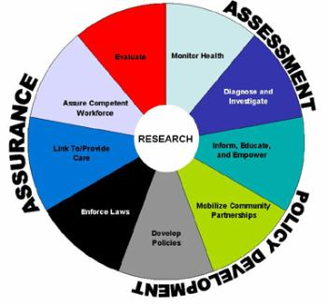

Creating Demand for Public Health
Public health is…
what we do as a society to ensure the conditions in which people can be healthy
federal, state and local partners with unique but interconnected responsibilities, one dependent upon the other , working together to assure the conditions in which people can be healthy
Lead Public Health is…
a way to create demand for public health through education, outreach and dialogue
an opportunity to create a vision for an equitable and robust public health system in Connecticut
www.ct.gov/dph/leadpublichealth
The 10 Essential Public Health Services

Slide 3
Ten Major Public Health Achievements
2000 - 2010
Vaccine preventable diseases
Prevention and control of infectious diseases
Tobacco control
Maternal in infant health
Motor vehicle safety
Cardiovascular disease prevention
Occupational safety
Cancer prevention
Childhood lead poisoning prevention
Improved public health preparedness and response

Slide 4
  Health not health care
  Population not individual
  Know the community
  Well being not illness
  Prevention not treatment
  Conditions in which we live
  Equally for all!

Slide 5
PARTNERING FOR HEALTH

Slide 6
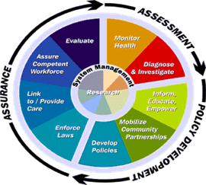
POLICY DEVELOPMENT
ASSESSMENT
ASSURANCE

Slide 7
Tour
  Stations
  Door prizes
  Discussion
  Survey

