Slide 1
Plainville-Southington Health District Open House July 16, 2014
Connecticut Department of Public Health
Plainville-Southington Health District
With funding provided by The Aspen Institute

Slide 2
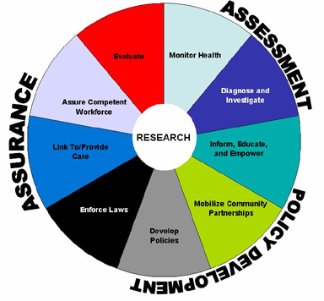
Creating Demand for Public Health
Public health is…
what we do as a society to ensure the conditions in which people can be healthy
federal, state and local partners with unique but interconnected responsibilities, one dependent upon the other , working together to assure the conditions in which people can be healthy
Lead Public Health is…
a way to create demand for public health through education, outreach and dialogue
an opportunity to create a vision for an equitable and robust public health system in Connecticut
www.ct.gov/dph/leadpublichealth
The 10 Essential Public Health Services

Slide 3
What is Public Health
The science and art of preventing disease, prolonging life and promoting health through the organized efforts and informed choices of society, organizations, public and private, communities and individuals.
All of the things we do as a society to ensure the conditions in which people can be healthy.

Slide 4
CT Local Health Departments/Districts

Slide 5
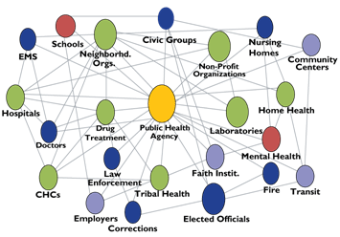

Slide 6
10 Essential Public Health Services
Monitor health status to identify and solve community health problems.
Diagnose and investigate health problems and health hazards in the community.
Inform, educate, and empower people about health issues.
Mobilize community partnerships and action to identify and solve health problems.
Develop policies and plans that support individual and community health efforts.
Enforce laws and regulations that protect health and ensure safety.
Link people to needed personal health services and assure the provision of health care when otherwise unavailable.
Assure competent public and personal health care workforce.
Evaluate effectiveness, accessibility, and quality of personal and population-based health services.
Research for new insights and innovative solutions to health problems.

Slide 7
Contact Information
Connecticut Department of Public Health
410 Capitol Avenue, PO Box 340308,
Hartford, CT 06134
Phone: 860-509-8000
Katharine K. Lewis, Deputy Commissioner
katharine.lewis@ct.gov
Plainville-Southington Health District
196 North Main Street
Southington, CT 06489
Phone: 860-276-6275
Shane Lockwood, Director of Health
Slockwood@pshd.org

