Slide 1

2014 CT State Health Care
Facilities and Services Plan
Advisory Group Meeting
Thursday, July 31, 2014
9:00am – 11:00am

Slide 2
Today’s Agenda
9:00 | Welcome and Introductions | CT DPH
9:10 | Health Care Facilities and Services Survey | HRiA and large discussion
9:40 | Bed Need Projections | CT DPH and large discussion
10:05 | Unmet Need and Gaps in Services | HRiA, CT DPH, and large discussion
10:40 | Planning Process for Developing the 2014 Recommendations | HRiA
10:40 | Next Steps and Adjourn | CT DPH

Slide 3
CT DPH 2014 Facilities and Services Supplemental Plan
Builds off of the 2012 Plan, to include:
  An inventory of the availability and accessibility of services and facilities
  An assessment of the unmet health care related needs of persons at-risk and vulnerable populations;
  Projections of future demand, capacity and need for acute care hospital inpatient services
  Recommendations for the expansion, modification, or reduction of certain health care facilities or services
The 2014 report serves as supplement to the more comprehensive 2012 report
  For overarching issues: What has changed since 2012?
  Focus on vulnerable populations and projected demand and unmet need
  Can align with CT State Health Improvement Plan
Notes:
PHAB Accreditation Process
Voluntary program
Uses performance standards in 12 domains
CDC 10 essential services plus…
…Governance, Admin. & Management
Intended for state, local, tribal, and territorial health departments
Internal preparation and application
External evaluators
Three required components:
State Health Assessment
State Health Improvement Plan
Agency Strategic Plan

Slide 4
Project Timeline
Dec 2013 | Kick Off Meeting
Jan – July 2014 | Data Collection and Analysis: Facility Survey Identify Vulnerable Populations Projections of Future Demand and Unmet Need
July – Sept 2014 | Recommendations/Planning Process Meetings of Work Groups to identify and flesh out recommendations
Oct 2014 | Final 2014 CT State Health Care Facilities and Services Plan Completed

Slide 5
Health Care Facilities and Services Survey
Develop an inventory of the availability and accessibility of outpatient surgical services, imaging services, and hospital-based services including primary care services:
  name and location of facility,
  type of facility,
  hours of operation,
  description of services provided, and
  total number of clients, treatments, patient visits, procedures, and/or scans performed in a calendar year.

Slide 6
Health Care Facilities and Services Survey
Similar questions to the 2012 instruments with some minor revisions
Final instrument consisted of four surveys geared towards facilities that provide:
    Acute-care hospital-based service lines
    Hospital-based primary care services
    Imaging services
    Outpatient surgery services
Four surveys then streamlined into single, web-based instrument
  Survey pilot tested by OHCA staff and sample of facilities with assistance from associations

Slide 7
Health Care Facilities and Services Survey
Survey Administration
  Survey web-link/hard copies disseminated by association leaders and HRiA
  Administered between April and June 2014 with extensive follow-up regarding missing, incomplete, or unclear responses executed through July 2014
  All complete surveys combined into large database by survey type (i.e., imaging services, outpatient surgery services, etc.)
  Currently in process of cleaning data and reformatting for publication
Data on non-surveyed facilities being compiled via e-licensure files

Slide 8
Challenges to the Health Care Facilities and Services Survey
Unresponsiveness of some facilities
Duplications – some facilities submitted multiple surveys by different staff with different information
Misinterpretation that survey is not a requirement
Concerns about information being public – specifically about number of scans and patient visits
New information for current calendar year needed, so facilities could not just confirm previous data for all fields

Slide 9
Acute Care Hospital Bed Need
Brian A. Carney, MBA, Connecticut Department of Public Health

Slide 10
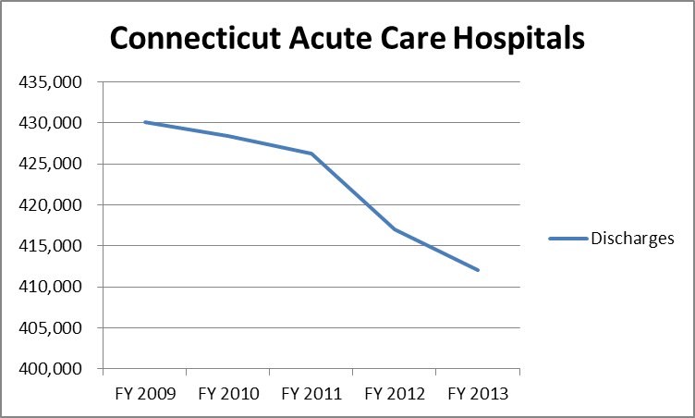
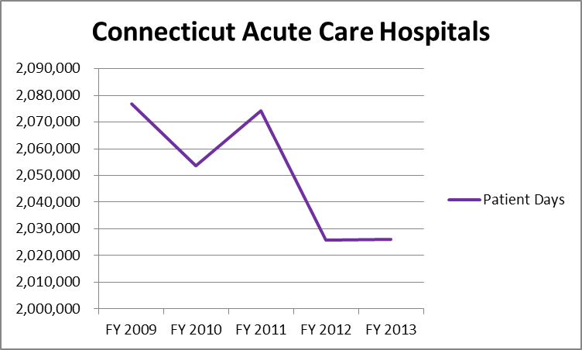
Acute Care Hospital Utilization:

Slide 11
Utilization (continued):

Slide 12
Bed Need Methodology:

Slide 13
Bed Need Results:

Slide 14
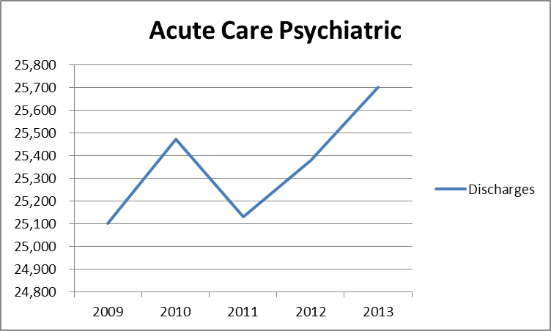
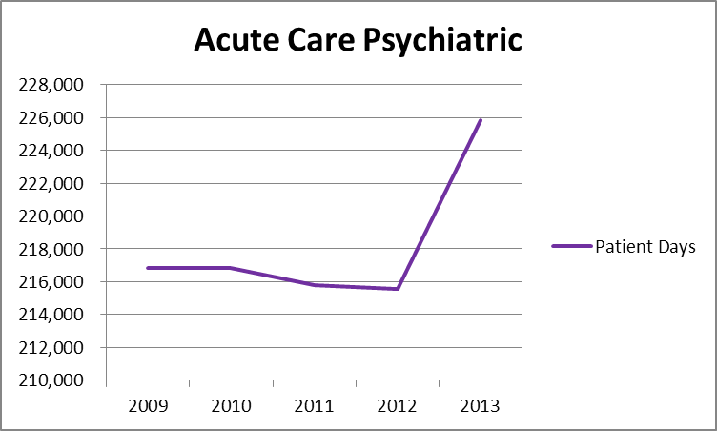
Availability of Care/Unmet Need
(Sec. 19a-634):

Slide 15
Available Bed Allocation:

Slide 16
Comments/Questions?

Slide 17
Unmet Need and Gaps in Services
Review of data on at-risk and vulnerable populations
  Elderly, disabled, less educated, uninsured, immigrants, etc.
Examination of wide geographic variations of health status across the state
Review of all community health needs assessments and strategic implementation plans of Connecticut hospitals

Slide 18
Top Health Issues across 21 CHNAs
Health Needs | # of CHNAs Identifying Health Need
Chronic Disease | 18
Overweight, Obesity, Nutrition, & Physical Activity | 16
Gaps in Primary Care | 13
Substance Abuse | 12
Mental Health | 12
Gaps in Mental Health Care | 7
Respiratory Health | 5
Maternal & Child Health | 5
Healthy Aging | 4
Housing | 4

Slide 19
Examination of Unmet Need
When looking at unmet need, it is important to look at issues of access
Further work aims to examine the range of issues that affect unmet need across the state. Goal is to develop an index to compare scores across the state. Including:
  SES factors such as poverty, unemployment, less than HS education, transportation
  Health status indicators such as hospitalizations for ambulatory care sensitive conditions, mortality rates

Slide 20
Planning Process for 2014 Recommendations
Work groups to meet in the next few weeks to develop 2014 recommendations
Meetings to revisit and build off of 2012 recommendations
Meeting process to be determined by work group – may be virtual or in-person

Slide 21
Next Steps and Adjourn

