Slide 1
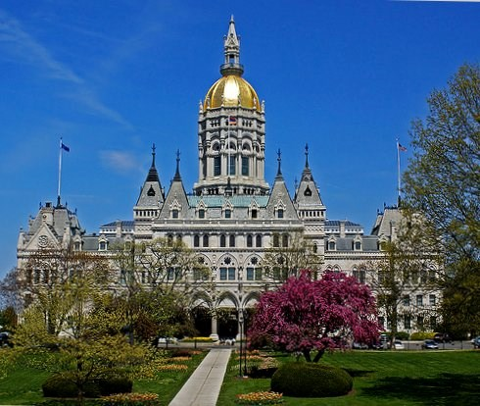
ePOC for LTC Facilities
Connecticut Department of Public Health
Facility Licensing and Investigations Section
June 2017

Slide 2
Use of ePOC

Slide 3
Select Application Window

Slide 4
ePOC Menu - User with Multiple Facilities

Slide 5
ePOC Menu - User with Single Facility

Slide 6
Letters Window

Slide 7
Attachments
Supported document types are .DOC, .DOCX, .XLS, .XLSX, .PDF, .JPG, .JPEG, .GIF, .TIFF, and .TXT. File size is limited to 4MB per file.
Upon approval of POCs for all tags on a survey, all ePOC attachments are removed.

Slide 8
Email - Survey results Posted to Facility
Sample Email
Subject: Statement of Deficiencies (SOD) Posted for State CO: DDD711 - ABC HEALTH CARE CENTER (Survey Completed 05/15/2013)
Facility Type: SNF/NF
Survey Category: CMPIVT
Survey Dates: 05/15/2013 - 05/15/2013
Event ID: DDD711Facility: 111111/ABC HEALTH CARE CENTER
Plan of Correction (POC) Due Date:05/25/2013
The Statement of Deficiencies for the survey completed at your facility on the above referenced date has been posted on the ASPEN Web: Electronic Plan of Correction (ePOC) website. Please login to the CMSNET VPN, click on the bookmark labeled 'CMS QIES Systems for Providers', then click on the Aspen Access (ePOC) hyperlink to review the deficiencies, and to enter Plan of Correction (POC) information, if required.
Contact your state survey agency or CMS regional office, as appropriate, with questions regarding this matter.
Please do not reply to this message.
Thank you.

Slide 9
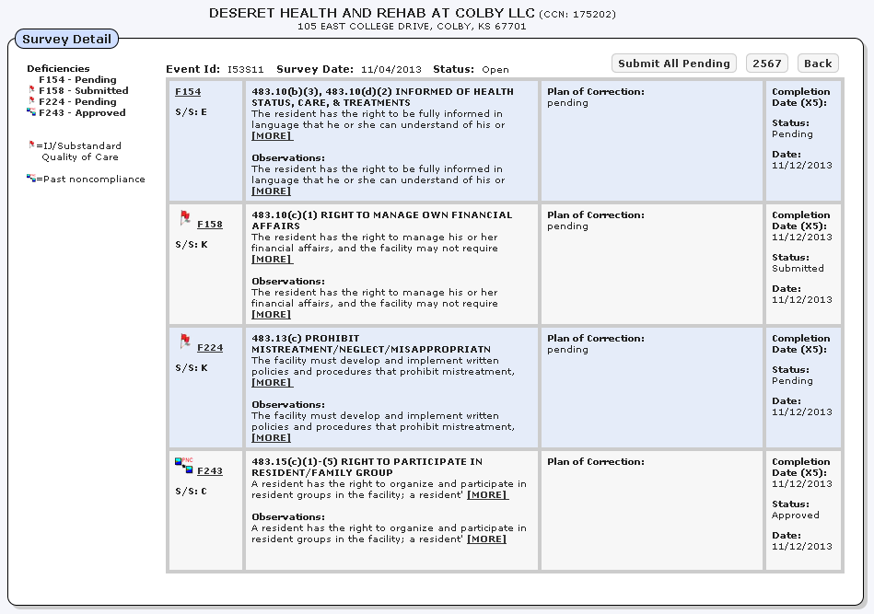
Survey Detail

Slide 10
Citation Detail

Slide 11
POC Backup
ASPEN Web: ePOC automatically backs up POC text every two minutes. If the application closes unexpectedly, you can recover unsaved POC text entered prior to the last backup.
When you log back into ASPEN Web: ePOC and open the Plan of Correction entry page for the applicable tag, a message appears and offers the option of restoring the unsaved Plan of Correction text. If you choose OK, the automatically saved text is entered in the POC Description field.

Slide 12
Submit All Pending

Slide 13
Printing Pending 2567 with POC
As soon as you enter your POC statement, you can print the 2567
However, it will have a watermark of “POC NOT FINAL” all over it

Slide 14
Printing Pending 2567 with POC

Slide 15
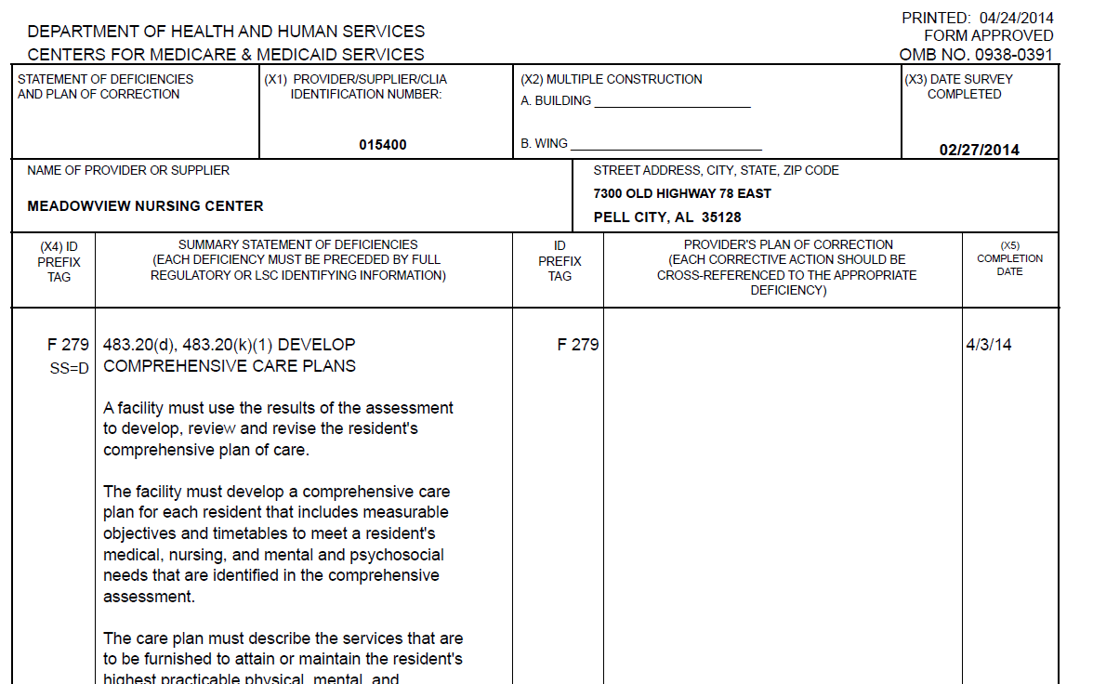
Printing Approved 2567 with POC
After you receive your email notification that your plan of correction has been accepted,
Login and select survey, click “2567”

Slide 16
POC Timing Out
If you do not enter POC text for a period of 15 minutes, a message appears and you have the option of keeping the Plan of Correction page open (for another 15 minutes) or not. If you do not respond within one minute, the page is automatically closed. Unsaved work is lost and the POC is released for editing by another user.
If you close the browser or back out of the page while editing a POC, the ePOC application assumes you are still editing it. In such a case, the lock on that POC is released automatically after 17 minutes.

Slide 17
ePOC
Questions?
For questions please contact Surjit Sethuraman (Surjit.Sethuraman@ct.gov)

