Slide 1
ePOC for LTC Facilities
Connecticut Department of Public Health
Facility Licensing and Investigations Section
June 2017

Slide 2
ePOC Introduction
The electronic Plan of Correction (ePOC) system provides a convenient, centralized workplace, which enables CMS and the State Survey Agency (SSA) to electronically manage and track POCs for ePOC-enrolled health care providers under their oversight.
To enhance communication and monitor timeliness, automated email notification is provided to specified SSA and facility recipients as needed throughout the ePOC life cycle.
ePOC will be used for all Health, Life Safety Code, Revisits, and Complaint surveys.

Slide 3
ePOC Introduction- Continued
Statements of deficiency 2567 (SOD), which are now mailed to nursing facilities by DPH FLIS, will soon be made available to you via a secure website created by CMS. Electronic Plans of Correction (ePOC) will allow enrolled Federally Certified Skilled Nursing Facilities (SNFs) and Nursing Facilities (NFs) to:
See their CMS 2567 Statements of Deficiencies (SODs) online;
Submit their Plan of Correction (POC) online;
Eliminate the need for paper based communications regarding POCs;
Review letters added to the survey by the State Agency or CMS Regional office
Attach documentation to support their Plan of Correction; and
Print the 2567 from the ePOC website.

Slide 4
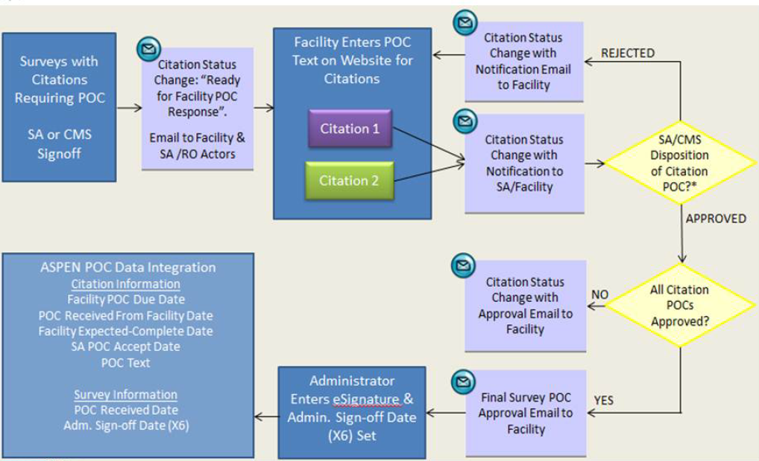
ePOC Process Flow

Slide 5
ePOC Rollout Plan
Phase 1: Training
Facility ePOC users online training video – No Registration needed
Phase 2: Enrollment
Enroll facility designated ePOC users access the ePOC website.
Phase 3: Go-Live
Starting Oct 1st, 2017 DPH FLIS will start posting SOD’s (Statement of Deficiencies) and receive POC’s(Plan of Correction) through the ePOC website.

Slide 6
ePOC Phase 1- Training
Phase 1: Training
CMS has created a training video to explain how LTC facilities will use the system for submitting their plans of correction using the ePOC process.
No Registration needed and this training video is available at DPH ePOC webpage www.ct.gov/dph/epoc
Designated facility ePOC users must view the online webinar training before they will be able to enroll for IDs and Passwords to access the system.
Submit the “Attestation of Completion of Online ePOC Training” survey

Slide 7
ePOC Phase 2- Enrollment
Phase 2: Enrollment
Before applying for enrollment in ePOC, each facility must designate at least 2 persons to receive the rights and passwords to access the ePOC system. Make sure these designated facility users have completed the online training.
In order to enroll in ePOC online a facility user will need two accounts:
CMSNet account (for network access) and
QIES User account (ePOC online access)

Slide 8
ePOC Phase 3- Go-Live
Phase 3: Go-Live
Starting Oct 1st, 2017 DPH FLIS will start posting SOD’s (Statement of Deficiencies) and receive POC’s(Plan of Correction) through the ePOC website.
So please make sure all the facility users have watched the training video, enrolled to login to ePOC and their respective facilities are enabled to ePOC process.

Slide 9
ePOC Useful Links
The CMSNet account registration form is available at: https://www.qtso.com/cmsnet.html.
Please note that a provider may request Individual Facility Access or may request Multiple Facility/Corporate Access. You can find information about both of these options at: https://www.qtso.com/accessepoc.html
For more information on facility training, enrollment and other questions please visit www.ct.gov/dph/ePOC

Slide 10
ePOC Assistance
Who to call for assistance?
For assistance with the CMSNet Secure Access Service Login or installation of the Juniper Network Client contact the CMSNet Help Desk at 888-238-2122.
For assistance with the ePOC User Registration contact the QTSO Help Desk at 888-477-7876.
Other questions that cannot be answered in the online ePOC procedure manual can be emailed to Surjit.Sethuraman@ct.gov.

Slide 11
ePOC
Questions?

