Slide 1
Climate and Health Equity Coalition
10/15/2024

Slide 2
Welcome + Icebreaker (10 minutes)
Announcements (10 minutes)
AAEP Update (10 minutes)
Symposium Agenda Proposal (15 minutes)
Curriculum Update (15 minutes)
LHAQP Update (25 minutes)
Wrap up (5 mins)

Slide 3
Intros + Icebreaker
What is one small thing that has been bringing you joy lately? If it has to do with the environment, all the better!
Notes:
Climate and Health Equity Coalition (ct.gov)
Public meeting – agendas and materials will be posted online, and members of the public can attend

Slide 4
Announcements
Request for Applications from local health departments/districts (LHDs) for Round 2 of DPH pilot grants for Local Heat and Air Quality Preparedness and Response Planning launching soon!
Application opening date: late Oct 2024
Application closing date: early Dec 2024
Announcement of pilot grants awards: by Feb 2025
Expected pilot grant period: July 1, 2025 – June 30, 2026
LHD contracts for Round 1 of pilot grants

Slide 5
AAEP / Evaluation: Overview
AAEP = Adaptation Action and Evaluation Plan. This is a CDC requirement for each of our two Adaptation Actions:
AA1: Develop and implement an educational program for local health departments in socially vulnerable communities to reduce resident exposure to the health effects of climate change.
AA2: Develop guidance for local heat and air quality response plans (LHAQPs; including alerts and communication strategies) and support local implementation through trainings and capacity building.
AAEP components:
Part 1: Description of Adaptation Action
Part 2: Communications
Part 3: Evaluation
Part 4: Project Management

Slide 6
AAEP / Evaluation: Status Update
AAEPs were drafted in 2023 for AA1 and AA2
Currently revising with CDC technical assistance, with focus on revising evaluation questions to reflect current activities, plans, capacity, and needs:
For AA1: revise evaluation questions to reflect quantitative and qualitative outcomes of curriculum
For AA2: revise evaluation questions to distinguish between LHAQP development and implementation (mostly qualitative)
Aiming for updated drafts to be ready for Coalition feedback by year-end via:
Written comments/edits
Discussion at January coalition meeting
Notes:
AA1 original questions and current thinking:
How engaged were stakeholders and how can we engage them more effectively?
How did the curriculum impact individual knowledge, attitudes, and beliefs related to the health risks of climate change? Pre-post survey in CT Train
How did the training impact the behaviors of local health departments regarding willingness/interest to plan and implement climate and health activities in their communities? Survey & interviews at 1-2 intervals post-training
AA2 original questions and current thinking:
How did the Adaptation Action support local health departments to develop their LHAQP, and how could the strategy be improved to better support them? Not precise enough; adapt Maine’s questions focused on plan development.
How engaged were stakeholders and how can we engage them more effectively? Keep/fold into questions on plan development.
In the participating municipalities, how did extreme heat and air quality preparedness and response change as a result of the adaptation action? Separate this out with a set of questions on plan implementation, which would be for a smaller set of LHDs (1st round of pilot grantees implementing in 2025-2026, and any other early adopters of the template/toolkit).
Coalition feedback: focus on M&E Subcommittee but happy to hear feedback from all

Slide 7
2025 Connecticut Symposium on Climate Change and Health: Overview
Half-day in-person event in late March, tentatively at SCSU.
Objective: Build awareness, engagement, and community in CT around the health impacts of climate change, and solutions to protect health.
Target audiences:
People working in public health; health care; emergency management; social services; education; and planning and development
People from communities affected by climate/environmental injustice
Members of Climate and Health Equity Coalition; Connecticut Equity and Environmental Justice Advisory Council (CEEJAC) and its subcommittees; and other interested groups
Researchers, journalists, and advocates interested in climate change and health
Students from Connecticut and nearby colleges, public health schools, medical schools, etc.
Notes:
Will send save-the-date to Coalition ASAP / share widely.
Share speaker suggestions
Professionals could be from state and local government, regional planning agencies, etc.

Slide 8
Symposium Proposed Agenda
Time | Agenda item | Notes
8:30 – 9:00 (30 min) | Breakfast & registration
9:00 – 9:15 (15 min) | Welcome and opening remarks
9:15 – 10:15 (60 min) | Part 1 – CHALLENGES: Climate hazards, health risks, and health equity in Connecticut Format: 3-4 invited presentations + moderated panel discussion | Focus on what’s already happening. Topics could include heat, air quality, extreme weather, vector-borne diseases, water quality/quantity.
10:15 – 10:30 (15 min) | Break
10:30 – 12:00 (90 min) | Part 2 – SOLUTIONS: Actions and solutions to promote a healthy, resilient Connecticut Format: Speed talks + interactive session | Focus on recent successes and work in progress to inspire replication & collaboration. Speed talks: several invited presentations from local & state government, nonprofits, others. Interactive session: participants break into groups to reflect on speed talks and share their own work/ideas.
12:00 – 1:30 (60 min) | Lunch | Could explore informal coalition meeting at end?
Notes:
Open to speaker suggestions
Coalition meeting: just hang out in person, reflect on Symposium
Because of objective to build community and interactive component, want to do this fully in-person, but will look into recording for broader reach/access.

Slide 9
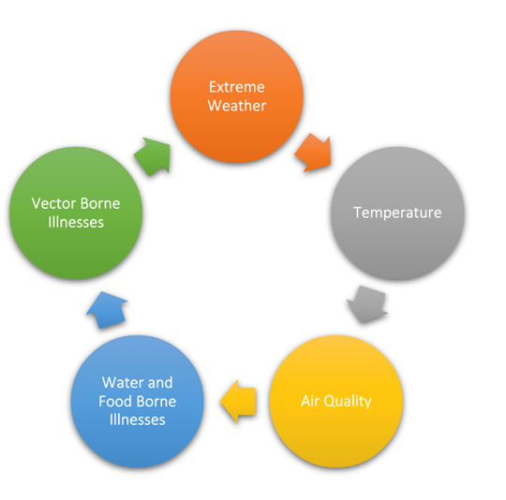
Curriculum Update
This course will include five modules, with corresponding submodules
Ex. Temperature includes Extreme Heat and Extreme Cold
Each will include information pertaining to:
Environmental hazard intersections
Physical health implications
Mental health considerations
Social disparities and health equity
Future implications and resilience strategies

Slide 10
Curriculum Update
Resilience Strategies (first draft)
Formulation for Extreme Heat Response
Open cooling centers in various municipal buildings. Be sure that these cooling centers can be located by calling 211 or visiting 211ct.org.
Provide electrolytes/water for people in various locations throughout cities
Give people prevention tips
Keep cool to prevent heat related illness
Stay in air-conditioned rooms/buildings.
Call 2-1-1 for a list of cooling centers or visit 211ct.org
Do not rely solely on a fan for cooling
Limit outdoor activities to mornings and evening and rest often
Make efforts to avoid direct sunlight.
Wear light colors and lightweight clothing
Take cool showers
Check on those at higher risk throughout the day
Bring pets inside if possible
If not possible, provided access to shade and water
Don’t leave kids, pets, or babies inside parked vehicles
Stay hydrated and drink more water
Don’t wait until you’re thirsty to drink more fluids.
Drink two to four cups of water every hour while working or exercising outside.
Avoid liquids high in sugar
Ensure others drink enough water

Slide 11
Curriculum Update
Revised resiliency strategies:
Heat Related Concerns Policy Framework.docx

Slide 12
Curriculum Update
Discussion:
Thoughts on revision?
Anything missing from strategies?
Is this useful/accessible for local health departments/districts?
Is it useful/accessible to other health professionals?
How do we maximize efficacy of focus groups?
Recruitment
Timing
Has anyone had experience planning and facilitating?

Slide 13
LHAQP Update
LHAQP = Local Heat and Air Quality Preparedness and Response Plan
Waiting to begin work with two pilot grantees (Ledge Light Health District and Bridgeport Health Department)
A template for LHAQPs had been drafted, and is now being updated and built out into a toolkit to achieve the the following objectives:
Support pilot grantees in developing their LHAQPs
Provide a resource for other LHDs to develop LHAQPs
YCCCH overseeing the template/toolkit development, with support from student team in Clinic in Climate Justice and Public Health
Key integrations to consider:
With AA1 (curriculum)
With other initiatives within DPH and state/local government

Slide 14
Wrap Up
Hiring process is underway
Next coalition meeting: January 15th, 2025
Symposium: narrowing down to a late March date (half-day conference)

