Slide 1

National Flood Insurance Program (NFIP)
Silver Jackets Flood Awareness Workshops 2023
May 4 (Fairfield), May 23 (Orange), June 6 (West Hartford),
June 13 (Willimantic), June 21 (Kent)
Diane Ifkovic, State NFIP Coordinator

Slide 2

Certified Floodplain Manager (CFM) This workshop is pre-approved for 6 Continuing Education Credits (CEC) from Association of State Floodplain Managers (ASFPM)

Slide 3

National Flood Insurance Program Programtory and Flood Maps
Billion Dollar Betsy, hurricane 1965
National Flood Insurance Act of 1968
Flood Maps – FEMA produces flood maps
Flood Regulations – Communities must adopt the flood maps and minimum FEMA construction requirements into local zoning regulations
Flood Insurance – FEMA makes federal flood insurance available to property owners
in NFIP participating communities
NFIP

Slide 4

Roles and Responsibilities
Federal Emergency Management Agency
State NFIP Coordinating
Agency - CTDEEP
Community (Town, City, Borough, Fire District, Association –
regulates development through zoning)

Slide 5
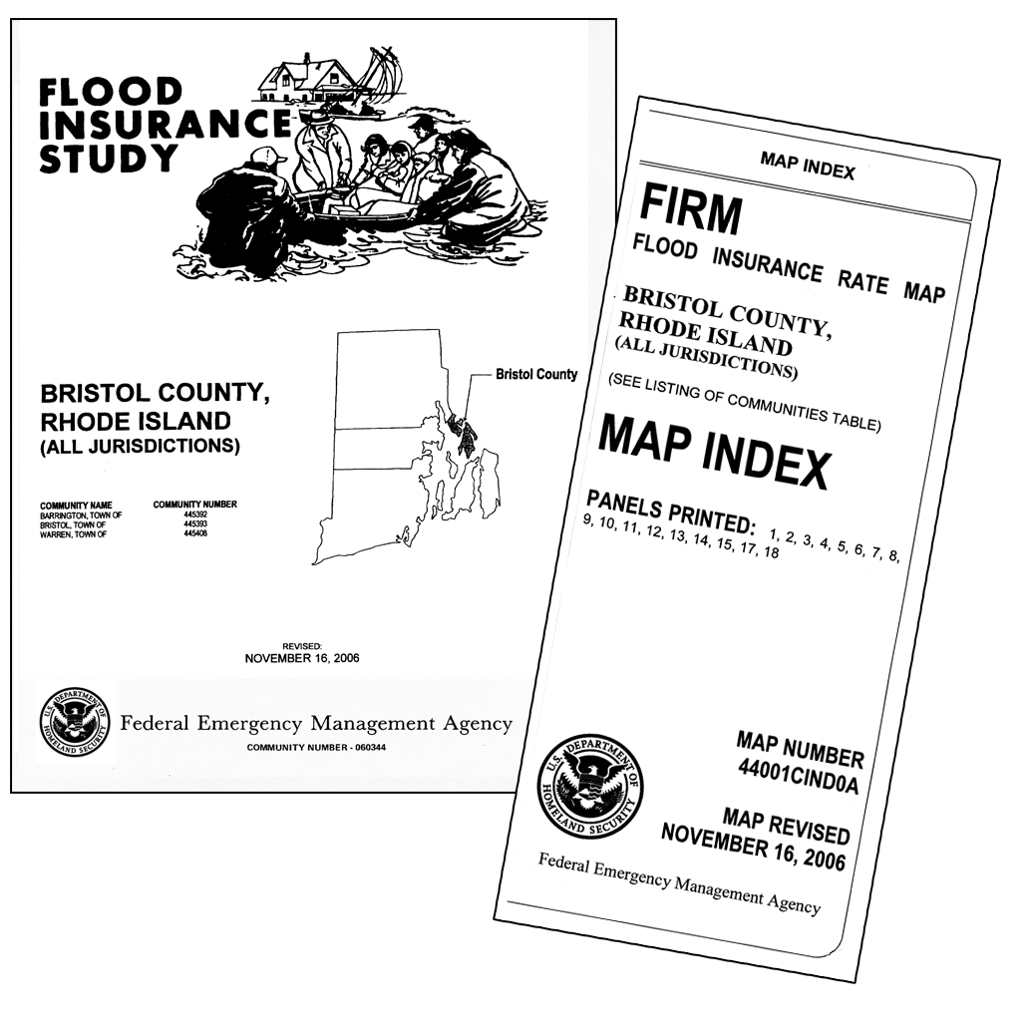
Flood Maps and Flood Studies
The NFIP is administered by the Federal Emergency Management Agency (FEMA).
Flood Insurance Rate Map (FIRM)
Primary floodplain management tool. It all starts with the FIRM.
Product of the Flood Insurance Study (FIS).
Identifies flood zones in your community
Product is used by many audiences
Government Officials
Lenders
Insurance Agents
Surveyors
Design Professionals
Realtors
Residents

Slide 6
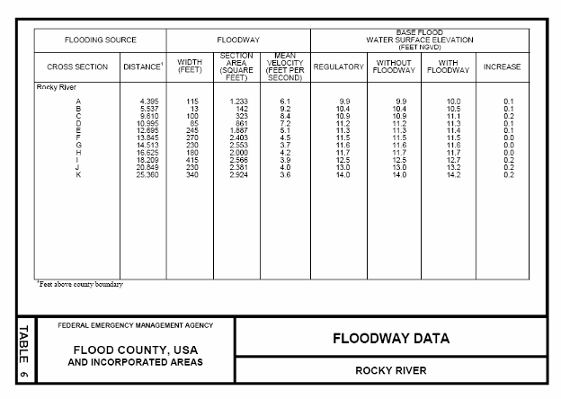
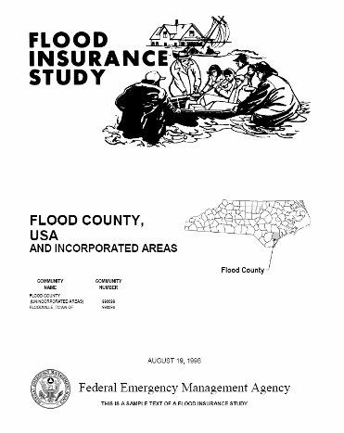
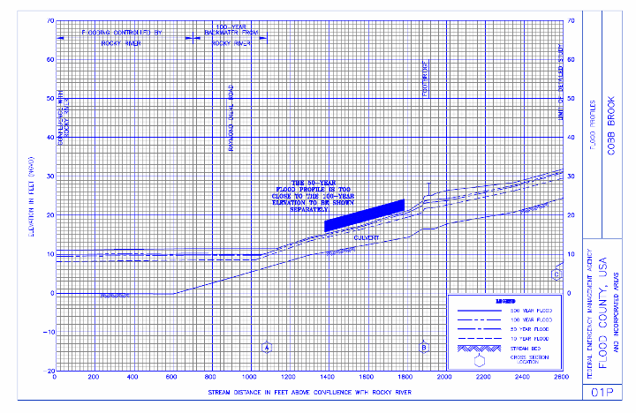
Notes:
6
Display all pictures of slide, clicking mouse 2 times.
Here are some example pages from a Flood Insurance Study. The front sheet is a flood profile. We’ll look at this in more detail when we get to the map reading exercise in a couple of minutes.
6

Slide 7
What is the 100-Year Floodplain?
100 Year Floodplain
Flood Fringe
Floodway
Flood Fringe
Flood Zone AE & Zone A
Base Flood Elevation (BFE)
1 ft
The 100-year floodplain is the land subject to a 1% or greater chance of flooding in any given year. It is also called the Special Flood Hazard Area (SFHA) by FEMA. Floodway is the channel and adjacent land reserved in order to discharge the base flood.
Notes:
FEMA has chosen the 100-year flood as its "base flood" which all maps and regulations are based on. Every participating community is provided flood maps and a flood insurance study, both of which must be incorporated by reference into the regulations or ordinance.
The 100-year flood, or the base flood, is the flood having a 1% chance of being equaled or exceeded in any given year. It is called the 100-year flood because using statistics and probability, theoretically, it is the flood that will occur once in a 100 years. However, this is misleading. The 100-year flood can happen anytime, the description is only based on probability and not actual circumstances.
The 100-year floodplain contains the floodway and the floodway fringe (SFHA). The floodway is the channel of the waterway and any adjacent land that must be reserved to discharge the base flood without cumulatively increasing the water surface area more than 1 foot. The floodway fringe is what we typically call the floodplain and is the area that gets inundated in the 100-year or base flood. In other words, if you filled the entire flood fringe, the floodway would increase by one foot.
No development is allowed in the floodway unless it is demonstrated and certified by a PE using hydraulic and hydrologic modeling that there will be a 0.00 increase in flood heights. No variances may be issued from the floodway regulations.

Slide 8
Notes:
North Canaan is in Litchfield County.
Somers is in Tolland County.
Changes in the pipeline that were completed.
After Hurricane Katrina, there were no levee standards implemented by the USACE. CT River Levee System had to be re-accredited. Hartford and East Hartford spent millions of dollars upgrading and fixing the system. Without this accreditation, the levee could not be shown as providing protection on a flood map.

Slide 9
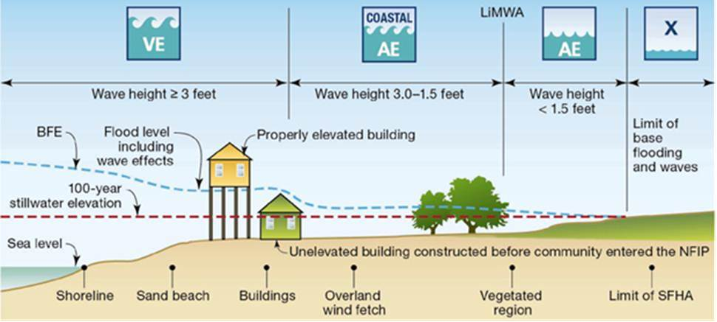
Coastal (VE and Coastal AE Zones)

Slide 10
Notes:
North Canaan is in Litchfield County.
Somers is in Tolland County.
Changes in the pipeline that were completed.
After Hurricane Katrina, there were no levee standards implemented by the USACE. CT River Levee System had to be re-accredited. Hartford and East Hartford spent millions of dollars upgrading and fixing the system. Without this accreditation, the levee could not be shown as providing protection on a flood map.

Slide 11
Mapping Process Timeline
Congressional Appropriation $
Consultation
Coordination
Officer (CCO)
meeting
Letter of
Final Determination
(LFD)
FEMA
Resolves
Appeals
Discovery Meeting
Work
Maps
Preliminary
FIRM/FIS
Newpaper Notices
Effective FIRM/FIS
90-Day
Appeal
Period
6 Months
Ordinance/Reg Review
FEMA Public Open House
6 months
Notes:
FEMA initiated its Map Modernization (MapMod) program to update flood maps starting in 2004.
Countywide format, no more individual community maps. Better topographic data through LIDAR (10ft or 2ft contours). On USGS quads with aerial photograph.
Main goal was to convert these into a digital format so they would be easier to update in the future. Very little hydraulic re-study was done. If your original map was produced with a hydraulic study done in 1982, then this what was transferred over into a digital format on your “new” maps.

Slide 12
CT Flood Map Updates - Watersheds
Quinebaug River Watershed
New London County – Griswold, Jewett City, Lisbon, North Stonington, Preston, Voluntown
Effective Maps August 1, 2023
Windham County – Brooklyn, Danielson, Killingly, Plainfield, Pomfret, Putnam, Sterling, Thompson
Effective Maps September 7, 2023
Notes:
FEMA initiated its Map Modernization (MapMod) program to update flood maps starting in 2004.
Countywide format, no more individual community maps. Better topographic data through LIDAR (10ft or 2ft contours). On USGS quads with aerial photograph.
Main goal was to convert these into a digital format so they would be easier to update in the future. Very little hydraulic re-study was done. If your original map was produced with a hydraulic study done in 1982, then this what was transferred over into a digital format on your “new” maps.

Slide 13
CT Flood Map Updates - Watersheds
Saugatuck River Watershed
20 communities in Fairfield County
Preliminary maps/study end of May 31, 2023
Farmington River Watershed
23 communities in Hartford & Litchfield Counties
Hartford County – prelim maps/study June 1, 2023
Litchfield County – prelim maps/study April 14, 2024
Notes:
FEMA initiated its Map Modernization (MapMod) program to update flood maps starting in 2004.
Countywide format, no more individual community maps. Better topographic data through LIDAR (10ft or 2ft contours). On USGS quads with aerial photograph.
Main goal was to convert these into a digital format so they would be easier to update in the future. Very little hydraulic re-study was done. If your original map was produced with a hydraulic study done in 1982, then this what was transferred over into a digital format on your “new” maps.

Slide 14
CT Flood Map Updates - Watersheds
Thames River Watershed
16 communities in New London County
Work maps June 20, 2023
Shetucket River Watershed
23 communities in New London, Tolland and Windham Counties
Work maps June 20, 2023
Notes:
FEMA initiated its Map Modernization (MapMod) program to update flood maps starting in 2004.
Countywide format, no more individual community maps. Better topographic data through LIDAR (10ft or 2ft contours). On USGS quads with aerial photograph.
Main goal was to convert these into a digital format so they would be easier to update in the future. Very little hydraulic re-study was done. If your original map was produced with a hydraulic study done in 1982, then this what was transferred over into a digital format on your “new” maps.

Slide 15
CT Flood Map Updates - Watersheds
Housatonic River Watershed
54 communities in Fairfield, Hartford, Litchfield & New Haven Counties
Includes levee study on Naugatuck River (Ansonia & Derby)
Work maps December 6, 2023
Lower Connecticut River Watershed
45 communities in Hartford, Middlesex, New London and Tolland Counties
Work maps September 12, 2023
Notes:
FEMA initiated its Map Modernization (MapMod) program to update flood maps starting in 2004.
Countywide format, no more individual community maps. Better topographic data through LIDAR (10ft or 2ft contours). On USGS quads with aerial photograph.
Main goal was to convert these into a digital format so they would be easier to update in the future. Very little hydraulic re-study was done. If your original map was produced with a hydraulic study done in 1982, then this what was transferred over into a digital format on your “new” maps.

Slide 16
CT Flood Map Updates – Coastal
Coastal Erosion Study
Non-regulatory product to be used for planning purposes.
Covers all coastal towns in Connecticut.
FEMA Contractor doing field work in New London County week of May 22, 2023, and other counties June-July 2023.
Coastal Re-Mapping Study
FEMA will be staring a new coastal remapping study soon, final effective maps are years away
Notes:
FEMA initiated its Map Modernization (MapMod) program to update flood maps starting in 2004.
Countywide format, no more individual community maps. Better topographic data through LIDAR (10ft or 2ft contours). On USGS quads with aerial photograph.
Main goal was to convert these into a digital format so they would be easier to update in the future. Very little hydraulic re-study was done. If your original map was produced with a hydraulic study done in 1982, then this what was transferred over into a digital format on your “new” maps.

Slide 17

Where can I get a FIRM or FIS?
https://msc.fema.gov/portal/home
Hard copy in town hall- planning, zoning, engineering, building, town clerk, can reprint from MSC
Notes:
17
17
How many of you are experts in working with flood maps?
Hold your hand up for participant responses. It is unlikely many, if any, will call themselves an “expert.”
This UNIT will help you get familiar with different types of flood maps and how to use them.

Slide 18
Floodplain Regulations
To participate in the NFIP, municipality must adopt and enforce floodplain management regulations or ordinance that meet FEMA minimum standards
Currently, ALL Connecticut municipalities participates in the NFIP!
Mortgages (Mandatory Purchase Requirement)
Federal Disaster Assistance for community (Public Assistance – PA $$$)

Slide 19
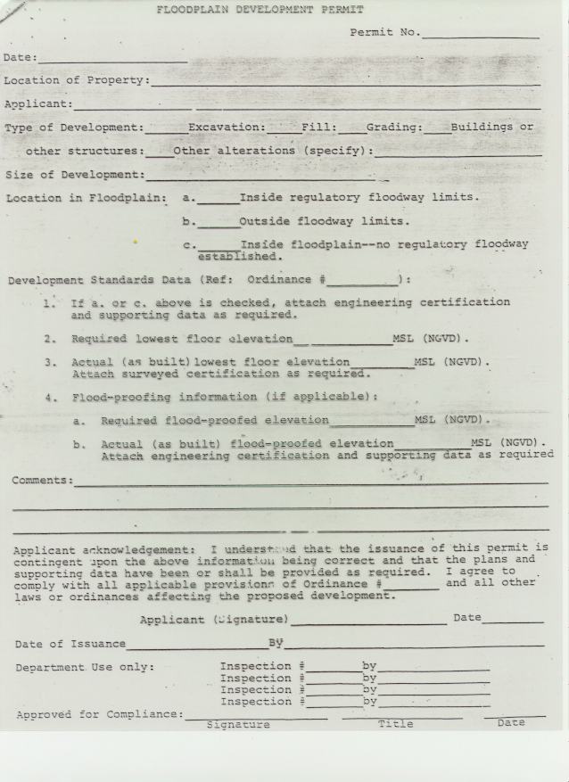
Permits and Enforcement
Municipality enforces the federal NFIP standards through local zoning and building permit process
Zoning Permit
Development Permit
Building Permit
Land Use Permit
Floodplain Permit

Slide 20
State Building Code Update
2015 International Residential Code (IRC) adopted October 1, 2018
2021 IRC adopted October 1, 2022
Section R322, Flood-Resistant Construction
AE and A Zones – Lowest floor elevated to BFE plus 1 foot
Coastal AE and VE Zones – Bottom of the lowest horizontal structural member supporting the lowest floor elevated to BFE plus one foot on pier, post or pile foundation. Coastal AE zone breakaway walls must also contain flood vents.
Coastal High Hazard Area now includes VE zones and Coastal AE zones
Coastal AE zone defined by the Limit of Moderate Wave Action (LiMWA) line on a FIRM. Area with wave action between 3.0 - 1.5 ft.

Slide 21
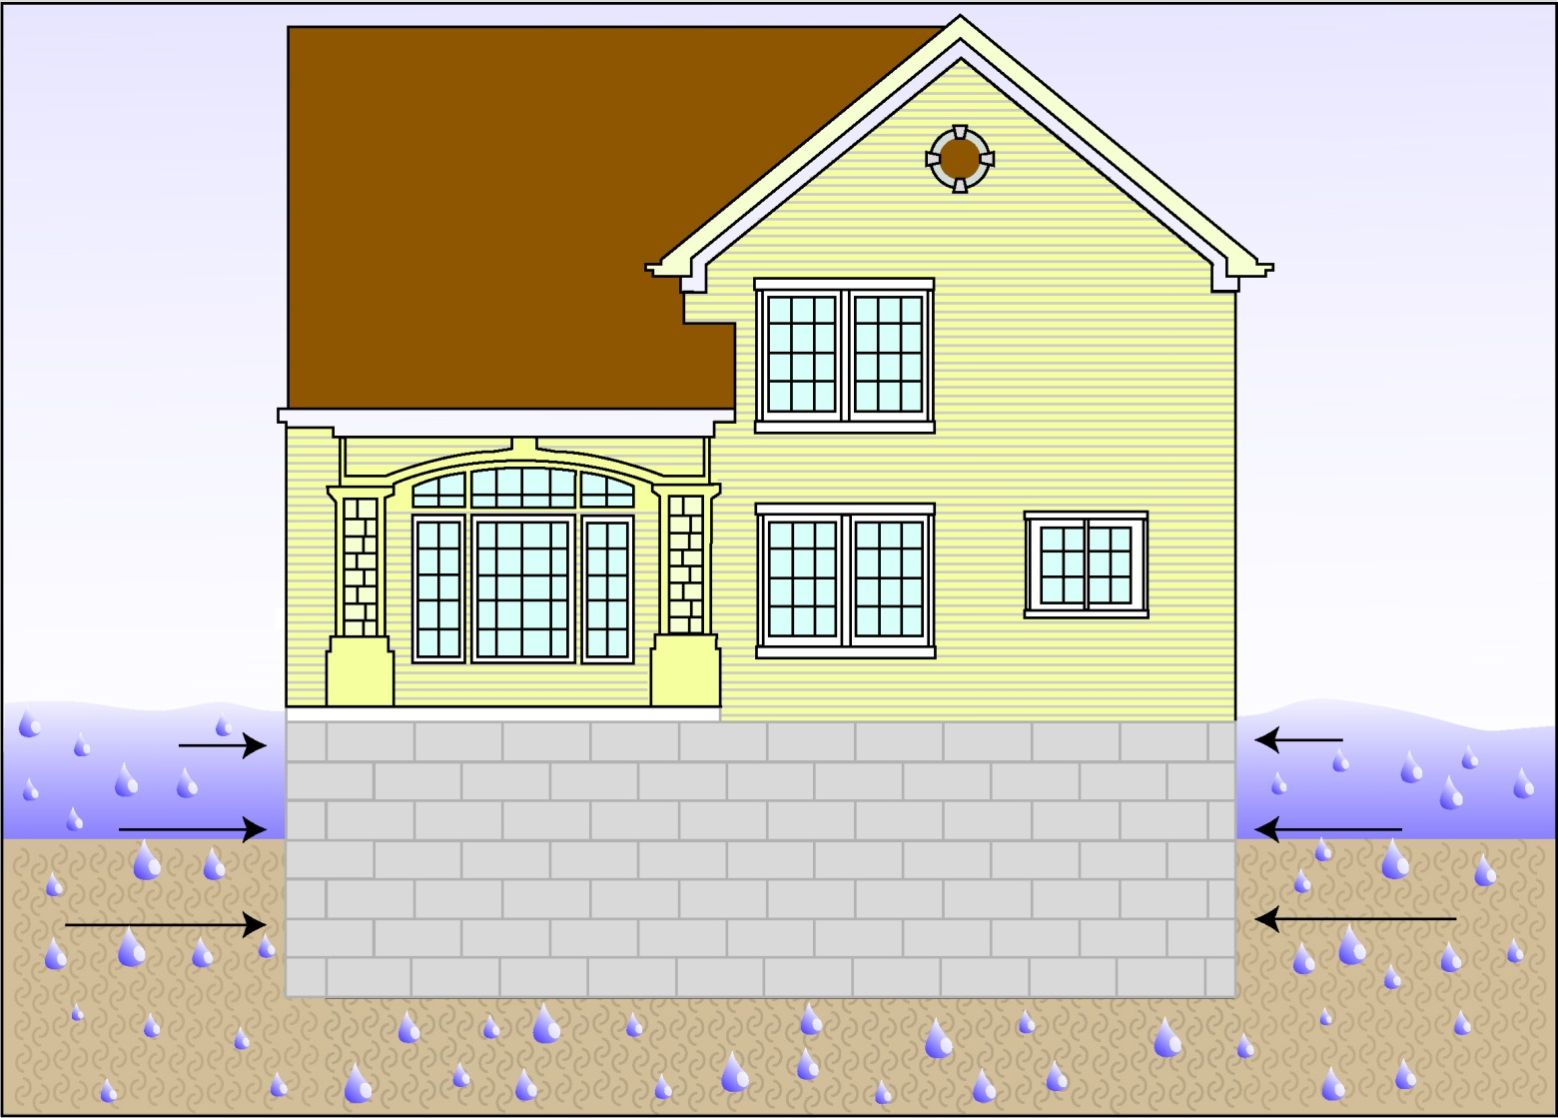
Hydrostatic Forces
Weight of standing water on a structure exerts a horizontal force. The deeper the water, the more it weighs and the greater the hydrostatic pressure. Installation of flood vents allow pressure to equalize so foundation does not collapse.
Notes:
Hydrostatic Forces is the force of STANDING water on a solid object. Flood waters that stand for days and don’t recede can cause damage to a foundation. Water has tremendous weight. Force increases as depth increases. Usually once about 3 feet of water is acting against a foundation such as this, there is foundation failure, basically the walls implode or collapse under the pressure of the water.

Slide 22
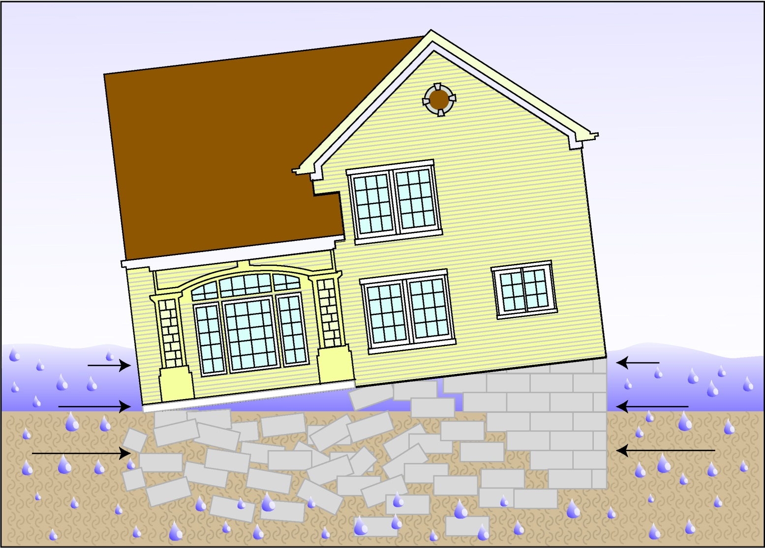
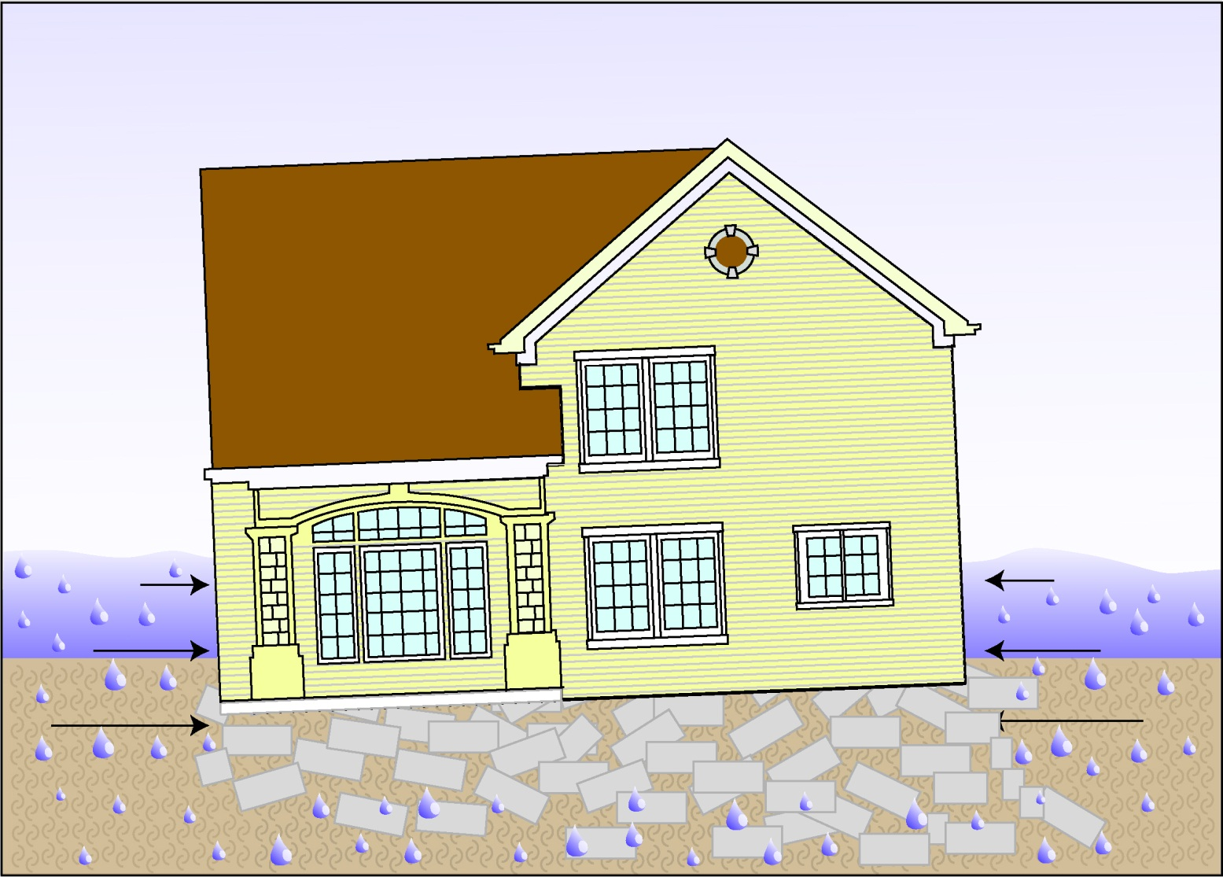

Hydrostatic Forces

Slide 23
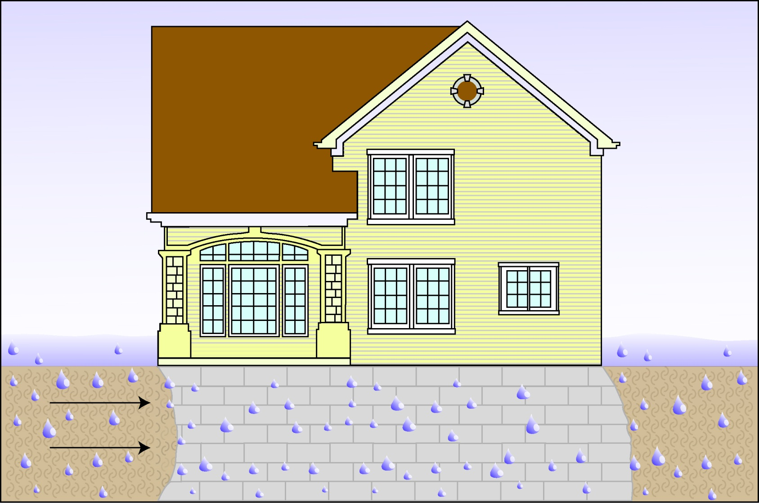
Hydrodynamic Forces
Moving water creates hydrodynamic forces that can create frontal impacts, drag effects, and negative pressure (suction). This can destroy the foundation or move a structure off its foundation.
Notes:
Hydrodynamic force is the pressure of MOVING water pushing on a solid object, not just stand water (hydrostatic). Common failure from hydrodynamic force is a building’s separation for its foundation systems or a complete failure as it is being washed away.

Slide 24
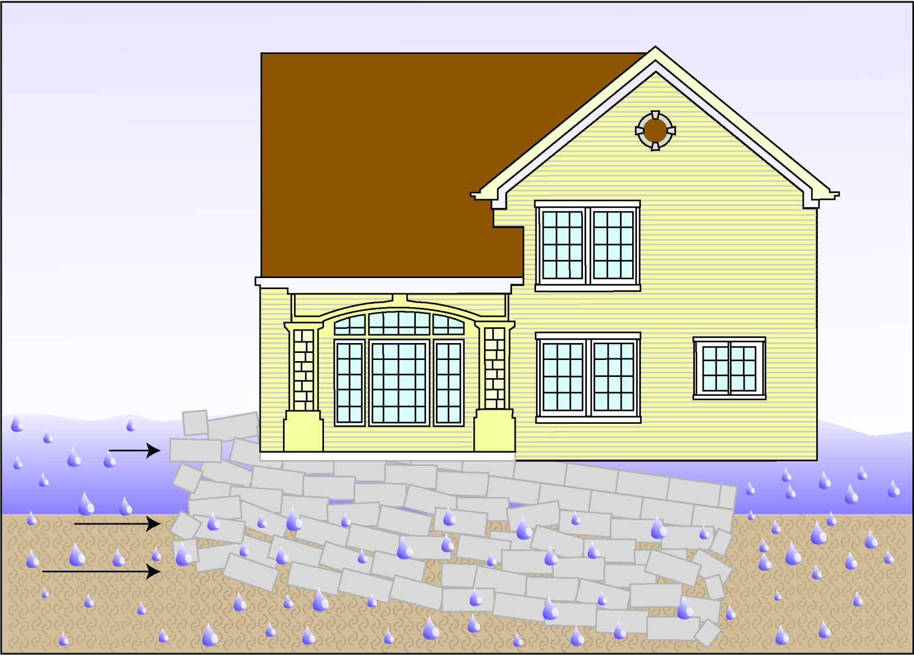
Hydrodynamic Forces

Slide 25
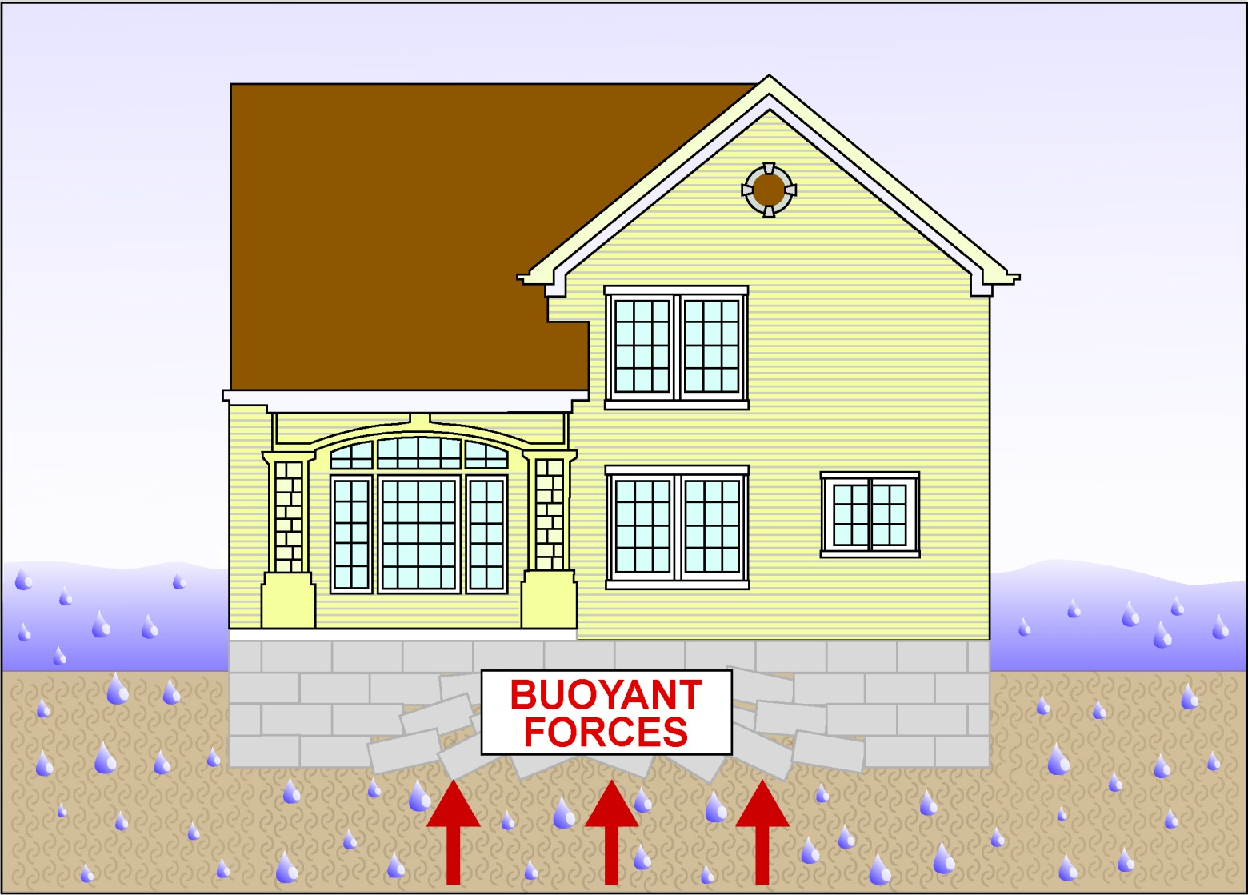
Buoyant Forces
Upward force, up thrust
Notes:
Buoyancy can start to push on the floor and cause uplift, collapse and breakage of the foundation.

Slide 26
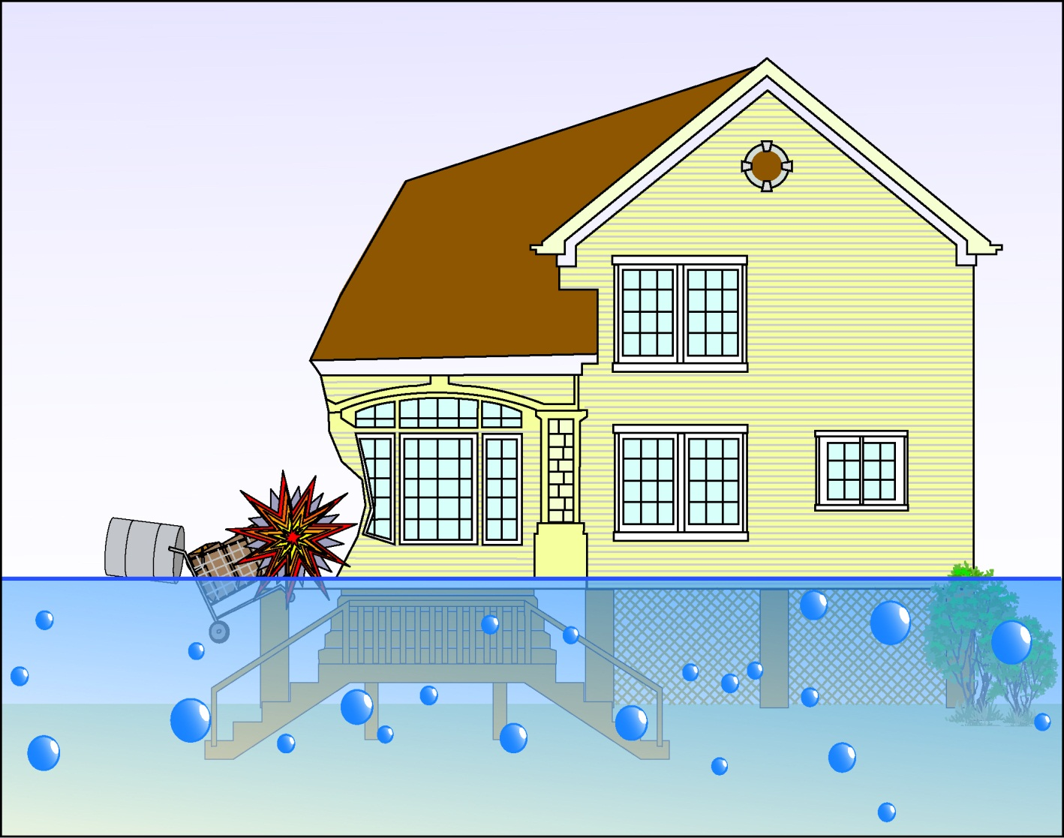
Debris Impact Forces
Tanks, logs, lumber, ice, boats, vehicles
Notes:
Debris impact can compromise the foundation, causing blockages that can aggravate other forces and cause more damage.

Slide 27
Elevated Residential Structures in Riverine AE & A Zones Lowest floor must be elevated at or above BFE
BFE+1
Notes:
Elevation is the most commonly used and preferrable method for A zone construction. Fill is allowed for elevation provided it is outside of the designated floodway.
The most important thing to remember when using this method is that the lowest floor includes the basement and it must be elevated to or above the BFE for residential structures. FEMA regulations used to say the "lowest habitable floor". The intent was the lowest floor in which one could live. The common interpretation was the first floor that was habitable which resulted in basements below the BFE.
Basement is defined as any area of a building having its floor subgrade (below ground level) on all sides.
This is very important to FEMA since basement failure has historically been their greatest source of claims. A second reason is that utilities are often located in the basement and must be located above the BFE.

Slide 28
Fully Enclosed Areas Below BFE FEMA Technical Bulletin 1, Openings in Foundation Walls and Walls of Enclosures FEMA Technical Bulletin 2, Flood Damage Resistant Materials FEMA Technical Bulletin 7, Wet Floodproofing Requirements
Wet Floodproofing, relieves hydrostatic pressure
Area below BFE
fay be used for:
1) Parking
2) Building Access
3) Limited Storage
No utilities or finishings
BFE+1
Flood Vents
Minimum 2 vents on adjacent walls
Sq. inches vent = square feet of enclosed area
Openings may be equipped with screens, louvers,
valves or other coverings or devices provided they
allow automatic entry and exit of flood water
Bottom of vent no higher than 1 ft above grade
At Least One
Side at Grade
Notes:
Constructing Fully enclosed areas below the BFE that are allowed to flood is called wet-floodproofing. Wet-floodproofing is allowed for both residential and non-residential uses but only in A Zones.
The idea of this method is to allow flood water to automatically enter and exit a portion of a structure without damaging the structural integrity of the structure. It is not to be used in basements. At least on side of slab must be at grade. No utilities or finished materials are allowed in these areas. These areas can only be used for parking, building access, and limited storage.
1. a minimum of two openings having a total net area of not less than one square inch for every square foot of enclosed area subject to flooding must be provided.
2. The bottom of all openings shall be no higher than one foot above surface grade.
3. Openings may be equipped with screens, louvers, valves or other coverings or devices provided that they permit the automatic entry and exit of floodwaters.
4. Must be certified by a registered PE or architect.

Slide 29
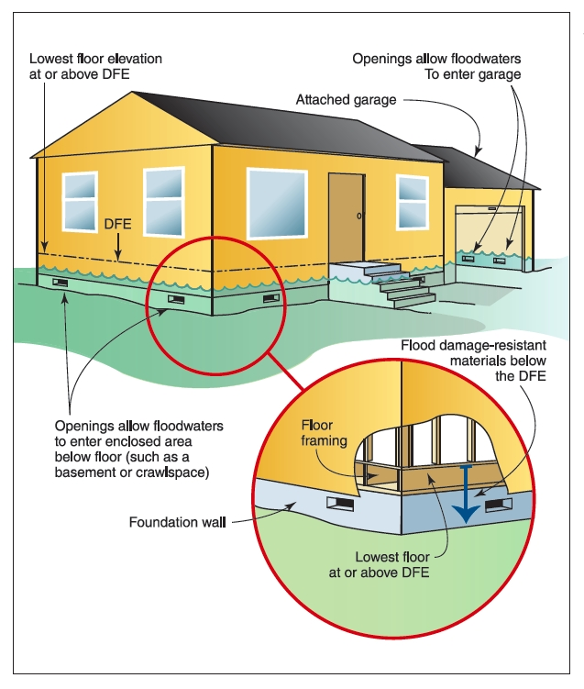
FEMA Technical Bulletin 11- Crawlspace Construction for Buildings in the Special Flood Hazard Area
Below grade crawlspaces are considered “basements” under the FEMA definition. They can only be allowed if specific language is adopted into your local ordinance.
Below grade crawlspaces will also incur increased insurance costs.
Wet Floodproofing

Slide 30
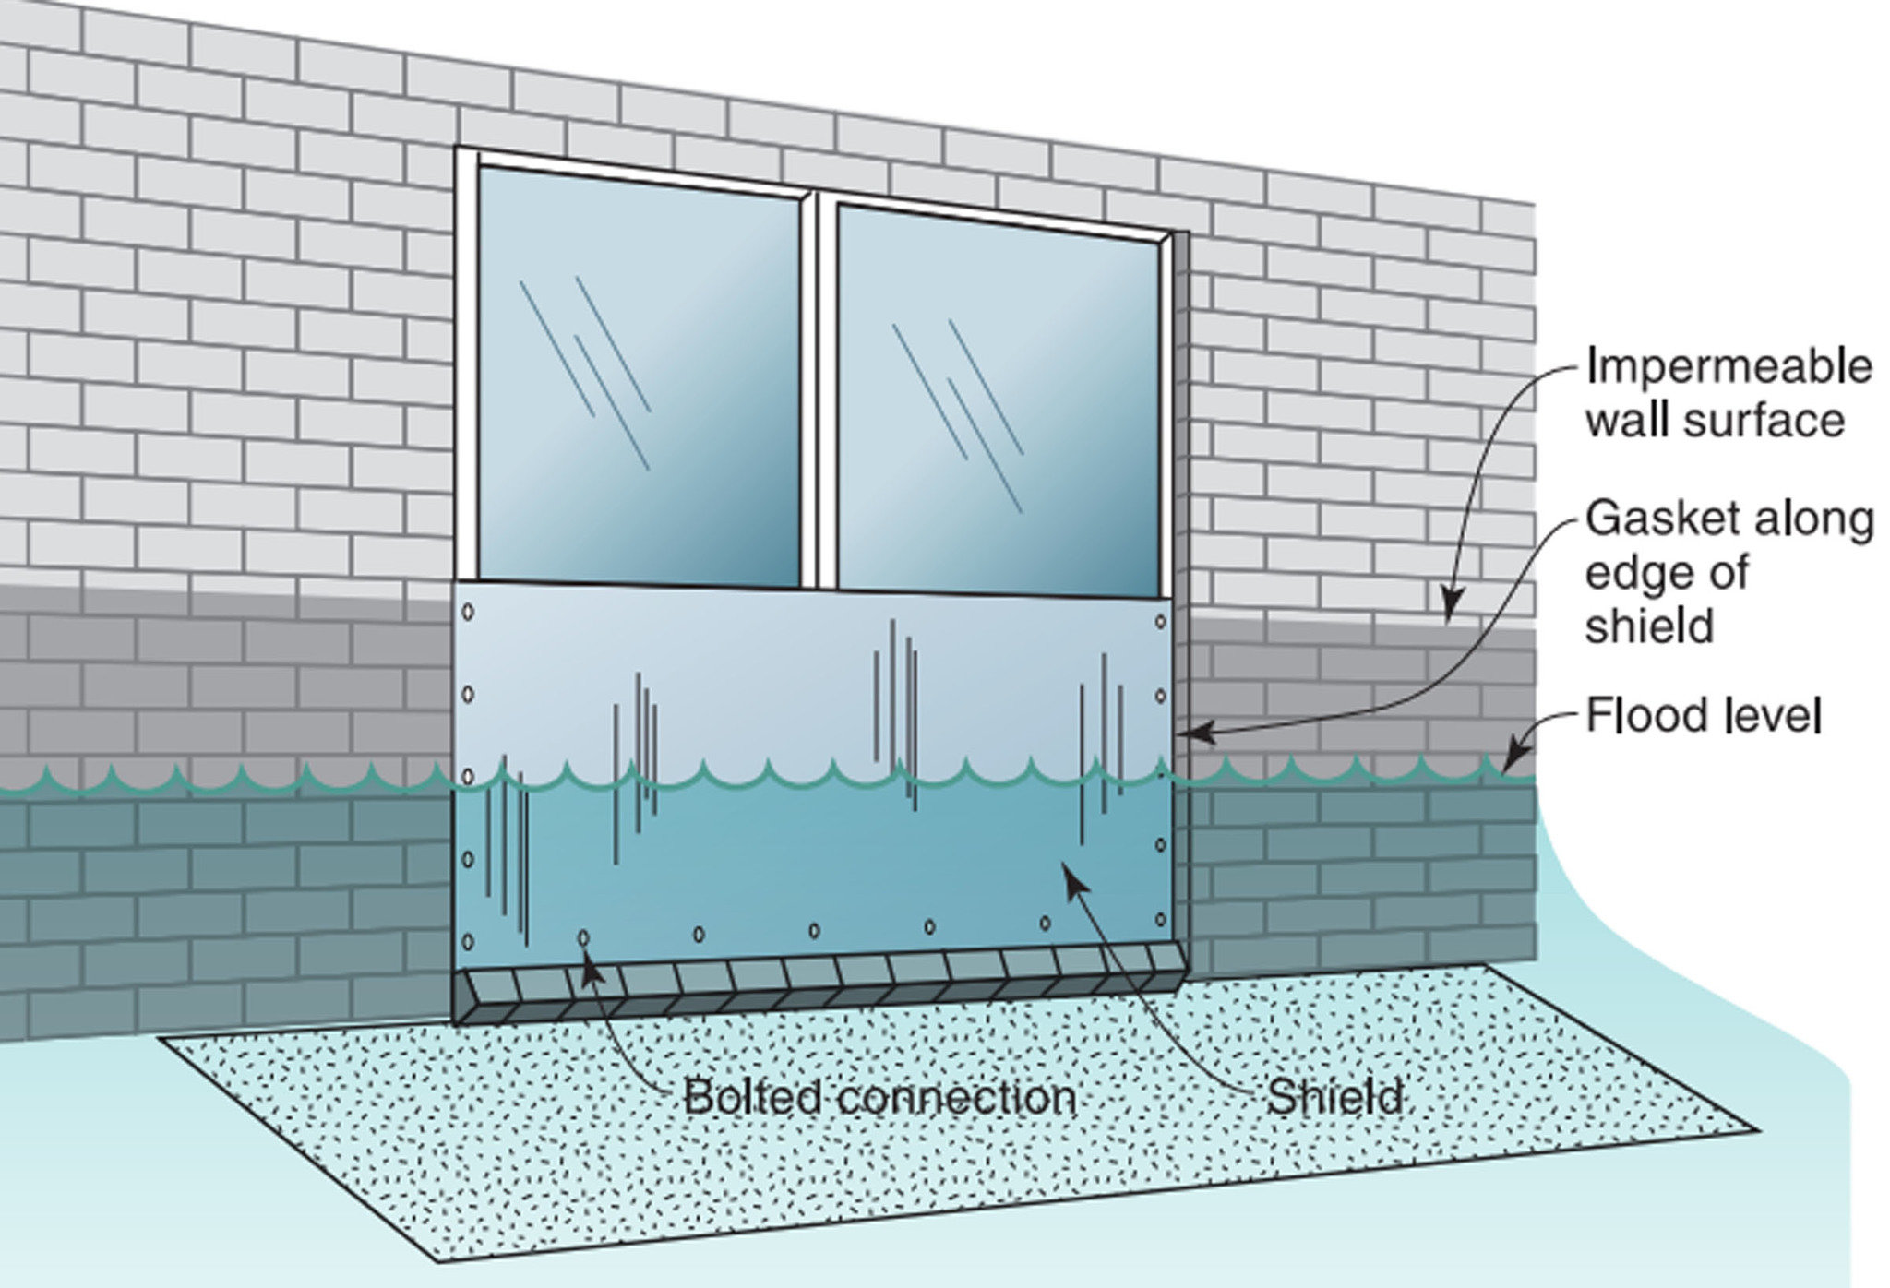
Inland Non-Residential (A & AE)
FEMA Technical Bulletin 3 – Non-Residential Floodproofing
FEMA 102, Floodproofing Non-Residential Structures
FEMA P-936, Floodproofing Non-Residential Buildings
Dry Floodproofing
BFE+1 ft
BFE

Slide 31



VE & Coastal AE Zone Construction
UPLIFT ON STRUCTURE
FEMA Technical Bulletin 5 – Free of Obstruction
FEMA Technical Bulletin 4 – Elevator Installation
FEMA Technical Bulletin 9 – Design and Construction Guidance for Breakaway Walls
16,772 LBS
2/3 (8)
68/2 = 34
16,169LBS
10/2 = 5
120,560 LBS
Lowest horizontal structural member above BFE. No utilities below BFE. Parking, access, storage.
Pier, post, or pile foundation and no fill for structural support. No alteration of sand dunes.
Breakaway walls, lattice or open design (free of obstruction).
Building be certified to withstand both wind and water loads acting on it (engineer, architect).
Notes:
VE zone construction (and Coastal AE/LiMWA if adopted by community) consists of a foundation on piers, posts or piles. The lowest horizontal structural member has to be at or above BFE. Area below structure must be “free of obstruction” with open foundation, lattice or breakaway wall. No fill can be used for structural support. No construction landward of mean high tide. No utilities or mechanical below BFE. Must be built to withstand both wind and water. Structure must be anchored to foundation to resist lateral movement. The alteration of sand dunes is prohibited.

Slide 32
Homeowner’s versus Flood Insurance
Water that falls from the sky that damages your home is covered by your Homeowner’s Insurance Policy.
Broken pipe, sewer backflow covered by homeowner’s policy or separate policy rider.
If water flows over the ground from a watercourse or ocean, it is covered by a separate flood insurance policy.

Slide 33
Risk Rating 2.0 – October 1, 2021
Fundamental change to rating flood risk.
Individualized property risk.
Many more data points used in rating algorithm.
Federal and commercial data sets.
Rates that are easier to understand for agent and policyholder.
New policies rated with RR 2.0 on October 1, 2021.
Renewed policies rated with RR 2.0 on April 1, 2022.
Previous grandfathering rules/rates slowly phased out to actuarial rate.

Slide 34
Risk Rating 2.0 - Rating Criteria
Distance to the flooding source/water
Stream order
Broader range of flood frequencies (10, 50, 100, 500 year)
Flood type (coastal, riverine, ponding)
Ground elevation (topography)
First floor height (not basement floor height)
Number of floors
Foundation type (slab on grade, crawlspace, basement, elevated)
Construction type (wood, masonry)
Building occupancy (residential, commercial)
Prior claims
Cost to rebuild (affordability)

Slide 35
Legacy Rating (Old Rating Structure)
Flood zone from the flood map
Base flood elevation ( BFE)
Lowest floor elevation
Foundation Type
Date of Construction
Elevation Certificate is optional for rating under RR2.0 but can be helpful for proper rating

Slide 36
Risk Rating 2.0 - Mitigation Discounts
Flood Vents
Elevation of machinery and equipment to first floor or above
Dry floodproofing of non-residential structure

Slide 37
Questions?
Diane Ifkovic, State NFIP Coordinator
Phone: (860) 424-3537
Email: diane.Ifkovic@ct.gov

