Slide 1

NWS New York NY Impact Decision Support Services (IDSS)
CT DEMHS/Silver Jackets Flood Awareness Workshop – Region2
United Illuminating
National Weather Service New York, NY
Nelson Vaz – Warning Coordination Meteorologist
Building a Weather-Ready Nation

Slide 2
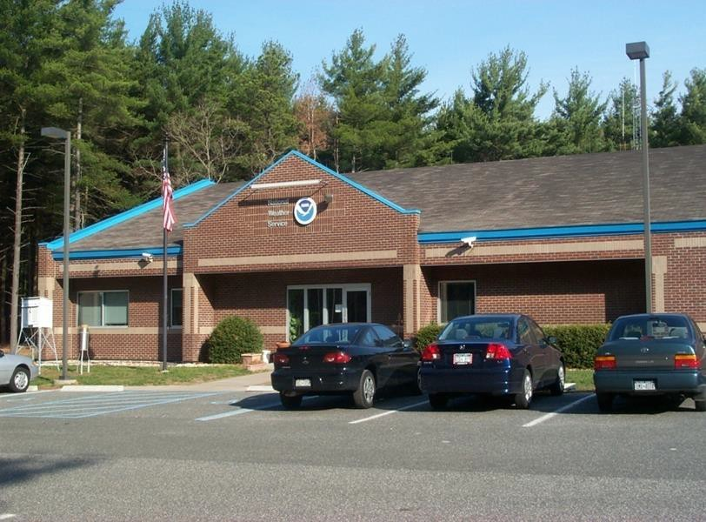
NWS Weather Forecast Office
MISSION - Protect life and property and enhance the national economy through timely and accurate weather and water observations, forecasts, warnings and IDSS.
Weather Observations (Radar, surface, upper air, etc.)
Provide weather forecasts
  General 7-day forecast
    Precipitation, wind, sky cover, temperature, etc.
Provide warnings for hazardous weather conditions
  Winter storms, severe thunderstorms/tornadoes, tropical cyclones,
  flooding, strong/damaging winds, extreme temperatures, etc.
Specialized forecast products
  Aviation
  Marine
  Coastal Flooding
  Fire weather
  Impact Decision Support Services
4/13/2021

Slide 3

Tri-State Area – Many High Impact Events
National Weather Service – New York, NY
46 Presidential Major Disaster Declarations since 2010 for the Tri-State Area
- 19 New York
- 16 New Jersey
- 11 Connecticut
Flooding
Severe Thunderstorms and Tornadoes
Tropical Cyclones and Remnants
Blizzards and Winter Storms

Slide 4
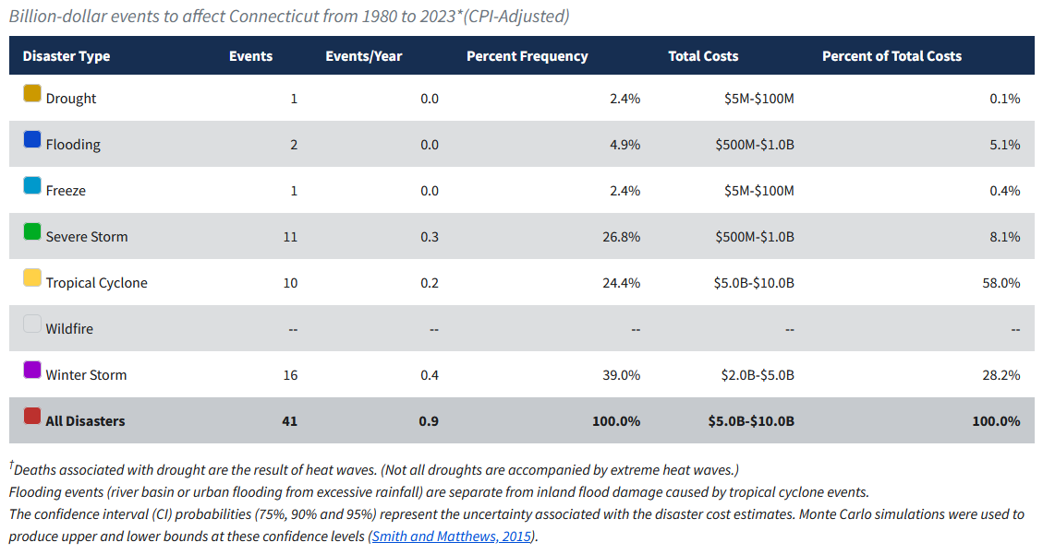
Billion Dollar Disaster Conneticut
(1980-2022) From NOAA NCEI

Slide 5
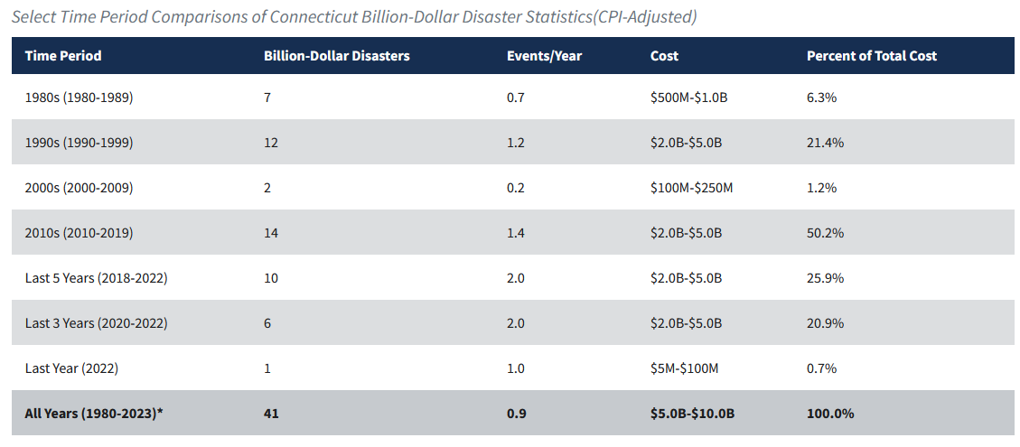
Billion Dollar Disaster Conneticut
(1980-2022) From NOAA NCEI

Slide 6
Weather Related Fatalities for Local Tri-State
(2007-2021)Based on Storm Data

Slide 7
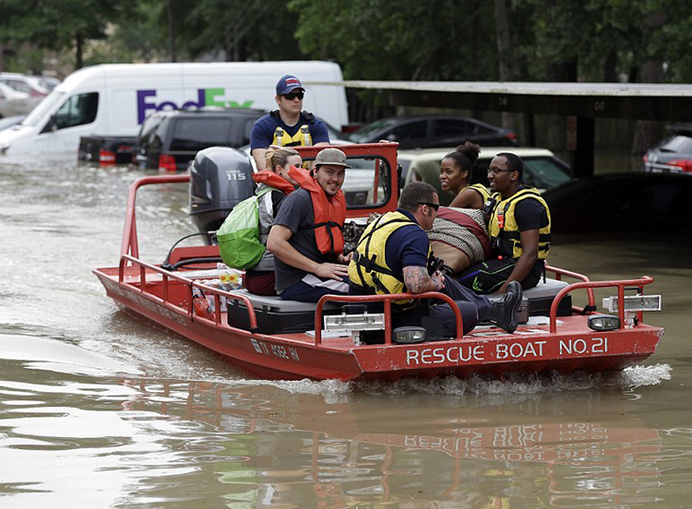
NWS Overview – Vision
National Weather Service – New York, NY
VISION
A weather-ready nation:
Society is prepared for and responds to weather, water, and climate-dependent events.
Notes:
The vision going forward: To Build a Weather-Ready Nation where society is prepared for and responds to Weather-Dependent events

Slide 8
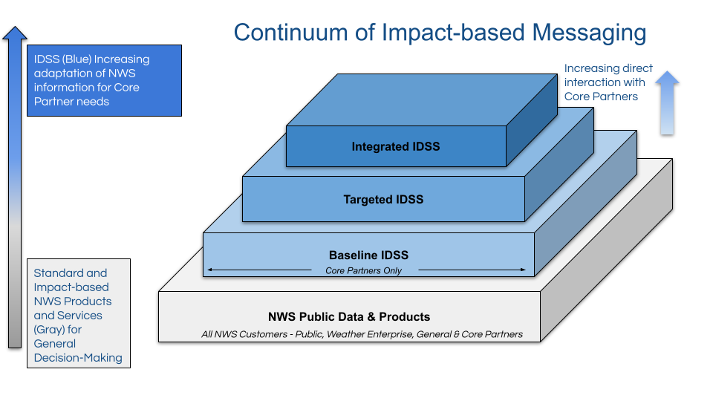
Impact Decision Support Services
(Virtual or Onsite)
(Event/Partner Specific)

Slide 9
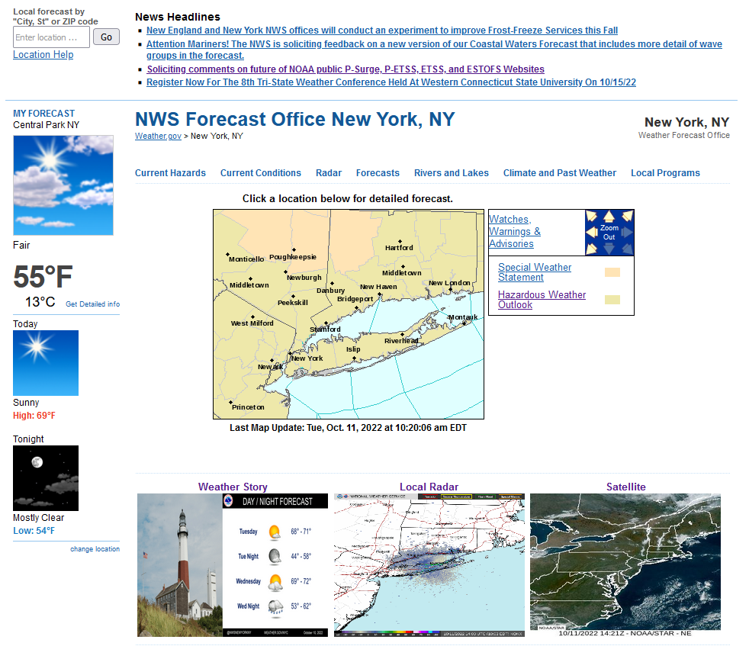
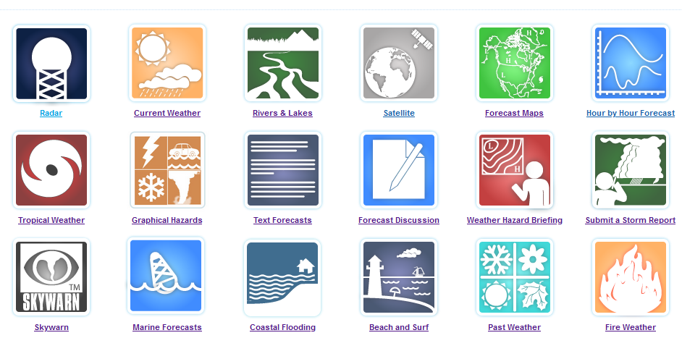
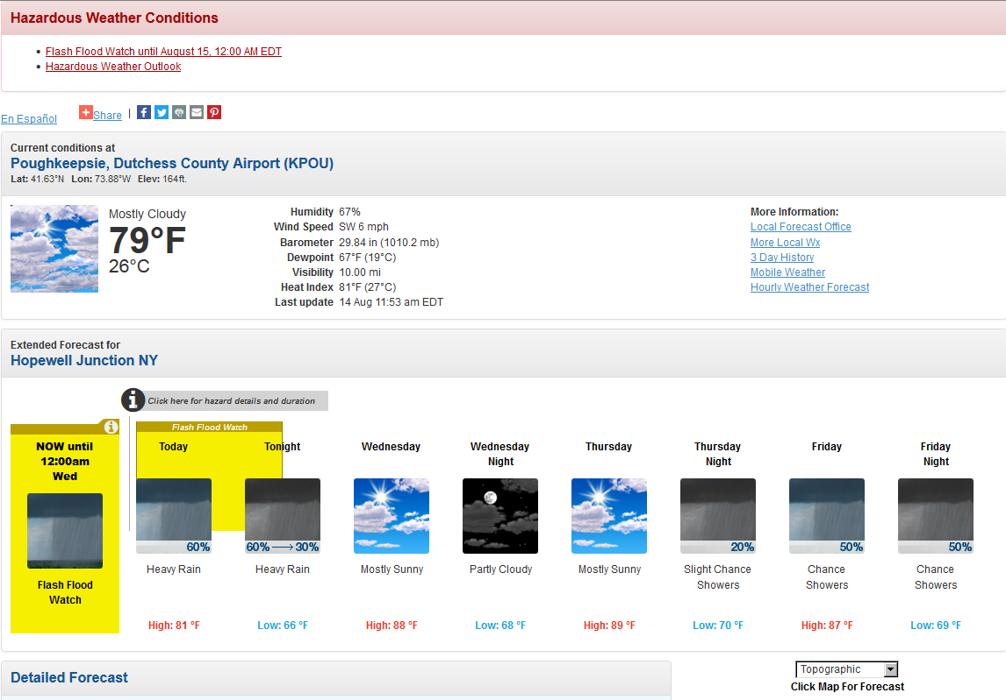
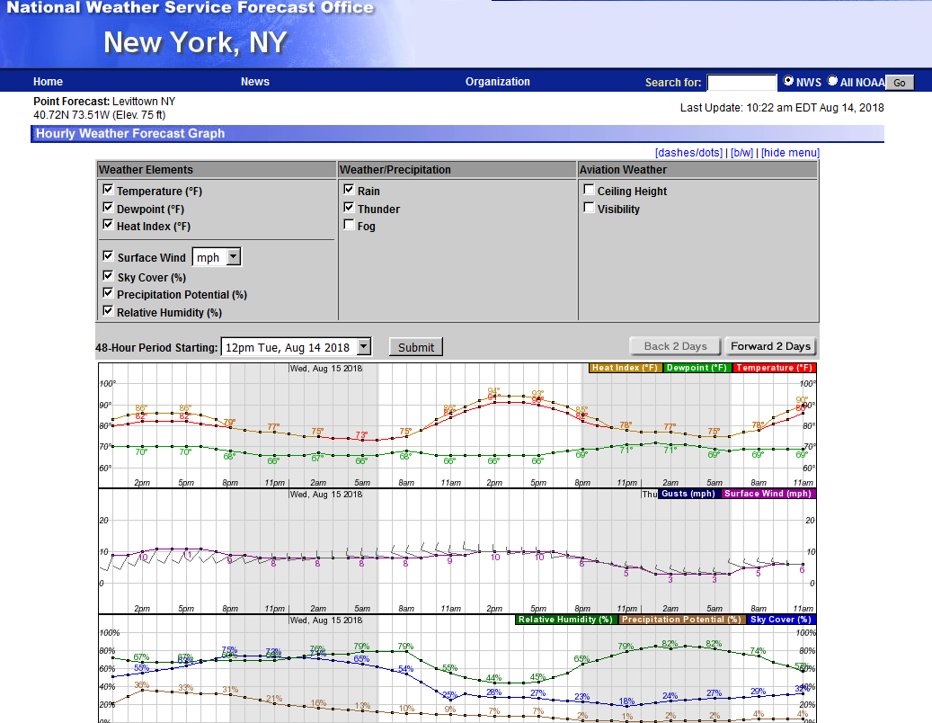
NWS New York Home Webpage
https://www.weather.gov/okx/

Slide 10

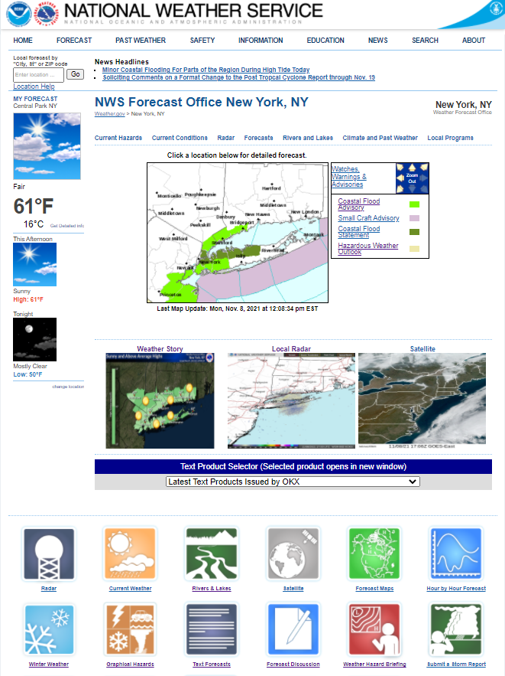

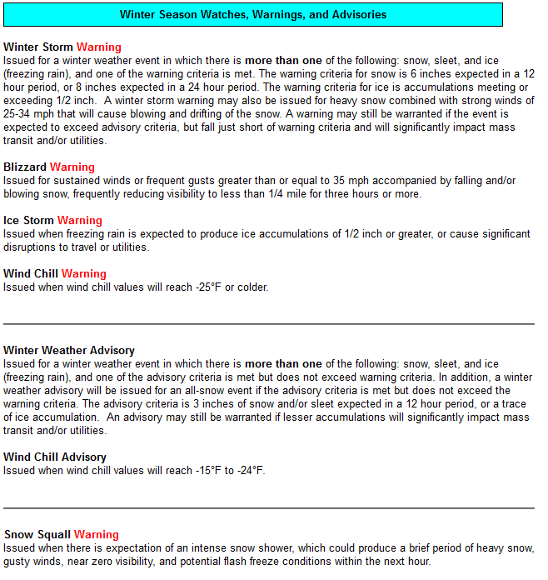
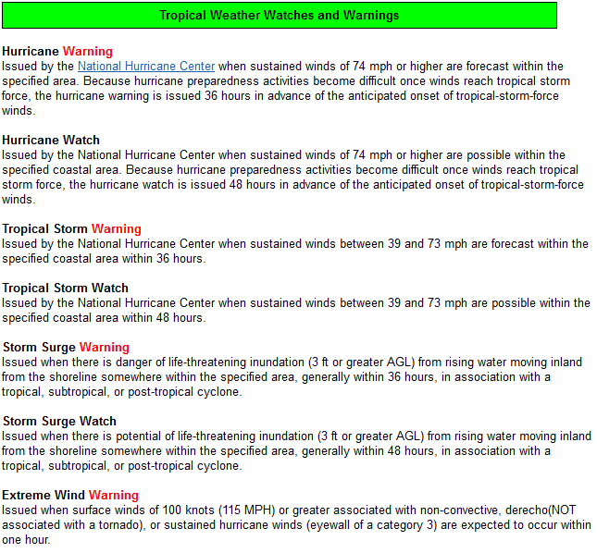
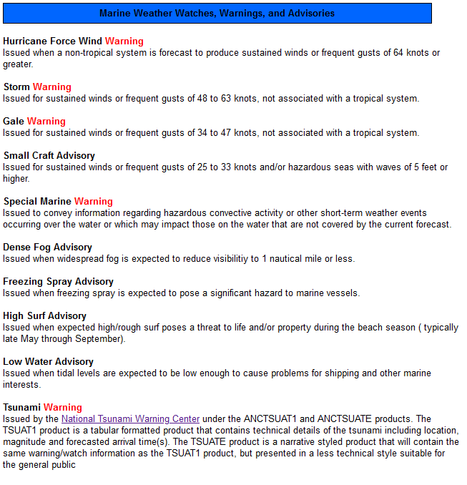
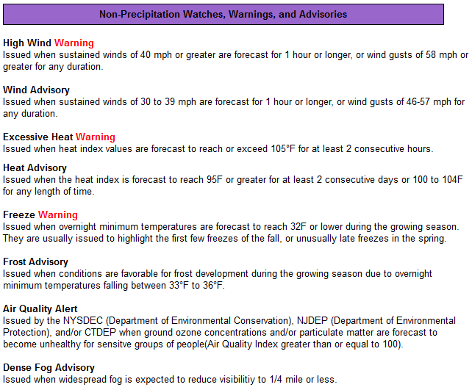
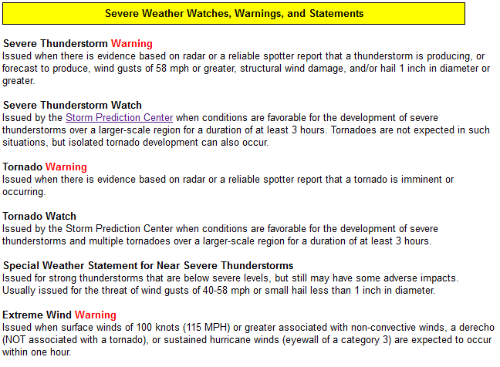
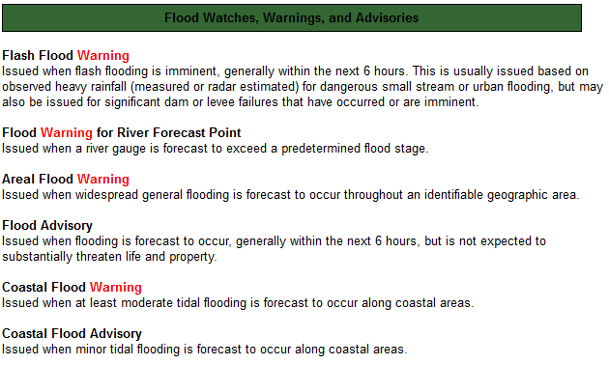
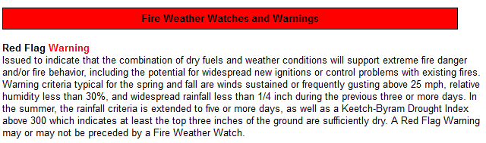

NWS New York Watch/Warning/Advisory/Statement Products
NWS New York
https://www.weather.gov/okx/wwa_definitions
National Weather Service
WFO New York, NY

Slide 11
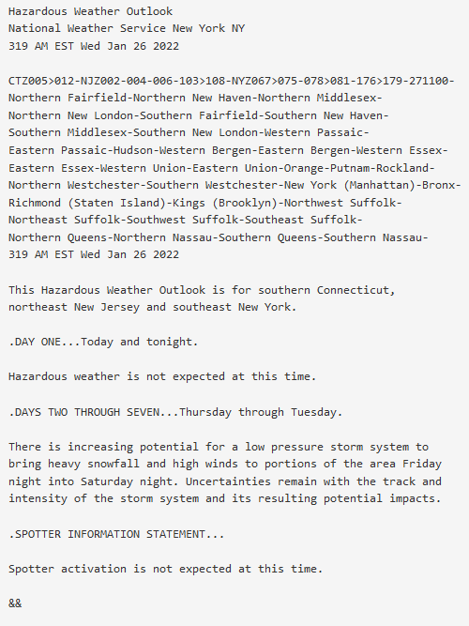
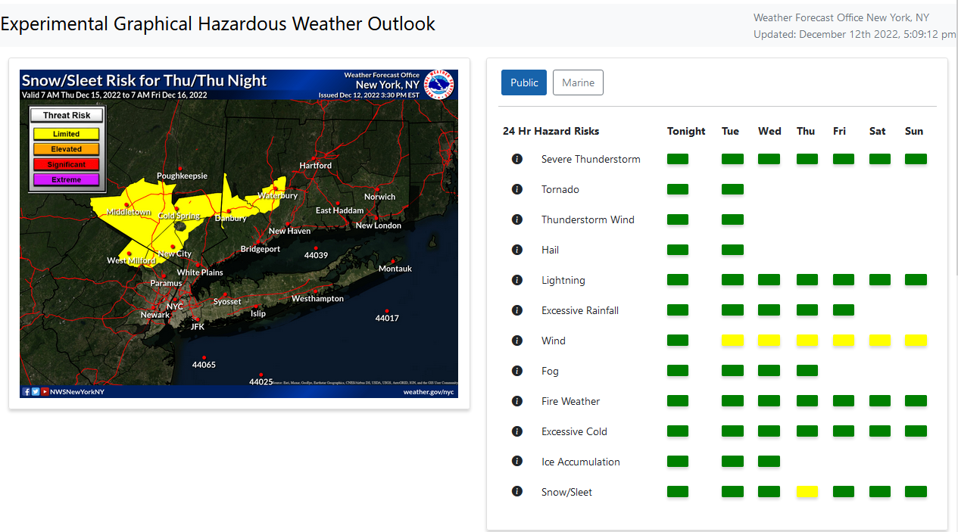
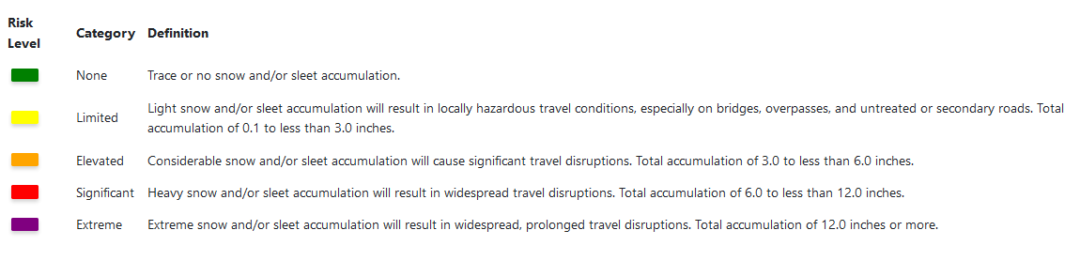
NWS New York Hazardous Weather Outlook
NWS New York
https://www.weather.gov/erh/ghwo?wfo=okx
National Weather Service
WFO New York, NY
https://forecast.weather.gov/product.php?site=NWS&issuedby=OKX&product=HWO

Slide 12
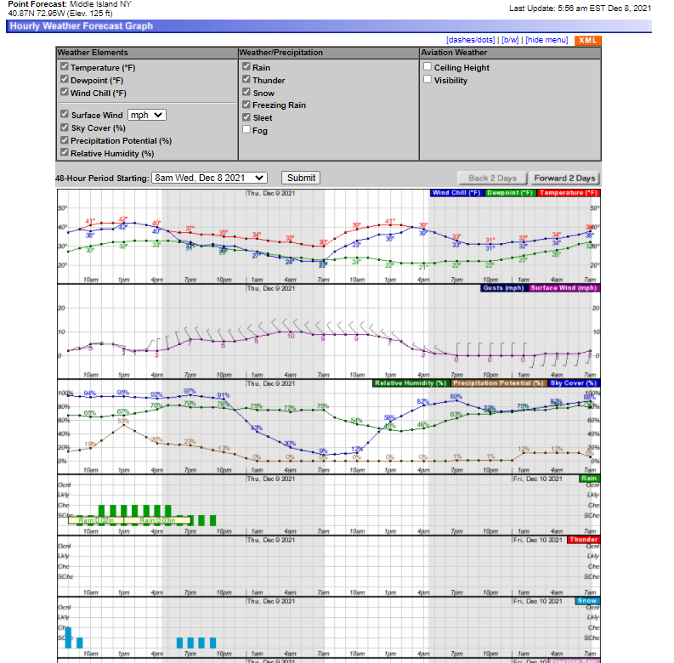
NWS New York Hourly Weather Forecast Graph
NWS New York
https://forecast.weather.gov/gridpoint.php?site=okx&TypeDefault=graphical
National Weather Service
WFO New York, NY
Notes:
Hazardous Weather Event Briefing Template

Slide 13
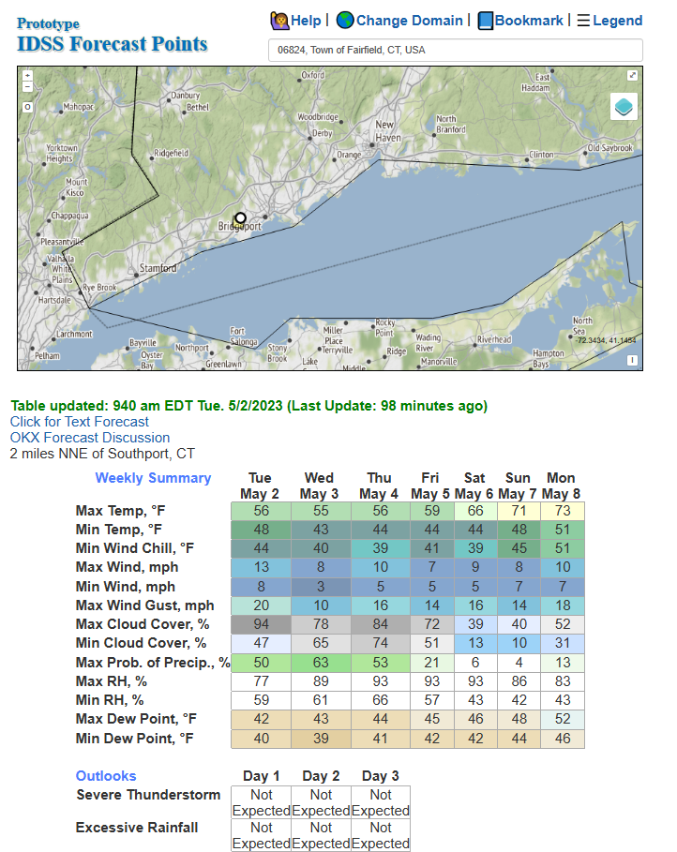
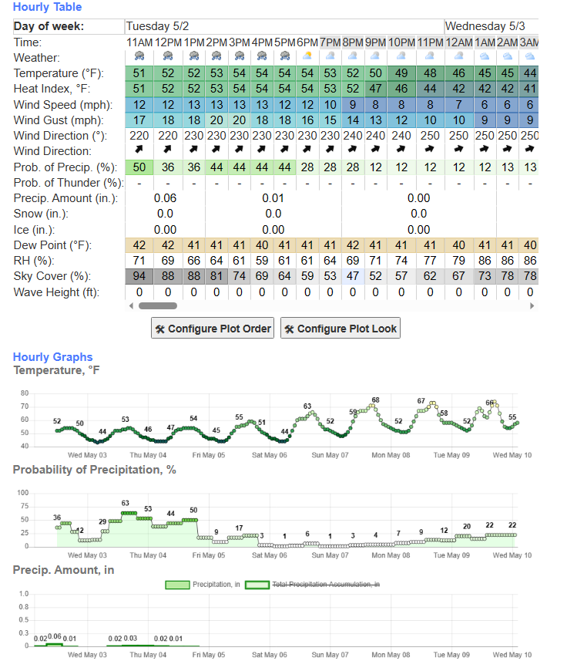
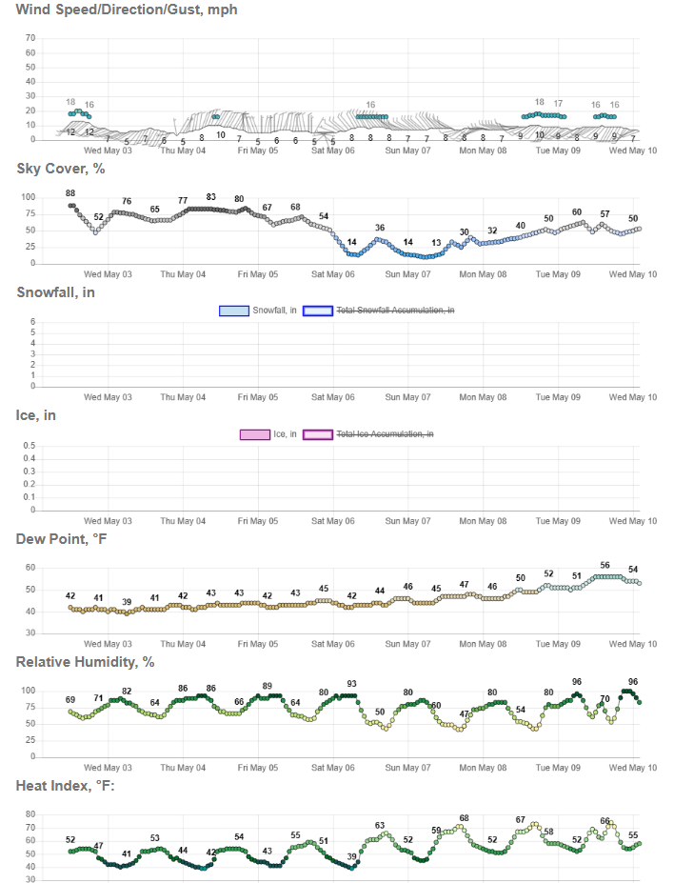
NWS New York Impact Decision Support Service (IDSS)
Prototype IDSS Forecast Points
NWS New York
National Weather Service
WFO New York, NY
https://www.weather.gov/forecastpoints
Notes:
Hazardous Weather Event Briefing Template

Slide 14
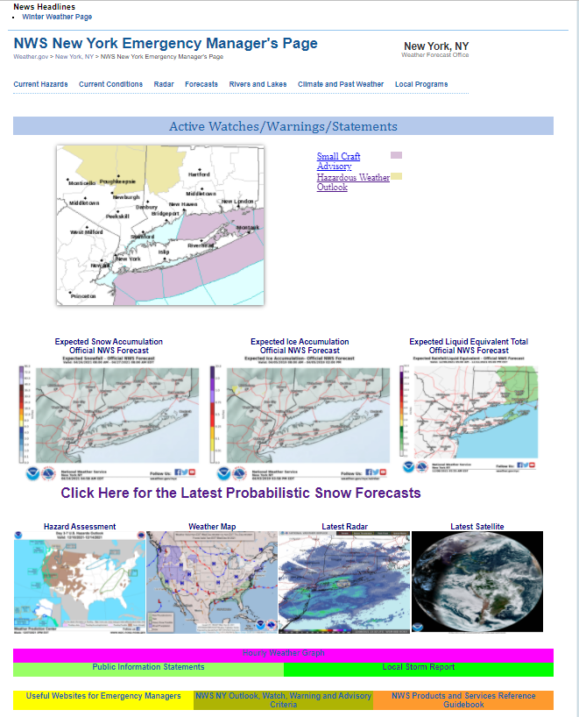
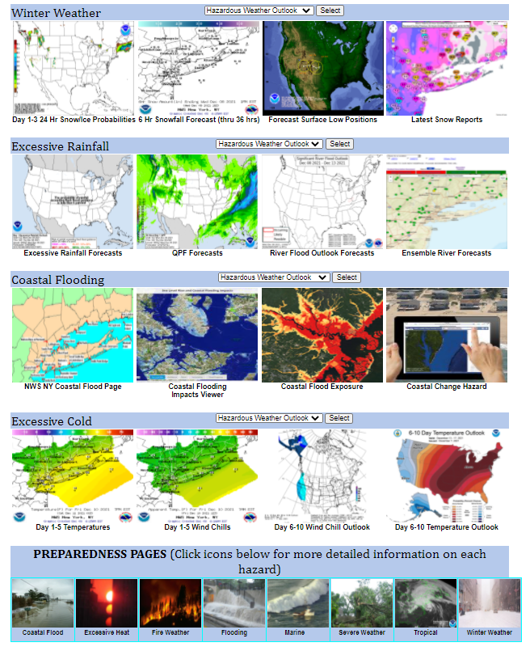
NWS New York Emergency Manager Page
NWS New York
https://www.weather.gov/okx/emnew_winter
https://www.weather.gov/okx/emnew_summer
National Weather Service
WFO New York, NY

Slide 15
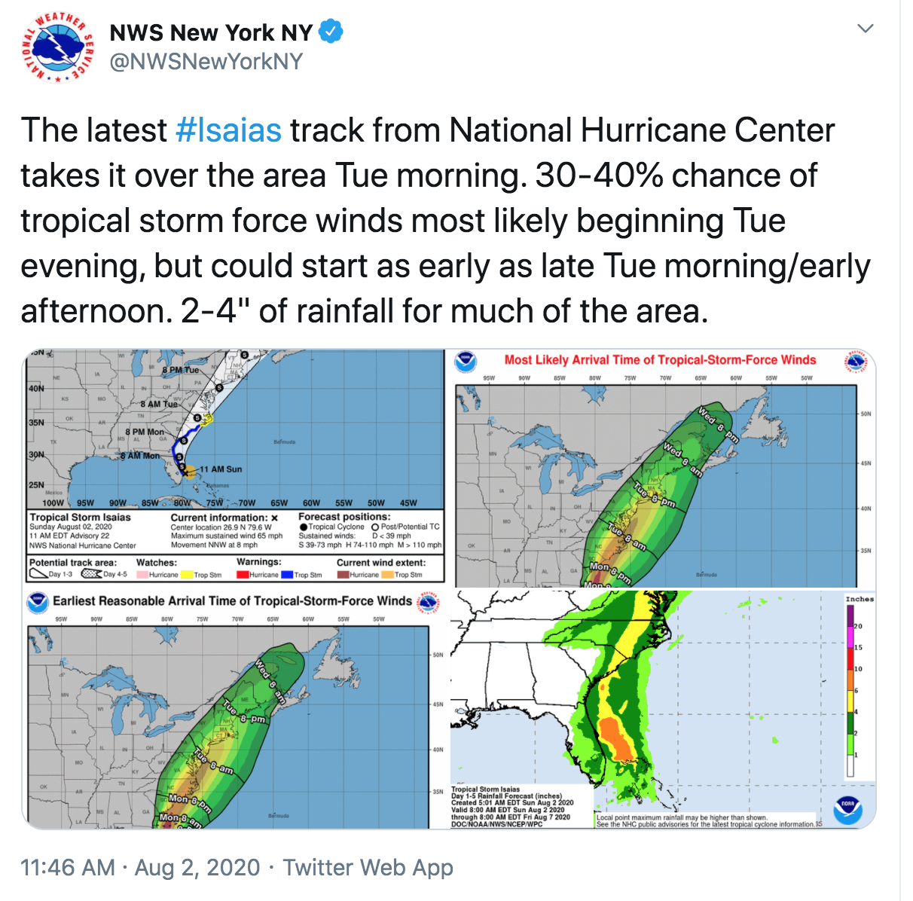
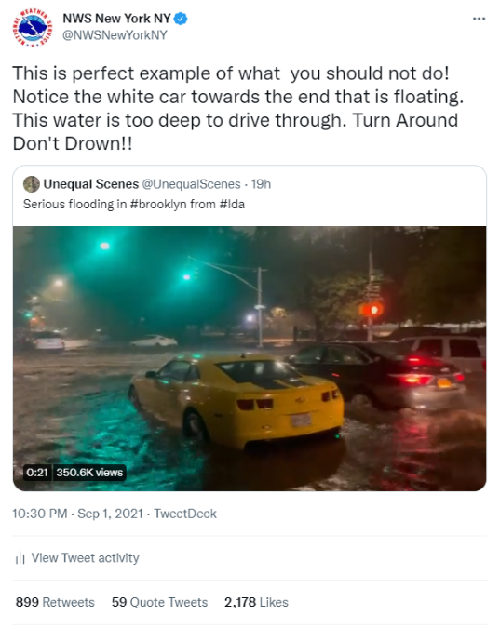


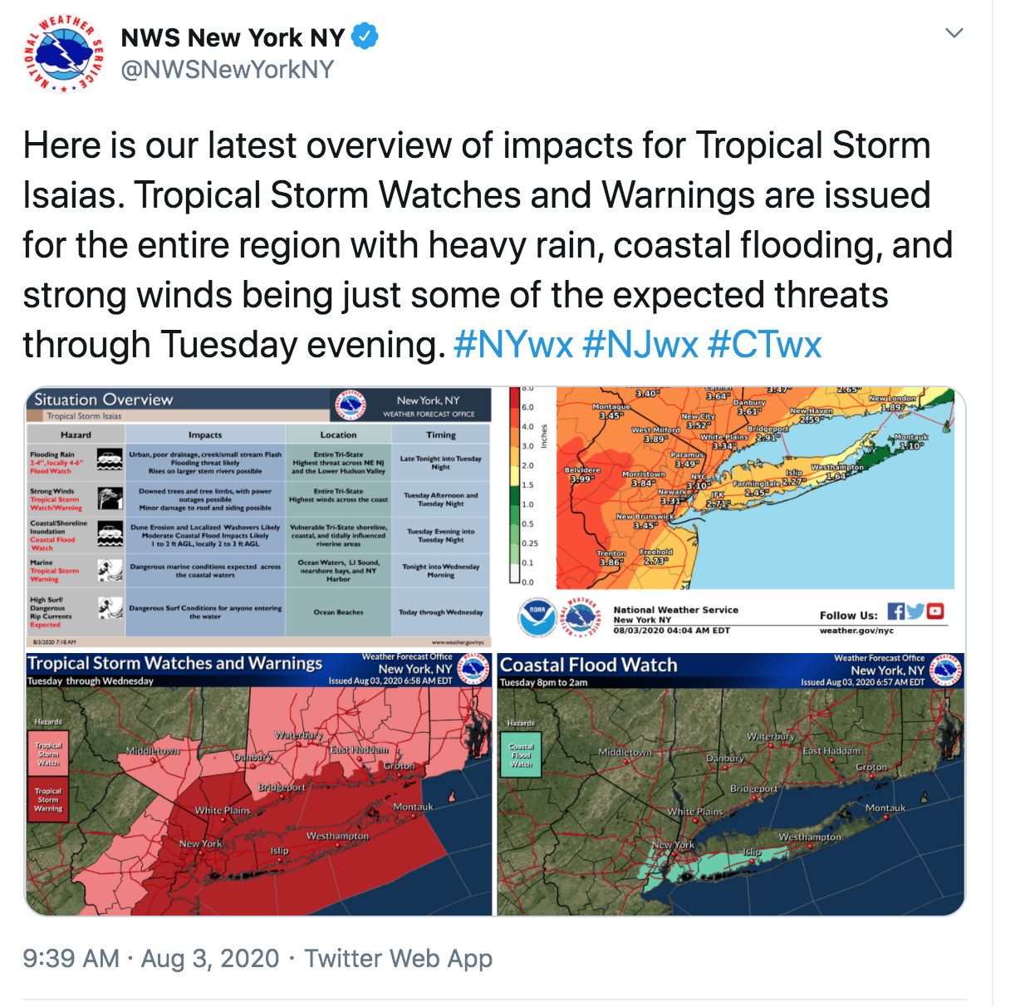
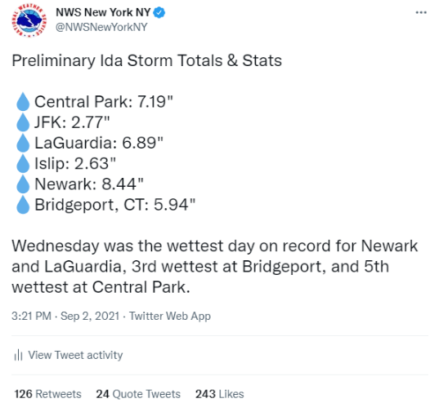

Getting NWS Forecasts & Alert
Social Media
Facebook:
http://www.facebook.com/NWSNewYorkNY
Twitter:
http://www.twitter.com/NWSNewYorkNY
YouTube:
https://www.youtube.com/user/NWSNewYorkNY

Slide 16
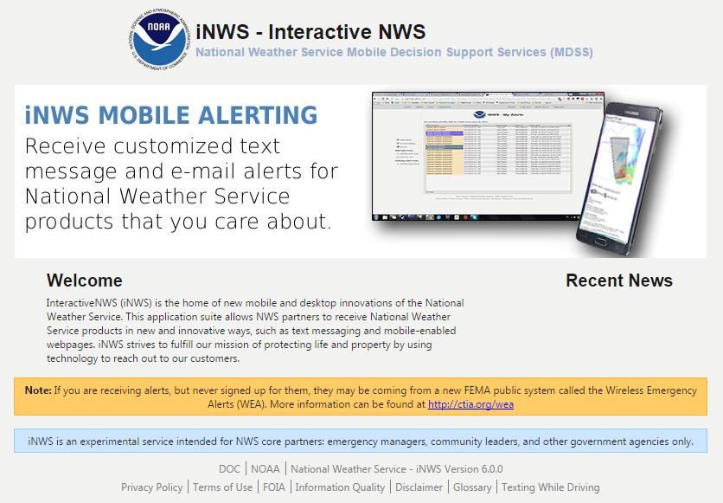
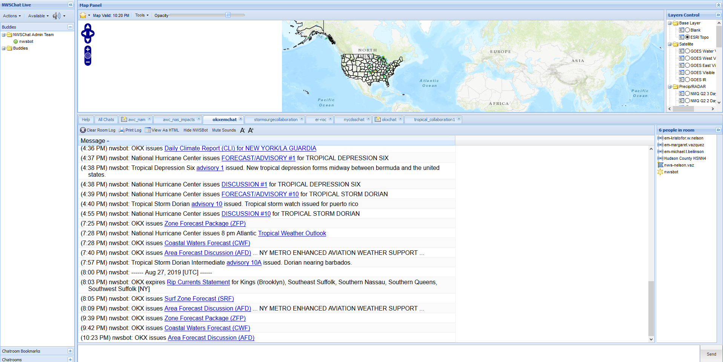
Getting NWS Forecasts & Alerts iNWS and NWSChat/Slack
iNWS
Text Messaging and E-mail for Core Partners
http://inws.ncep.noaa.gov
NWSChat
NWS based Instant Messaging Service
https://nwschat.weather.gov/

Slide 17
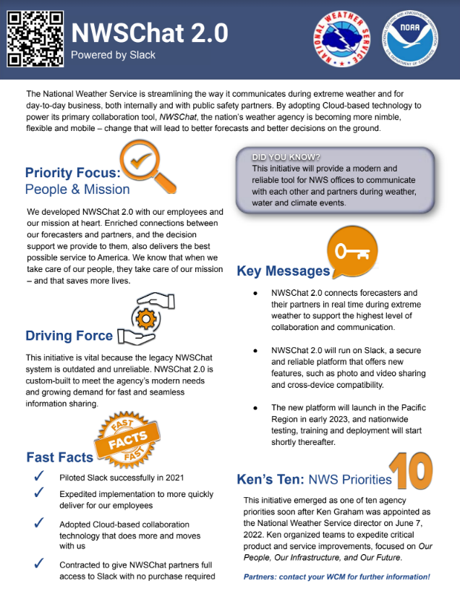
Getting NWS Forecasts & Alerts iNWS and NWSChat/Slack
NWSChat
NWS based Instant Messaging Service
https://nwschat.weather.gov/
iNWS
Text Messaging and E-mail for Core Partners
http://inws.ncep.noaa.gov

Slide 18
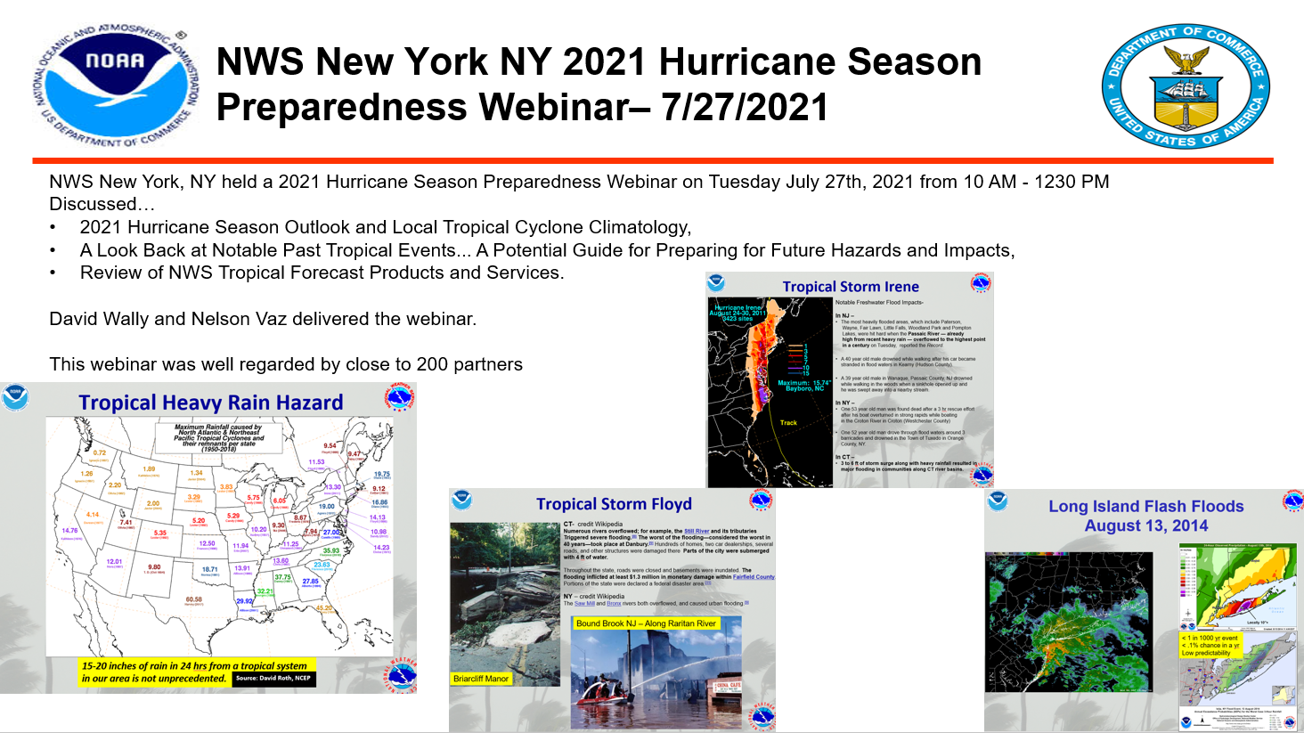
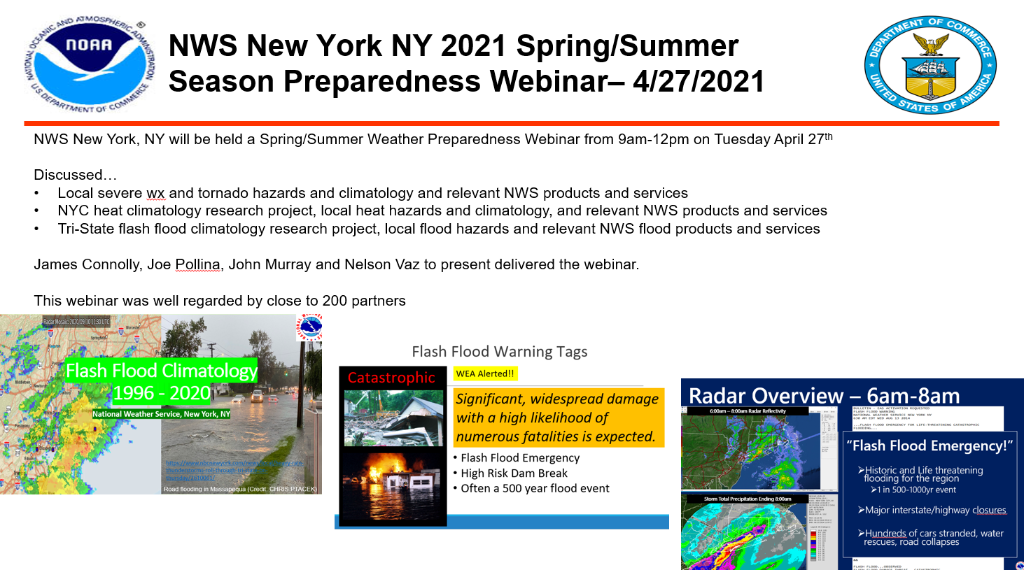
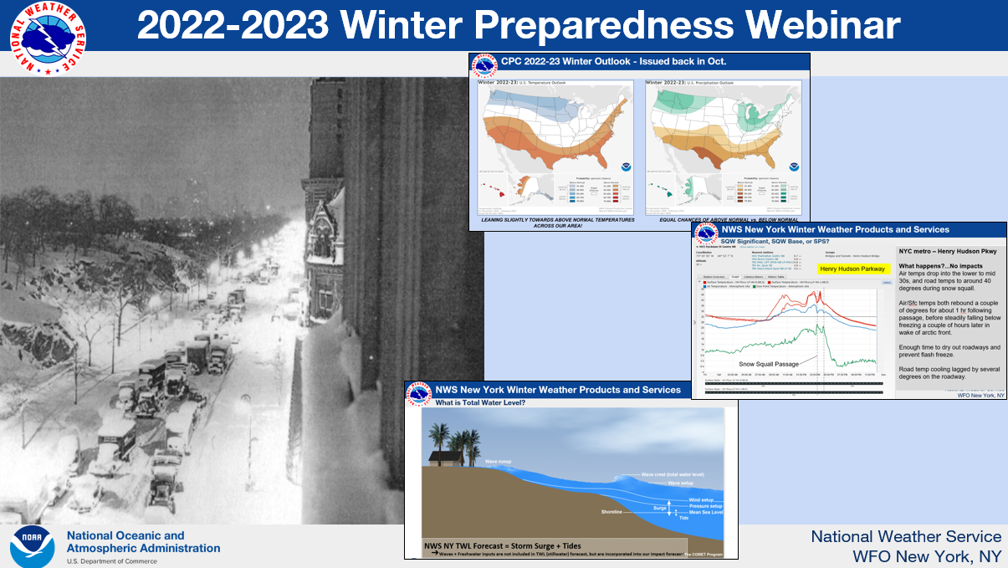
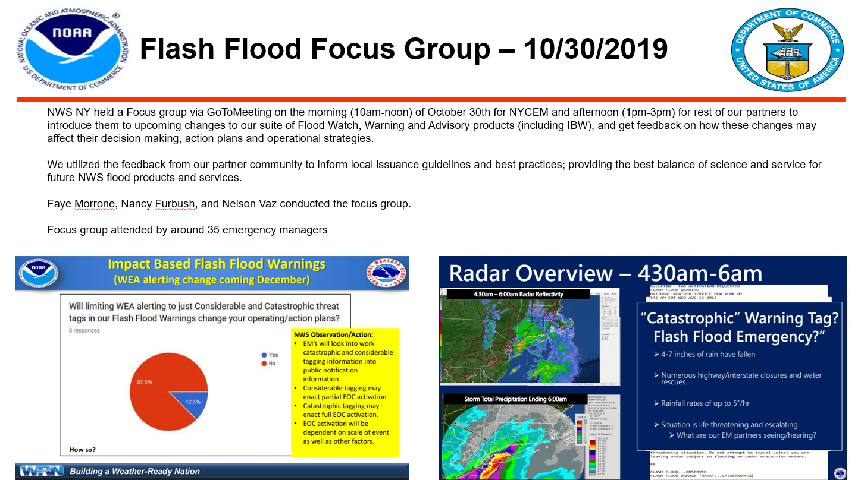
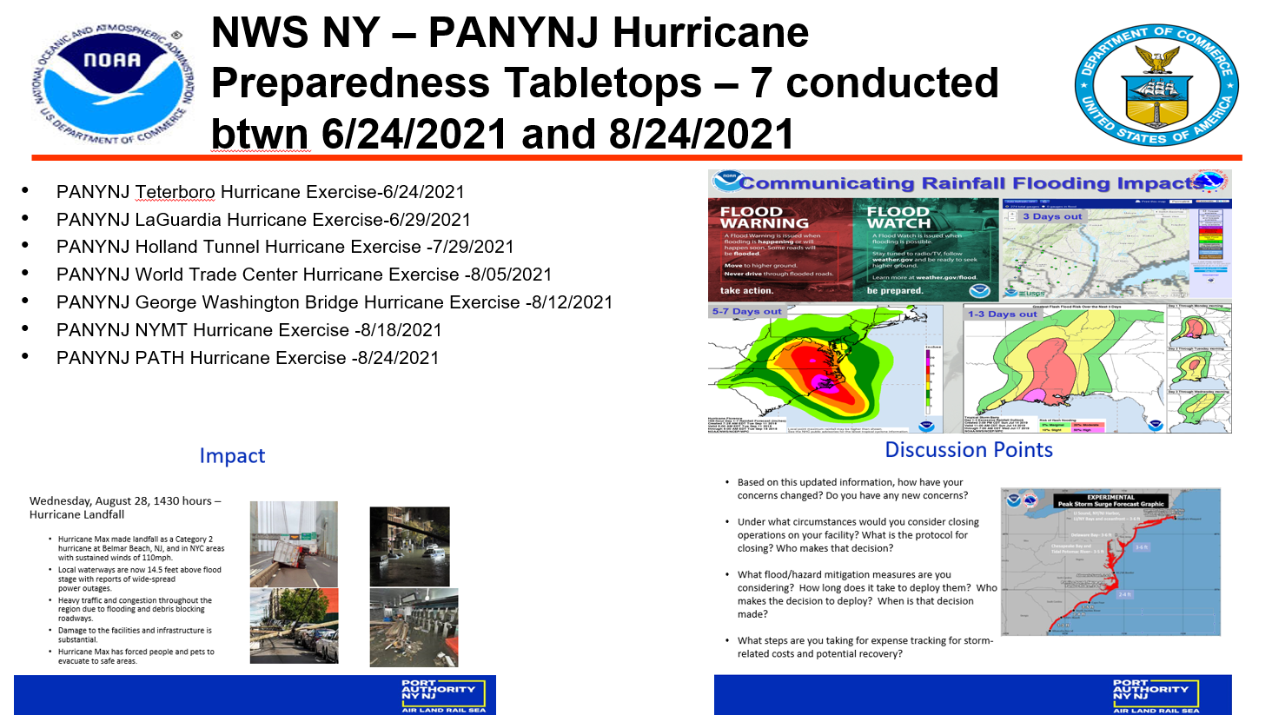
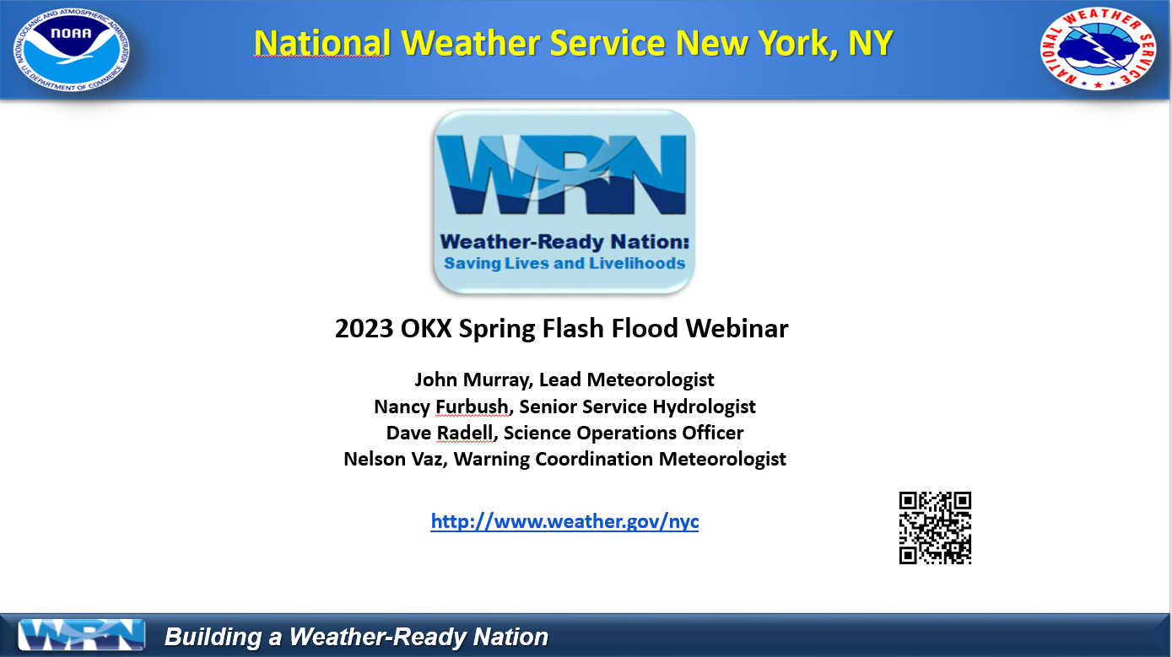
Impact Decision Support Services
Pre-Season Education/Outreach – PARTNERSHIP BUILDING
The NWS vision is to build a Weather-Ready Nation; building community resilience in the face of increasing vulnerability
to extreme weather, water, and climate events.

Slide 19
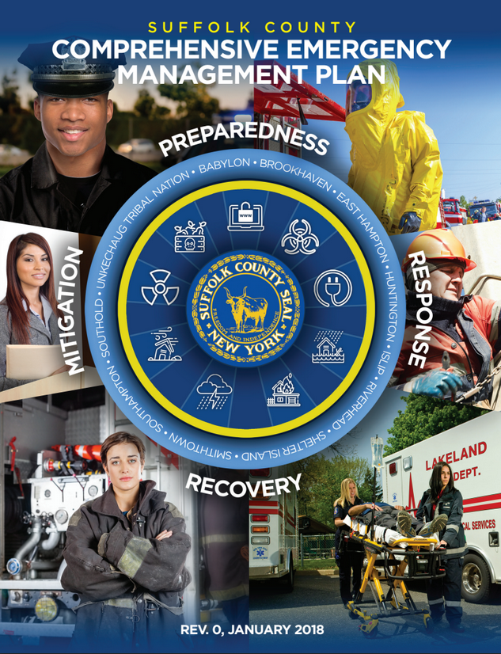
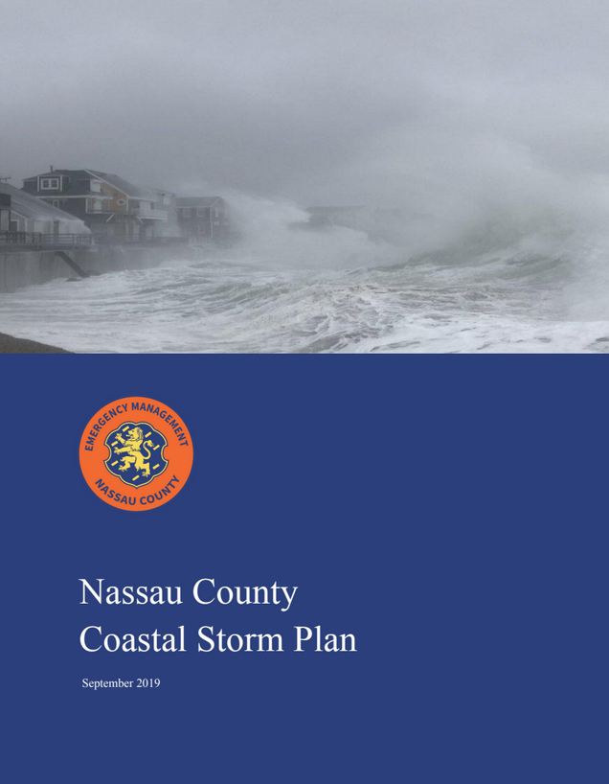
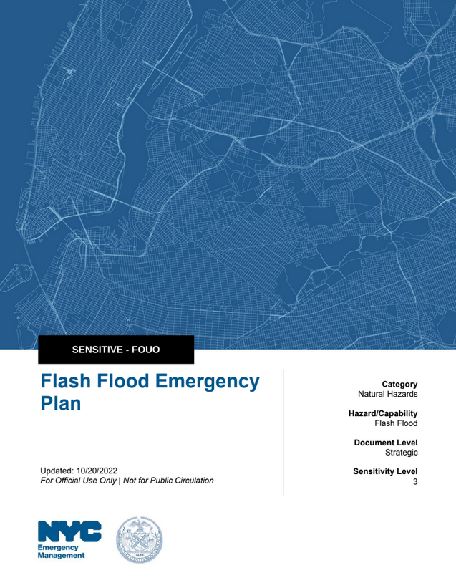
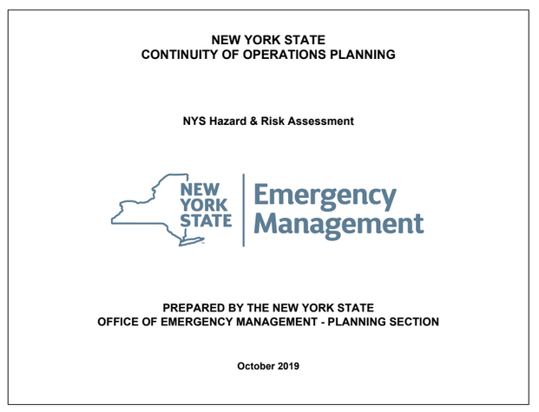
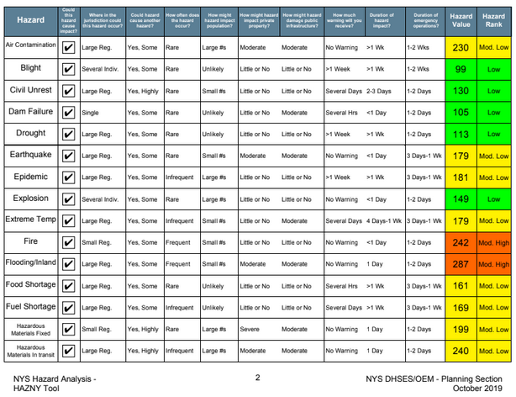
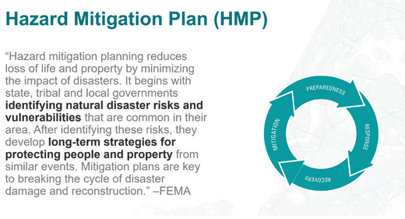
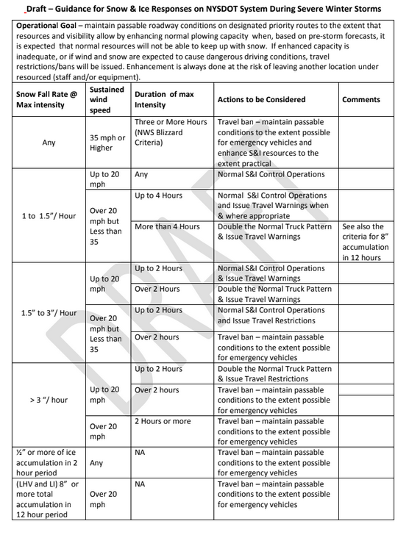
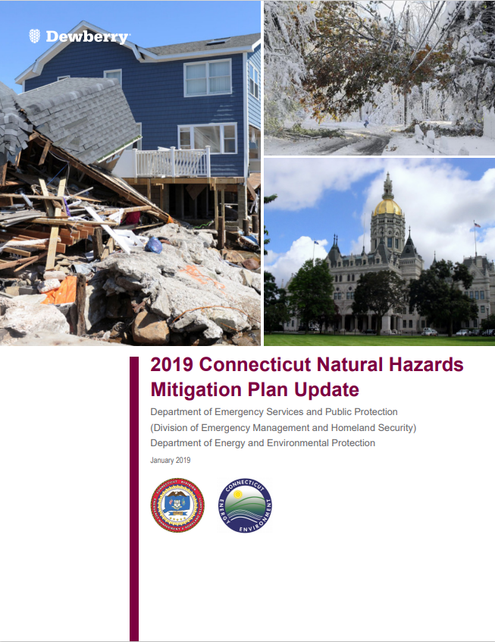
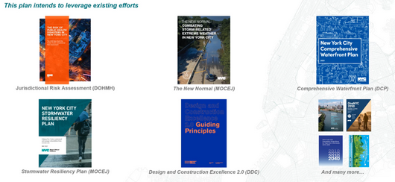
Impact Decision Support Services
Consultation on Weather Risks and Preparedness – PARTNERSHIP BUILDING

Slide 20
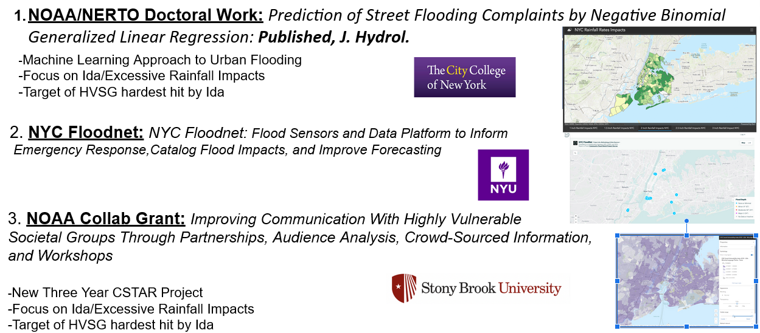
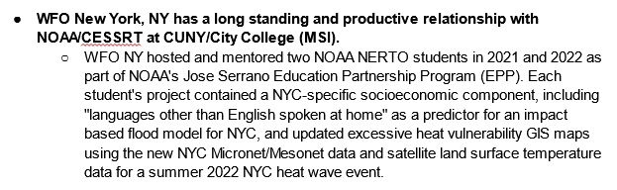




Impact Decision Support Services
Reaching Historically Vulnerable and Underserved Communities
Leverage EM community outreach, academic partnerships, elected officials, and technology

Slide 21





Impact Decision Support Services
NWS Weather Briefings and Webinars
One Pagers
PPT Briefings
Webinars
We are available 24/7 for phone
Consultations and briefings!!
EM only line: 631-924-0383

Slide 22







Impact Decision Support Services
NWS NY High Impact Weather Support
Virtual/Onsite – Connecting weather information to your decision making!

Slide 23







Impact Decision Support Services
NWS NY Public Safety/SEER Event Weather Support

Slide 24




Impact Decision Support Services
HAZMAT Incidents

Slide 25


Impact Decision Support Services
Coastal Services

Slide 26


Impact Decision Support Services
Coastal Services

Slide 27





Impact Decision Support Services
SAR, Recovery ops, and Maritime safety weather support
COIMBRA - Support delivered to NOAA Emergency Response Division - Office of Response & Restoration, USCG LI Sector, and NYS DEC

Slide 28



Impact Decision Support Services
SAR, Recovery ops, and Fire Weather Services
Extensive relationship building with EM’s and fire managers

Slide 29






Impact Decision Support Services
Spot Forecasts
https://www.weather.gov/spot/

Slide 30



Impact Decision Support Services
Spot Forecasts
https://www.weather.gov/spot/

Slide 31
Impact Decision Support Services
Challenges
  Balance between science and service
  Consistent and clear communication of probability and uncertainty information.
  One size doesn’t fit all
  Message Integrity
    Game of telephone
  Meteorology/hydrology is often just one piece of decision making.
  Political landscape and turnover
Notes:
NV

Slide 32








Building a Weather-Ready Nation…
Connecting NWS Forecasts to Decisions
Impact-Based Decision Support Services
Connecting those forecasts/warnings with partner decision-making process
Impact-based
Decision
Support
Services
Generating forecasts
and warnings
=
Fulfilling Mission
&
Building Trust
Providing the best hydrometeorological forecasting in the world
Developing
relationships / Knowing partner needs
“Ready, Responsive, Resilient Communities”

Slide 33


Contact Information
Nelson Vaz
Warning Coordination Meteorologist
Nelson.Vaz@noaa.gov
631 924 0037 x 223
I. Ross Dickman
Meteorologist-In-Charge
I.Ross.Dickman@noaa.gov
631 924 0037 x 222
24/7 Operations:
631-924-0383
E-mail:
okx.operations@noaa.gov
Notes:
FINAL SLIDE - (MANDATORY)
If it is NOT your final briefing, then make sure the Approximate time of the next briefing is filled out (ONLY USE the hour, not the minutes - i.e. 12 or 3), along with whether it will be “Today” or “Tomorrow”. Also make sure to select the Next Briefing Method.
If it IS your final briefing, select only the “Final Briefing” option and leave everything else blank.
HIDE UNNECESSARY SLIDES
- Once you have finished running through the GUI, hide any slides you dont want in the PowerPoint presentation.
SAVE AND ARCHIVE
To SAVE and ARCHIVE the entire briefing packet:
Click the “Save and Archive PPT and PDF Files” button under the “Custom Templates” tab. This will save a .pdf file and a .pptm file to our default folder location.
Y:\Weather Briefing\yyyy Briefings\ddmmmyyyy-#, where “yyyy” is the current year on the day it is saved and the “#” refers to the number of files saved on that day. An example: …\2018 Briefings\09Feb2018-1

Slide 34

NWS Overview – Mission
National Weather Service – New York, NY
MISSION -
Protect life and property
Enhance the national economy
Notes:
The vision going forward: To Build a Weather-Ready Nation where society is prepared for and responds to Weather-Dependent events

Slide 35







Collaborative Forecast
Weather Forecast Office New York, NY
In addition…
More than 12 National Centers:
Storm Prediction Center (SPC)
National Hurricane Center (NHC)
Weather Prediction Center (WPC)
Climate Prediction Center (CPC)
National Water Center (NWC)
Aviation Weather Center (AWC)
NERFC River Forecast Centers

Slide 36
WFO New York, NY
Partners
Federal, State, Local EMs and Public Safety
  NYC - New York City Office of Emergency Management (8 ½ to 11 Million people)
  State, County, Local - NYS DHSES, NJ OEM, CT DEMHS + NY and NJ County + local Tri-State EM’s
  Aviation - FAA, CWSU, TRACON, AWC, ATCSCC, Airlines
  Port Authority of NY/NJ - Airports (LGA, JFK, EWR, TEB, SWF), NY/NJ Port, Rail, Bus, Bridges & Tunnels
  Transportation - NY,CT and NJ DOTs, NYS Thruway
  Marine – USCG NY and LI Sector
  Utilities - National Grid, PSEG LI-NJ, LIPA, Con Ed, ORU, NYSEG, NYPA, Eversource, CT United Illuminating
  Hospital Systems – NYPresbyterian, NYU, NYC Health and Hospitals, North Shore, Northwell, NJ Hospital Assoc,
  Other - USGS, USACE, DEPs, DECs
Academia
  NY SeaGrant, Hofstra, NYU, Stony Brook, CUNY, Stevens Institute, UCONN, etc.
Media - #1 Media Market in US
  Average 10 per day (fair weather)
    Exponential increases during high impact events
  Ethnic Media – 360 outlets in NYC alone
  National media requests
Connecting our forecasts/warnings with partner decision-making process

Slide 37

WFO New York
Key Challenges
Decision Support Services
  New York City (8 ½ -11 million people) + 3 States, 11 Counties, and dozens of Local Emergency Managers (19 million people)
  Transportation, Utilities, Hospital Systems, Port Authority NY/NJ etc. (Public/Private)
Aviation Weather Services - Aviation is a high priority
  3 Major airports - 45% of CONUS air travel and ⅔ of delays through NYC
Marine/Coastal Services
  Busiest Port in the Nation (NY/NJ Harbor)
  4 million residents susceptible to storm surge
#1 Media Market + Ethnic Media
Diversity of Population (NYC alone)
  Over 3.0 million Foreign-Born (over 37%)
  Over 2 million are non-english proficient
Diversity of Weather Hazards:
  Severe Weather and Flash Flooding in a highly urbanized area
  Hurricane and Nor’Easters (High winds, heavy precip, storm surge)
  Heavy Snow Banding and Winter Precipitation type predictability issues
Upper Air Responsibilities
Outreach Staff Hours: More than 1000 hours per year - ER Annual Avg: 457 Hours
Logistics: Need to take Ferry and travel over bridges (2-3 hrs one way) to fix equipment and outreach
Cost of Living

Slide 38



NWS New York Products and Services
NWS New York Outlook, Watch, Warning, Advisory Definitions
https://www.weather.gov/okx/wwa_definitions
National Weather Service
WFO New York, NY

Slide 39




Getting NWS Forecasts & Alerts
Wireless Emergency Alerts (WEA)

