Slide 1
FEMA Hazard Mitigation Assistance Programs
Division of Emergency Management and Homeland Security
Danielle Moyer – EMPS, Hazard Mitigation Unit

Slide 2
FEMA Hazard Mitigation Assistance Programs
HMGP
BRIC
FMA
Disaster-dependent
State-managed and competitive
15% of the first $2 billion in Public Assistance Award
Nationally competitive
Annual program
Reducing losses to National Flood Insurance Policy Properties
Nationally competitive
Annual program
Replaced Pre-Disaster Mitigation (PDM) in 2020
Nationally competitive
Annual program
Replaced Pre-Disaster Mitigation (PDM) in 2020
All programs continue to follow project eligibility and programmatic policies in the 2023 Hazard Mitigation Assistance Guide
Home Acquisitions
(pictured, Westport)
Infrastructure Projects
Community and Capacity Building Activities
Home Elevation
(pictured, Milford
Notes:
Three programs under the HMA umbrella
Images are some eligible activities under each grant (BRIC picture posted is a stormwater management retention pond in Ohio)
All programs follow 2015 HMA guidance

Slide 3
Eligible Mitigation Activities
Eligible mitigation activities as listed in the 2023 HMA Guide
Eligible activities under PDM are eligible under BRIC
Construction Mitigation Projects
Culverts and Drainage Projects
Generators for Critical Facilities
Property Elevation/Acquisition
Dry Floodproofing
Localized Flood Risk Reduction such as Seawall Upgrades
Mitigation Reconstruction
Hazard Mitigation Planning
Community and Capacity Building Activities
New under BRIC and FMA (2020)
Management Costs

Slide 4
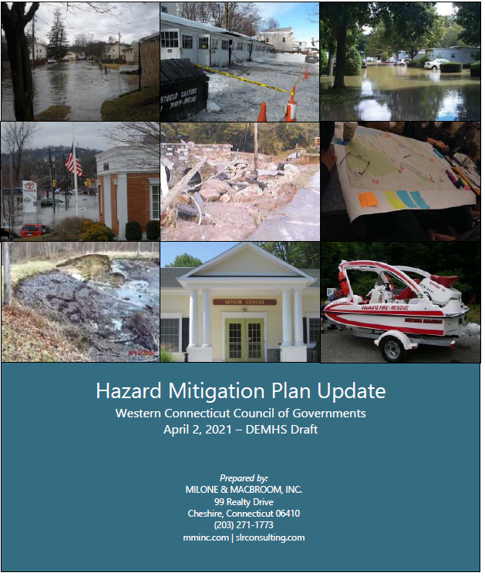
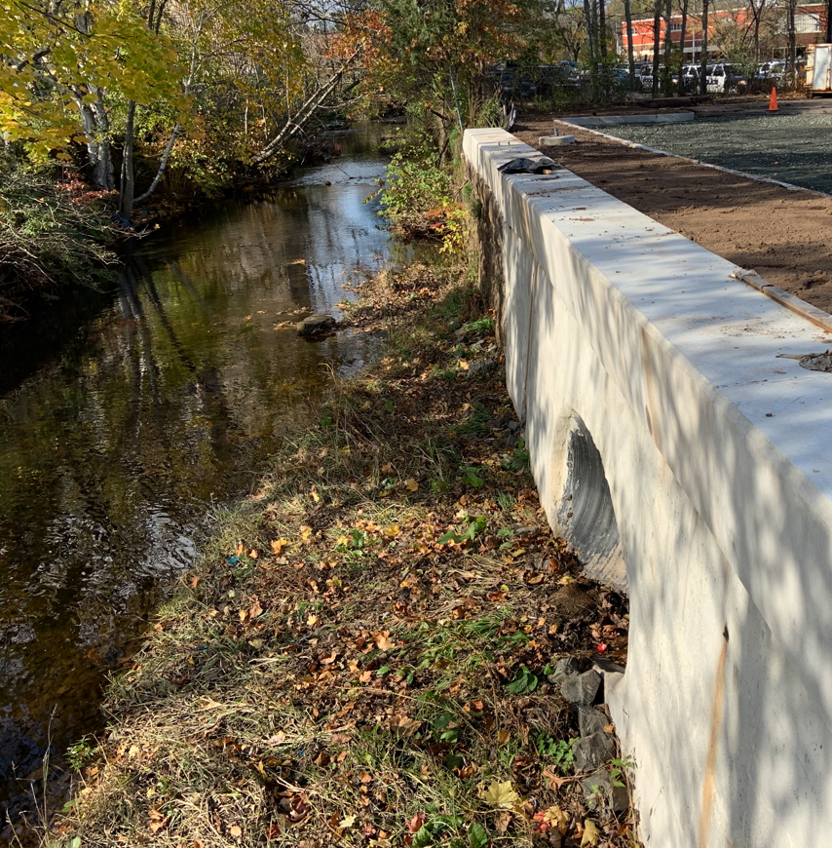
Common Mitigation Activities in Connecticut
Mitigation Plan Updates
Project Scoping Activities
Culverts and Drainage Projects
Generators for Critical Facilities
Property Elevations and Acquisitions
Greater New Haven Water Pollution Control Facility Generators: HMGP-4106
Western COG Multi-Jurisdictional Mitigation Plan Update PDM-2018
Sub-applicants are required to have a FEMA-approved Local or Tribal Hazard Mitigation Plan in accordance with 44 CFR Part 201 by the Application deadline and at the time of obligation of grant funds for mitigation projects and C&CB activities (with the exception of mitigation planning)
Meriden Harbor Brook Flood Control, Meriden: HMGP-4023

Slide 5
Hazard Mitigation Grant Program (HMGP)
Disaster or Emergency
Presidential Disaster Declaration
HMGP Application Period:
1 year from Date of Declaration
HMGP Notice of Sub-Application Intent
FEMA Review and RFI
FEMA Award and DEMHS Sub-Award
HMGP Sub-Application Submission
Begin Period of Performance
HMGP (Section 404 Robert T. Stafford Act) is awarded upon Presidential Disaster Declaration
15% of the total Public Assistance Award set aside for HMGP (up to the first $2 Billion)
Application Period is 1 year from Disaster Declaration
Projects chosen and submitted by State to FEMA
State ranking process only
Eligible Sub-Applicants
State/Local Government
Non-Profit Organizations
Federally Recognized Tribal Governments
Cost Share is 75% Federal, 25% Non-Federal
Notes:
Refer to the flowchart – don’t need to go over the first bullet, it was covered in the previous slide

Slide 6
Flood Mitigation Assistance (FMA) Program
Annual, non-disaster program
Funds projects to reduce or eliminate risk of flood damage to buildings that are insured under the National Flood Insurance Program (NFIP).
Eligible Sub-applicants
State/Local Government
Federally Recognized Tribal Governments
Cost Share
Severe Repetitive Loss Property Mitigation (100/0)
Repetitive Loss Property Mitigation (90/10)
All other eligible projects identified in the 2023 Hazard Mitigation Assistance Guidance and Notice of Funding Opportunity (75/25)
*All projects must be in compliance with CT DEEP Regulations and Requirements*
Examples of Eligible FMA Projects
Localized Flood Control
Property Elevation/Acquisitions
Floodwater Storage & Diversion
Floodplain and Stream Restoration
Stormwater Management
Wetland Restoration/Creation
Notes:
Emphasis on mitigating NFIP-insured properties

Slide 7
Building Resilient Infrastructure and Communities (BRIC)
The BRIC program provides federal funds to states, territories, tribal governments and local communities for pre-disaster mitigation activities
Disaster Recovery Reform Act, Section 1234 amended Section 203 of Stafford Act
Eligible Sub-Applicants
State/Local Government
Federally Recognized Tribal Governments
Non-Profit Organizations
Differences from Pre-Disaster Mitigation Program
Focus on Community Lifelines & Infrastructure Projects
Encourages Building Code Projects
Emphasis on Mutual/Shared Responsibility & Partnerships
Innovative Projects including Nature-Based Solutions
FEMA Community Lifelines
Notes:
Focus more on the differences from PDM
Community Lifeline alignment
Individuals, businesses, and non-profit organizations are not eligible to apply for HMA funds; however, an eligible Applicant or subapplicant may apply for funding on behalf of individuals, businesses, and nonprofit organizations
Under BRIC, to be eligible – State must have received a major disaster declaration under the Stafford Act in the 7 years prior to the annual grant application period start date. → this is every state in the nation so far
More Federal Funding for Mitigation and Resiliency
BRIC is funded by a 6% earmark from federal post-disaster grant funding
The funding “pots” are:
State and Territory Allocation
Tribal Set-Aside
National Mitigation Project Competition
Project Types
Eligible Activities under HMA Guide 2015 for PDM
Additional eligible activity types
Capability & Capacity Building (C&CB) Activities
Cost Share is 75% Federal, 25% Non-Federal
Small impoverished communities are eligible for an increase in cost share up to 90 percent federal/10 percent non-federal.

Slide 8
Questions, Comments, and Discussion: DEMHS.HMGP@ct.gov

