Slide 1


Accessibility and Emergency Management:
Reaching the Whole Community
Alexis Steele, Member of ESF-15
Emergency Management Program Specialist with CT DEMHS
Alexis.Steele@ct.gov
Connecticut Department of Emergency Service & Public Protection
Division of Emergency Management & Homeland Security
1111 Country Club Rd, Middletown, CT 06457
Phone: 860.685.8531 / Fax: 860.685.8902
An affirmative Action/Equal Employment Opportunity Employer
Notes:
I sat down with a 2 advocates from the ESF-15 diverse communities taskforce, and we came up with

Slide 2


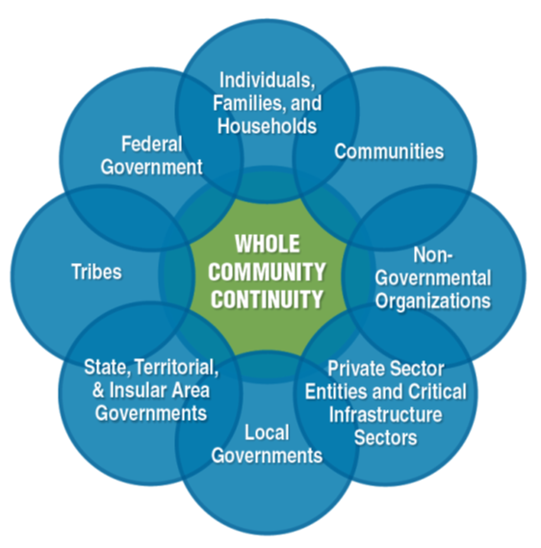
The Whole Community Concept
Notes:
As we all know, there are pockets of underserved residents in our communities. There always has been and there always will be. As emergency managers, we need to try our very best to reach these communities and deliver messaging in a clear and effective way. I know a very intelligent woman who detests the “whole community” term, because information flow between all of these facets can sometimes feel impossible to achieve. It can feel like an overwhelming task, but today I wanted to bring some tips and tricks your way to keep the Whole Community on the forefront of your work. Especially related to flood awareness messaging.

Slide 3

Public Information for all
Plain language always – reading level should not be more than 2nd grade.
Nearly 1 in 5 adults in America cannot comprehend fourth-grade-level text
  Lots of pictographs/infographics supporting your message.
  Telling social stories.
  Considering making a “silent” video
    Your message will reach non-English speakers, people who need plain English, and those who cannot read small text.
Source: Snob Monkey. https://snobmonkey.com/importance-of-infographics/

Slide 4
Which top languages are spoken in your community?
22.1% of households in CT reported speaking a non-English language at home as their primary shared language. What are the top 5 in CT?
Imperative to have all preparedness materials in the top three non-English languages spoken in your community.
  Flood awareness materials
  Designated radiological Emergency Planning Zones (EPZ)
  Evacuation routes
  How to build a “go bag” – Red Cross Ready has free programs/advocates that train residents in different languages
Spanish
Portuguese
Polish
Chinese (Mandarin)
Italian

Slide 5
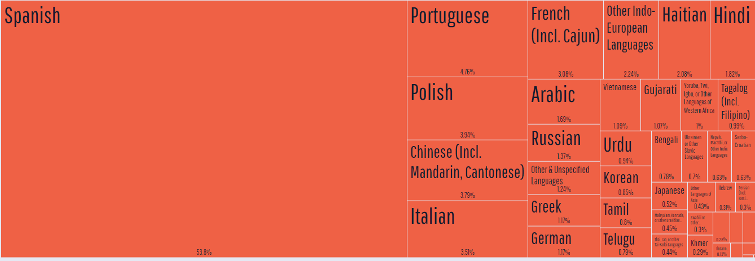
Languages spoken in Connecticut
Source: DataUSA. https://datausa.io/profile/geo/connecticut/#demographics

Slide 6
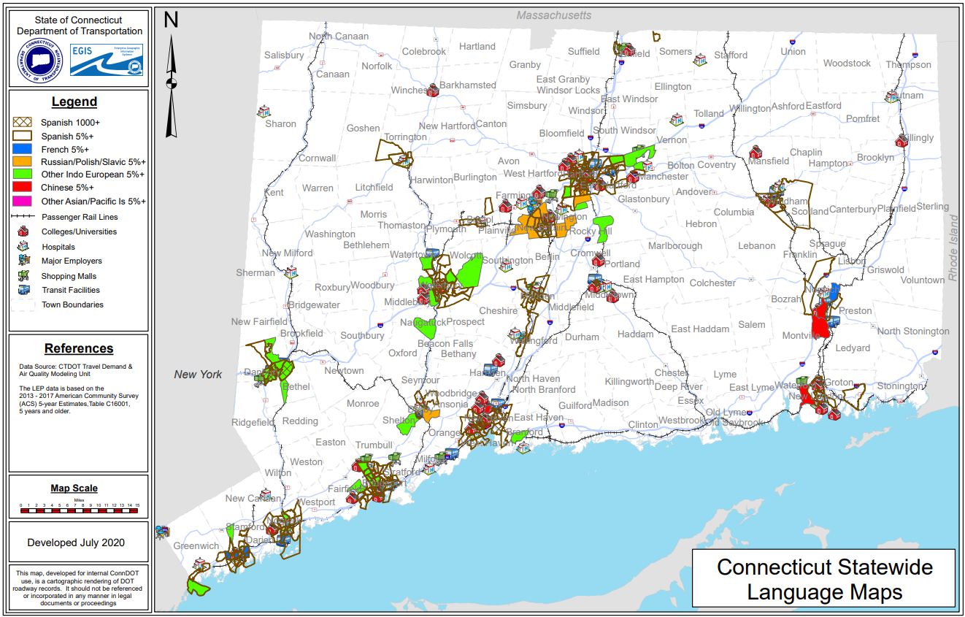
Locations of Non-English-Speaking Populations in CT
Source: ConnDOT. https://portal.ct.gov/-/media/DOT/documents/dcontractcompliance/2020-maps/Statewide-Language.pdf

Slide 7
Start assessing the resources in your own community
Trusted messengers – every community has them, its up to you to seek them out and build a partnership.
Ensure that you are disseminating the appropriately translated materials to these locations.
Utilizing the power of Faith-based communities
There may be worshiping spaces in your community you are not aware of.
Ethnic media & Public Radio stations – direct local info
Reach out BEFORE disaster strikes to establish a relationship. They may be willing to translate and disseminate important messaging during an emergency!
Notes:
After you figure out which 3 major languages besides English are spoken in your community….

Slide 8
Building your personal toolkit
Resources all Emergency Managers should have in their toolkit:
LanguageLine or adjacent translations services.
Google Translate should never be used – always inaccurate and offensive.
Community health workers in your community – often trusted messengers and multi-lingual.
211 has a list of translation services in your community. See what other connections United Way 211 has!
Connecticut Council on Developmental Disabilities – National organization, federally funded. Can provide support on these populations.
State Independent Living Council
Aging and Disabilities Community of Practice – Connecticut

Slide 9
Disability is a spectrum
Not JUST the aging population – lifespan
1 in 4 adults have a disability.
Disability doesn’t discriminate. Anyone can age into a disability, have an accident, or may have an invisible disability.
Not one-size fits all solution. Emergency response planning should be broad and person-centered.

Slide 10
It’s the law!
Americans with Disabilities Act of 1990
  The Americans with Disabilities Act (ADA) prohibits discrimination against people with disabilities in employment, transportation, public accommodations, communications and access to state and local government' programs and services.
Rehabilitation Act of 1973
  Rehabilitation Act of 1973 prohibits discrimination based on disability in programs conducted by federal agencies, in programs receiving federal financial assistance, in federal employment and in the employment practices of federal contractors.
Executive Order 13347 – Individuals with Disabilities in Emergency Preparedness
  “…consider, in their emergency preparedness planning, the unique needs of agency employees with disabilities and individuals with disabilities whom the agency serves.”
Pets Evacuation and Transportation Standards Act of 2006
  ensure that state and local emergency preparedness operational plans address the needs of individuals with household pets and service animals prior to, during, and following a major disaster or emergency.

Slide 11
Access and Functional Needs
Are you unaware of the scope of needs in your community?
Hold a Virtual Town Hall targeting this population and see who shows up.
This population comes with “extensions” of themselves that should NEVER leave their side.
Personal Care assistant
Reaching communication-based needs residents:
Large and simple font on all materials
Social media use as much as possible
Training on how to use accessibility resources
Grammarly, Microsoft Word Accessibility Checker
Communication based needs to consider:
People who have visual, audio, and/or cognitive needs related to the receipt of and response to information.
People who require alternative formats of information
No one knows their needs better than them!
Medications
Service animals
Assistive devices
Whatever else they may need – do not separate them from their devices.

Slide 12
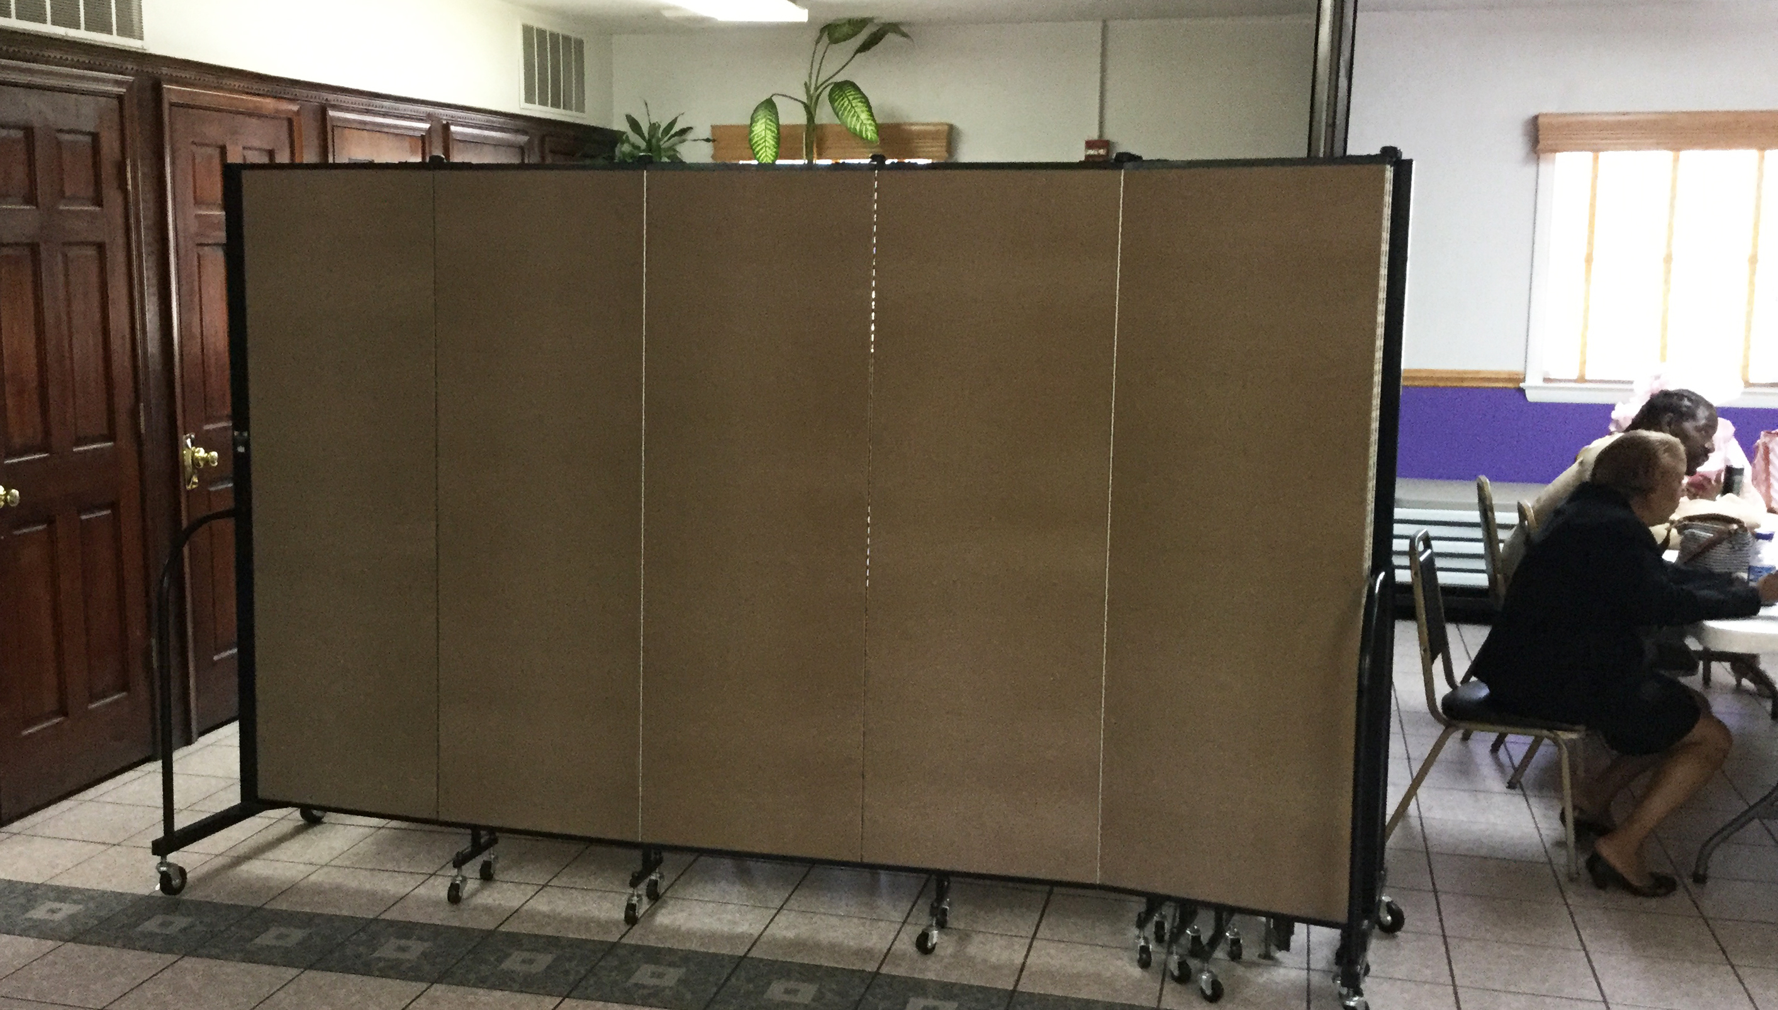
Residents who may be on the spectrum
Sensory overload will impact people on the spectrum.
Scents, lights, and sounds can be triggers.
To combat this, create sensory rooms/areas.
Room dividers assist with creating these spaces.
As always, keep all interaction Person centered – treat all people with dignity!
Don’t ignore them because you feel unsure and ill-equipped to fit their needs.

Slide 13

Assistive Technology
Screen readers - the communication device of sight-impaired folks
  Use headings to organize documents
    Screen reader will differentiate between structural elements in the document in a clearer manner.
  Using page numbers and tables of contents.
  Check your color palette for contrast.
  Always having an “alt text” or “photo ID” when you post photos on social media!
Photo ID: Green frog that appears to be smiling, sitting on a green leaf.
Source: Dartmouth Center for the Advancement of Learning. https://dcal.dartmouth.edu/resources/teaching-methods/creating-accessible-materials

Slide 14
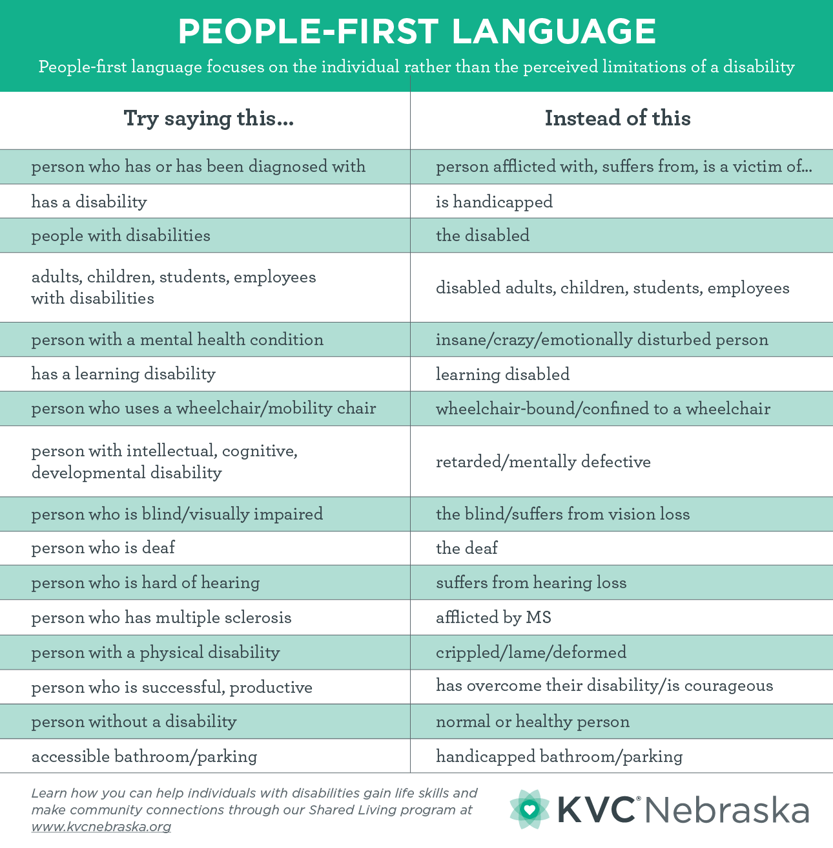
Etiquette for ALL populations
People-first language
  “an individual with a disability” as opposed to “disabled person.”
Speak to people with empathy!
  We are all human beings who deserve respect, patience, and the ability to belong to the community.
Consistent and ongoing communication with all populations is key, before, during and after a disaster
The individual knows what they need. All you have to do is ask!

Slide 15
References
ESF-15 Advocates that provided their knowledge for the creation of this presentation:
Doris Maldonado
  maldonado.doris.a@gmail.com
Rich Luby
  rich.luby@indnw.org
My information:
Alexis Steele
  Alexis.Steele@ct.gov

