Slide 1
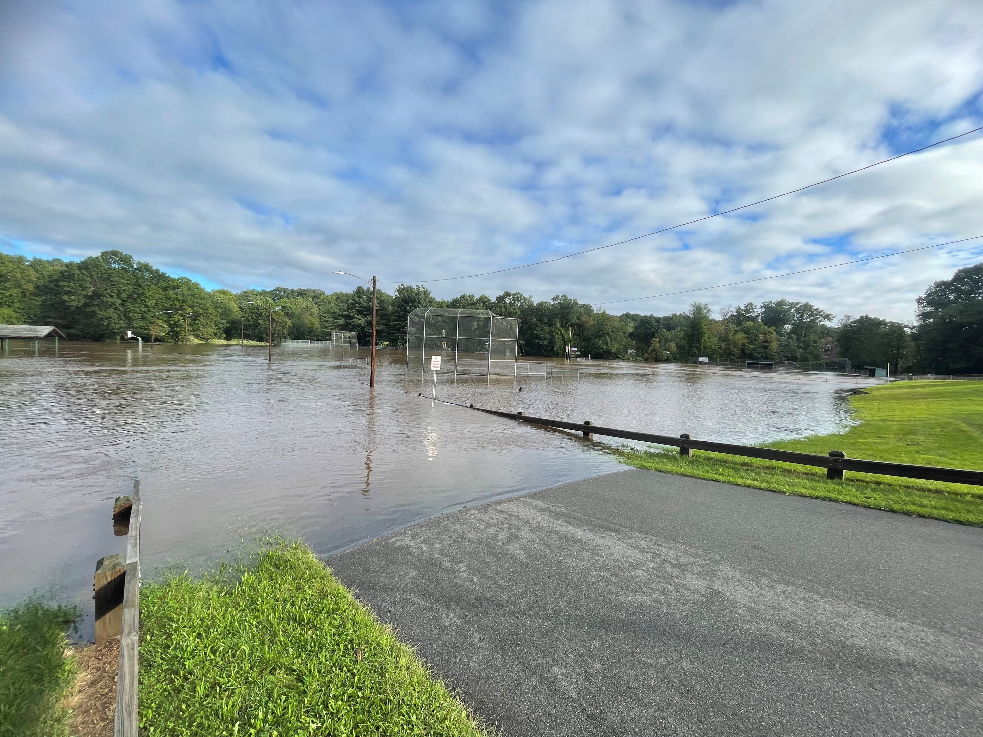
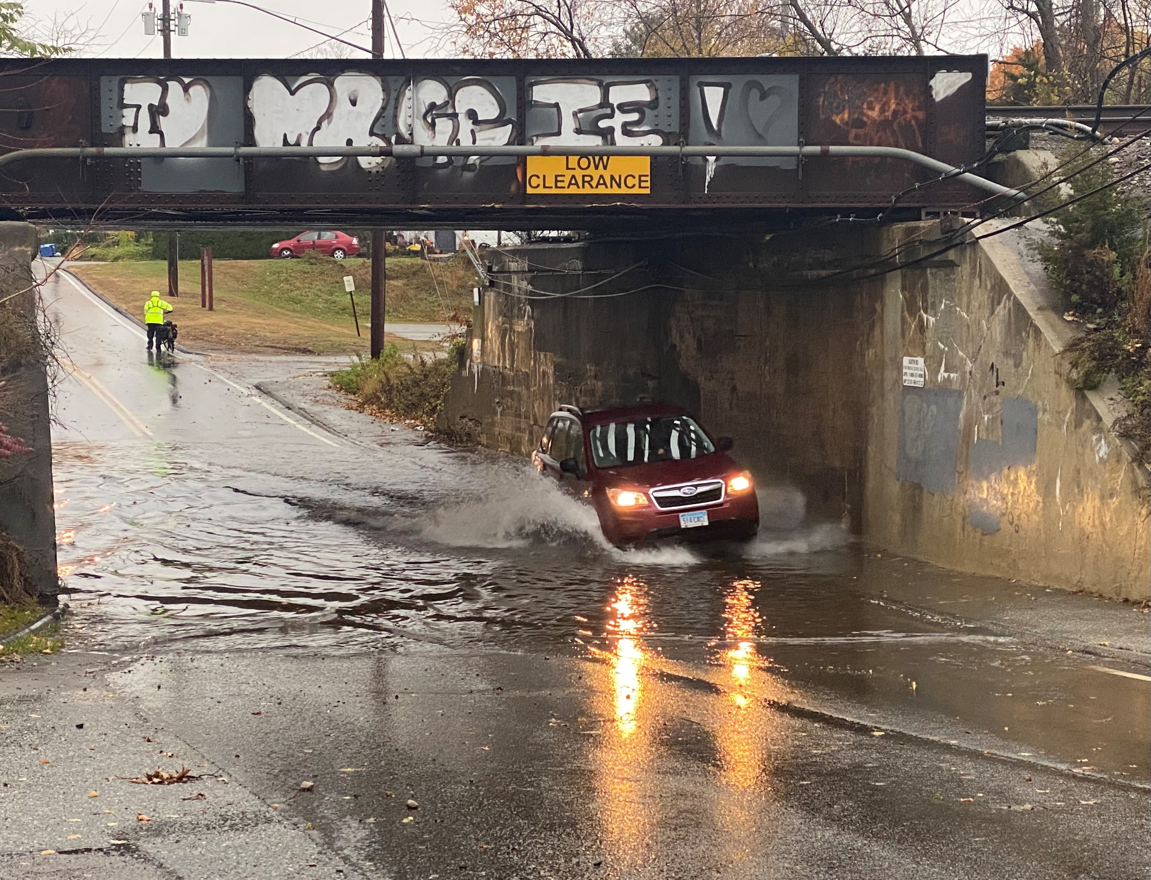
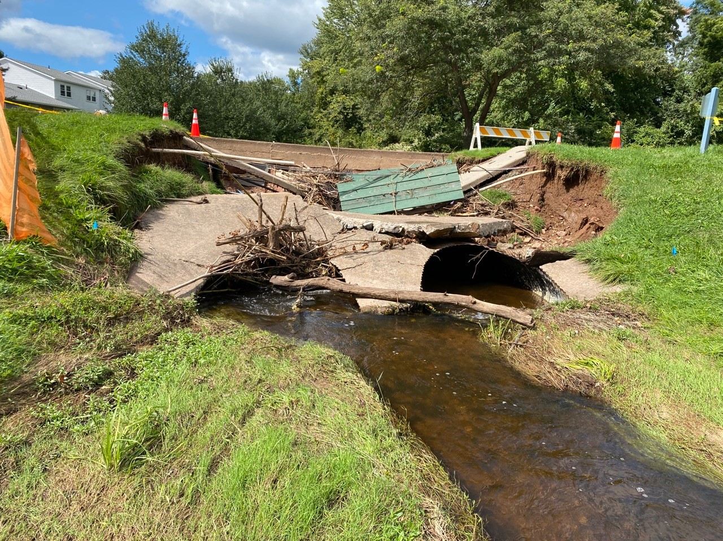
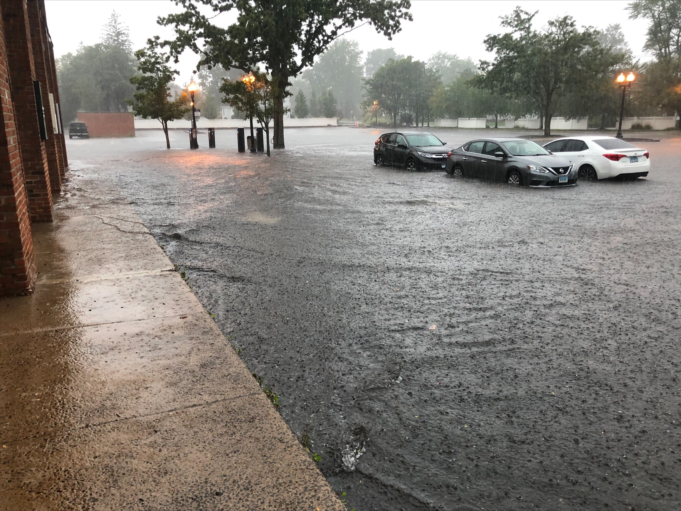
Flood awareness workshops May and June 2023
The Impact of Climate Change on
Flooding Caused by Intense Precipitation
David Murphy, PE, CFM

Slide 2
Agenda
Recent Events
Figures for Connecticut
National Climate Assessment
Connecticut State Water Plan
Connecticut Physical Climate Science Assessment Report
NOAA Resources

Slide 3
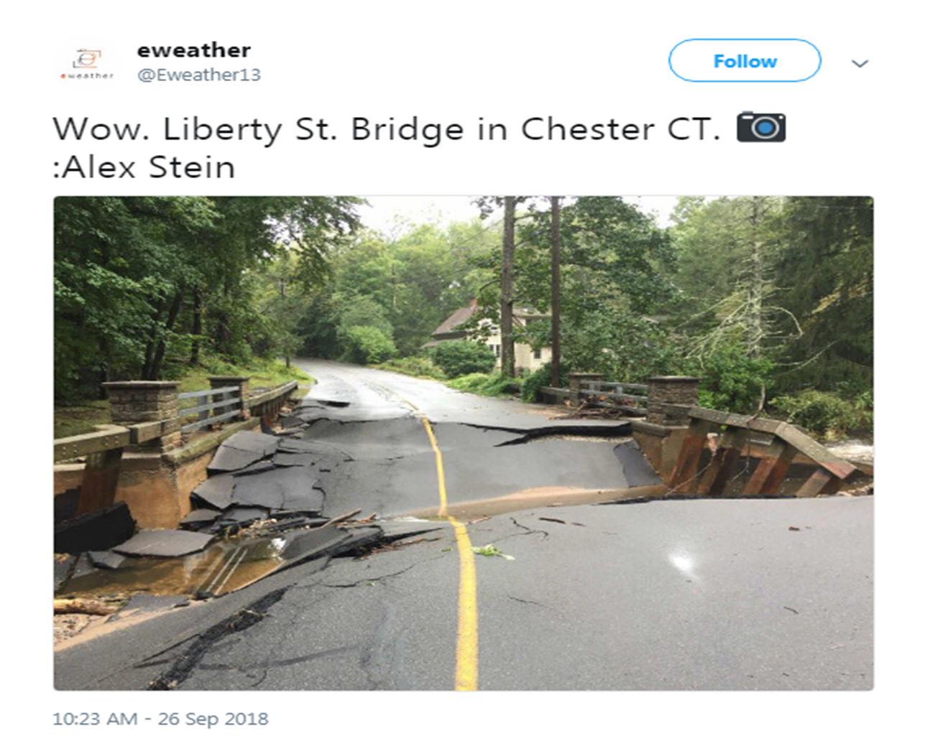
Recent Events
Flood of September 2018
A slow-moving storm system moved through Connecticut which resulted in torrential rainfall from Fairfield to Lebanon.
The event brought between 5 and 9 inches of rainfall in a 3-to-4-hour timeframe.
Courtesy of weather.gov

Slide 4
Recent Events
Summer 2021
TS Elsa – up to 5”
Extratropical Storm Fred – up to 2”
TS Henri – up to 4”
Extratropical Storm Ida – up to 8”

Slide 5
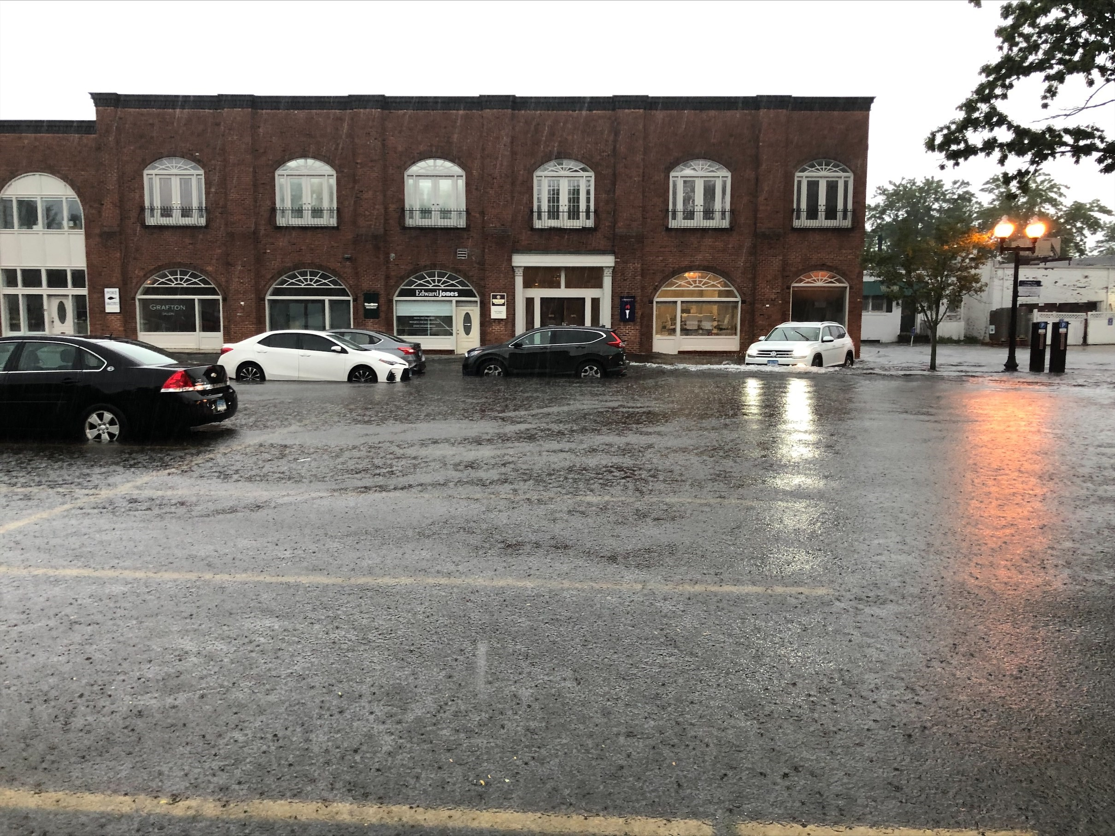
Recent Events
Summer 2021
Storm Fred damage in
West Hartford (my own pics)
TS Henri damage in Manchester (courtesy of the Town)

Slide 6
Recent Events
Summer 2021
Unnamed
Storm caused
road washout
in Ashford
(courtesy of
NBC Connecticut)

Slide 7
Recent Events
September 2022
A late summer storm caused more than 5” of rain in southeastern Connecticut
River flooding of Yantic River
Stormwater flooding in Lisbon (pictured)

Slide 8
Figures for Connecticut
4th National Climate Assessment (2018)
The recent dominant trend in precipitation throughout the Northeast has been towards increases in rainfall intensity, with recent increases in intensity exceeding those in other regions in the contiguous United States.
Further increases in rainfall intensity are expected, with increases in precipitation expected during the winter and spring with little change in the summer.
Monthly precipitation in the Northeast is projected to be about 1 inch greater for December through April by end of century (2070–2100) under the higher [emissions] scenario.
Although future projections of major floods remain ambiguous, more intense precipitation events have increased the risk of some types of inland floods.

Slide 9
Figures for Connecticut
Connecticut State Water Plan (2018)
The Connecticut State Water Plan included a climate change analysis.
Results of a "hybrid delta ensemble" (HDe) analysis were presented in the plan.
Four scenarios were the focus of the analysis: "warm/dry," "warm/wet," "hot/dry," and "hot/wet.“
Precipitation projections are variable although consistently project a wetter future for all four scenarios.
The largest precipitation increases are projected for the wetter months (higher percentiles) including extreme wet months.
The seasonality plots in the plan show that winter and spring precipitation changes are projected to be larger than summer and autumn changes.

Slide 10
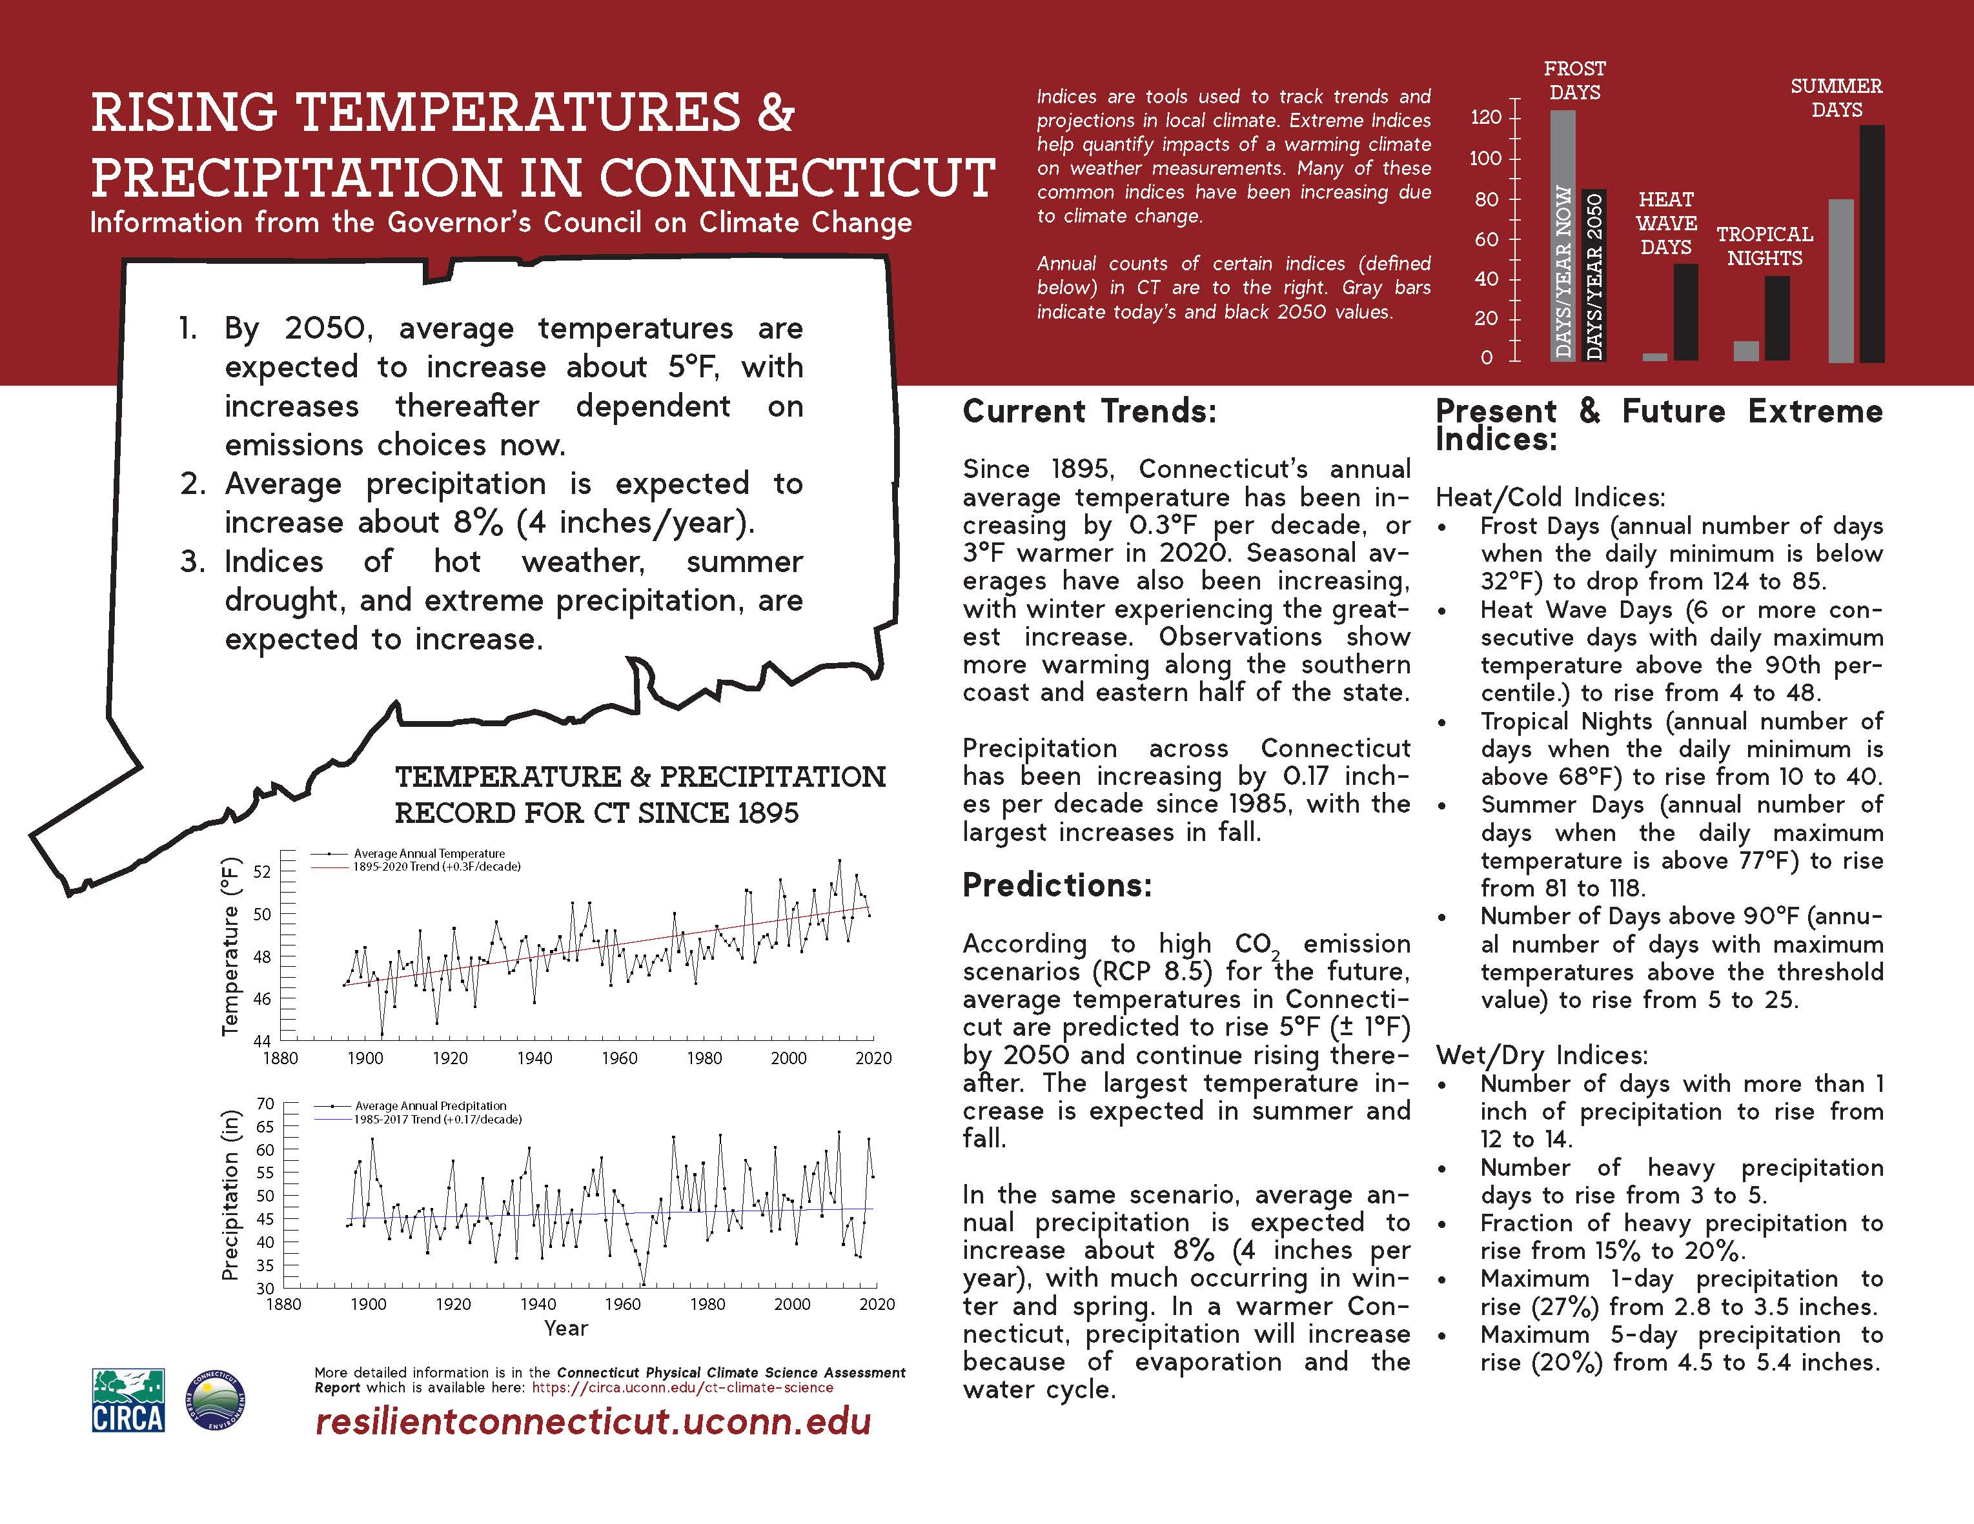
Figures for Connecticut
Connecticut Physical Climate Science Assessment Report (2019)
Highlights
Average annual precipitation expected to increase 8%
Number of days with heavy precipitation to rise from 3 to 5 days
Maximum one-day precipitation to increase

Slide 11
Figures for Connecticut
NOAA Resources: NCEI State Climate Summary (2022)
Annual precipitation has been highly variable, with a slight increase since 1895.
Increases in the frequency and intensity of extreme precipitation events are projected, as are increases in winter and spring precipitation.
Increases in total precipitation and in the number of extreme precipitation events may increase inland flooding risks.

Slide 12
Figures for Connecticut
NOAA Resources: Atlas 14 and Upcoming Atlas 15
With the 2022 Bipartisan Infrastructure Law, OWP received Federal funding to (1) update the NOAA Atlas 14 precipitation frequency standard while accounting for climate change, and (2) develop precipitation frequency estimates for the entire U.S. and its territories.
Volume 1 will account for temporal trends in historical observations
Volume 2 will use future climate model projections to generate adjustment factors for Volume 1

Slide 13
Figures for Connecticut
Example of Application from CIRCA’s Resilient Danbury Study
Storm Event (24-hr duration) | NOAA Atlas 14 Precipitation Depth (in) | Future Precipitation Mid-century CT PCSAR Projections (%) | Future Precipitation Mid-century CT PCSAR Projections (in) | Future Precipitation Late Century CT PCSAR Projections (%) | Future Precipitation Late Century CT PCSAR Projections (in)
1 | 2.89 | 27% | 3.67 | 22% | 3.53
2 | 3.55 | 27% | 4.51 | 22% | 4.33
5 | 4.63 | 27% | 5.88 | 22% | 5.65
10 | 5.53 | 49% | 8.24 | 31% | 7.24
25 | 6.77 | 59% | 10.76 | 36% | 9.21
50 | 7.68 | 76% | 13.52 | 42% | 10.91
100 | 8.68 | 91% | 16.58 | 49% | 12.93
Credit: Fuss & O’Neill for CIRCA

