Slide 1
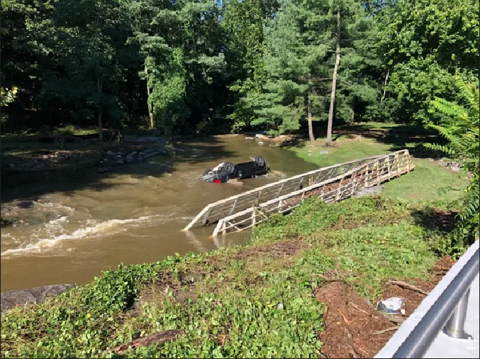
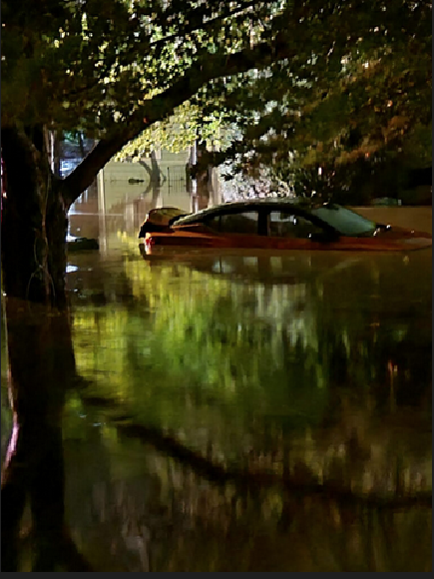
River and Stream Flooding
May 23rd, 2023
John Cristantello
Lead Meteorologist
National Weather Service Forecast Office
New York, NY
National Weather Service
WFO New York, NY
Notes:
Hazardous Weather Event Briefing Template

Slide 2
River and Stream Flooding
Objective
The objective of this presentation is as follows:
To aid our partners in understanding & evaluating
River Flooding Risk
National Weather Service
WFO New York, NY
Notes:
…which involves accessing & interpreting information that’s available to you

Slide 3
River and Stream Flooding
What You Should Know
How to access river related hydrological information
How to access river related meteorological information
How we develop & commmunicate a qualitative risk evaluation in the medium & longer term, and a quantitative risk evaluation in the short & near term
How to access the official NWS river flood forecast(s) and information
National Weather Service
WFO New York, NY
Notes:
Hydrologic: antecedent conditions – River Stage readings, Soil Moisture
Meteorological: Actual or anticipated rain amounts & rain rates
Qualitative: General categories – Low/Medium/High
Quantitative: More specific & higher confidence - based on current observations or our forecasts and warnings

Slide 4
River and Stream Flooding
Evaluating Antecedent Conditions
Preparing for a Potential River / Stream Flood Event
If there’s potential for a (heavy) rain event:
Assess Antecedent Conditions to help determine the flood risk
Ask Yourself:
What is the Hydrologic State of things? …or…
“How much ‘room’ does the river/stream have before it fills & floods?”
This assesment is similar to the way we think about Flash Flood Guidance, which estimates how MUCH rain is needed to approach flood stage.
National Weather Service
WFO New York, NY
Notes:
So if there’s potential for a (heavy) rain event…

Slide 5
River and Stream Flooding
Evaluating Antecedent Conditions
Preparing for a Potential River / Stream Flood Event - cont.
Things to consider (e.g. relatively wet period preceding the event):
River Stages: Are we elevated to begin with (preceding an approaching storm?)
Baseflow Chances : Are the water tables elevated ?
Soil Moisture : For when we get closer in, is this elevated? >= 50%
Runoff : How quickly do we get to this ? - Resultant streamflow ?
National Weather Service
WFO New York, NY
Notes:
Already elevated River Stages & a higher risk of Baseflow
Soil Moisture 50-60%= conditions become more prone to flooding→increases the chances of runoff

Slide 6
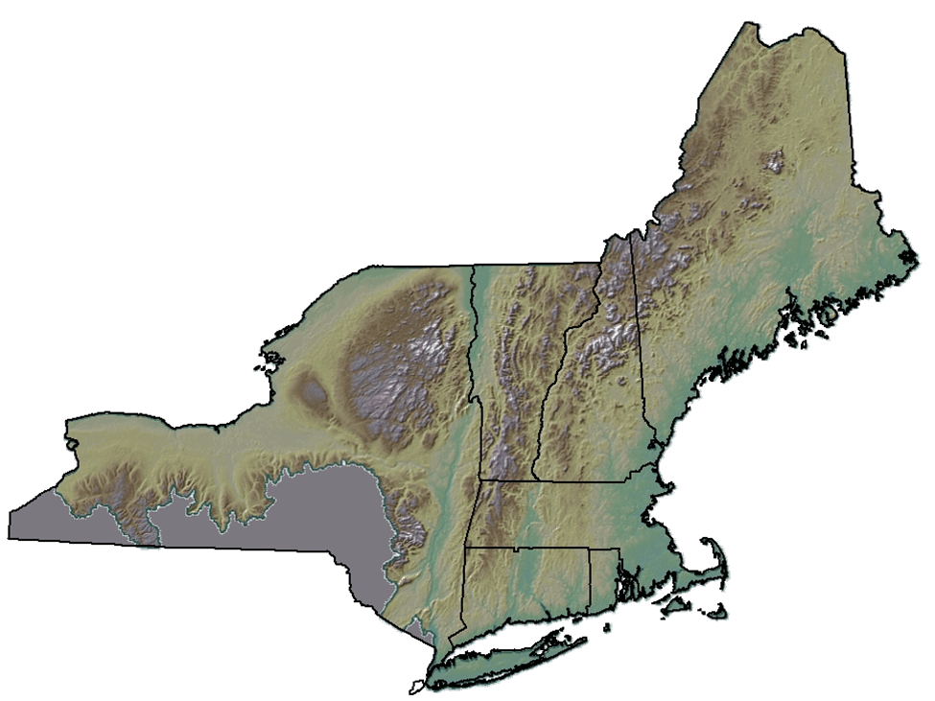
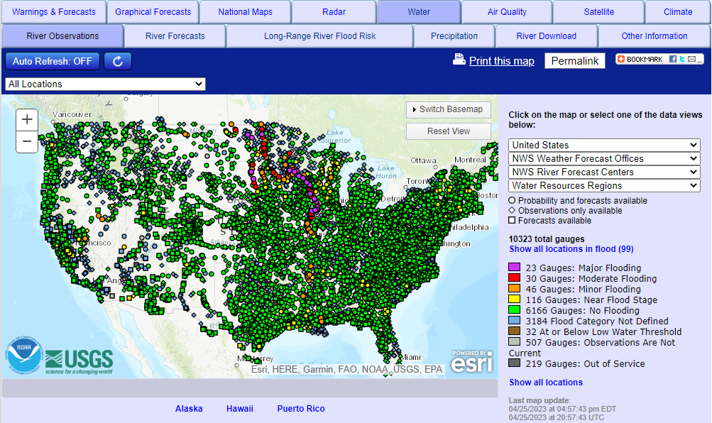
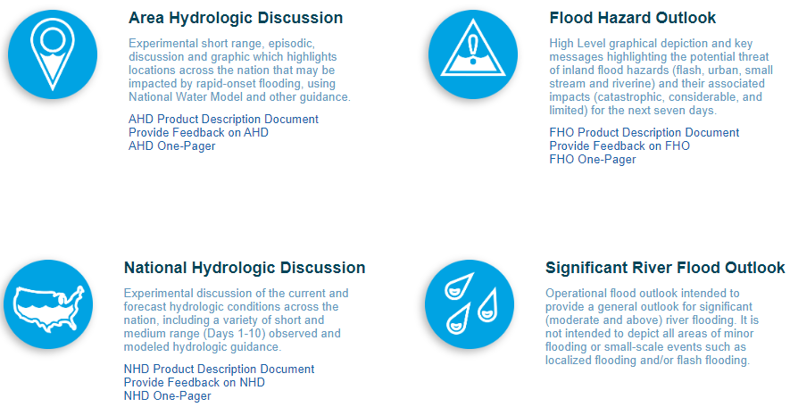
River and Stream Flooding
Evaluating Antecedent Conditions
Sources of Information
(National/Regional Centers):
Northeast River Forecast Center (NERFC)
Advanced Hydrologic Prediction Service (AHPS)
National Water Center (NWC)
We will close out the presentation with a “more local” WFO product perspective.
This is when the final answer / best guess is delivered from combining the hydrology and meteorology to deliver watch / warning and other WFO products.
National Weather Service
WFO New York, NY
Notes:
NERFC: Their expertise is in assessing the antecedent conditions (soil moisture/anticipated snow melt) and estimating how much rainfall it would take to cause flooding.
AHPS: Web-based source of river-related observations and forecasts.
National Water Center: newer/emerging national center that I’ll talk about a little later on
Later on we’ll take a look at some of the products that OUR office has avaialable to you based on our synthesis of all of this information from the National and Regional centers.

Slide 7
River and Stream Flooding
Evaluating Antecedent Conditions
Northeast River Forecast Center (NERFC)
River Forecast Points in Southern CT
(routine river stage forecasts issued by NERFC)
WFO New York
Yantic River / Yantic (YTCC3)
Quinebaug River / Jewett City (JCYC3)
Naugatuck River / Beacon Falls (BEAC3)
WFO Albany
Housatonic River - Stevenson (STVC3)
WFO Boston
Connecticut River - Middle Haddam (MHDC3)
National Weather Service
WFO New York, NY
Notes:
NERFC routinely issues river stage forecasts for these points.
If a River Flood Warning is issued, it will be issued by one of 3 Weather Forecast Offices

Slide 8
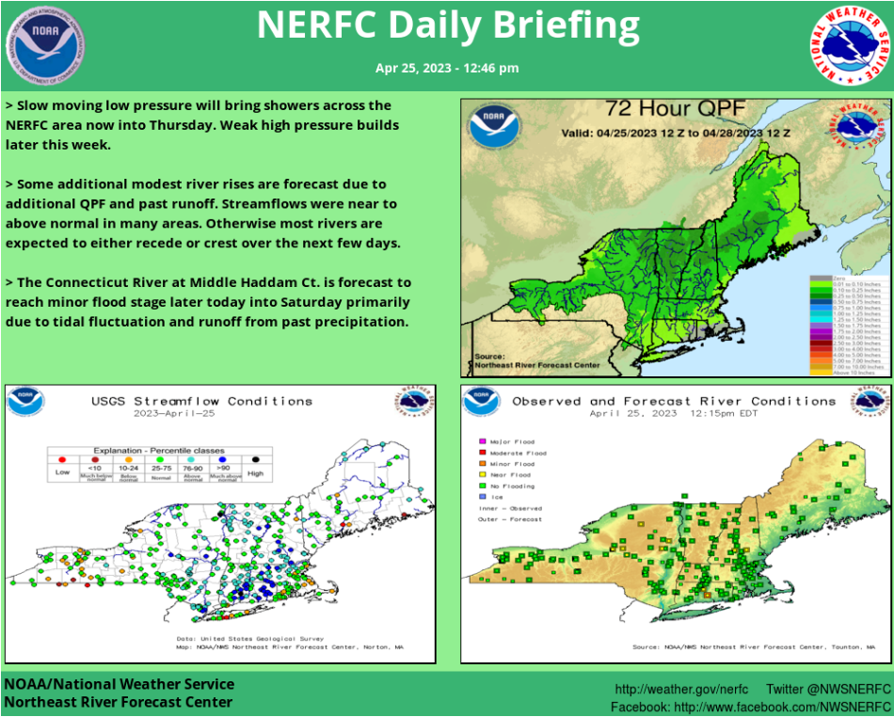
River and Stream Flooding
Evaluating Antecedent Conditions
Northeast River Forecast Center (NERFC)
Various outlooks and graphical information available.
National Weather Service
WFO New York, NY
Notes:
Issued around noon every day

Slide 9
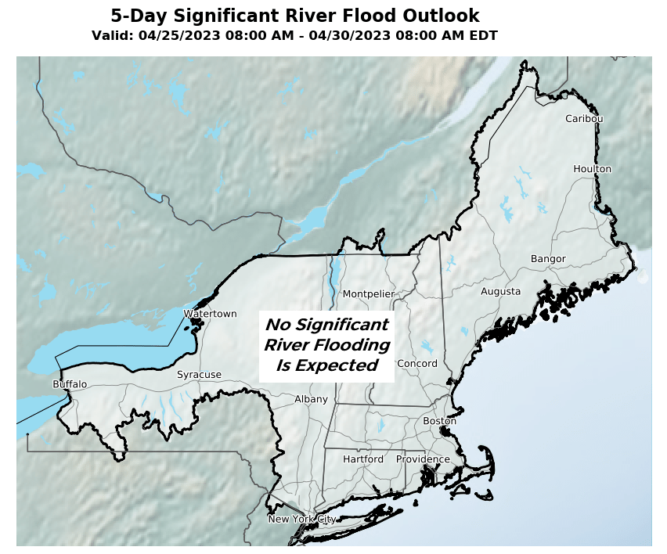
River and Stream Flooding
Evaluating Antecedent Conditions
Northeast River Forecast Center (NERFC)
Various outlooks and graphical information available.
National Weather Service
WFO New York, NY
Notes:
5-Day significant River Flood Outlook
Risk categories are color coded

Slide 10
River and Stream Flooding
Evaluating Antecedent Conditions
Advanced Hydrologic Prediction Service (AHPS)
Interactive map
Select Precipitation tab to get past / recent rainfall
National Weather Service
WFO New York, NY
Notes:
Zoomable, but if you go to our website you can get a link that’s already zoomed-in on the Tri-State Area…

Slide 11
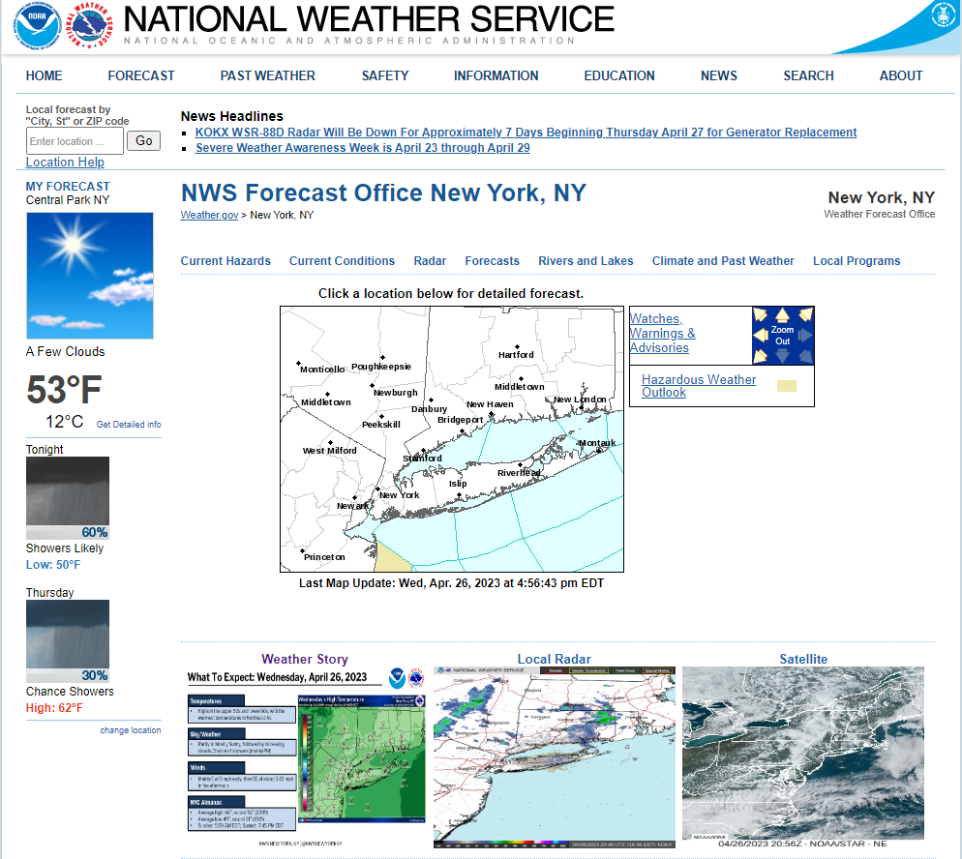
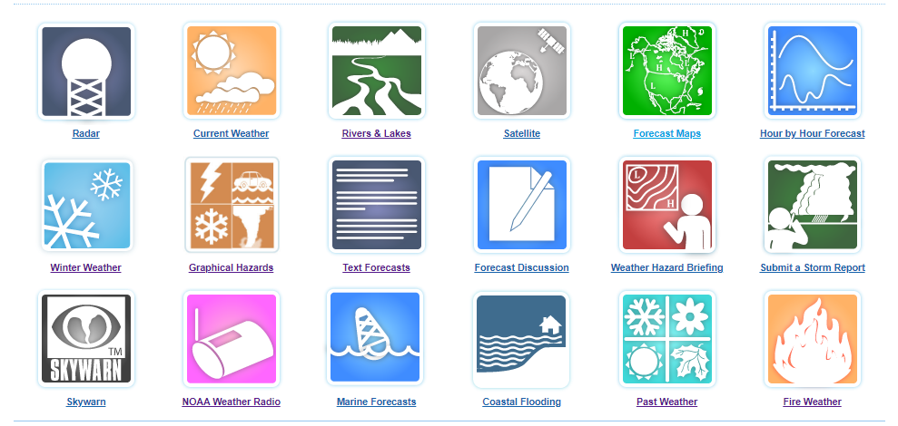
River and Stream Flooding
Evaluating Antecedent Conditions
WFO - New York, NY
Scroll down webpage (weather.gov/nyc)
Select Rivers & Lakes tile to access AHPS and gauges !
National Weather Service
WFO New York, NY

Slide 12
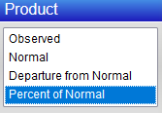
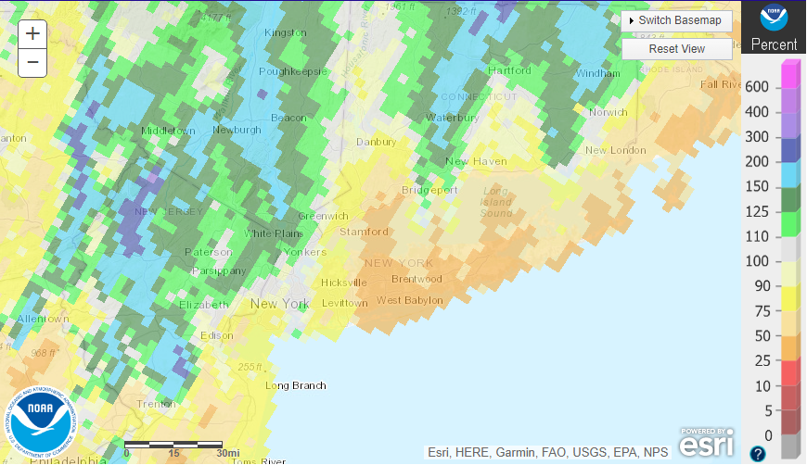
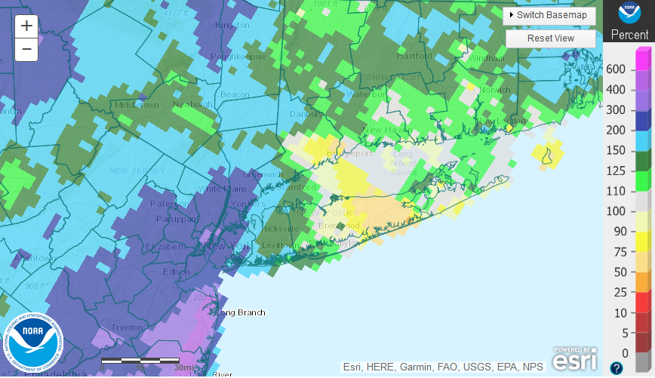
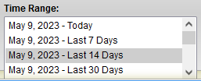
River and Stream Flooding
Evaluating Antecedent Conditions
Advanced Hydrologic Prediction Service (AHPS)
Interactive map:
- This example shows the total amount of preciptation over the past 14 days, relative to normal.
National Weather Service
WFO New York, NY
Notes:
1.5 to 3.0 inches of rain had fallen right at the end of April into the beginning of this month.

Slide 13
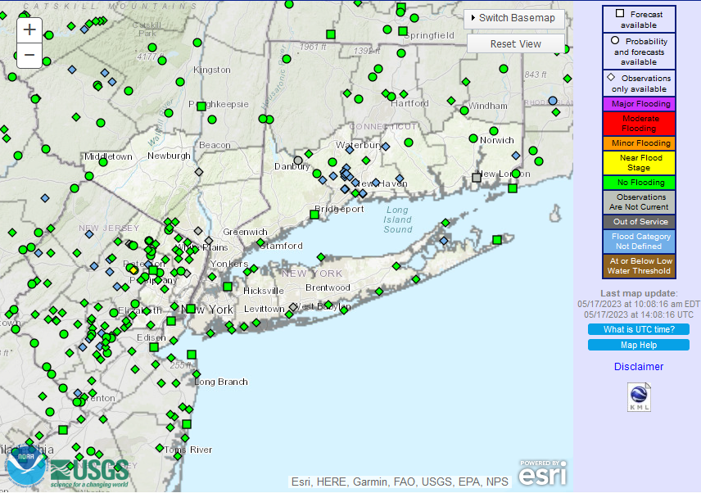
River and Stream Flooding
Evaluating Antecedent Conditions
Advanced Hydrologic Prediction Service (AHPS)
Click on a gauge for a hydrograph
Quick snapshot of observed/forecast river stages
Color coded categories
National Weather Service
WFO New York, NY
Notes:
Default View from when you click on our link
Quick snapshot of observed + forecast river stages
Color coded

Slide 14
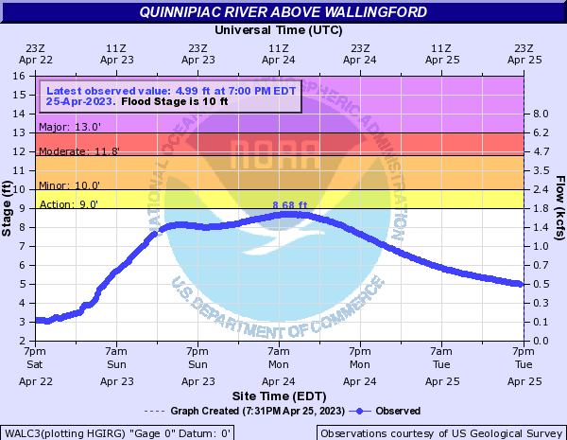
River and Stream Flooding
Evaluating Antecedent Conditions
Advanced Hydrologic Prediction Service (AHPS)
- Quinnipiac River above Wallingford was just below “Action” stage at 7am on Monday, April 24th after a
~ 2 inch rain event
- Values then gradually fell well below action stage.
- In spite of 2 inches of rain, no flooding occurred thanks to an extended relatively dry period that preceded it.
National Weather Service
WFO New York, NY

Slide 15
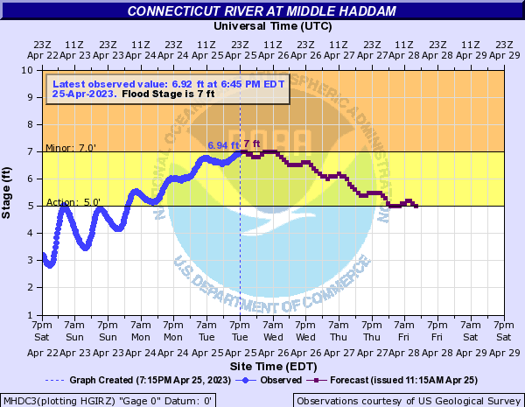
River and Stream Flooding
Evaluating Antecedent Conditions
Advanced Hydrologic Prediction Service (AHPS)
Forecast portion
of hydrograph
- Forecast point (purple line)
- CT River at Middle Haddam touched minor flood stage at 7pm on Tuesday, April 25th after a ~ 2 inch rain event
- Slower response time, being a longer stem river
-Tidal forcing helped push the stage to the threshold of minor flooding
This particular site experiences TIDAL FORCING,
Notice in this example the embedded tidal cycle !
National Weather Service
WFO New York, NY
Notes:
Hydrograph of a FORECAST POINT – (purple line)
Longer stem river, had a slower response than the Quinnipiac – took at least a day and a half longer to crest.

Slide 16
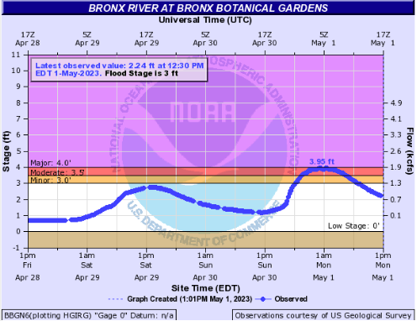
River and Stream Flooding
Evaluating Antecedent Conditions
Advanced Hydrologic Prediction Service (AHPS)
April 29th- May 1st event
- Example of a “flashy” river.
- 2 peaks from the 2 periods of rain – faster response time.
- More difficult to forecast. Guidance from the National Water Center will eventually help more with forecasting the levels & impacts with smaller rivers and streams.
1st Peak
2nd Peak
National Weather Service
WFO New York, NY
Notes:
An example of something more typical of a “flashier” river

Slide 17
River and Stream Flooding
Evaluating the Antecedent Conditions
-
National Water Center (NWC)
A new “emerging” national center
The establishment of the NWC to meet the nation’s water resources challenges due to extreme floods & extreme droughts, and to ensure optimal use of our increasingly limited water supply in the face of competing demands
Uses the National Water Model (NWM) / version 3.0 later this year
Expand the focus to include guidance for smaller rivers & streams (work in progress)
National Weather Service
WFO New York, NY
Notes:
Their plan is to expand the focus

Slide 18
River and Stream Flooding
Evaluating the Hydrologic and Meteorological Conditions
National Water Center (NWC)
-
Operational & Experimental Products
Interactive map with multiple guidance type selections
National Weather Service
WFO New York, NY
Notes:
NWC visualization services – interactive map where you can select from different types of guidance

Slide 19
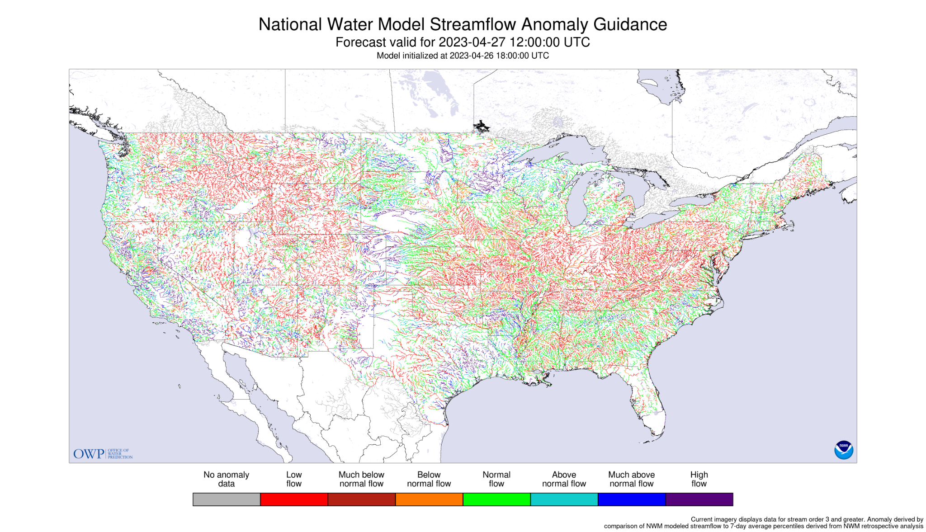
River and Stream Flooding
Evaluating the Hydrologic and Meteorological Conditions
National Water Center (NWC) products via Map Viewer
NWC Visualization Services
Includes Experimental Products:
Streamflow Anomaly Guidance
Also:
- High Flow Magnitude
- High Water Arrival Time
- High Water Probability
- Rapid Onset Flooding
National Weather Service
WFO New York, NY
Notes:
Forecast for the next day.
Color density → accounts for smaller rivers & streams

Slide 20
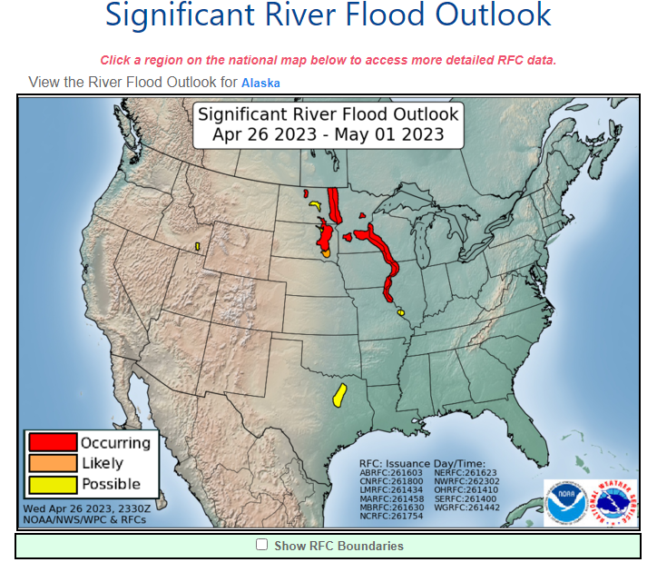
River and Stream Flooding
Evaluating the Antecedent Conditions
National Water Center (NWC)
-
Significant River Flood Outlook
A General Outlook for significant river flooding covering the current day + next 5 days
Note: Not intended to depict all areas of minor or small-scale events
Go to the River Forecast Center for areas of minor flooding or small-scale events
National Weather Service
WFO New York, NY
Notes:
Here’s an example of one of their outlooks

Slide 21
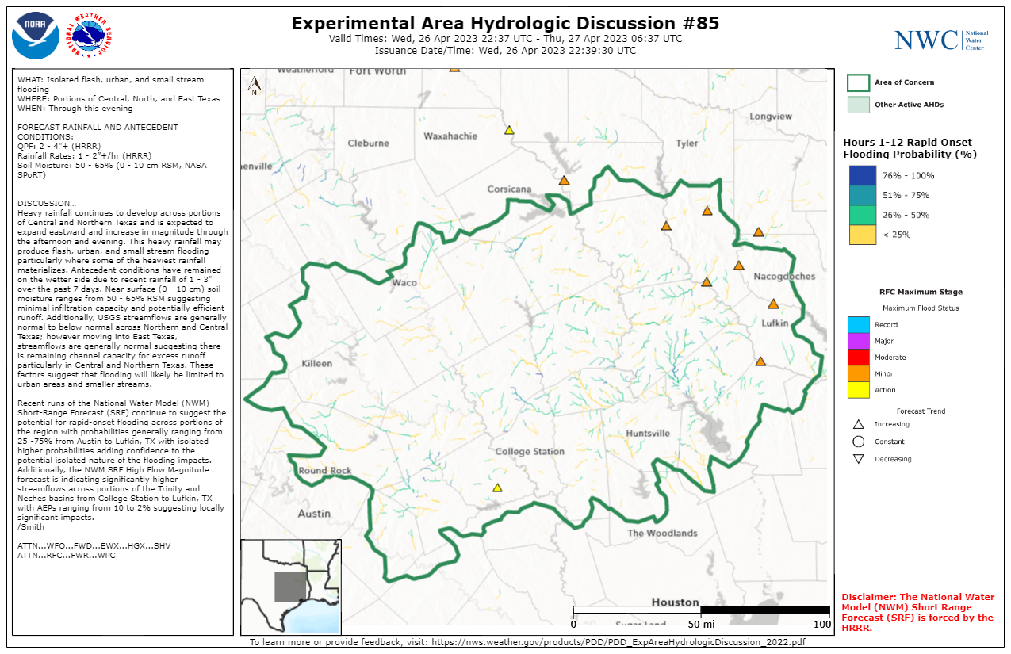
River and Stream Flooding
Evaluating the Hydrologic and Meteorological Conditions
National Water Center (NWC)
-
Experimental Hydrologic Discussion
A new experimental product
Gives forecasters a heads-up regarding high risk areas on a more regional scale.
It utilizes the NWM (National Water Model), taking into account antecedent conditions.
Provides additional input / perspective from a National Center going forward.
National Weather Service
WFO New York, NY
Notes:
Here’s an example of one of their discussions.
Anticipated rainfall + rainfall rates
Soil moisture
Current streamflow
Gives us the NWC’s meteorologists’ interpretation of the National Water Model guidance and how it’s currently performing

Slide 22
River and Stream Flooding
Evaluating the Hydrology with the Meteorology
Northeast River Forecast Center (NERFC)
Ensemble Forecast Systems
Multi-Model Ensemble Forecast System (MMEFS)
4-10 day outlook expressed in probabilistic terms
Helps account for uncertainty by showing the range of possible river levels
Based on 60 computer-generated rainfall forecasts
(Official day 1-3 forecast based on 1 human-generated rainfall forecast)
National Weather Service
WFO New York, NY

Slide 23
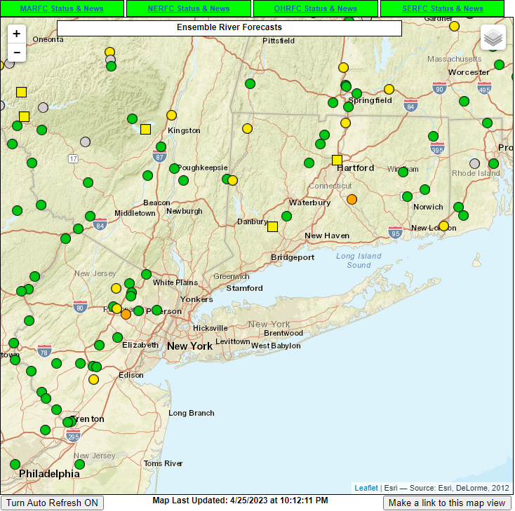
River and Stream Flooding
Evaluating the Hydrology with the Meteorology
Northeast River Forecast Center (NERFC)
Looking Ahead - cont.
Click for a forecast graph
MMEFS Website
http://www.weather.gov/erh/mmefs
Quick view of all of the river forecast points
Uses same color coding as AHPS
Circles are 30% probability of exceedance
Squares are 70% probability of exceedance
National Weather Service
WFO New York, NY
Notes:
Quick view of all of the river forecast points showing the MMEFS forecast
Clicking on one of these points brings you to a graph showing you the range of possible outcomes

Slide 24
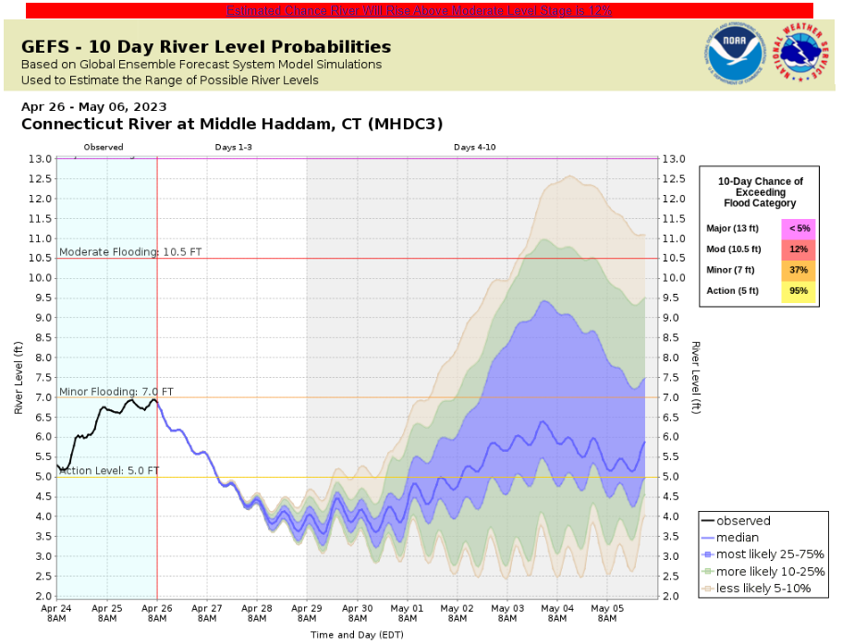
River and Stream Flooding
Evaluating the Hydrology with the Meteorology
Northeast River Forecast Center - MMEFS - Expressing a “RANGE OF POSSIBLE OUTCOMES”
National Weather Service
WFO New York, NY
Notes:
Solid blue line is the median or the 50th percentile: half of the outcomes were higher than the blue line and half were below
Shaded blue area is the area where the eventual river stage readings will most likely end up.
Green areas are less likely
Beige areas are the least likely

Slide 25
River and Stream Flooding
Evaluating the Meteorology
Going from Qualitative to Quantitative in Terms of Risk
We do this as the confidence for the signal in a “heavy rainfall event” increases (i.e. somewhere in our area)
We can do this as the confidence increases in the signal for a “heavy rainfall event” somewhere in our area (e.g. several models showing something similar)
Keep in mind there will most often be uncertainty in magnitude and coverage / duration / localization. Where exactly does the heaviest rain occur, and for how long?
Especially within hours of the event - incorporate state-of-the-art computer forecast guidance (higher spatial & temporal resolution)
National Weather Service
WFO New York, NY
Notes:
Especially when we’re within hours of the event

Slide 26
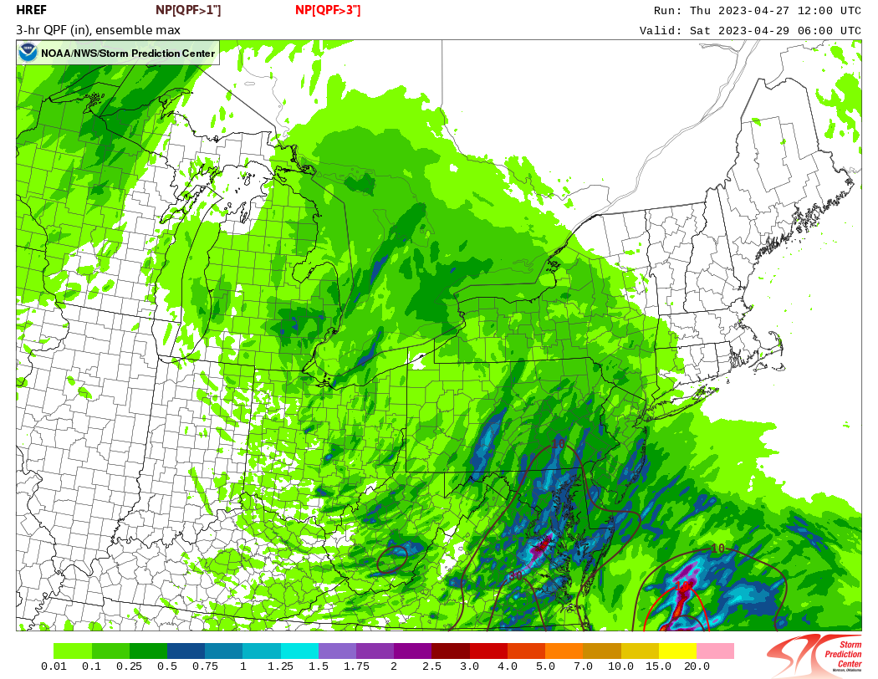
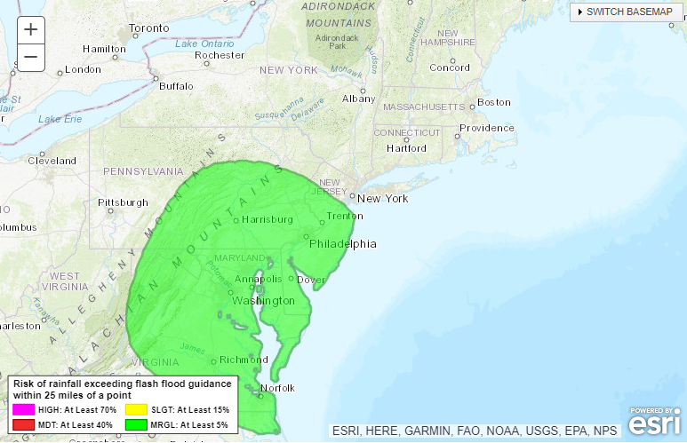
River and Stream Flooding
Evaluating the Meteorology
Going from Qualitative to Quantitative - Where to Look
Storm Prediction Center (SPC) - Forecast tools with more precision
Weather Prediction Center (WPC) - Excessive Rainfall Outlook (ERO)
PROBABILITY OF 1” IN 3 HRS.
MARGINAL RISK just to our Southwest.
National Weather Service
WFO New York, NY
Notes:
HREF →ensemble type of guidance→attempts to predict finer details
WPC ERO→days 1-5
Mesoscale Precipitation Discussion→next 6 hours
Both products will often mention current & forecast rainfall rates & the implication on flooding potential.

Slide 27
River and Stream Flooding
Evaluating the Hydrology with the Meteorology - FINAL WFO PRODUCTS
Weather Forecast Office (WFO) Products
Area Forecast Discussion (AFD)
Sections where flood-related discussion may be found:
Near Term Discussion:Typically within the next 12 hours
Short Term Discussion:Typically within the next 12-36 hours
Hydrology Section: Consider this “insider” information, essentially our thought process going into the official forecast.
National Weather Service
WFO New York, NY
Notes:
Synthesizing National/Regional Center guidance with our own analysis of obs & guidance
All 3 sections may mention forecast rainfall amounts & flooding potential
Hydrology section typically goes into more detail.

Slide 28
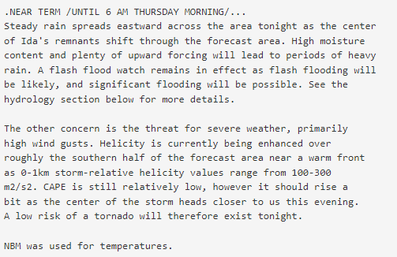
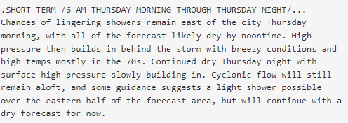
River and Stream Flooding
Evaluating the Hydrology with the Meteorology - FINAL WFO PRODUCTS
Example of AFD WFO Components - Example(s) here from Tropical Storm Ida
NEAR TERM SECTION
SHORT TERM SECTION
National Weather Service
WFO New York, NY
Notes:
Hydro Section:
rain amounts
timing & location of the heaviest rainfall,
anticipated flooding magnitude & its associated impacts.

Slide 29
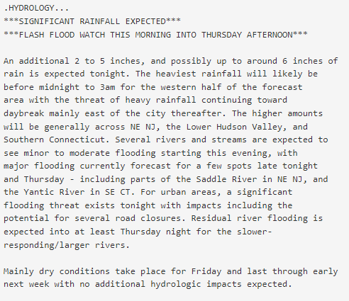
River and Stream Flooding
Evaluating the Hydrology with the Meteorology - FINAL WFO PRODUCTS
Example of AFD WFO Components - Example(s) here from Tropical Storm Ida
HYDROLOGY SECTION
Rain amounts
Timing & location of heaviest rainfall
Anticipated flooding magnitude & its associated impacts
National Weather Service
WFO New York, NY
Notes:
Hydro Section:
rain amounts
timing & location of the heaviest rainfall,
anticipated flooding magnitude & its associated impacts.

Slide 30
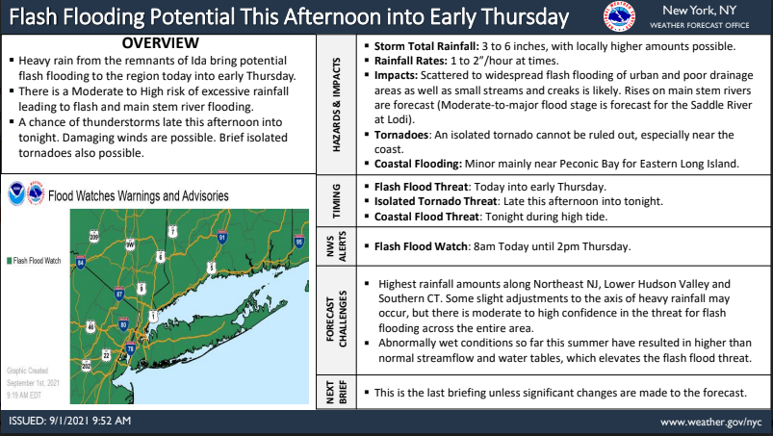
River and Stream Flooding
Evaluating the Hydrology with the Meteorology - FINAL WFO PRODUCTS
Example of Briefing - Example(s) here from Tropical Storm Ida
National Weather Service
WFO New York, NY
Notes:
Especially if a Flood Watch is issued→emailed briefings (also on our website)→has all of the details
Detail on the impacts
Discussion on where uncertainty may lie and the overall level of forecast confidence.

Slide 31
River and Stream Flooding
Evaluating the Hydrology with the Meteorology - FINAL WFO PRODUCTS
Example of Briefing cont. - Example(s) here from Tropical Storm Ida
National Weather Service
WFO New York, NY
Notes:
Also included in the briefing
Snapshot image from an RFC webpage
Text summary of the flooding forecast

Slide 32
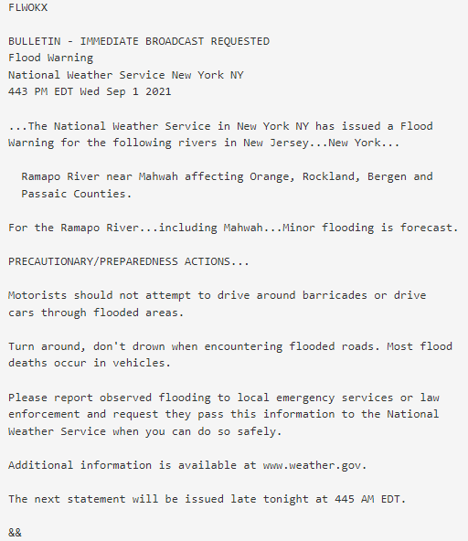
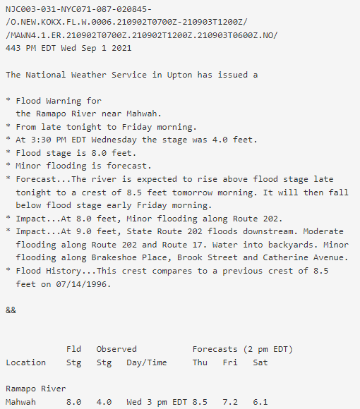
River and Stream Flooding
Evaluating the Hydrology with the Meteorology - FINAL WFO PRODUCTS
Example of River Flood WARNING - Example(s) here from Tropical Storm Ida
National Weather Service
WFO New York, NY
Notes:
Right side:
Current stage
Forecast stage
Impacts for a given stage

Slide 33
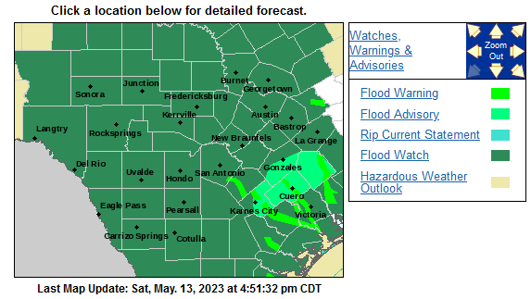
River and Stream Flooding
Evaluating the Hydrology with the Meteorology - FINAL WFO PRODUCTS
WFO - New York, NY
Scroll down webpage (weather.gov/nyc)
Select Text Forecasts tile to access flooding-related text products and Forecast Discussion
National Weather Service
WFO New York, NY
Notes:
Where you can find text products on our website

Slide 34
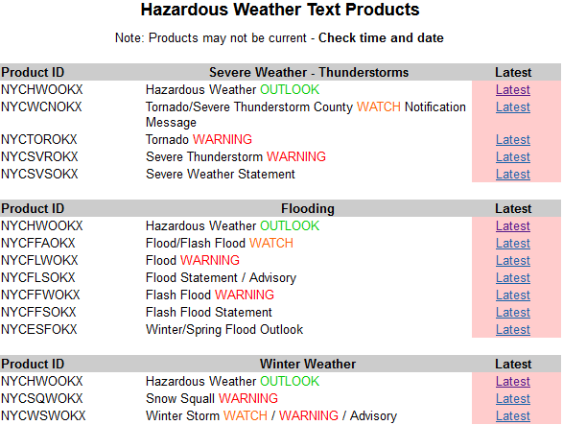
River and Stream Flooding
Evaluating the Hydrology with the Meteorology - FINAL WFO PRODUCTS
WFO - New York, NY
Scroll down webpage (weather.gov/nyc)
Select Text Forecasts tile to access flooding-related text products
National Weather Service
WFO New York, NY
Notes:
Flood section with all of the flood-related products

Slide 35
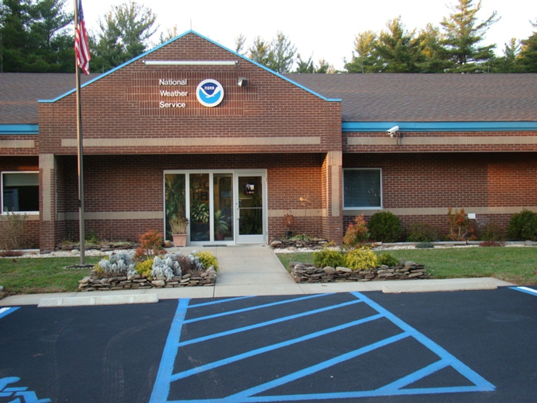
River and Stream Flooding
How to Reach Us - Email : okx.operations@noaa.gov EM Line : 631-924-0383
National Weather Service Forecast Office
New York, NY
Additional Information and Resources:
Stay alert, by monitoring NWS New York, NY forecasts, NOAA weather radio, television and radio news, cable and satellite weather programming, and commercial services, as well as the following NWS resources...
NWS New York Website
NWS New York Winter DSS Website
NWS New York Probabilistic Winter Wx Forecasts
NWS New York Coastal Flood Website
River Gauges and Forecasts
NWS New York Facebook
NWS New York Twitter
Online Severe Weather Reporting
National Weather Service
WFO New York, NY

