Slide 1
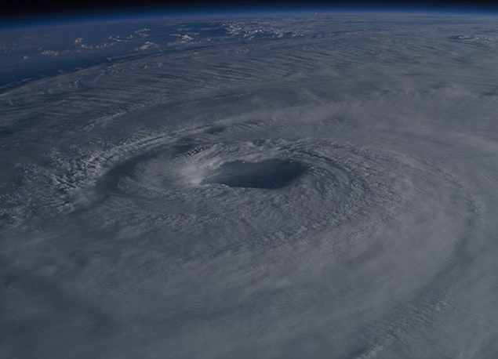
Department of Emergency Services and Public Protection
Division of Emergency Management and Homeland Security
James C. Rovella
Commissioner
Brenda M. Bergeron
Deputy Commissioner
2023 HURRICANE SEASON
Below Normal Year Expected ???
Douglas W. Glowacki & Josh Cingranelli
Emergency Management Program Specialists
Division of Emergency Management
and Homeland Security
Silver Jackets Flood Awareness Workshop May 4, 2023 William H. Turner III, Director

Slide 2
2023 HURRICANE FORECAST
Why is a Below Normal Season Expected
Current neutral ENSO conditions look fairly likely to transition to El Niño this summer/fall. However, there is considerable uncertainty as to how strong an El Niño would be, if it does develop. Sea surface temperatures in the eastern and central Atlantic are much warmer than normal, so if a robust El Niño does not develop, the potential still exists for a busy Atlantic hurricane season. Larger-than-normal uncertainty exists with this outlook. We anticipate a near-average probability for major hurricanes making landfall along the continental United States coastline and in the Caribbean. As is the case with all hurricane seasons, coastal residents are reminded that it only takes one hurricane making landfall to make it an active season for them. They should prepare the same for every season, regardless of how much activity is predicted.
Department of Emergency Services and Public Protection
Division of Emergency Management and Homeland Security
Silver Jackets Flood Awareness Workshop May 4, 2023 William H. Turner III, Director

Slide 3
2023 HURRICANE FORECAST
HURRICANE RETURN PERIODS IN CONNECTICUT
(Not Including Hybrid Storms Such as Sandy)
CATEGORY WINDS RETURN LAST
PERIOD OCCURRED OVERDUE
◆ CAT. I 74-95 MPH 18 Years 1985 20 years Overdue
◆ CAT. II 96-110 MPH 40 Years 1985 In 2 Years
◆ CAT. III 111-130 MPH 70 Years 1954 In 1 Year
◆ CAT. IV 131-155 MPH 155 Years < 1851 17 Years Overdue
◆ CAT. V > 155 MPH 400 Years < 1851 In 238 Years
Department of Emergency Services and Public Protection
Division of Emergency Management and Homeland Security
Silver Jackets Flood Awareness Workshop May 4, 2023 William H. Turner III, Director

Slide 4
2023 HURRICANE FORECAST
NAMES FOR THE 2023 HURRICANE SEASON
Arlene Harold Ophelia Bret Idalia Phillippe Cindy Jose Rina Don Katia Sean Emily Lee Tammy Franklin Margot Vince Gert Nigel Whitney
Department of Emergency Services and Public Protection
Division of Emergency Management and Homeland Security
Silver Jackets Flood Awareness Workshop May 4, 2023 William H. Turner III, Director

Slide 5
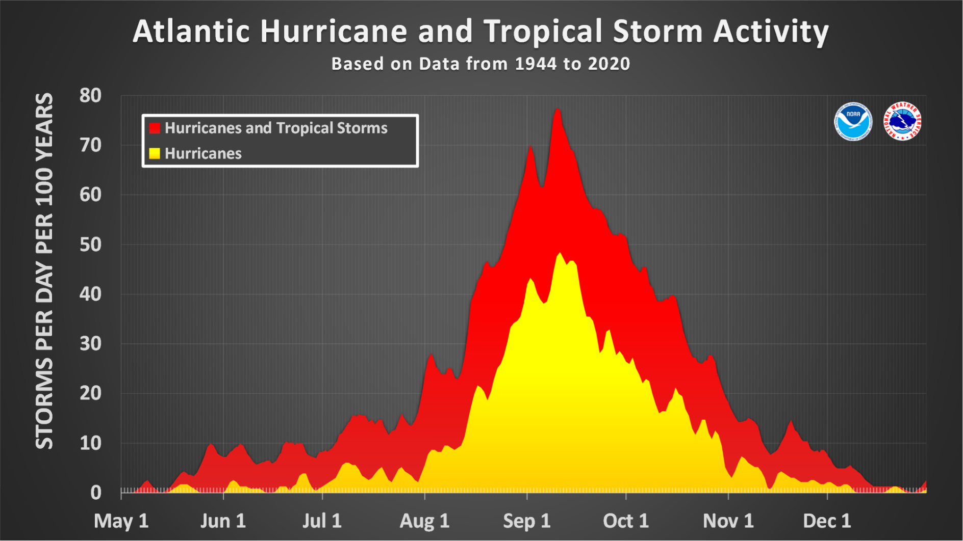
2023 HURRICANE FORECAST
This graph shows the number of storms that have occurred during an 86-year period.
Department of Emergency Services and Public Protection
Division of Emergency Management and Homeland Security
Silver Jackets Flood Awareness Workshop May 4, 2023 William H. Turner III, Director

Slide 6
2023 HURRICANE FORECAST
Progress of the average Atlantic season (1991-2020). Date upon which the following number of events would normally have occurred.
Number | Named systems | Hurricanes | Major Hurricanes
1 | Jun 20 | Aug 11 | Sep 1
2 | Jul 17 | Aug 26 | Sep 19
3 | Aug 3 | Sep 7 | Oct 28
4 | Aug 15 | Sep 16 | -
5 | Aug 22 | Sep 28 | -
6 | Aug 29 | Oct 15 | -
7 | Sep 3 | Nov 15 | -
8 | Sep 9 | - | -
9 | Sep 16 | - | -
10 | Sep 22 | - | -
11 | Oct 2 | - | -
12 | Oct 11 | - | -
13 | Oct 25 | - | -
14 | Nov 19 | - | -
Department of Emergency Services and Public Protection
Division of Emergency Management and Homeland Security
Silver Jackets Flood Awareness Workshop May 4, 2023 William H. Turner III, Director

Slide 7
2023 HURRICANE FORECAST
Colorado State University Hurricane Forecast Accuracy
Colorado State University (CSU) has a pretty good track record for forecasting annual hurricane activity in the Atlantic Ocean. The graph to the right shows the Accumulated Cyclone Energy (ACE) forecast as a red line and the actual ACE as a blue line. Since 2011 most of the CSU forecasts were very accurate. Last year however, there was an un-expected sudden drop in ACE.
Department of Emergency Services and Public Protection
Division of Emergency Management and Homeland Security
Silver Jackets Flood Awareness Workshop May 4, 2023 William H. Turner III, Director

Slide 8
2023 HURRICANE FORECAST
Tonga Still a Wild Card
The eruption of Tonga may have influenced our winter weather. Temperatures in Connecticut averaged nearly 5 F above normal from December to February. Forbes reports that the epic volcanic eruption in the Pacific in mid January last year is likely to keep causing havoc for the planet. The Tonga undersea volcano unleashed staggering power, the equivalent of up to 18 mega tons of TNT, according to experts at NASA.
Department of Emergency Services and Public Protection
Division of Emergency Management and Homeland Security
Silver Jackets Flood Awareness Workshop May 4, 2023 William H. Turner III, Director

Slide 9
2023 HURRICANE FORECAST
Hot Summer Potential
The problem is that the blast emitted 50 million metric tons of water vapor into the atmosphere, an increase of about 5%. In turn, that’s likely to mess with the climate. We can expect hot weather extremes this summer in the northern hemisphere as water vapor traps heat from escaping. Tonga will be impacting our climate for another few years before the water vapor dissipates.
Once the vapor dissipates, the stored up heat in the atmosphere and oceans could result in above normal hurricane and severe weather activity later this decade.
Department of Emergency Services and Public Protection
Division of Emergency Management and Homeland Security
Silver Jackets Flood Awareness Workshop May 4, 2023 William H. Turner III, Director

Slide 10
2023 HURRICANE FORECAST
COLORADO STATE UNIVERSITY
JUNE 1ST - NOVEMBER 30TH
Updated on April 13, 2023
CATEGORY # OF STORMS NORMAL % of Normal
NAMED STORMS 13 14.4 90%
HURRICANES 6 7.2 83%
INTENSE HURRICANES* 2 3.2 64%
ACCUMULATED CYCLONE ENERGY 100% 123% 81%
MAJOR HURRICANE STRIKE PROBABILITIES
EAST COAST 22% 21% Florida to Maine
GULF COAST 28% 27% Texas to Florida
* Category III and Above
Department of Emergency Services and Public Protection
Division of Emergency Management and Homeland Security
Silver Jackets Flood Awareness Workshop May 4, 2023 William H. Turner III, Director

Slide 11
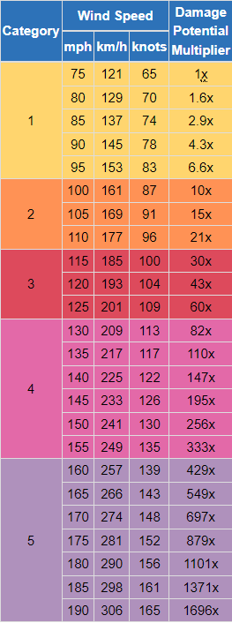
2023 HURRICANE FORECAST
Looking at hurricane wind damage by category
WIND MULTIPLIER
Damage exponentially increases as the wind increases.
The wind damage is 10 times worse for a Category 2 hurricane compared to Category 1.
CONNECTICUT HAS A LOT OF TREES
Highest urban tree cover in the nation.
10 million trees within 50ft of a roadway in CT.
Department of Emergency Services and Public Protection
Division of Emergency Management and Homeland Security
Silver Jackets Flood Awareness Workshop May 4, 2023 William H. Turner III, Director

Slide 12
2023 HURRICANE FORECAST
What would a landfalling hurricane do?
CATEGORY 1 HURRICANE
20 PERCENT TREE LOSS
(Irene took out 1 to 2 percent of trees)
727,000 POWER OUTAGE REPORTS
101 ROADS CLOSED DUE TO FALLEN TREES AND POWER LINES.
RECOVERY OF 1 TO 2 WEEKS.
CATEGORY 2 HURRICANE
40 PERCENT TREE LOSS
CATEGORY 3 HURRICANE
50 PERCENT TREE LOSS
40,000 MILES OF DOWNED POWER LINES
RECOVERY OF A MONTH(S)
Carol in 1954 and the Hurricane of 1938 were Category 3 strength.
Department of Emergency Services and Public Protection
Division of Emergency Management and Homeland Security
Silver Jackets Flood Awareness Workshop May 4, 2023 William H. Turner III, Director

Slide 13
Department of Emergency Services and Public Protection
Division of Emergency Management and Homeland Security
James C. Rovella
Commissioner
Brenda M. Bergeron
Deputy Commissioner
1938 Was Also a Below Normal Season !!!
PLEASE REMEMBER IT ONLY TAKES ONE !!!
Silver Jackets Flood Awareness Workshop May 4, 2023 William H. Turner III, Director

