Slide 1
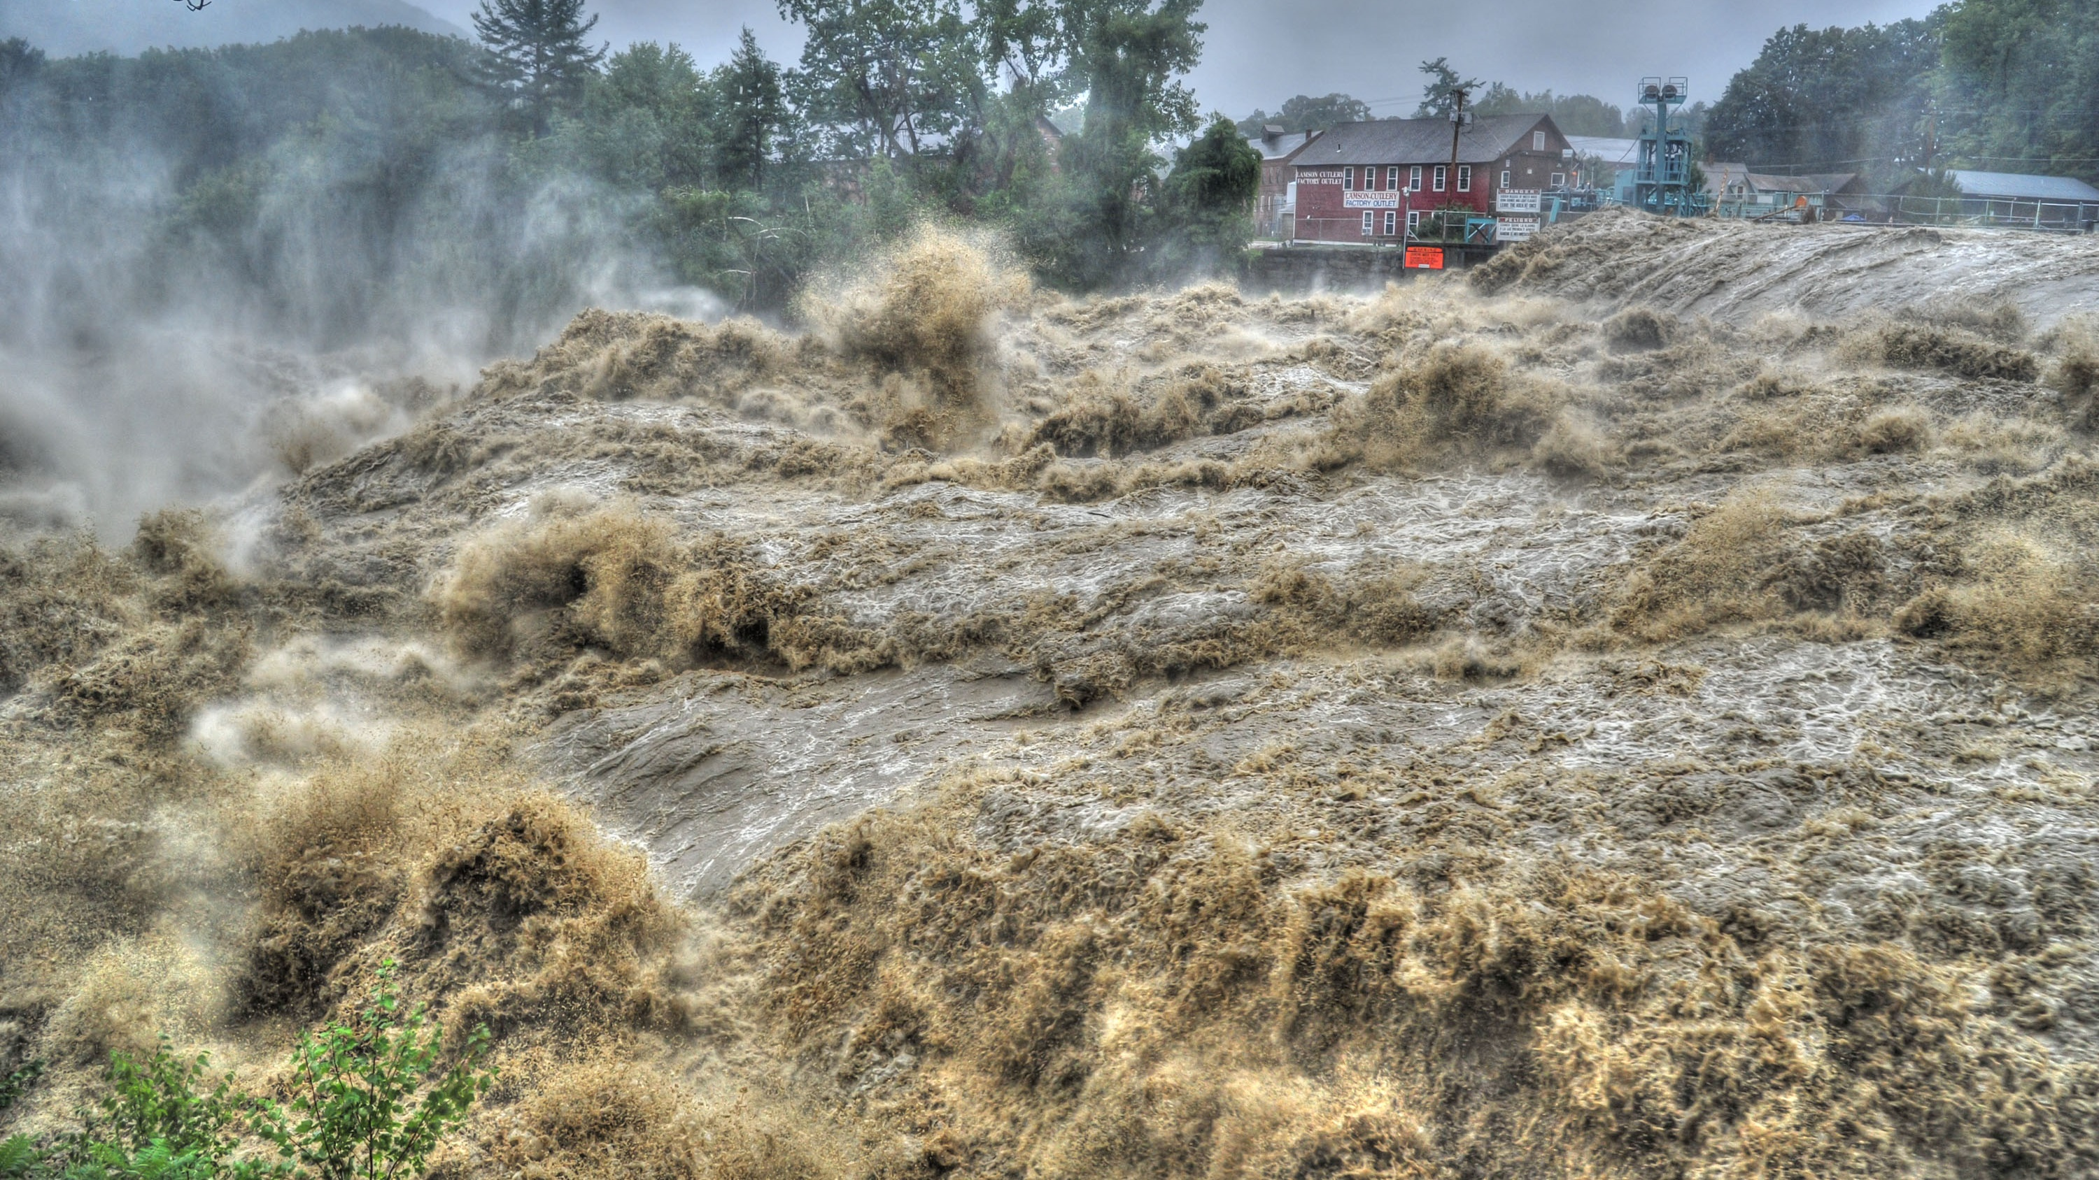
U.S. Geological Survey Flood Capabilities
Connecticut Flood Awareness Workshop
Region II
Orange, CT
May 23, 2023
Gardner Bent, U.S. Geological Survey
Tropical Storm Irene – Aug. 28, 2011 – Deerfield River, Dam #3 at Shelburne Falls, MA
Photo courtesy of John Robison

Slide 2
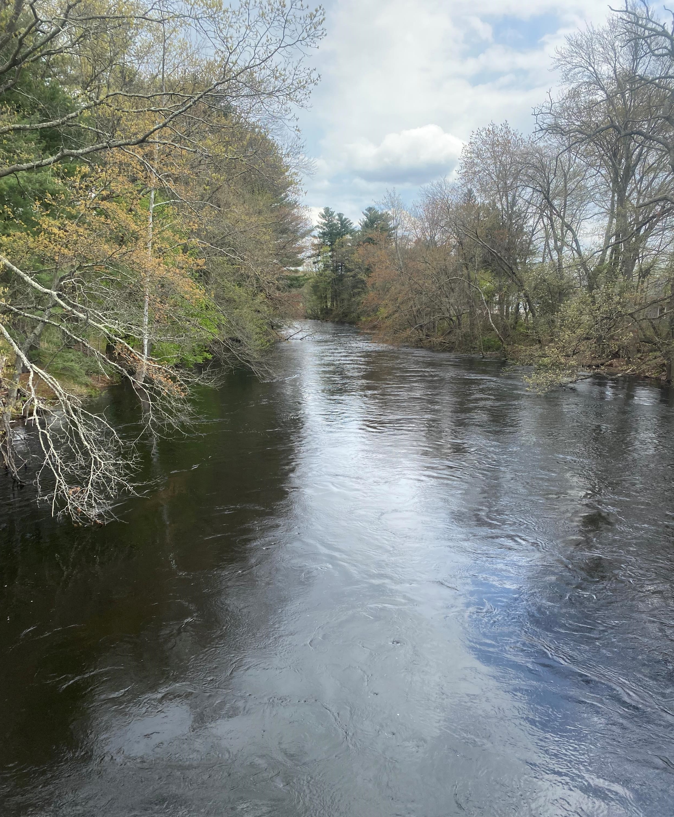
Overview USGS Real-Time Connecticut Data Network
Streamflow – 72 streamgages
Estuary – 8 tide gages
Precipitation – 18 gages
Groundwater levels – 10 gages (44 monthly measurement sites)
Water-quality – 24 gages (other discrete sampled sites)
This includes a number of streamgages not show by the Northeast River Forecast Center

Slide 3
Connecticut Real-Time Streamflow https://waterwatch.usgs.gov/new/index.php?r=ct&m=real
Notes:
Color code when 30 years of day
This graphic is “for this day in history” not all days

Slide 4
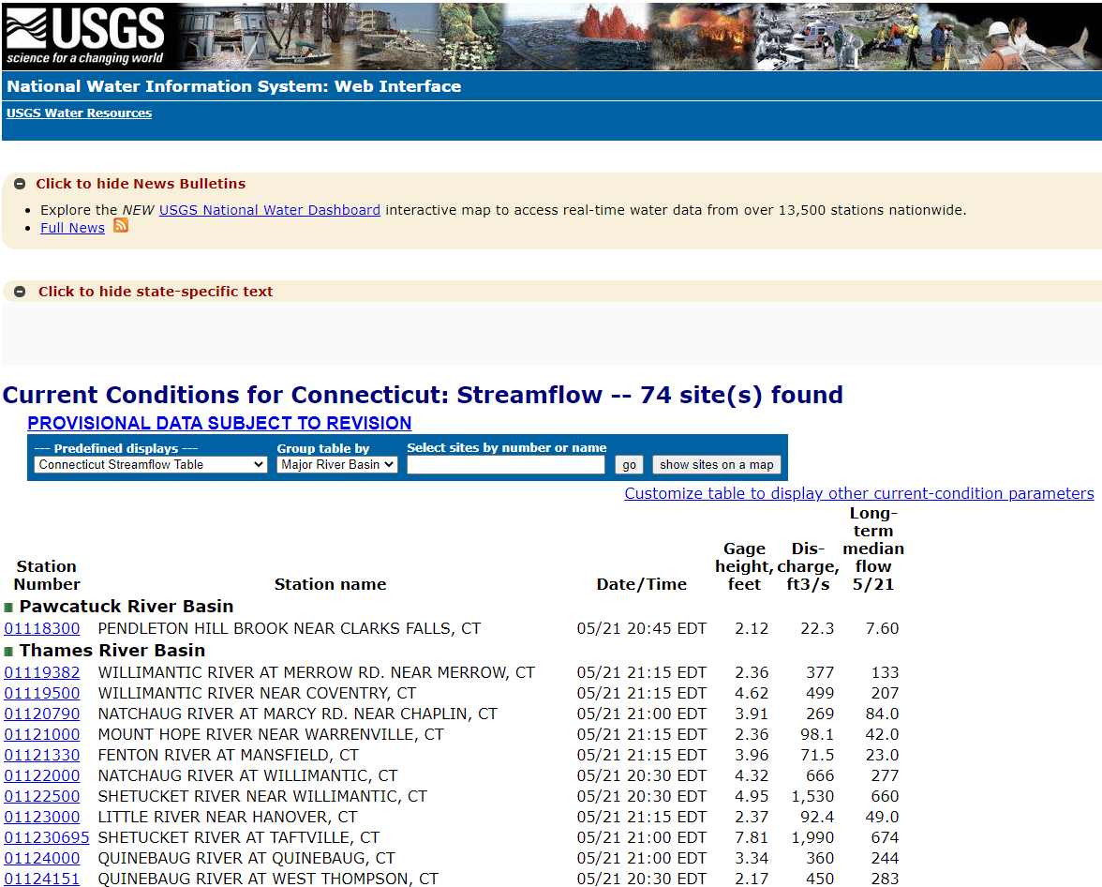
Connecticut Real-Time Streamflow Table
https://waterdata.usgs.gov/ct/nwis/current?type=flow

Slide 5
Streamflow Hydrograph

Slide 6
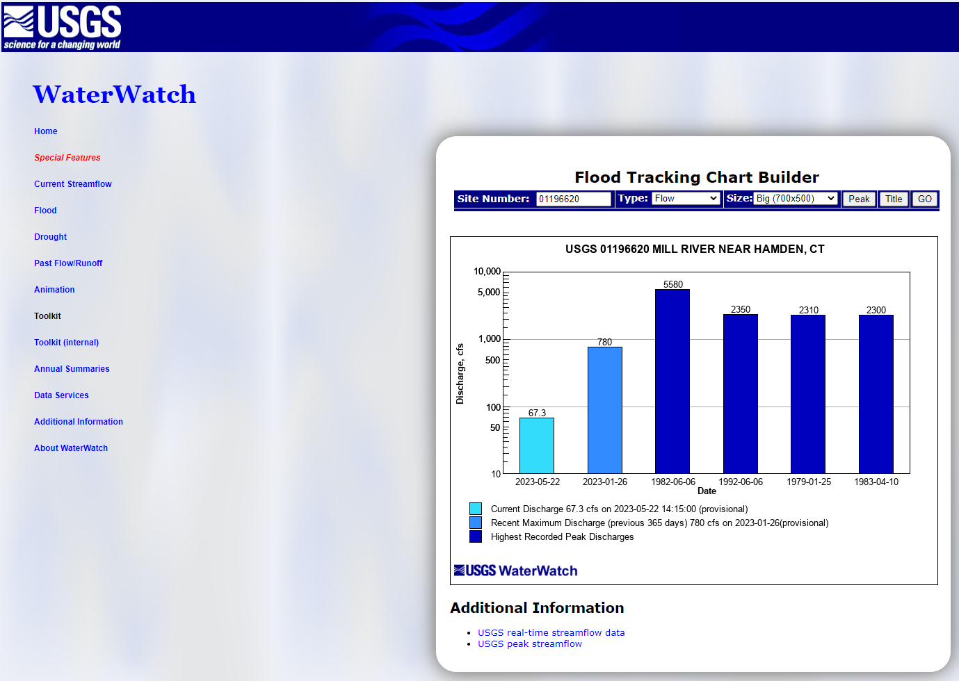
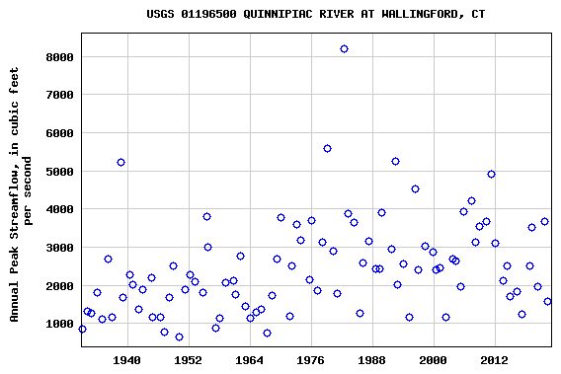
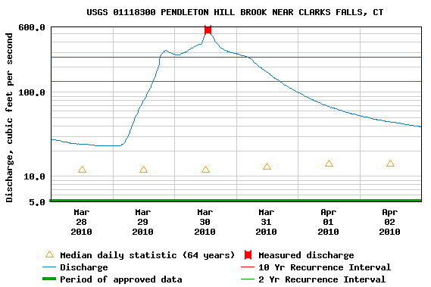
Flood Documentation
USGS NWISweb – plots and tables of annual peakflows
USGS WaterWatch – tools to create selected graphics showing current peakflow, last 365 days, and previous 4 highest peaks of record
Peakflow recurrence intervals on real-time NWISweb streamflow hydrographs
Ahearn (2020) at-site streamgage annual exceedance probability (AEP) flood flows

Slide 7
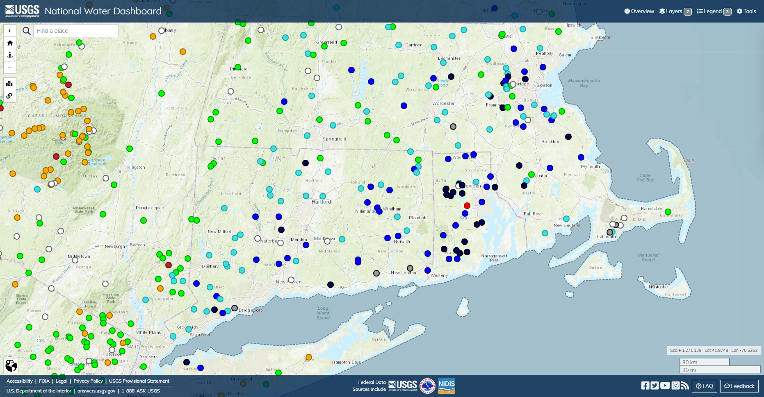
National Water Dashboard
https://dashboard.waterdata.usgs.gov/app/nwd/en/?aoi=default

Slide 8
Connecticut Precipitation Table

Slide 9
Connecticut Precipitation Hydrograph

Slide 10
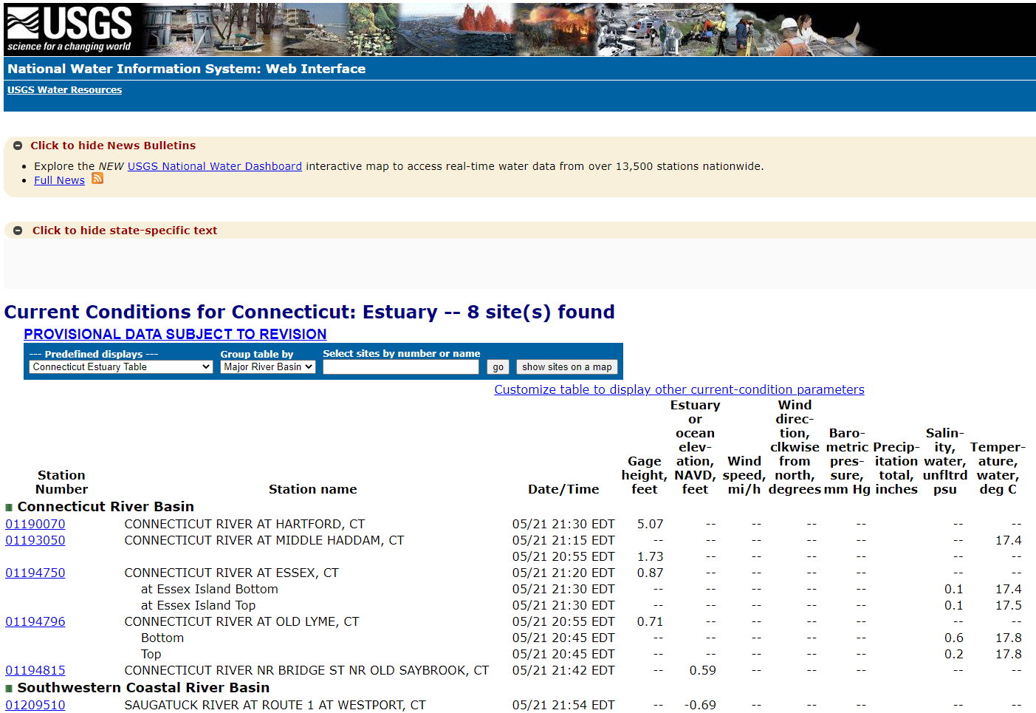
Real-Time Tide Data
https://waterdata.usgs.gov/ct/nwis/current/?type=estuary&group_key=basin_cd

Slide 11
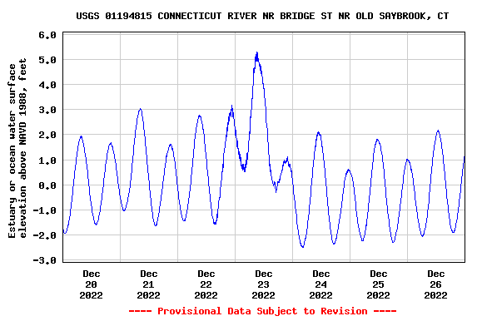
Connecticut Water-Level Hydrograph

Slide 12
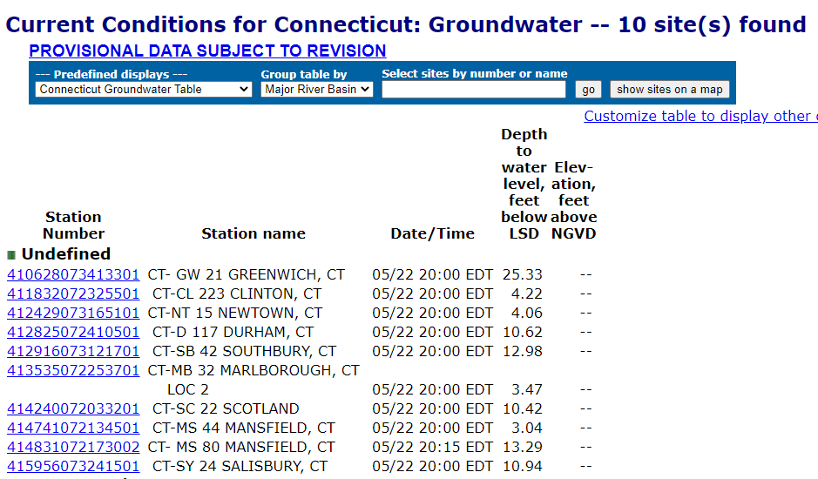
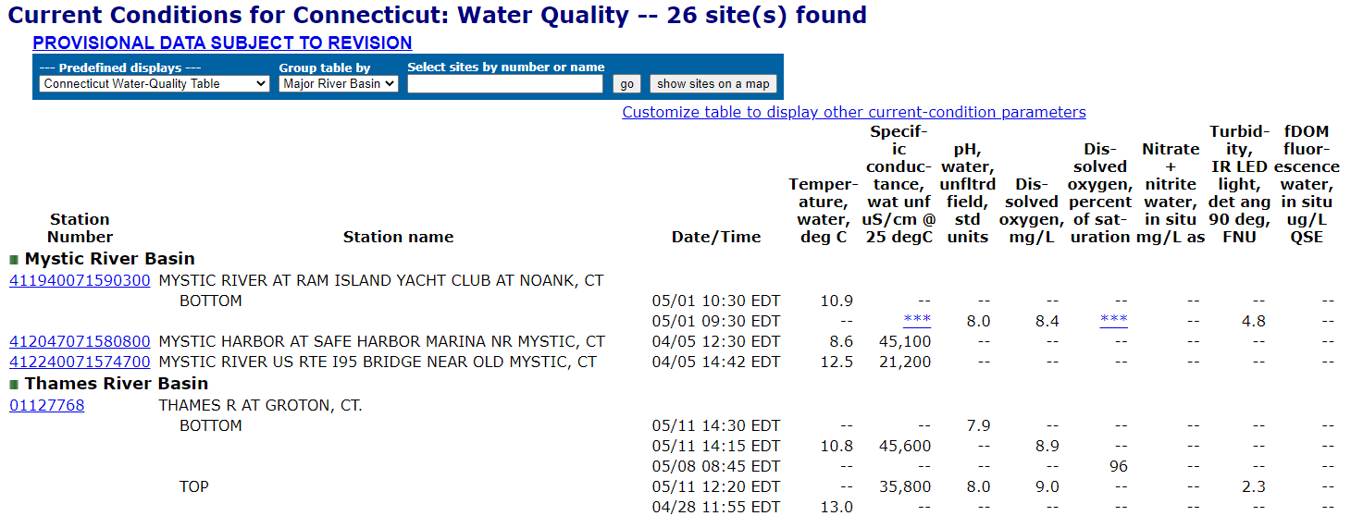
Groundwater Levels Data
https://waterdata.usgs.gov/ct/nwis/current/?type=gw&group_key=basin_cd
Water-Quality Data
https://waterdata.usgs.gov/ct/nwis/current/?type=quality&group_key=basin_cd

Slide 13
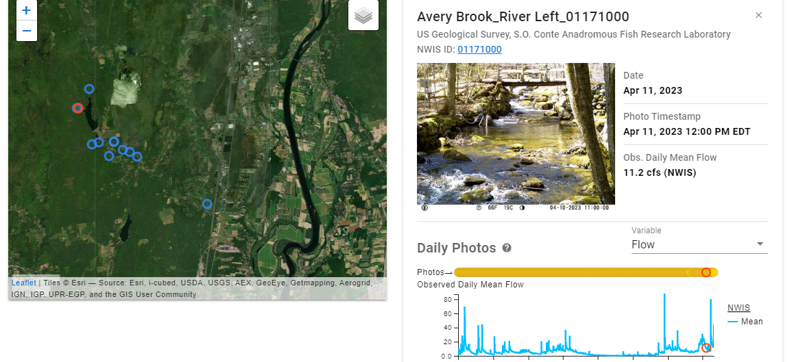
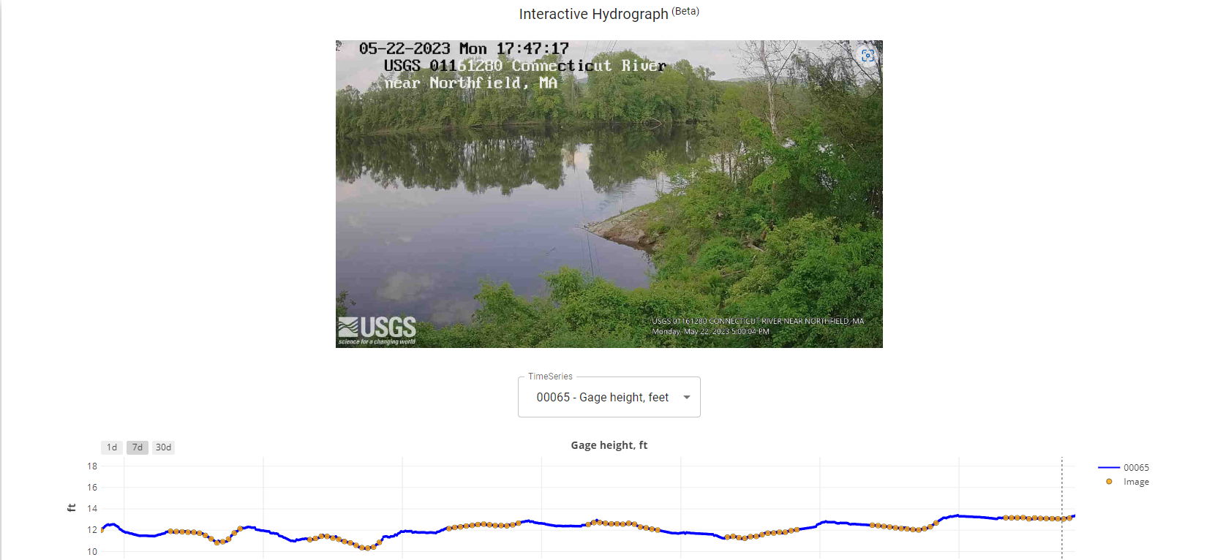
Hydrologic Imagery Visualization
USGS HIVIS (Hydrologic Imagery Visualization and Information System)
Flow Photo Explorer | USGS
Next Generation Water Observing System (NGWOS) | U.S. Geological Survey (usgs.gov)

Slide 14
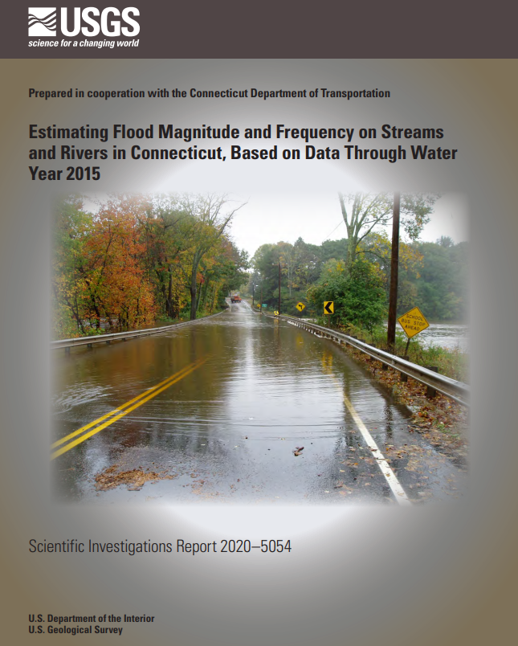
Connecticut Peakflow Statistics and Equations
At-site (streamgage) statistics of the 50-, 10-, 4-, 2-, 1-, 0.5-, and 0.2-percent annual exceedance probabilities flood flows
Equations for estimating the 50-, 10-, 4-, 2-, 1-, 0.5-, and 0.2-percent annual exceedance probabilities flood flows
https://pubs.er.usgs.gov/publication/sir20205054

Slide 15
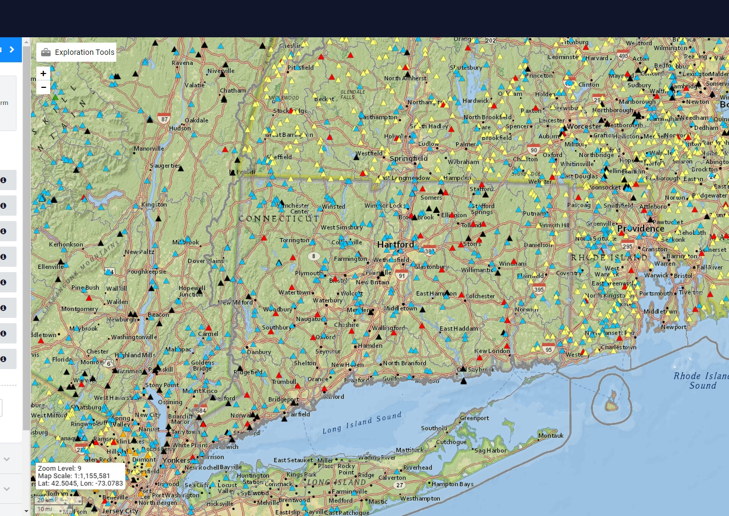
USGS StreamStats
User can access at-site (streamgage) flow statistics
User can click on any ungaged stream location and return estimated peakflow and low-flow statistics
https://streamstats.usgs.gov/ss/

Slide 16
USGS Flood Event Viewer
USGS water-level data for major riverine and tropical cyclone flood events:
Rapid-deployment gages
Temporary storm sensors
High-water marks
Hurricane Sandy October 29, 2012
https://stn.wim.usgs.gov/FEV/

Slide 17
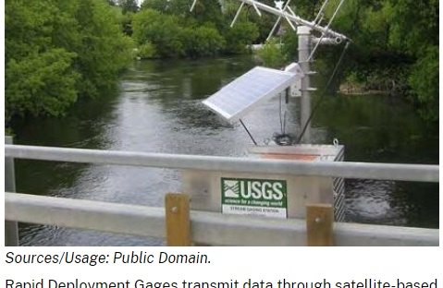
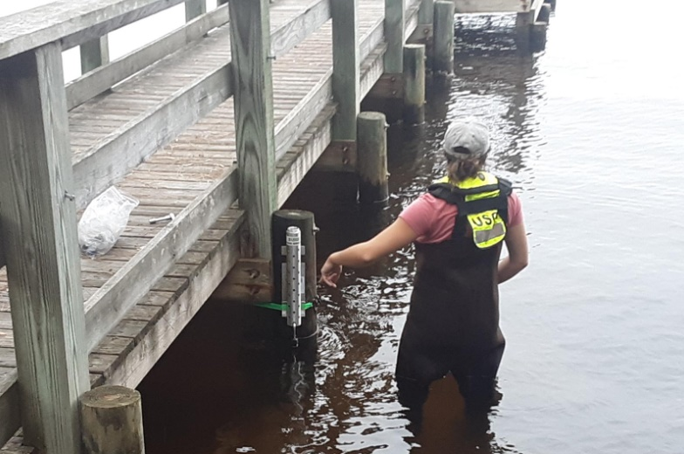
Rapid Deployment Gages and Temporary Storm Sensors

Slide 18
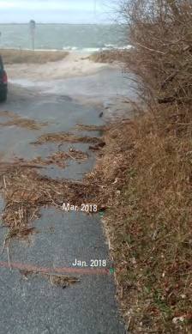
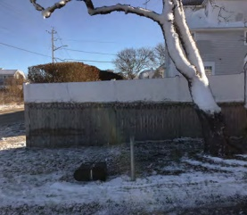
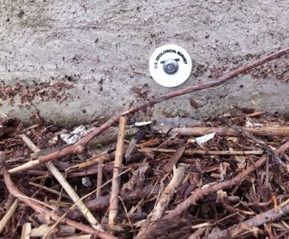
High-Water Marks

Slide 19
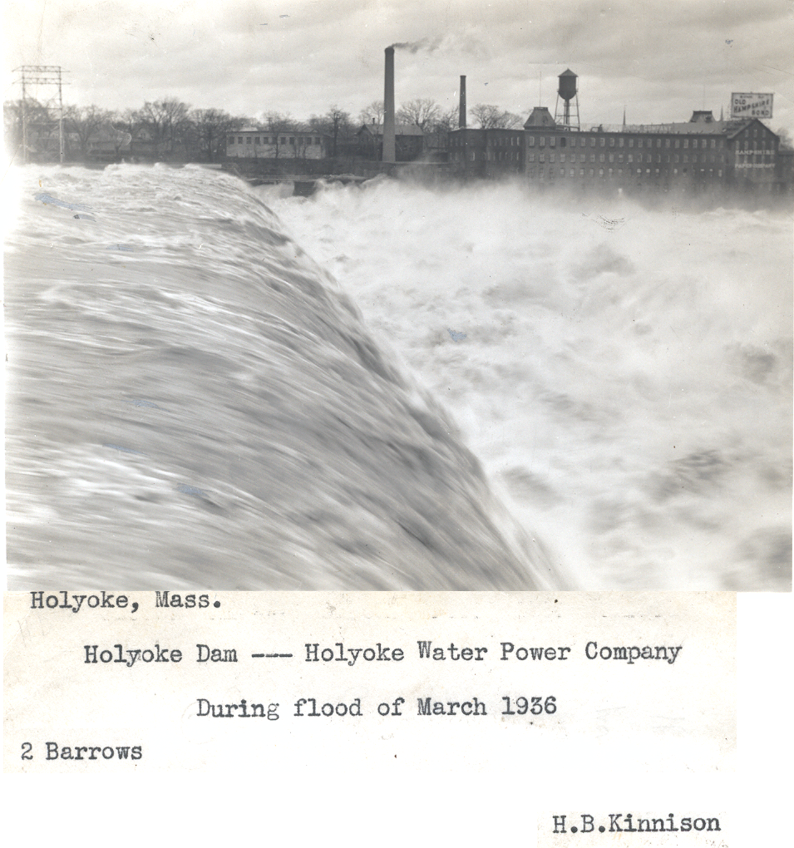
Questions
USGS New England Flood Information: New England Flood Information | U.S. Geological Survey (usgs.gov)
Contacts:
Tim Sargent tcsargen@usgs.gov 860-291-6754
Jon Morrison jmorriso@usgs.gov 860-291-6761
Liz Ahearn eaahearn@usgs.gov 860-291-6745

