Slide 1
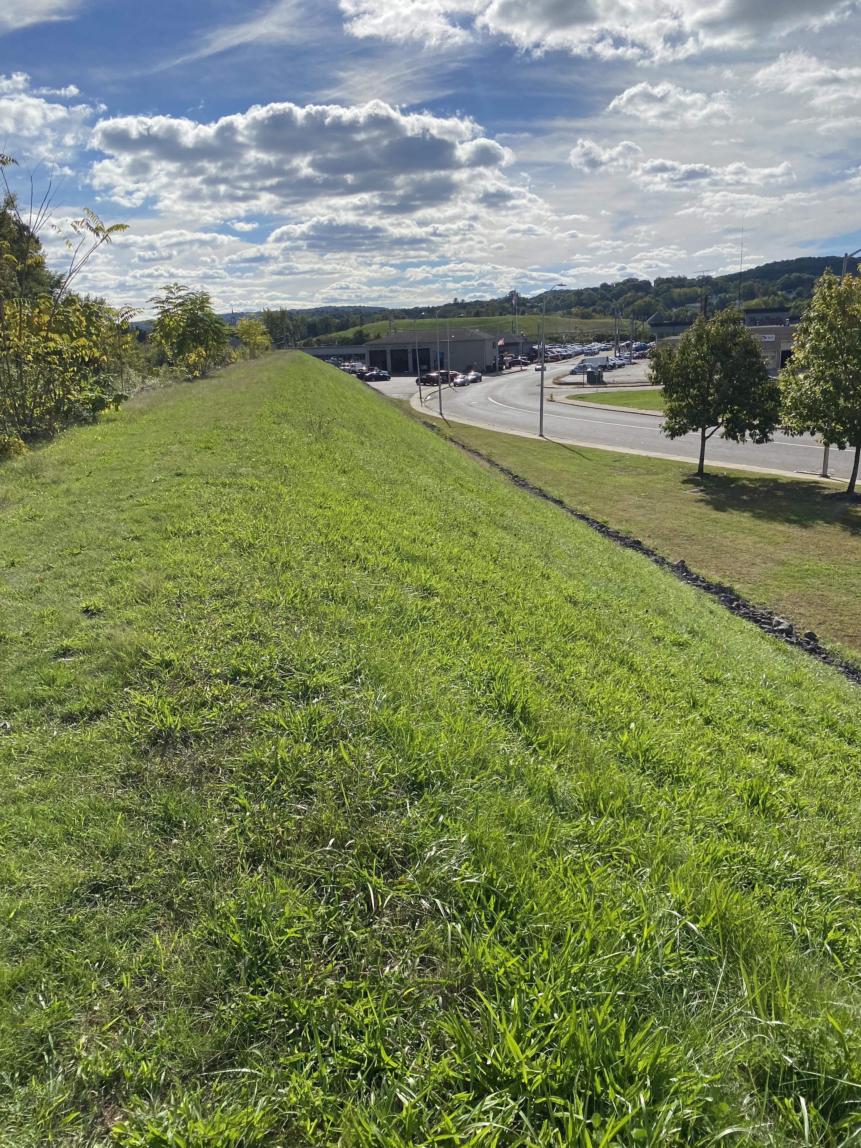
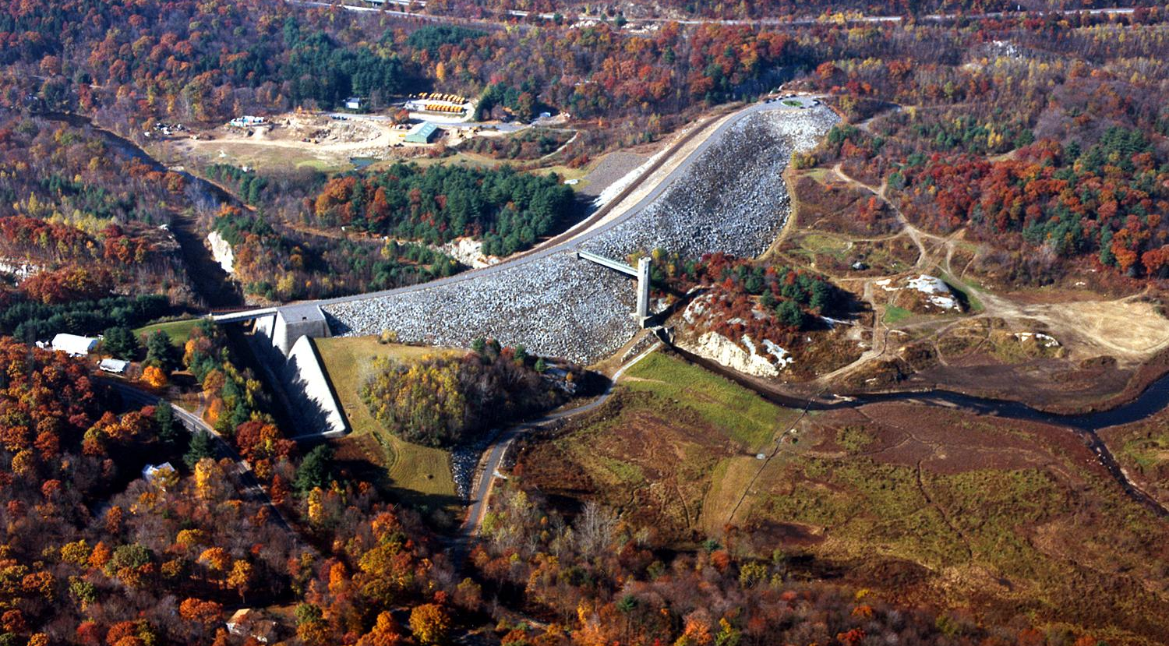
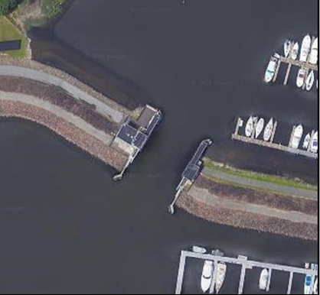
USACE Flood Risk Management Program
CT Flood Awareness Workshop
May 4, 2023
Megan Pierce
Risk Communication Lead
New England District, USACE
Megan.E.Pierce@usace.army.mil
Thomaston Dam
STAMFORD HB

Slide 2
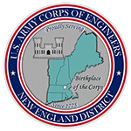
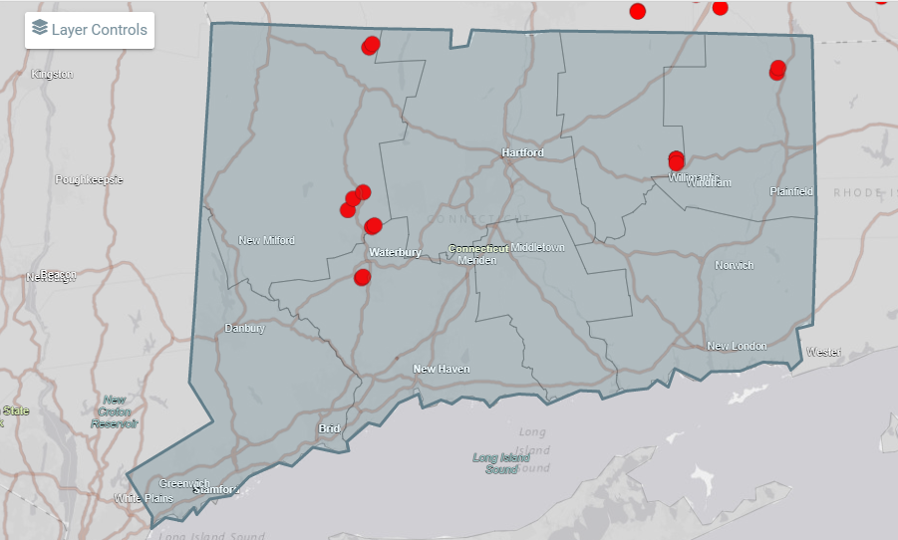
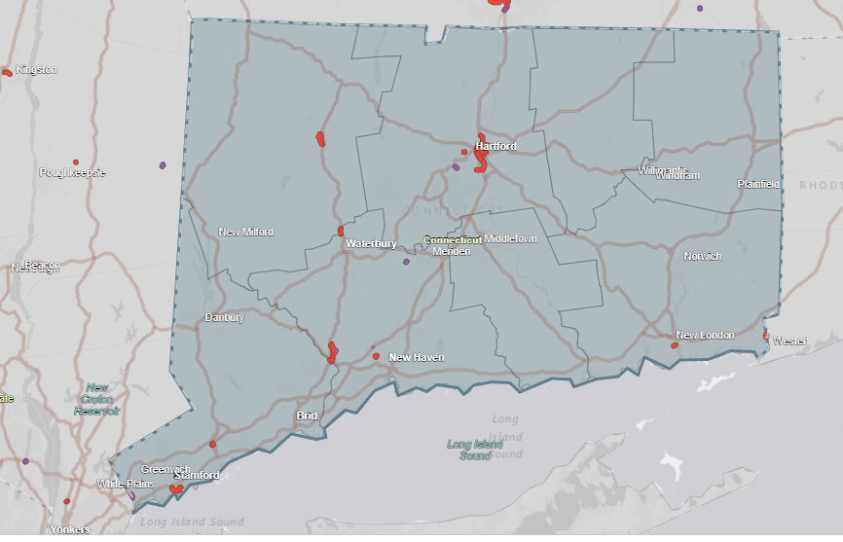
Connecticut Infrastructure
Dams: 12
Levees: 20
Hurricane Barrier: 1
8 USACE owned, operated dams
4 USACE Built and CT-DEEP owned
East Branch Dam
Hall Meadow Dam
Sucker Brook Dam
Mad River Dam
20 USACE Levees (23 mi)

Slide 3
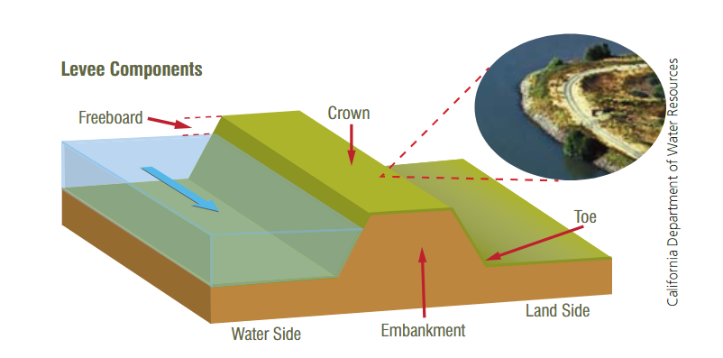
What is a levee?
“man-made structure, usually an earthen embankment, designed and constructed in accordance with sound engineering practices to contain, control, or divert the flow of water so as to provide protection from temporary flooding.” (FEMA)

Slide 4
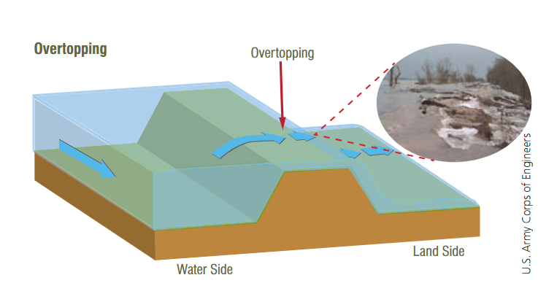
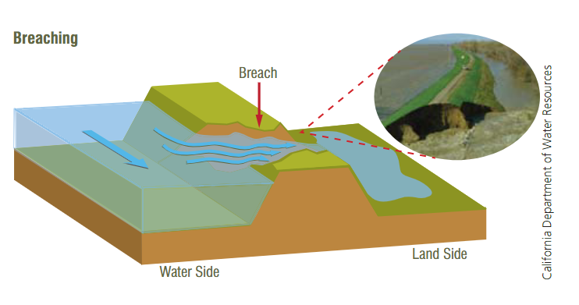
Levees
No levee is floodproof, when a flood is too large the levee may overtop
Breaches can be gradual or sudden
Causes
Strong river currents can erode the surface
debris or ice damage
burrowing animals
Trees growing and blowing over creating holes
Earthquakes can cause a loss of soil strength
Notes:
Levees designed for far lower level of protection compared to dams

Slide 5
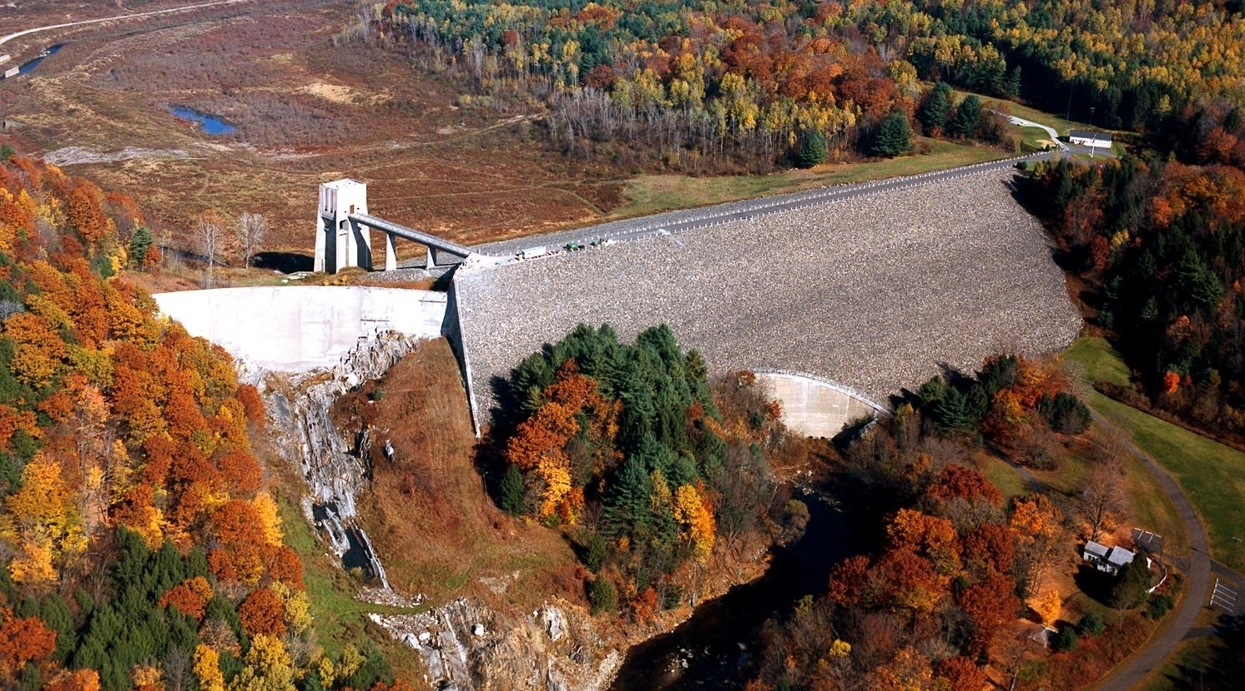
What is a dam?
UPSTREAM
Control Tower
Spillway Weir
Embankment
DOWNSTREAM
Notes:
I will describe the operation of a flood control dam using another one of our dams, Knightville Dam. A flood control dam is a structure that limits the amount of water flowing downstream during/following floods in order to mitigate damages.
This is Knightville Dam located in Huntington, MA, but provides a good representation of most of the Corps built dams in New England. This is an image of the dam looking upstream.
It is comprised of an earthen embankment, a control tower, and a concrete spillway weir
We will use this dam as an example during the presentation, and later show you a video of this project when it had a spillway flow
We will go over the specific components you are seeing later in this presentation. You will hear the term “spillway weir” many times throughout the presentation
During large storm events, the dam stores storm water in the reservoir to minimize damaging flows downstream.

Slide 6
High Pool example
1984 HIGH POOL
Example USACE Dam
Knightville Dam (Huntington, MA)
Notes:
In this slide you see a comparison of what our reservoir looks like during most day-to-day operations
(*CLICK*)
and what it looks like during flood operations
Tower looks a little different due to more recent renovations.

Slide 7
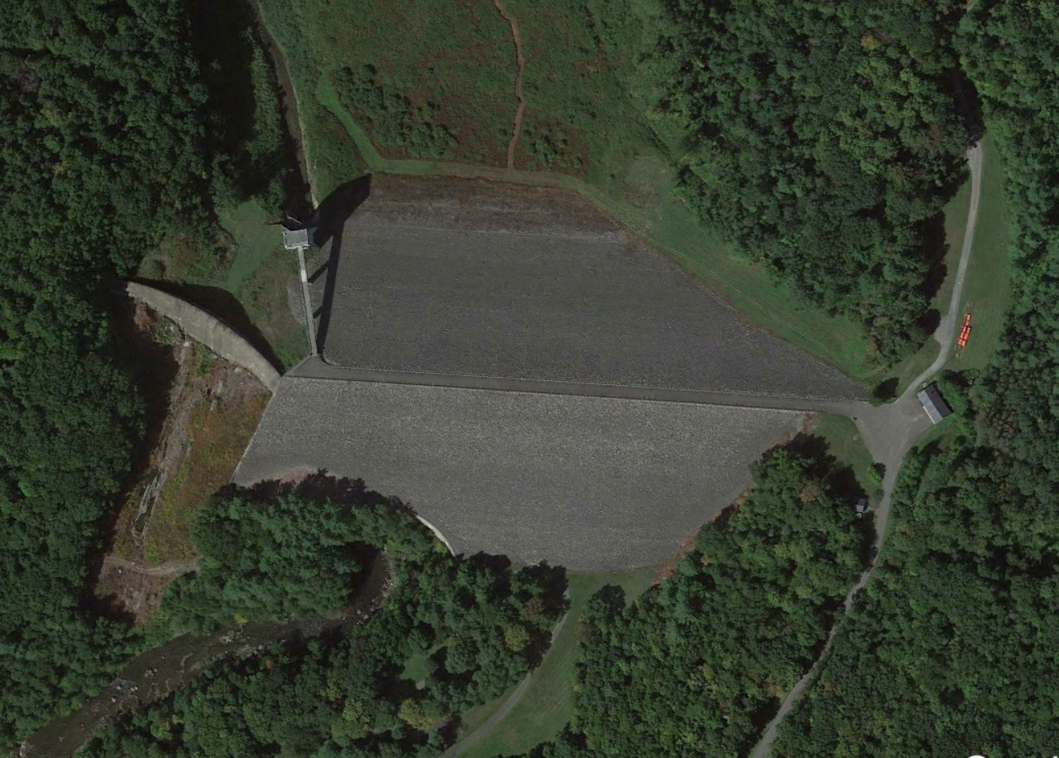
High Pool example
UPSTREAM
Inlet Channel
Control Tower
(Operating House)
Outlet Works with Conduit
Outlet Channel
DOWNSTREAM
Example USACE Dam
Knightville Dam (Huntington, MA)
Notes:
During day-to-day operations, flows from upstream to downstream are allowed to pass through the outlet works which include a conduit.
The conduit is a concrete tunnel through the base of the dam that is a part of the outlet works. Water is typically flowing through the conduit during day-to-day operations.
Most Corps operated dams in New England have gates that can be opened and closed to limit or increase the amount of water passed through the conduit.

Slide 8
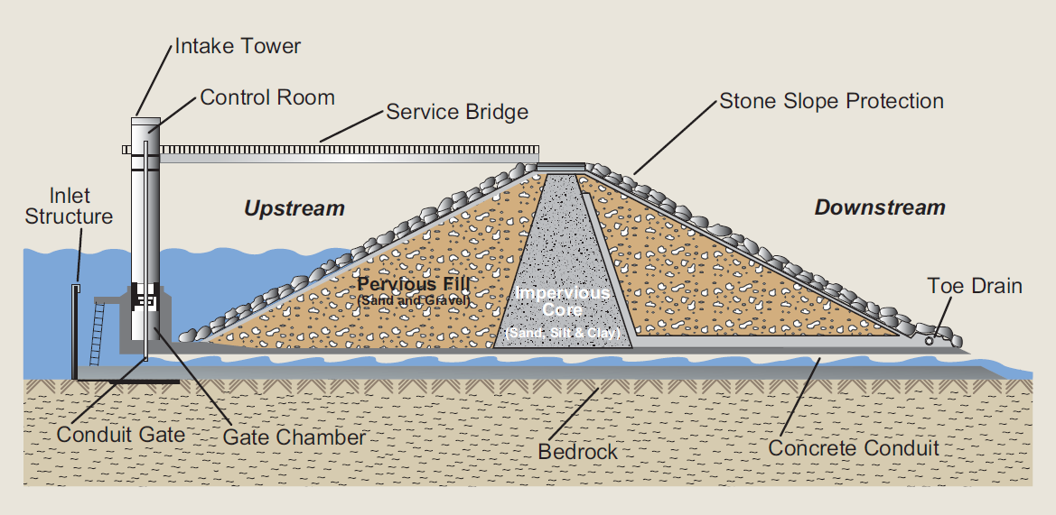


Dam Profile
The gate opening determines how much water is flowing through the outlet works.
Embankment
Example USACE Dam
Notes:
This a cross-section through the dam, showing the outlet conduit at the base of the dam.
The gates are controlling the amount of water flowing through the outlet works.
Operations staff work with the Reservoir Control Center, or RCC to determine the appropriate gate changes.

Slide 9
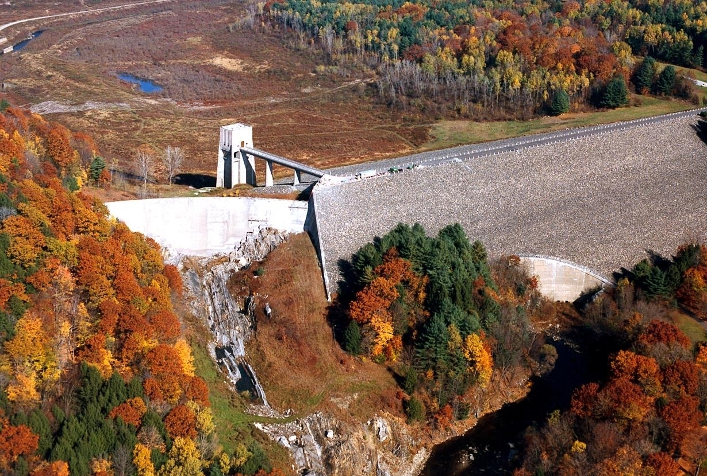
Full Storage
During extreme rain events the amount of water entering the reservoir can fill the reservoir to capacity.
A dam is 100% full when the reservoir is at the top of the spillway crest NOT the top of the dam.
Once the reservoir is full, as more water enters the reservoir water will begin to discharge over a concrete spillway.
Concrete Spillway Weir
Top of Dam Embankment
Notes:
During an extremely large storm, due to the amount of water entering the reservoir, the reservoir could fill up completely (100% full).
A dam is 100% full when the reservoir is at the top of the spillway weir crest NOT the top of the dam. A spillway is a concrete structure that is at a lower elevation than the top of the dam. It is designed to allow water to flow over it.
Once the reservoir extends beyond 100% full, water discharges over the spillway weir. Flows over the spillway prevent water from flowing over the dam embankment (overtopping the dam).

Slide 10
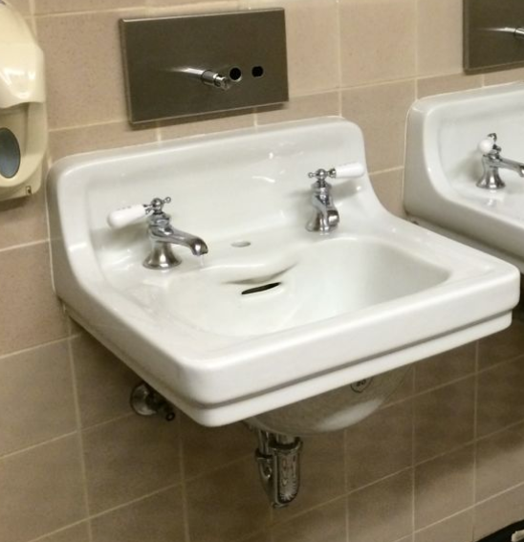
Full Storage
Concrete Spillway Weir
A dam is 100% full when the reservoir is at the top of the spillway crest NOT the top of the dam.
Notes:
The spillway functions similar in concept to a sink overflow opening that prevents a sink bowl from completely overflowing.
(*CLICK*)
The outlet conduit acts like the sink’s drain.

Slide 11
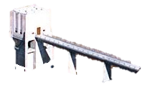
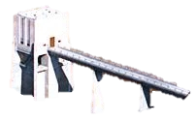
1) Storm waters are entering the reservoir causing the reservoir to fill. Project staff are making gate changes to minimize downstream flows through the conduit.
2) Excessive storm waters continue to flow into reservoir. Reservoir is 100% full, water is at the top of the spillway weir.
3) Reservoir is over 100% full, water is moving over the spillway.
Notes:
So what happens during an extreme flood event?

Slide 12
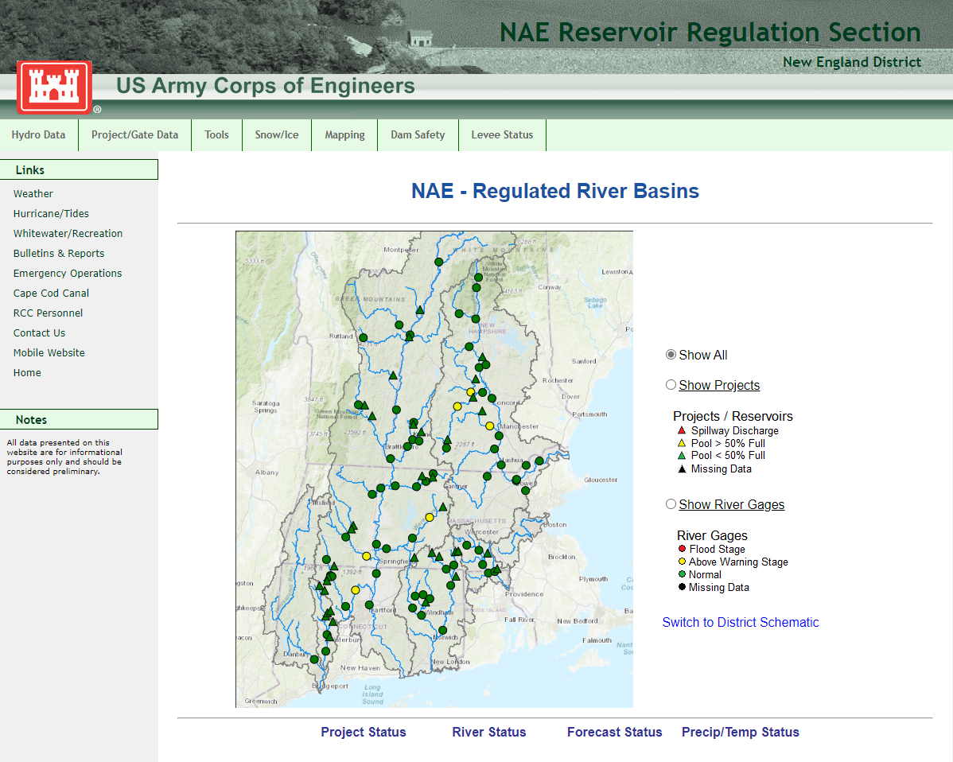
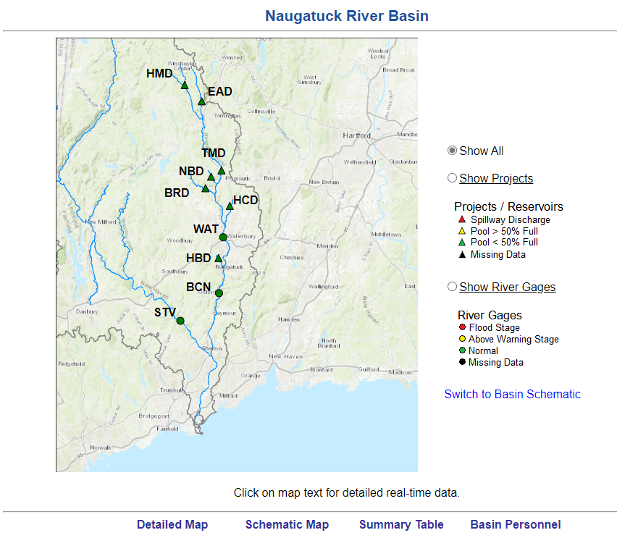
Reservoir Regulation
Reservoircontrol.com
Notes:
The Reservoir Control Center (RCC) is an engineering group within our office at Concord, MA, that determines the appropriate gate changes during both day-to-day and flood conditions.
The RCC is informed by instrumentation at the dams, current river conditions, historical precedence, as well as the project water control manuals, to determine the appropriate gate changes to be made at each project. Instrumentation information is provided by satellite which allows for instrumentation readings when other network communications are lost
Operations project staff make gate changes based on RCC direction
Refer to Basin Regulator – Laura Fraser

Slide 13
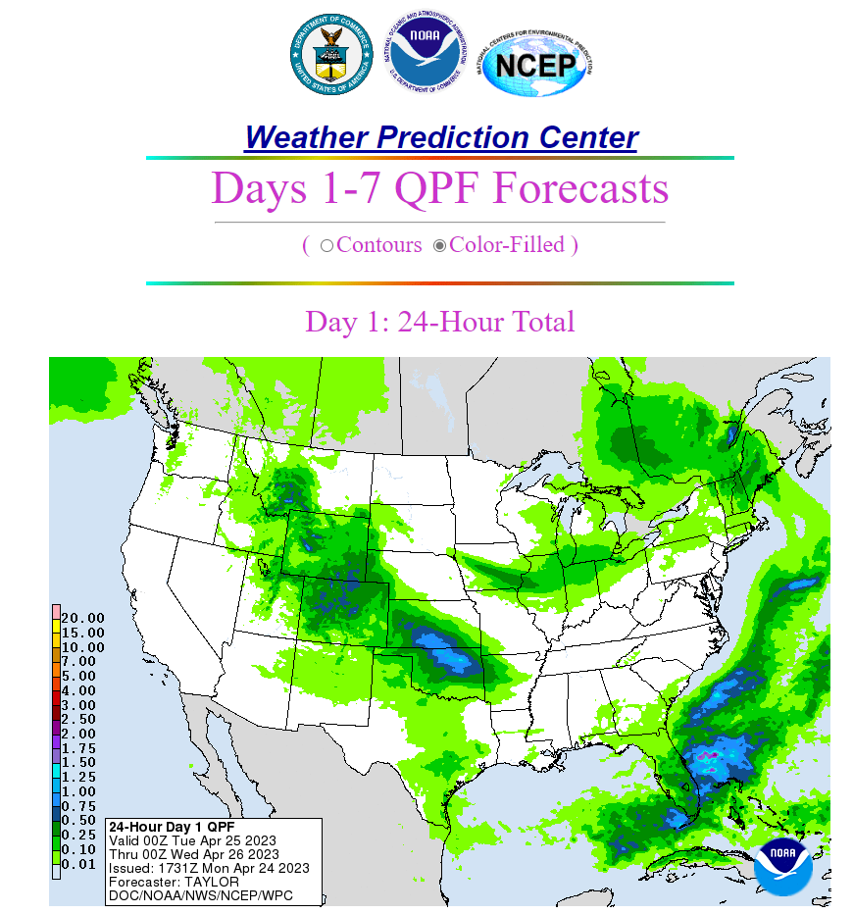
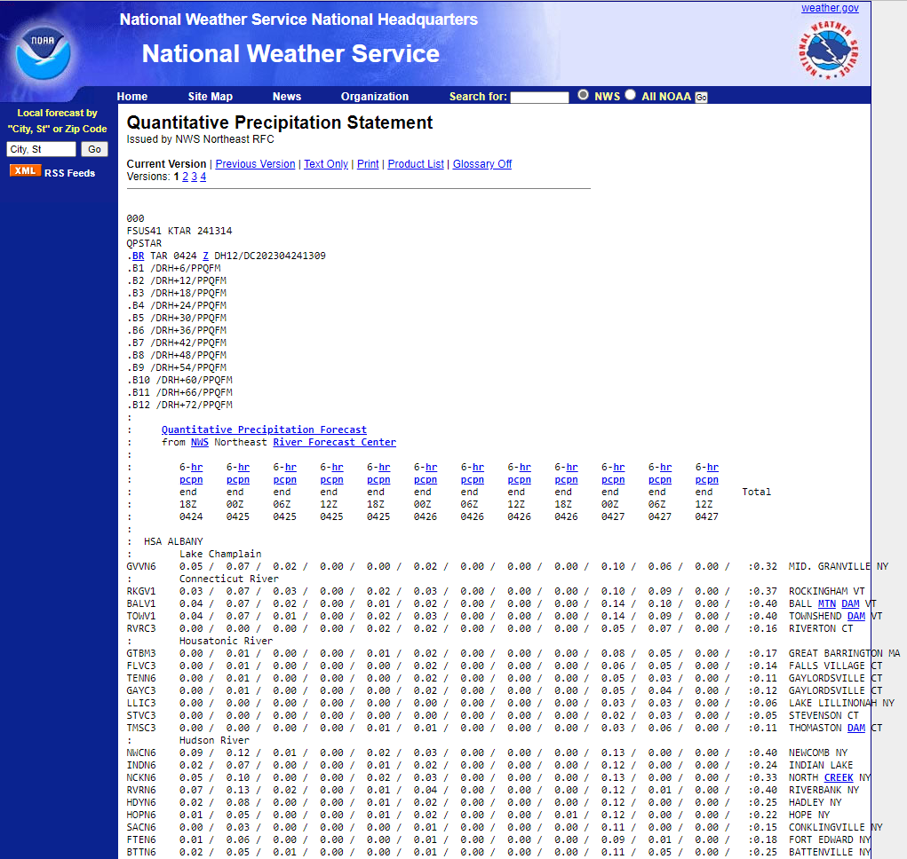
Weather Forecasting

Slide 14
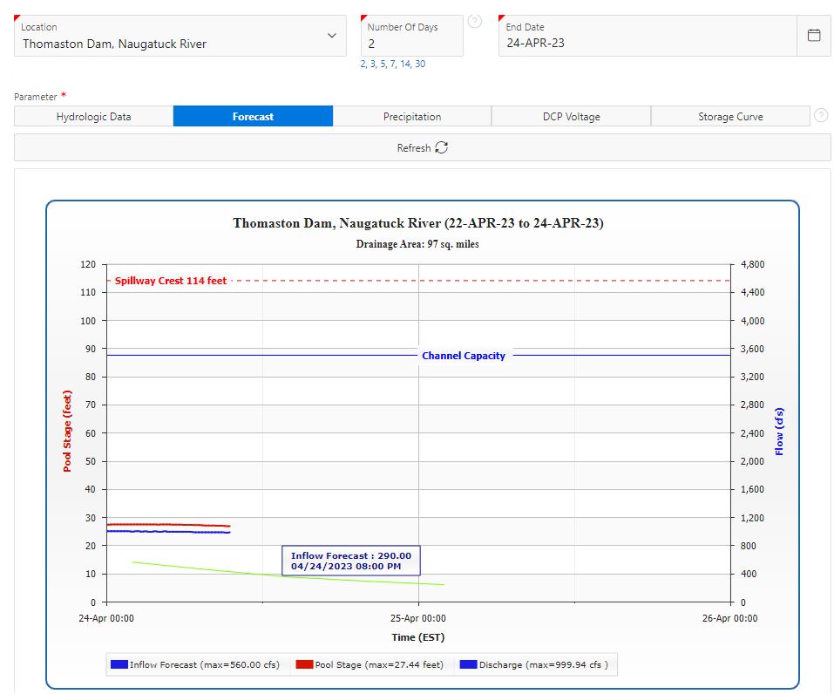
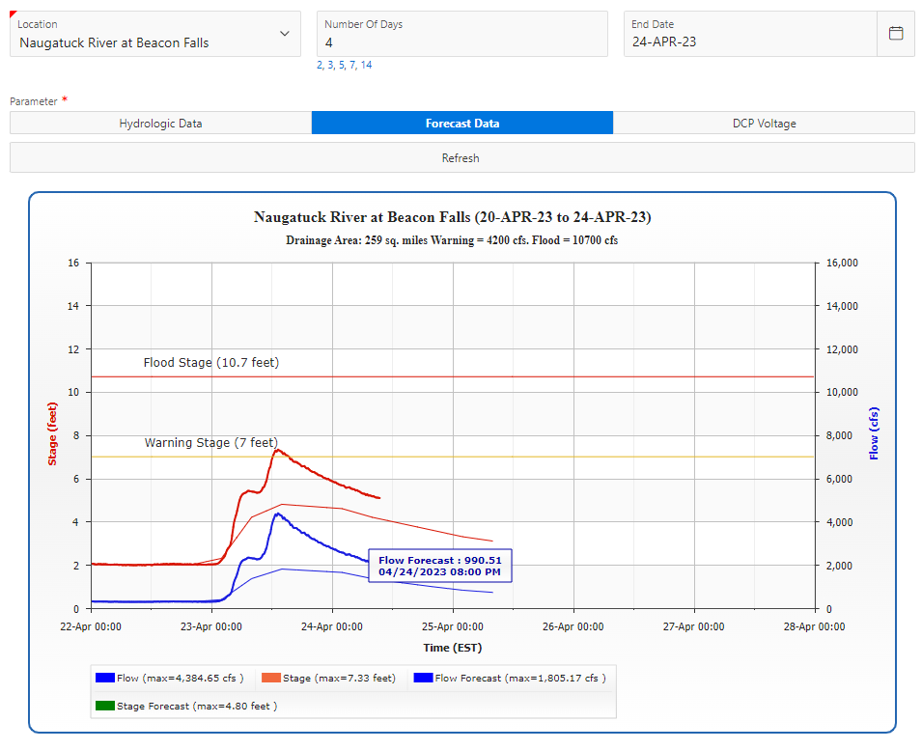
River and Inflow Forecasting
Reservoirs
River Gages
Reservoir Regulation Center Data
NERFC Inflow Predictions
USGS Gages
NERFC: Advanced Hydrologic Prediction Service

Slide 15
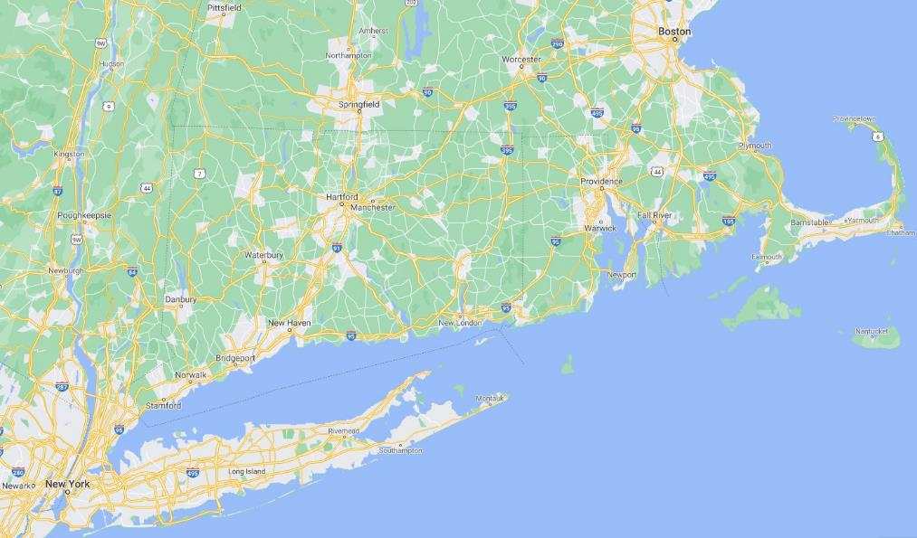
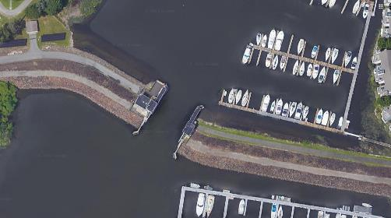
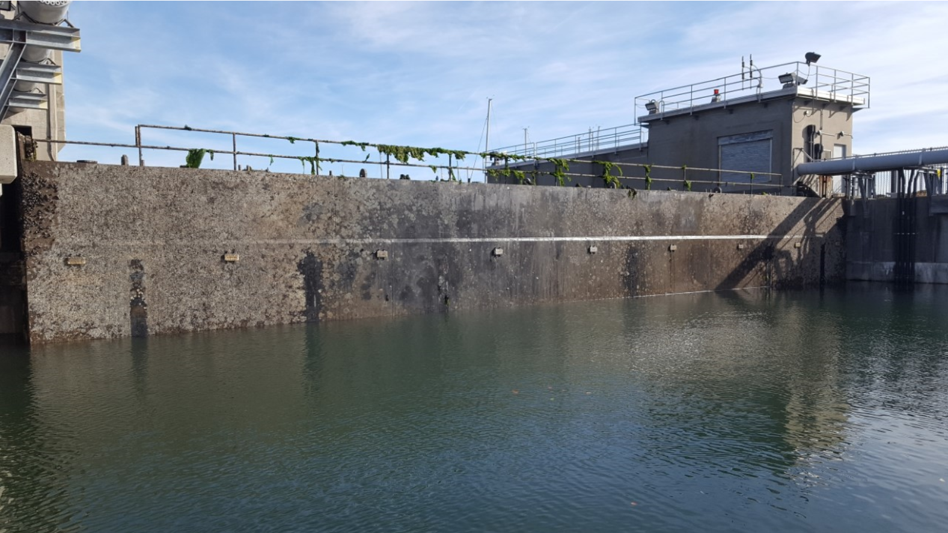
Stamford Hurricane Barrier

Slide 16
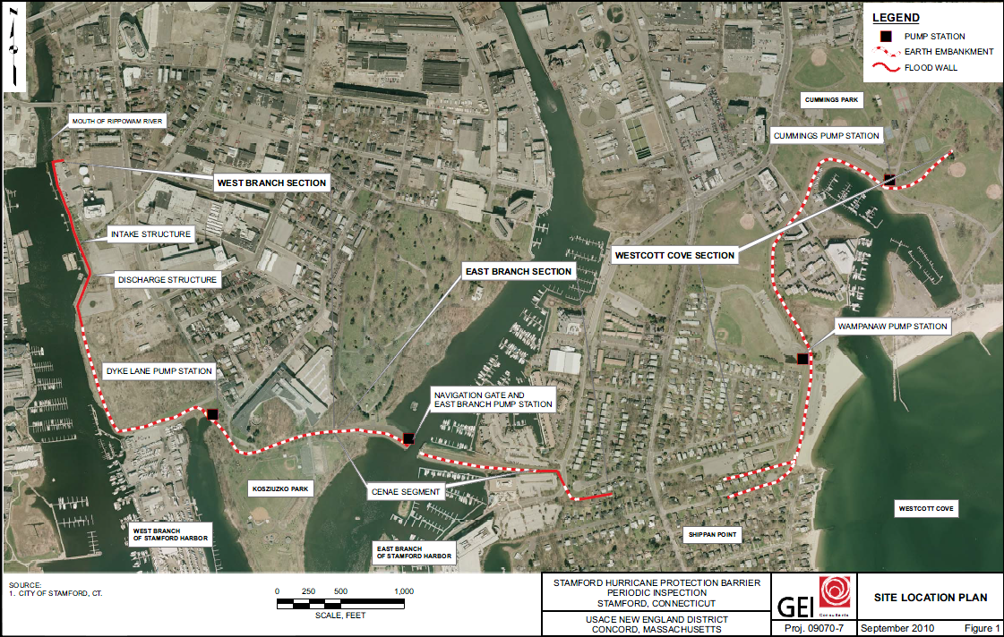
Stamford Hurricane Barrier

Slide 17
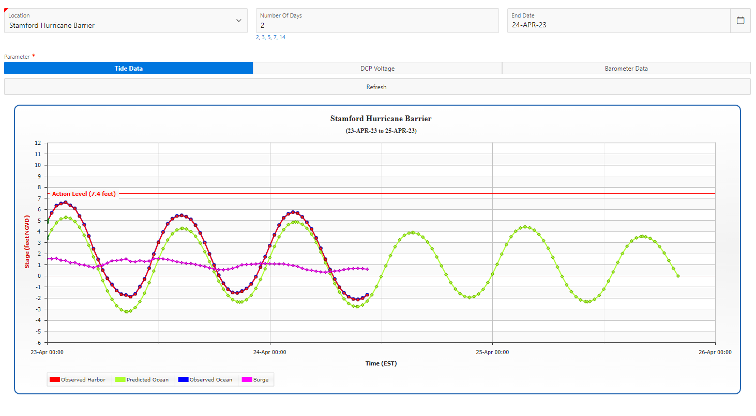
Stamford Real-Time Data

Slide 18
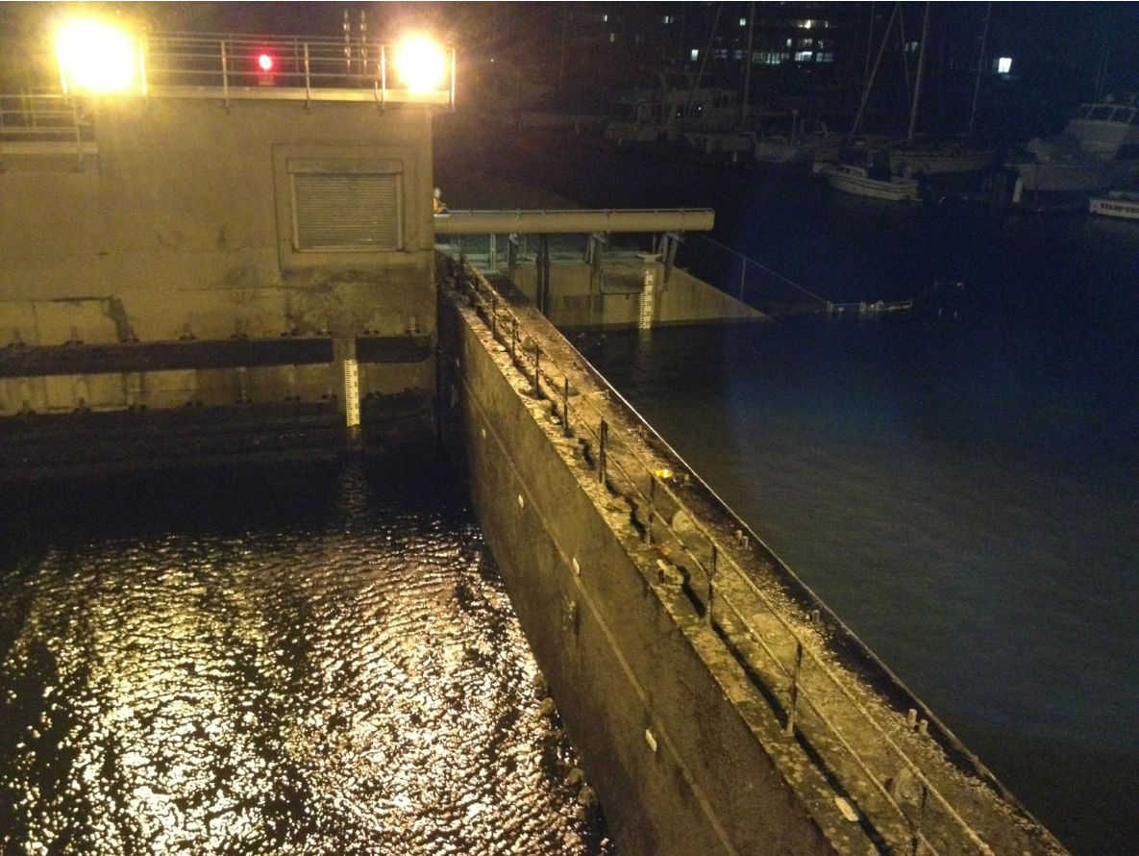
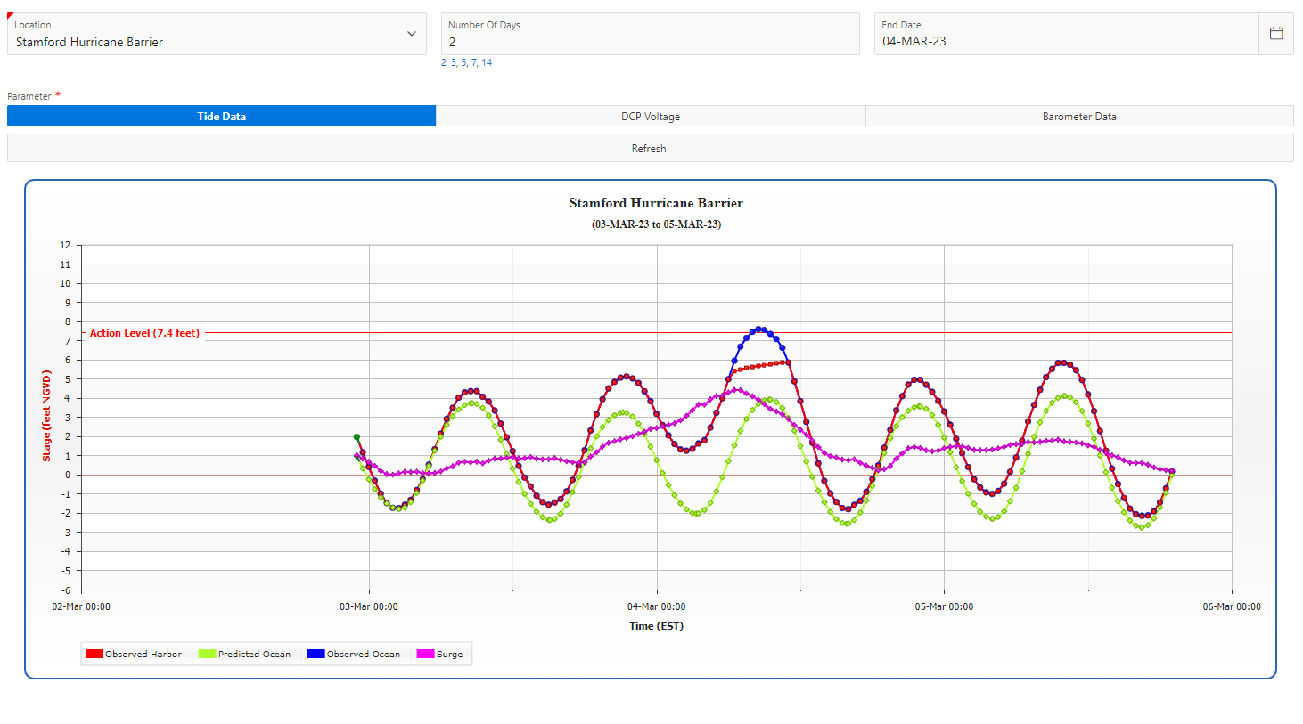
Stamford Operations
Barrier Closure
Barrier Opening

Slide 19
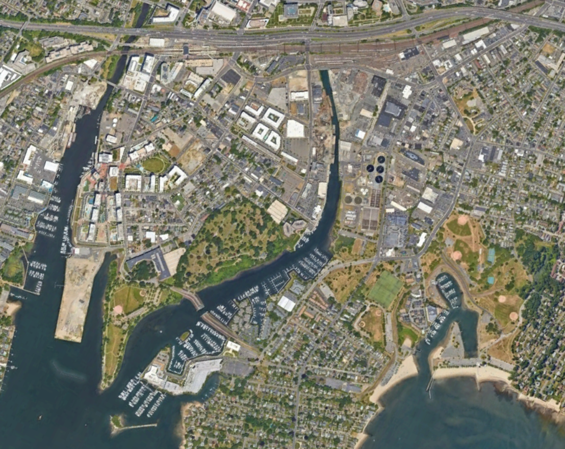
Stamford’s History
HISTORICAL FACTS:
Location: Stamford, CT
Protects ~600 ac
manufacturing plants, main commercial district, residential areas
Placed into operations in 1969
Gate Type: Flap gate (hinged at the bottom)
Damages to-date prevented are over $80M
Operates on average 15 times a year

Slide 20
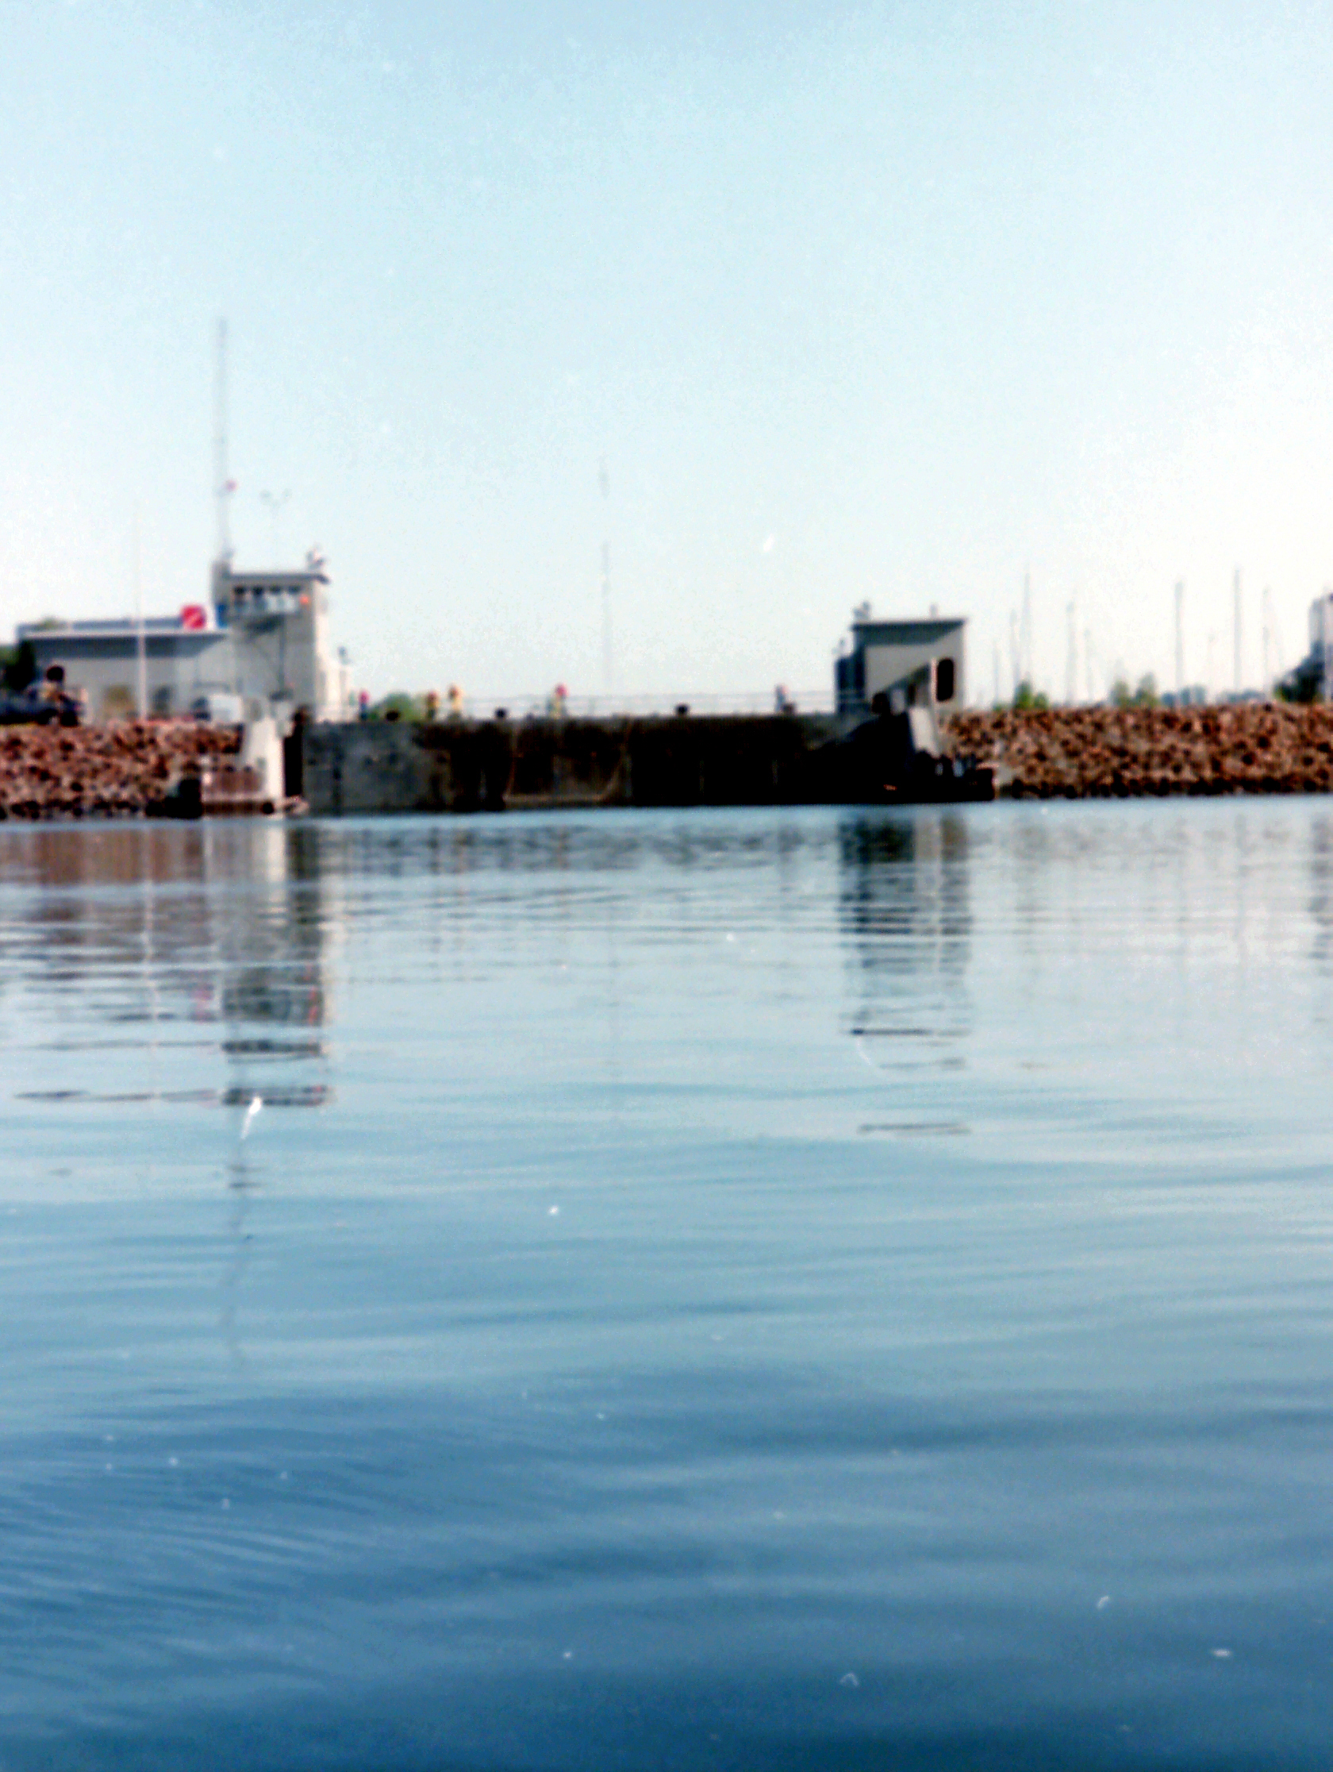
Stamford’s History
BARRIER CLOSURE CRITERIA:
Record high tide was Hurricane Sandy (2012) at 11.1’ NGVD
Top of barrier: 17’ NGVD
Barrier closure criteria historically has been 7’ NGVD projected at the barrier.
Several factors determine when to close the barrier:
NOAA Predicted Astronomical Tides
Wind – speed and direction
Storm surge
Upstream Inflow
If projected Tide + Wind + Storm Surge + Inflows > closure criteria target
Operate to keep Harbor below 5.8’ NGVD
It is Art and Science.

Slide 21
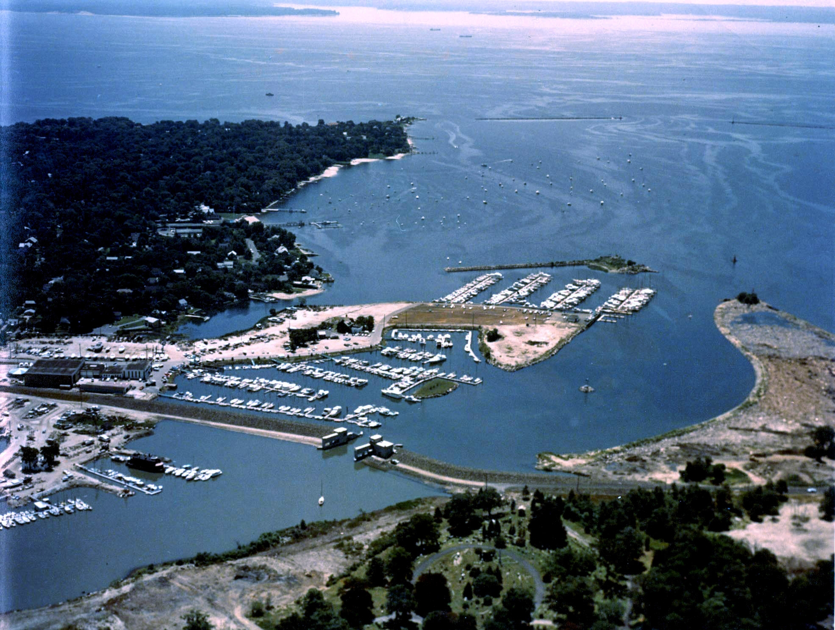
Stamford Barrier Repair
Issues: Bent hinges and gate mis-aligned gate
Evaluating detailed inspection results and developing repair approach and schedule
Stamford Hurricane Barrier Gate is expected to be out of service for a minimum of 4 months during the repair
We will continue to share information with the city of Stamford and our stakeholders to ensure transparency during the repair or replacement.
Notes:
We will continue to work with the city and stakeholders in the coming months to identify critical infrastructure (e.g., wastewater treatment plant) and water elevations of concern in the hopes of managing risk.
Technically assisting with interim risk reduction measures
Temporarily increase operational level to 7.4’ NGVD to minimize operations

