Slide 1
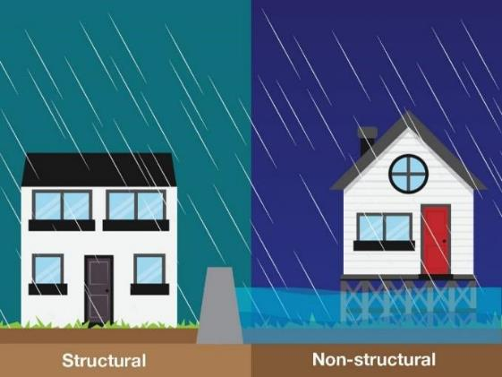
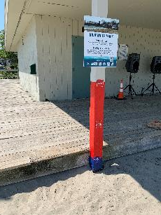
Nonstructural Flood Risk Management and Flood proofing Measures
Sheila Warren
Silver Jackets Coordinator
Planning/New England District
Date: 23MAY2023

Slide 2
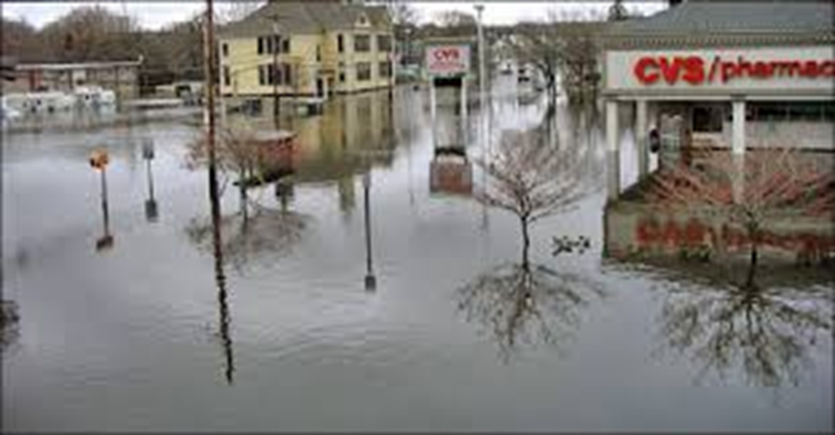
Flooding issues in Connecticut
Riverine Flooding
Flash Flooding
Coastal Flooding
Winter Thaws
Spring rains
Thunderstorms
Nor’Easters
Tropical and Extra-Tropical Storms
Hurricanes

Slide 3
Nonstructural presentation
This presentation will discuss
Flood Risk Mitigation Resources and where to find them
Nonstructural measures to flooding problems
Floodproofing Buildings - Nonstructural methods
What is Nonstructural?
You are not going to “build” something to change the path of the flood.

Slide 4
Flood Mitigation Resources
Process for identifying potential projects
– Receive requests from communities
– Review Hazard Mitigation Plan and State priorities
– Identify other grant program proposals that were not funded
– Technical Assistance ideas from Silver Jackets team or other USACE staff

Slide 5
Flood Mitigation Resources
Consider programs that might be more suitable:
– USACE - Planning Assistance to States, Floodplain Management Services and the Continuing Authorities Program
– Other federal and state agency programs
FEMA - Hazard Mitigation Grant Program (now BRIC),
HUD Community Development Block Grant
EPA various grant opportunities
NOAA various grant opportunities
NRCS specific programs coordinated with the state

Slide 6
USACE Technical Assistance Programs*
* Info current as of 2017 – please verify cost shares, etc. still current be using.
Authority (as amended) | Purpose | Cost Share (Fed / non-Fed) | Comments
Section 22, WRDA 1974, as amended | Planning Assistance to States (PAS) Develop plans and conduct studies related to development, use and conservation of water and related land resources. | 50% / 50% May include work-in-kind. | Technical or planning assistance only; cannot conduct feasibility-level planning, site specific design or studies leading to construction.
Section 206, Flood Control Act of 1960, as amended | Flood Plain Management Services (FPMS) Provide technical & planning services to encourage prudent floodplain development | 100% / 0%
Section 729, WRDA 1986, as amended | Watershed Planning Assess water resource needs for management, restoration and development in river basin | Federal 75% / 25%
Section 203, WRDA 2000, as amended | Tribal Partnership Program (TPP) Assist with water resources projects that address economic, cultural and environmental needs. | 50% / 50% | Construction must be Congressionally authorized and appropriated
Interagency & International Services | Support for Others Provide technical assistance to others (except DoD agencies and private citizens) | 0% / 100% | Thomas Act Restrictions

Slide 7
Flood plain management services (FPMS)
Provides USACE expertise to address flood plain and off flood plain use changes, flood risk and flood hazards
Studies / guidance / assistance for non-Federal governments at full Federal cost*;
ability to accept contributions to achieve greater outcomes
*cost-recovery basis for other Federal agencies or private persons
Some FPMS Activities & Products
Floodplain delineation
Flood hazard evaluation
Hurricane evacuation
Flood warning / preparedness
Comprehensive floodplain management
Flood risk reduction
Urbanization impacts
Storm water management
Inventory of flood-prone structures
Workshops
Guides and Pamphlets / Risk Communication
Tabletop exercises
Emergency Action Plan / Floodplain Management Plan Assistance
Natural and nature-based solutions
Assessment tools and processes
Notes:
Emphasize the broad range of what can be done under this authority
Mention the other sub-programs
Urge people to contact their District or MSC FPMS PM
Mention broad administrative and Congressional support, hence increasing budget
Bottom-driven
Avenue by which we can provide USACE expertise to meet non-Federal governmental needs/priorities

Slide 8
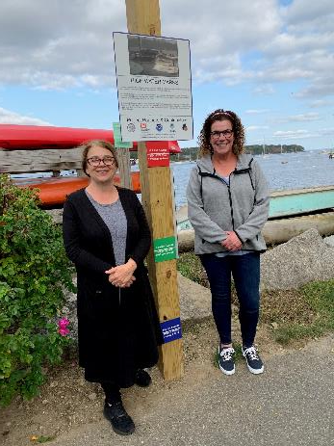
FPMS Interagency Nonstructural Efforts in New England
Risk Communication:
ME High Water Marks: Portland, York, South Portland, Scarborough and Belfast
MA High Water Marks: Boston
Floodproofing Building Approaches:
Gardiner, ME Flood Proofing Study
Nonstructural Assessments of Historic Structures in Kennebunk and Kennebunkport, ME
Assessment of Historic Structures, Cape Cod, MA
Historic Structure Flood Mitigation Guidance, North Kingstown, Bristol and Newport, RI
Modelling and Mapping Tools:
VT Inundation Mapping in Montpelier
VT HEC-RAS and EAP, Brattleboro
ME Dynamic Inundation Mapping Project: Casco Bay

Slide 9
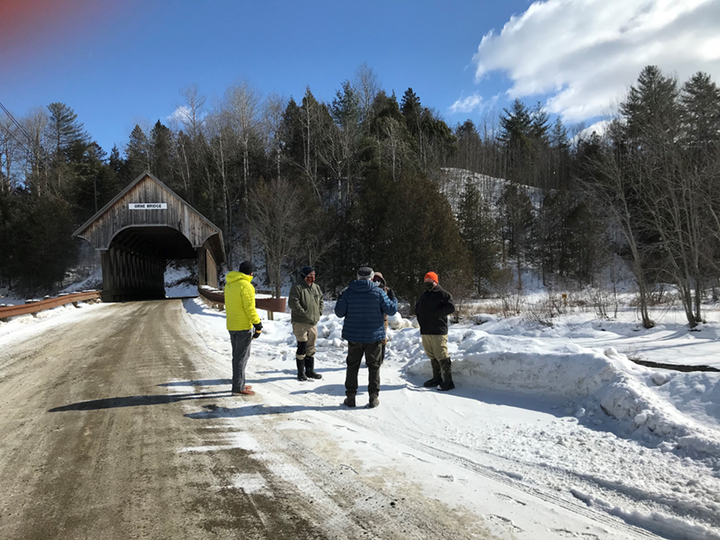
FPMS Interagency Nonstructural Efforts in New England
Information Sharing:
NH Flood Hazards Handbook
CT Flood Toolkit
Emergency Action Planning:
MA Town of Charlemont Flood Risk Action and Evacuation Plan
NH Buildout the Silver Jackets Role in State Disaster Recovery Plan
Ice Jams:
NH Ice Jam Outreach Project
CT Ice Jam Outreach Project
VT Ice Jam Assessment and Outreach
Analysis and Assessment:
RI Historical Structure Flood Hazard Vulnerability Assessment

Slide 10
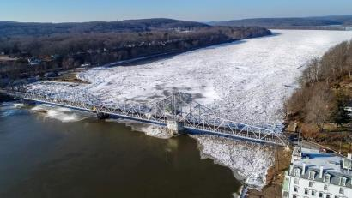
FPMS Interagency Nonstructural Connecticut Silver Jackets Ice Jam Assessment
Partners: CT Department of Emergency & Homeland Security; CT Department of Energy & Environment Protection; Town of Haddam, Town of Kent, FEMA R1; NOAA NWS; USGS
Project Description: Ice jams and ice jam related flooding cause damages including loss of life and property, structural damage, bed and bank erosion and scour, riprap failure, increased flood fighting and assistance costs, and environmental damage. Ice jam issues and possible mitigation techniques were evaluated in four communities across the state.
Objectives:
Through partnership with USACE Cold Regions Research and Engineering Laboratory, and The National Weather Service, state and local officials have increased their understanding of ice jam science and the causative mechanisms leading to such occurrences.
Total project cost: $100K; $70K USACE/$30K Partners
Outcomes: Town officials along with NWS are now observing and monitoring ice development in the rivers.
Benefits to Partner/Community: The engagement of local, state and federal agencies with the communities with respect to mitigation strategies including early warning systems and awareness demonstrates responsiveness to local concerns which will continue into the future.
POC: Sheila Warren, New England District.

Slide 11
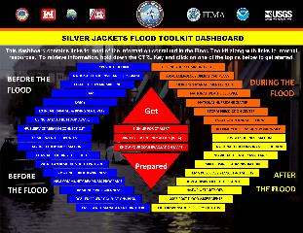
FPMS Interagency Nonstructural Connecticut Silver Jackets Flood Toolkit
Partners: CT Department of Emergency & Homeland Security; CT Department of Energy & Environment Protection; FEMA R1; NOAA NWS; USGS.
Project Description: Produce a focused guide (toolkit) for municipalities/tribal nations to use before, during, and after a flood. CT Silver Jackets team, comprised of many of the state and federal agencies that towns coordinate following a flood event, compiled a statewide flood response toolkit to be provided to each town to help address flood response and recovery issues.
Objectives:
The toolkit will provide information for town officials and staff regarding where to obtain flood risk data and information, how to manage a flood during the event, and resources available to recover from a flood.
Local officials using the toolkit will have expert guidance and potential sources of assistance from state and federal programs that can help them work towards a more flood-resilient future through better community preparedness and mitigation efforts.
The toolkit is a “live dashboard” available online for all to use.
Total project cost: $60K; $30K USACE/$30K Partners
Outcomes: The Toolkit increases awareness of CT natural hazards and state planning efforts by encouraging State agencies, regional entities, local communities, and the general public to be proactive in taking actions to reduce long-term risk to life and property.
Benefits to Partner/Community: This comprehensive resource guide benefits local Emergency Management Directors (EMD), Chief Elected Officials (CEO), and citizens of CT aiding in planning for, responding to, and recovery from flooding events.

Slide 12
Flood Objective Outcomes:
Progression from Awareness to Action
Reduce or manage flood risk.
Raise flood risk awareness.
Prompt flood risk action.
Progression from Awareness…
To Action…
To Impact
Notes:
Our goal Seeking:
Progression from identification/assessment and awareness, through action, to reduced risk
Progression from what COULD happen to specific changes that WILL result in some sort of measurable reduction in risk.
Non-monetary social benefits - Other desired outcomes we look for are non-monetary social benefits such enhanced social cohesion at the community or neighbor-to-neighbor level, improved livability, quicker and better flood recovery, reduced human health impacts, improved life safety, and improved protection of cultural features.
Improved Environmental function - And improved environmental function which might include reduced stream or shoreline erosion, protected or restored habitat, and restored natural floodplain functions.

Slide 13
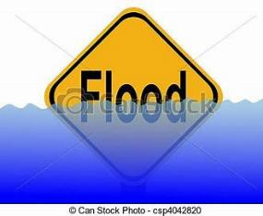
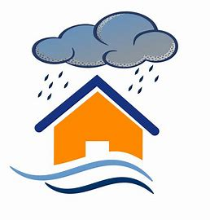

Mitigation: THREE STRATEGIES:
1: Structural | 2: Nonstructural | 3: Nonphysical
Modify floods | Modify susceptibility to flood damage | Modify the adverse impacts on individuals and communities

Slide 14
Floodproofing Buildings –
Nonstructural Measures
Physical Measures:
Elevation
Wet Floodproofing
Dry Floodproofing
Basement Removal
Relocation
Acquisition
Nonphysical Measures:
Floodplain Mapping
Flood Insurance
Land Use Zoning
Operational Changes
Emergency Preparedness Plans
Flood Warning
Evacuation Plans
Notes:
This slide describes nonstructural flood risk adaptive measures in two categories; physical (implemented on individual structures) and nonphysical (implemented as management practices within the floodplain)

Slide 15
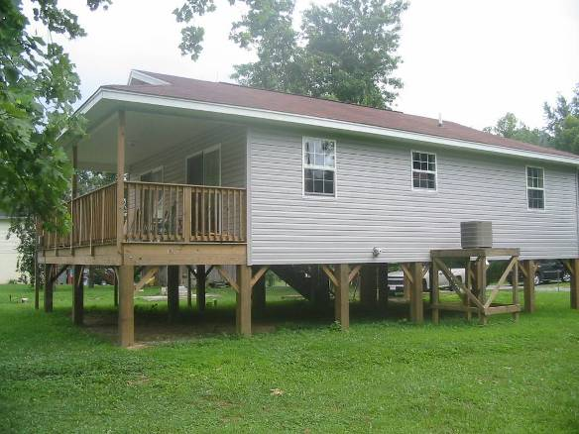
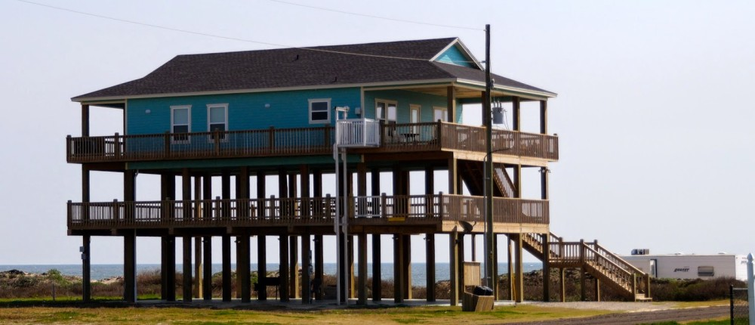
Elevation On Posts or Piles
Notes:
Elevation on posts or piles
Need to elevate utilities too
12 foot max elevation for first floor
Wind loads can become a significant cost factor when considering elevation at or above 12-feet.
Will also require landings for stairways beyond 12-foot elevation
Better for higher velocity areas, like coastal areas, V-zones, where velocity can be an influence.
Need to consider scour at piers and possibly protect against that if soils are erodible. The house in the upper left picture experienced such a failure, and they had to extend piers deeper when they fixed the issue.

Slide 16
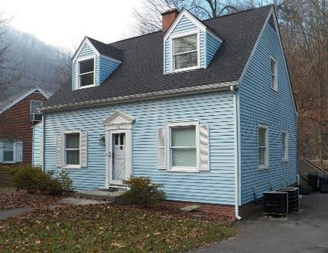
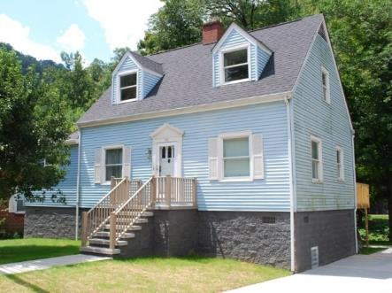
Elevation on Walls
Notes:
Elevation as a physical nonstructural mitigation technique on extended foundation walls. Flood vent shown highlighted in ‘red’ circle
Best for low velocity areas, so that foundation walls are not adversely impacted.
As a rule of thumb, can elevate to a maximum height of 12 feet. Above that height can cause high risk for trapped inhabitants and first responders.
Heights greater than 12 feet also trigger more building code compliance issues. For example, there must be a landing on staircases when the height is greater than 10-12 feet.
Also increases structural design complexity.
One downside is that homeowners often try to use their new space as living space, which defeats the purpose of flood proofing.
Hydrostatic pressure on solid foundation walls are a concern, hence the need for adequate flood vents near the bottom of the foundation walls.

Slide 17
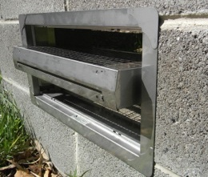
Purpose of a Flood Vent

Slide 18
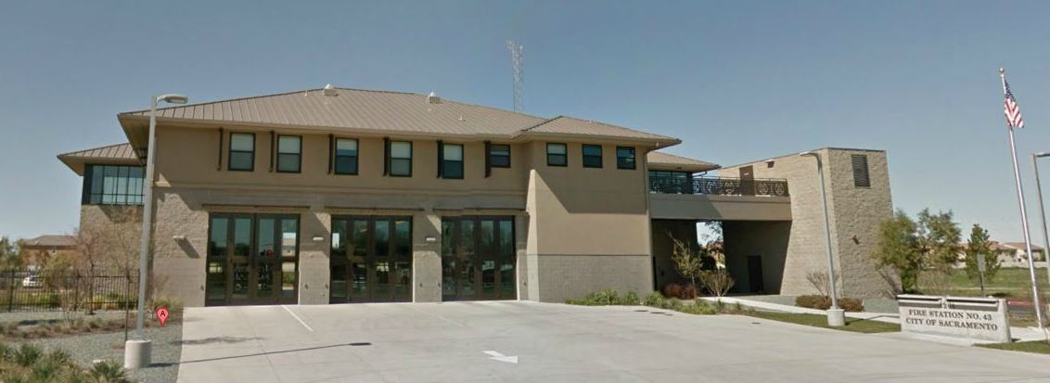
Wet Floodproofing
Notes:
Wet Flood Proofing
The living quarters, kitchen, and communication center are elevated onto second flood at the fire station

Slide 19
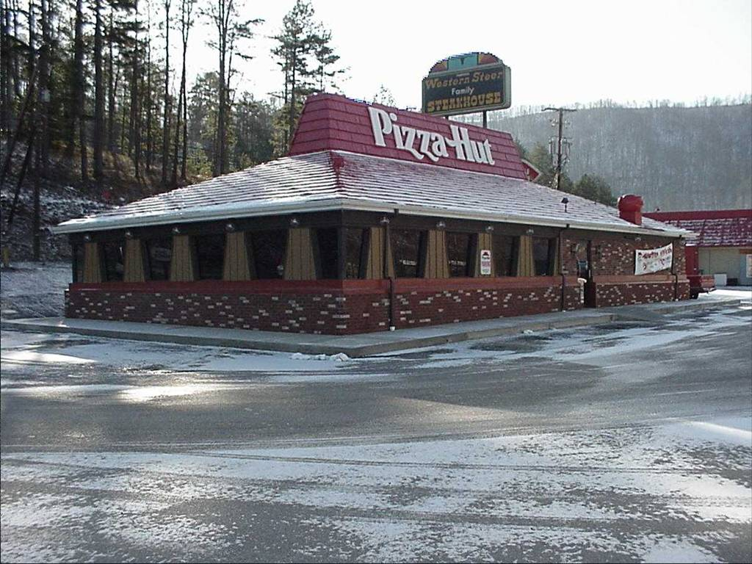
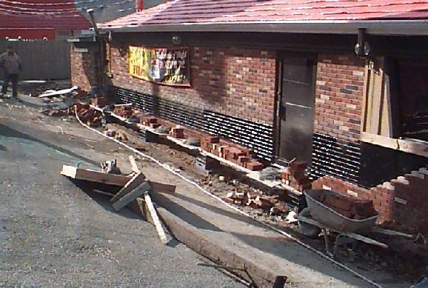
Dry Floodproofing - Passive
Notes:
Dry Flood Proofing
For general construction (wood frame), dry flood proofing is favorable for flood depths of 3 - 4 feet. May be able to go higher with stone/masonry walls
Need structurally sound exterior walls to retrofit or with new construction
Can’t have a basement or crawl space as flood waters will seep into these voids and possibly enter the first floor from below.
Example of permanent floodproofing, and they will also need to employ a temporary barrier across the door.

Slide 20
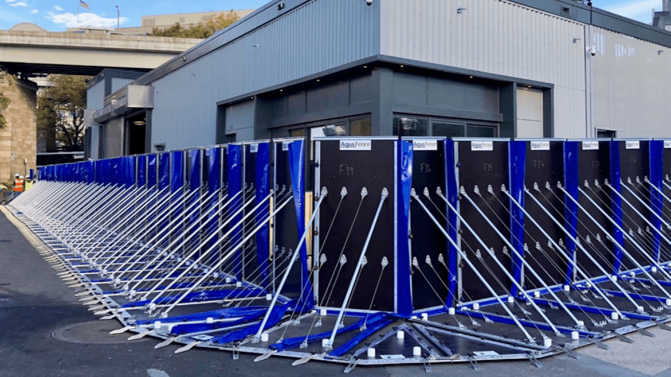
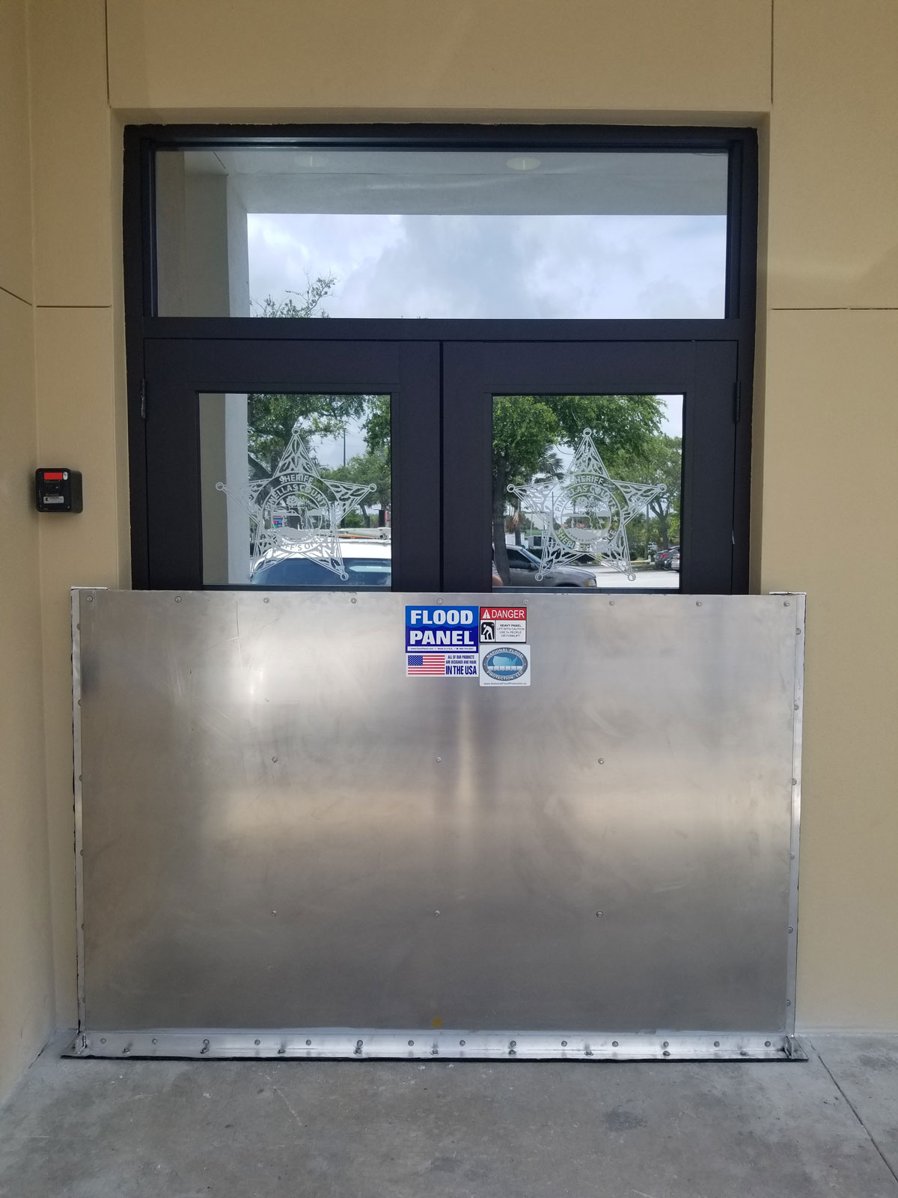
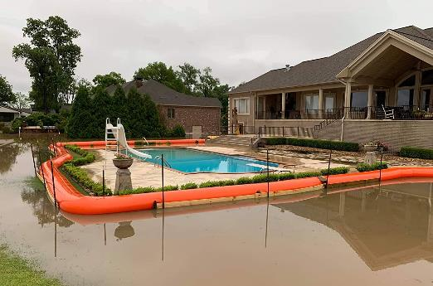
Dry Floodproofing - Active

Slide 21
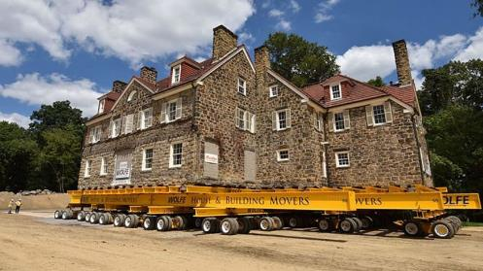
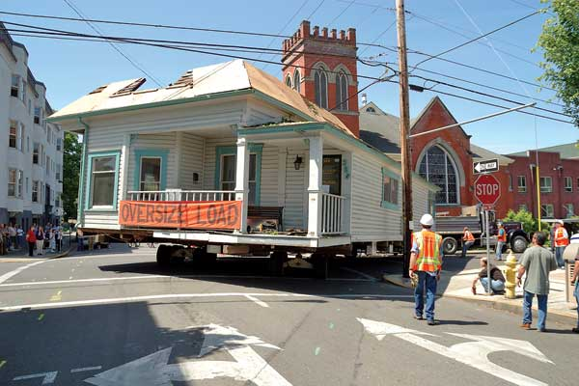
Relocation

Slide 22
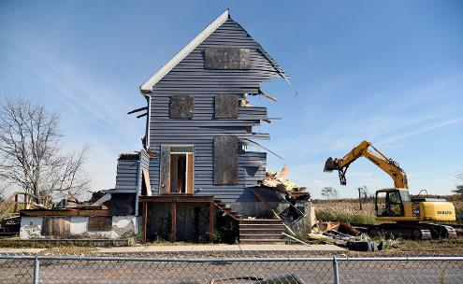
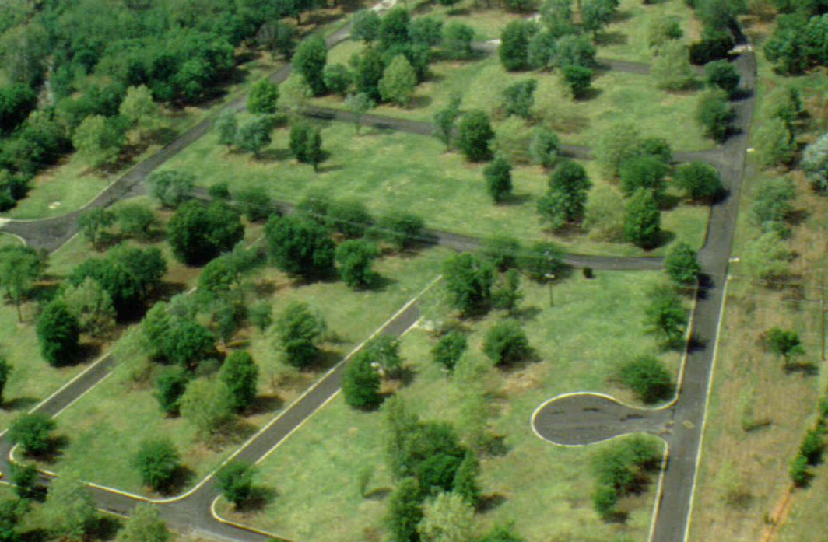
Acquisition

Slide 23






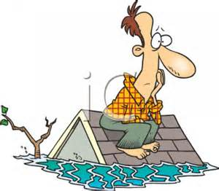
Assessing The Situation
Flood Characteristics
Flood depth, Flood velocity, Flood duration, Rate of rise, Debris/Ice flows, Wave action, Floodway, Other(?)
Site Characteristics
Location, Soil type, Topography, Site size, Urban/Rural, Other(?)
Building/Structure Characteristics
Type of construction, Foundation, Condition of the building, Lower levels (Basement), Historical Significance, Other(?)
Other Considerations
Building Occupancy, Building Codes, Zoning Ordinances and Local Restrictions, Other Agencies (Local / State / Federal), Aesthetics, Public Health/Safety/Welfare, Other(?)
Notes:
This slide depicts the specific areas of consideration when contemplating potential nonstructural techniques for an individual structure.
Flood characteristics
Site characteristics
Building/structure characteristics
Other considerations
These physical nonstructural techniques are different than the nonphysical techniques, in that they are applied to individual structures.

Slide 24
matrix
May 2019 Planners Assoc. |  | Flood Damage Reduction Measures
 |  | Nonstructural Mitigation Measures
FLOOD DAMAGE REDUCTION MATRIX |  | Elevation on Perimeter Walls | Elevation on Piers | Elevation on Posts or Columns | Elevation on Piles | Elevation on Fill | Relocation | Buyout/ Acquisition | Dry Floodproofing | Wet Floodproofing | Flood Warning Preparedness
Flooding Characteristics | Flood Depth
 | Shallow (<3 ft.)
 | Moderate (3 to 6 ft.)
 | Deep (>6 ft.)
 | Flood Velocity
 | Slow (<3 fps)
 | Moderate (3 to 5 fps)
 | Fast (>5 fps)
 | Flash Flooding
 | Yes (less than 1 hour)
 | No
 | Ice and Debris Flow
 | Yes
 | No
Site Characteristics | Site Location
 | Floodway
 | Coastal Flood Plain
 | Beach Front (V-Zone)
 | Interior (A-Zone)
 | Riverine Flood Plain
 | Soil Type
 | Permeable
 | Impermeable
Building Characteristics | Structure Foundation
 | Slab on Grade
 | Crawl Space
 | Basement
 | Structure Construction
 | Concrete or Masonry
 | Metal
 | Wood
 | Structure Condition
 | Excellent to Good
 | Fair to Poor

Slide 25

Questions?
FOR MORE INFORMATION
USACE Silver Jackets Web Site
http://silverjackets.nfrmp.us/
USACE NAE SILVER JACKETS COORDINATOR
Sheila Warren, Sheila.M.Warren@usace.army.mil

