Slide 1
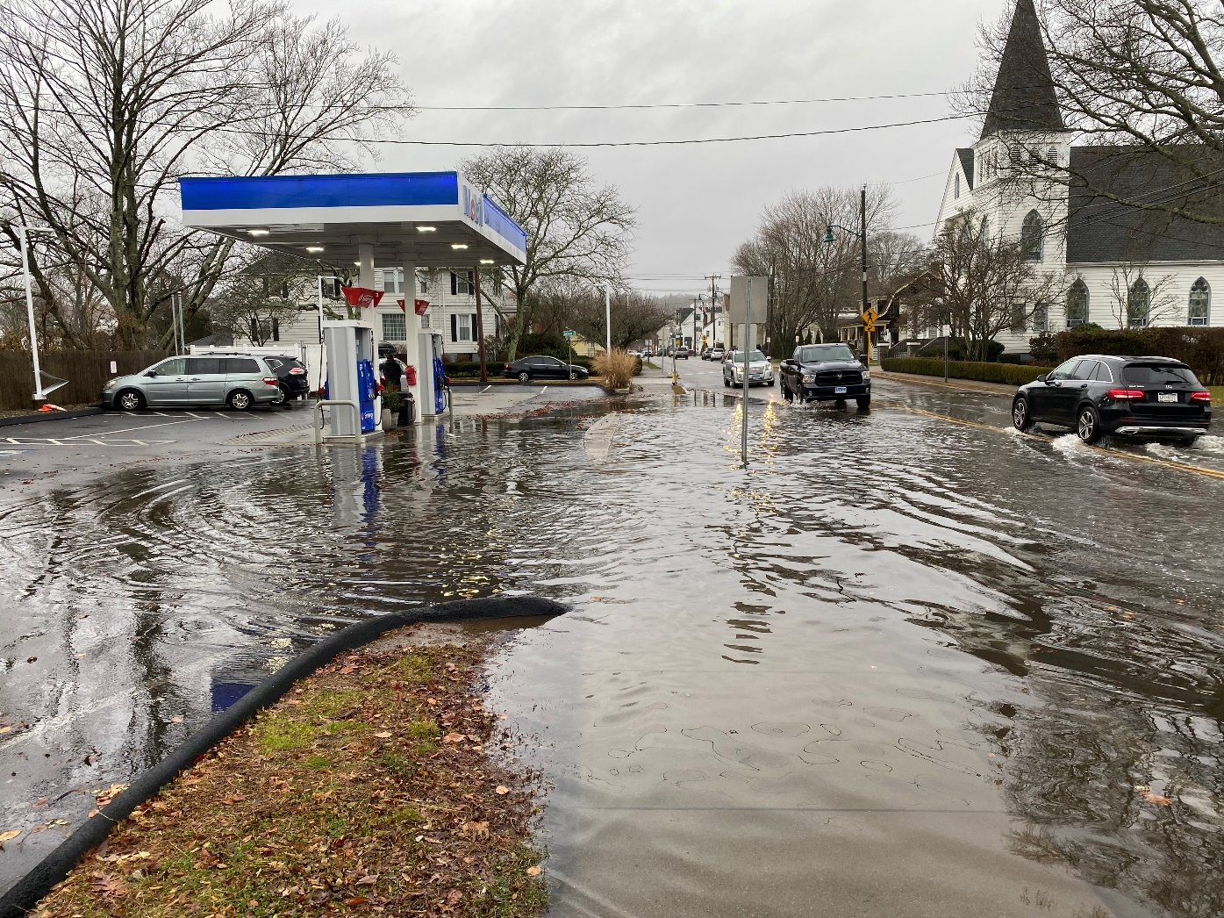
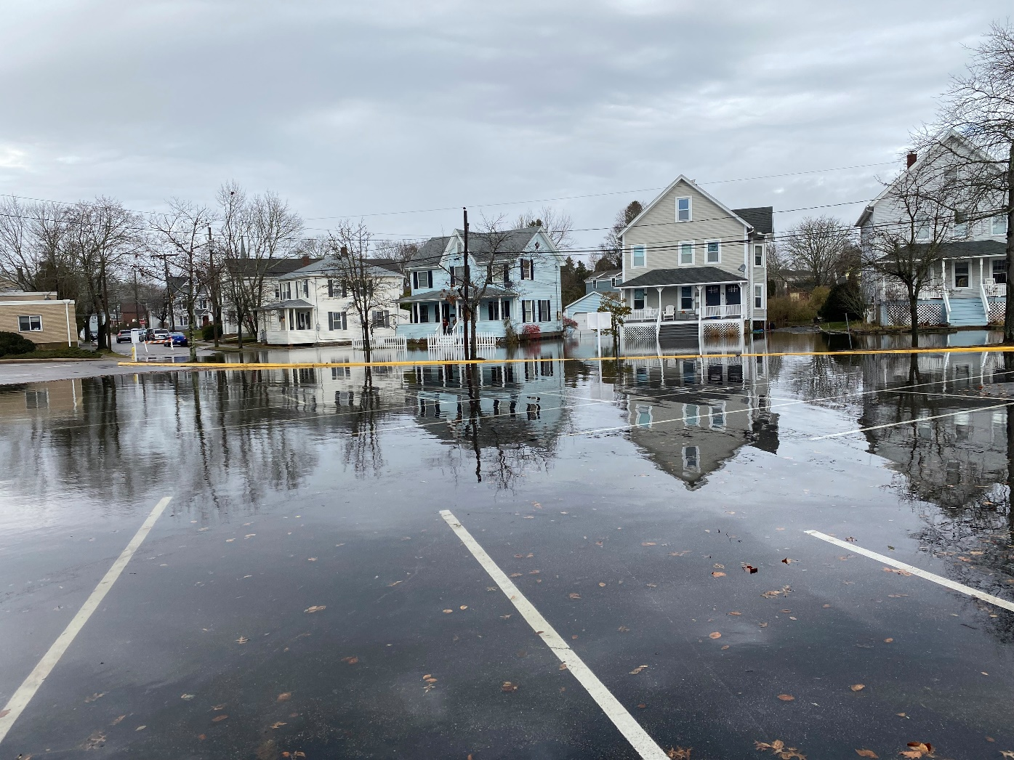

John Truscinski, CFM
Director of Resilience Planning
Connecticut Institute for Resilience and Climate Adaptation
Climate Change Effects on Coastal Flooding in Connecticut
May 23rd, 2023
Notes:
Sandy was a wake up call for changes to BAU. Since that time CIRCA has set about trying to answer key questions related to climate impacts for CT.

Slide 2
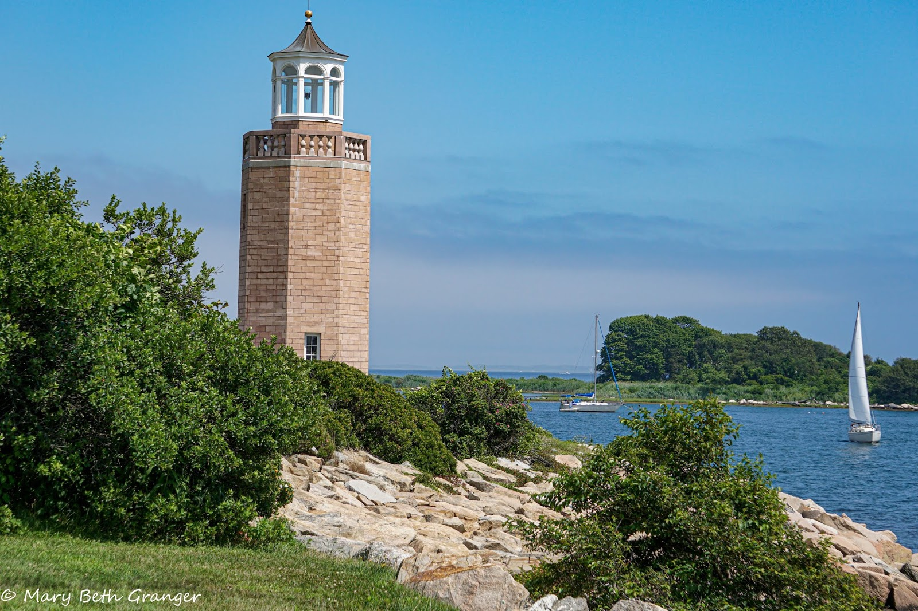

Increase the resilience and sustainability of vulnerable communities in Connecticut’s coastal and inland areas to severe storms and the growing impacts of climate change on the natural, built, and human environment in response to critical, identified needs and priorities.
CIRCA Mission
Notes:
CIRCA was created in 2014 as a partnership between the CT DEEP and U. of Conn. With the mission of helping coastal and inland communities respond to recent disasters and increase preparedness to climate impacts going forward.
The idea of this partnership was to connect the scientific expertise and research capacity of the University with the practical needs of state agencies, municipalities, and regional planning organizations in CT, in responding to climate change.
We work with local communities, state agencies, regional planning organizations, NGOs, private sector, academic partners to help CT address practical and applied issues around climate adaptation.

Slide 3
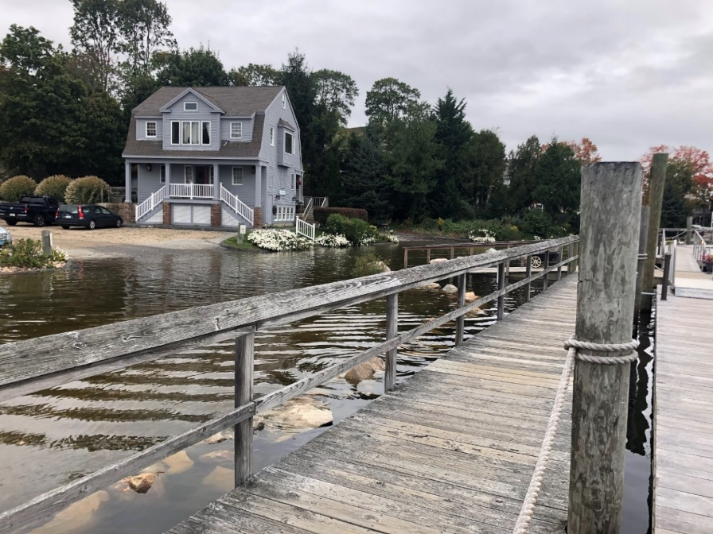
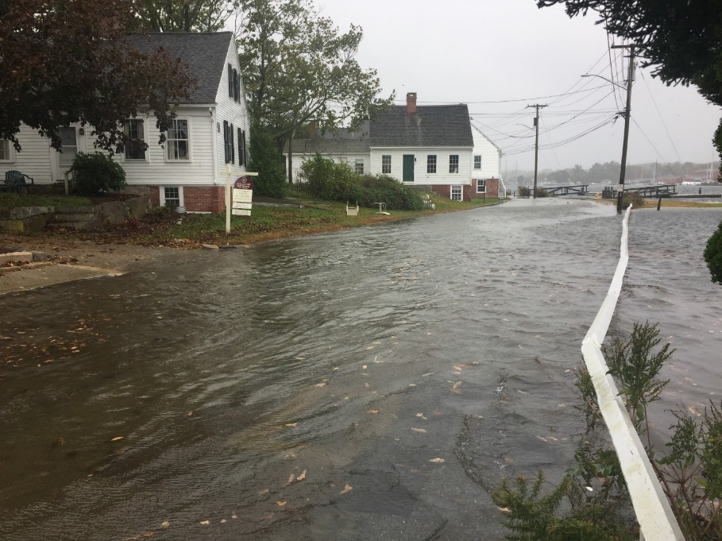
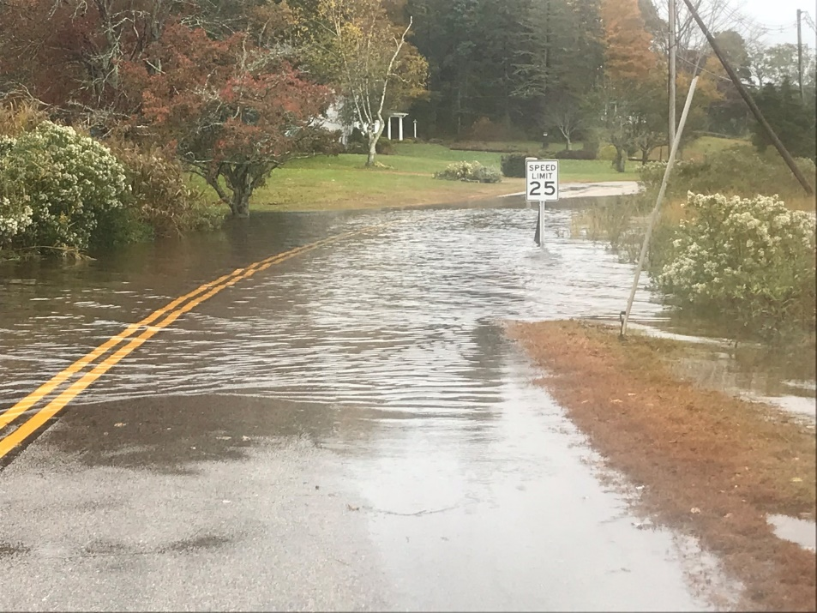
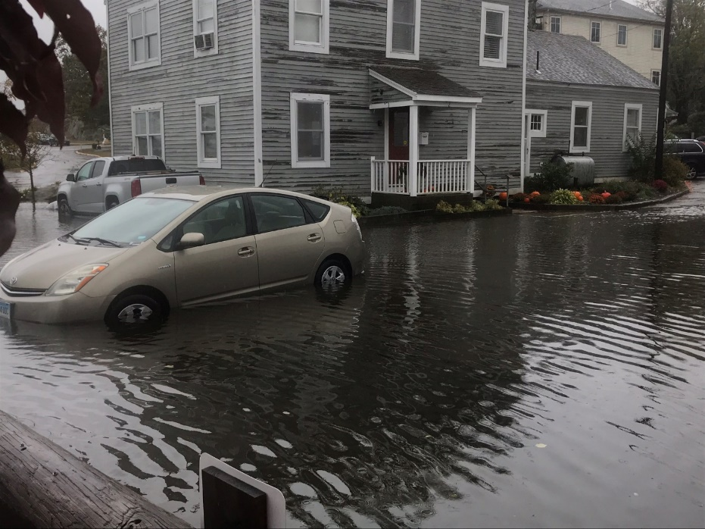
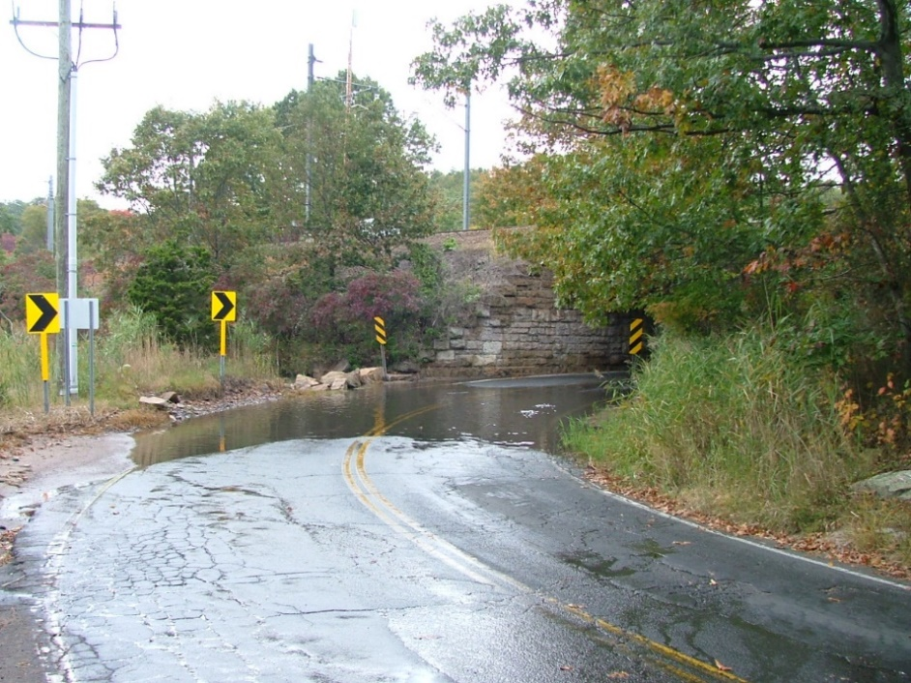
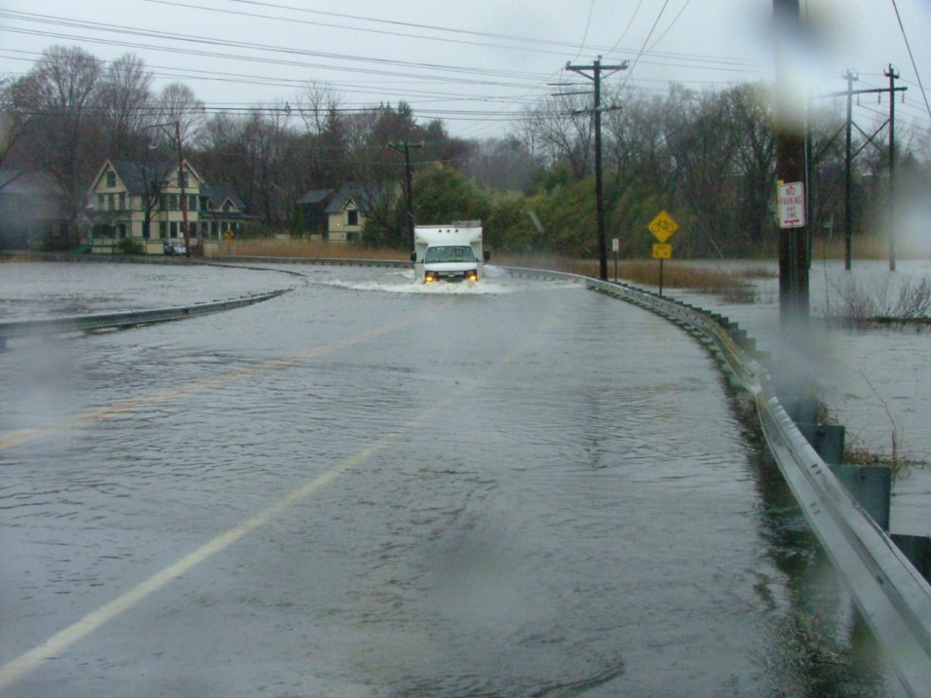
Groton
Mystic
Mystic
Groton
Branford
Guilford
Notes:
The Connecticut shoreline is also increasingly vulnerable to flooding from nor-easters (extra tropical cyclones) and low severity hurricanes
These occur much more frequently, about ones a week in the winter, but aren’t as devastating and hurricanes (tropical cyclones).
These are all images taken in the last few years in Groton, Mystic, Branford and Guilford
Increasing mean sea level means that flooding the storm cause be more extensive. Properties and road that get flooded once in five year now, could expect it perhaps once every year in 2050.
But addressing these problems is practical. Smaller projects can restore risks to what they were 100 years ago. But we need many of hem and they will all be different.

Slide 4
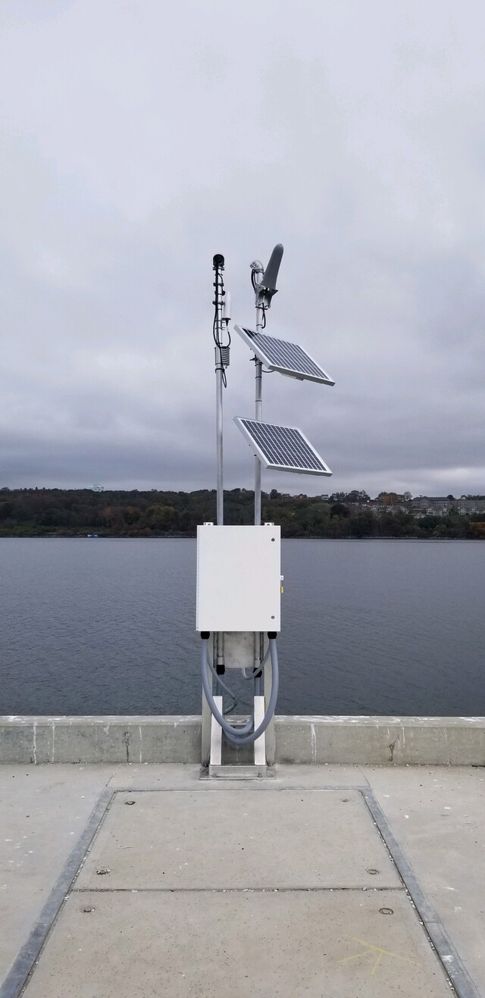
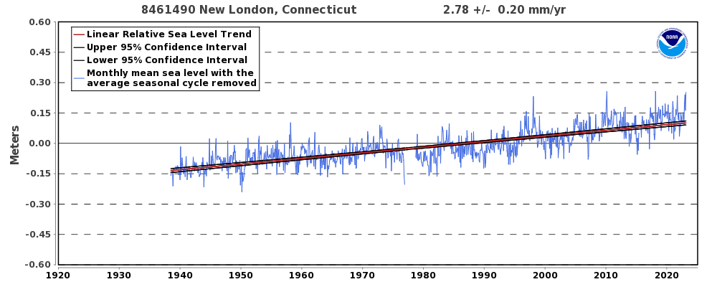
https://tidesandcurrents.noaa.gov/stationhome.html?id=8461490

Slide 5
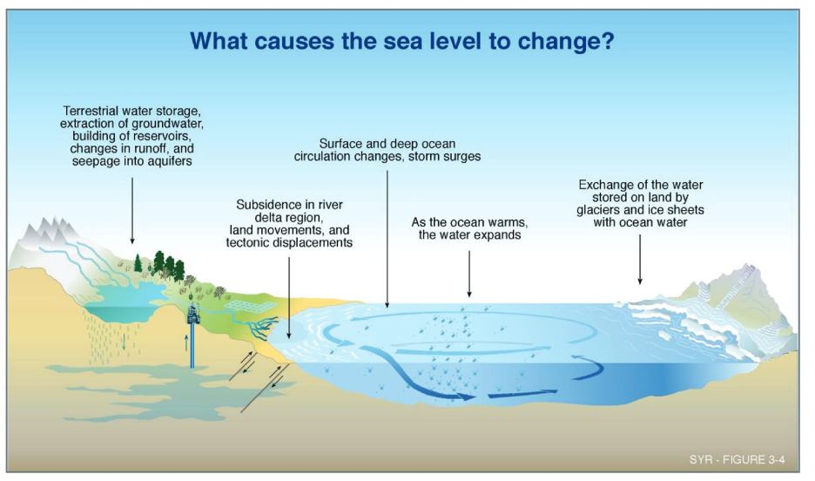

Slide 6
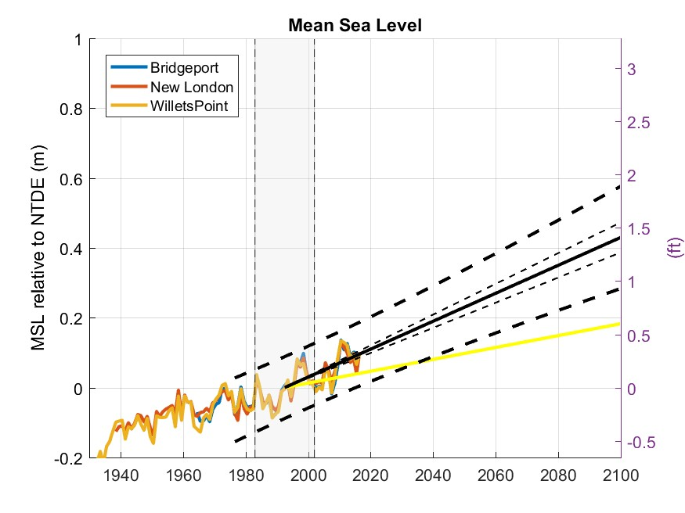
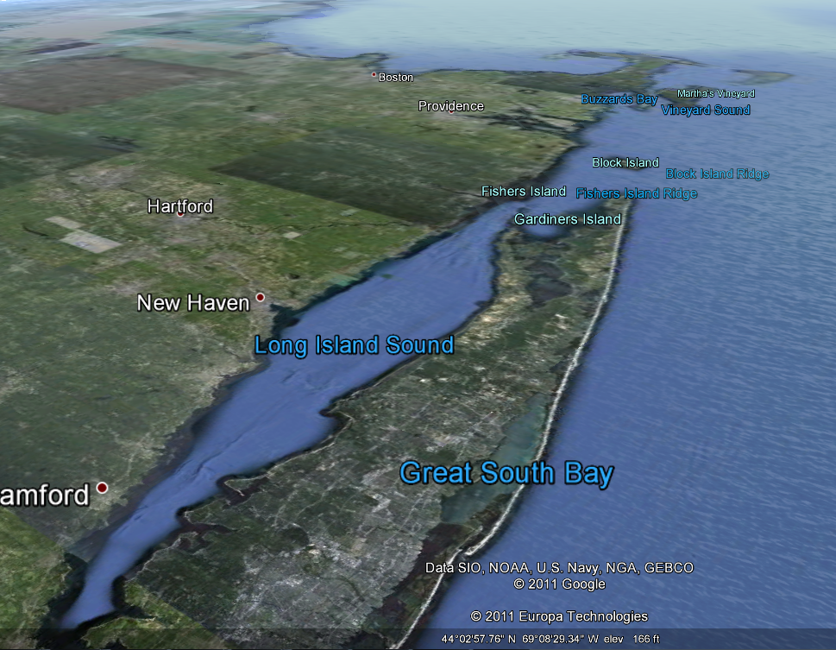
New London
Montauk Pt.
New Haven
Bridgeport
Kings/Willets Pt.

Slide 7
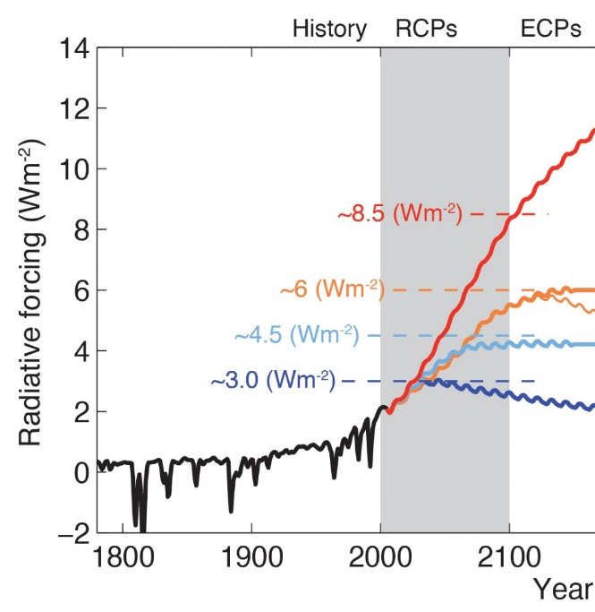
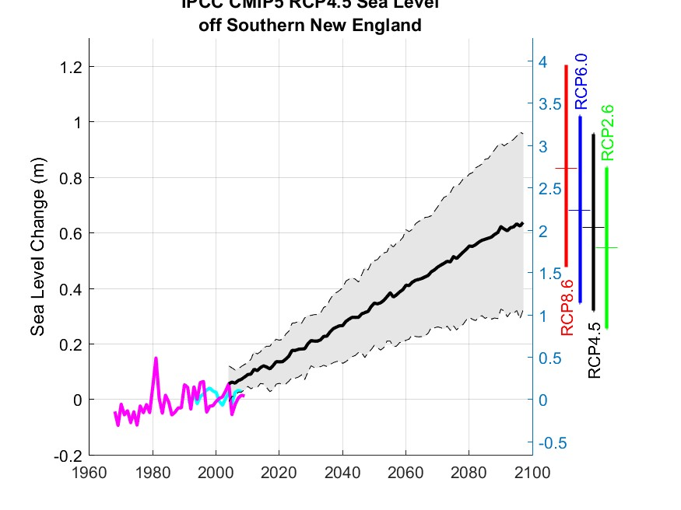
Net Change in “radiative forcing”
Model Projection of Mean Sea Level Near CT

Slide 8
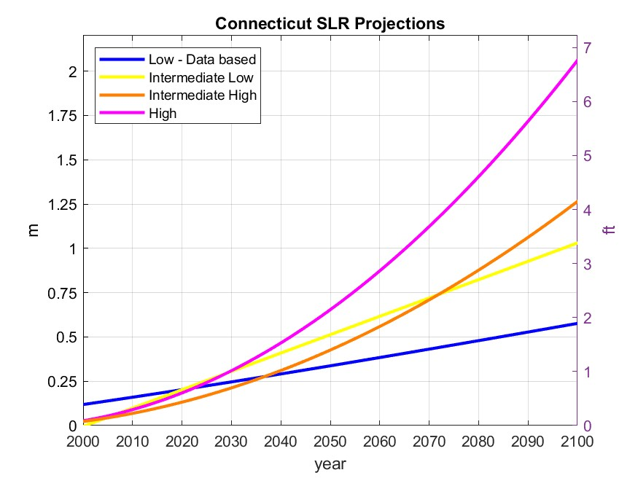
Alert threshold
Planning threshold
O’Donnell, 2018
https://circa.uconn.edu/sea-level-rise/
Notes:
Some things can be predicted with more confidence than others.
Changes in global averages are easier to estimate than for any region the size of CT
There is high confidence that warming will occur .. it could be UP TO 5F (3C) by 2050.
There is high confidence the global mean sea level will rise. At CT it will e higher than average and more uncertain.
Measurement in Connecticut show warming over the last century
Simulations project UP TO 3ºC (5ºF) by 2050
Measurements at New London show sea level has risen in the last century
We project an increase of UP TO 20 inches by 2050

Slide 9
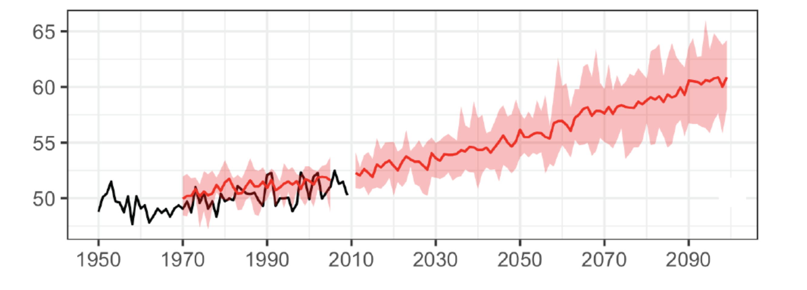
Climate Change in Connecticut
Measurements and model projections (with no CO2 reductions) of annual mean temperature in CT – CIRCA’s PCSAR report (Seth et al, 2019)
Alert threshold
Planning threshold
Plan for:
Sea level rise UP TO 20 inches (0.5m) by 2050
Air warming UP TO 5ºF (3ºC) by 2050
Increases in avg. annual and extreme precipitation
Continue to update guidance every 5 years as science evolves (next update in 2023)
O’Donnell, 2018
https://circa.uconn.edu/sea-level-rise/
https://circa.uconn.edu/ct-climate-science/
Notes:
Some things can be predicted with more confidence than others.
Changes in global averages are easier to estimate than for any region the size of CT
There is high confidence that warming will occur .. it could be UP TO 5F (3C) by 2050.
There is high confidence the global mean sea level will rise. At CT it will e higher than average and more uncertain.
Measurement in Connecticut show warming over the last century
Simulations project UP TO 3ºC (5ºF) by 2050
Measurements at New London show sea level has risen in the last century
We project an increase of UP TO 20 inches by 2050

Slide 10
“Small changes to our climate can have big impacts on the conditions that affect people, infrastructure, ecosystems, and land use patterns.”
Governor’s Council on Climate Change (GC3) Infrastructure and Land Use Adaptation Working Group Recommendations Report
September 21, 2020

Slide 11
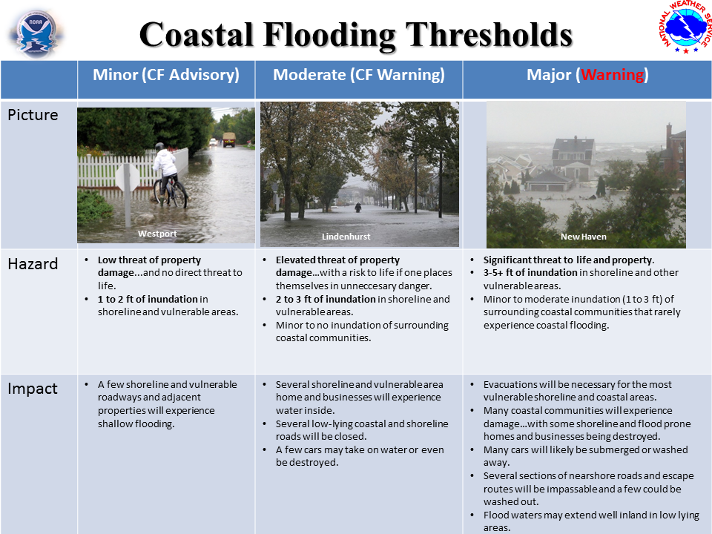
https://www.weather.gov/images/okx/coastalflood/Coastal%20Flood%20Threshold%20Definitions.png

Slide 12
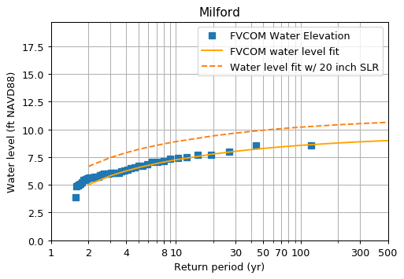
What we experience today as a 1% annual chance or “100-year storm” surge, will occur much more frequently, ~ 20% annual chance or “5-year storm”

Slide 13
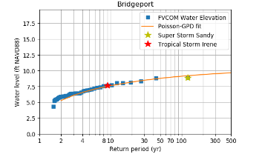

Slide 14
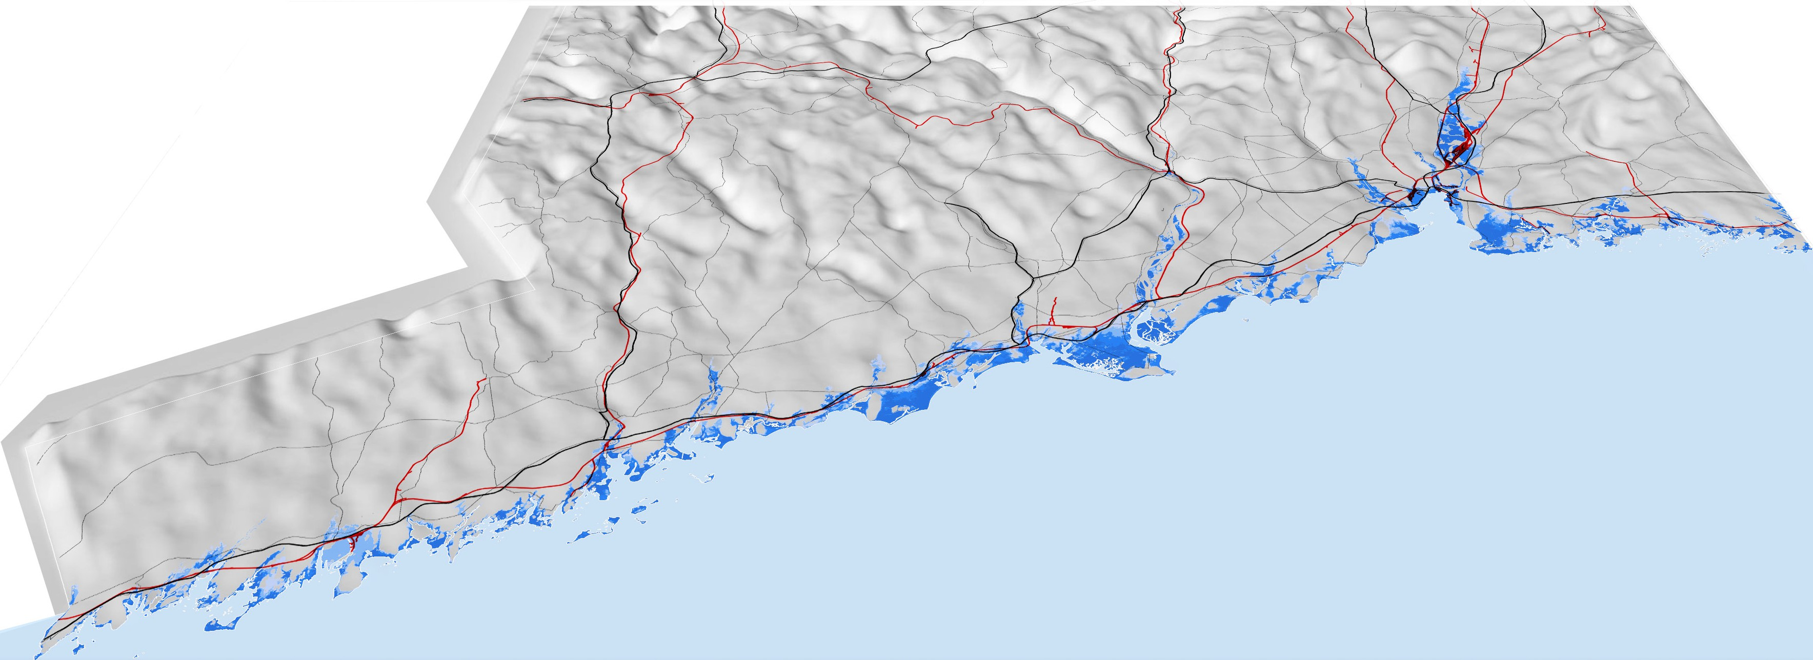
Connecticut’s patches of risk

Slide 15
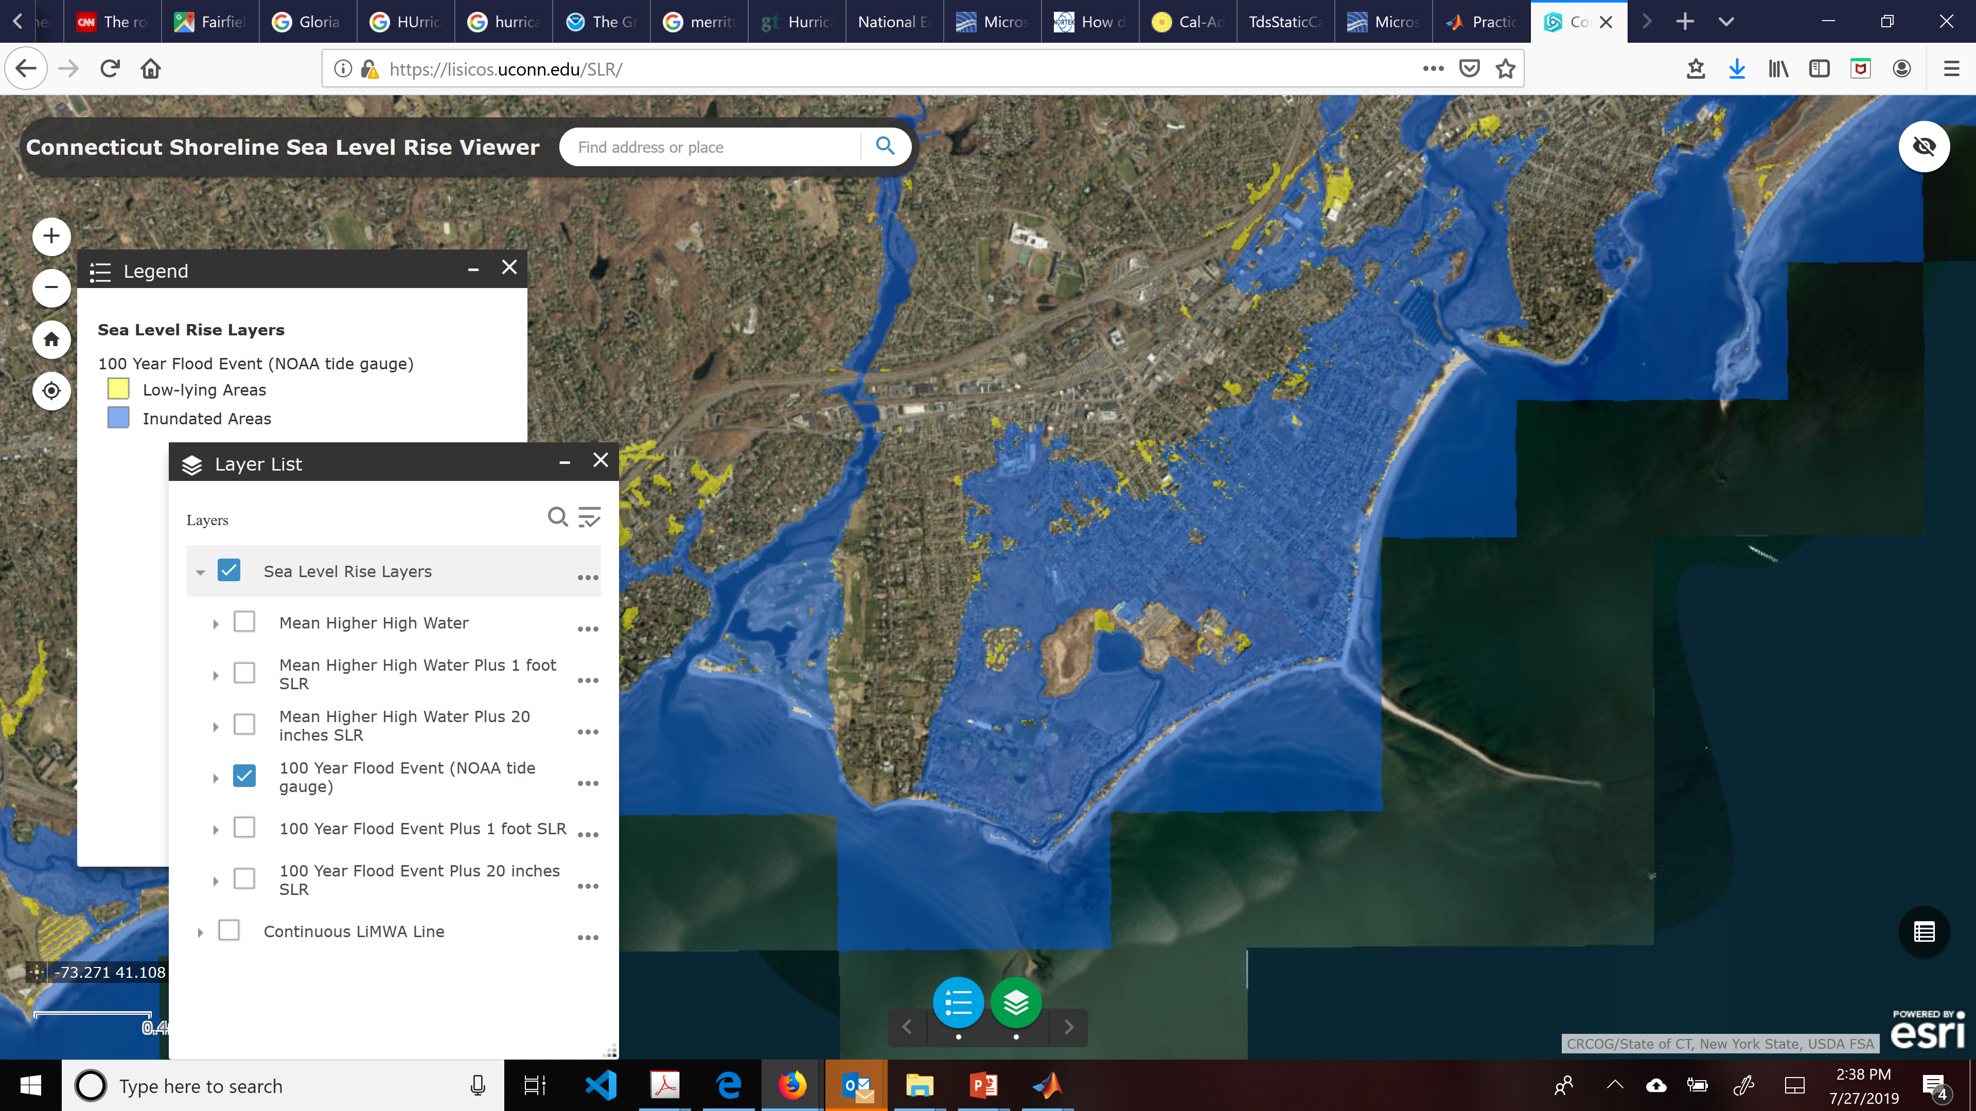
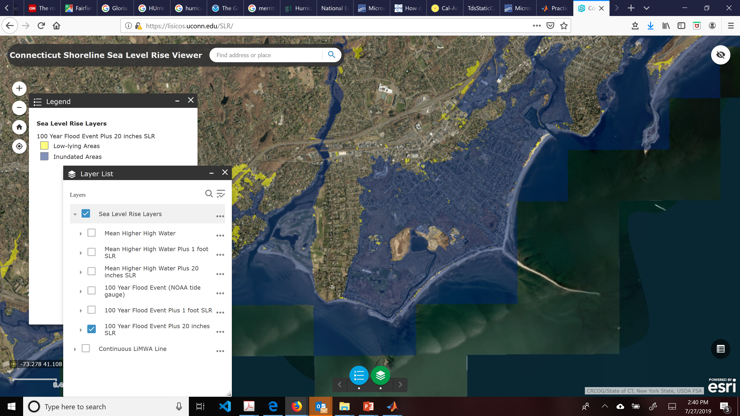
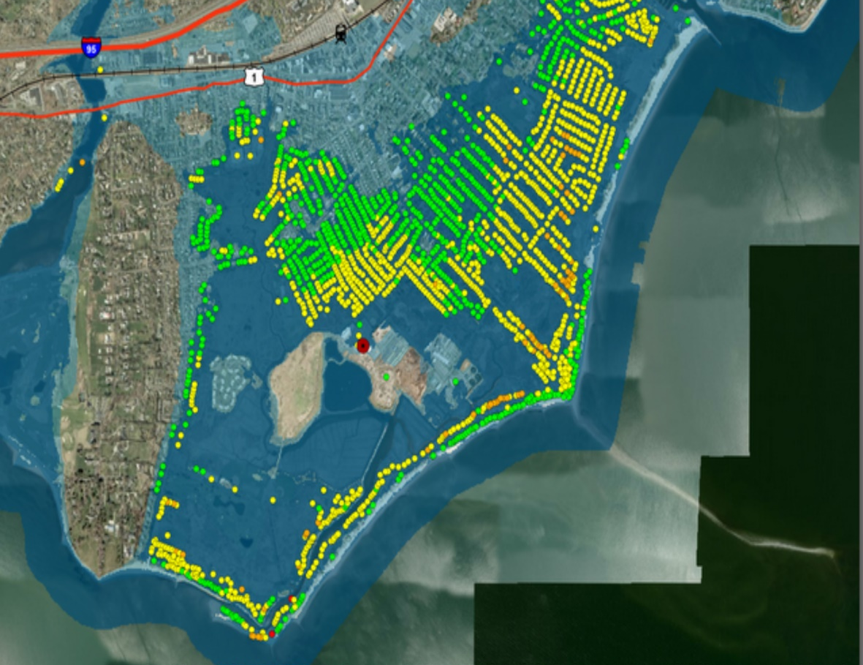
IMPACTS
Hurricanes are potential devastating and costly, but infrequent.
$675 billion in assets insured and at risk of hurricane damage on the CT coast as of 2017
The 100 yr flood zones will not expand very much because of the geology of CT
Properties Flood in Fairfield During Sandy
The water levels that lead to flooding will occur more frequently.
In 2050 the risk of the flooding like occurred in Sandy could be 5-10 time higher depending upon local geography. Generally, increases will be higher in the east.
https://lisicos.uconn.edu/SLR/
Notes:
These changes will have a big impact on Flood risk and Heat Stress.
The uncertainty in these projections at 2050 is not large
Increases will continue after 2050
Hurricanes in CT are already, potentially, devastating and extremely expensive
$675 billion in assets insured and at risk of hurricane damage on the CT coast as of 2017.

Slide 16
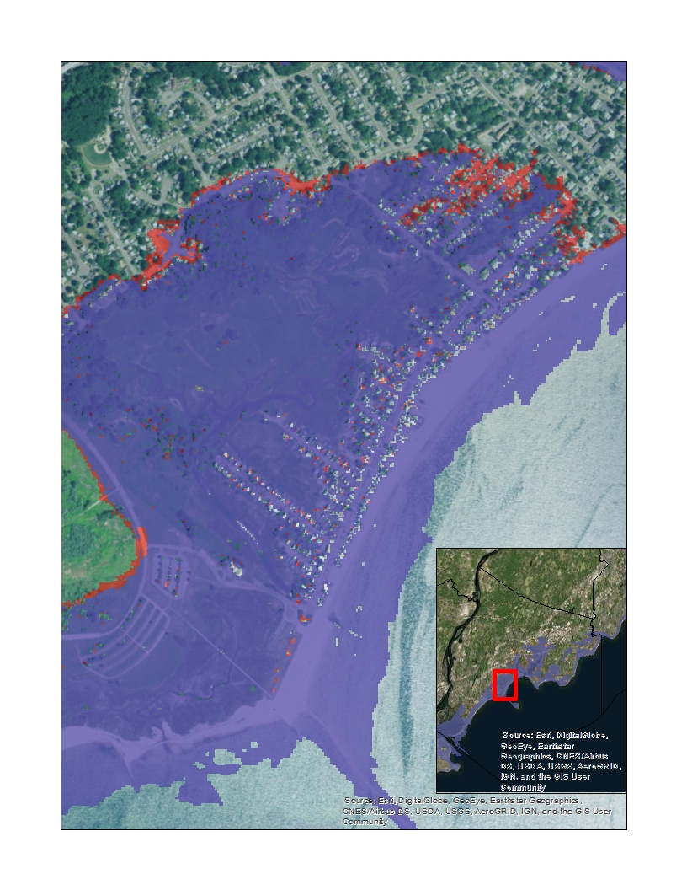

Slide 17
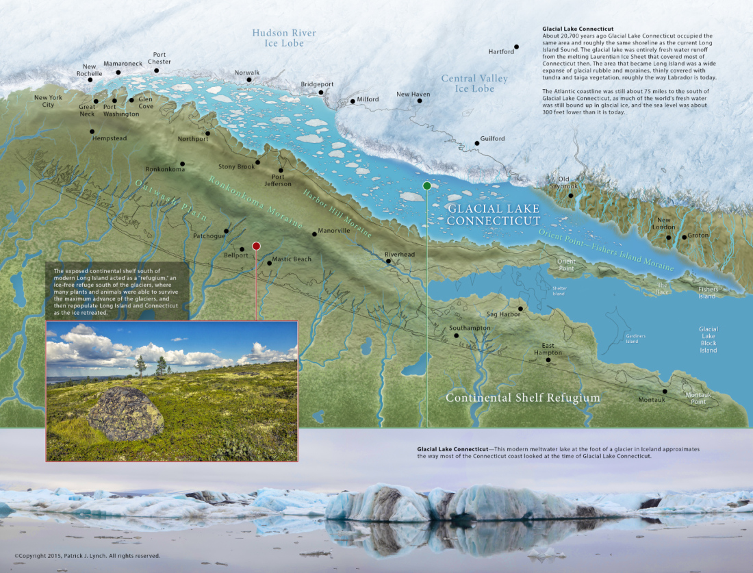
https://coastfieldguides.com/2015/07/21/glacial-lake-connecticut-map/

Slide 18
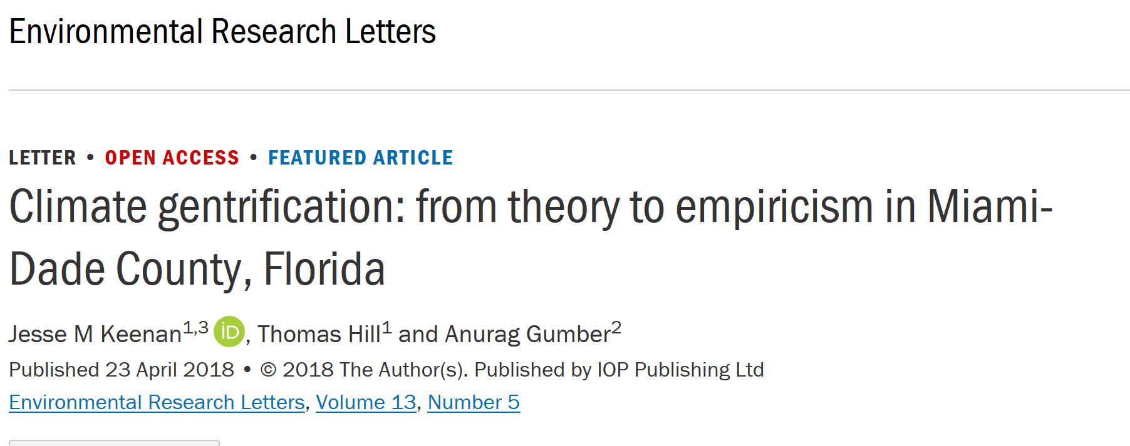
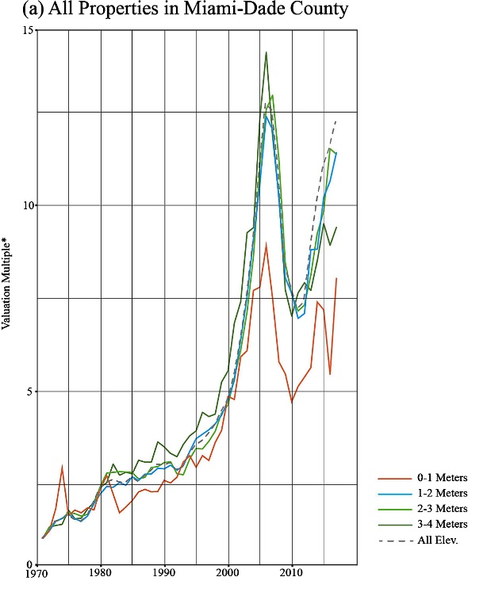
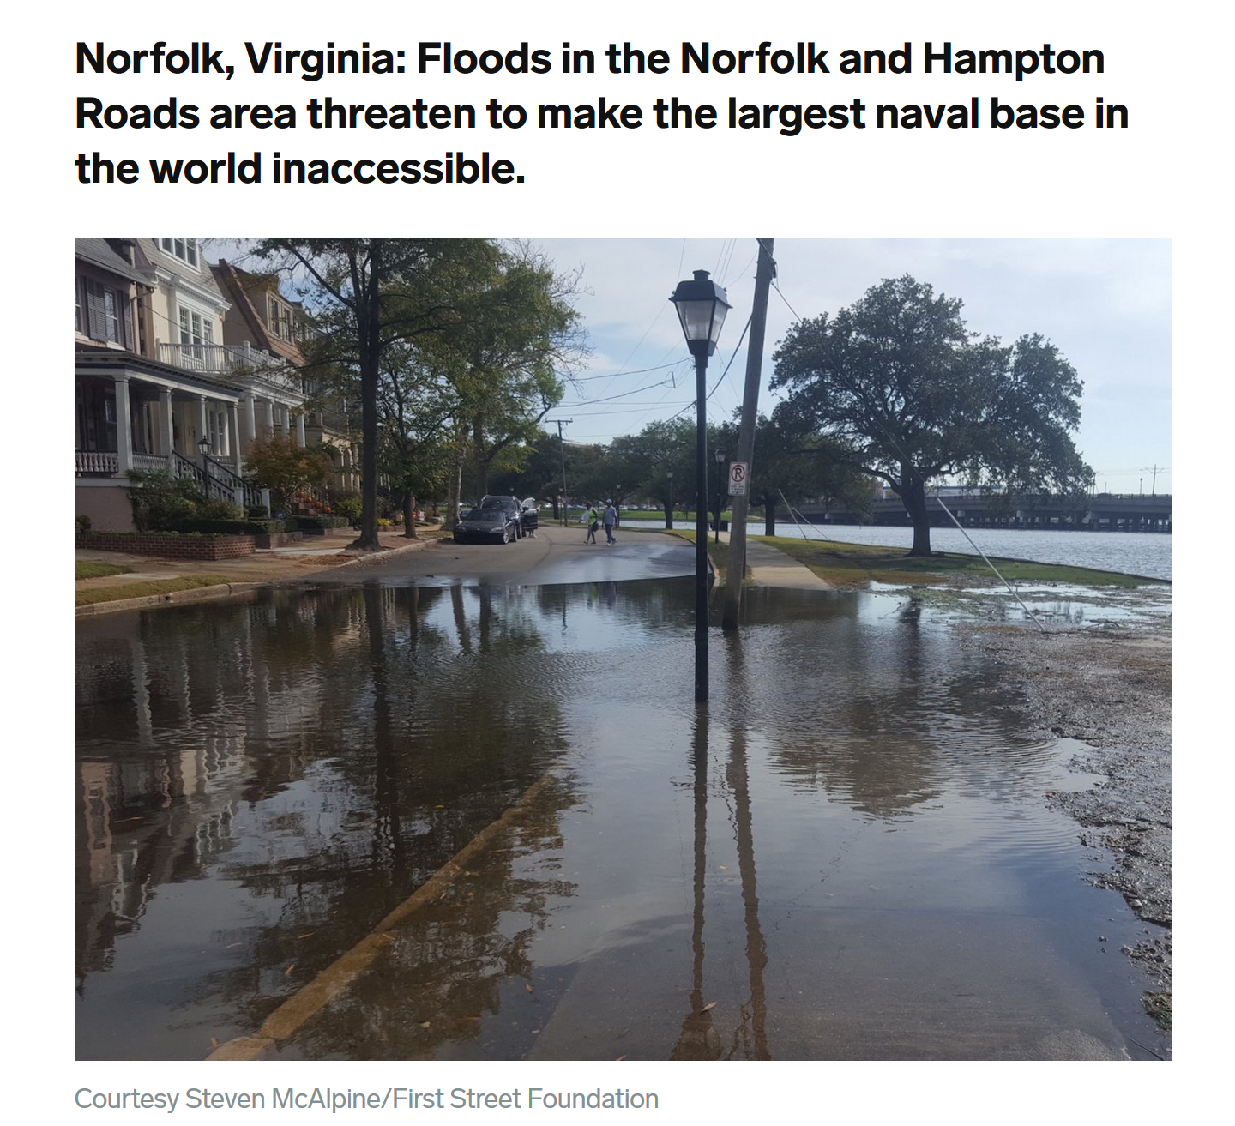
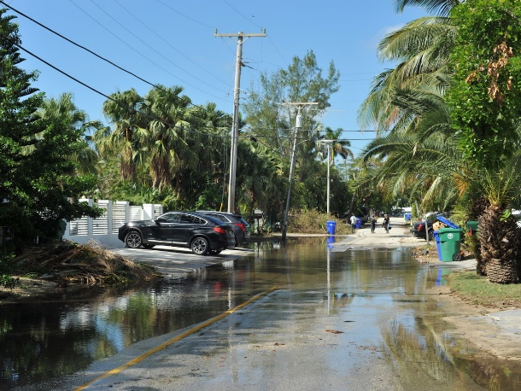
Sea Level Rise Means that flooding in coastal CT that is expected once in 10 years
should be expected every 2 or 3 years in 2050.
This will raise the cost of living by the shore and likely impact property
values in flood prone areas.
This is happening in Virginia and Florida
Sunny day flooding in Miami
Reduction in value
Single Family home value index
https://www.businessinsider.com
Notes:
https://iopscience.iop.org/article/10.1088/1748-9326/aabb32
https://www.businessinsider.com/sea-level-rise-high-tides-sunny-day-flooding-coastal-cities-2018-4#san-francisco-california-many-places-havent-seen-dramatic-flooding-yet-but-high-tides-combined-with-recent-weather-show-how-quickly-waters-can-spill-over-the-walls-11

Slide 19
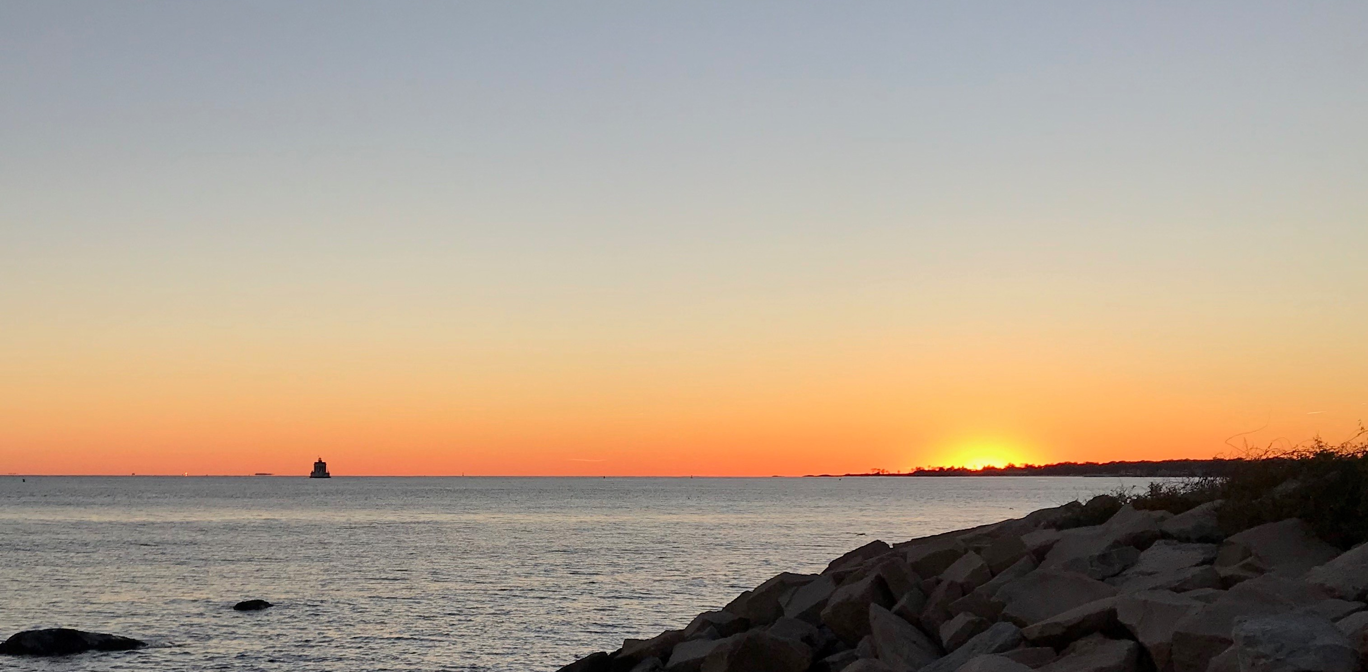
Thank You!
Resilientconnecticut.uconn.edu
John.truscinski@uconn.edu

