Slide 1
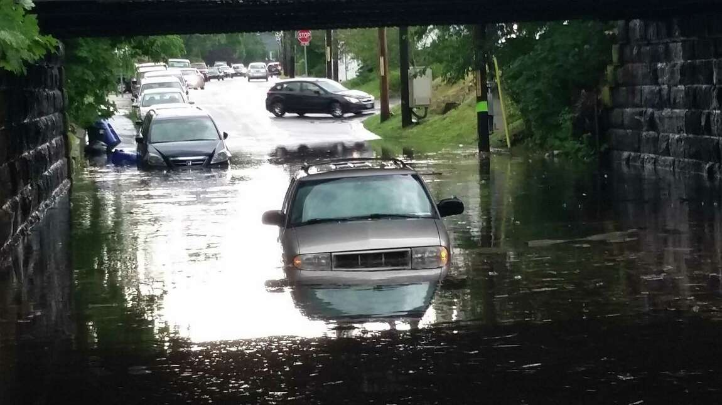
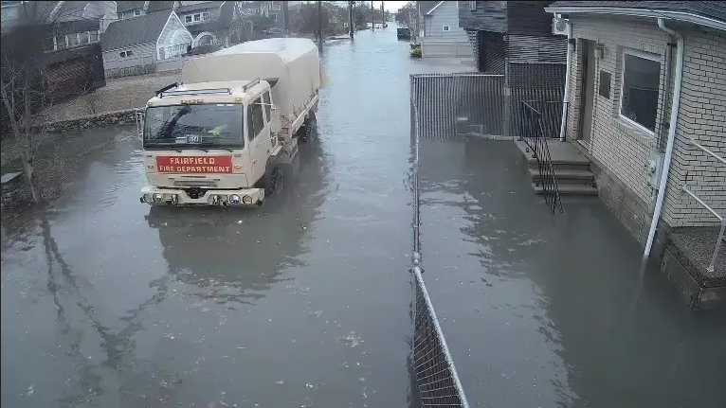
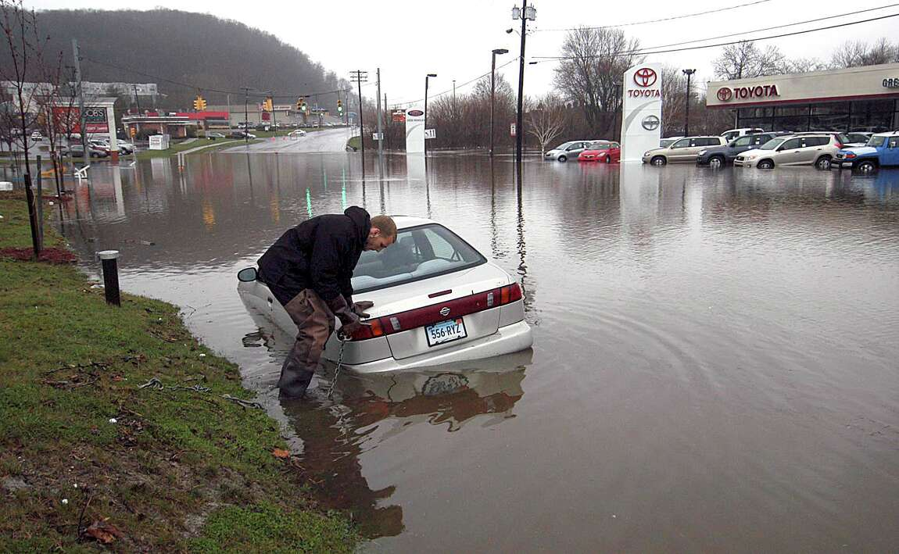
Urban Flooding
Silver Jackets Flood Awareness Workshop
Nancy Furbush
Senior Service Hydrologist
National Weather Service, New York, NY
National Weather Service
WFO New York, NY

Slide 2
Urban Flooding
Topics
Overview of Flood Products and Services
Hydrologic and Situational Awareness tools used to evaluate urban flooding potential
On going local research to address urban flash floods
National Weather Service
WFO New York, NY

Slide 3
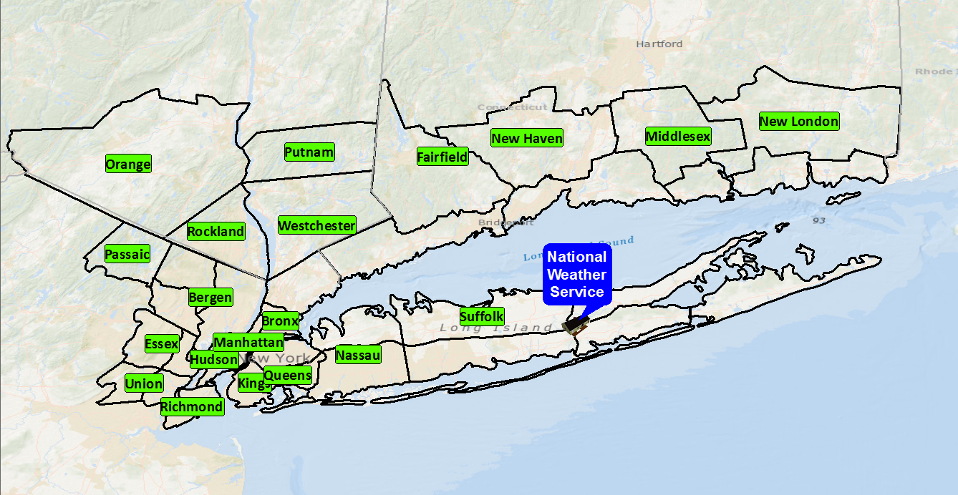
Urban Flooding
Area of Responsibility
Population: ~18.6 million
National Weather Service
WFO New York, NY

Slide 4
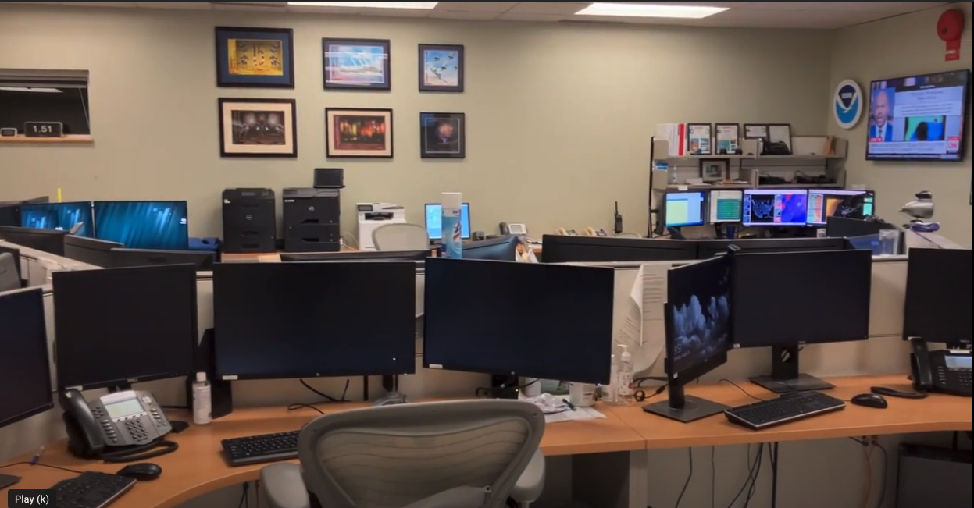

Slide 5
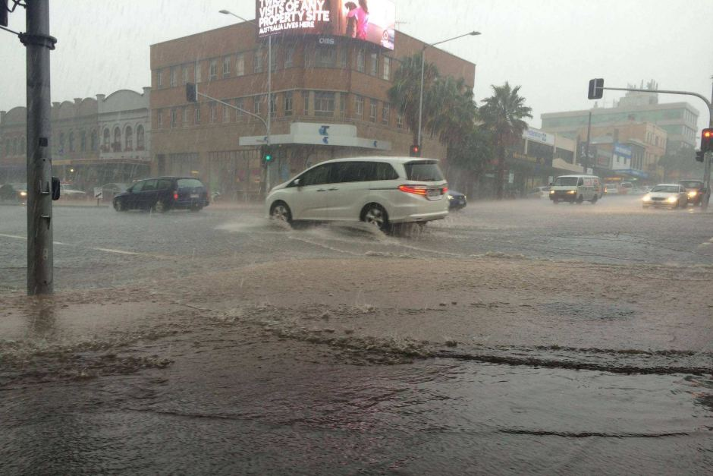
Urban Flooding
Overview of Flash Flood Products for Urban Flooding
Flood Watches
Generally issued 12 to 48 hours before a potential flood event.
Flood watches provide advance notice and up-to-date information on the possibility of flooding and allows users to begin monitoring conditions more closely and elevate flood mitigation resources to a higher state of readiness, thus helping to protect life and property.
National Weather Service
WFO New York, NY

Slide 6
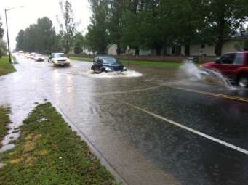
Urban Flooding
Overview of Flash Flood Products for Urban Flooding
Flood Advisory
Issued when there is a potential for ponding of water in urban areas, low lying roads, or poor drainage areas.
This product is reserved for short-term events (<6 hrs)
National Weather Service
WFO New York, NY

Slide 7
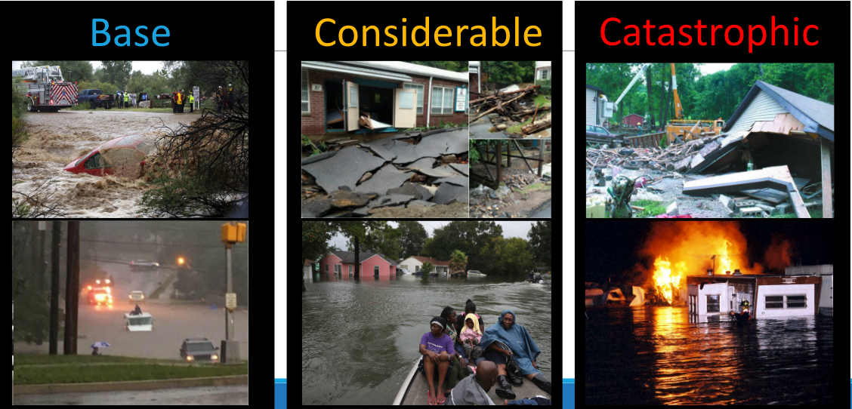
Urban Flooding
Overview of Flash Flood Products for Urban Flooding
Flash Flood Warning are Impact Based
Flash Flood Warning Tags
National Weather Service
WFO New York, NY

Slide 8
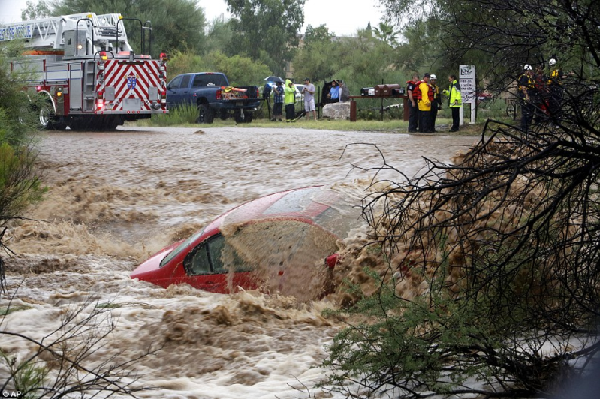
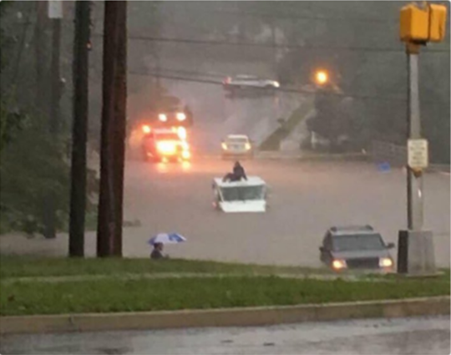
Urban Flooding
Overview of Flash Flood Products for Urban Flooding
Flash Flood Warning
Base Level
Issued for Standard Flash Flood Case
Multiple streets closed or impassable
6 inches or more of flowing water over a road/bridge
3 feet or more of standing water that poses a threat to life or property
Water causing damage to the first floor of a residence or public building
Basement flooding
Person or vehicle trapped by flowing water from runoff
National Weather Service
WFO New York, NY

Slide 9
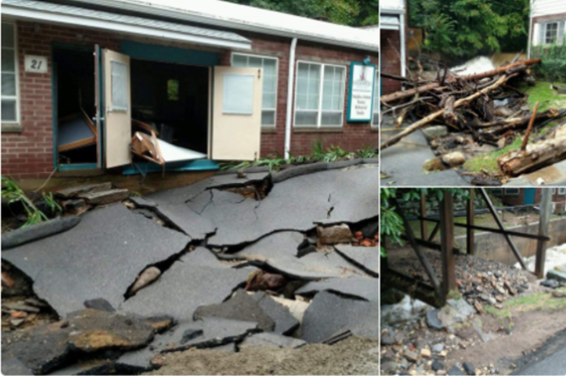
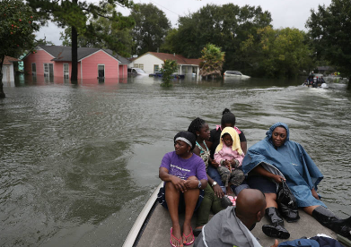
Urban Flooding
Overview of Flash Flood Products for Urban Flooding
Flash Flood Warning
Considerable Level
Issued for Extreme and Rare Flash Flood Event
Risk of fatalities, urgent action needed to protect life and property
Evacuations required
Numerous Water Rescues performed because of people unable to get out of the way of rising water. Not based on vehicles driving into flood waters.
WEA Alerted!
National Weather Service
WFO New York, NY

Slide 10
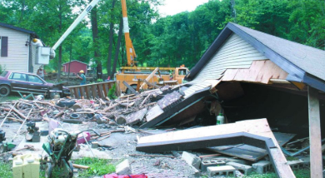
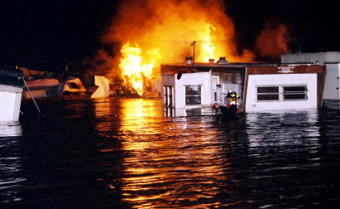
Urban Flooding
Overview of Flash Flood Products for Urban Flooding
WEA Alerted!
Flash Flood Warning
Catastrophic Level
Issued for Significant, widespread flood damage
Flash Flood Emergency
Homes/Business Destroyed
Water rescues are difficult to impossible
High Risk Dam Break
National Weather Service
WFO New York, NY

Slide 11
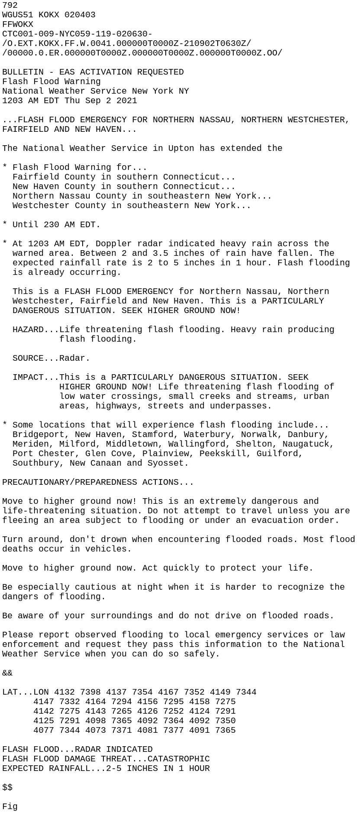
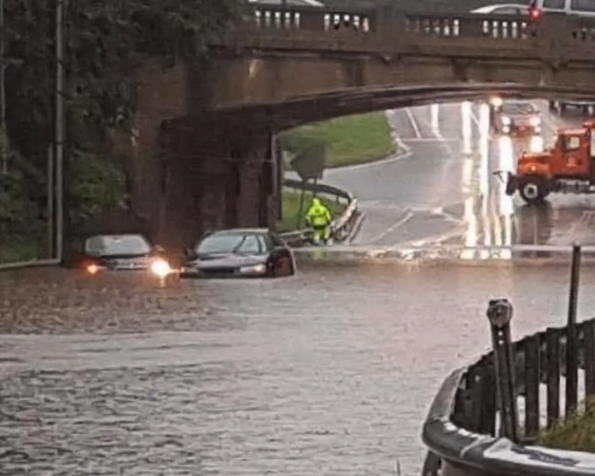
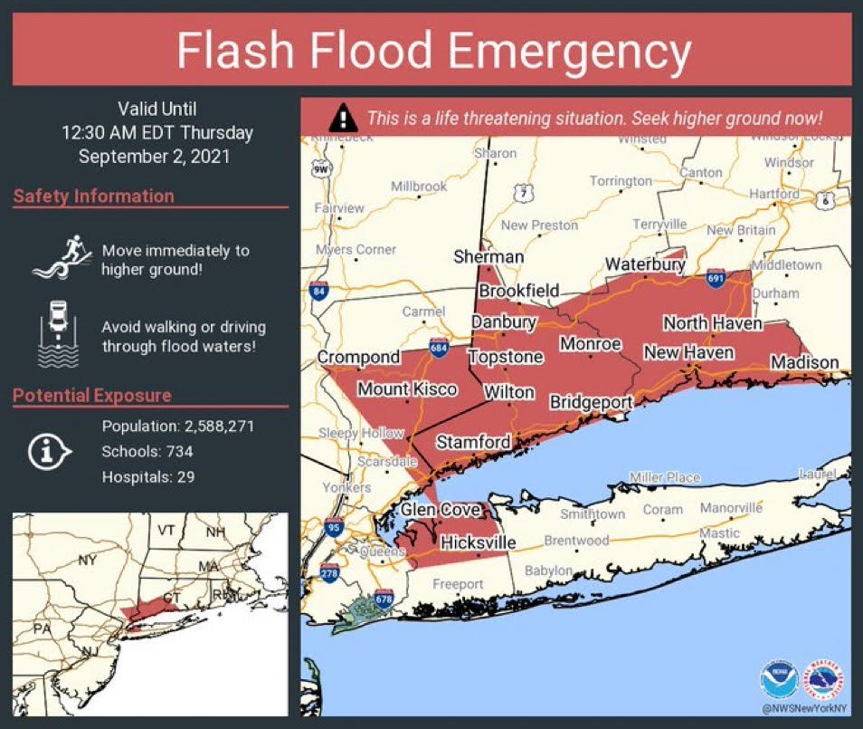
Urban Flooding
Ida ( September 1st, 2021)
National Weather Service
WFO New York, NY

Slide 12
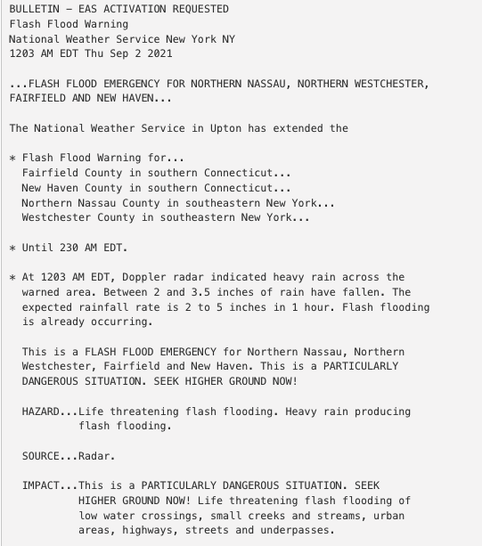
Urban Flooding
Ida ( September 1st, 2021)
National Weather Service
WFO New York, NY

Slide 13
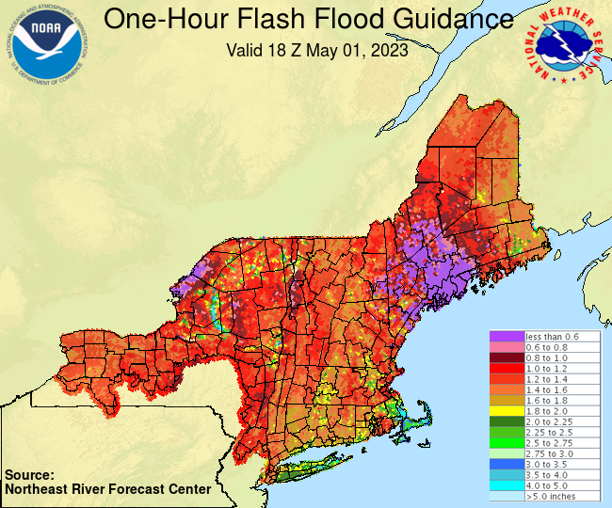
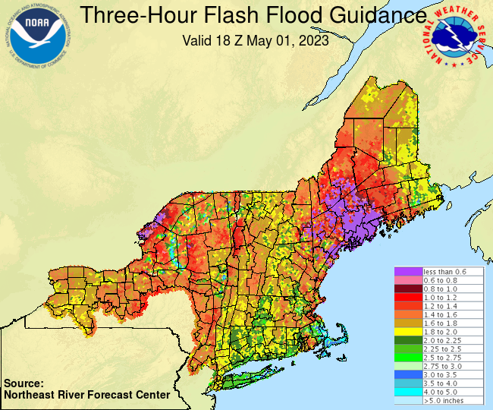
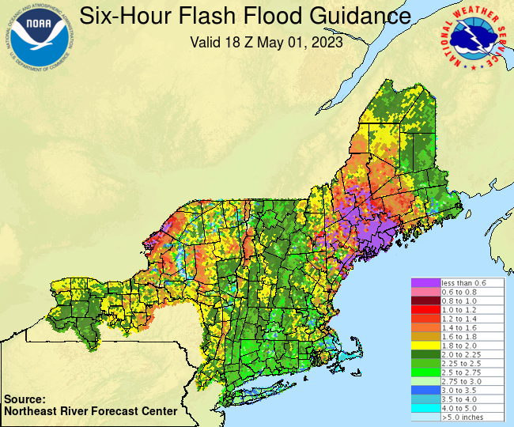
Urban Flooding
Hydrologic Tools and Situational Awareness Tools for evaluating Urban Flooding Potential
Flash Flood Guidance from Northeast River Forecast Centers
This guidance is an estimate of the amount of rainfall required over a given area during a given duration to cause small stream flooding. These estimates take into account soil moisture and stream flow.
National Weather Service
WFO New York, NY

Slide 14
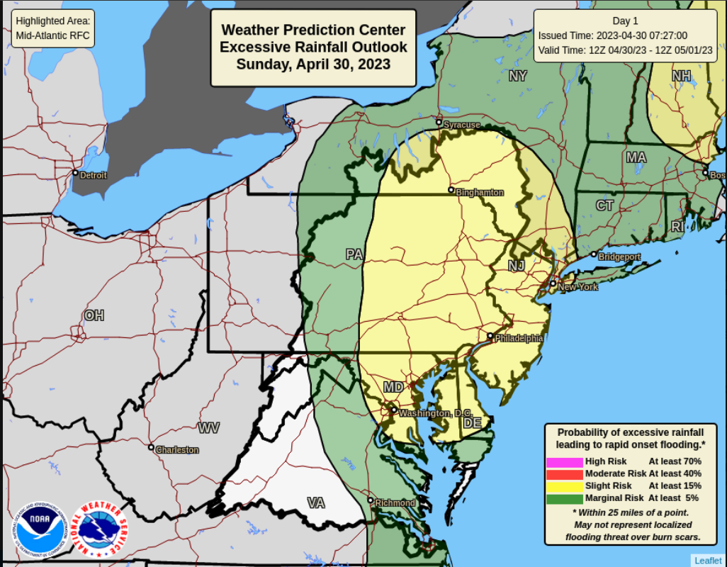
Urban Flooding
Hydrologic Tools and Situational Awareness Tools for evaluating Flooding Potential
Weather Prediction Center
Excessive Rainfall Outlook
Situational Awareness: What are the chances of rainfall causing flash flooding
Day 1-3 Experimental out to Day 5
Collaborated with local WFOs
National Weather Service
WFO New York, NY

Slide 15
Urban Flooding
Hydrologic and Situational Awareness Tools for evaluating Urban Flood Potential
National Weather Service
WFO New York, NY

Slide 16
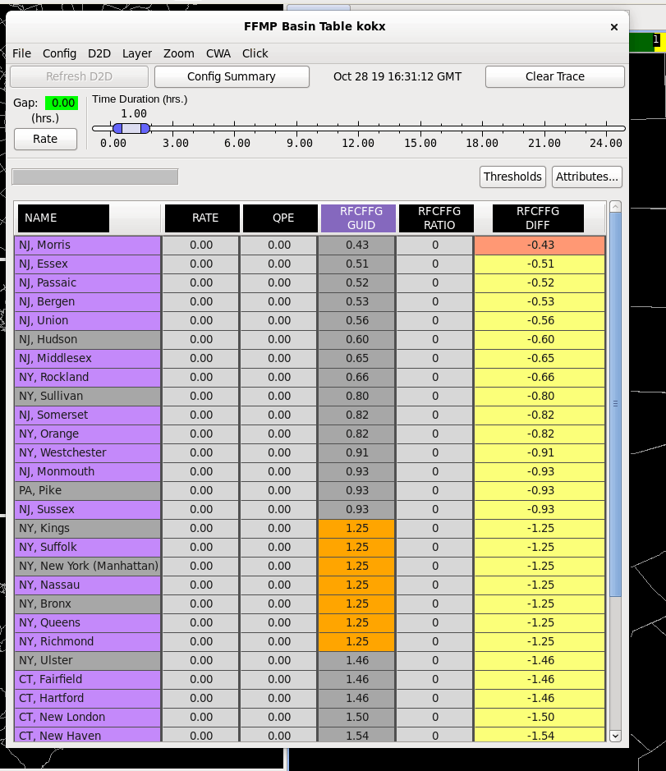
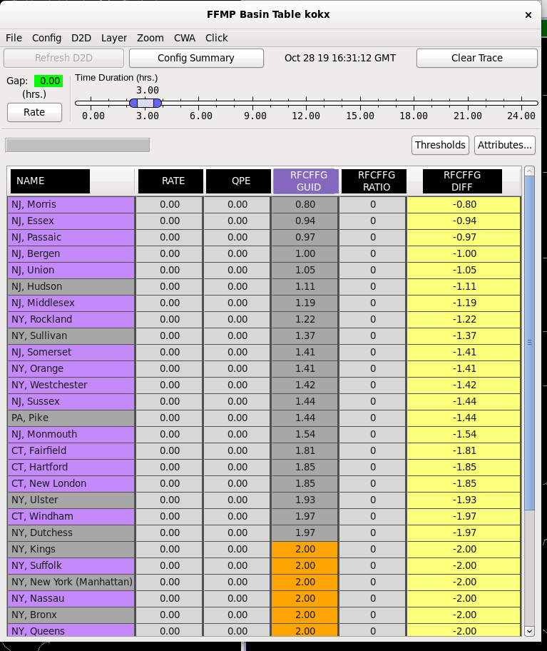
Urban Flooding
Hydrologic and Situational Awareness Tools for evaluating Urban Flood Potential
Flash Flood Monitoring and Prediction (FFMP)
Multi Sensor Application that detects analyzes and monitors precipitation and generates short-term guidance for flash flooding
National Weather Service
WFO New York, NY

Slide 17
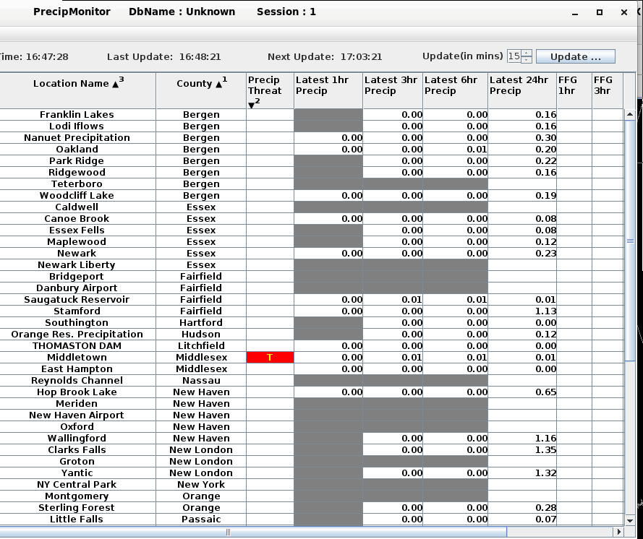
Urban Flooding
Hydrologic Tools and Situational Awareness Tools for evaluating Urban Flooding Potential
Precipitation Monitor Table
A situational awareness tool table that highlights data values of concern across the CWA and surrounding WFO offices.
National Weather Service
WFO New York, NY

Slide 18
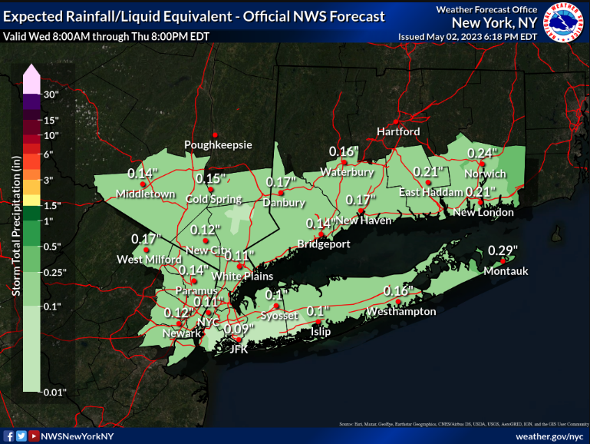
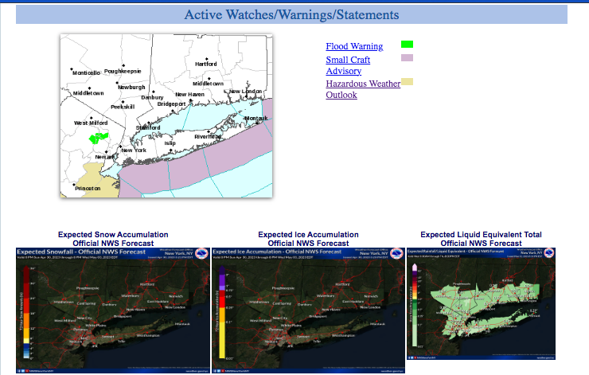
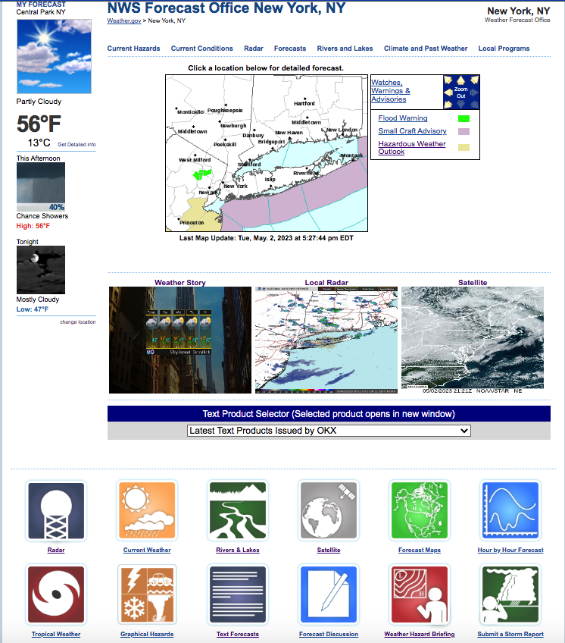
Urban Flooding
Products and Services
National Weather Service
WFO New York, NY

Slide 19
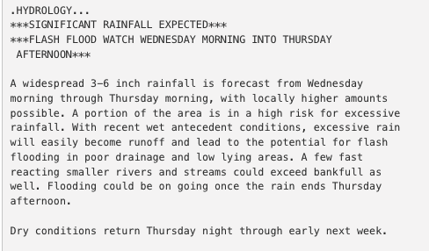
Urban Flooding
Products and Services
National Weather Service
WFO New York, NY

Slide 20
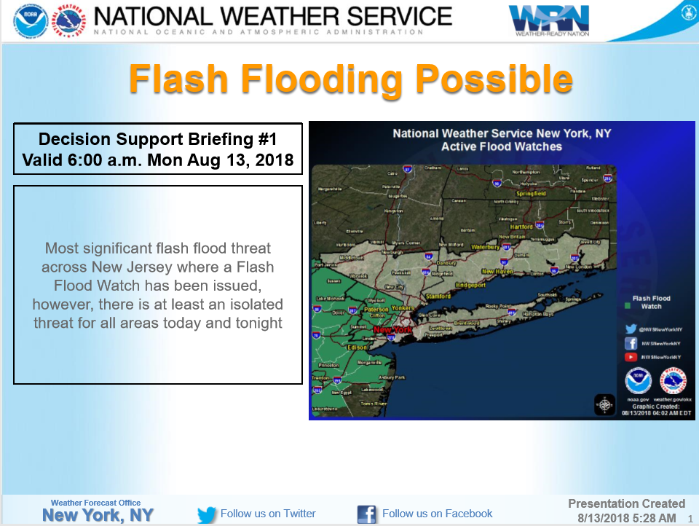
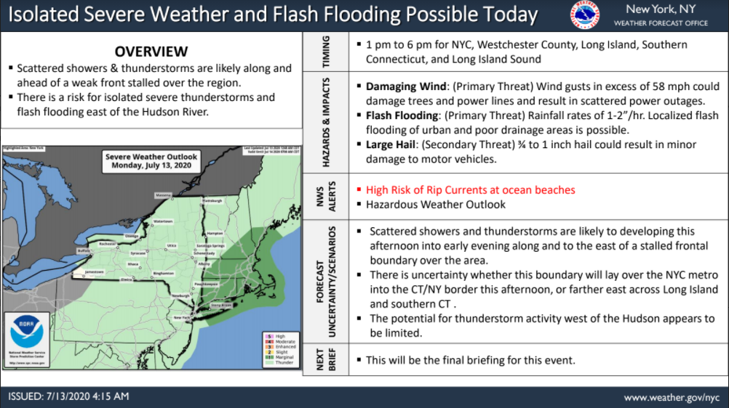
Urban Flooding
Products and Services
Weather Briefings we provide to our Partners ahead of a high impact event.
National Weather Service
WFO New York, NY

Slide 21
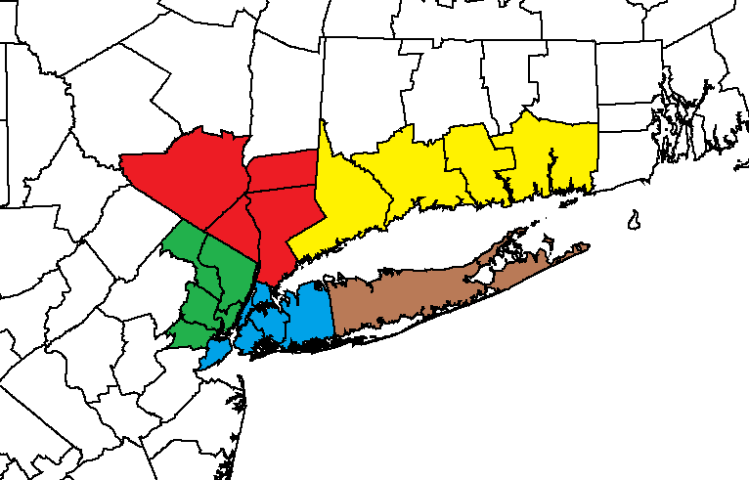
Urban Flooding – On going research
Local Flash Flood Research – Improve Urban flood lead times and Situational Awareness
Flash Flood Climatology Research for the local Tri State Area looking at events from 1996 to 2022
Total Flash Floods Per Region
Northeast NJ: 698
NYC+Nassau: 494
Southern CT: 329
Lower Hudson Valley: 323
Suffolk NY: 173
National Weather Service
WFO New York, NY

Slide 22
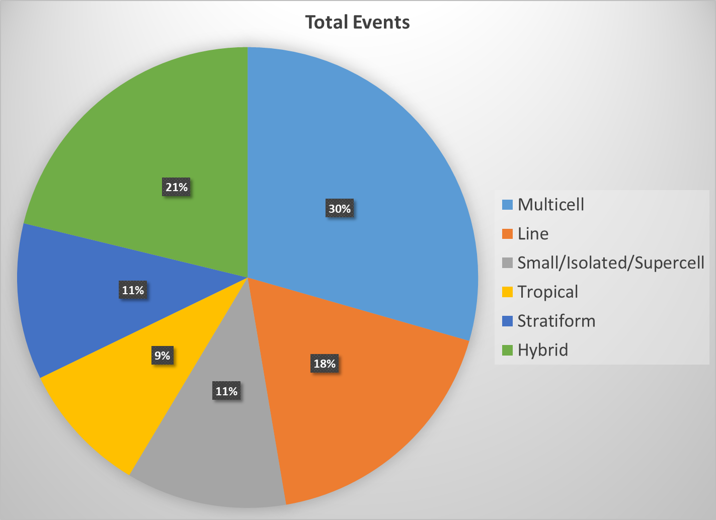
Urban Flooding – On going research
Local Flash Flood Research – Improve lead times and Situational Awareness
Flash Flood Climatology Research for the local Tri State Area looking at events from 1996 to 2022
National Weather Service
WFO New York, NY

Slide 23
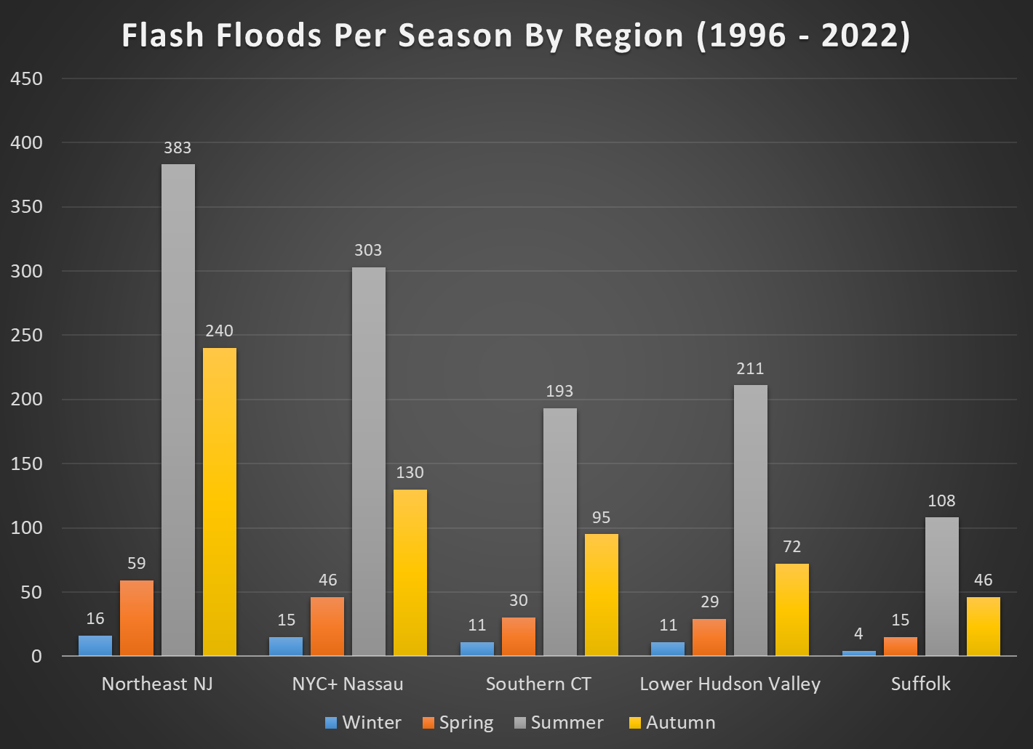
Urban Flooding – On going research
Local Flash Flood Research – Improve lead times and Situational Awareness
National Weather Service
WFO New York, NY

Slide 24
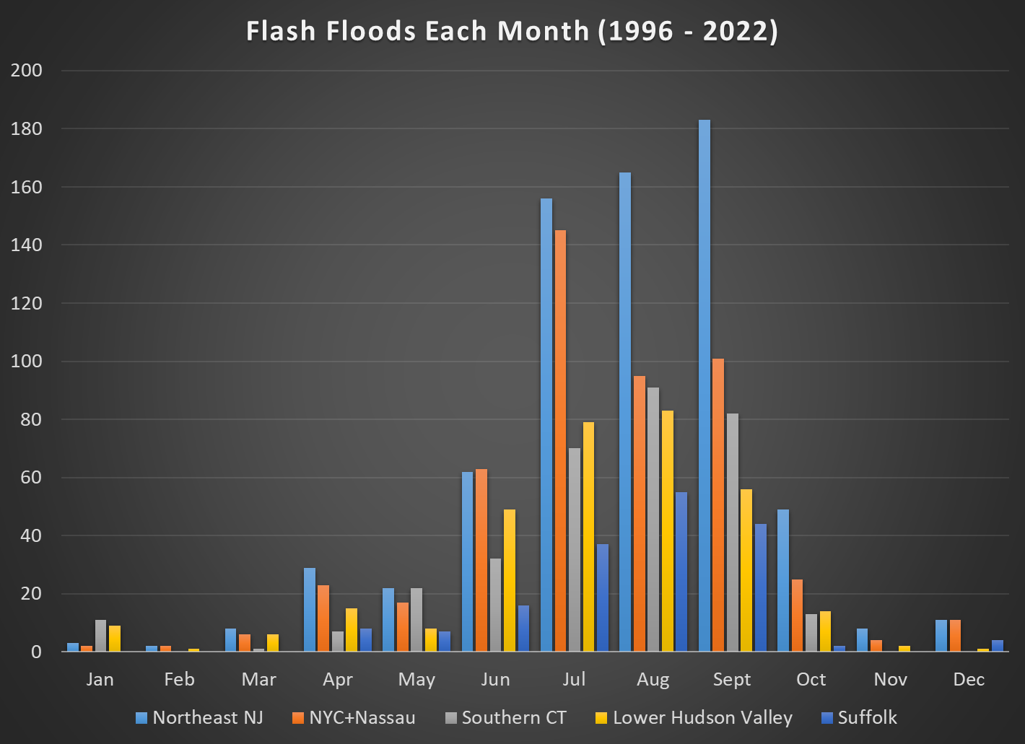
Urban Flooding – On going research
Local Flash Flood Research – Improve lead times and Situational Awareness
Findings
Southern CT
Most of the flooding occurs during the month of August
National Weather Service
WFO New York, NY

Slide 25
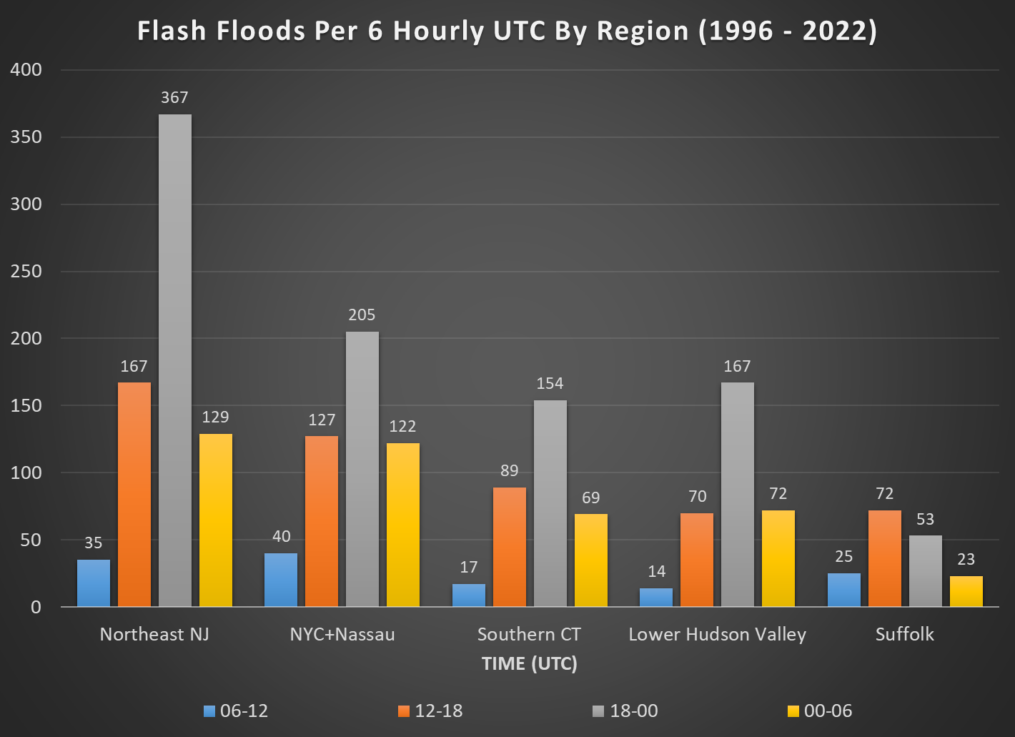
Urban Flooding – On going research
Local Flash Flood Research – Improve lead times and Situational Awareness
Findings
Southern CT
Most of the flooding occurs between 2pm – 8pm
National Weather Service
WFO New York, NY

Slide 26
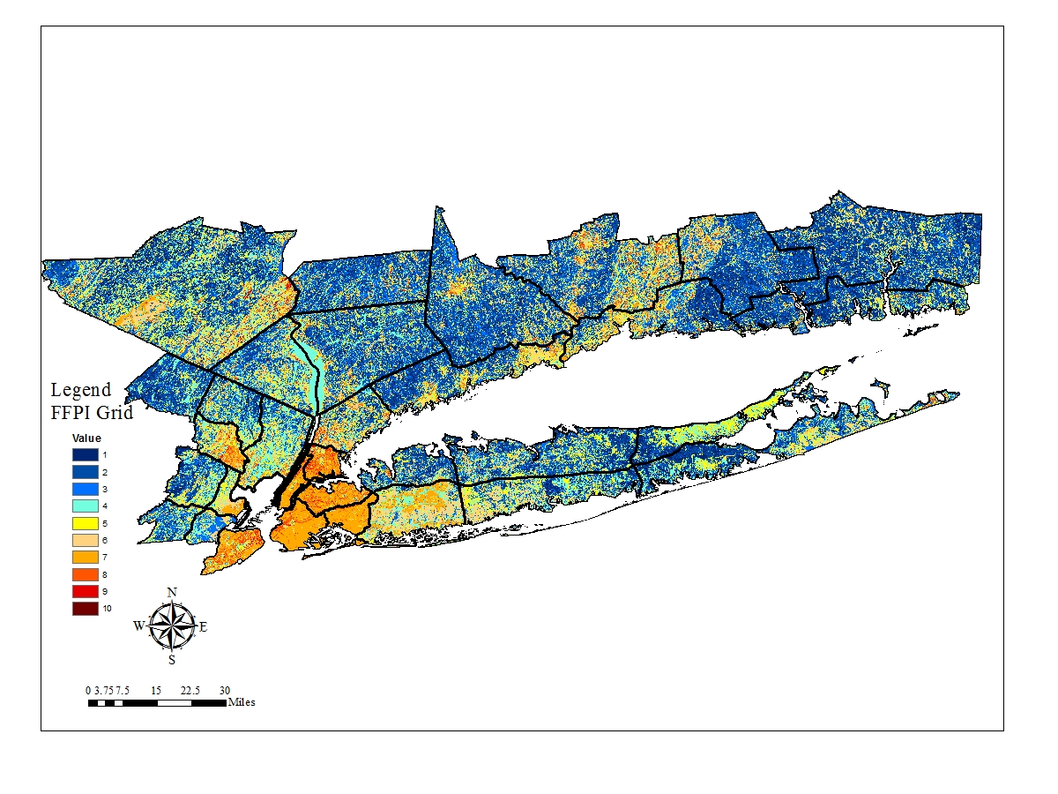
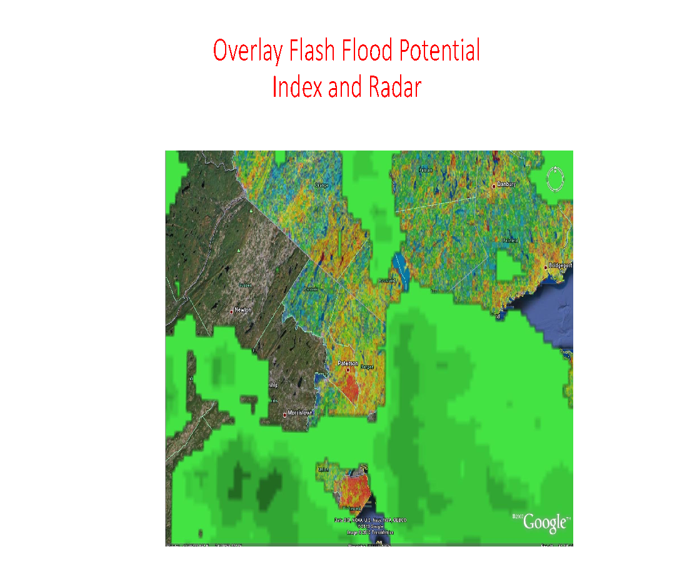
Urban Flooding
Local Flash Flood Research – Improve lead times and Situational Awareness
Flash Flood Potential Index Map
1 (Least Flash Flood Prone) to
10 (Most Flash Flood Prone)
Soil, Slope, Forest Density & Land Cover Data
National Weather Service
WFO New York, NY

Slide 27
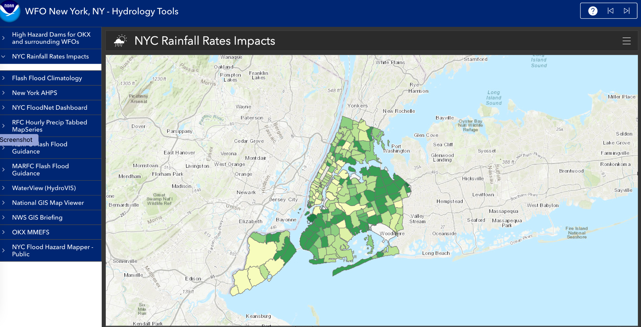
Urban Flooding
Other Projects and Partnerships – Improve lead times and Situational Awareness
Doctoral Student from the City College of New York did a study of street flooding based on 311 complaints.
Findings were collected and displayed onto a GIS Map to better display the areas with the highest flooding complaints based on: 1, 1.5, 2, 2.5 and 3 inches of rainfall
GIS Dashboard created for Situational Awareness
National Weather Service
WFO New York, NY

Slide 28
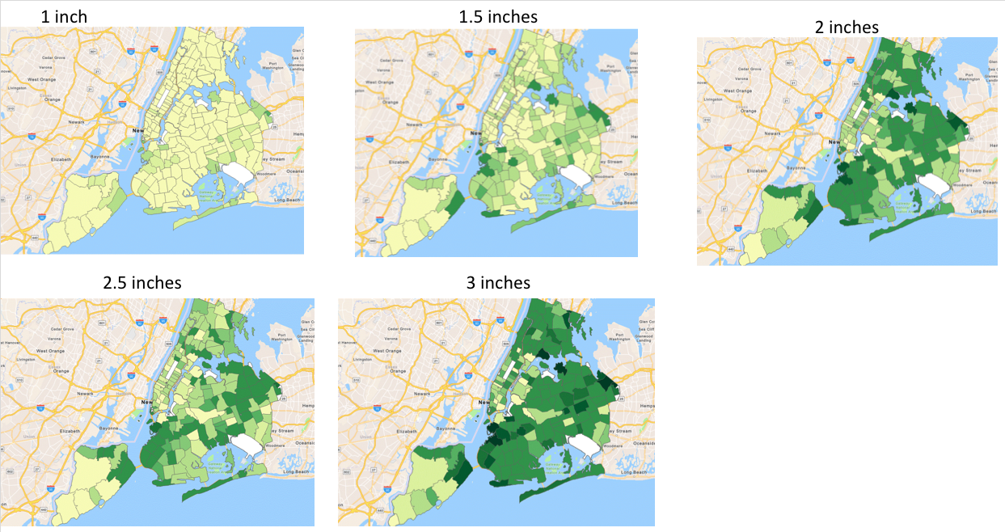
Urban Flooding
Other Projects and Partnerships – Improve lead times and Situational Awareness
National Weather Service
WFO New York, NY

Slide 29
Urban Flooding
Products and Services
Nancy Furbush, Senior Service Hydrologist
Nancy.Furbush@noaa.gov
Web:
http://www.weather.gov/okx/
E-mail:
okx.operations@noaa.gov
Facebook:
http://www.facebook.com/NWSNewYorkNY
YouTube:
https://www.youtube.com/user/NWSNewYorkNY
Twitter:
http://www.twitter.com/NWSNewYorkNY
National Weather Service
WFO New York, NY

Slide 30
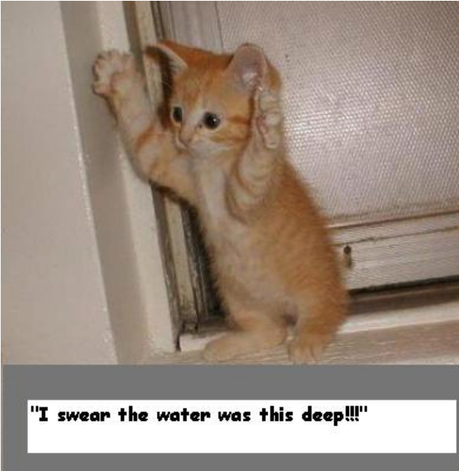
Urban Flooding
Questions?
National Weather Service
WFO New York, NY

