Slide 1
Connecticut Coalition for Sustainable Materials Management Full Coalition Meeting
February 7, 2022

Slide 2
CCSMM Housekeeping
This meeting is being recorded.
Please keep your microphones muted unless sharing information.
Municipal participants will be revised to "Panelist" status. Once in the Panelist area of the webinar, please rename yourself to reflect your organizational affiliation.
Municipal participants are encouraged to turn webcams on and actively participate during the meeting.
Non-municipal participants: Please share your questions, comments & ideas through the ZOOM Chat feature. There will also be opportunity for public comment at the end of the meeting.
Feedback can also be sent by email to: DEEP.RecyclingProgram@ct.gov
Notes:
Chris N to cover

Slide 3
CCSMM Full Coalition Meeting Agenda
Business Recycling Assistance Program
Legislative Session Preview
Bottle Bill Updates
Sustainable Materials Management Grant Program
DEEP Permitting Updates
Municipal/Regional Updates
Other Topics
Public Comment
Notes:
Katie / Laura / Matt
Note that we are up to 90 CCSMM towns
Latest additions: Meriden, Trumbull & Bethany

Slide 4
Business Recycling Assistance Program
Kat McCarthy – Center for EcoTechnology (CET)
Notes:
Laura
Kat McCarthy is a Project Manager for the Center for EcoTechnology (CET). Kat has an MBA in Sustainability, B.A. in Environmental Studies, and brings a wealth of experience working with local government, businesses and communities to reduce waste.
Prior to her current role with CET, Kat served on the board of the New York State Association for Reduction, Reuse, and Recycling as the Organics Council Chair, coordinated compost and recycling initiatives at events, and provided direct support to businesses.
Call to action (after Kat's presentation): encourage towns to get word out to their businesses

Slide 5
Legislative Session 2022 Preview
Harrison Nantz, CT DEEP
James Albis, CT DEEP
Notes:
Katie / Laura / Matt

Slide 6
2022 Legislative Session Rules
Short session – Feb 9th through May 4th
Virtual session through February
Legislature to reassess the current rules come late February
Notes:
Harry

Slide 7
Bottle Bill Updates
$0.05 Fee on Miniatures
New Retail RVM Requirements
Beverage Container Recycling Grant Program (aka Redemption Center Grant Program)
Notes:
James

Slide 8
Bottle Bill Updates : $0.05 Fee on “Miniatures"
Overview
Effective Oct. 1, 2021
Wholesalers must assess a $0.05 fee on all miniature alcohol bottles sold to retailers
Revenues from the $0.05 fee are disbursed from wholesalers to municipalities every April and October
Municipalities can use funds for reducing MSW generation or reducing litter
Notes:
James

Slide 9
Bottle Bill Updates : $0.05 Fee on “Miniatures"
Of Note
Miniatures are not part of the deposit redemption system
No state involvement aside from semiannual report from wholesalers
Notes:
James

Slide 10
Bottle Bill Updates : $0.05 Fee on “Miniatures"
What to Expect
Wine & Spirits Wholesalers of CT (WSWC) have indicated that they will aggregate fee revenues from all wholesalers and provide one check per municipality
Package stores had stock on shelf purchased prior to Oct. 1 when law went into effect; April 2022 checks to towns won’t necessarily reflect 6 full months of sales
Notes:
James

Slide 11
Bottle Bill Updates : $0.05 Fee on “Miniatures"
What to Expect
¹ https://www.connecticut-demographics.com/cities_by_population
² Data provided by the Wine and Spirits Wholesalers of CT (WSWC)
Notes:
James

Slide 12
Bottle Bill Updates : New retail RVM Requirements
Overview
Effective Oct. 1, 2021
Applies to retail establishments that:
Part of a chain
Operate 10 or more units in the state
>7,000 sq ft devoted to sale of merchandise
Must install at least two RVMs
Notes:
James

Slide 13
Bottle Bill Updates : New retail RVM Requirements
What to Expect
Supply chain backlog and COVID requirements have led to delay in full implementation
Over 300 new locations now have RVMs
Over 600 locations in total required to install and maintain RVMs
Notes:
James

Slide 14
Bottle Bill Updates : Beverage Container Recycling Grant Program
Overview
Grants up to $150,000 available
Eligible locations:
Environmental justice communities
Urban centers
Target applicants:
New redemption centers
Locally-owned, minority-owned, women-owned
Municipalities/COGs eligible to apply
Notes:
James

Slide 15
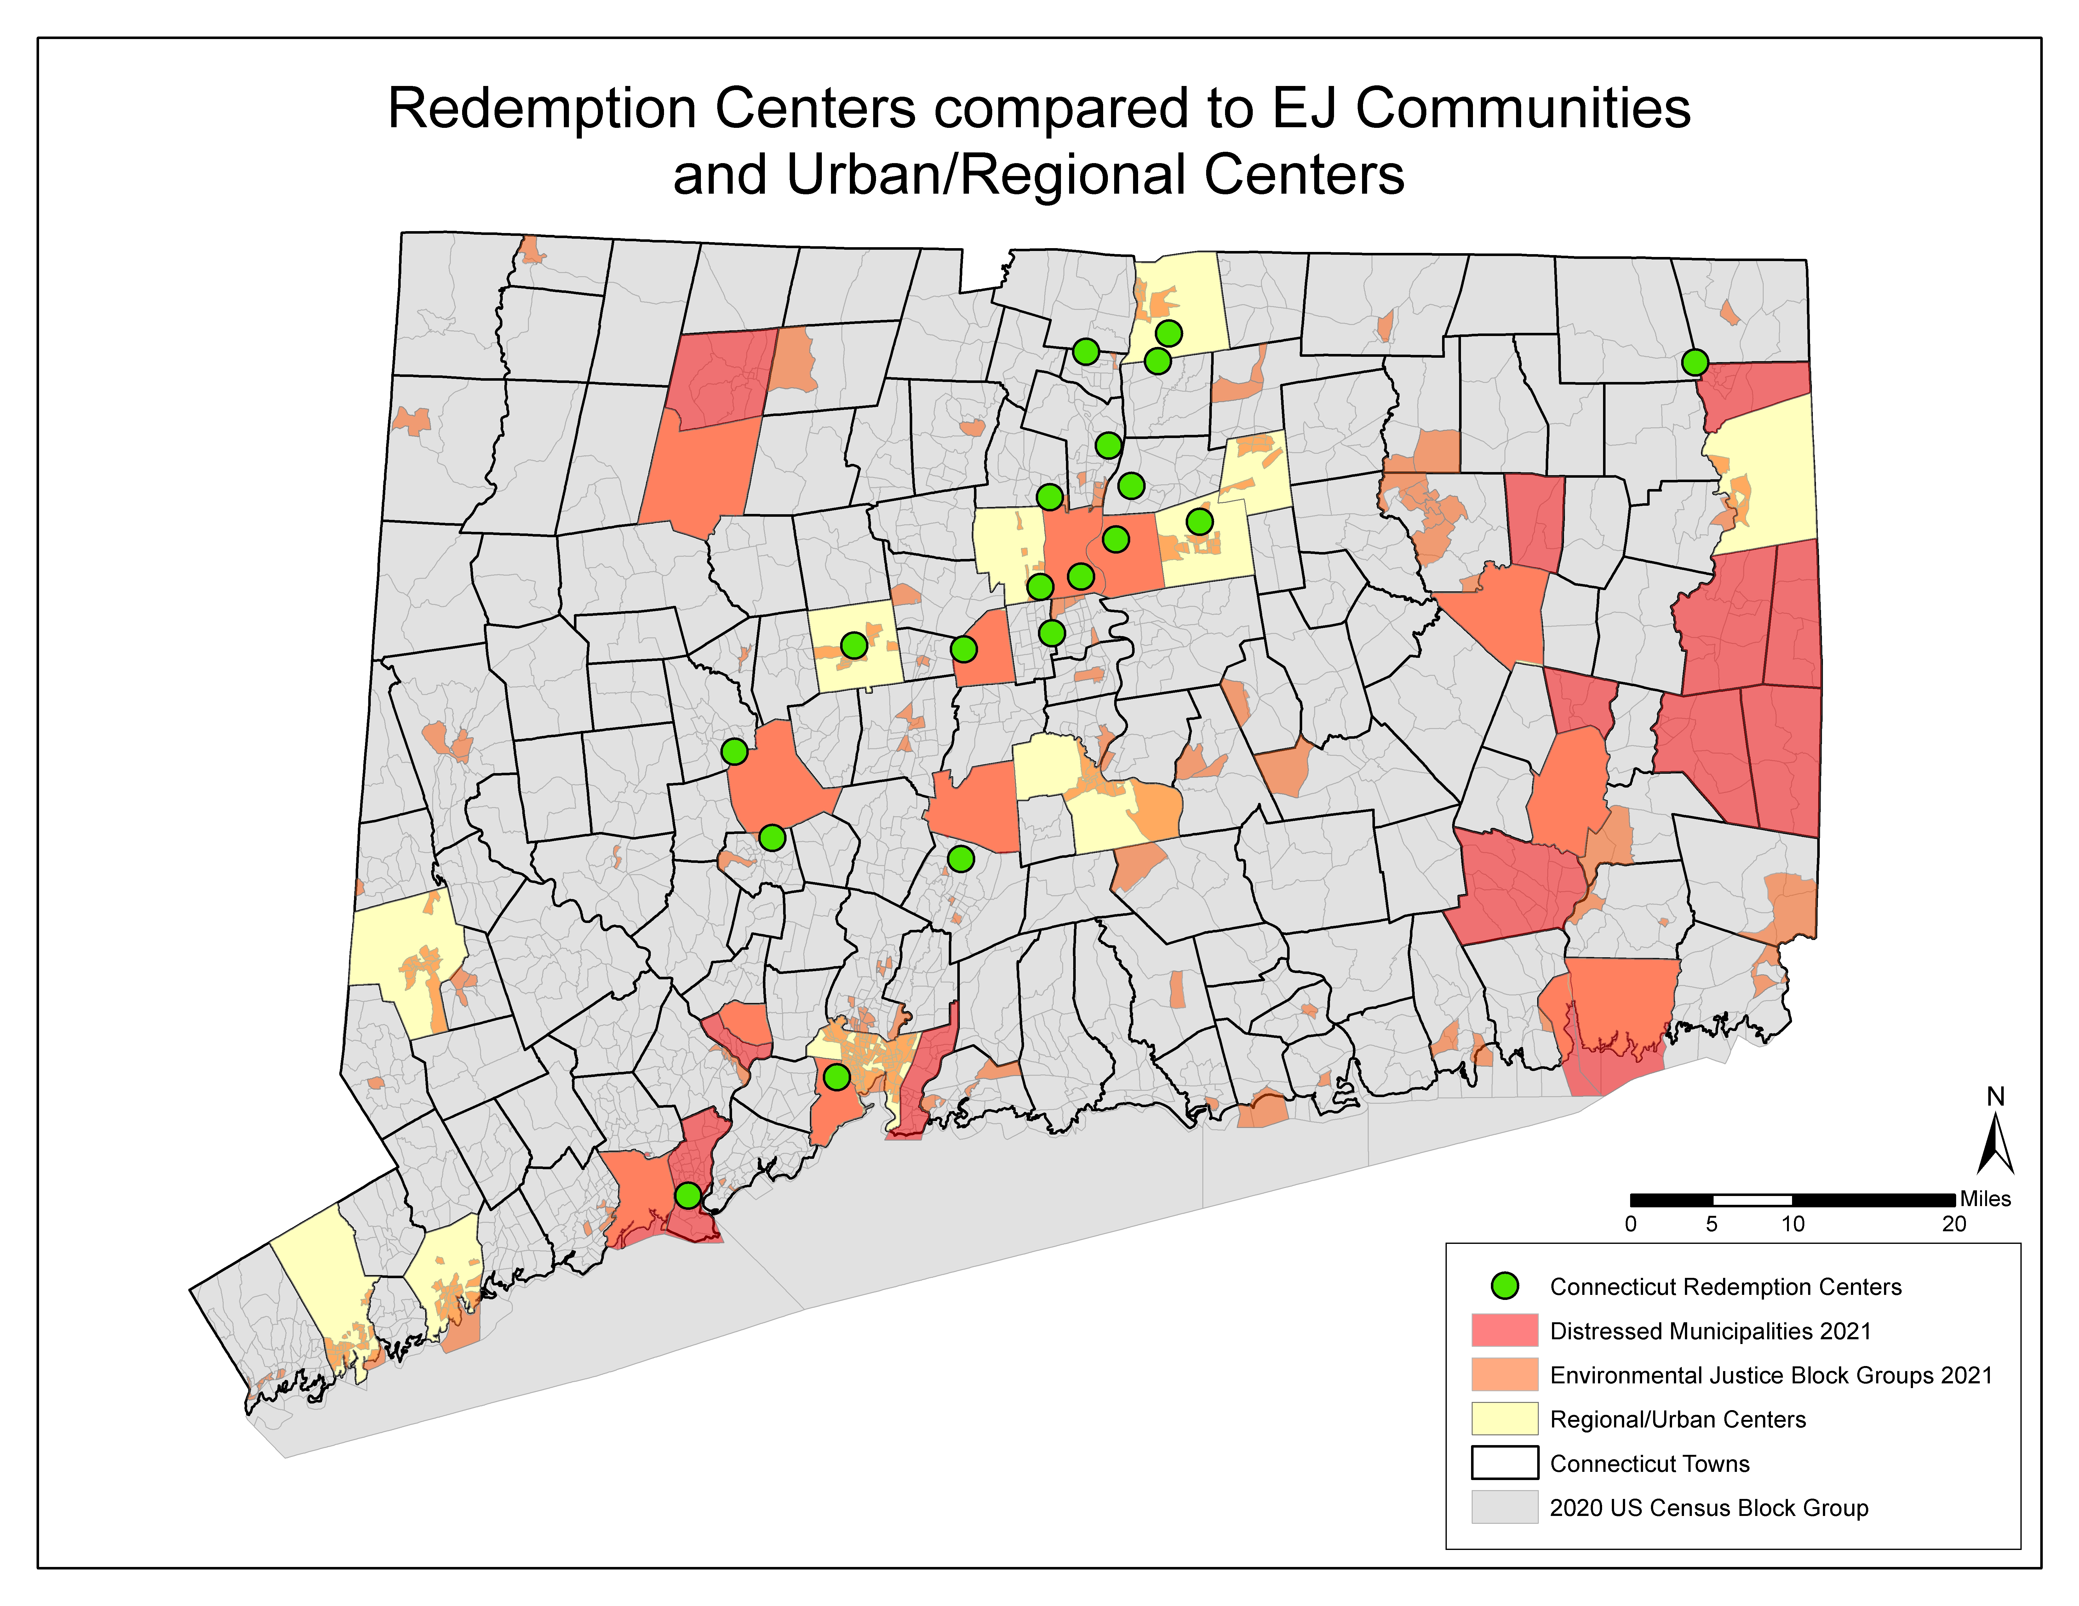
Bottle Bill Updates : Beverage Container Recycling Grant Program
Notes:
James

Slide 16
Bottle Bill Updates : Beverage Container Recycling Grant Program
How to Apply
Applications accepted on a rolling basis through May 31, 2022
Resources, like UConn Small Business Development Center, are available to applicants
More information available on DEEP’s website
Questions? Email DEEP.RecyclingProgram@ct.gov
Notes:
James

Slide 17
Bottle Bill Updates: Questions?
$0.05 Fee on Miniatures
New Retail RVM Requirements
Beverage Container Recycling Grant Program (aka Redemption Center Grant Program)
--------------------------------------------
Email: james.albis@ct.gov
Notes:
James

Slide 18
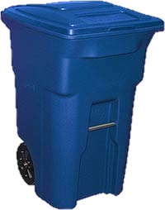
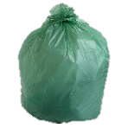
Sustainable Materials Management Grant Program Overview
Trash
Notes:
Katie intro – Chelsey Hahn speaking
Chelsey:
We are so thrilled with the results from Phase 1 –
We received 55 Expressions of Interest - 41 municipalities and 6 COGS/regional groups (some munis and regions duplicative)
31 UBP + food scrap collection programs
16 FS-only programs (transfer station drop-off or curbside)
35 applicants invited to Phase 2 (4 regional groups and 31 municipalities)

Slide 19
Sustainable Materials Management Grant Program Invited Applicants
Purple-shaded towns – Towns invited to Phase 2
Cross-Hatch Towns – Regional Waste Authority or COG applicants
Blue lines – COG borders
Notes:
Again, we are very excited about the commitment to reduce waste, which ties into the goals of all the CCSMM working groups and the Menu of Options.
Exciting time, lots of interest in UBP and food waste
Especially important is really exploring the pathway to permanence.

Slide 20
Sustainable Materials Management Grant Program Overview of Expected Project Types
Pay-As-You-Throw program
Food Scrap collection – co-collected with Trash or collected separately
Programs looking to self-compost food scraps at municipal-run aerated static compost sites
Plans to collect food scraps from the commercial and/ or school sectors

Slide 21
Sustainable Materials Management Grant Program Expected Projects Details
Food Scrap Collection bins for residential use
Collection route-optimization to reduce transportation and vehicle emission costs
How/ where to sell PAYT and food waste bags AND how many bags to possibly give away
Working to get partner support from environmental groups
Working to build new habits and buy-in to the program

Slide 22
Sustainable Materials Management Grant Program Wrap Up
Accepting Applications from Phase 2 Applicants until March 31, 2022
Checking reporting and compliance with applicable waste laws and regulations
Meeting throughout February and March to support applicants
Any Questions: DEEP.RecyclingProgram@ct.gov

Slide 23
DEEP Solid Waste Permitting Updates – Appendix H: Food Waste
The CCSMM menu of options identified the need for a network of facilities to feed into larger food waste processing facilities.
Streamlined permitting to develop infrastructure was identified as an action item for DEEP.
Issued modified General Permit to Construct and Operate a Commercial Facility for the Management of Recyclable Materials and Certain Solid Wastes, including new appendix for food waste facilities.
Appendix H: Food Waste, issued January 13, 2022.
The General Permit, application and instructions can be found on the DEEP website here.
Notes:
Katie into
Brent Madho from WEED Permitting presenting

Slide 24
Commercial General Permit Appendix H: Food Waste
Provisions of Food Waste Facility Appendix :
Two Subcategories:
1)Receipt, Storage, Transfer
2)Receipt, Storage, Transfer, and Limited Processing
Two Tiers:
Tier I
Accept up to 20 tons per day of food waste, 120cy storage
May 1 to October 31, up to 72 hours of on-site storage
Tier II
Accept up to 50 TPD of food waste, 200cy storage
May 1 to October 31, up to 48 hours of on-site storage
November 1 to April 30, seven days on-site storage
Sanitary operations, maintenance, and facility design conditions
Notes:
Brent

Slide 25
Additional Resources for Current Food Waste Permitting Options
WEED Pre-application meetings.
The Food Waste Permit Options Pathways table initially presented at the July 16, 2021 CCSMM meeting showing current authorization pathways for food waste collection and processing is located here.
Projects with multiple permitting requirements or cross-cutting programmatic needs may benefit from DEEP’s Client Concierge Service.
Farm-Based Anaerobic Digestion Fact Sheet
Notes:
Brent

Slide 26
Municipal Transfer Station General Permit
The Municipal Transfer Station General Permit will expire on November 29, 2022.
The Department plans to reissue the MTS General Permit this year.
Anticipates public notice of intent to reissue in mid 2022.
Any feedback on the General Permit reissuance can be sent to the department any time up to and through the public comment period.
Please submit any feedback to elizabeth.moore@ct.gov
Notes:
Brent

Slide 27
DEEP Permitting Contacts
Additional questions regarding solid waste permitting can be sent to:
Frank Gagliardo
Supervising Environmental Analyst – Western Division
Frank.P.Gagliardo@ct.gov
860-424-3130
Kevin Barrett
Supervising Environmental Analyst – Eastern Division
Kevin.Barrett@ct.gov
860-424-3697
Notes:
Brent

Slide 28
Municipal and Regional Projects Updates
Smart Feed facility
Meriden co-collection pilot
Fairfield glass collection pilot
Wilton Food Scrap Collection at schools
Others – please share updates on any CCSMM-related efforts that your municipality may be working on!
Notes:
Laura intro
Smart Feed facility – Jonathan Fife
Meriden co-collection pilot – Howard Weissberg
Fairfield glass collection pilot - Becky Bunnell, Sustainable Fairfield Task Force
Wilton Food Scrap Collection at schools - Tammy Thornton, Wilton Go Green

Slide 29
Other Topics
Are there any other CCSMM-related topics that municipalities or regional organizations would like to discuss?
Notes:
Katie/Laura/Matt to facilitate

Slide 30
Public Comments
Attendees can post questions in the chat box or raise hand to request to speak.
Notes:
Katie/Laura/Matt to facilitate

Slide 31
Additional ways to keep informed
Sign up for CCSMM updates HERE.
Participate in Solid Waste Advisory Committee (SWAC) meetings:
Remaining 2022 meeting dates: March 22, June 28, October 25
SWAC meeting agendas & materials are posted HERE
Instructions for self-subscription to the SWAC email listserv are posted HERE
Municipal representatives should sign up for the CTRecyclers listserve and the CT Municipal Recycling Coordinator Newsletter
Contact sherill.baldwin@ct.gov for more details
Notes:
Chris

Slide 32
Thank you CCSMM Members
Connecticut Coalition for Sustainable Materials Management
Notes:
Katie/Laura/Matt to offer final words and thanks for joining

