Slide 1
Notes:
Red words require changes

Slide 2
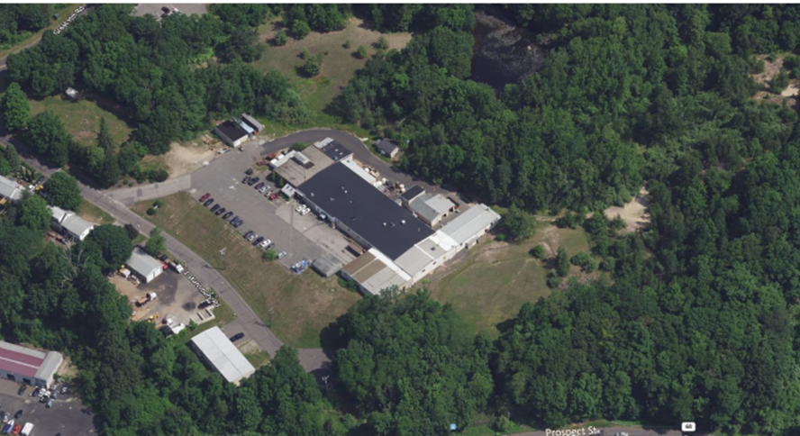
UniMetal Surface Finishing, Naugatuck, Connecticut Stewardship Permit (Renewal)
Public Informational Meeting
July 20, 2022
Online
CT DEEP, UniMetal Surface Finishing LLC

Slide 3
Agenda
Welcome from CT DEEP and Introductions
Explanation of Stewardship Permit
Property Background-location and operations history
Timeline of Investigations and Remediation
Actions to be Completed Under Renewed Stewardship Permit
Opportunity for the Public to Comment or Ask Questions
Note: All participants will be muted until the meeting is open to public participation. Please note that all or portions of the meeting may be recorded.

Slide 4
Introductions
Connecticut DEEP
Sarah McQuade, Remediation Analyst, RCRA Corrective Action Program Coordinator, WPLR, CT DEEP
Facility
Christopher Frey, Sr. Project Manager, GZA
Diane Duva, Director, Planning, ERSPD, MMCA, CT DEEP
Pat Hayden, Sr. V-P, UniMetal

Slide 5
Permit Overview
Why we are here:
To continue the property's cleanup progress
To offer an opportunity for public comment on the property’s cleanup
Why is a Stewardship Permit Required?
Regulatory basis:
Federal and state laws require that this type of facility has an enforceable cleanup schedule in place to advance site cleanup and ensure remedies remain effective into the future.

Slide 6
Permit Overview
What is a Stewardship Permit?
Cleanups at some sites require long-term monitoring and care to ensure that the remedy remains protective of human health and the environment.
There is a need to keep our promise to the future by having a transparent process that tracks those obligations.
A Stewardship Permit issued by the State of Connecticut is an enforceable mechanism to help keep that promise.

Slide 7
CT DEEP Stewardship Permit Links Together the Property and the Community and Ensures Remedies Remain Effective into the Future
Environmental STEWARDSHIP
Community
Institutional Controls
Financial Assurance
Engineering Controls

Slide 8
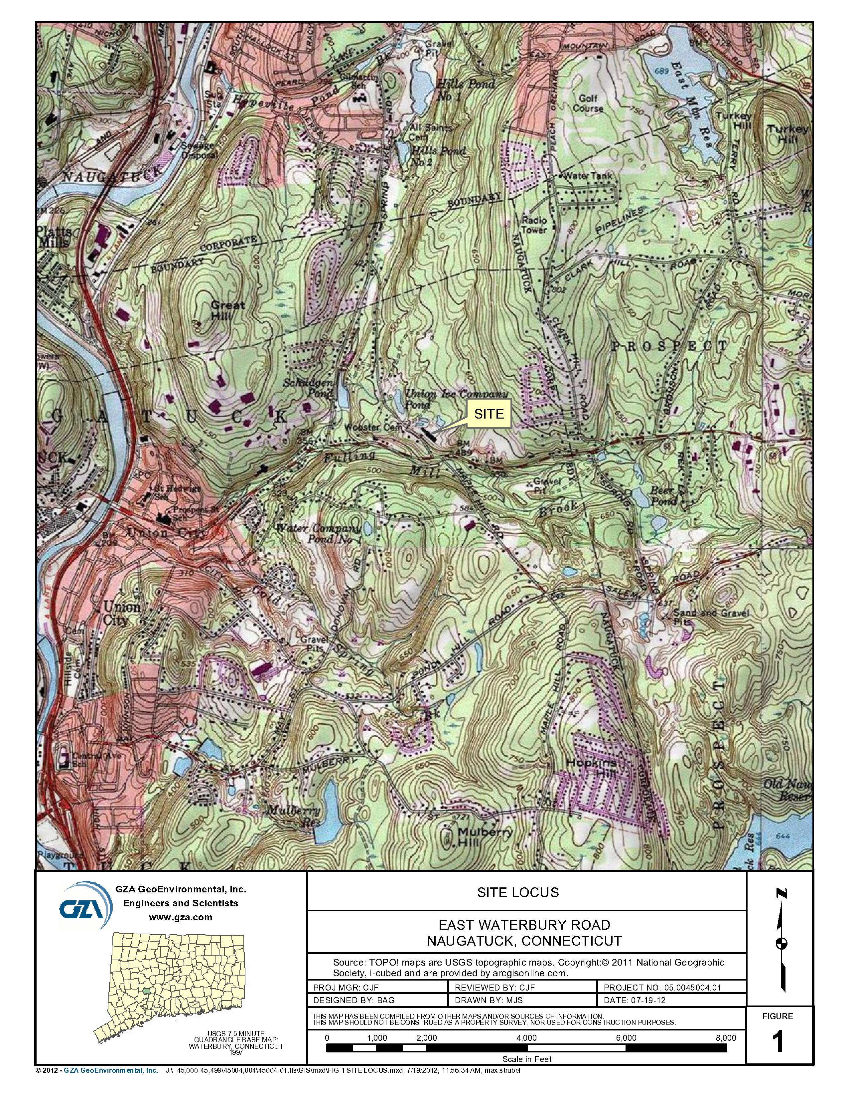
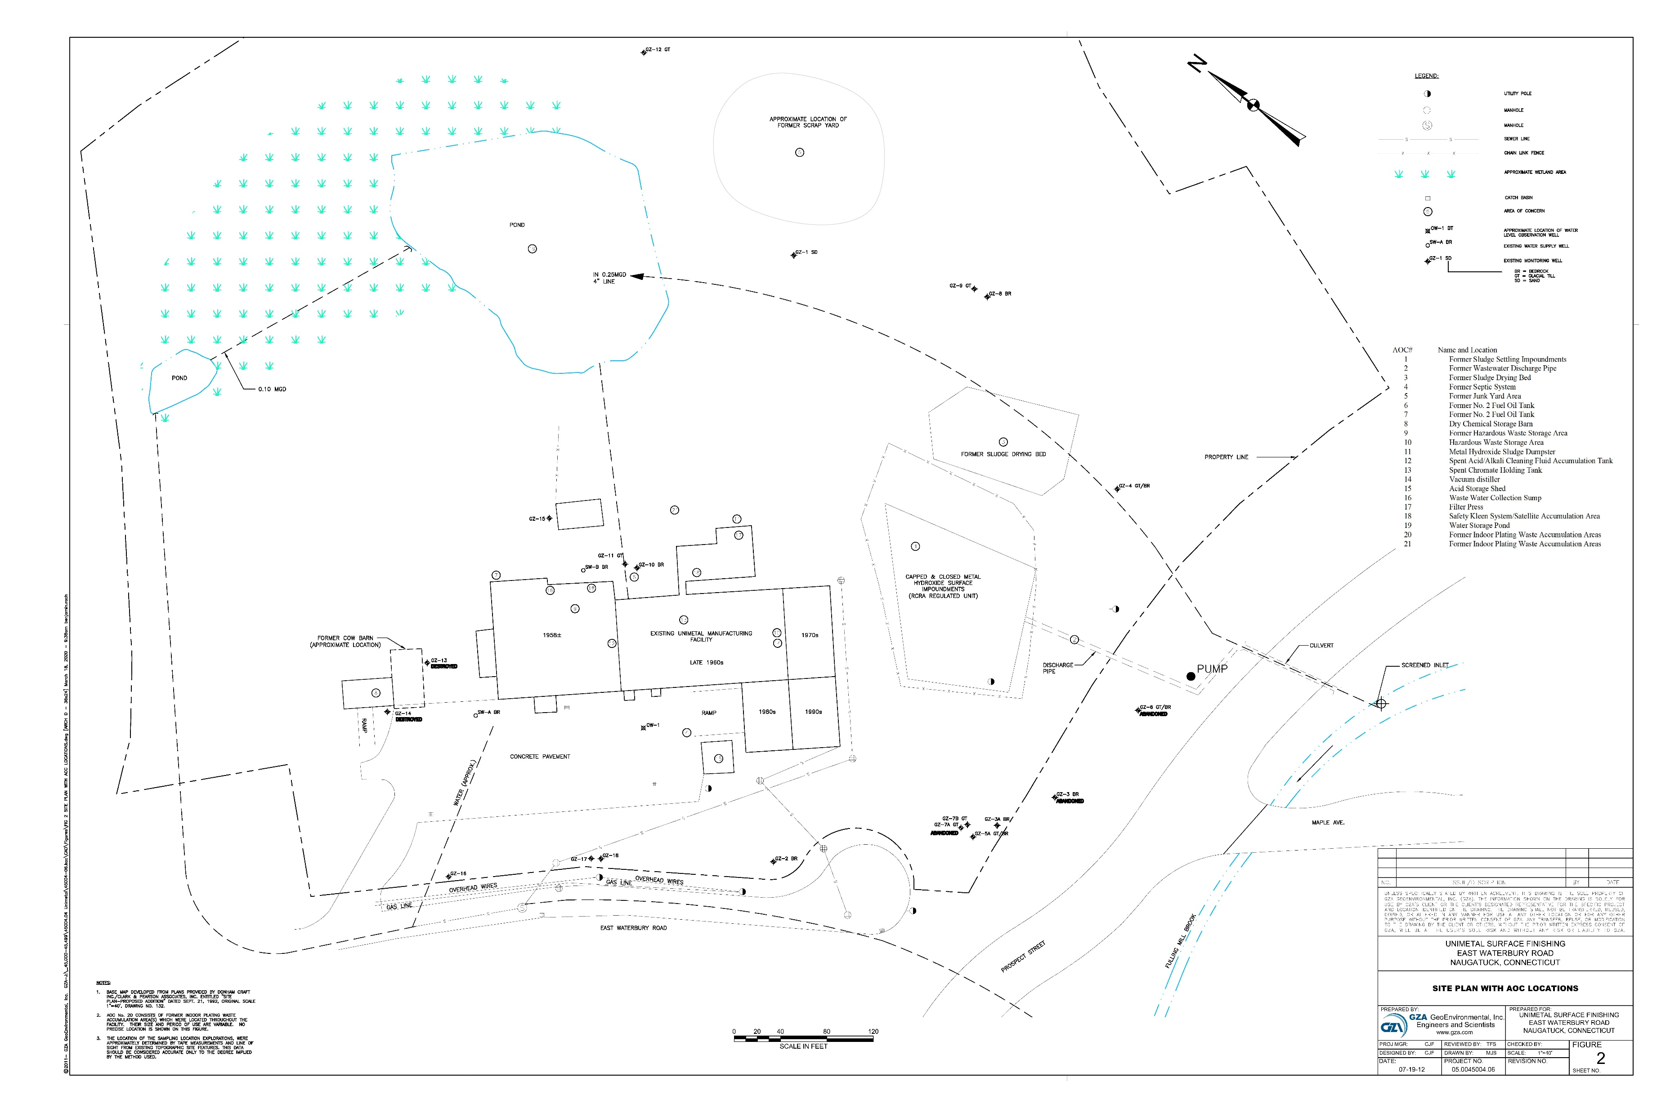
Property Location, Setting, Overview
15 Waterbury Road, Naugatuck, Connecticut
The site is currently owned by UniMetal Surface Finishing, LLC.​
Notes:
Start: LEP Presenting
Replace Photos with aerial shots of your site. Include below the photo where they were pulled from

Slide 9
Facility History
UniMetal is a metal surface plating facility that specializes in plating:
Zinc
Copper
Nickel
Tin
Silver
Gold
The facility has been operating as a plating facility since the 1920s under various owners:
Roberts Plating (1950 to 1971)
Donham Craft (1971 to 2011)
UniMetal Surface Finishing (2011 to Present)

Slide 10
Facility History
UniMetal performs a wide variety of precious metal and commercial finishing processes for parts used in a wide variety of applications, including:
Automotive Medical Telecommunications Aerospace
Marine Defense Electronics Cosmetics
Military Battery Hardware/Fastener Furniture

Slide 11
Facility History
Processes used include:
Bright Dipping Cleaning Copper Plating Deburring
Nickel Plating Oxides Passivation
Precious Metals Tin Plating Tri-Plating
Zinc Alloy Plating Testing Other Services
Chemicals used in these processes include:
Alkaline cleaning solutions Pickling acids (nitric, hydrochloric, sulfuric)
Cyanide stripping solutions Chomating (aluminum, zinc)
Passivation (Nitric acid) Lacquer Waxes Dry Film Lubricants
Electroplating metal solutions (zinc, copper nickel, tin, lead, silver, gold)

Slide 12
Environmental Concerns
Two Closed/Capped Metal Hydroxide Wastewater Impoundments
Located within a fenced enclosure east of the main facility building
Closed under an impermeable cap - December 1989
Impacted soils were removed to the bedrock surface
Some residual deposits containing nickel left in cracks in the bedrock surface
Confirmation samples at the perimeter indicated compliance with closure criteria
Now exists as a grass-covered landform
Monitored and maintained under a post-closure care monitoring program

Slide 13
Environmental Concerns
Soil Investigations
Investigations of exterior soils were completed in 1992 under a RCRA Facility Assessment
Results indicated that soil conditions met cleanup criteria for industrial/commercial areas
A CA-725 Human Exposures Controlled designation was awarded to the facility in 1999
Soils below process areas within the building will require investigation
Investigations are deferred until facility operations are cease process areas are no longer in use

Slide 14
Timeline of Investigations and Remediation
Groundwater Investigations
Groundwater investigations completed in 1992 during RCRA Facility Assessment
Groundwater also monitored downgradient of the RCRA landform for 30+ years
No release detected.
A CA-750 Migration of Contaminated Groundwater Under Control designation was awarded to the facility in 2003
Groundwater monitoring results under the Post-Closure Care program indicate groundwater meets drinking water standards, with the exception of sodium in well in the southeast of the Site
Suspected to be from road salt applications on East Waterbury Road

Slide 15
Actions Required in Permit
Establishment of an EUR Prohibiting:
Residential Activities – Entire Property
Demolition of Site building
Disturbance of concrete floors and underlying soils
Continue Post-Closure Care and Monitoring Program – Closed Surface Impoundment Area
Triennial Groundwater Monitoring (Once every 3 years)
Monitoring and Inspection of Landform cover and fencing
Maintain and complete repairs as needed
Notes:
End: LEP presentation

Slide 16
Actions Required in Permit
Implement Annual Detection Groundwater Monitoring Program
Downgradient of Manufacturing Building
Annual Groundwater Monitoring
Confirm building is acting as impermeable cap over underlying soils
Establishment of a Financial Assurance Fund
Completion of Annual Progress Reports
Summary of Actions Completed in the Year
Report of Groundwater Monitoring Results
Results of Inspections and monitoring
Due March 1st Each Calendar Year
Notes:
End: LEP presentation

Slide 17
Summary: Stewardship Permit
Ensures public participation in proposed cleanup
Documents the completion of cleanup
Memorializes phases of completed remediation
Addresses financial assurance obligations
Spells out long-term obligations of permit holder to simplify transfer of property
Notes:
Start: DEEP presentation

Slide 18
CT DEEP Stewardship Permit Public Comment Period
Opportunity to Comment on Draft Permit
July 7, 2022-Draft permit available for public review
Notice of tentative determination to issue a permit renewal was published, beginning the Public Comment period
Information published in Waterbury Republican-American
Radio announcements on WTIC 1080 am
July 20, 2022-Public Informational Meeting
September 1, 2022-End of Public Comment period
Next: CT DEEP will review comments, consider if changes needed, then issue final decision

Slide 19
Public Comment Process
Once all written comments are received, CT DEEP will review the comments received in writing and verbally at this meeting prior to finalizing the decision regarding the permit renewal.
This presentation will be posted:
https://portal.ct.gov/DEEP/Public-Notices/Public-Notices-Proposed-Actions---Opportunity-for-Comment/Proposed-Individual-Permits

Slide 20
Public Comments Welcome
Please send written comments to:
Email:
Sarah.mcquade@ct.gov
with a copy to
DEEP.REMStewardship@ct.gov
Mail:
Sarah McQuade, Environmental Analyst
Remediation Division
Bureau of Water Protection and Land Reuse, 2nd Floor
CT Department of Energy and Environmental Protection
79 Elm Street, Hartford CT 06106-5127
All comments must be received by SEPTEMBER 1, 2022

Slide 21
Questions and Comments Welcome
Please note that all or portions of the meeting may be recorded.
If you wish to speak, please use the “Raise your hand” feature​
The moderator will call your name ​
Unmute your phone / computer ​
If possible, turn your camera on while making a comment​
State your name and address clearly ​
When done, please place your phone / computer back on mute
Thank you!

