Slide 2
Purpose of the Presentation
Steve Cofer, Lead team member for the Evaluation Administrator team.
DEEP requested we present on the intersection between QA/QC and evaluation.
Today’s brief presentation will cover:
  Evaluation Administrator and role of evaluation
  What evaluation does and does not do
  What is QA and QC
  Why QA/QC matters for evaluation
  Program impacts of strong QA/QC
  Upcoming evaluation activities

Slide 3
Energize Connecticut Evaluation Administrator
State law charges DEEP with the adoption of an independent, comprehensive program evaluation, measurement, and verification process.
The EEB, through its Evaluation Committee, works with consultants who act as an Evaluation Administrator. The Evaluation Administrator advises the EEB regarding development of a schedule and plan for evaluations and oversees the implementation of the evaluation process.
We don’t conduct evaluations, we oversee them.

Slide 4
What Evaluation Does and Does Not Do
DOES
DOES NOT DO
Measure energy savings and program impacts. That means verifying installations, reviewing documentation, and analyzing energy use.
We also look at program processes and identify ways programs can improve over time.
Assess data quality.
Provides actionable recommendations to improve program design or delivery.
These results are used by program administrators to understand how well programs are performing.
Evaluators do not manage contractors or enforce program requirements. Instead, we independently review the outcomes of program activities.
Evaluation measures what happened, but it relies on program implementation and documentation to do that effectively.
Does not control data or program quality or effectiveness.
Evaluation reflects what happens in the field, it does not create those outcomes.
Does not design or implement programs or its policies and rules.

Slide 5
Quality Assurance & Quality Control
What it is
Quality Assurance | Quality Control
Prevents problems Happens before or during work Focuses on processes and standards Training, procedures, and system rules | Detects problems Happens after work is completed Focuses on inspection and verification Field inspections, file reviews, etc.
Examples
Quality Assurance | Quality Control
Contractor trainings Program installation standards and technical manuals Clear measure eligibility rules | Field inspections File reviews Spot-checking tracking system entries

Slide 6
Why QA/QC is Important?
QA/QC supports accurate and reliable program results
Ensures installed measures match what is reported
Improves accuracy of energy savings estimates
Reduces data errors and missing information
Supports consistent program delivery across contractors
Strong QA/QC leads to:
Greater alignment between reported and verified savings
Fewer issues identified during evaluation
Increased confidence from regulators and stakeholders
More stable and predictable program performance

Slide 7

Weak or Inconsistent QA/QC Leads To
Increased review and oversight
Delays in project processing
Less certainty in reported program results

Slide 8
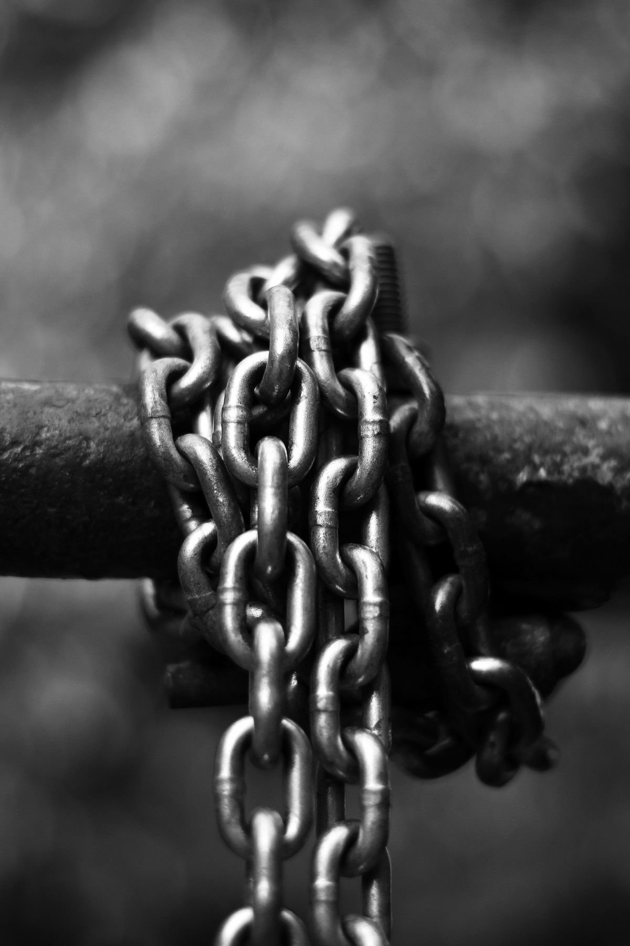
“Chain Reaction”
Small improvements in QA/QC can have large downstream impacts.
Reliable evaluation results
High confidence in savings
Stable programs
Quality Installations + Good Data =

Slide 9
Upcoming Evaluation Activities
There are several residential, commercial and cross-cutting evaluations underway.
A few of these evaluations include conducting survey and interviews with members of the contractor network.
These are excellent opportunities to provide your feedback. All responses are kept confidential and are aggregated and anonymized.

Slide 10
Thank You
Any Questions?
Steve Cofer
Energize Connecticut Evaluation Administrator

