Slide 1
Multifamily Revolving loan program
Seema Malani, Director of Office of Affordable Housing Energy Retrofits
Bureau of Energy and Technology Policy

Slide 2


Agenda overview
  Welcome and Meeting Overview
  Program Background and Context
  Problem Statement
  Program Overview
  Key design elements
  RFI questions and feedback process
Notes:
Seema

Slide 3
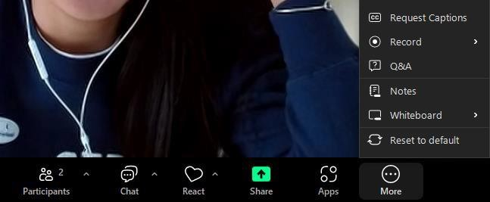

Participation Guidelines
  Please update your Zoom name to include your name and affiliation
  Utilize the Q&A feature to ask questions; the chat has been disabled
  State your name and affiliation/organization
  Keep comments brief, respectful, and constructive
Please mute your microphone
Quick polls will be used, select the option that best reflects your perspective
Meeting is being recorded and slides will be available afterwards
4

Slide 4
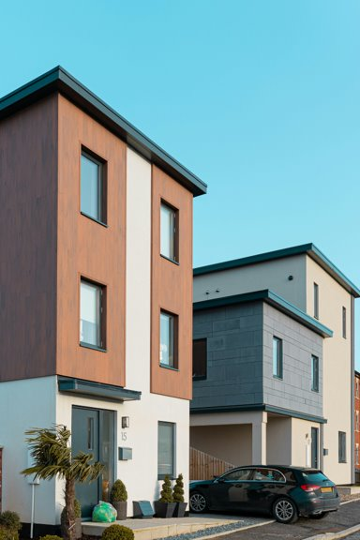
Welcome & meeting overview
  Welcome and introductions
  Purpose of today’s session
  Overview of the program and RFI
  Opportunities for feedback
Notes:
Vicki/ Andy

Slide 5
background
CGS § 8-240a-8-240b established a $125M Housing Environmental Improvement Revolving Loan Fund. Legislature recently authorized an additional $100M bringing the total to $225M.
Of this, $12M is allocated to pilot the Multifamily Revolving Loan Program focused on energy upgrades in existing low-income affordable multifamily housing developments with five or more units.
Prioritizes energy efficient, all-electric upgrades when feasible and cost effective, with funding also supporting energy related pre-development activities and enabling rehabilitation work
DEEP released RFI on March 18, 2026, to garner feedback on how to best design and implement the revolving loan program.

Slide 6
Problem statement
Persistent barriers to energy efficiency and electrification upgrades for MF affordable properties:
High upfront costs and limited access to flexible capital
Timing mismatches between construction and incentive payments
Navigating complex funding stacks and their requirements
Need to address underlying health & safety issues
Frequently deferred or scaled back upgrades, ultimately limiting energy savings and long-term benefits
MF affordable properties vulnerabilities:
Flooding
Wind
Other climate-related hazards
Threaten building systems and undermine long-term energy performance
Notes:
Seema

Slide 7
Polling Question #1
What is the single biggest barrier to moving affordable multifamily housing energy retrofit projects forward?
Answer Choices (pick one)
  Upfront capital costs
  Limited access to flexible capital
  Incentive timing
  Contractor or workforce availability
  Navigating increased project complexity (multiple funding sources and requirements)
  Other

Slide 8
Program overview
Proposed Program Goals
Enable deeper energy measures
Enable increased resilience of affordable MF
Support inclusion of energy and electrification measures
Ensure that energy performance goals are preserved throughout project development
  Program funds should supplement, not supplant, existing grants, financing, incentives, or rebates.
  Program expected to leverage existing programs and infrastructure so that loans can be deployed quickly across the state without duplicating systems or creating new intermediaries.
Projects must demonstrate 20% reduction in energy consumption with 70% of total Program funding per project dedicated to EE and electrification measures.

Slide 9
Proposed Property eligibility
5+ units where at least 50% of units are occupied by residents with household incomes at or below 80% AMI or 60% SMI
Existing housing development (note: new construction and adaptive reuse are not eligible)
Demonstrate financial feasibility consistent with Program’s underwriting standards
Must agree to tenant protections
Maintain required level of affordability for either the life of the loan or 10 yrs
Program-funded improvements cannot be used as justification for rent increases or tenant displacement
Naturally Occurring Affordable Housing (NOAH): must submit written attestation property meets income eligibility thresholds and will remain in compliance
NOAHs = unsubsidized multifamily properties with rents affordable to low-income households

Slide 10
Proposed Eligible activities
Pre-development
Early planning activities that help determine project feasibility and readiness. E.g., technical assistance, energy audits, feasibility studies
Energy Efficiency and Water Conservation Measures
E.g., heat pumps, insulation, air sealing, ventilation systems, low-flow fixtures, heat pump water heaters, energy efficiency appliance upgrades, necessary electric system or wiring improvements
Health, Safety, and Enabling Rehabilitation
Remediation of conditions that directly prevent or limit energy upgrades. E.g., mold, moisture, asbestos, lead, radon, electrical hazards, plumbing deficiencies, and moderate rehabilitation (building envelope upgrades, roof replacements, exterior door upgrades, repairs to structural and safety concerns)
Resilience Measures
Measures that support or enable EE outcomes
E.g., solar + storage, FORTIFIED roofs, floodproofing

Slide 11
Proposed Program implementer requirements
DEEP anticipates selecting one or more implementers
Eligible entities include nonprofits, quasi-public entities, or electric distribution or gas companies
Must demonstrate the following:
Experience financing MF properties, particularly energy efficiency and clean energy upgrades
Capacity to coordinate energy, health and safety, and rehab scopes
Ability to operate statewide
Experience coordinating with lenders, utilities, public agencies, as well as developers, and property owners
Implementer example tasks:
Compliance with program rules
Data tracking and reporting
Handling intake, screening, underwriting recommendations
Coordination with incentives
Fund disbursement, verification, servicing, and repayment
The interest rate, estimated at 1-3%, is designed to cover reasonable servicing and administrative costs
Notes:
Zoemma

Slide 12
Polling Question #2
What type of implementer is best suited to deliver the program and coordinate with existing programs and funding sources?
Answer Choices (pick one)
  Nonprofit
  Quasi-public entity
  Electric distribution or gas companies
Notes:
For those who said ‘maybe’, what would make this usable for you? Size of funding, speed of access, simplicity or what are your concerns?

Slide 13
Proposed Project caps
Per unit cap of $40,000 per eligible affordable unit
Funds available to be used across the whole project
Intended to promote equitable distribution of funds across properties
Per project cap of $500,000 for small properties (5-20 units) and $1M for larger properties (20+ units)
Intended to limit concentration of funds for any single project

Slide 14
Proposed Loan term and repayment structure
DEEP anticipates that revolving loan financing will be structured as low-interest mortgage product, with pricing sufficient to recover reasonable servicing and administrative costs while preserving the revolving nature of the fund.
Loan may be subordinate to existing mortgages or primary lender
Loan sizing based on most restrictive of per-unit or per-project caps, as well as property’s ability to reasonably support debt service
Loan options:
Bridge Capital
Term: 12-24 months
Permanent Amortizing
Term: 5-15 years
Hybrid
Bridge loan converts to amortizing loan at completion with incentives applied as principal reduction

Slide 15
Polling Question #3
How important is the interest rate in making this financing work for your projects?
Answer Choices (pick one)
  Very important, needs to be as low as possible
  Important, but other terms matter too
  Less important than structure (e.g., flexibility, timing)
  Not sure
Notes:
For those who said ‘maybe’, what would make this usable for you? Size of funding, speed of access, simplicity or what are your concerns?

Slide 16
Proposed Project caps
Per unit cap of $40,000 per eligible affordable unit
Funds available to be used across the whole project
Intended to promote equitable distribution of funds across properties
Per project cap of $500,000 for small properties (5-20 units) and $1M for larger properties (20+ units)
Intended to limit concentration of funds for any single project

Slide 17
Proposed Program structure
Pre-development screening
Pre-development funding
Eligibility confirmation
Revolving loan financing for comprehensive energy upgrades
Implementation, verification, and repayment
Applications will be accepted year-round on a rolling basis
Projects may apply directly for EE loan financing (#3) if pre-development funding is not needed
Initial assessment funding may be forgiven if project does not move forward

Slide 18
Polling Question #4
Would access to a small, potentially forgivable pre-development loan, around $8,000-$10,000 for energy audits and assessments help move your projects forward?
Answer Choices (pick one)
  Yes, definitely
  Maybe
  No
  Not applicable
Notes:
For those who said ‘maybe’, what would make this usable for you? Size of funding, speed of access, simplicity or what are your concerns?

Slide 19
Proposed Success metrics
Estimated energy savings and GHG reductions
Depth and comprehensiveness of retrofits (including electrification)
Loan deployment and repayment performance (including effective recycling of capital)
Leverage of additional public and private capital
Advancement of projects from predevelopment to full energy upgrades
Program processing timelines (including application review and disbursement)
Number of units and low-income residents served
Overall Program efficiency and borrower experience
Notes:
Zoemma

Slide 20
Key RFI question topics
Coordination with existing programs
Project costs
Loan structure and sizing
Program safeguards
Program outreach
Program implementer qualities
Notes:
Zoemma, you cover the key RFI Q topics. I’ll ask the 1-2 Qs and facilitate the discussion.

Slide 21
Key RFI questions
Q1: How can this program best align with existing housing financing and underwriting workflows without creating duplication and unnecessary complexity?
Notes:
Seema

Slide 22
Key RFI questions
Q2: What aspects of loan structure or sizing are most important to make this financing usable in your deals?
Notes:
Seema

Slide 23
RFI info
Due date: Wednesday April 15th, 2026 at 5:00 PM ET
How to respond: Submit responses to DEEP.EnergyBureau@ct.gov and include answers to as many or few questions as is relevant or practical
Link: multifamily-revolving-loan-fund--rfi.pdf
Notes:
Zoemma

Slide 24
Next steps
DEEP will review all feedback from the RFI and incorporate relevant and feasible suggestions.
DEEP will procure an implementer(s).
DEEP hopes to launch the program in 2026.
Notes:
Zoemma

Slide 25


Questions and Public comment
Notes:
Zoemma

Slide 26

DEEP.EnergyBureau@ct.gov
Thank you!
Notes:
Zoemma

