Slide 1

Connecticut Long-Term Economic Recovery
Briefing to COG Directors, DEMHS Regional Coordinators, CCM, and COST
Presented on September 21, 2020, watch online at: https://www.youtube.com/watch?v=VbtmOjCprec&feature=youtu.be
Agenda
• Background about Economic Recovery Priorities – Mary Glassman, Senior Advisor to the Governor & Chair, CT Long Term Economic Recovery
• Phase 1 Resilient Economic Recovery Planning Goals and Team Introductions– Prof. Stephen Flynn, Global Resilience Institute, Northeastern University
• Overview of the Capacity Building Process – Ryan Flynn, McChrystal Group
• Research Process and Examples of Information Requests for RRSCs – Warren Edwards and Liz Allen, Global Resilience Institute

Slide 2
Agenda for Today
Background: Economic Recovery Priorities
Team Introductions
Project Vision and Goals
Overview of Capacity Building Process
Research Process for Resilience Baseline Assessments

Slide 3
Background: Economic Recovery Priorities
The COVID-19 crisis requires focused effort from leaders at all levels to secure funding for critical recovery and development projects
To maximize funding, CT must develop a comprehensive strategy that enables an equitable, sustainable, and resilient recovery
Funders are seeking scalable and impactful projects that address long-standing equity issues, increase inclusivity in economic development, and build long-term resiliency
​Without a different approach to planning and community- and funder-engagement, CT risks missing out on available funding for recovery

Slide 4
Statewide Long-Term Economic Recovery Strategy
Phase 1
Sept – Dec 2020
Phase 2
2021 – 2022
In partnership with the State, Advance CT, 9 COGs, 5 DEMHS Regions & Philanthropic Organizations, GRI and McChrystal Group will provide capacity building support to the newly-formed Regional Recovery Steering Committees and produce regional resilience baseline assessments.
GRI will leverage the existing economic development planning and recovery efforts across the state of Connecticut and develop a toolkit for community resilience analysis that will support updating and adapting these plans to support recovery from the COVID-19 emergency. GRI will pilot an inclusive planning process in representative communities in each of the 9 COGs.
GRI and McChrystal Group will support capacity-building and planning efforts supported by the U.S. Economic Development Administration and led by Connecticut’s Councils of Governments:
Recovery Coordinators for each of the 9 COGs | Regional Business Resource Centers (RBRCs) Statewide Business Retention and Expansion | Reimagining CT’s Innovation Corridor (CIC) Regional CEDS Repositioning

Slide 5





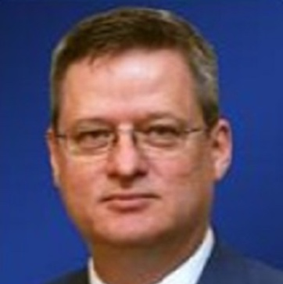


Our Core Team Brings Diverse Backgrounds and Decades of Experience to Support CT’s Recovery Planning
Stephen Flynn
Founding Director
GRI
Robin White
Exec. Director for Research
GRI
Warren Edwards
Distinguished Senior Fellow
GRI
Marcella Nunez-Smith
Distinguished Senior Fellow
GRI
Ryan Flynn
Senior Principal
McChrystal Group
Caroline Kramer
Analyst
McChrystal Group
Liz Allen
Post-Doc Research Associate
GRI
Howard Smith
Senior Research Analyst
GRI
Chike Aguh
Advisor
McChrystal Group
Greg Vogle
Advisor
McChrystal Group

Slide 6
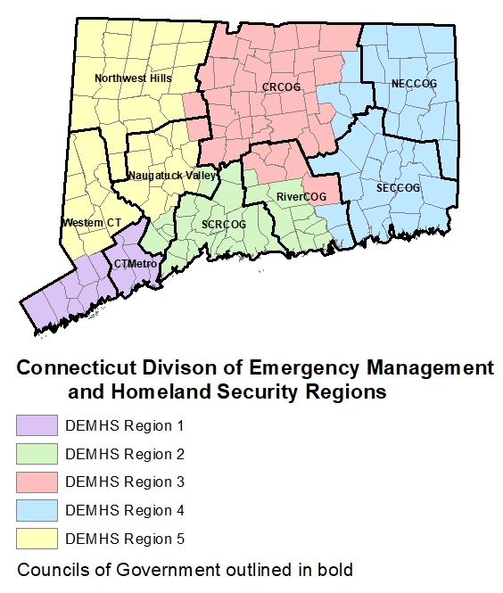
Our Shared Objective is to Maximize Available Resources for Recovery and Ensure Community Support for Projects
The Regional Recovery Steering Committees will:
  Integrate activities already underway
  Increase inclusion of communities hit hardest by the crisis
  Focus stakeholders on mutually beneficial projects that are best positioned to receive funding
​This effort - supported by CARES Act and EDA funding - is designed to provide the RRSCs with the information, capabilities, and resources they need to fill this crucial role

Slide 7
Our Shared Objective is to Maximize Available Resources for Recovery and Ensure Community Support for Projects
In support of one another the RRSCs, COGs, and GRI will:
  Assess the current situation and identify high-impact interventions through a GRI Baseline Assessment which will synthesize information about social and economic issues facing each region and help to further coordinate planning
  Engage community stakeholders to inform and validate ongoing needs assessments and identify shared opportunities for development
  Provide validated analysis and recommendations that serve as a connecting point between economic development plans and equity and resilience opportunities
  Improve connectivity and visibility between the state, regional, and local planners and philanthropic organizations that will maximize shared resources
  Facilitate community buy-in through consensus-building around prioritized recovery plans at the local level

Slide 8
The RRSCs Play a Key Role in Integrating Traditionally Independent Efforts and Driving Action Across Shared Priorities
We need leadership at every level to help guide CT through this crisis and the RRSCs were stood up to provide an additional, more inclusive, regional resource.
Effective and engaged RRSCs will support:
Networked communication to engage state, regional, and local planners and organizations in a real-time decision-making process.
Empowered and informed feedback to ensure equity and inclusivity in terms of need and approach.
Improved effectiveness in leveraging community expertise and planning for short, medium, and long-term recovery.
To achieve success on mission-critical tasks in response to Covid-19, the RRSCs must provide adaptable, regional-level leadership to match disaster-caused needs with resources that will help CT recover.

Slide 9
Phase 1 Will Provide Critical Analysis and Capacity Building to the Newly-Formed Regional Recovery Steering Committees
Key Activities:
Resilience Analysis
Initial Data and Information Collection
Stakeholder Engagement to Inform Analysis
Baseline Analysis Complete
Economic Development Recovery Strategy
SEPTEMBER 2020 | OCTOBER 2020 | NOVEMBER 2020 | DECEMBER 2020
RRSC Alignment & Operating Cadence Refinement
Equity-Focused Technical Assistance & Validation
Decision Support & Process Refinement
Feedback Session & Process Handover

Slide 10

Initial Activities Build a Foundation to Enable Effective and Inclusive Execution of the Planning Process
Initial Resilience Analysis
Support to RRSCs
Publicly available resilience data and information
State Economic Recovery Plan
Regional economic development plans and strategies
Leverages FEMA Rapid Needs Assessment
Informs stakeholder engagement strategy
Baseline current processes and key activities
Refinement of communication and operating cadence
Development of shared mission and guiding principles to inform decision-making
De-biasing exercise for critical responses to GRI information requirements
By the end of October, RRSCs will be prepared to quickly and inclusively engage in critical recovery planning activities and will be supporting GRI’s community-informed data collection process

Slide 11
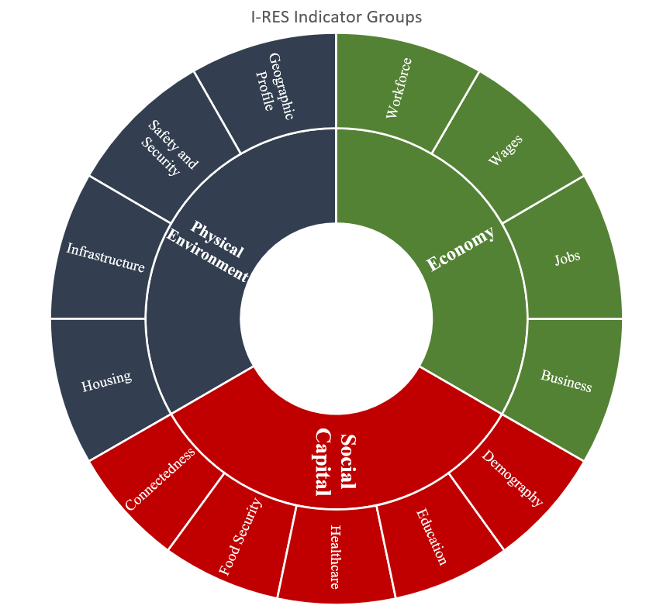
Elements of Resilience Analysis
Focal areas for Resilience Baseline Assessments
Economy
Financial/budget considerations
Unemployment rates
Economic drivers by sector
Income inequality
Workforce development
Social Capital
Healthcare access
Education
Food and housing security
Physical Environment
Built environment
Transportation
Telecommunications

Slide 12
Resilience Baseline Assessment Process Overview
Publicly Available Data
Community Context
Explores
Publicly Available Data through state/ national benchmarks
Knowledge Gaps in Indicator Data
Resilience Issues Potentially Affecting Community or Investment
Resilience Indicators
Community Resilience Snapshot
Community Engagement & Regional Recovery Steering Committee Team Support
Community-held Data
Economic Landscape
Potential Resilience Enhancement Considerations
Analyzes
Community Data with Indicators
Synergies of Indicators with Economic Landscape
Contextualized Community Solution Preferences
Resilience Analysis
Community Baseline Resilience

Slide 13
Questions & Discussion

