Slide 1
JobsCT Incentive Strategy
New 2020 tools to facilitate private sector job creation:
Transparent — clear, simple incentive for companies to evaluate when considering growing in or relocating to Connecticut.
Earn-As-You-Grow — rebate earned as jobs are created/maintained over time which mitigates state exposure to credit/business risk.
Targeted – industries and focus areas build on our strengths of today — and the ecosystems we want to grow in our economy of tomorrow.

Slide 2
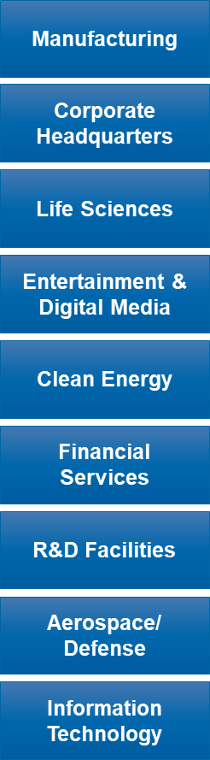
S.B. 9: JobsCT
Eligible employers who meet the below requirements will be rebated 25% of the withholding taxes from net new employees.
Employers that locate or grow in a Distressed Municipality or Opportunity Zone: employer is eligible for 50% rebate.
Program requirements
  Create a minimum of 25 new jobs.
  Salaries must be 85% of the median household income of the municipality where the jobs will be located.
  Employers must be in a Jobs CT focus area.
  Minimum annual salary: $37,500.
  Rebate per job, per year will be floored @ $1,000 and capped @ $5,000.
  Base incentive rebate in years 3 through 7. Years 8 and 9 discretionary.

Slide 3
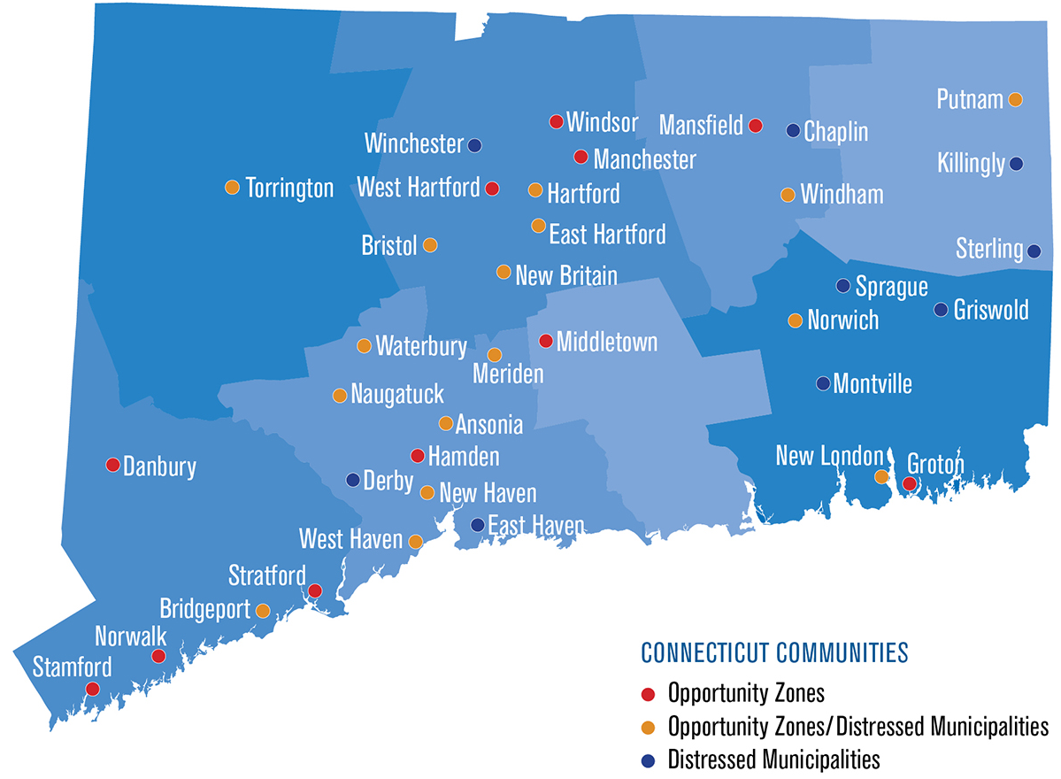
Map of Distressed Muni/OZ

Slide 4
Example
  Company in focus area creates 25 jobs
    Salary per job: $100,000
    Income tax rate: 5.5%
  Net new tax revenue over seven years: $962,500
    State’s portion: 25% $790,625 – 50% $618,750
    Company rebate: 25% $171,875 – 50% $343,750
New Tax Revenue | $137,500 | $137,500 | $137,500 | $137,500 | $137,500 | $137,500 | $137,500 | $962,500
Year | 1 | 2 | 3 | 4 | 5 | 6 | 7 | Total
State revenue | $137,500 | $137,500 | $103,125 | $103,125 | $103,125 | $103,125 | $103,125 | $790,625
Company rebate (25%) | $0 | $0 | $34,375 | $34,375 | $34,375 | $34,375 | $34,375 | $171,875
Year | 1 | 2 | 3 | 4 | 5 | 6 | 7 | Total
State Revenue | $137,500 | $137,500 | $68,750 | $68,750 | $68,750 | $68,750 | $68,750 | $618,750
Company Rebate (50%) | $0 | $0 | $68,750 | $68,750 | $68,750 | $68,750 | $68,750 | $343,750
Year | 1 | 2 | 3 | 4 | 5 | 6 | 7 | Total
*Actual time of rebate: Year 4, Q1

