Slide 1

Connecticut Cultural Districts
Standards and criteria overview

Slide 2
Our Team Today
Elizabeth Shapiro, Director of Arts, Preservation and Museums, CT Office of the Arts, DECD
Wendy Bury, Executive Director, Cultural Coalition
Lisa Scails, Executive Director, Cultural Alliance of Western CT

Slide 3
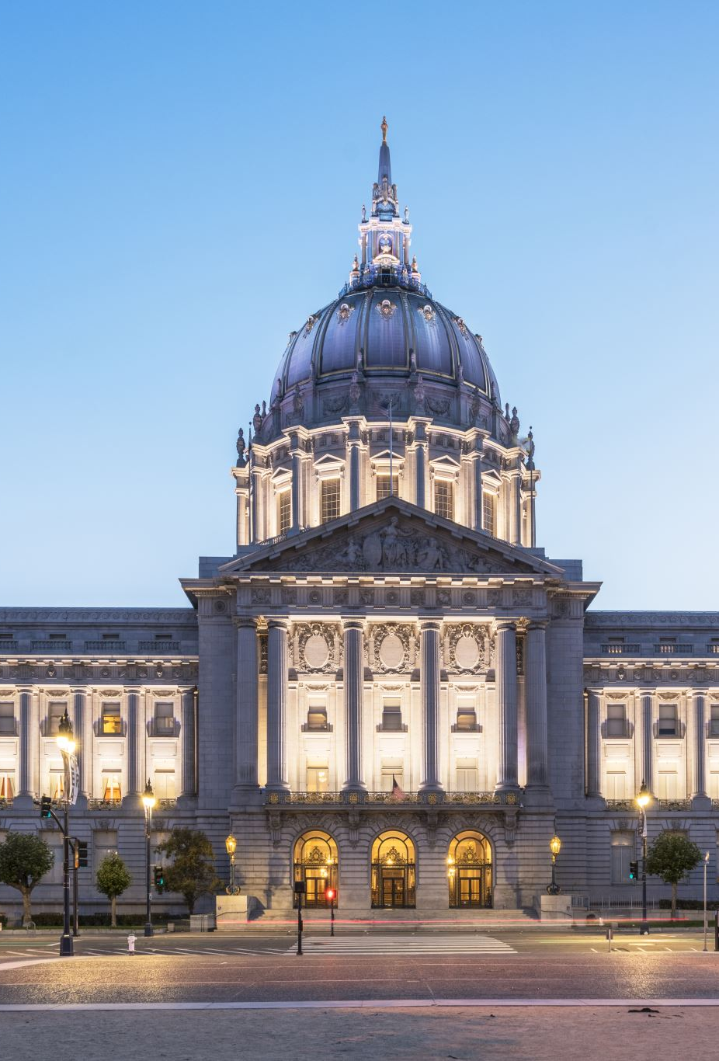
Cultural Districts Legislative Statute
Cultural Districts (Legislative Statute- An Act Concerning the Establishment of Municipal Cultural Districts effective October 2019)

Slide 4
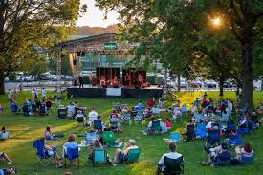
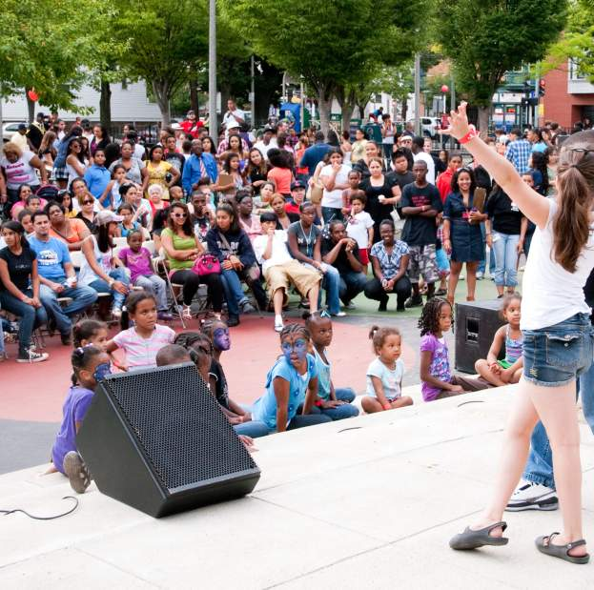
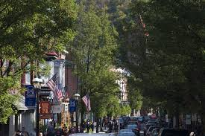
CULTURAL DISTRICT DEFINITION
A Cultural District is a specific area of a city or town identified by the municipality that has a number of cultural facilities, activities and/or assets – both for profit and nonprofit.
It is…
A walkable, compact area that is easy for visitors to recognize.
A center of cultural activities – artistic and economic.
A place in your city/town where community members congregate, and visitors may enjoy those places that make a community special.
Notes:
Because each community is unique, each Cultural District will look different.

Slide 5
WHY ESTABLISH A CULTURAL DISTRICT?
Market
Market arts and culture attractions to visitors
Promote
Promote and encourage artists, entrepreneurs and creative businesses
Tourism
Promote tourism and increase visitation
Quality of Life
Improve the quality of life for residents
Strengthen
Strengthen distinctive character of communities
Economic Growth
Create a plan to drive economic growth and expand tax base
Sustainable CT Support
Support Sustainable CT certification https://sustainablect.org/actions-certifications/
Contribute
Contribute to Connecticut’s cultural assets
Highlight
Highlight culture and history of your community

Slide 6
ASSESS READINESS
Cities and towns should assess their readiness to establish a Cultural District.
Assess the inventory and location of cultural assets in the municipality.
Confirm if your city or town is eligible by reviewing the Standards & Criteria.
Submit a letter of intent to establish a Cultural District to your Designated Regional Service Organization (DRSO).
Notes:
(DRSO- handout) The Connecticut Office of the Arts partners with nine Regional Service Organizations that serve as local field offices to constituents and citizens. This statewide network of designated service agencies plays a key role that is mutually beneficial to the state’s citizens and creative economy, the regional arts and cultural infrastructure, and COA’s goals, programs and services. There are nine DRSO’s in CT.

Slide 7
ROLE OF DRSO
Designated Regional Service Organization of CT Office of the Arts to support Department of Economic & Community Development
Guidance
Process
Support
Convene & Connect
Recommendations
Answering Questions
Different Approaches by DRSOs

Slide 8
STANDARDS AND CRITERIA
The municipality must vote to approve Cultural District.
The municipality must be in Connecticut.
The Cultural District must meet the requirements of Cultural District definition.
The Cultural District must have defined boundaries.
The Cultural District must be walkable and accessible.
The Cultural District must have cultural facilities and assets.
The Cultural District should have public infrastructure and amenities.
The municipality must hold at least one community input meeting in order for people to learn about the proposed Cultural District and goals.
The municipality must pass a resolution following the community input meeting/s.
The municipality must form a Cultural District Commission.
More standards & criteria on next slide.

Slide 9

STANDARDS AND CRITERIA continued
Cultural Districts that span more than one town/city, both municipalities must have a supporting resolution
Municipalities that have more than one cultural district, one resolution is enough.
An inventory of cultural assets must be identified and included on a map.
Notes:
1) Cultural Districts that span more than one town/city, both municipalities must have a supporting resolution.
2) For municipalities that have more than one cultural district, one resolution is enough.
3) INVENTORY OF CULTURAL ASSETS - defines and locates the district’s cultural assets. Many municipalities have access to Geographic Information System (GIS) mapping system and tools. Google maps and other asset mapping software may be utilized. DRSOs may be able to help identify and develop a list of assets.

Slide 10

MAPPING
The map should show the boundaries of the proposed Cultural District and where the district is in the municipality (color maps are best).
The map should include the following:
● Cultural facilities
● Artistic spaces
● Creative businesses
● Historic sites
● Locations of cultural activities
Notes:
Include a key to the assets and define a scale of distance. Show the location of cultural assets, both for profit and nonprofit.
Locations of cultural activities – For example: indoor and outdoor, such as festivals, etc. If applicable, list the events and activities that take place at each location.
Municipalities may mark cultural assets that are located outside the proposed district on the map.

Slide 11

CULTURAL DISTRICT COMMISSION
A city or town must establish a Cultural District Commission. A Cultural District Commission may be established through one of the Three models and in accordance with the municipality’s governance structure

Slide 12
CULTURAL DISTRICT COMMISSION
Create new Board/Commission in accordance with local charter requirements.
1
Assign to an existing Board/Commission and create an Advisory Council subcommittee reporting to the existing Board/Commission.
2
Assign Cultural District oversight to an existing Board/Commission, if the Board or Commission can meet the community representation requirement.
3
Notes:
1. Create new Board/Commission in accordance with local charter requirements. This requires new volunteers to serve as Commissioners.
2. Assign to an existing Board/Commission and create an Advisory Council subcommittee reporting to the existing Board/Commission. This creates a non-voting advisory council and could be an informal working group, where there is some fluidity in membership. This requires additional volunteers.
3. Assign Cultural District oversight to an existing Board/Commission, if the Board or Commission can meet the community representation requirement (noted below under “Members” section). This could be an existing entity, such as an Economic Development Commission, or it could be the municipality’s governing body (Council/Board of Selectmen). This does not require additional volunteers, but places increased responsibilities onto existing volunteers.
The Cultural District Commission should be able to exercise any power and perform any duties necessary or desirable for the purpose of managing the district.
This includes but is not limited to consulting / collaborating with the Office of the Arts, Tourism (state and local) and the DRSO for assistance with:
marketing, connecting with and/or convening local arts and culture community representatives,
asset mapping,
advocacy,
directing resources, and
applying for or soliciting and accepting any grant, contribution, or other funding.

Slide 13
Members
Cultural District Commission members should include at least one representative from the following six (6) categories:
● ● Local cultural council / arts council
● Cultural organizations (historical society, museum, ethnic heritage organization)
● At least one artist that lives and/or works in the district
● Organizations that represent artists (artist cooperative, etc.) if applicable
● For-profit creative business i.e. gallery, theater
● Local business and/or chamber of commerce
Notes:
Cultural District Commission members should represent a diverse mix of organizations and businesses. Three-quarters of the membership must represent the arts/culture community. The Cultural District Commission should represent the shared interests of the district. The majority must live or work in the district. The size of the Cultural District Commission should be commensurate with the needs of the municipality and its population, with a minimum of six (6) members.

Slide 14
Members continued
A city, town or borough may elect to include additional representatives. This will depend on the assets in the Cultural District and the district’s goals. They can be from:
● Tourism
● Historic Preservation/History
● Leisure Industry (including restaurants, hotels and similar businesses)
● Educational Institutions
● Economic/Community Development
Notes:
Cultural District Commission members should represent a diverse mix of organizations and businesses. Three-quarters of the membership must represent the arts/culture community. The Cultural District Commission should represent the shared interests of the district. The majority must live or work in the district. The size of the Cultural District Commission should be commensurate with the needs of the municipality and its population, with a minimum of six (6) members.

Slide 15

Duties and Procedures
The Cultural District Commission should be responsible for developing a management plan and provide oversight with implementation.
The Cultural District Commission should convene on a regular basis and operate in accordance with municipality’s governance structure.

Slide 16
Duties and Procedures continued
The Cultural District Commission must develop:
Goals and objectives
A management plan
A cultural assets map and inventory
A marketing plan*
Goals and success measures for the district

Slide 17


QUALIFY FOR STATE’S INVESTMENT OF RESOURCES
The Department of Economic and Community Development, including the Office of the Arts and the Office of Tourism, and Designated Regional Service Organizations are committed to supporting the formation, development and establishment of Cultural Districts.
All of the above agencies/organizations can provide additional in-kind marketing, promotion and resources for established Cultural Districts.

Slide 18
Types of Investment in Cultural Districts
Promotion of Cultural District by CT Office of Tourism and recognition on State’s tourism website, CTVisit.com
Promotion of Cultural Districts by CT Office of the Arts
Promotion of Cultural Districts by local Designated Regional Service Organization (DRSO)
Support FROM DRSO’s (i.e. time, expertise, consulting, etc. as available)
Other investment opportunities as they become available
Notes:
List of documents:
Letter of endorsement from Chief Elected Official
Copy of Resolution from the City Council/Board of Selectmen (see sample resolution)
Master Map: Please provide a map of the Cultural District
List of cultural assets, including cultural events held at locations within the proposed Cultural District
List of available municipal resources that would support and/or benefit Cultural District (ex. tax credit, incentives, etc.)
Official legal documents on zoning overlaps or ordinances relevant to the Cultural District, such as existing Arts or Historic District (if applicable)
Marketing materials, if relevant to the Cultural District
Once the materials are submitted, you will be contacted to arrange a site visit for representatives from DECD, COA and local DRSO. Coordinating and conducting a site visit, as part of a review for additional investment, is intended to share information and build and strengthen relationships between DECD, COA, DRSOs and Cultural Districts in order to maximize mutually beneficial opportunities. The site visit includes a tour of the proposed cultural district and a meeting to discuss and highlight plans, assets and goals for the district.

Slide 19
To qualify for State’s investment of resources
Submit (ELECTRONICALLY) the following documents to Your Designated Regional service organization for review:
Letter of endorsement from Chief Elected Official
Copy of Resolution from the City Council/Board of Selectmen (see sample resolution)
List of Cultural District Commissioners and their relevant role/category as per representation guidelines
Master Map: Please provide a map of the Cultural District
List of cultural assets, including cultural events held at locations within the proposed Cultural District
List of available municipal resources that would support and/or benefit Cultural District (ex. tax credit, incentives, etc.)
Official legal documents on zoning overlaps or ordinances relevant to the Cultural District, such as existing Arts or Historic District (if applicable)
Marketing materials, if relevant to the Cultural District
Additional Information (POCD, Relevant existing Commissions, Arts Curriculum)
Note: DRSO will forward documents to Ct office of the arts
Notes:
List of documents:
Letter of endorsement from Chief Elected Official
Copy of Resolution from the City Council/Board of Selectmen (see sample resolution)
Master Map: Please provide a map of the Cultural District
List of cultural assets, including cultural events held at locations within the proposed Cultural District
List of available municipal resources that would support and/or benefit Cultural District (ex. tax credit, incentives, etc.)
Official legal documents on zoning overlaps or ordinances relevant to the Cultural District, such as existing Arts or Historic District (if applicable)
Marketing materials, if relevant to the Cultural District
Once the materials are submitted, you will be contacted to arrange a site visit for representatives from DECD, COA and local DRSO. Coordinating and conducting a site visit, as part of a review for additional investment, is intended to share information and build and strengthen relationships between DECD, COA, DRSOs and Cultural Districts in order to maximize mutually beneficial opportunities. The site visit includes a tour of the proposed cultural district and a meeting to discuss and highlight plans, assets and goals for the district.

Slide 20
SITE VISIT
A meeting with the chief elected official and/or designee and/or other relevant municipal employees
A walking tour of the proposed Cultural District
A meeting with the Cultural District Commission/Committee members and appropriate stakeholders to hear about the goals, objectives and plans for the Cultural District
Notes:
Notice of the outcome of the review to the city or town will be sent via email. Final decisions
are made by DECD’s CT Office of the Arts.

Slide 21
ADDITIONAL RESOURCES
Sustainable CT Alignment
(In progress) Municipalities participating in Sustainable CT may be able to meet the criteria and received points for Action Item 3, Vibrant and Creative Cultural Ecosystems, through the Cultural District designation. Sustainable CT municipal participants are eligible to apply for Community Matching Funds. Community Matching Funds provide one-to-one matching funds for projects that align with Sustainable CT actions and Community Match Fund projects helps towns earn points towards certification.

Slide 22
ADDITIONAL RESOURCES
At present, the statute that established the legislation does not include grant funds. A variety of funding opportunities are available through the Connecticut Office of the Arts, the State Historic Preservation Office, Sustainable CT, and Connecticut Humanities.
CT Office of the Arts
State Historic Preservation Office
Connecticut Humanities
CT Tourism Districts
Notes:
Include a key to the assets and define a scale of distance. Show the location of cultural assets, both for profit and nonprofit.
Locations of cultural activities – For example: indoor and outdoor, such as festivals, etc. If applicable, list the events and activities that take place at each location.
Municipalities may mark cultural assets that are located outside the proposed district on the map.

Slide 23
For more information
CT.Gov.Home -> DECD -> Arts & Creativity -> Programs & Services ->
Cultural Districts - https://portal.ct.gov/DECD/Content/Arts-and-Culture/Programs_Services/Cultural-Districts
DRSO list - https://portal.ct.gov/DECD/Content/Arts-and-Culture/Our-Regional-and-State-wide-Partners/Designated-Regional-Service-Organizations
Liz Shapiro - elizabeth.shapiro@ct.gov
Lisa Scails – lscails@cawct.org
Wendy Bury – W.Bury@Culturesect.org

