Slide 1

Water Safety
Health Standard- 17-1
Educational Support & Staff Development
November 1st, 2025
Notes:
Drowning and near-drowning accidents are usually the result of mistakes or failures to take basic safety precautions. All too often, the underlying cause is associated with the failure to provide necessary supervision to individuals who are not able to swim or otherwise protect themselves from the hazards associated with water. While drowning accidents are often associated with bodies of water like a pool or lake, many of these accidents occur at home. It is essential for services providers to recognize that a person can drown in just a few minutes, and without making a sound. Service providers must always take precautions to make sure that individuals are protected from these preventable accidents. Health standard 17-1 outlines basic strategies that staff should follow whenever an individual is in or near water.

Slide 2
Agenda
Introduction
Definitions
Prevention strategies during bathing
Prevention strategies during aquatic activities
Documentation
Notification
Aquatic Activity Screening Form

Slide 3
Introduction
Health Standard – 17-1 applies to all individuals for whom the department bears direct or oversight responsibility for their health and safety. This standard also applies to all public and qualified provider staff who plan and coordinate care for individuals or who provide direct support to individuals.

Slide 4

DEFINITIONS

Slide 5
Aquatic Activity
means all water-related activities including swimming, boating, fishing, hot tubs, water parks and those activities that take place near to water

Slide 6
Near To Water
means aquatic activities at any location where there is a body of water at the intended destination that is open and accessible to individuals. This means that there are no barriers to prevent access such as secure fencing or padlocked gates. Contact with the water may, or may not be intended. Bodies of water include, but are not limited to, streams, creeks, oceans, lakes, ponds, pools, hot tubs, wading pools, or natural or man-made water areas. Near to water activities include, but are not limited to, picnics in a park where there is water, feeding ducks at a pond, unrestricted access to backyard wading or swimming pools or hot tubs, or walks on the beach.

Slide 7
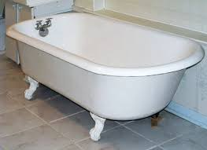
PREVENTION STRATERGIES

Slide 8
While Bathing
Know the level of supervision and support that each individual needs to remain safe.
Make specific staff assignments
Eliminate distractions and interruptions that interfere with supervision responsibilities. Bathing
Take special precautions with individuals who have seizure conditions
Avoid thinking that nothing bad can happen in a minute or two.
Drain the bathtub or sink right away
Gather all items needed for hygiene prior
Notes:
Prevention Strategies during Bathing Activities Pr
When routinely assisting individuals with bathing, staff shall:
Know the level of supervision and support that each individual needs to remain safe. Some individuals require more supports and supervision than others based upon their needs and circumstances. There should be a clear plan about the amount of supervision and assistance each individual needs while bathing. Individuals who need assistance from staff while bathing are never to be left alone in a bathtub, even for a second.
Make specific staff assignments. Staff responsibilities for supervising and assisting individuals should be specific to avoid any confusion and mistakes about who is performing a particular activity. Staff assigned to assist an individual during bathing should never assume that someone else will take over these duties. For example, it would be a serious mistake for a staff person to assume that he or she was relieved of their supervision responsibility because other staff are in or near the bathroom.
Eliminate distractions and interruptions that interfere with supervision responsibilities. Bathing activities for individuals who need staff supervision and support should be planned for those times that maximize staff resources. For example, avoid scheduling bathing activities during other peak activity times like meal times or when staff members are scheduled for breaks.
Take special precautions with individuals who have seizure conditions. Individuals with seizure conditions must never be left alone in a bathtub. Hot baths may lower a person’s threshold for seizures. Because an individual can lose consciousness during a seizure, a staff member must be prepared to take immediate action. Appropriate provisions for an individual’s privacy should always be maintained consistent with his or her support needs.
Avoid thinking that nothing bad can happen in a minute or two. A drowning or near-drowning accident can happen suddenly in a minute of distraction. If a phone or a doorbell rings when an individual is taking a bath or showering the individual should never be left unattended. Let the caller leave a message or let someone else answer the door.
Drain the bathtub or sink right away. Staff should never allow standing water to remain in a bathtub, sink or other container.

Slide 9
Aquatic Activities
Refer to the level of supervision needed in the individual’s Aquatic Screening
Know each individual’s swimming abilities.
Make specific staff assignments.
Take special precautions with individuals who have seizure conditions
Make sure floatation devices and lifesaving vests are used properly.
Obey all posted rules and signs and only allow swimming in designated areas of a pond, lake, river, or ocean.
Have a cellular phone available so assistance can be requested quickly in emergencies.
Know the weather conditions and location of underwater hazards before allowing an individual to enter a body of water.
Know CPR and basic life saving techniques.
Notes:
Prevention Strategies during Aquatic Activities
While enjoying activities at a pool, beach, lake, river, or water park staff shall:
Refer to the level of supervision needed in the individual’s Aquatic Screening, which is part of the DDS Individual Plan (IP), IP Short, or used as a separate document for individuals who do not have an assigned DDS Case Manager.
Know each individual’s swimming abilities. The swimming abilities of each individual should be considered beforehand to make sure there is sufficient staff consistent with each individual’s swimming skills and supervision needs. Staff should ensure that individuals are never left alone in or near the water if they require supervision.
Make specific staff assignments. Staff should be assigned responsibility for supervising specific individual(s), as appropriate. The duties of each staff member at the waterfront and while in the water must be explicit. Staff must clearly understand supervision levels and how they are to supervise each individual, such as remaining within arms-length or maintaining visual contact.
Take special precautions with individuals who have seizure conditions. Seizure conditions should be considered when supervision needs are assigned on the Aquatic Activity Screening. Additional support may need to be assigned based upon the location and conditions of the planned activity.
Make sure floatation devices and lifesaving vests are used properly. These devices should be properly sized and worn by all non-swimmers. These devices may give a false sense of security and their use should never be a substitute for appropriate staff supervision. Inflatable inner tubes, water wings, and noodles should never be considered safety devices for any individual.
Obey all posted rules and signs and only allow swimming in designated areas of a pond, lake, river, or ocean. Avoid swimming or other water activities in areas that are isolated or lack lifeguards or other persons to assist in the event of an emergency.
Have a cellular phone available so assistance can be requested quickly in emergencies. Seconds count when it comes to water emergencies and having a cell phone to quickly summon assistance can make a significant difference in the outcome of an accident. Staff should check to make sure there is adequate service at the site of the aquatic activity.
Know the weather conditions and location of underwater hazards before allowing an individual to enter a body of water. Staff should check on weather conditions prior to an aquatic activity to avoid having to use emergency measures to protect individuals from bad weather. Staff should check on conditions in the water that could prove hazardous (i.e., strong currents, rocks in the water, steep or sudden drop-off in the water).
Know CPR and basic life saving techniques.

Slide 10
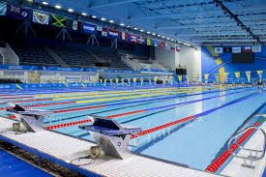
NOTIFICATION
&
DOCUMENTATION

Slide 11
Documentation
Any incident during bathing or an aquatic activity requires an incident report (255)
Notes:
Any incident during bathing or aquatic activities, including all drowning or near-drowning accidents, shall be documented by staff in accordance with I.D.PR.009 Incident Reporting on the DDS Incident Report Form 255.

Slide 12
Notification
1. Call 911
2. Notify the Supervisor
3. The supervisor will notify the manager/manager on call
Notes:
If an individual has been submerged under water resulting in the need for physical assistance or resuscitation, staff shall:
Call 911 for ambulance transport to the nearest hospital.
Call their immediate supervisor, without delay, to notify the supervisor of the incident. If this supervisor is not available, a message should be left and staff should then call the next person in the line of supervision. Staff should continue to call supervisors in the chain of command until the incident is reported directly to a supervisor.
In any incident involving an individual who shows signs of distress or has been submerged or required resuscitation, the supervisor who has been directly notified by staff shall immediately notify their Program Manager or, if after normal business hours, notify the DDS Manager-on-Call.

Slide 13
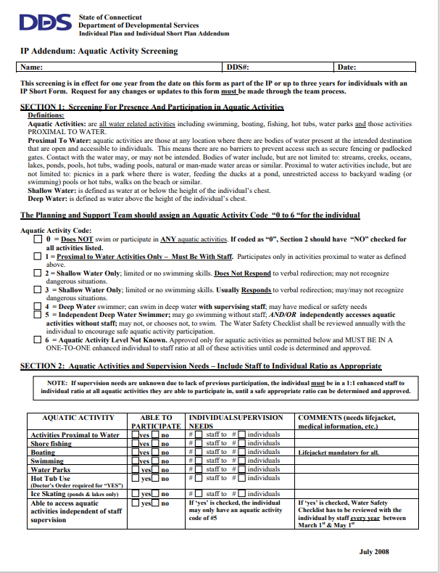
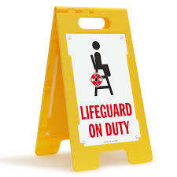
AQUATIC SCREENING FORM
Notes:
The Aquatic Activity Screening Form is a Connecticut Department of Developmental Services (DDS) document used to assess an individual's safety and supervision needs for water-related activities, ensuring appropriate staffing and safety measures are in place, and is part of the larger Individual Plan (IP). It categorizes water activity levels and specifies the staff-to-individual ratio required for participation in activities like swimming, boating, and visiting water parks.

Slide 14
THANK YOU
Health Standard- 17-1
Questions: Contact dds.training@ct.gov

