Slide 1
Risk Assessment of Aggression to Self and Others
Brooke Lloyd, Psy.D.
Consulting Psychologist
Peter Tolisano, Psy.D.
DDS Director of Psychological Services
Achieving a better understanding of the risk assessment process

Slide 2
Top Factors
Risk Assessment of Aggression
The co-occurrence of the following 3 factors significantly predict violence:
Substance Use Disorder
Severe Mental Illness(es)
Recent Violence (History of Violence)
These risk factors may help identify individuals who should undergo a more formal violence risk assessment.

Slide 3
Substance Use Predicts Violence
Risk Assessment of Aggression
Diagnosis | Percent that are Violent in Past Year
No Disorder | 2%
Mania or Bipolar Disorder | 11%
Major Depressive Disorder | 12%
OCD | 11%
Schizophrenia | 13%
Panic Disorder | 12%
Alcohol Abuse or Dependence | 25%
Cannabis Abuse | 19%
Other Drug Abuse/Dependence | 35%
Substance Use
+
Major Mental Illness
(Schizophrenia, Bipolar, Major Depression, Obsessive Compulsive Disorder, or Panic Disorder)
= Highest predictor of violence

Slide 4
Other considerations that predict violence:
Risk Assessment of Aggression
First psychotic episode: 34% of patients commit some act of violence before receiving treatment
Positive symptoms INCREASE risk of serious violence such as persecutory thoughts
Negative symptoms DECREASE risk of serious violence such as social withdrawal
Quickly growing paranoid fear: especially fear for life/safety.
Preoccupation with an energy burst
Delusions that are suspicious/persecutory in nature are highly associated with violence.

Slide 5
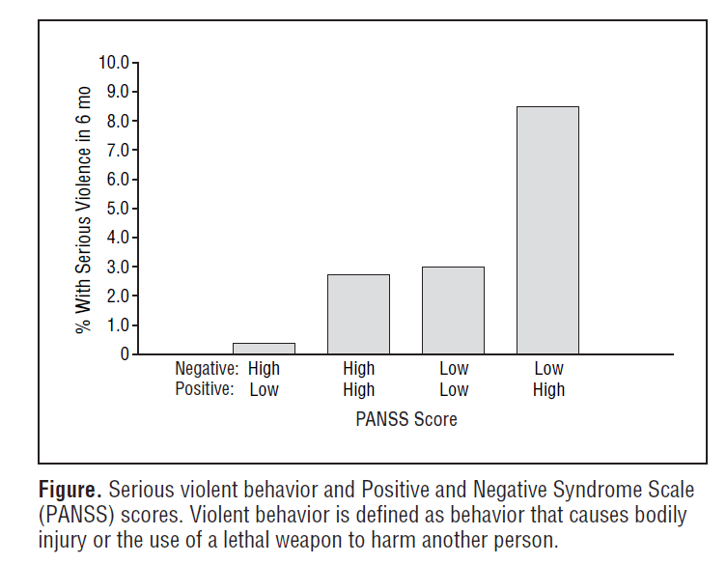

Slide 6
Who are mostly like to be hurt?
Caretakers
Among Schizophrenic individuals, caregivers are typically:
Parents (68%)
Mothers tend to outlive fathers.
Mothers are also more likely to give “unconditional love”.
When asked if they will still love their child if he/she commits a brutal murder:
98% of mothers say YES
46% of fathers say YES
Siblings (12%)
Spouses (7%) – many spouses leave/divorce

Slide 7
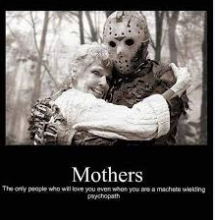
The only people who will love you even when
you are a chain saw wielding psychopath.

Slide 8

Risk Assessment of Aggression
Prevention doesn’t require prediction.
It is our responsibility to mitigate risk, NOT necessarily predict risk.
GOAL: Prevent violence through structure and guided decision-making.
Adopt a dynamic approach to risk assessment that focuses on proximal indicators.
That is, don’t overly focus on childhood history, but rather aspects in background that correlate with current relevant issues.

Slide 9
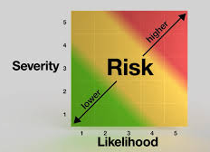
Risk Assessment of Aggression
Understanding and Avoiding Risk is Multifaceted:
Nature
Likelihood
Frequency
Seriousness
Imminence
Context

Slide 10
Risk Assessment of Aggression
Key Factors to consider in an adequate risk assessment:
Recognize risk level
Evaluation conducted in a timely manner
Sufficient collateral data
Determine deterrents to mitigate threat
Blind spots in Risk Assessment:
Stereotypes about who poses risk
Accommodation to aggression and violence (e.g., Emergency Department provider reports they frequently see many suicidal individuals)

Slide 11
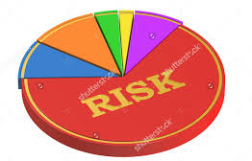
Risk Assessment Domains:
Biological (history of CNS trauma)
Historical (treatment failure)
Dispositional (age 15-24, male gender, socioeconomic status)
Social and Contextual (peer influences, access to victims, situational stresses)
Clinical (substances, mood functioning, impulsivity associated with borderline personality)

Slide 12
Examples of Factors that Affect Risk Assessment:
Knowledge of the client’s history (actuarial facts)
Familiarity with their clinical history
Understanding of their support system

Slide 13
Key STATIC Risk Factors of Violence
STATIC: Does not change over time and is not changed by intervention (untreatable).
Age – late teens to early 20’s
Sex – Males more likely than females
Lower Social Class
History of violence toward others
Criminal History
History of childhood abuse
Childhood behavioral issues
Personality Pathology or Psychopathy

Slide 14
Key DYNAMIC Risk Factors of Violence
DYNAMIC: Can be changed by intervention. Best short-term predictor of violence.
ACUTE DYNAMIC (Rapidly increase risk, can rapidly change):
Current alcohol/substance use
Irritability
Emotion Dysregulation
STABLE DYNAMIC (Take longer to treat/address):
Living setting
Access to weapons
Psychotic symptoms (especially paranoia)
Feeling a lack of alliance with others
Personality Pattern of Aggression (tendency to
approach frustration with aggression)
Probationary supervision
Recent violent behavior
Recent victim of violence
Substance Use Disorders

Slide 15


Modes of Violence:
Affective
Emotionally-based (e.g., anger or fear)
Reactive and defensive with purpose to reduce
immediate threat risk
A risk factor is the presence of a mood-related
disorder
Both types are biologically based, but neurologically different.
Predatory
Instrumental, premeditated, intended, and targeted
No emotionality or cognitive loading
Often the function is power, revenge, or control
Risk factor: Personality-Related Disorder

Slide 16

Case Illustration of Warning Signs and Behaviors:
DDS Case Example containing the following warning signs:
Relevant history of aggression
Legal History
Childhood abuse
Male between ages 18-24
Multiple Mental Health Disorders from childhood
Mild Intellectual Disability
Behavioral trials: similar acts in smaller ways
Sensitization and Desensitization Pattern of escalation
Fixation (preoccupation)
Energy burst
Emotional state of anger: “Cry A Little”
Psychopathic pattern: no remorse, predatory approach

Slide 17
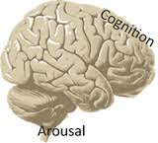
Mental Status In Risk Assessment
Capacity to:
Organize thoughts in clear and coherent manner
Contain emotions and impulses
Execute willful and purposeful behavior
Lack of insight, especially into psychosocial triggers, is key risk factor on parallel with weapons, substances, and major affective disorder.
Not alienation (feeling alone), but ISOLATION (being alone) is also a significant risk factor

Slide 18

Foreseeability
The primary issue in ethical and legal involvements.
It brings into question the manageability of the situation (i.e., Did you make a reasonable effort?). Keep in mind that the jury (not necessarily people in the field of healthcare) will make this determination.

Slide 19
Other Important Clinical Considerations:
Duty to warn:
When violence is foreseeable and the victim is identifiable.
Use agency supervisory hierarchy and best to use police to warn potential victims.
Acceptable to break confidentiality and HIPAA (Document as “Because of risk, I disclosed…”)
First inclination should always be to protect.
People can “pull it together” to avoid hospitalization, but still call police or collaborate with ED with the rationale to maintain safety.

Slide 20
CT Involuntary Commitment Law:
Criteria for Threshold of Involuntary Psychiatric Admission
Dangerous to self or others with Substantial risk of harm
2) Grave disability (unable to provide for basic needs due to mental/emotional impairment, usually psychosis)

Slide 21
Specific Interventions To Reduce Risk:
Seek immediate psychiatric evaluation/treatment at hospital and/or mental health center
Increase participation in treatment and positive activities
Contact family
Complete direct observations
Ensure no access to weapons
Enhance level of supervision as indicated
Support sobriety
Seek substance abuse treatment if indicated
Review treatment plan with team
Seek risk assessment if indicated
21B

Slide 22
What to Do If Client at Risk
Ensure team is aware of concerns and completes a Violence Prevention Plan (example):
Risk Factor | Management/Treatment | Status
Client (“Jim”) living with a roommate (“Fred”) who is in frequent conflict with Jim. Jim filed a protective order against Fred after Fred assaulted him on 5/8/17. | 1. Evaluate risk of Fred to aggress by a licensed professional. 2. Move Fred to respite until a living arrangement with compatible roommates OR alone can be arranged. 3. Ensure that Fred has appropriate level of supervision with trained staff to prevent return to his previous residence. 4. Ensure staff at Jim’s residence are aware of the protective order and follow directives to call police if Fred returns. | 1. Fred taken to ED after assault for psychiatric evaluation. 2. Fred was moved to New Haven area respite on 5/8/17 at 6PM. 3. Respite staff were trained on BSP & LOS with particular detail to protective order on 5/9/17. 4. Residential manager at Jim’s home was notified on 5/8/17 and directed to train staff.

Slide 23

General Risk Factors of Harm to Self
Thoughts to harm self or others
Alcohol or substance abuse
Plan to harm self or others
Command hallucinations about harming self or others
History of previous attempts
Suffering a recent loss (actual or perceived)
Emotional crisis within 3 months
Negative or pessimistic thoughts about the future
Self-deprecating remarks
Anxious or agitated

Slide 24
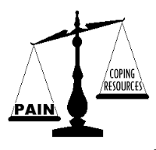
General Risk Factors of Harm to Self
Increased degree of isolation
“Ended” relationships/refusal to meet
with friends or family
Giving away possessions
Verbalized abandonment, hopelessness, helplessness, or despair
Experiencing the anniversary of a sad event
Changes in the routine (loss of school or work)
Changes in sleep, appetite, or motor activity
Sudden IMPROVEMENT in mood and affect
Perception of oneself as a burden on others
Feeling of not belonging
Vectors of anger (toward self vs. against others)

Slide 25

General Risk Factors of Violence Toward Others:
Substance abuse (withdrawal, not just abuse can be predictive)
Availability of lethal means
Self-report of likelihood to hurt someone (as well as collateral report)
Past violent acts (“Most violent thing you ever did?”)
Specific person threatened
Motives
Poor control of anger
Employment status
Victim or witness to childhood abuse
Below average intellectual functioning
History of impulsivity

Slide 26
Protective Factors
Basic Needs
Basic needs are met (availability of resources for health: food, clothing, healthcare, etc.)
Enjoyment of specific daily activities
Personality & Coping
Generally optimistic
Engaged in treatment (medication compliance, participation, etc.)
Healthy coping skills: humor
Meaning-Making
Specific reasons to live
Spirituality
Moral objection to harm self or others
Cultural prohibition of harming self or others
Feelings of responsibility toward family
Interest in others
Attachment to staff or caregivers
Family supports
Supportive relationships

