Slide 1

Ke is DCF!
SAC Presentation
Data on Prevention and Well-being,
November 2025
Chief of Continuous Quality Improvement,
Rosemary Wieworka, LMSW
Data Scientist
Kathleen McKay, PhD

Slide 2
Community pathways programs
The Prevention Care Management program (PCME): A centralized hub for the assessment/referral, care coordination, and case monitoring of children and families defined under Connecticut's Family First candidacy populations: community/self-referrals, behavioral health, and known-to-DCF referrals. The 3 PCME programs are:
Community Pathways (CP): CP accepts referrals from families and community partners and provides information, access, and connection to community-based supports and evidence-based interventions.
Voluntary Care Management (VCM): The VCM serves families and youth with emotional challenges, mental illnesses and/or substance use disorders. Its goals are to help families meet their own needs, increase their access to care and connect to traditional and non-traditional supports in their community.
Integrated Family Care and Support (IFCS): IFCS is a strengths-based program to help keep families together, safely at home. Goals include helping families meet their own needs and connect to traditional and non-traditional resources. Families are referred to IFCS from DCF.

Slide 3
Acronyms
  CAPTA: The Child Abuse Prevention and Treatment Act is a federal law that provides grants to states to address child abuse and neglect. In Connecticut, there is a CAPTA portal for hospitals to report to DCF when there is birth of a newborn with suspicions of abuse or neglect, and/or substance exposed.
  ACRI: Administrative Case Review Instrument

Slide 4
Prevention
Indicators |  | FY24 Annual | FY25 Annual | FY26 Target
Families receiving primary prevention services¹ (Community Pathways, Voluntary Care Management) (n) |  | 355 | 628
Families receiving secondary prevention services (Integrated Family Care & Support, Community Support for Families) (n) |  | 3203 | 2987
Infants with Family Care Plans (% of CAPTA notifications with verified or developed plans) |  | 80% | 92%
Children entering foster care in Connecticut | Rate per 1000 children in the population | 1.9 | 1.8 | ≤2.7
 | Number of children | 1596 | 1575
Children ages 0-5 entering foster care (n) |  | 767 | 787
Prevention outcome: Provide early interventions and upstream support for families.
* 2.72 AFCARS national rate 2024 in US per 1000 children
Notes:
2.7 is the rate of entry into foster care AFCARS for
FY25
Primary Prevention:
Community Pathways 78 (Carelon); VCM 550 (Bethany Zorba, Program Lead); total: 628
Secondary Prevention:
IFCS: 1187 (Carelon) CSF: 1800 (Carelon) Total: 2987

Slide 5
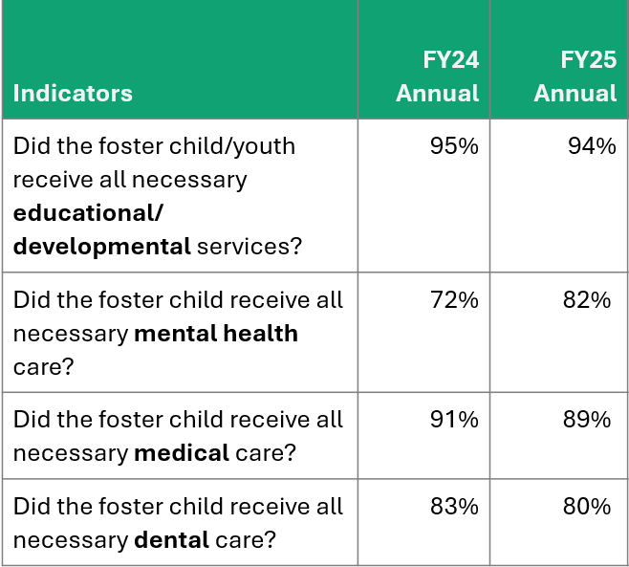
Well-Being
Well-being outcome:
Contribute to child and family well-being by enhancing assessment and interventions.
Notes:
Source: Mindshare ACRI from 11/2024-6/2025; ACR LINK reports prior to 11/2024.

Slide 6

Questions?
Thank you
Notes:
Please let us know if you have any questions,

