Slide 1
An Introduction to Mobile Crisis Intervention Services
Overview of MCIS services & the Impact of COVID- 19
December 9th, 2020
Emily Morse, LCSW
MCIS Program Manager

Slide 2
What is Mobile Crisis?
Mobile Crisis is a statewide, voluntary crisis stabilization/hospital diversion program offered throughout the state of Connecticut.
To access Mobile Crisis services, dial 211, press 1, then press 1 again.
Alternate Phone Number for 211:
1-800-203-1234

Slide 3
Why call Mobile Crisis?
To provide crisis intervention services for youth who are experiencing behavioral and/or mental health crises.
To avoid youth having unnecessary assessments at the emergency department for behavioral health and mental health crises.
Mobile Crisis can team with schools and other providers to address complex situations and make referrals for services in the community to prevent future crises.
Mobile Crisis can bridge services until a youth is able to start long-term treatment when clinically appropriate.

Slide 4
Mobile Crisis at A Glance
Who does Mobile Crisis serve? Mobile Crisis is available for any youth 0-17 years old (no minimum age) and 18 year olds who are still in high school/currently at the school in the state of CT who are experiencing a mental or behavioral health crisis.
What constitutes a “crisis”? The crisis is defined by the caller; however, we frequently respond to calls for suicidality, homicidality, self-injurious behaviors, disruptive and combative behaviors, and symptoms of anxiety and depression.
Where are youth assessed?: Typically about half of our calls come from schools and the other half come from families directly. We can assess youth anywhere in the community as long as we have permission to be there.
When can families receive services?: MCIS is mobile from 6am-10pm Monday-Friday and 1pm-10pm Saturday-Sunday. A clinician is available for phone support 24 hours a day/ 365 days per year.
What is the cost for services? There is no out of pocket cost to families for MCIS services, regardless of if the family has insurance. MCIS attempts to obtain insurance information to bill insurance; however, if the claim is denied or if there is a co-pay, the MCIS grant covers the cost.

Slide 5
Mobile Crisis Assessments & Follow Up
During a MCIS assessment:
After a MCIS assessment:
Follow-up telephone call to family.
Follow-up calls to current providers, school, etc.… (if releases were signed).
Referral to treatment when needed.
Bridging of care when appropriate (must maintain outpatient level of care).
Gathering of background information from youth, guardians, and/or other involved parties.
Risk assessment is conducted.
Safety plan is created.
Treatment recommendations are made.

Slide 6
Other Pertinent Information:
Mobile Crisis is a voluntary service. Families can decline services at any time regardless if they made the initial 211 call.
Assessments can take place anywhere in the community; however, MCIS needs permission from homeowners/renters to conduct assessments in their homes.
On average, a full assessment takes about two hours.
Mobile Crisis is an unlimited use service.

Slide 7
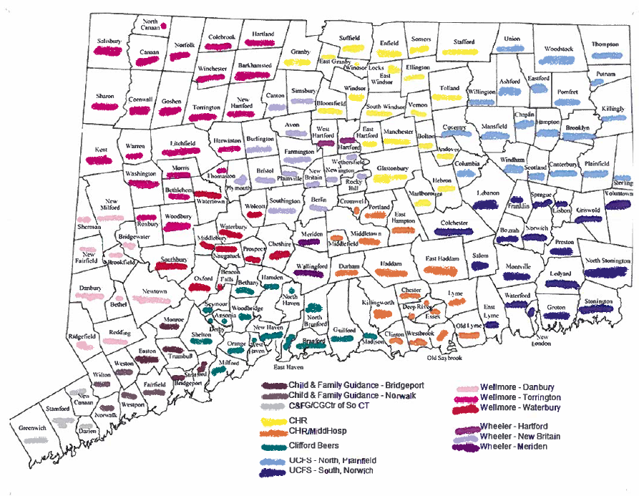
MCIS Catchment Area by Provider

Slide 8
UCFS MCIS Program Structure
Samantha Robinson, LCSW
Director of Clinical Community Based Programs
Emily Morse, LCSW
Program Manager
Jennifer Croce, LCSW Vernalisa Walton-Bogel, LCSW Lauren Whitmore, LCSW Crissy Waggoner
Supervisor- Norwich Supervisor- Norwich Supervisor- Plainfield Project Assistant/Case Manager
Clinicians/Liaisons
FT Case Managers
Notes:
MCIS clinicians are Master’s level clinicians who are license eligible. 14 full-time clinicians (including two facility liaisons), 1 part time clinician (DDS liaison), 2-3 per diem clinicians, 2 full-time case managers, 3 supervisors, 1 project assistant/case manager, 1 program manager, 1 director

Slide 9
Proactive Community Involvement
Members of Systems of Care collaboratives in both the NE and SE.
Participation in:
Community Coalition for Children (CCC)
Eastern CT Suicide Advisory Board
Juvenile Review Boards
Client Care Teams (CCT) and Child and Family Team (CFT) meetings
Human Anti-Trafficking Response Team
Provide trainings and presentations on mental health
QPR (Question, Persuade, and Refer) trainings to local entities including fire departments
SBIRT (Screen to Brief Intervention, Referral to Treatment)
Presentations to local high school students on suicide awareness and prevention and mental health
Classroom de-escalation techniques
Introduction to Child Trafficking in CT training
Participating in community events including health fairs, open houses, etc.…
Provide support for schools and communities when there is an untimely death or community crisis.

Slide 10
Impact of COVID- 19 on MCIS
Telehealth/telephonic assessments
Call volume/referral source
Impact on mobility and response time
Acuity/Emergency Department referrals

Slide 11
Impact on Mobility at the Start of COVID- 19

Slide 12
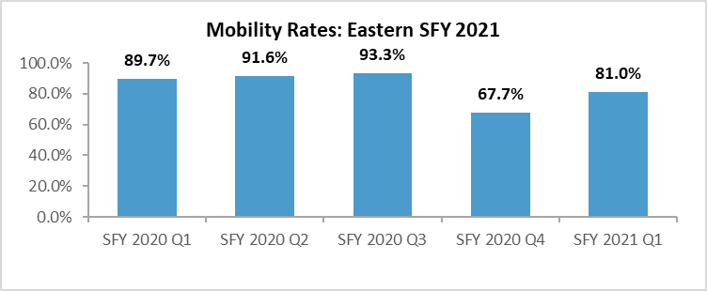
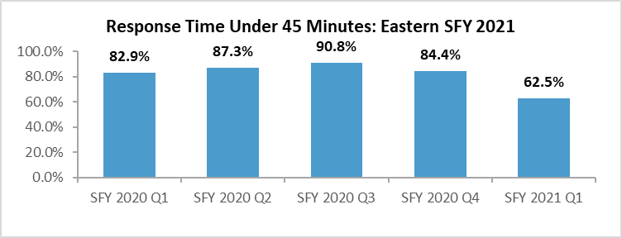
DCF Benchmarks
Mobility-
90% Benchmark
Response Time-
80% Benchmark
In SFY 2021 Q1, the mobility rate for the Eastern Region was 81.0% compared to 89.7% for SFY 2020 Q1.
*Change to mobility in starting Q2 2021
In SFY 2021 Q1 62.5% of all mobile responses achieved the 45 minute mark, compared to 82.9% of mobile responses in SFY 2020 Q1. The median response time for SFY 2021 Q1 was 35 minutes.

Slide 13
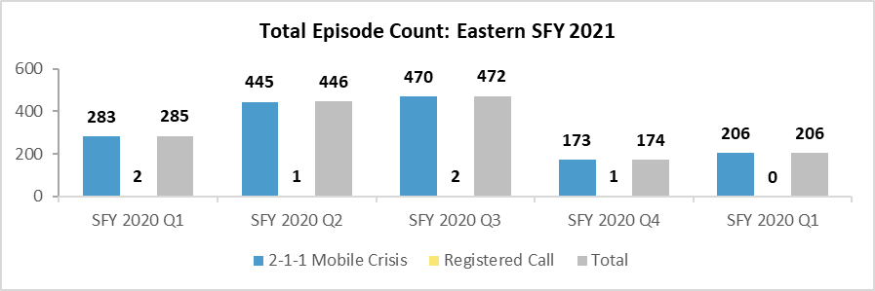
Impact of COVID- 19 on Call Volume
Q1 2021 had a 27.7% decrease when compared to SFY 2020 Q1.

Slide 14
Referral Sources During Q1 2021
Referral Source:
73.4% - Self/Family
8.2% - Schools
8.2% - Other Community Provider Agency
4.3% - Psychiatric Hospital
2% - Foster Parent
2% - Physician- 2%
1% - Emergency Department- 1%
.5% - Other Program within Agency
.5% - Police- .5%

Slide 15
Referrals to the ED: Q4 2019-Q2 2021
Number of ED Referrals Per Quarter
Percentage of Total Calls Referred to ED Per Quarter
# of Referrals

Slide 16
Was the youth admitted inpatient?
Outcome of ED Referrals

Slide 17
Any questions?
Emily Morse, LCSW- 860-822-4796 / emorse@ucfs.org

