Slide 1
Overview of CT Data
January 2, 2020

Slide 5
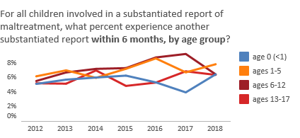

Slide 6
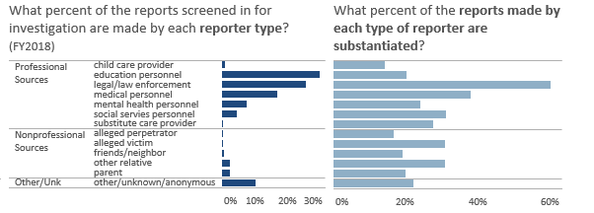

Slide 10
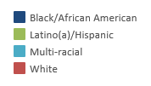

Slide 11
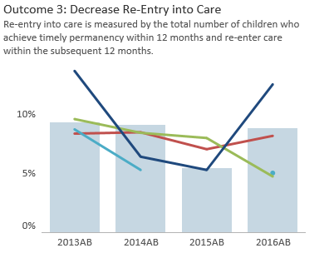

Slide 12
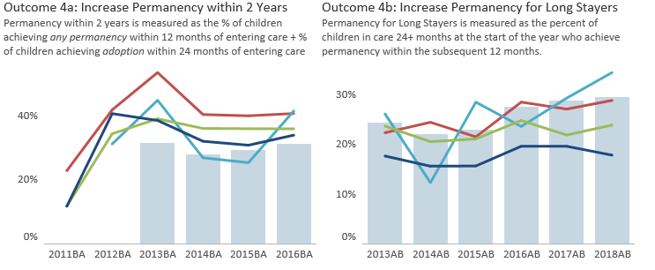

Slide 17
Questions?
Susan Reilly
sreilly@casey.org

