Slide 1
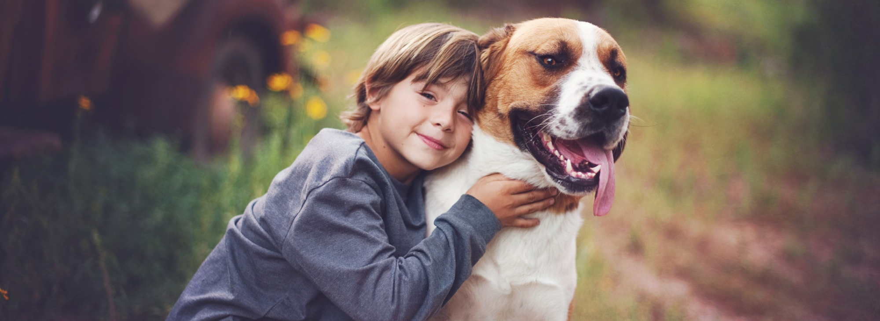
Cross Reporting
“When animals are abused, people are at risk. When people are abused, animals are at risk.”
CT Department of Children and Families
DCF Staff Training - January 2020

Slide 2






Cross Reporting Training Objectives
Cross Reporting Definition & Who
is Involved
The LINK between animal cruelty & child abuse & neglect
What the Research
Tells us
The Cross Reporting Process for DCF, ACO’s, and DoAg
Recognizing
Animal Cruelty

Slide 3
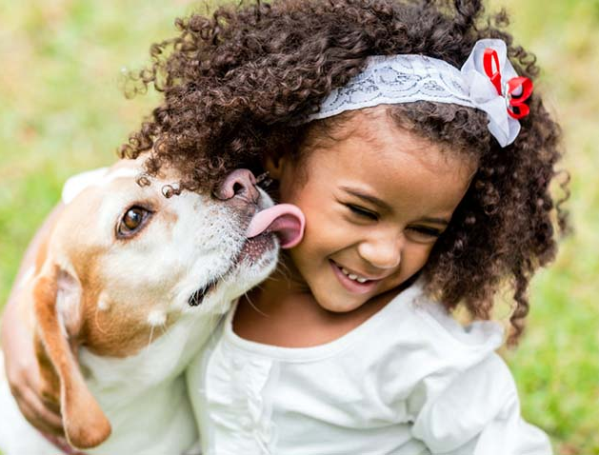
What is Cross Reporting?
Cross Reporting is a law in CT that requires DCF staff and Animal Control Officers (ACO) to work together to “cross report” animal cruelty and child abuse and neglect.
The law is called: PUBLIC ACT 14-70 - AN ACT CONCERNING CROSS REPORTING OF CHILD ABUSE AND ANIMAL CRUELTY. The laws has been in place since 2011 and was expanded in 2014.
The law was enacted because of mounting evidence from researchers who say there’s a strong LINK between animal abuse and child abuse, intimate partner violence, and elder abuse.
Notes:
After bullet #2: Other states have this law too - in 13 states including Connecticut, State Legislatures have passed Cross Reporting bills which mandate the “cross-reporting” however, CT is only one of 3 states that mandates both ACO and child protection to report.

Slide 4
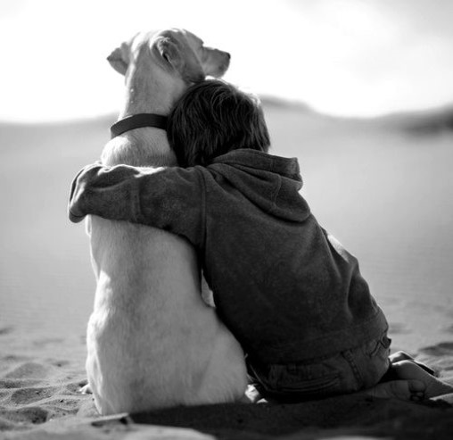
Why is Cross Reporting and the LINK important?
Animal abuse is “the tip of the iceberg”: the way animals are regarded in a family is a window into interpersonal relationships and family dynamics. Investigators who find animal cruelty, abuse or neglect are rarely surprised to see other issues lurking beneath the surface.
Notes:
Almost 1/3 of all CT households has a dog or a cat and family violence doesn’t stop at the human species line.
Animal abuse is a potential indicator and predictor of interpersonal violence
We can prevent family violence more effectively by recognizing animal abuse as a potential indicator of other violence occurring.
Working in partnerships, cross-reporting can overcome challenges at the intersections of animal abuse and other family violence.
By recognizing how human and animal violence are intertwined, violence prevention is enhanced and families and communities are safer – and more humane.

Slide 5
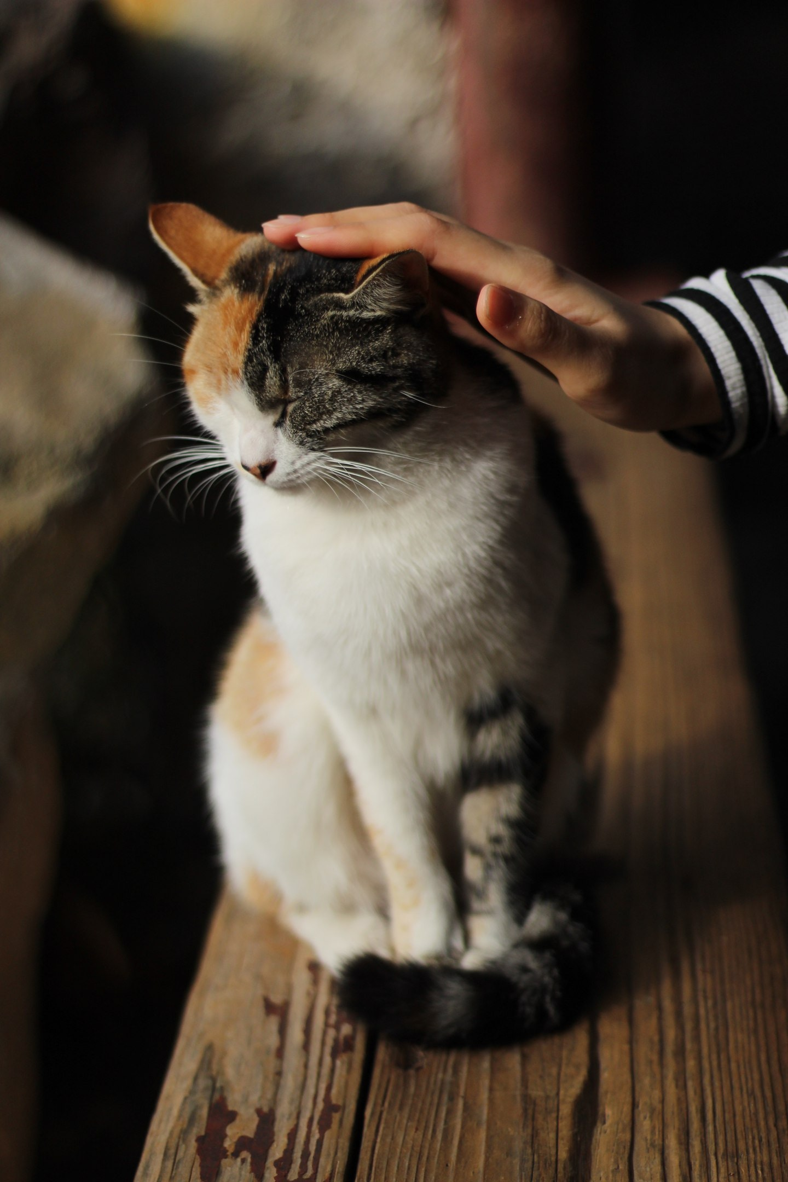
The LINK between animal cruelty and child abuse and neglect explained
Mistreating animals is no longer seen as an isolated incident
Frequently, animal abuse is part of a continuum of abuse within families.
Cross-reporting among DCF employees and animal control officers will heighten awareness among child welfare and animal control professionals of this strong correlation and likely improve outcomes for children and animals.
Notes:
1 (after 1st bullet) that can be ignored and it is often an indicator or “red flag” that other family members in the household may not be safe.
2. (after 2nd bullet) Often, animal abuse represents a way to coerce, intimidate, and further control child victims and force them into silence and fear.

Slide 6
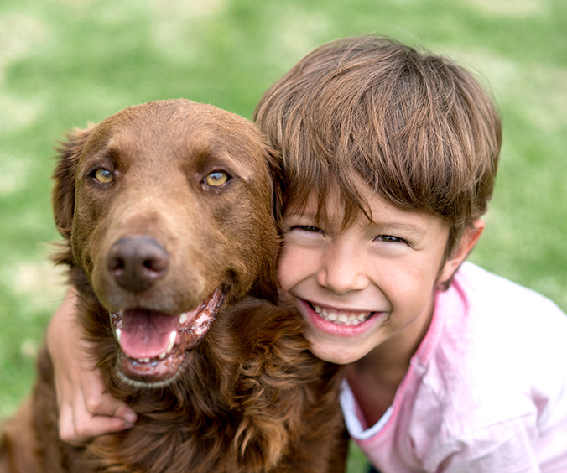
The LINK between animal cruelty and child abuse and neglect explained
Domestic violence and child abusers may kill, harm or threaten animals to exert dominance and power over their victims.
Abusers and impressionable children who witness or perpetrate abuse become desensitized to violence and the ability to empathize with victims.
When children are cruel to animals it could represent a way for an abused child who feels powerless to exert control over his or her own victim and gain a sense of power.
Notes:
(after 1st bullet above) In this way, animal abuse silences domestic violence and sexual abuse victims, is a serious risk to pets, and is a significant barrier that prevents victims from leaving violent relationships.
(after 2nd bullet above) Abuse is often cyclical and inter-generational. The earlier professionals can intervene to break the cycles of violence, the higher the rate of success may desensitize them against all forms of violence.
(after 3rd bullet above) According United States Humane society data: 94% of animal cruelty acts are performed by males and 31% of animal cruelty acts are performed by children under the age of 18. Most acts of animal cruelty happen to pets (76%) and 21% of animal cruelty acts also involved acts of family violence (intimate partner violence, child, elders)
Animal cruelty is more than just a legal issue. It’s a community issue. If you improve animal welfare in a community, you improve public safety for everyone.

Slide 7
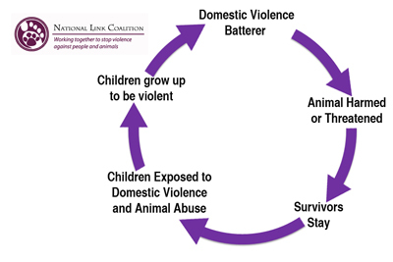
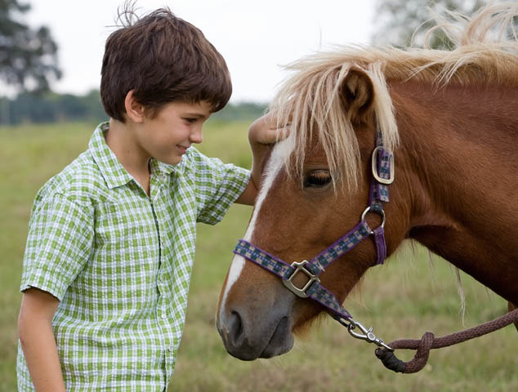
The LINK between Animal Cruelty and Child Abuse and Neglect – wheel of violence
may
Notes:
Nationally, 60% of families that are investigate for child abuse or neglect have abused or neglected their pets
In families where there was physical abuse of a child, 88% also abused their pets
Animal cruelty is especially prevalent in families where there is intimate partner violence. If fact, 71% of IPV victims reported that their abuser threatened, harmed, or killed their pet and many women stay in abusive relationships for fear of their pet’s welfare.
Why do abusers target animals?
Mostly because it works! It demonstrates the abuser’s power and perpetuates a landscape of terror in the home. Its also prevents from leaving -Women often endure the abuse to save their pet.
Children are especially drawn to animals and often confide their secrets, fears and angers to their pets; abused children more likely to do this.
Pets may be a child’s only friend in chaotic homes

Slide 8
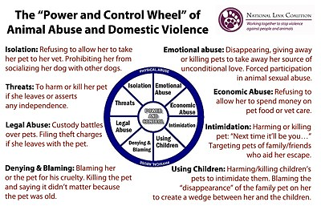
How animal cruelty victimizes families and their pets.
Notes:
Luckily, in December 2018, congress passed the PAWS act – Pet and Women Safety which means on a federal level, anti stalking and protective orders are extended to pets and 3 million dollars in federal funds are available for women/pet co-sheltering in a IPV situation
Many states offer a pet fostering network to IPV victims in shelters and some states have facilities to house/care for victims and their pets.
As a result, there are 132 pet friendly shelters in the USA
In Ct, Safe Futures in New London is the first shelter in CT that allows the victim’s pet

Slide 9
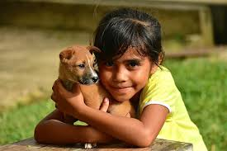
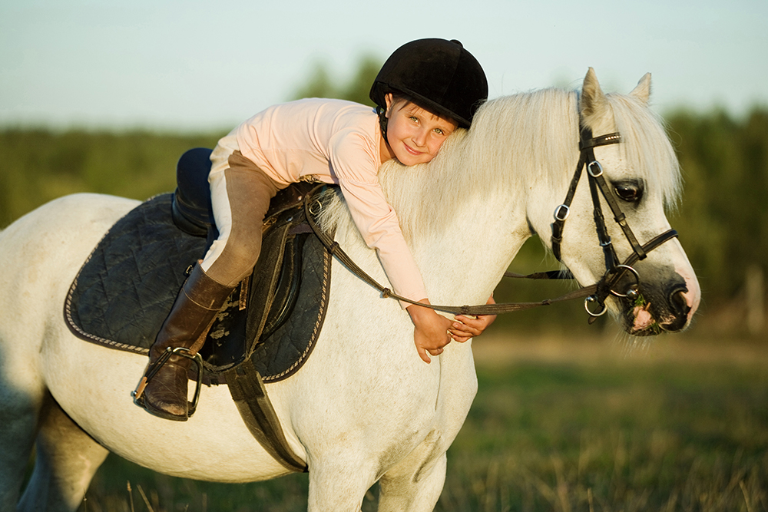
What else the researchers are saying:
Childhood witnessing of animal cruelty results in significantly more risk of adolescent or adult interpersonal violence. (DeGue & DeLillo, 2009)
43% of school shooters have histories of animal cruelty. (Arnold Arluke and Eric Madfis, 2013)
Children who abuse animals are 2-3 times more likely to have been abused themselves. (Lee-Kelland & Finlay, 2018)

Slide 10

What can happen to kids if we do nothing?
Acts or threats of harm to a child’s pets can force children to be silent about abuse.
Acts of animal abuse damage a child’s sense of empathy and safety, desensitize children to violence, and foster a dynamic of inflicting pain to achieve power and control.
A child’s cruelty to animals may indicate that he or she has suffered serious neglect or abuse.
Youths who perpetrate or witness animal cruelty are more likely to commit other violent behaviors in childhood and adulthood.
Animal abuse in the home greatly increases the risk of children being bitten or attacked by pets.

Slide 11
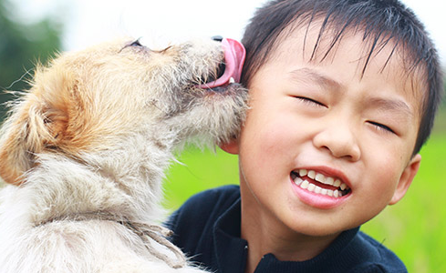
QUIZ #1
What is Cross Reporting?
  DCF reports animal abuse to the Department of Agriculture
  Animal Control reports animal abuse to the Department of Agriculture
  DCF reports animal abuse to Animal Control Officers
  Both DCF and Animal Control officers report animal cruelty to the Department of Agriculture
  ANSWER: d
  2. How do IPV abusers use animals to threaten victims:
  IPV abusers do not involve animals when threatening victims
  They refuse to allow her to take the pet to the veterinarian
  They give away or kill the pet to remove her source of unconditional love
  They are more affectionate with the pet to make the victim jealous
  Both b and c.
  ANSWER: e
  What outcomes are possible for kids if we do not report animal cruelty?
    It may desensitize children to violence
    It may damage a child’s sense of empathy for animals
    It raises the risk of children being bitten by pets
    It may force children to be silent about there own abuse
    All of the above
    ANSWER: e

Slide 12
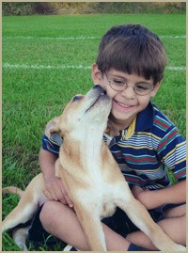
Cross Reporting Responsibilities – DCF
All DCF staff who work with families in the community are required by law to make cross reports of animal cruelty.
DCF workers with reasonable cause to suspect that an animal is being harmed, neglected, or treated cruelly will contact their local Animal Control Officer (ACO) and make a written report to the Department of Agriculture within 48 hours via a DCF-736 form.
The ACO’s then investigate the report from DCF regarding the suspected animal cruelty
Notes:
List of local ACOs available
PDC of 736 available
call the local ACO – a list of ACOs covering our 169 CT towns can be found on DCF PAWS FOR KIDS
ASK 3 QUESTIONS -
1. Are there animals at home?”
2. “How are they cared for?”
3. “Are you worried about their welfare?”

Slide 13
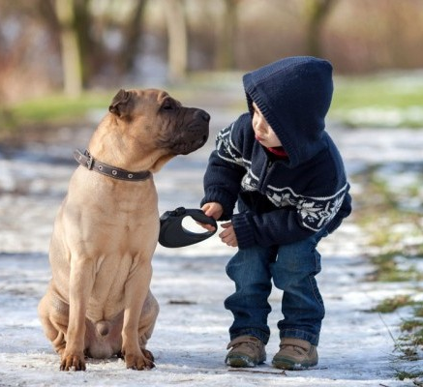
What is “reasonable cause to suspect” animal cruelty?
As with child abuse/neglect, there are many indicators of animal cruelty that speak to “reasonable cause”:
Observed physical abuse by the animal’s owner or caretaker
Extremely thin animals with ribs clearly visible
Animals observed with open wounds or multiple healed wounds
Animal observed with a loss of hair, scaly skin, bumps or rashes - Flea, tick or other external parasite infestation
Animals kept on a chain for long periods of time without adequate food, water or shelter
Animals that are regularly left alone for long periods of time without food or water
Animals kept outside in inclement weather without access to adequate shelter or water.

Slide 14
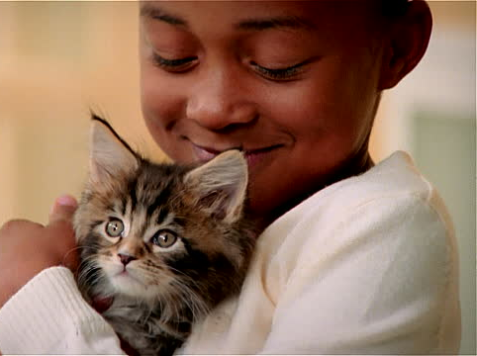
What is “reasonable cause to suspect” animal cruelty?
Animals showing how extreme fear or extreme aggression
Animals with a collar embedded in the pet’s neck or so tight it is causing a wound
Animals with severely matted fur, overgrown nails, or filthy coat
Animals limping or can't walk or stand
Animals with heavy discharge from eyes or nose
Animals with visible signs of confusion or extreme drowsiness
Animals living in filthy conditions are (feces, garbage, broken glass, etc.)
Animals kept only in a crate and not let outside.
Home is overcrowded with animals in cages/kennels
Animals in cages that are too small to allow them to stand or turn around
Notes:
We have laminated cards that clearly list all of the information above that you can take out in the field with you that we will be sending to each office shortly.

Slide 15
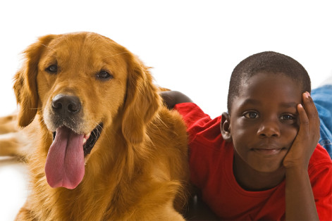
Cross Reporting Responsibilities – ACO’s & DoAg
When ACOs respond to animal cruelty reports and have reasonable cause to suspect that an animal is being harmed, neglected, or treated cruelly, the ACO will make a written report to the DOAG no later than 48 hours after observation.
The ACO must report all investigations to DoAg which then are forwarded to DCF monthly.
The report then gets forwarded monthly to the DCF Commissioner and DCF Careline where research if there is an open case, closed case, and whether the report meets the statutory definition of abuse or neglect.
Within one week of receiving the report, and it is determined that there is an open child protective case, the assigned DCF social worker is notified.
Notes:
In 2019, between January and November, there were 46 reports received from the Department of Agriculture. Of the 46 cases reported, 7 (15%) had open DCF cases, 11 (24%) had a prior history with DCF and together, 18 of 46 families reported had an open case with DCF at one time, 39%!

Slide 16
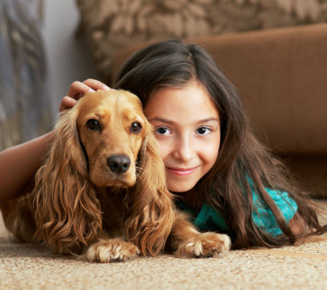
Cross Reporting Responsibilities – ACO’s & DoAg
If it is determined that the details in the report on the open case meets the legal sufficiency of an accepted DCF report, it will be opened as a new investigation.
If the report from DoAg does not have an open child protective services case but meets the legal sufficiency for investigation by DCF, DCF will conduct and investigation of the allegation and follow all established protocols.
If the report from DoAg does not have an open child protective services case and does not meet the legal sufficiency for investigation by DCF, no further investigative action is taken.

Slide 17
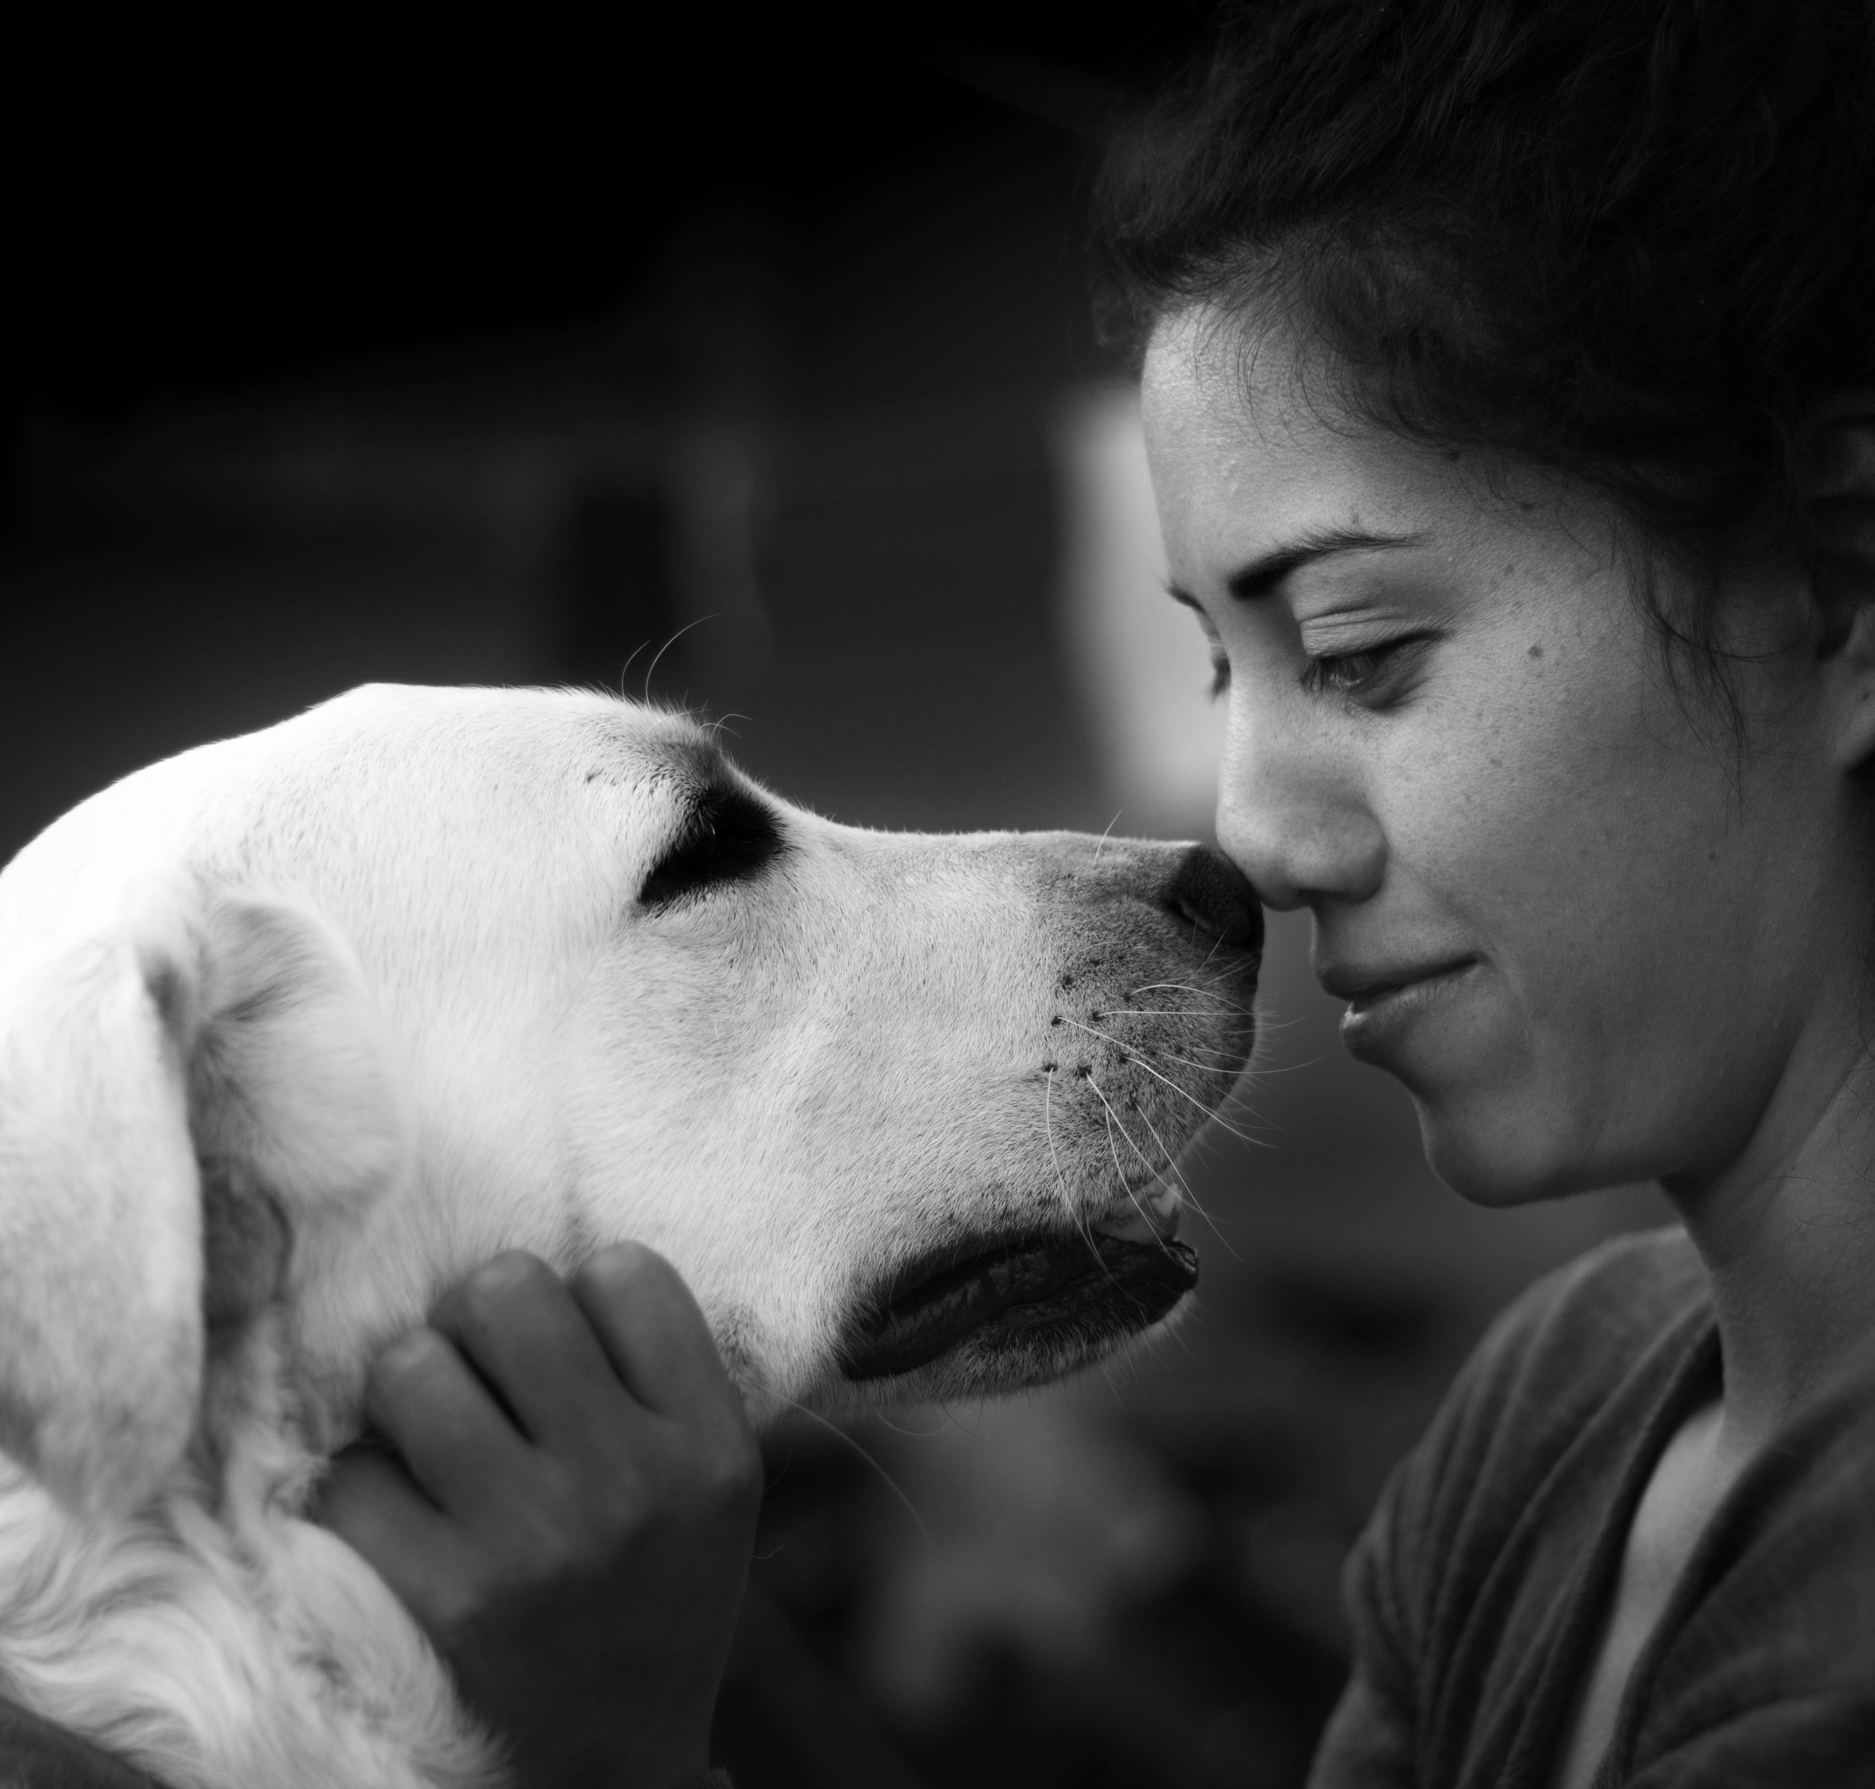
Additional information about Animal Control Officers in CT
Animal Control Officers (ACO) work in every town in CT and some towns employ multiple ACOs.
Many ACOs are town employees -some work for police department and others work for the municipality.
ACO’s are not mandated reports of child abuse and neglect
Although ACOs do not work directly for the Department of Agriculture, DoAg is the organizational body that is responsible for collecting and forwarding all incidents of animal cruelty from ACOs to DCF.
DoAg also educates the public and the 289 ACOs that handle animal cruelty incidents in Connecitcut.
Notes:
169 towns

Slide 18
Quiz #2:
What are examples of “reasonable causes” of animal cruelty that I social worker may encounter when doing an investigation or home visit?
  Animals that aren’t pet by the caretaker during the visit
  Animals that don’t have food present at the time of the visit
  Animals showing extreme fear or aggression towards its owner or child
  Animals kept outside in inclement weather without adequate shelter or water
  Observed physical abuse by the animal’s owner or caretaker
  All of the above
  c, d, e, only
  ANSWER: g
  Is Cross Reporting a law in the State of CT?
    Yes
    No, its something DCF social workers should do but it’s not a law
    ANSWER: a
    How long do DCF staff have, once witnessing animal cruelty, to make a report to the Department of Agriculture?
      72 hours
      24 hours
      48 hours
      ANSWER: c
      What kinds of animal cruelty investigations are Animal Control Officers (ACOs) required to report to the Department of Agriculture that get forwarded to DCF?
        All investigations
        Investigations where it is known that there is a child also residing in the home
        Only investigations where a child is bitten or hurt by an animal
        ANSWER: q

Slide 19
Resources:
For more detailed information about Cross Reporting, go to this link: https://www.cga.ct.gov/2014/ACT/pa/pdf/2014PA-00070-R00HB-05037-PA.pdf
The National LINK Coalition: http://nationallinkcoalition.org/
DCF’s Paws for Kids: https://portal.ct.gov/DCF/PawsForKids/Home
Notification to the Dept. of Agriculture of suspected Animal Harm, Neglect or Cruel Treatment (FORM 736)
https://portal.ct.gov/-/media/DCF/Policy/NEW-fillin-Forms/DCF-736.pdf?la=en

Slide 20
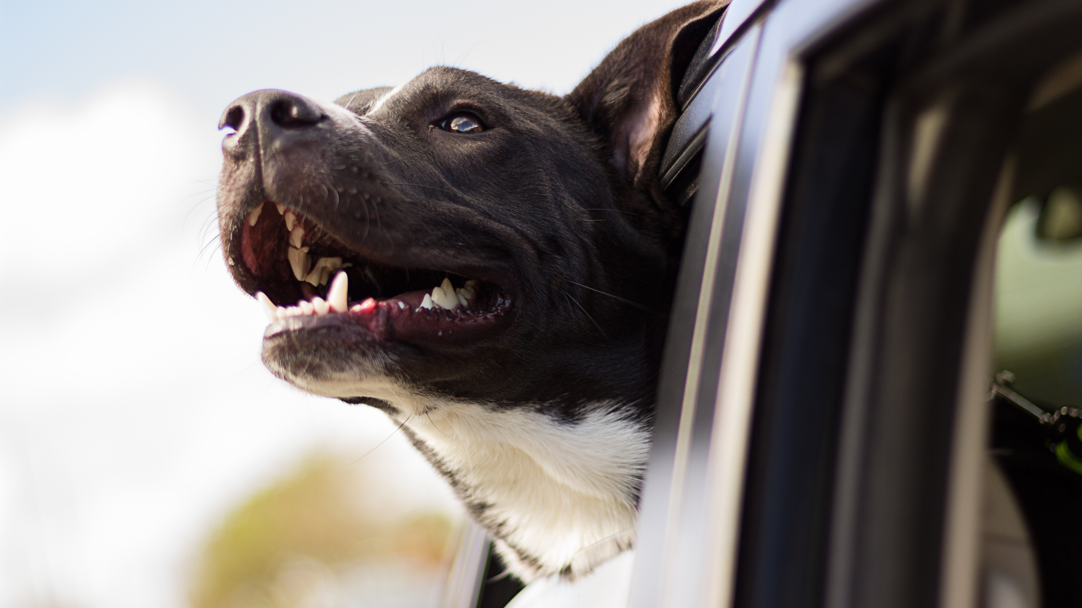
THANK YOU
Insert Image
THANK YOU!

