Slide 1

Executive Board Meeting
November 24, 2020

Slide 2
Agenda
Welcome and introductions
2021 Calendar Approval
SLDS grant timeline
  Legal agreements
  Research planning
  Technical upgrade
CREATES overview and discussion
Prioritized Research Agenda Review

Slide 3
Agenda
Welcome and introductions
2021 Calendar Approval
SLDS grant timeline
  Legal agreements
  Research planning
  Technical upgrade
CREATES overview and discussion
Prioritized Research Agenda Review

Slide 4
Agenda
Welcome and introductions
2021 Calendar Approval
SLDS grant timeline
  Legal agreements
  Research planning
  Technical upgrade
CREATES overview and discussion
Prioritized Research Agenda Review

Slide 5
Agenda
Welcome and introductions
2021 Calendar Approval
SLDS grant timeline
  Legal agreements
  Research planning
  Technical upgrade
CREATES overview and discussion
Prioritized Research Agenda Review

Slide 6
P20 WIN Vision
P20 WIN informs sound policies and practice through the secure sharing of critical longitudinal data across the participating agencies to ensure that individuals successfully navigate supportive services and educational pathways into the workforce.
  Agreed upon by Executive Board in June 2020

Slide 7

SLDS Grant – Connecticut Deliverables
Add Data Sources: OHE, DCF, DSS and CCEH
Build and Sustain Analytic Capacity
Boost Data Matching
Produce Research & Corresponding Data tools
  5+ research projects, data tools and communication

Slide 8
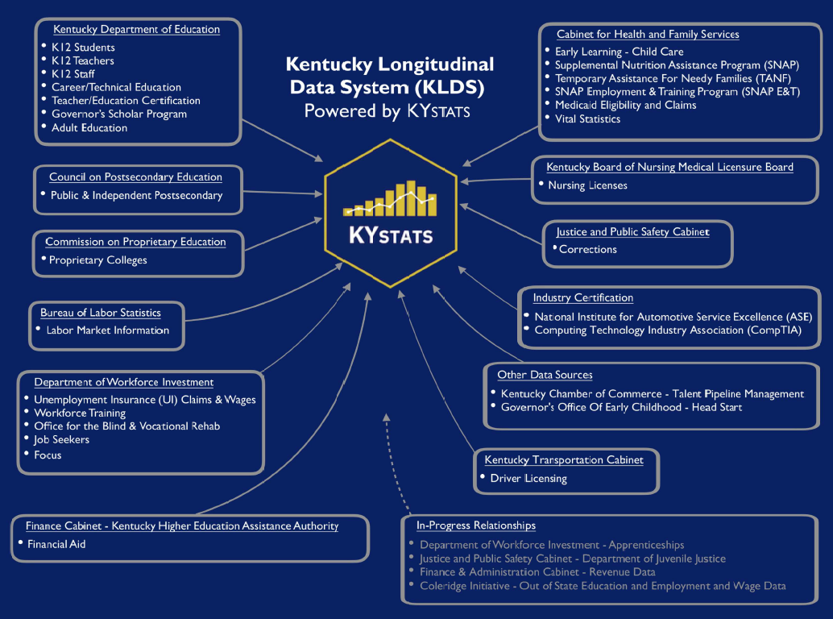
Kentucky Education and Workforce Reporting System

Slide 9
Original SLDS Grant timeline – Major activities
Quarter / Activity | Q3 2020 | Q4 2020 | Q1 2021 | Q2 2021 | Q3 2021 | Q4 2021 | Q1 2022 | Q2 2022 | Q3 2022 | Q4 2022 | Q1 2023 | Q2 2023 | Q3 2023 | Q4 2023 | Q1 2024
Onboarding new agencies
Sustainability plan
Hiring analytical / technical staff
Technical upgrade
Predictive models
Students at lowest levels of readiness
Financial aid
Workforce training
Barriers to success

Slide 10
Revised SLDS Grant timeline – Major activities
Quarter / Activity | Q3 2020 | Q4 2020 | Q1 2021 | Q2 2021 | Q3 2021 | Q4 2021 | Q1 2022 | Q2 2022 | Q3 2022 | Q4 2022 | Q1 2023 | Q2 2023 | Q3 2023 | Q4 2023 | Q1 2024
Onboarding new agencies
Research planning groups
Build analytic capacity
Technical upgrade planning group
Build technical capacity
College and career readiness
Workforce training
Student readiness
Financial aid
Barriers to success
Sustainability plan
Identify hiring needs
Align with IT optimization, CREATES timing
Identify hiring / resource needs

Slide 11
Agenda
Welcome and introductions
2021 Calendar Approval
SLDS grant timeline
  Legal agreements
  Research planning
  Technical upgrade
CREATES overview and discussion
Prioritized Research Agenda Review

Slide 12
Agenda
Welcome and introductions
2021 Calendar Approval
SLDS grant timeline
  Legal agreements
  Research planning
  Technical upgrade
CREATES overview and discussion
Prioritized Research Agenda Review

