Slide 1
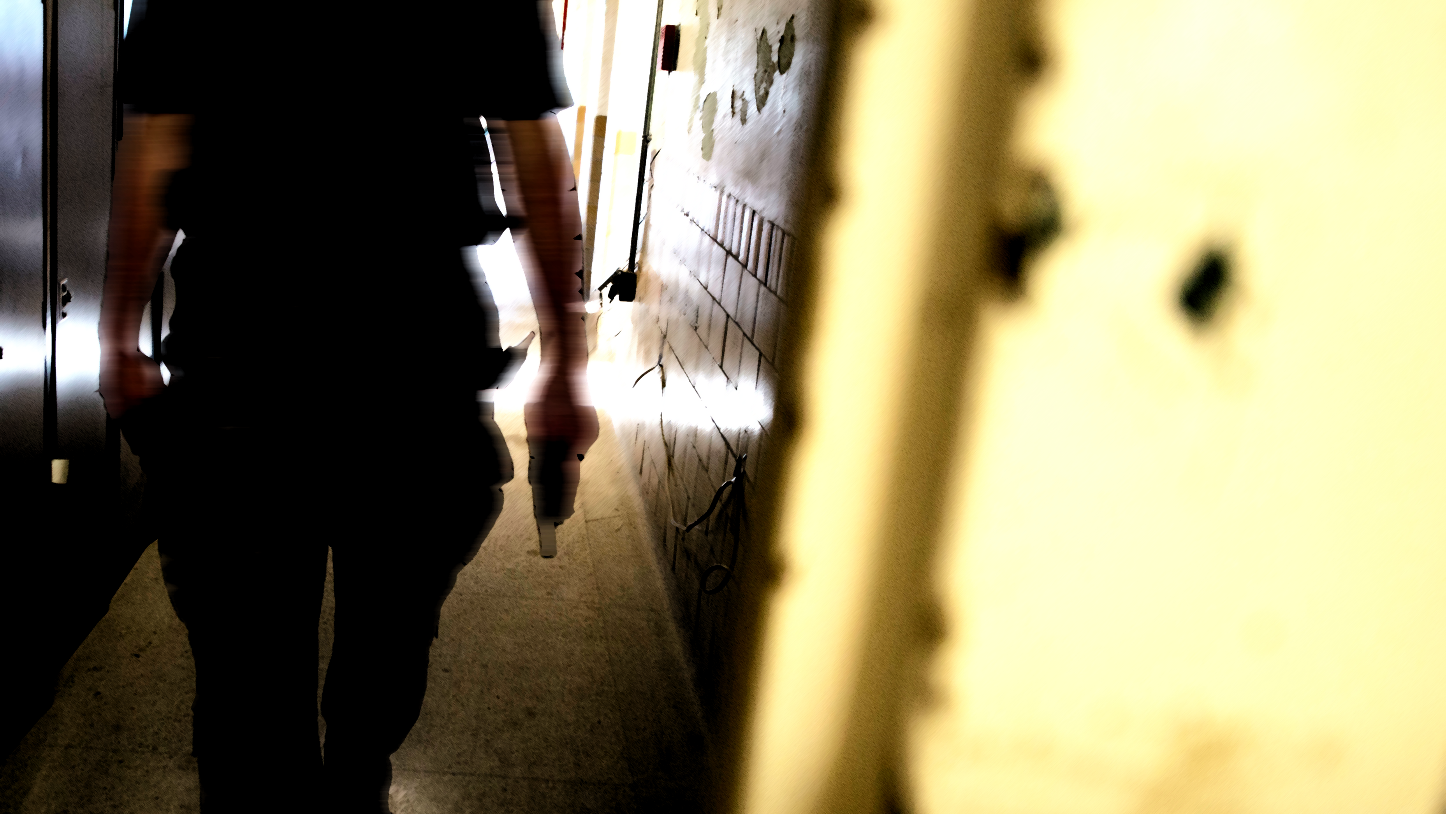
State of Connecticut
Active Shooter Response
Training Course
Presented by DAS and the Connecticut State Police
This course is designed for State of Connecticut Employees

Slide 2
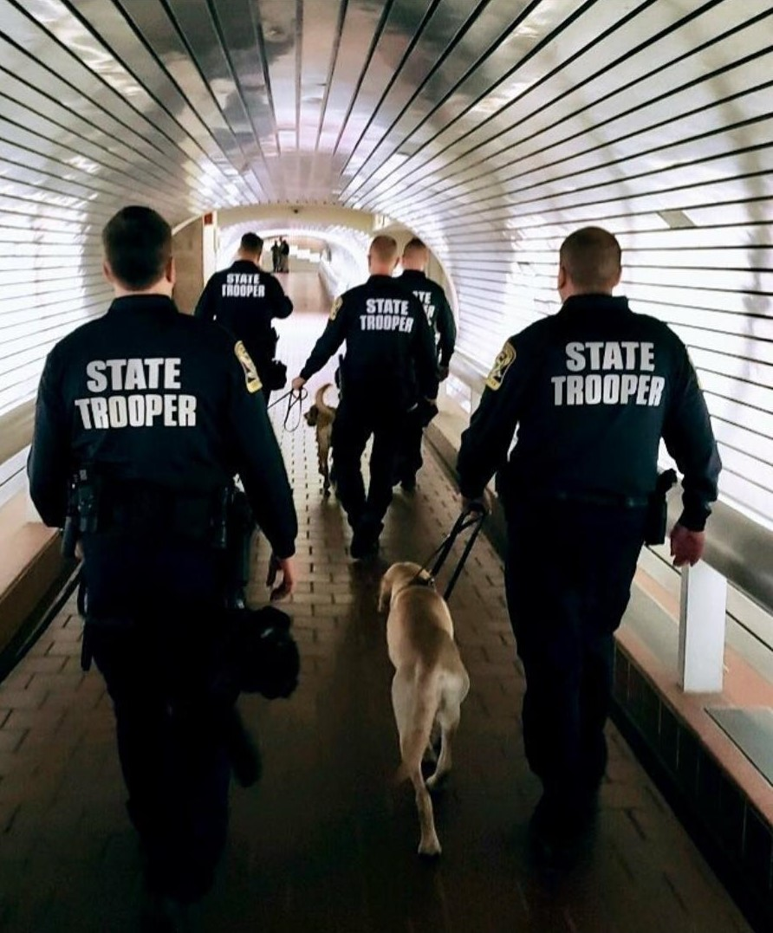
Active Shooter Response Training
Course Objectives
Identify Threats
Suspicious Persons
Suspicious Sounds
How to Stay Safe
Survival Mindset
Run, Hide, Fight
How to Respond
Know what to do when law enforcement arrives

Slide 3
Table of Contents
What Should I Know?
What Should I Do?
Law Enforcement Response
Conclusion

Slide 4
Introduction
Disclaimer:
This course contains video clips and photos of violence that you may find disturbing. You may choose not to watch the videos. Take the time you need to complete the training. Speak with your supervisor for additional assistance.
The goal of this training is to keep employees safe. Because most active shooter incidents are over within minutes, individuals must be prepared to deal with the situation until law enforcement arrives. Your administration wants you to have the tools to prepare, decide and act in the event that you are faced with an active shooter at work.
This training does not take place of the Workplace Violence Prevention training required for all state employees by state statute. This training is additional material to help employees be prepared and safe.
There will be a series of knowledge checks throughout the course and a final assessment at the end.

Slide 5
What Should I know?
Active shooting incidents can happen anywhere and have happened in the State of Connecticut. The State of Connecticut has established safety standards to protect employees.
Violence in the Workplace Prevention Policy
State owned or leased building are “Weapon Free Zones”
The only people who may have firearms at a state work site are those authorized to carry a weapon for their state job – such as a police officer, game warden etc. No one else should ever bring a firearm into a state building
If you see someone with a gun,
follow emergency procedures and report this right away!

Slide 6
Knowledge Check
As you enter work, you notice a stranger in the hallway outside your office area. Thirty minutes later, while heading to a meeting, you notice the person is still in the hallway and ask if you can help them. The person declines and turns away.
Select the most appropriate action you should take.
It is everyone’s responsibility to keep our workplace safe. Please try again.
Continue on to your meeting; you’ll be late and this isn’t a big deal
Stop what you are doing and report their location and physical description to security or administrative management
Great choice! The stranger is acting suspiciously, and even if they have good reason to be in the building, reporting the situation to an authority is advisable.
Proceed to the next question
Telling others about a suspicious person does not create a safer workplace or resolve the situation.
Please try again.
Continue to the meeting but mention this to others and ask their opinion
It is not a safe practice to confront or question a person behaving suspiciously, as you may be put in harm’s way.
Please try again.
Pursue your line of questioning, asking who they are there to see and offer to escort them there

Slide 7
What Should I Do?

Slide 8
Law Enforcement Response

Slide 9
Conclusion

