Slide 1
CT Municipal and State Procurement Summit 2019
September 25, 2019

Slide 2
Microsoft 365
Notes:
We’ve made a substantial investment in our statewide network infrastructure
Network usage grew 67% in FY 15. Typical growth has been 40%.
Typically run over 37.5Gbps this spring with spikes up to 50Gbps across the network
Optical backbone is capable of 4Tbps running 40x100GE circuits.
Demand for mobile devices is exploding. Given our current BYOD approach, use has tripled since last summer.
Agencies are seeking to reduce/consolidate office space, support alternate work locations.
Communications platforms must support our BC/DR plans

Slide 3
Microsoft 365
The M365 suite includes licensing for:
Windows 10 Enterprise
Office 365 Pro Plus – Outlook, Word, Excel, PowerPoint, Access, and Publisher
Multiple copies of the Office suite for up to five devices
Exchange Online – mailboxes for all users - enabled for legal hold
OneDrive for Business – 1 TB Personal Drive
SharePoint Online – Intranets, Group Sharing (internal and external)
Microsoft Teams – Single interface for the entire Microsoft collaboration stack
Skype for Business
Other applications - Forms, Stream, Planner, and more

Slide 4
Microsoft 365
The M365 suite includes licensing for:
Advanced Threat Protection – email security for attachments and links
System Center Configuration Manager – hardware and software management
Intune – mobile device and application management for phones and tablets
Security Suite – Privileged Identity, Conditional Multi-Factor Authentication, Azure Active Directory

Slide 5
Microsoft 365 Compliance
Standards
ISO 27001
SOC 1 Type 2
SOC 2 Type 2
PCI DSS Level 1
Cloud Controls Matrix
ISO 27018
Content Delivery and Security Association
Shared
Assessments
United States
FedRAMP
Moderate/High
HIPAA / HITECH
FIPS 140-2
21 CFR
Part 11
FERPA
DISA Level 2,4,5
CJIS
IRS 1075
ITAR-ready
Section 508 VPAT
Unique to Microsoft 365 for US Gov
FedRAMP Moderate | CJIS | IRS 1075 | CONUS Core Content | US citizen ops

Slide 6
Government F1 vs E3
Microsoft Gov F1 is intended for workers who only occasionally use a computer. In many cases, F1 users may not have had IT services provided for them in the past as they were cost prohibitive.
Similar to the Gov E3 license, F1 users have:​
Windows Server CALs​
Windows 10 Enterprise ​
System Center Configuration Manager​
Intune mobile device management​
Azure Active Directory Premium - Conditional Access/MFA​
Microsoft Teams – can join meetings, but cannot host meetings.​
Mobile device apps for Word, Excel, PowerPoint, Teams.

Slide 7
Government F1 vs E3
Unlike the Gov E3 Platform, the following major differences exist:​
Email is accessible only via a web browser (OWA) and/or a mobile device​
Email boxes are limited to 2 GB in size and cannot be placed on legal hold without an optional add-on service​
OneDrive storage is limited to 2 GB​
Microsoft Office is blocked from connecting to all M365 services for F1 users. Users must rely solely on web apps for Word, Excel and PowerPoint. Note that Office Web apps are less functional than the fully installed Office 365 Pro Plus desktop software.​
Files are accessible only within email attachments, SharePoint, OneDrive or Teams. Files stored on file servers are not accessible to Office Web Apps and F1 users.

Slide 8
Notable Considerations
. Windows 7 will no longer be supported after Dec 31, 2019.
Approximately 4,000 out of 30,000 state devices are running versions of Windows 10. The remainder will need to be upgraded during the calendar year.
Office 2010 will no longer be supported after October 13, 2020.
Approximately 9,000 out of 30,000 state devices are running versions greater than Office 2010. The remainder will need to be upgraded during the calendar year.
Office 365 ProPlus does not change versions.
Upgrades will take place continually so no large version change or end of life issues in the future
Government Cloud is more restrictive than the commercial cloud.
There is higher level of security compliance so applications and features are vetted before being allowing in Government cloud
Agencies still have to purchase some online products separately.
Visio, Project, and PowerBI are tools that are outside the agreement.
The state’s email system is running Exchange version 2013 in hybrid mode with Exchange online.
The state plans to go fully online before any additional investments in the on premise infrastructure are needed.

Slide 9
DAS M365 Enterprise Agreement
Many agencies in the state do not purchase Enterprise Agreements that allow them to upgrade with changing technologies.
The agreement only covers Executive Branch Agencies
The M365 Enterprise Agreement is with DAS not the agencies individually. DAS will be provided the funding from OPM to make payments to Microsoft over the term of the five year agreement
Agencies will be working directly with their OPM Budget Analyst on the impacts to their individual budgets
Roughly 1/3 of the state user population has an enterprise agreement, 1/3 has a partial agreement, and 1/3 has no agreement.
To purchase other online tools like Visio, Project, and PowerBI, they must use an Enterprise Agreement
There is a statewide Enterprise Agreement that agencies can utilize for those purchases so they don’t have to set up a new one

Slide 10
Benefits
Discounts over entire five year term
Budget predictability
Greatly improved email security to prevent phishing and viruses
Up to five licensed devices per user
Mobile device management for all state owned devices
Complete statewide visibility into software and asset management
Additional products to reduce reliance on external security tools
Ability to reduce quantities during the life of the agreement as employee numbers fluctuate
Full coverage of all state agencies to eliminate license compliance and out-of-support conditions - especially in agencies that need to meet external regulations.

Slide 11
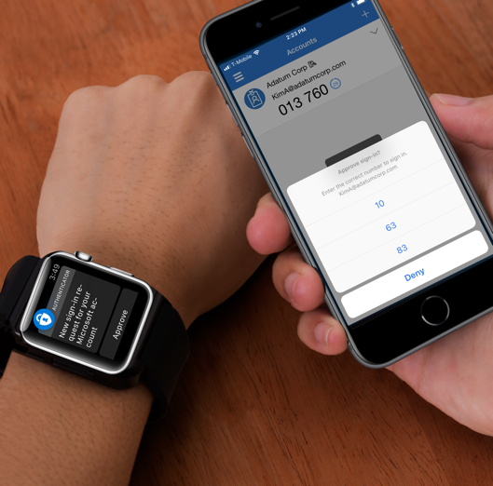
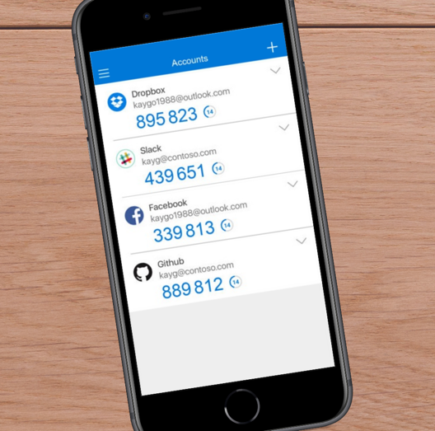
Protect and Govern
Secure authentication using Multi-Factor Authentication (MFA)
Multi-factor authentication prevents 99.9% of identity attacks
Push notification
SMS
Voice call
OATH Token
OATH codes
State is implementing Conditional MFA which means once you set up for the first time at the office and you will not be prompted again when on a state network but you will on other internet connections like public wifi or at home

Slide 12
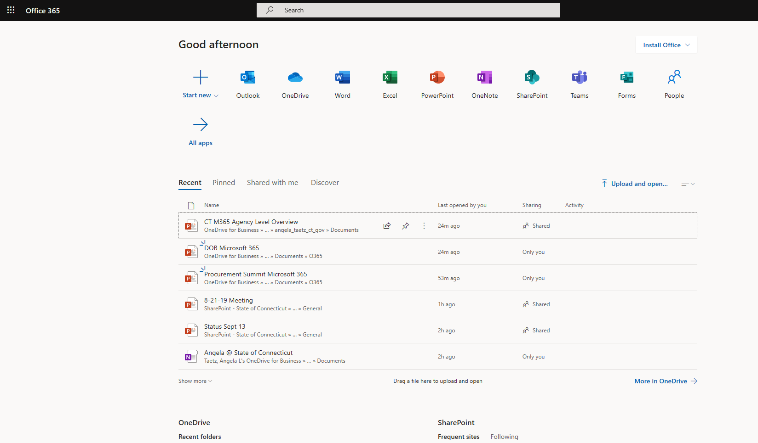

Slide 13
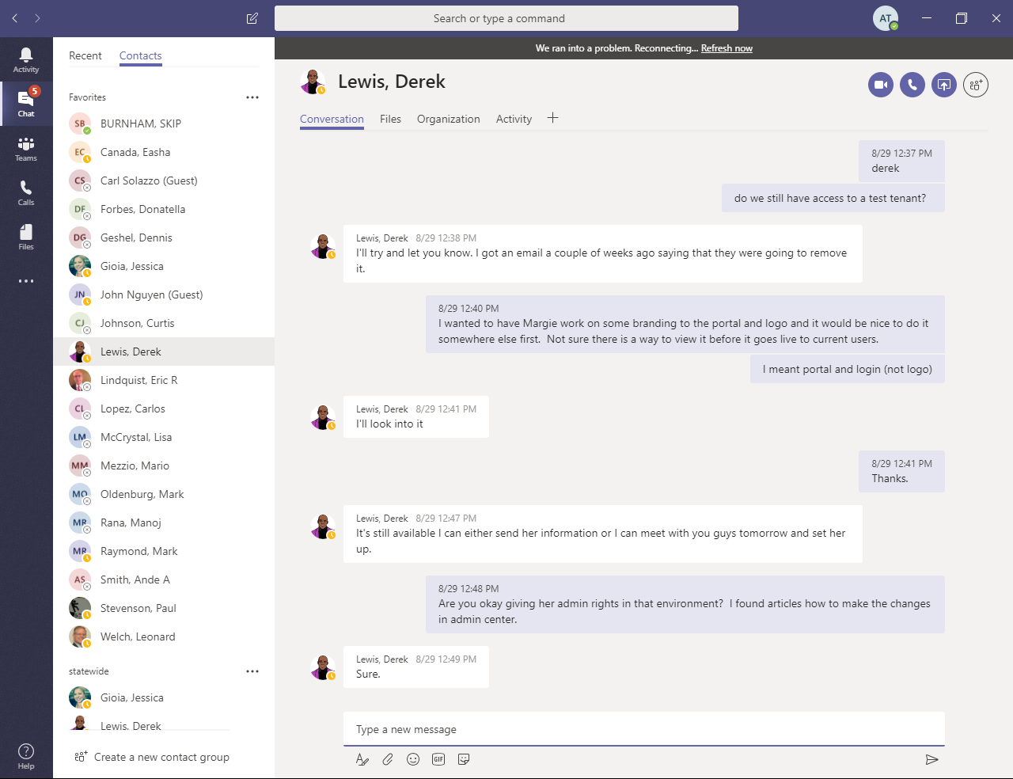
Teams
Single tool for
Instant messaging
File repository and sharing
Web and video conferencing
Discussion forum and wiki
Meeting notes
Project management

Slide 14
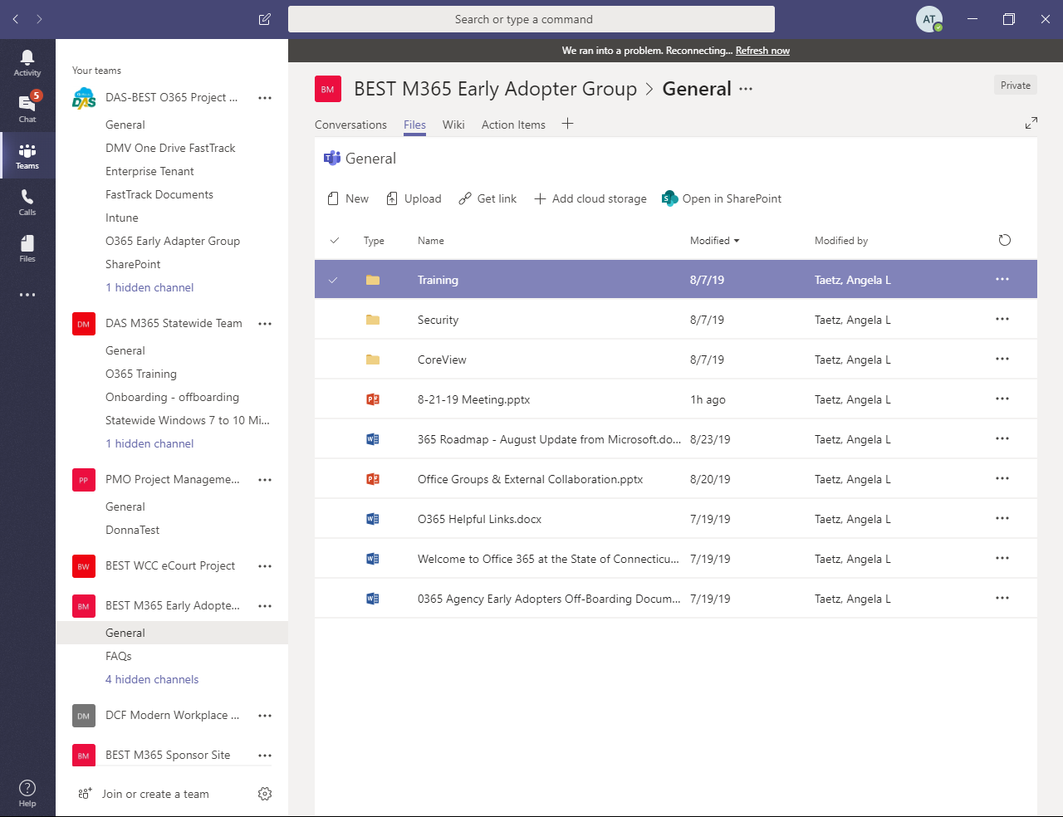
Teams
Single tool for
Instant messaging
File repository and sharing
Web and video conferencing
Discussion forum and wiki
Meeting notes
Project management

Slide 15
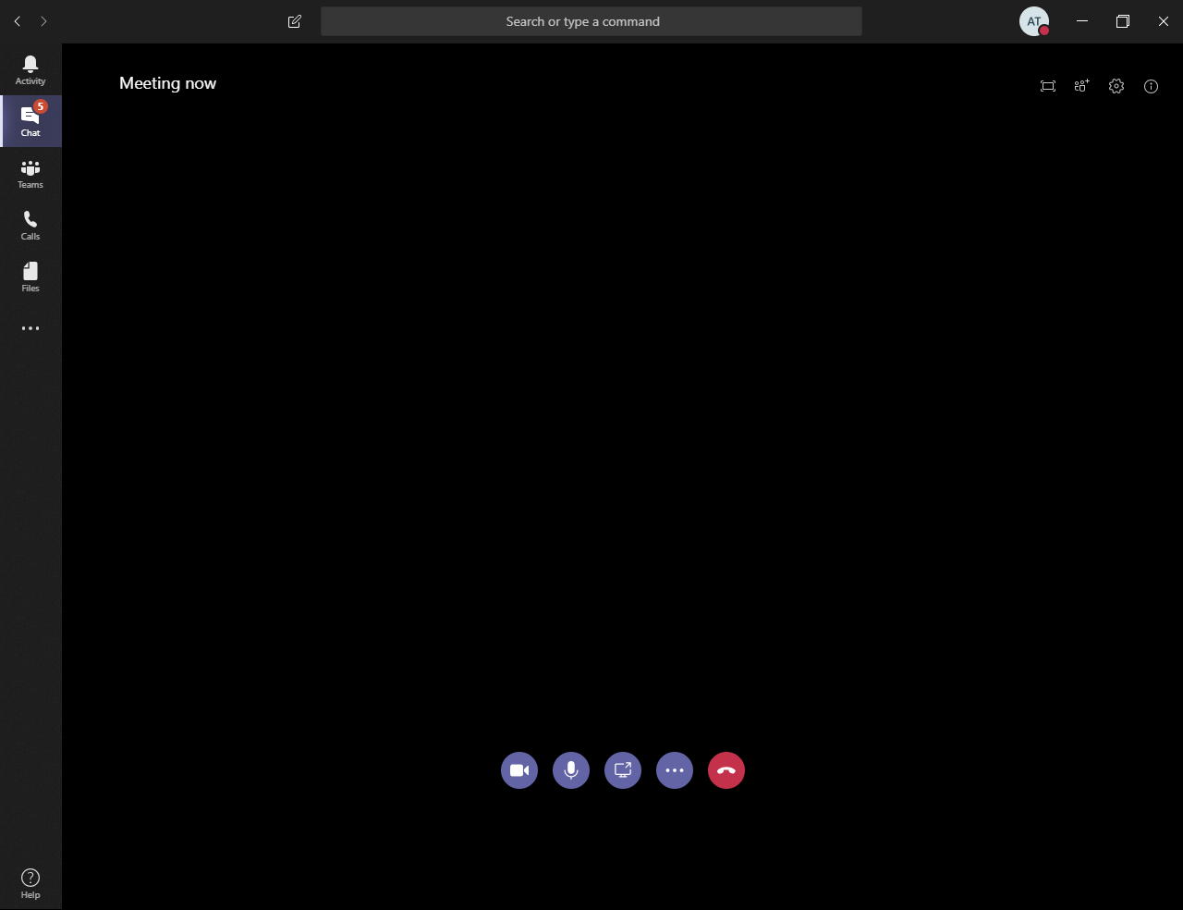
Teams
Single tool for
Instant messaging
File repository and sharing
Web and video conferencing
Discussion forum and wiki
Meeting notes
Project management
Note: Audio lines are not included. Additional fees apply

Slide 16
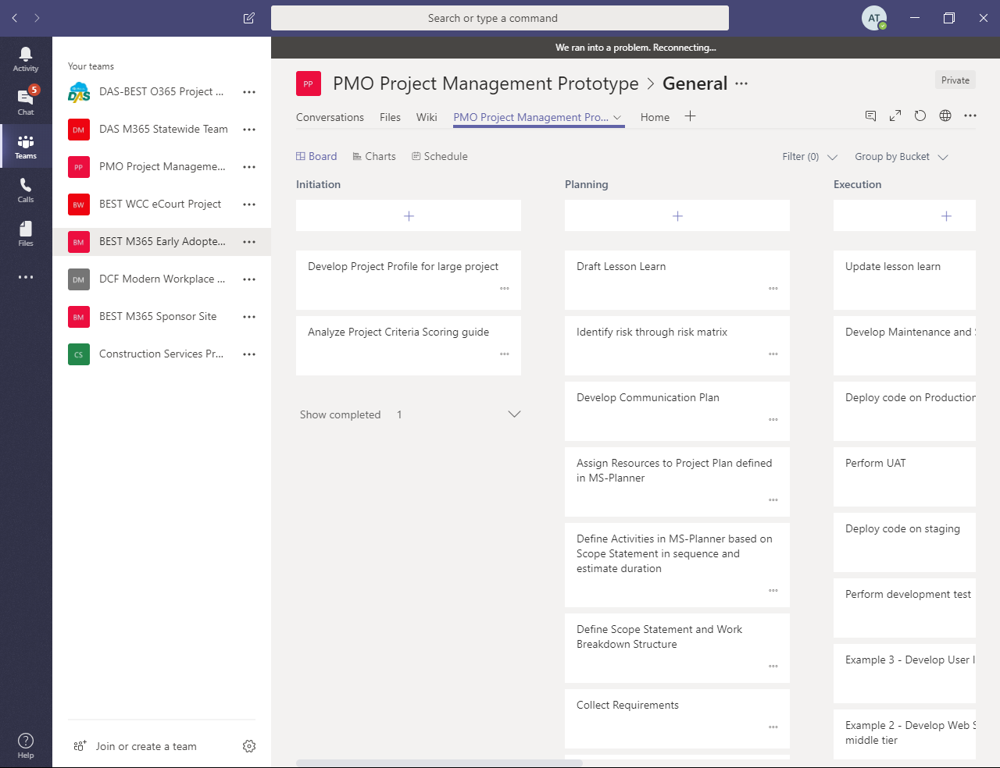
Teams
Single tool for
Instant messaging
File repository and sharing
Web and video conferencing
Discussion forum and wiki
Meeting notes
Project management

Slide 17
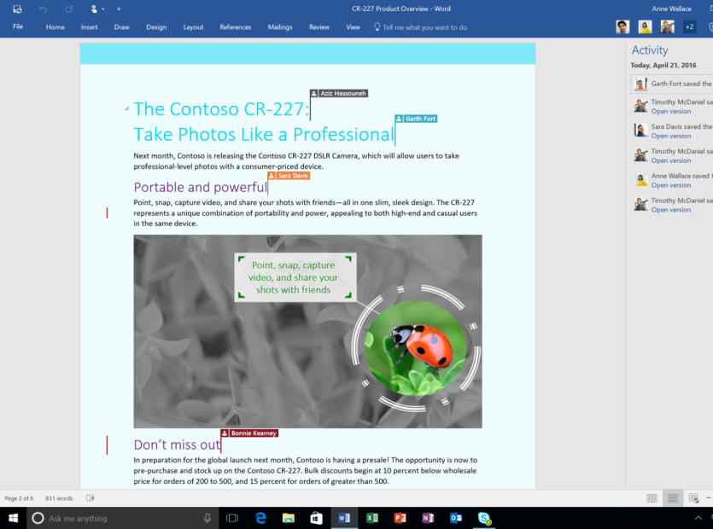
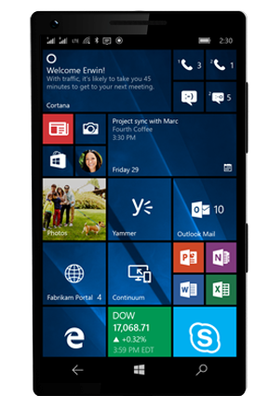
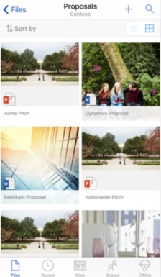
Create and collaborate with Microsoft Office 365 Pro Plus
Create, share, and co-author Word documents, Excel spreadsheets, and PowerPoint presentations with coworkers.
Get access to the latest version of your documents from your favorite devices, anywhere you have an internet connection.
SharePoint is an easy drag and drop intranet for documents and files.

Slide 18
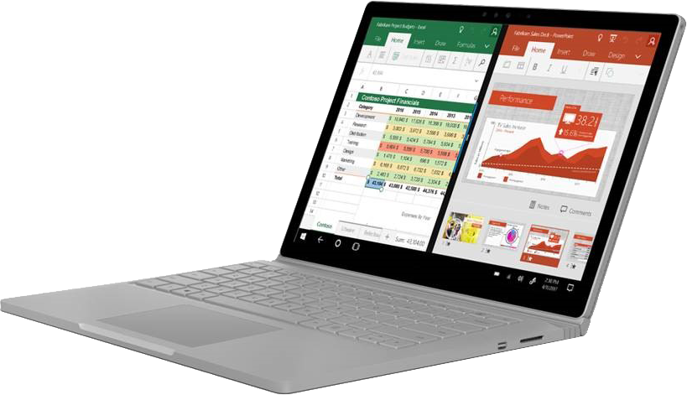
Sync files automatically and work offline with OneDrive for Business
OneDrive for Business enables online and offline access and automatic syncing of files to reflect the most recent edits.
Access and edit documents offline; when you're back online updated files sync automatically. Pick up where you left off on your document when switching devices.
Create, share, and edit Word, Excel, PowerPoint documents anytime, anywhere..

Slide 19
Next Steps
Plan
Communications
Testing
Training
Administration
Schedule
Deploy
Windows 10
Office 365 ProPlus
Exchange Online
Productivity Tools
Support
Technical support
Step-by step guides
Champions/super users

Slide 20
Angela.Taetz@ct.gov 860-622-2415

