Slide 1
CT Digital Service
2019 DAS Procurement Summit

Slide 2
I will take the lead by investing in the first all-digital government, and reverse engineer every transaction from the taxpayer’s shoes. The entry point to Connecticut will be through its digital front door, a one-stop-shop for everything current and prospective citizens need from their government. We will be online, not in line. It won’t be done overnight, but let’s start today.
GOVERNOR LAMONT
State of the State Address
Notes:
Governor Lamont recognizes these challenges and is committed to fixing them.
Coming to office with a business background he understands better than most how important technology is to all of the other goals we have across government, ranging from providing better services to citizens and businesses, using data to make better policy decisions about which programs and working and which aren’t, and to use software to automate low-value, repetitive processes and reduce cost.
Meaningful change requires strong leadership from the top, and this Governor is truly committed to making progress in this area.

Slide 3
Status quo is not good enough
Citizens have growing expectations about their digital experience that stem from their commercial experiences
Employees have higher expectations around improved processes and tools
40% of IT workforce set to retire within 3 years
Motivated leadership for change
Notes:
Citizen expectations and trust in technology have risen and cost effectiveness of implementing solutions has put these technologies in reach of governments limited investments.

Slide 4
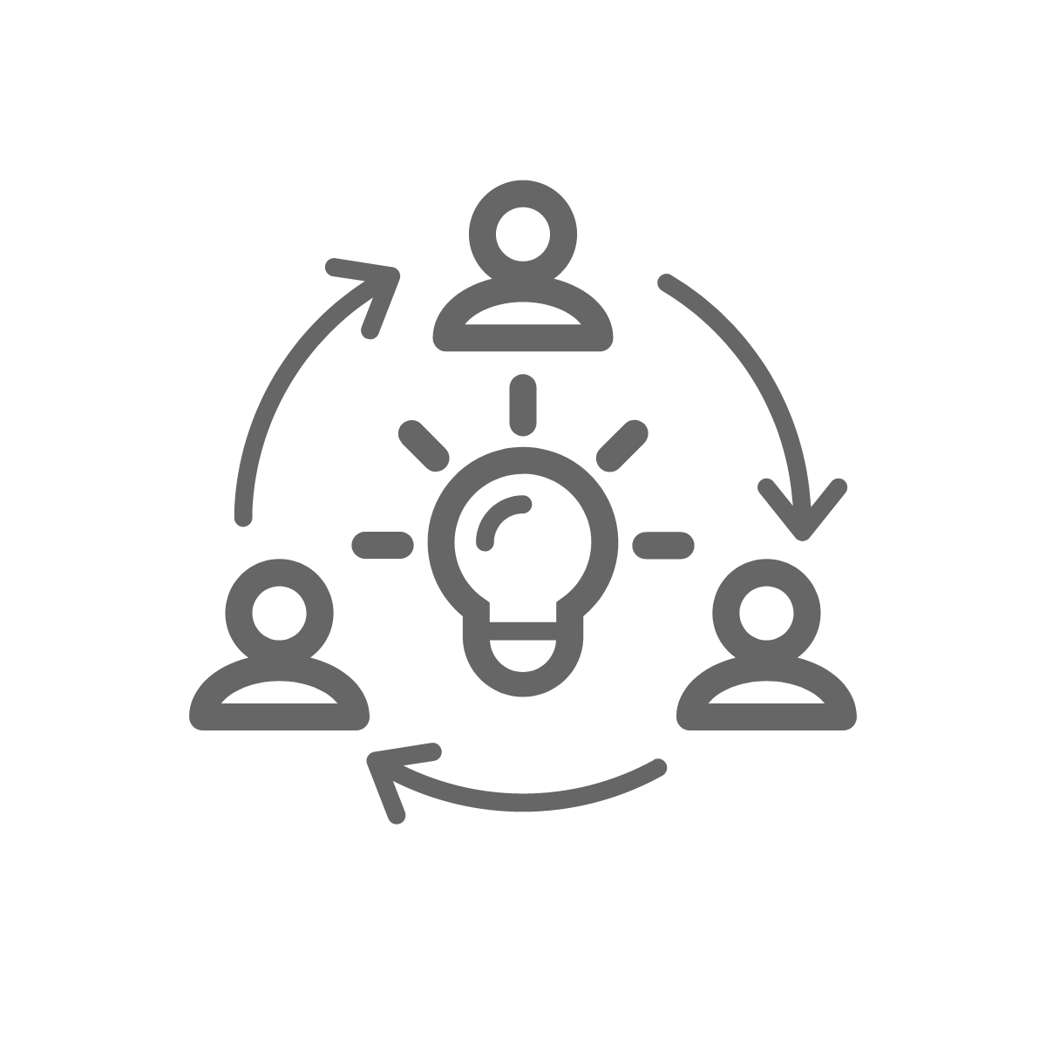
What is Digital?
DATA-DRIVEN
DECISIONS
USER-CENTERED
DESIGN
TRANSPARENCY
ITERATIVE
PROCESSES
Notes:
As we have begun to map out our digital transformation, it may be useful to first define what a digital approach means for the state of CT.
Data-Driven Decisions: Prioritize based on research, examine our impact, and track performance
User-Centered Design: Include users in the decision making and design process, build services from the outside in
Transparency: Work in the open, share success and failures, invite input and participation in solving problems
Iterative Processes: No more waterfall-approach to procurement or to designing and delivering technology. Have a long term strategy and architecture but ensure the short term actions are small enough to provide flexibility to learn and adjust as we go.

Slide 5
Our guiding principles focus on putting customers first
LISTEN
HIDE THE SEAMS
ACCESSIBILITY
MOVE FAST
User research
Web analytics
Build with empathy
Collaborate
Disguise org structure
Break down silos
ADA Compliant
Offline accessible
No Jargon
Mobile first
Perfect is the enemy of good
Agile
Don’t reinvent the wheel
Notes:
And as we think about implementing a digital transformation in CT we are establishing guiding principles to provide a north star for our work
LISTEN: Remember users are citizens, business, and state employees. We need to constantly be listening and incorporating user feedback into everything we do
HIDE THE SEAMS: We aren’t going to re-organize all of government to align to user needs, but we must to more in terms of cross-agency collaboration to hide the seams across our silos and change the culture that agency needs come first
ACCESSIBILITY: Unlike businesses who can choose which customers they want to serve, we need to be prepared to serve everyone who lives or works in this state. That means ensuring services are accessible to people which disabilities and people who aren’t digital natives/are low in digital literacy and need help from others. It also means using regular language to communicate that provide clarity for non-technical people. like most others, assume a future where the vast majority of information and transactions are accessed on mobile devices and build with that in mind
MOVE FAST: not historically government’s strong suit, but we must leverage best practices, avoid building things that have already been built, be prepared to make mistakes and learn as we go. This also means generally sticking to approaches and technologies that are fully battle tested and not doing a lot of experimentation with bleeding edge stuff. We don’t need to be in the “innovation” business to deliver enormous improvements
- this is going to be uncomfortable for lots of government processes - including leg, audit, agencies, partners

Slide 6
The Burden is on the User
To me I feel like the state resources and services make you feel like a number and it doesn’t make you feel like a member of the community.
Majority of transactions are manual, paper processes
Where transactions have been moved online, poor usability
We deliver according to state organization not user needs
The experience should make me feel like my time is also valuable. Sometimes people working in these areas make you feel like they’re the only ones with valuable time.
-FEMALE, 36,
NORWALK
-FEMALE, 58, WETHERSFIELD
Notes:
The results of our historical approach is clear when we look at the impact on our users, the citizens of CT.
In a time when services are online shopping and banking are setting exceptionally high standards and expectations for ease of use and efficiency in transactions, we have an ever increase gap between those benchmarks and the transactional services we provide.
Most state transactions are still manual, often requiring you to print and fill in a PDF. We’ve estimated that only about 5% of state transactions can be completed online.
Those transactions that have been moved online have a user interface that looks like it is 10 years old, typically because it actually is
And critically, transactions are provisioned in those same agency silos, forcing users to understand and navigate the state’s organizational structure, rather than organized intuitively by task or persona to help users quickly and easily access the services they need
We’ve been doing to some primary research of user insights and the results are clear. Citizens see the gaps in our digital capabilities and they drive inefficiency and frustration.
Mark: “Since agencies are responsible for individuals missions, there has been little effort

Slide 7
When it comes to the State of Connecticut government, citizens want to feel:
Citizens have told us that they were extremely frustrated when they couldn’t find out all the steps and information needed to apply for services before they began the process.
In control
Citizens want to know that their chains of communication ultimately lead to someone who can give them the information they seek.
Connected
Citizens want their interpersonal interactions with government employees to be premised on a sense of kindness and respect.
Recognized
Deloitte User Research, May 2019
Notes:
From this research we are learning about what citizens want and expect from us.
Common desires are to be in control, to be able to self service information and complete transactions
When they do need help they want to know help is there, when and how they want it
And they want to be recognized and respected. And we think of respect in the obvious terms – not wasting people’s time on hold or inline – but also in the smaller nuisances, like not asking them to reenter basic personal information like their address in every transaction. The state already knows some much about you, we should not have to ask questions we already know the answers to.
The good news? These desires are very similar to those we have for the rest of the digital experiences in our lives. Which means the solutions can also leverage approaches and technologies that are delivering positive results in other industries.

Slide 8
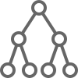
We’re taking a hybrid approach to governance
CENTRALIZED
DECENTRALIZED
User Experience
Design Standards & Tool kit
Data Standards
CT Tech Stack
Core infrastructure
Unique needs
Agency-specific applications
Notes:
To achieve our goals our governance model needs to evolve.
We see a need for a stronger centralized digital governance to establish standards and provide services that are not unique to each agency and their missions.
This starts with the user experience and design standards to support it, ensuring we are consistent and consistently great across our entire online surface area. We’ve made progress in this area in recent years, bringing most CT.gov websites to a common look and feel, but we are still providing little more than a Hollywood set which looks nice from the outside, but as soon as you walk in the door the experience falls apart.
We also envision a CT Tech Stack to provision digital services that can be more efficiently procured and delivery centrally than by each agency reinventing the wheel. More on this in a second.
And finally continuing to centrally manage and modernize our core infrastructure, embracing modern cloud services and supporting our “debt diet” by dramatically reducing our IT hardware spending
However we still envision a model where agencies own the business applications unique to their missions and needs, but subject to the standards we’ve established centrally. This is a practical necessity given our constraints but helps ensure decisions are getting made by the people who understand the truly unique aspects of each agency’s work and needs.

Slide 9
A Safe & Secure “CT Tech Stack”
EXAMPLE COMPONENTS
BENEFITS
Identity verification
Personalized portal
Single Sign-on
Consent management
Payments gateway
Forms engine
E-signature
SMS communications
Security tools
User-centricity
Drives efficiency
Standardized experience
Modernizing legacy systems
Supports resource-strained agencies
Security prioritized
Notes:
What is a “tech stack”? Think of this is a core centralized sent of capabilities and resources,
Regarding the CT Tech stack, think of this as a set of tools that provide services that are not agency unique but serve as enablers to achieve our goals of user-centered design, data interoperability and efficiency.
We are thinking of this as a platform approach, that establishes a common technical approach to deploying these services across the state, sharing and integrating data across silos and helping streamline workflow.
Over time this platform will help us modernize or consolidate our legacy transactional systems, although this will take many years and in the meantime it will provide integration capabilities with those systems as they continue to handle many of the state’s heaviest workloads.

Slide 10
We’ll Prioritize High Impact, Low Lift Projects
EASY TO DO
HARD TO DO
IMPACTS FEW PEOPLE
IMPACTS MANY PEOPLE
Notes:
We know there is more to do than resources to do it all at once so prioritization will be critical. We will need to say no more than we say yes, something that all people and organizations struggle with, especially ones that answer to dozens of commissioners, hundreds of legislators and 3.5M citizens.
In the next month we expect to finalize our prioritization of initiatives. We are approaching this using many factors but primarily based on transaction volumes (the frequency a citizen, business or employee uses the service) and citizen inputs, and degree of difficulty (however recognizing that some initiatives that will be very complex need to begin now).
Expect this graph to start to be populated next month—and we’ll start sharing our progress more publically

Slide 11
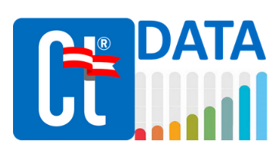
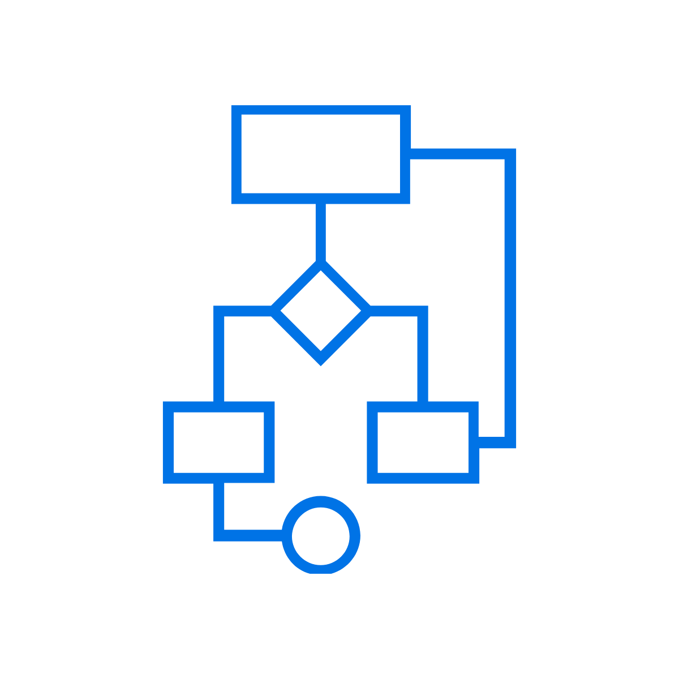
In progress now
Making improvements to the online experiences at CT.gov based on user feedback and web analytics
Making more data more available to the public
Citizen, agency and other external research
Establishing technology architecture
#CutRedTapeCT Campaign
Conversations with other states ahead of the digital curve
Expansion of the digital team
#CutRedTapeCT
DIGITAL
ARCHITECTURE
Notes:
Although we are only a few months into the new Administration this work is well underway.
Ct.gov: we’re improving load time on search results, reducing how often we ask you “helpful a page is”, and improving the user flow to the areas with the highest traffic and most dissatisfaction. We’re putting our google analytics data and that pesky survey data to use!
CT Data: Making more data public (starting with our own Google Analytics and survey data)—only State in the Country doing this (both that is)
Citizen research: We’re taking our research seriously—this is a huge part of user-centered design. teaming up with vendors and our own in house researchers to get serious about listening.
Architecture: extensive research on the long term architecture we want to establish for the state to ensure the short term projects we take on are aligned and not taking us down a dead end
CutRedTapeCT: we all know technology is only part of the solution to efficiency, and we are working to lean processes and streamline legislative and regulatory hurdles
State-to-State: Having conversation with the other states and who are blazing the digital trail

Slide 12
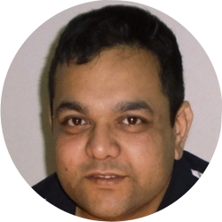
Cross-Agency Collaborative Team
Josh Geballe
DAS
Mark Raymond
DAS
Easha Canada
DAS
… and growing
John Vittner
OPM
Deb Sengupta
DAS
Notes:
To do all this we are building a small startup. We’ve already assembled a small, scrappy team with a very diverse set of skills and experiences to lead these initiatives.
In addition to the people already onboard in roles we are repurposing, the Governor’s budget provided seed funding for 5 HC to get us started. We are also taking a more deliberate approach to the IT Capital budgeting process to align project investments to our goals.
Like all startups it is all hands on deck as we continue to grow, learn and evolve. We are hiring and always interested in feedback, so if you’d like to get involved please let us know!

Slide 13
Thank You

