Slide 1
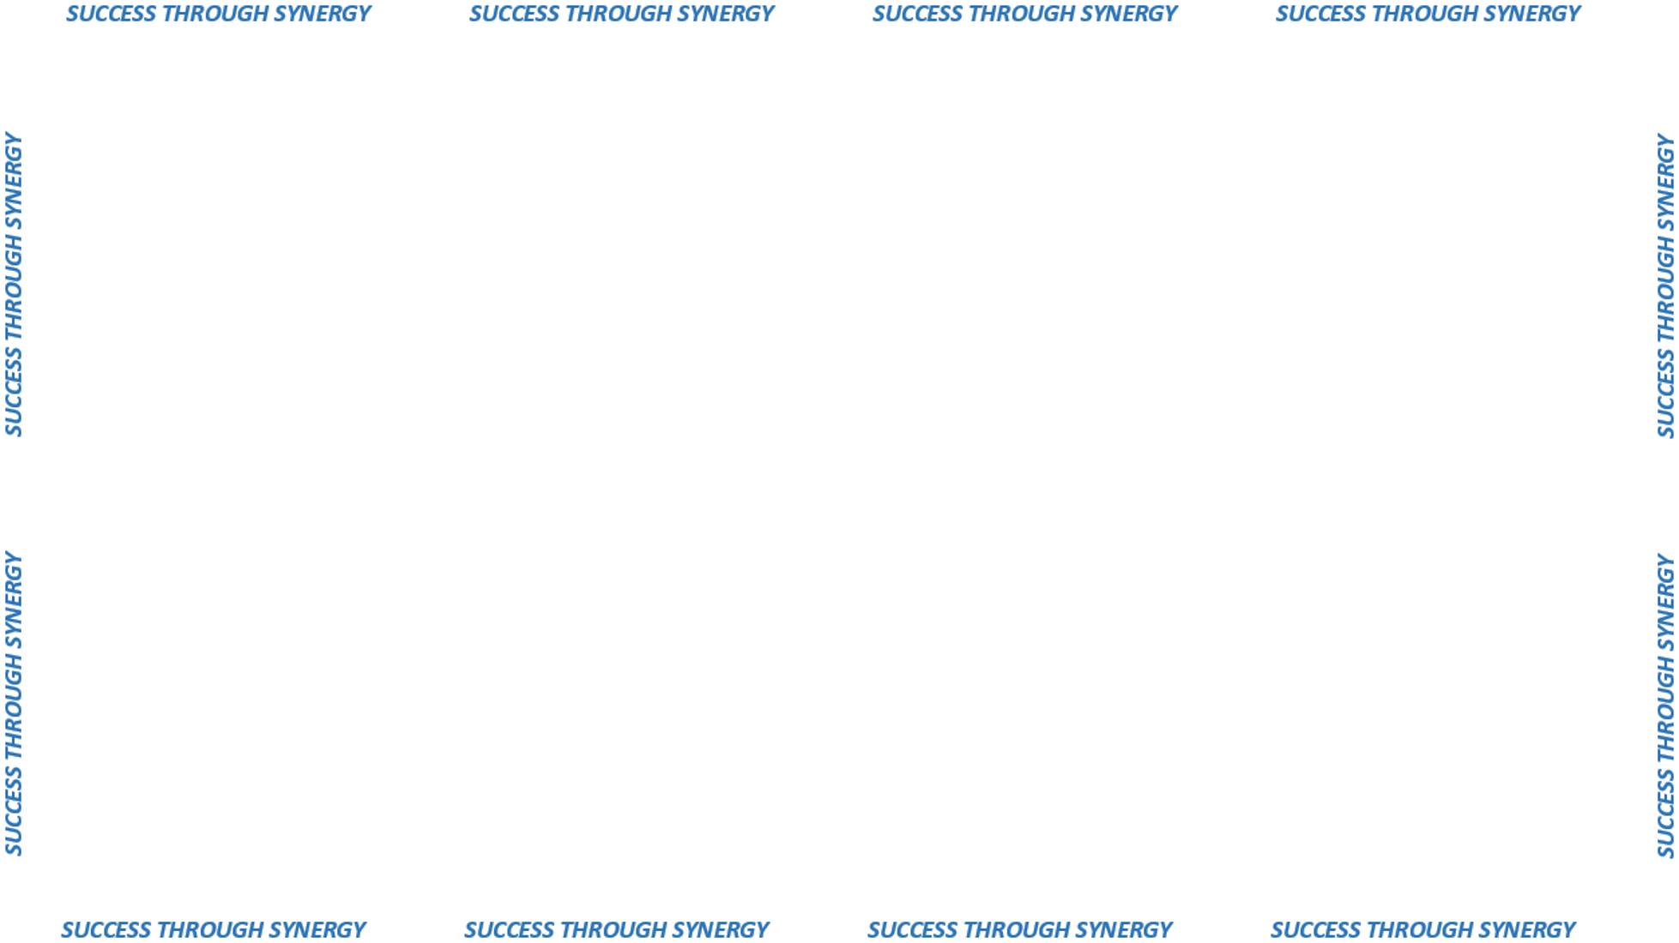

PUNCH OUT EXPANSION

Slide 2

Provides automated ordering,
budget-check and payment
Reduces catalog
and item maintenance
Successful Pilot with Office Supplies Contract
PUNCH OUT:
Ordering directly
from negotiated vendor
Website catalogs

Slide 3
Potential punch-out
CANDIDATES
“MRO”
AUTO PARTS
MEDICAL SUPPLIES
POLICE SUPPLIES

