Slide 1
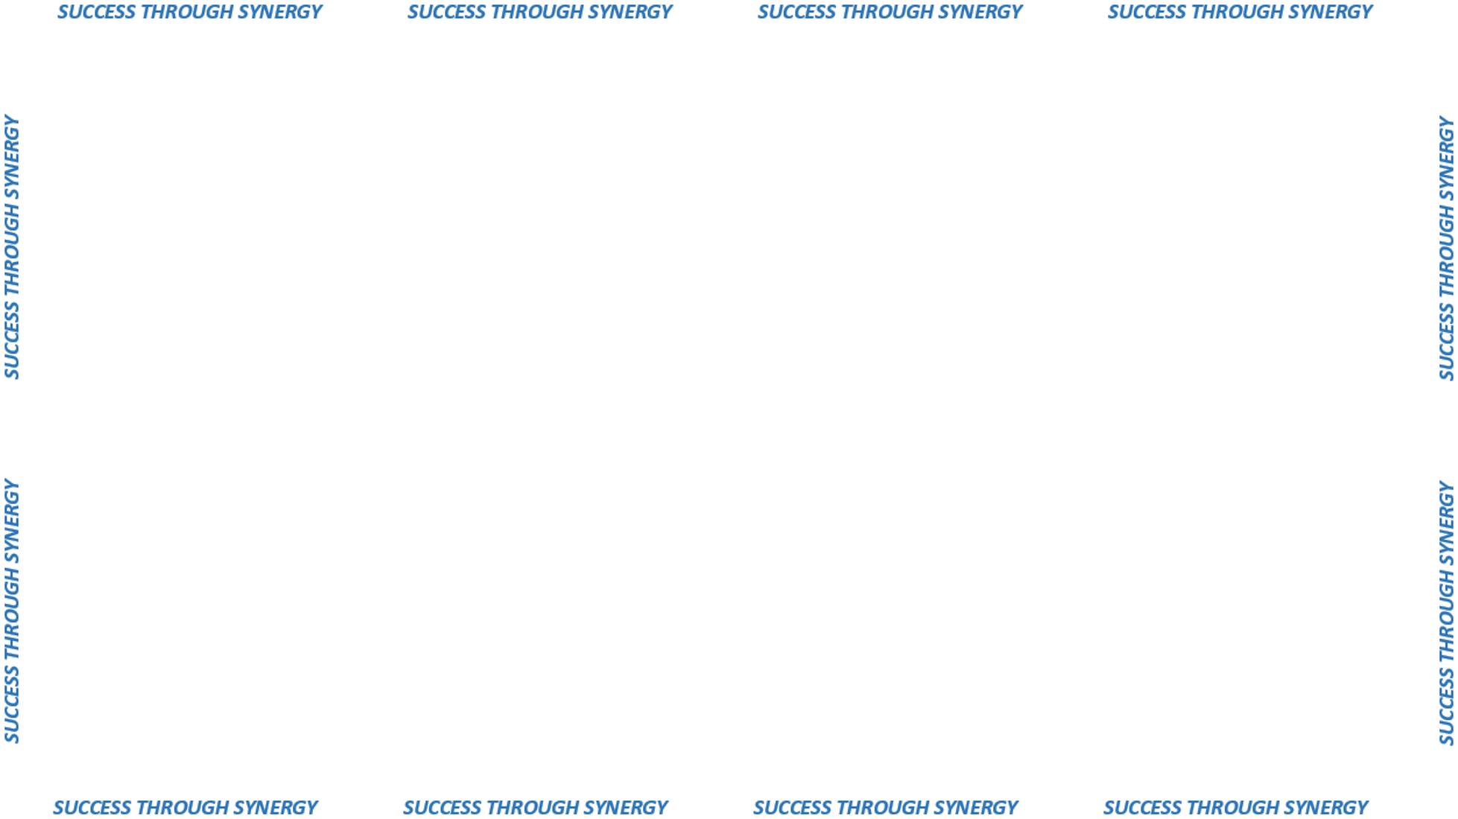

ORGANIZATIONAL ALIGNMENT

Slide 2






Slide 3


BENCHMARKING
ORGANIZATIONAL MODELS
PUBLIC & PRIVATE
SECTORS
COMMODITY TEAMS
CUSTOMER TEAMS

