Slide 1
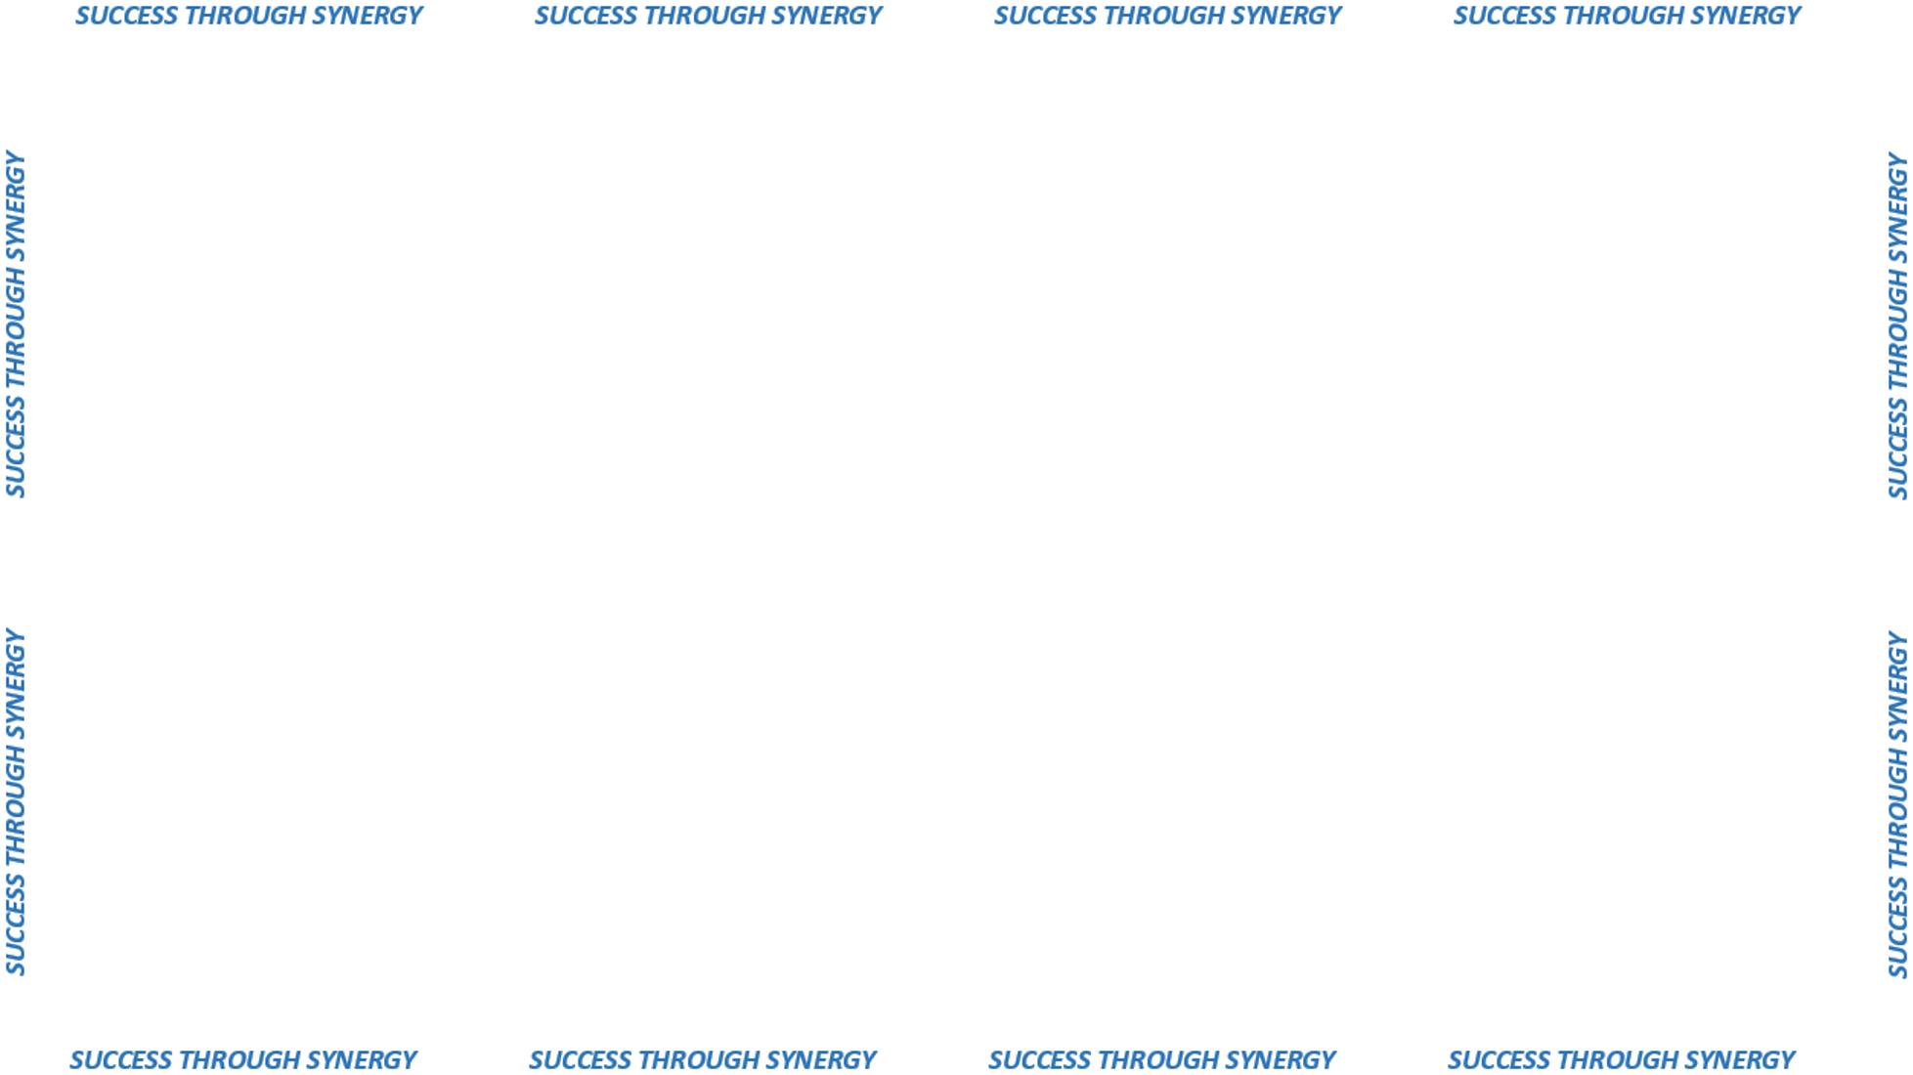

DAS PROCUEMENT:
OUR VISION STATEMENT
“INNOVATION
IN PUBLIC PROCUREMENT
TODAY AND TOMORROW”

Slide 2

STRATEGIC BUSINESS PLANNING
INITIATIVES THAT SUPPORT:
CONTINUOUS IMPROVEMENT
CUSTOMER SERVICE
INNOVATIVE BUSINESS SOLUTIONS

