Slide 1
ANNUAL
CUSTOMER SATISFACTION
SURVEY
WHAT GETS MEASURED
GETS DONE!

Slide 2
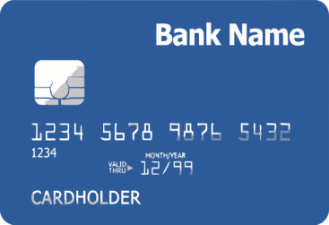
measure customer satisfaction
of all das procurement programs
SUPPLIER
DIVERSITY
CONTRACTING
STATE
SURPLUS
PROGRAM
P-CARD
PROGRAM
CONSTRUCTION
CONTRACTOR
PREQUALIFICATION30

Slide 3
CONTINUOUS IMPROVEMENT
ANGRY
SATISFIED
UNMET
NEEDS
CONFUSING
PROCESSES

