Slide 1
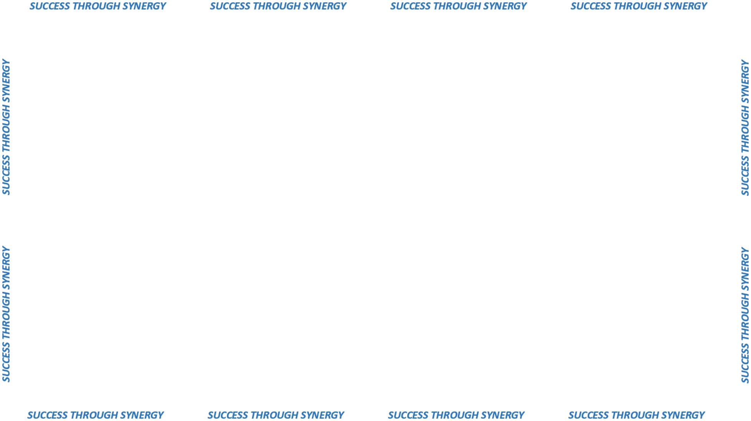
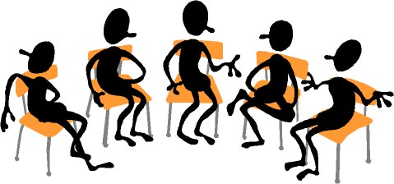

CUSTOMER ADVISORY GROUPS
COLLABORATE WITH PROCUREMENT
MEET AT LEAST ONCE PER YEAR
PROBLEM RESOLUTION
EXPLORE NEW IDEAS AND DIRECTIONS

Slide 2

PARTICIPANTS
State Agency
Staff
Vendors
Cities/Towns
Organizations

