Slide 1
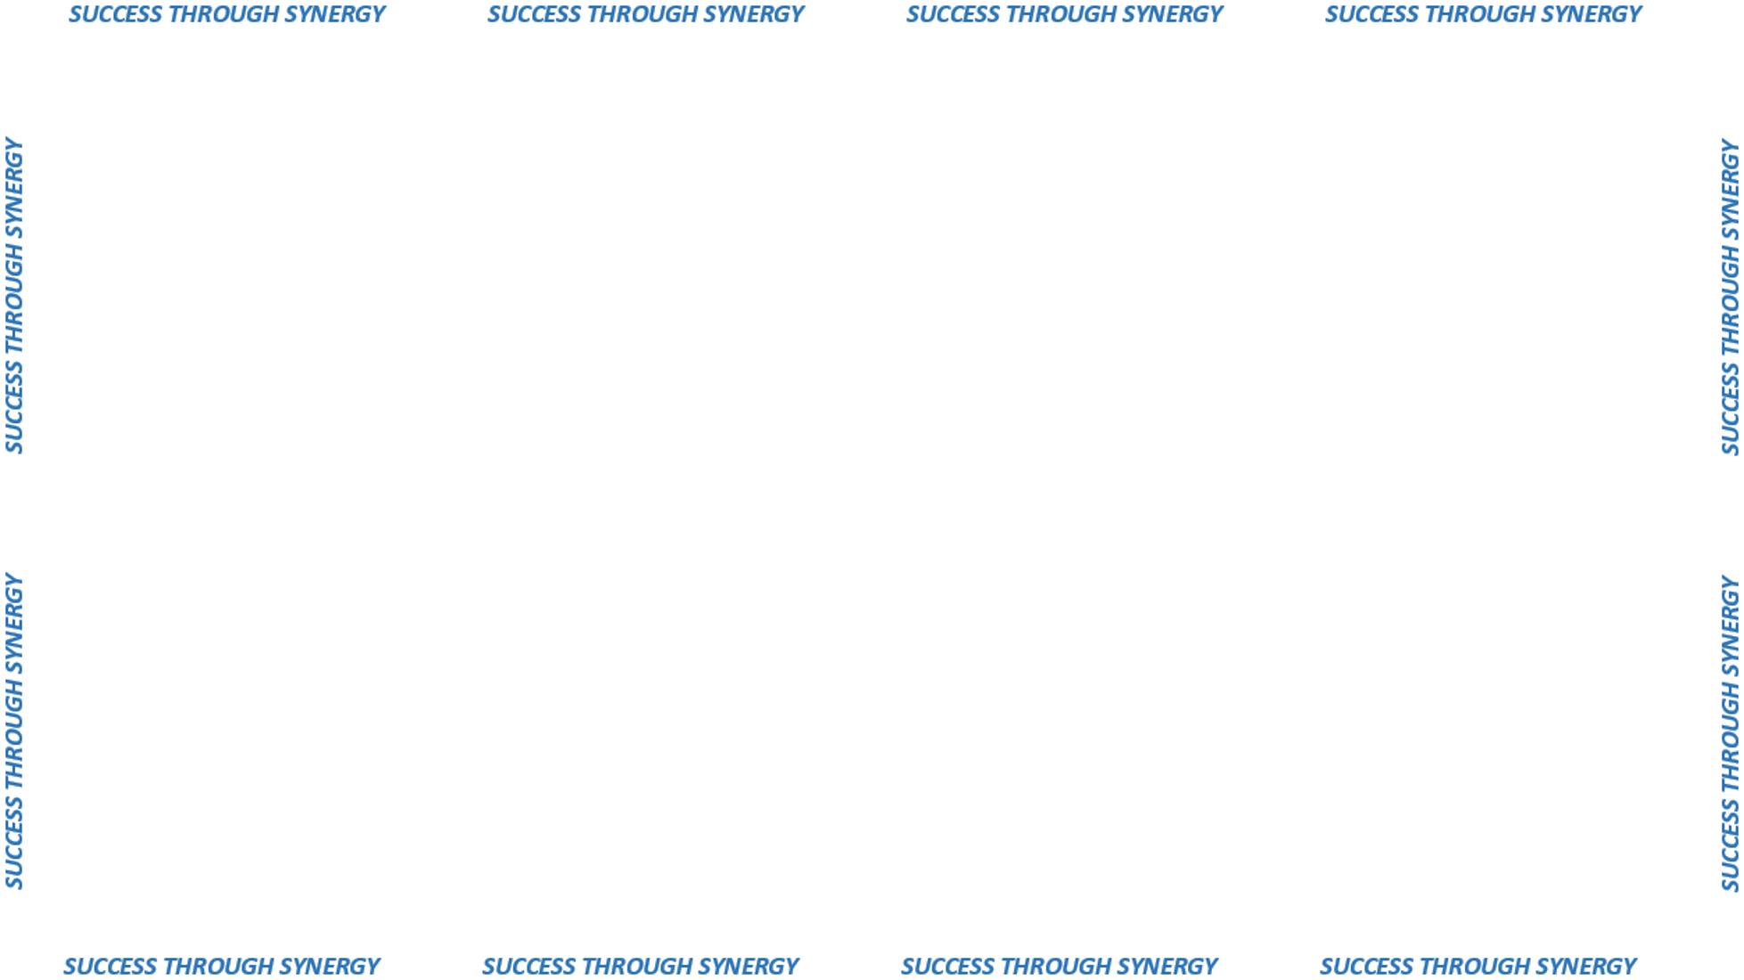

CONTRACT / CONTRACTOR

Slide 2

Mechanism to measure performance
What are they?
Can be applied to
contract and contractor
performance
Can include
Positive & Negative
Feedback

Slide 3
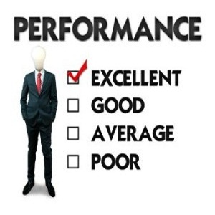



IMPROVES
COMMUNICATION !
Encourages
vendor improvement
and contract effectiveness
Establishes
Goals and
Expectations

