Slide 1
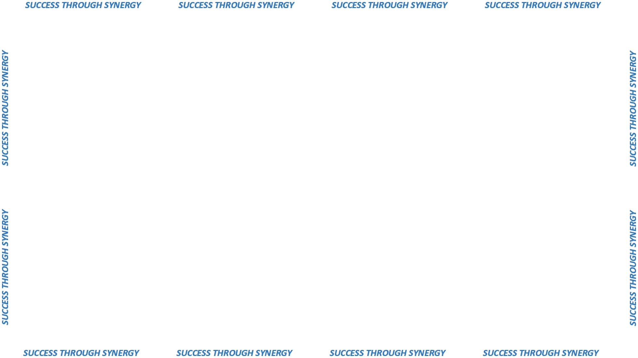
DEALING WITH A PROBLEM VENDOR 101

Slide 2
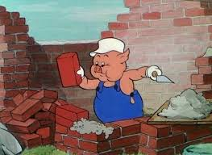
PREVENTIVE MAINTENANCE
GET YOUR HOUSE IN ORDER!

Slide 3
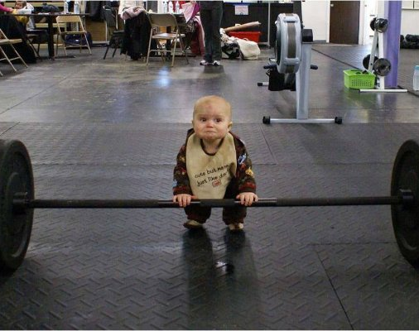
WHAT ARE CLIENT AGENCY EXPECTATIONS?
“Expectation is the root of heartache.”
- Wm. Shakespeare

Slide 4
PM starts with bid process,…what’s in your specifications?
  Specification integrity,…do specs require a revision or an update?
  EXPECT to get only what you ask for and not much else.
  ESPECIALLY EXPECT to get only what you pay for and not much else.
Assign one Agency Representative and one Alternate to communicate or facilitate communication with Contract Vendor.
  Be familiar with contract requirements.
  Be familiar with contract components (all Exhibits and Contract to Form).
Arrange a meeting with the Contract Vendor prior to the contract start date.
  Invite the Contract Specialist.
  Discuss specifications, job site quirks/characteristics and all other relevant dynamics associated with the work to be performed.
Keep notes. Document all contract-related communication with the Contract Vendor.

Slide 5
PM starts with bid process,…what’s in your specifications?
  Spec integrity,…do specifications require a revision or an update?
  EXPECT to get only what you ask for and not much else.
  ESPECIALLY EXPECT to get only what you pay for and not much else.
Assign one Agency Representative and one Alternate to communicate or facilitate communication with Contract Vendor.
  Be familiar with contract requirements.
  Be familiar with contract components (all Exhibits and Contract to Form).
Arrange a meeting with the Contract Vendor prior to the contract start date.
  Invite the Contract Specialist.
  Discuss specifications, job site quirks/characteristics and all other relevant dynamics associated with the work to be performed.
Keep notes. Document all contract-related communication with the Contract Vendor.
IF YOU REMEMBER NOTHING ELSE FROM THIS PRESENTATION,…..

Slide 6
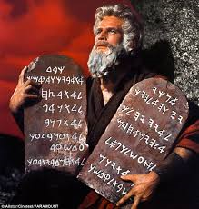
DOCUMENTATION

Slide 7
Maintain the integrity of the documentation.
Record Contract Vendor performance issues in writing; include dates and also include time of day if warranted.
Take photos if and where necessary.
Be fair and objective in your assessment.
Be detailed but concise; avoid demonstrative language, use descriptive language.

Slide 8
DEMONSTRATIVE:
The neglectful custodian’s really poor performance caused the office to smell really, really bad.
DESCRIPTIVE:
The custodian refused to remove the maggot-infested, dead rat that was decomposing behind the radiator and causing a bad odor.

Slide 9
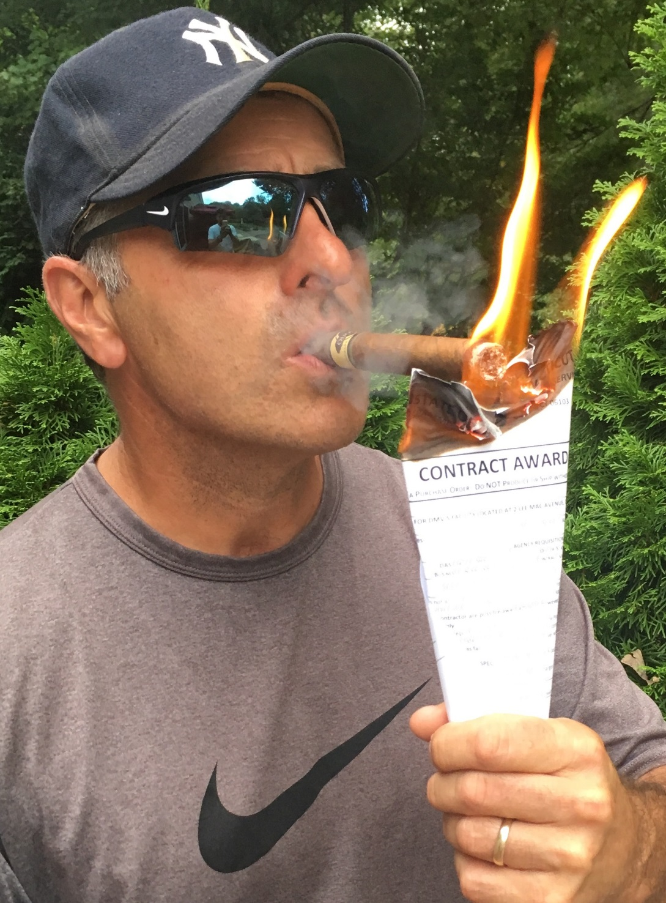
BREACH OF CONTRACT

Slide 10
•
Article 11 of the Form Contract
.
Ø
When
either party
does not perform
according to the
Contract.
•
Exhibit A
–
Description of Services. Has contract actually been
breached?
•
Breaching Party must be afforded due process.
Non
-
breaching party shall provide written notice and
Ø
afford the
breaching party
one (1) opportunity to cure.
Ø
DAS determines breach, not Client Agency.
•
What happens next?

Slide 11
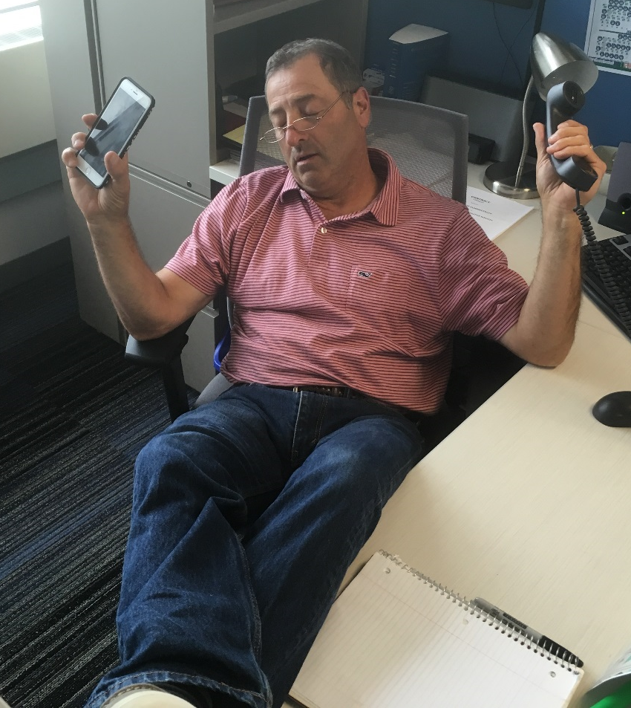
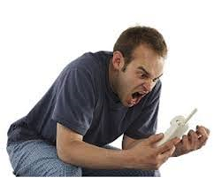

CLIENT AGENCY / CONTRACT VENDOR INTERVENTION
VENDOR
CONTRACT SPECIALIST
STATE AGENCY

Slide 12
All intervention meetings with Contract Vendor should include the Client Agency rep, Client Agency alternate rep if available, and the Contract Specialist ONLY.
Atmosphere should be professional and level-headed. Not jovial and definitely not hostile.
Don’t automatically assume that the Contract Vendor has read the entire contract.
All non-performance issues to be addressed must be supported by the detailed and concise documentation that I told you about four slides ago.

Slide 13
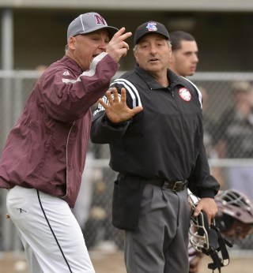
MAKING A FORMAL COMPLAINT

Slide 15

TERMINATION

Slide 16
•
Article 9 of the Form Contract
•
Pretext of Termination:
Convenience
Ø
–
DAS
has made written determination that
Contract
cancellation is in the b
est inter
e
st of the State.
Cause
Ø
–
DAS
has made written determination that Contract
Vendor has breached the Contract in accordance with
provisions of Article 11.
•
Is
termination really warranted
and is it
defensible
?
Has
Contract Vendor been afforded due process?
Ø
•
How far off is the contract end date? Is there a contingency plan for
the interim?

Slide 17

QUESTIONS

